Slide 1


How to Program in Assembly Language for the
How to Program in Assembly Language
Lesson 18: Sprites
Lesson 18: Sprites
Lesson 18: Sprites

Slide 2
VERA Sprites
} ^{Z3}
Sprite i
128 Independent Sprites
Variable Dimensions (8, 16, 32, 64 pixels)
16 colors (4bpp) or 256 colors (8bpp)
Place anywhere on 640x480 display
Assets stored at arbitrary VRAM locations
3 Z-levels, index-based priority
Line limit: based on sprite widths, color depths
Collision-driven interrupts
Sprite i+n
Layer 1
} ^{Z2}
Sprite j
Sprite j+n
Layer 0
} ^{Z1}
Sprite k
Sprite k+n
Background

Slide 3
VERA Registers
IEN (Interrupt ENable): $9F26
  Bit 2 set: enable sprite collision IRQ
ISR (Interrupt Service Routine): $9F27
  Bit 2 set on first IRQ after collision (latches)
  Bits 7:4 - Current collisions (whenever occurring)
DC_VIDEO: $9F29
  Bit 6 set: enable all sprites in Z1, Z2, Z3
IRQ Line(8) | - | - | - | AFLOW | SPRCOL | LINE | VSYNC
Sprite Collisions | AFLOW | SPRCOL | LINE | VSYNC
Current Field | Sprites Enable | Layer1 Enable | Layer0 Enable | - | Chroma Disable | Output Mode

Slide 4
VRAM Sprite Attributes
IEN (Interrupt ENable): $9F26
  Bit 2 set: enable sprite collision IRQ
ISR (Interrupt Service Routine): $9F27
  Bit 2 set on first IRQ after collision (latches)
  Bits 7:4 - Current collisions (whenever occurring)
DC_VIDEO: $9F29
  Bit 6 set: enable all sprites in Z1, Z2, Z3
IRQ Line(8) | - | - | - | AFLOW | SPRCOL | LINE | VSYNC
Sprite Collisions | AFLOW | SPRCOL | LINE | VSYNC
Current Field | Sprites Enable | Layer1 Enable | Layer0 Enable | - | Chroma Disable | Output Mode

Slide 5
Repeating a Note
Play Middle C on second channel for half second, rest half second, repeat 10 times
YM_REG = $9FE0 ldx #10 ldy #30
YM_DATA = $9FE1 @cycle_loop: @wai_off_loop:
KON = $08 bit YM_DATA wai
ALL_ON = $78 bmi @cycle_loop dey
CH2 = $01 lda #KON bne @wait_off_loop
KC = $28 sta YM_REG dex
MIDDLE_C = $3E lda #(ALL_ON | CH2) bne @cycle_loop
sta YM_DATA rts
ostinato: ldy #30
lda #KON @wait_on_loop:
sta YM_REG wai
lda #CH2 dey
sta YM_DATA bne @wait_on_loop
lda #(KC | CH2) lda #KON
sta YM_REG sta YM_REG
lda #MIDDLE_C lda #CH2
sta YM_DATA sta YM_DATA

Slide 6
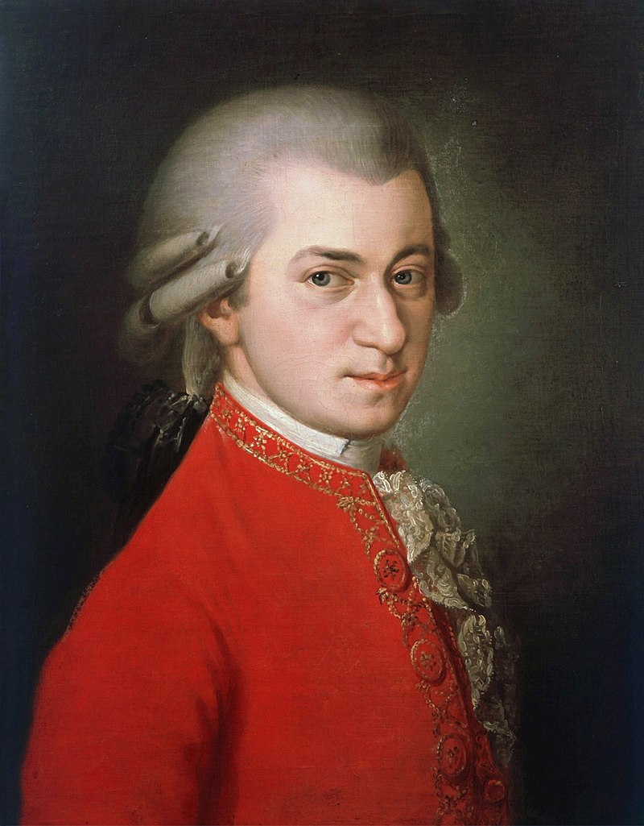

Example Program:
Music Player
Plays first 10 measures of “Eine kleine Nachtmusik”
  Wolfgang Amadeus Mozart (K. 525)
  “Mario Bros. Theme”
4 piano voices, 4 strings voices
Extra Program: Cavy’s Quest

