Slide 1


How to Program in Assembly Language for the
Lesson 9: Hello, VERA!

Slide 2
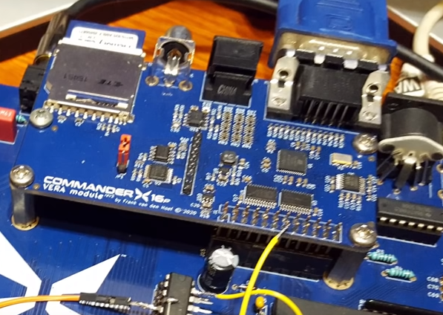
VERA: Versatile Embedded Retro Adapter
640x480 12-bit color graphics
  VGA (Standard, Interlaced)
  NTSC (Composite, S-Video)
  256 color palette
  Bitmap, Tiles, Text and Sprites
SD Card interface via SPI
Programmable Sound Generator (PSG)
  16 stereo channels, 4 waveforms, variable pulse width
Pulse Code Modulation Audio
  Up to 48kHz 8-bit or 16-bit stereo sample playback

Slide 3
X16 Memory Map
0000 | Zero Page | 256 Bytes
00FF
0100 | Stack | 256 Bytes
01FF
0200 | BASIC/Kernal RAM | 1.5 kB
07FF
0800 | BASIC Program | 37.75 kB
9EFF
9F00 | Input/Output | 256 Bytes
9FFF
A000 | RAM Banks | 8 kB
BFFF
C000 | ROM Banks | 16 kB
FFFF

Slide 4
VERA Registers
I/O Address Space: $9F20-9F3F (32 bytes)
Only way for CPU program to control and access VERA
Two 8-bit data channels to 17-bit VRAM address space (128 kB)
8-bit data channel to 4 kB PCM FIFO (write only)
8-bit data channel to SPI controller

Slide 5
VRAM Interface
CTRL: $9F25
  Set address port (ADDRSEL) in bit 0
ADDRx_H: $9F22
  Set bit 16 of VRAM address in bit 0
ADDRx_M (VRAM address bits 15:8): $9F21
ADDRx_L (VRAM address bits 7:0): $9F20
DATA0 (read or write byte from address 0): $9F23
DATA1 (read or write byte from address 1): $9F24
Reset (W/O) | - | - | - | - | - | DCSEL | ADDRSEL
Address Increment (Stride) | DECR | - | - | ADDR(16)

Slide 6
Reading and Writing VRAM
Copy byte from $02468 to $13579 in VRAM
VERA_addr_low = $9F20 sta VERA_addr_high
VERA_addr_high = $9F21 lda #<VRAM_SOURCE
VERA_addr_bank = $9F22 sta VERA_addr_low
VERA_data0 = $9F23 lda #1
VERA_data1 = $9F24 sta VERA_ctrl
VERA_ctrl = $9F25 lda #^VRAM_DEST
VRAM_SOURCE = $02468 sta VERA_addr_bank
VRAM_DEST = $13579 lda #>VRAM_DEST
start: sta VERA_addr_high
stz VERA_ctrl lda #<VRAM_DEST
lda #^VRAM_SOURCE sta VERA_addr_low
sta VERA_addr_bank lda VERA_data0
lda #>VRAM_SOURCE sta VERA_data1

Slide 7
Example Program

