Slide 1

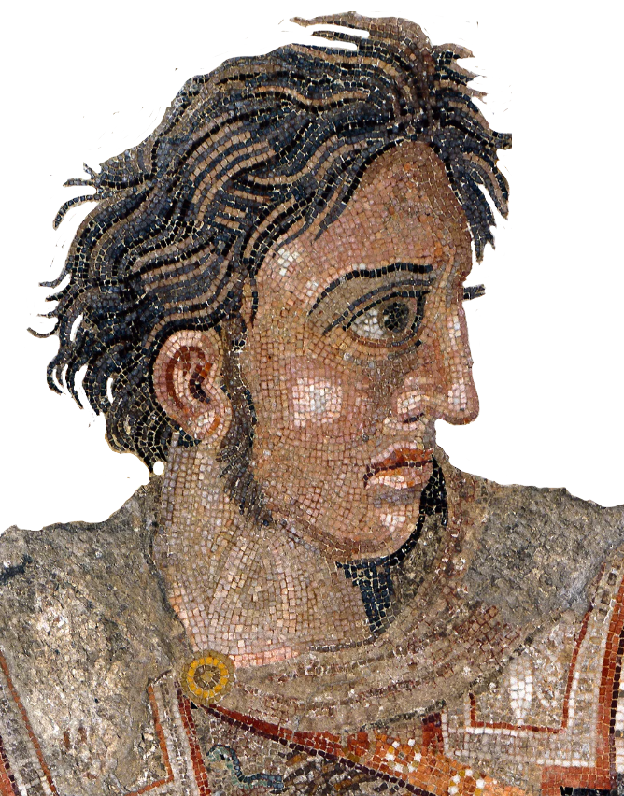
How to Program in Assembly Language for the
Lesson 12: Tiles

Slide 2
VERA Tile Modes
Each VERA layer can be any tile or bitmap mode
Variable map size
Text: 1 bit-per-pixel (1bpp), 8x8 pixels, Max = 256 characters
  16-color: background, foreground
  256-color: foreground; background = black
Graphics: Variable bpp, variable tile size, Max = 1024 characters
  2bpp, 4-color graphics
  4bpp, 16-color graphics
  8bpp, 256-color graphics

Slide 3
Tile Layer Configuration
L0_CONFIG: $9F2D; L1_CONFIG: $9F34
  Map Height/Width: 0 = 32 tiles; 1 = 64 tiles; 2 = 128 tiles; 3 = 256 tiles
  Color Depth: 0 = 1bpp; 1 = 2bpp; 2 = 4bpp; 3 = 8bpp
  T256: Color Depth == 1bpp → 0 = 16-color; 1 = 256-color
  Bitmap Mode: 0 = text/tile mode; 1 = bitmap mode
L0_MAPBASE: $9F2E; L1_MAPBASE: $9F35
  Tile map start address >> 9 (512-byte alignment)
L0_TILEBASE: $9F2F; L1_TILEBASE: $9F36
  Tile graphics base address >> 11 (2kB alignment)
  Tile Height/Width: 0 = 8 pixels; 1 = 16 pixels
Map Height | Map Width | T256 | Bitmap Mode | Color Depth
Tile Base Address (16:11) | Tile Height | Tile Width

Slide 4

2bpp Tiles
00 | 00 | 00 | 10 | 10 | 00 | 00 | 00
00 | 00 | 10 | 10 | 10 | 10 | 00 | 00
00 | 10 | 10 | 11 | 11 | 10 | 10 | 00
10 | 10 | 11 | 01 | 01 | 11 | 10 | 10
10 | 10 | 11 | 01 | 01 | 11 | 10 | 10
00 | 10 | 10 | 11 | 11 | 10 | 10 | 00
00 | 00 | 10 | 10 | 10 | 10 | 00 | 00
00 | 00 | 00 | 10 | 10 | 00 | 00 | 00
Each byte: 4 pixels
  8x8 tile: 16 bytes
  16x16 tile: 64 bytes
Colors: First four of any 16-color palette offset
  Default:
  0-3 remapped to 16-19, 32-35, 48-51, etc.
Good enough for…
  CGA!
  NES!
02 80
0A A0
2B E8
AD 7A
AD 7A
2B E8
0A A0
02 80

Slide 5
4bpp Tiles
0 | 0 | 0 | 2 | 2 | 0 | 0 | 0
0 | 0 | 2 | 8 | 8 | 2 | 0 | 0
0 | 2 | 8 | 7 | 7 | 8 | 2 | 0
2 | 8 | 7 | 5 | 5 | 7 | 8 | 2
8 | 7 | 5 | 6 | 6 | 5 | 7 | 8
7 | 5 | 6 | 4 | 4 | 6 | 5 | 7
5 | 6 | 4 | 0 | 0 | 4 | 6 | 5
6 | 4 | 0 | 0 | 0 | 0 | 4 | 6
Each byte: 2 pixels (nybble = pixel)
  8x8 tile: 32 bytes
  16x16 tile: 128 bytes
Colors: Any 16-color palette offset
  Default:
  0-15 remapped to 16-31, 32-47, 48-63, etc.
Good enough for…
  EGA!
  SNES (Modes 1, 2, 3, 5, 6)!
00 02 20 00
00 28 82 00
02 87 78 20
28 75 57 82
87 56 65 78
75 64 46 57
56 40 04 65
64 00 00 46

Slide 6
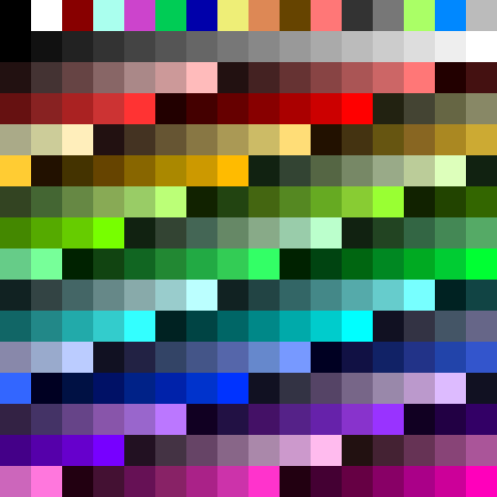
8bpp Tiles
9C | 0C | 0C | 9C | 9C | 9C | 9C | 0C
9C | 9C | 50 | 57 | 9C | 9C | 9C | 57
9C | 9C | 9C | 50 | 50 | 50 | 50 | 57
57 | 57 | 9C | 50 | 10 | 50 | 50 | 10
57 | 57 | 9C | 3B | 50 | 50 | 50 | 57
9C | 08 | 9C | 50 | 57 | 57 | 57 | 9C
9C | 08 | 50 | 57 | 50 | 57 | 50 | 9C
73 | 73 | 50 | 57 | 08 | 08 | 57 | 73
Each byte: 1 pixel
  8x8 tile: 64 bytes
  16x16 tile: 256 bytes
Colors: Full 256-color palette
  Default:
Good enough for…
  VGA!
  SNES (Modes 3, 4, 7)!
9C 0C 0C 9C 9C 9C 9C 0C
9C 9C 50 57 9C 9C 9C 57
9C 9C 9C 50 50 50 50 57
57 57 9C 50 10 50 50 10
57 57 9C 3B 50 50 50 57
9C 08 9C 50 57 57 57 9C
9C 08 50 57 50 57 50 9C
73 73 50 57 08 08 57 73

Slide 7

Graphical Tile Map Entry
Byte 0 | Tile Index (7:0)
Byte 1 | Palette Offset | V-Flip | H-Flip | Tile Index (9:8)
10-bit Tile Index (0 – 1023)
  Tile address = TILEBASE + Tile_Index * Tile_Size
Palette Offset: 0-15
  Offset = Starting_Index / 16
Flipping:
V:0, H:0 V:0, H:1 V:1, H:0 V:1, H:1

Slide 8
Writing Array to Even Addresses
Copy array bytes to even bytes in VRAM starting at $00000
VERA_addr_low = $9F20 lda #>VRAM_DEST
VERA_addr_high = $9F21 sta VERA_addr_high
VERA_addr_bank = $9F22 lda #<VRAM_DEST
VERA_data0 = $9F23 sta VERA_addr_low
VERA_ctrl = $9F25 ldx #0
VRAM_DEST = $00000 @loop:
array: .byte 8,5,12,12,15 lda array,x
start: sta VERA_data0
stz VERA_ctrl inx
lda #($20 | ^VRAM_DEST) cpx #(start-array)
sta VERA_addr_bank bne @loop

