Slide 1


How to Program in Assembly Language for the
Lesson 8: Meet the Kernal

Slide 2
Kernal with an A!
Provides stable, predictable subroutines for accessing input/output channels, system setup, and other common tasks
Based on Commodore 64 Kernal with compatible API
  Plus additional Commodore 128 subroutines
  Plus GEOS Frame Buffer, Graphics and Console APIs
  Plus Commander X16-specific subroutines
Always available in ROM
Can replace some by overwriting RAM vector

Slide 3
X16 Memory Map
0000 | Zero Page | 256 Bytes
00FF
0100 | Stack | 256 Bytes
01FF
0200 | BASIC/Kernal RAM | 1.5 kB
07FF
0800 | BASIC Program | 37.75 kB
9EFF
9F00 | Input/Output | 256 Bytes
9FFF
A000 | RAM Banks | 8 kB
BFFF
C000 | ROM Banks | 16 kB
FFFF

Slide 4
ROM Banks
Set by writing bank number (0-7) to ROM bank control register
  $01: Hardware
  $9F60: R38 Emulator
0: Kernal
1: Keyboard Layout Tables
2: CBM-DOS
3: GEOS
4: BASIC
5: MONITOR

Slide 5
ROM Banks
Set by writing bank number (0-7) to ROM bank control register
  $01: Hardware
  $9F60: R38 Emulator
0: Kernal
1: Keyboard Layout Tables
2: CBM-DOS
3: GEOS
4: BASIC
5: MONITOR

Slide 6
CHROUT: CHaRacter OUTput
ROM Address: $FFD2
  jsr $FFD2
RAM Vector: $0326
  jmp ($0326)
Prints character code in Accumulator at cursor
  If control code, processes it
  If visible character, screen code placed in VRAM to display glyph, cursor moves to next position
Will write character to file if opened as default output
Affected registers: None (A,X,Y preserved on stack)

Slide 7
Let’s Hack It!
Overwrite RAM vector with new subroutine address
ROM_BANK = $9F60 sta (ZP_PTR)
CHROUT = $FFD2 lda #>graphout
ZP_PTR = $30 sta (ZP_PTR),y
chrout_vector: .addr 0 jmp new_start
start: graphout:
stz ROM_BANK cmp #$20
lda CHROUT+1 bmi @done
sta ZP_PTR cmp #$60
lda CHROUT+2 bpl @done
sta ZP_PTR+1 ora #$80
lda (ZP_PTR) @done:
sta chrout_vector jmp (chrout_vector)
ldy #1 new_start:
lda (ZP_PTR),y lda #$41
sta chrout_vector+1 jsr CHROUT
lda #<graphout

Slide 8
CHRIN: CHaRacter INput
ROM Address: $FFCF
RAM Vector: $0324
Reads line typed to screen
  Blinks cursor at current position, advances past each glyph
  Loads each PETSCII code into line buffer
  Returns when Return key is pressed (RETURN code loaded to end of line buffer)
  Returns immediately if line buffer still populated
  A = Oldest PETSCII code in line buffer
  Removes returned code from line buffer
If file is default input, reads next byte only
  A = next byte
C = If set: error or end of file
Affected registers: A,Y

Slide 9
GETIN: GET INput
ROM Address: $FFE4
RAM Vector: $032A
Removes and returns oldest PETSCII code in keyboard buffer
  If keyboard buffer is empty, returns zero (NULL)
  A = PETSCII code
If file is default input, reads next byte
  A = next byte
C = If set: error or end of file
Affected registers: A,X,Y

Slide 10
Keyboard Buffer Handling
Wait for first keycode
Store in Zero Page variable
Flush buffer
GETIN = $FFE4
KEYCODE = $30
wait_loop:
jsr GETIN
cmp #0
beq wait_loop
sta KEYCODE
flush:
jsr GETIN
cmp #0
bne flush

Slide 11
SCREEN
ROM Address: $FFED
Returns the current screen dimensions (in 8x8 character tiles)
X = Number of columns (initial = 80)
Y = Number of rows (initial = 60)
Affected registers: X,Y

Slide 12
PLOT
ROM Address: $FFF0
If C = 0 (preceded by CLC):
  Move cursor to new position
  Cursor X = Y (column index 0 to 79)
  Cursor Y = X (row index 0 to 59)
If C = 1 (preceded by SEC):
  Return current cursor position
  X = Cursor Y
  Y = Cursor X
Affected registers: X,Y

Slide 13
Loading a File to RAM
Allocate buffer, specify filename, load entire file to buffer
SETLFS = $FFBA lda #(load_file-filename)
SETNAM = $FFBD ldx #<filename
LOAD = $FFD5 ldy #>filename
MAX_FILE_SIZE = 2000 jsr SETNAM
file_buffer: .res MAX_FILE_SIZE lda #0
filename: .byte “foo.bin” ldx #<file_buffer
load_file: ldy #>file_buffer
lda #1 jsr LOAD
ldx #8 rts
ldy #0
jsr SETLFS

Slide 14
SETLFS: SETup Logical File Settings
ROM Address: $FFBA
Selects logical file and defines device number and secondary address (SA)
Logical File Number = A
Device Number = X (8: SD Card or Emulator Host FS)
SA = Y (0: LOAD will use specified address)
Affected Registers: None

Slide 15
SETNAM: SET fileNAME
ROM Address: $FFBD
Sets filename for current logical file
Filename length = A
Filename buffer address
  Low byte = X
  High byte = Y
Affected Registers: None

Slide 16
LOAD
ROM Address: $FFD5
Loads entire file to RAM
Address Space = A
  0: CPU RAM
  2: VERA VRAM Bank 0
  3: VERA VRAM Bank 1
File data destination buffer address
  Low byte = X
  High byte = Y
C = Error
  If C = 1, A = Error Code
X/Y = Address of last byte loaded
Affected Registers: A,X,Y

Slide 17
Saving Memory Block to File
Allocate buffer, specify filename, load entire file to buffer
SETLFS = $FFBA lda #(load_file-filename)
SETNAM = $FFBD ldx #<filename
SAVE = $FFD5 ldy #>filename
ZP_PTR = $30 jsr SETNAM
MAX_FILE_SIZE = 2000 lda #<file_buffer
file_buffer: .res MAX_FILE_SIZE sta ZP_PTR
filename: .byte “foo.bin” lda #>file_buffer
save_file: sta ZP_PTR+1
lda #1 lda #ZP_PTR
ldx #8 ldx #<(file_buffer+MAX_FILE_SIZE)
ldy #0 ldy #>(file_buffer+MAX_FILE_SIZE)
jsr SETLFS jsr SAVE
rts

Slide 18
SAVE
ROM Address: $FFD8
Saves memory range to file
Zero Page Pointer to Buffer Start = A
End Address + 1
  Low Byte = X
  High Byte = Y
C = Error
  If C = 1, A = Error Code
Affected Registers: A,X,Y

Slide 19
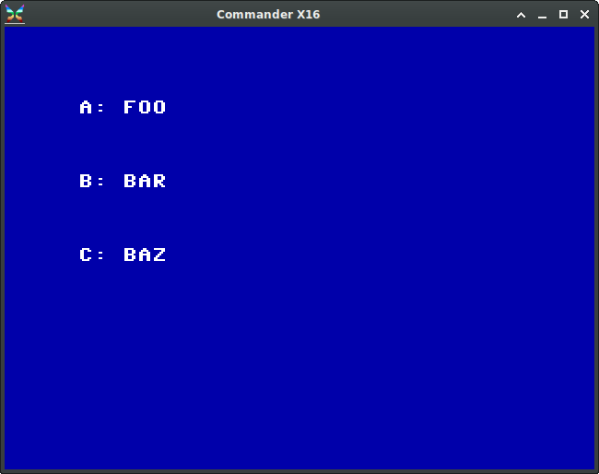
Example Program

