Slide 1


How to Program in Assembly Language for the
Lesson 9: Hello, VERA!

Slide 2
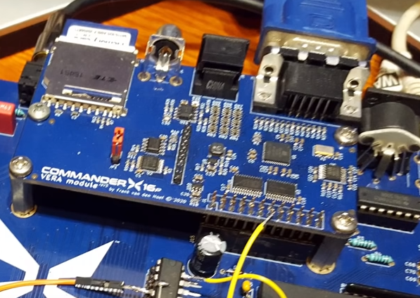
VERA: Versatile Embedded Retro Adapter
640x480 12-bit color graphics
  VGA (Standard, Interlaced)
  NTSC (Composite, S-Video)
  256 color palette
  Bitmap, Tiles, Text and Sprites
SD Card interface via SPI
Programmable Sound Generator (PSG)
  16 stereo channels, 4 waveforms, variable pulse width
Pulse Code Modulation Audio
  Up to 48kHz 8-bit or 16-bit stereo sample playback

Slide 3
X16 Memory Map
0000 | Zero Page | 256 Bytes
00FF
0100 | Stack | 256 Bytes
01FF
0200 | BASIC/Kernal RAM | 1.5 kB
07FF
0800 | BASIC Program | 37.75 kB
9EFF
9F00 | Input/Output | 256 Bytes
9FFF
A000 | RAM Banks | 8 kB
BFFF
C000 | ROM Banks | 16 kB
FFFF

Slide 4
VERA Registers
I/O Address Space: $9F20-9F3F (32 bytes)
Only way for CPU program to control and access VERA
Two 8-bit data channels to 17-bit VRAM address space (128 kB)
8-bit data channel to 4 kB PCM FIFO (write only)
8-bit data channel to SPI controller

Slide 5
VRAM Interface
CTRL: $9F25
  Set address port (ADDRSEL) in bit 0
ADDRx_H: $9F22
  Set bit 16 of VRAM address in bit 0
ADDRx_M (VRAM address bits 15:8): $9F21
ADDRx_L (VRAM address bits 7:0): $9F20
DATA0 (read or write byte from address 0): $9F23
DATA1 (read or write byte from address 1): $9F24
Reset (W/O) | - | - | - | - | - | DCSEL | ADDRSEL
Address Increment (Stride) | DECR | - | - | ADDR(16)

Slide 6
Reading and Writing VRAM
Copy byte from $02468 to $13579 in VRAM
VERA_addr_low = $9F20 sta VERA_addr_high
VERA_addr_high = $9F21 lda #<VRAM_SOURCE
VERA_addr_bank = $9F22 sta VERA_addr_low
VERA_data0 = $9F23 lda #1
VERA_data1 = $9F24 sta VERA_ctrl
VERA_ctrl = $9F25 lda #^VRAM_DEST
VRAM_SOURCE = $02468 sta VERA_addr_bank
VRAM_DEST = $13579 lda #>VRAM_DEST
start: sta VERA_addr_high
stz VERA_ctrl lda #<VRAM_DEST
lda #^VRAM_SOURCE sta VERA_addr_low
sta VERA_addr_bank lda VERA_data0
lda #>VRAM_SOURCE sta VERA_data1

Slide 7
VRAM Striding
ADDRx_H: $9F22
  Set address increment (bits 7:4) to stride for each data access
  Set DECR (bit 3) to 1 to decrement by the stride
Stride Values (mostly, stride = 2^{N-1}):
Address Increment (Stride) | DECR | - | - | ADDR(16)
$0: | No Stride | $1: | 1 byte | $2: | 2 bytes | $3: | 4 bytes
$4: | 8 bytes | $5: | 16 bytes | $6: | 32 bytes | $7: | 64 bytes
$8: | 128 bytes | $9: | 256 bytes | $A: | 512 bytes | $B: | 40 bytes
$C: | 80 bytes | $D: | 160 bytes | $E: | 320 bytes | $F: | 640 bytes

Slide 8
Writing Array to Even Addresses
Copy array bytes to even bytes in VRAM starting at $00000
VERA_addr_low = $9F20 lda #>VRAM_DEST
VERA_addr_high = $9F21 sta VERA_addr_high
VERA_addr_bank = $9F22 lda #<VRAM_DEST
VERA_data0 = $9F23 sta VERA_addr_low
VERA_ctrl = $9F25 ldx #0
VRAM_DEST = $00000 @loop:
array: .byte 8,5,12,12,15 lda array,x
start: sta VERA_data0
stz VERA_ctrl inx
lda #($20 | ^VRAM_DEST) cpx #(start-array)
sta VERA_addr_bank bne @loop

Slide 9
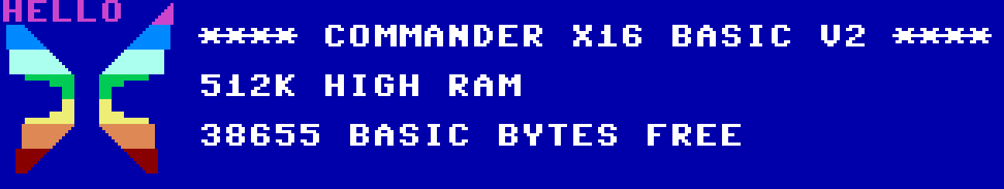
Wait, what?

Slide 10
VERA Graphics Configuration
DC_VIDEO: $9F29
  Default: $21 (Layer1 Enable, Output Mode = Standard VGA)
DC_HSCALE: $9F2A
  Default: 128 (640 pixels wide)
DC_VSCALE: $9F2B
  Default: 128 (480 pixels high)
L0_CONFIG: $9F2D; L1_CONFIG: $9F34
  Layer 1 Default: $60 (128x64 16-Color Text)
L0_MAPBASE: $9F2E; L1_MAPBASE: $9F35
  Layer 1 Default: $00 (Tile map starts at $00000 = $00 << 9)
L0_TILEBASE: $9F2F; L1_TILEBASE: $9F36
  Layer 1 Default: $7C (8x8 tiles start at $0F800 = $7C << 9)
Current Field | Sprites Enable | Layer1 Enable | Layer0 Enable | - | Chroma Disable | Output Mode
Map Height | Map Width | T256 | Bitmap Mode | Color Depth
Tile Base Address (16:11) | Tile Height | Tile Width

Slide 11
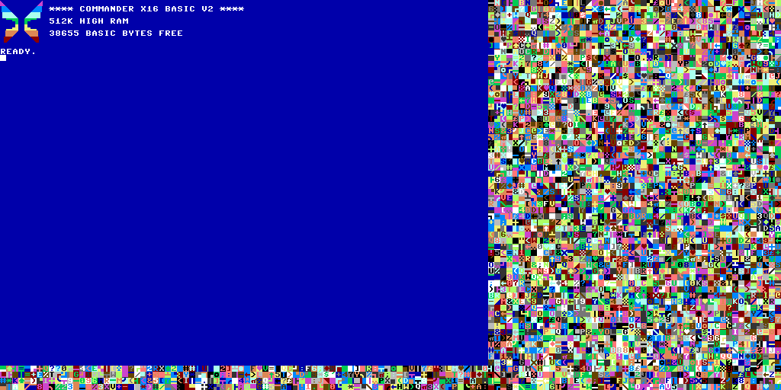
Layer 1 Tilemap
640
1024
$00000
480
512
$03FFF

Slide 12
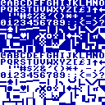
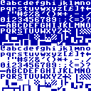
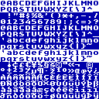
16-Color Text Map Entry
Byte 0 | Character Screen Code
Byte 1 | Background Color | Foreground Color
Character Screen Code ≠ PETSCII Code ≠ ASCII Code
Background and Foreground colors from first 16 colors in palette
Upper/Graphics
Lower/Upper
ISO 8859-1

Slide 13



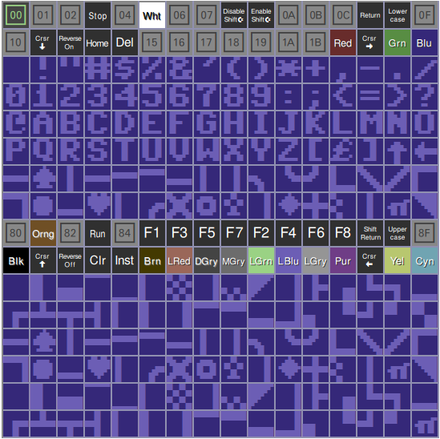
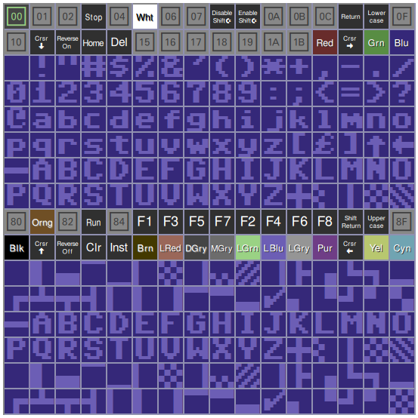
Screen Code vs. PETSCII Code
00000 | DF 64 |  | 08 64 |  | 08 61
00002 | 20 64 |  | 05 64 |  | 05 61
00004 | 20 64 |  | 0C 64 |  | 0C 61
00006 | 20 64 |  | 0C 64 |  | 0C 61
00008 | 20 64 |  | 0F 64 |  | 0F 61
0000A | 20 64 |  | 20 64 |  | 20 64
0000C | E9 64 |  | E9 64 |  | E9 64
hello: .byte 72,69,76,76,79
start:
clc
ldx #0
ldy #0
jsr PLOT
@loop:
lda hello,x
jsr CHROUT
inx
cpx #5
bne @loop
PETSCII Codes:
(with control codes)

Slide 14

8x8 1 Bit-per-Pixel (Text) Tiles
0F800 | 00111100
0F801 | 01100110
0F802 | 01101110
0F803 | 01101110
0F804 | 01100000
0F805 | 01100010
0F806 | 00111100
0F807 | 00000000
0F808 | 00011000
0F809 | 00111100
0F80A | 01100110
0F80B | 01111110
0F80C | 01100110
0F80D | 01100110
0F80E | 01100110
0F80F | 00000000
VRAM Addr = $0F800 + Code*8

Slide 15
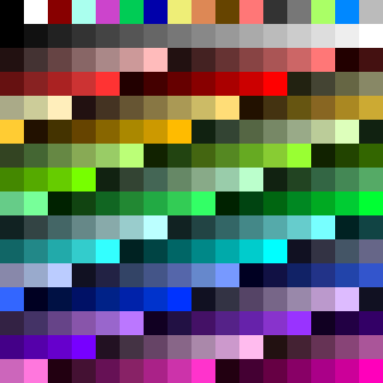
256-Color Palette
Reserved VRAM (512 bytes)
12-bit RGB color (2 byte entries)
  Low Byte:
  High Byte:
4-bit value * 17 ~ 8-bit value
  e.g. $23,$01 ~ #112233
Or, truncated 8-bit ~ 4-bit value
  e.g. #456789 ~ $68,$04
$1FA00
Green | Blue
0 | Red
$1FBFF

Slide 16
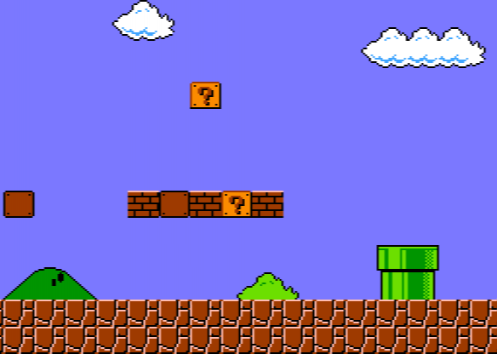
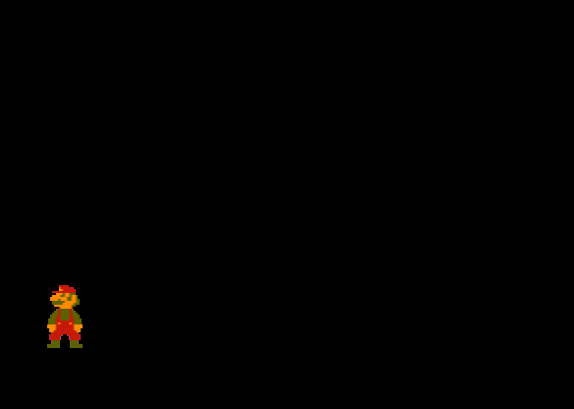
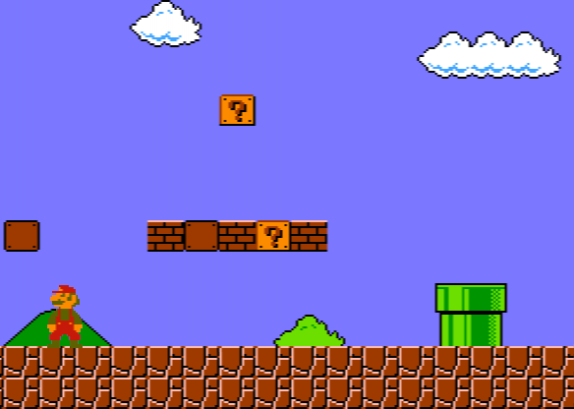
Layer 0
Disabled by default
Rendered “behind” Layer 1
Visible where Layer 1 color = color index 0 (default: black)
Tied to same display scale, but otherwise independent of Layer 1
Layer 0
Layer 1
Display
+
=

Slide 17

Example Program
1-5: Set Foreground Color
0,6-9: Set Background Color
I: Zoom In
O: Zoom Out
R: Toggle Character Set
S: Convert @→🙂
T: Toggle Layer 1
P: Toggle Layer 0
C: Toggle Color 1 White/Black

