Slide 1

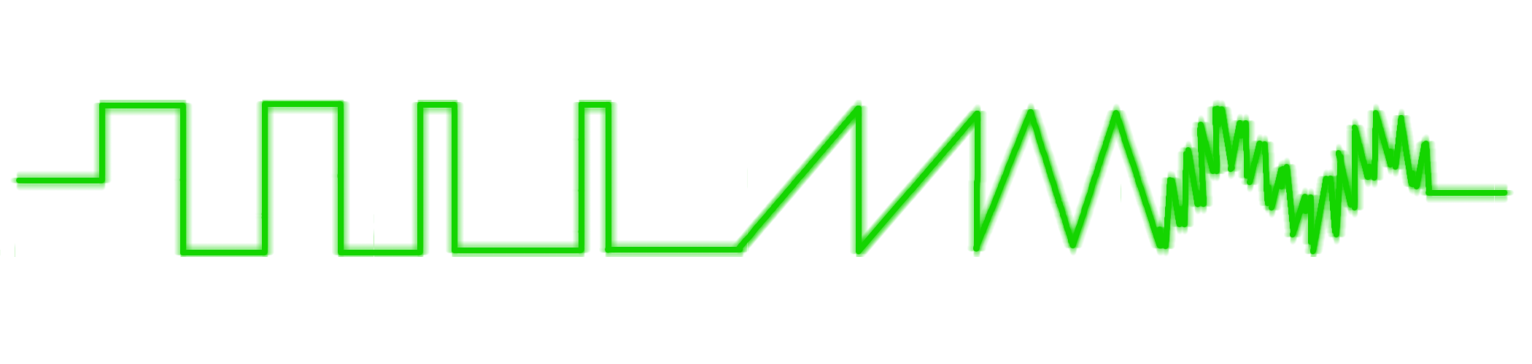
How to Program in Assembly Language for the
Lesson 13: PSG Sound

Slide 2
VERA VRAM Map
00000 | Default Layer 1 Map
03FFF
04000
0F7FF
0F800 | Default PETSCII Glyph Set
0FFFF
10000
1F9BF
1F9C0 | Programmable Sound Generator Registers
1F9FF
1FA00 | Palette
1FBFF
1FC00 | Sprite Attributes
1FFFF

Slide 3
PSG Registers
16 channels
4 8-bit registers for each channel
First 2 Bytes: Frequency encoded as little-endian 16-bit value
  Value = Frequency * 2¹⁷ / 48828.125
Third Byte:
  Volume: 0 = silent; 63 = loudest
Fourth Byte:
  Waveform: 0 = Pulse; 1 = Sawtooth; 2 = Triangle, 3 = Noise
  Pulse Width: 0 = Minimum Duty Cycle; 63 = 50% Duty Cycle
Right | Left | Volume
Waveform | Pulse Width

Slide 4
Waveforms
Pulse:
Sawtooth:
Triangle:
Noise:
50% (PW = 63)
25% (PW = 32)

Slide 5
Programming 4 Channels
Channel 0: Pulse, 1kHz ($0A7C), 25% duty cycle (32), ¾ volume (48)
Channel 1: Sawtooth, 500Hz ($053E), half volume (32), right speaker only
Channel 2: Triangle, 2kHz ($14F8), full volume (63)
Channel 3: Noise, 4kHz ($29F0), quarter volume (16), left speaker only
VERA_data0 = $9F23 lda #($C0 | 48) sta VERA_data0 lda #$C0
VRAM_psg = $1F9C0 sta VERA_data0 lda #$14 sta VERA_data0
stz $9F25 ; CTRL lda #($00 | 32) sta VERA_data0
lda #($10 | ^VRAM_psg) sta VERA_data0 lda #($C0 | 63)
sta $9F22 ; ADDR_H lda #$3E sta VERA_data0
lda #>VRAM_psg sta VERA_data0 lda #$80
sta $9F21 ; ADDR_M lda #$05 sta VERA_data0
lda #<VRAM_psg sta VERA_data0 lda #$F0
sta $9F20 ; ADDR_L lda #($80 | 32) sta VERA_data0
lda #$7C sta VERA_data0 lda #$29
sta VERA_data0 lda #$40 sta VERA_data0
lda #$0A sta VERA_data0 lda #($40 | 16)
sta VERA_data0 lda #$F8 sta VERA_data0

Slide 6
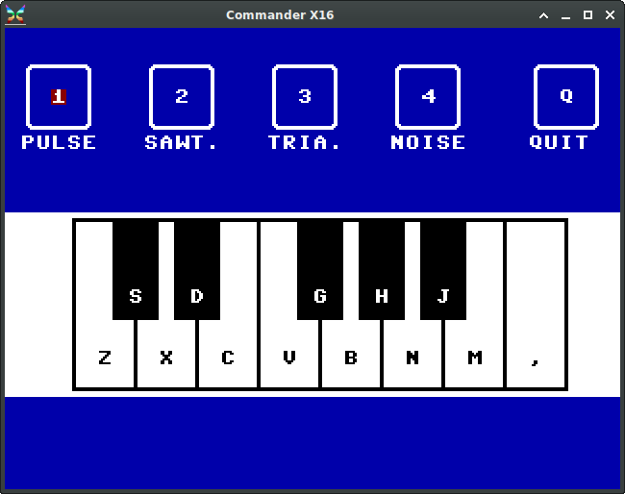
Example Program:
Waveform Demo
Sweep pulse frequency from Middle C up and back down
Sweep pulse width from 50% to minimum and back
Change to sawtooth, sweep up and down
Change to triangle, sweep up and down
Change to noise, sweep up and down
Extra Program: Piano

