Slide 1


How to Program in Assembly Language for the
Lesson 11: Advanced Math

Slide 2
Keep Calm and Carry On
Carry Bit: 8-bit arithmetic becomes, 16-, 24-, 32-bit, whatever!
ADC: Start with CLC
  foo = bar + baz
SBC: Start with SEC
  foo = bar - baz
ROR: Start with LSR
  foo = bar * 4
ROL: Start with ASL
  foo = bar / 4

Slide 3
Keep Calm and Carry On
Carry Bit: 8-bit arithmetic becomes, 16-, 24-, 32-bit, whatever!
ADC: Start with CLC
  foo = bar + baz
SBC: Start with SEC
  foo = bar - baz
ROR: Start with LSR
  foo = bar * 4
ROL: Start with ASL
  foo = bar / 4
lda bar
clc
adc baz
sta foo
lda bar+1
adc baz+1
sta foo+1

Slide 4
Keep Calm and Carry On
Carry Bit: 8-bit arithmetic becomes, 16-, 24-, 32-bit, whatever!
ADC: Start with CLC
  foo = bar + baz
SBC: Start with SEC
  foo = bar - baz
ROR: Start with LSR
  foo = bar * 4
ROL: Start with ASL
  foo = bar / 4
lda bar
sec
sbc baz
sta foo
lda bar+1
sbc baz+1
sta foo+1

Slide 5
Keep Calm and Carry On
Carry Bit: 8-bit arithmetic becomes, 16-, 24-, 32-bit, whatever!
ADC: Start with CLC
  foo = bar + baz
SBC: Start with SEC
  foo = bar - baz
ROR: Start with LSR
  foo = bar / 4
ROL: Start with ASL
  foo = bar * 4
lda bar+1
lsr
sta foo+1
lda bar
ror
sta foo
lsr foo+1
ror foo

Slide 6
Keep Calm and Carry On
Carry Bit: 8-bit arithmetic becomes, 16-, 24-, 32-bit, whatever!
ADC: Start with CLC
  foo = bar + baz
SBC: Start with SEC
  foo = bar - baz
ROR: Start with LSR
  foo = bar / 4
ROL: Start with ASL
  foo = bar * 4
lda bar
asl
sta foo
lda bar+1
rol
sta foo+1
asl foo
rol foo+1

Slide 7
Fixed Point vs. Floating Point
Fixed Point | Floating Point
Optimized for specific range and absolute precision Fast, native integer math Rigid Purpose-built Bespoke format | One-size-fits-all, precision based on significant digits Slow floating-point math in software Flexible Reusable library Common standards

Slide 8
Arbitrary Multiplication
Multiplying by powers of 2: Shift to the left!
So, factors need to be broken up into
Example:
10 * 25 = 10*16 + 10*8 + 10*1 = 160 + 80 + 10 = 250
But this time in binary:
00001010 * 00011001 = 00001010*00010000 +
  00001010*00001000 + 00001010*00000001
  = 10100000 + 01010000 + 00001010 = 11111010

Slide 9
Arbitrary Division
Dividing by powers of 2: Shift to the right!
But division isn’t transitive like multiplication
Non-Example:
30 / 5 ≠ 30 / 4 + 30 / 1
Instead, adding powers of 2
Actual Example:
30 / 5 = 4 + 2 = 6

Slide 10
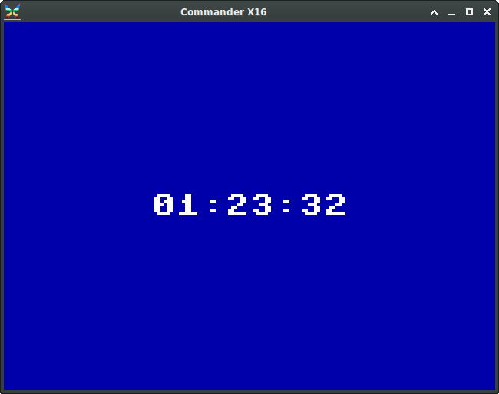
Example Program: Stopwatch
S: Start/Stop
R: Reset
Q: Quit

