Slide 1

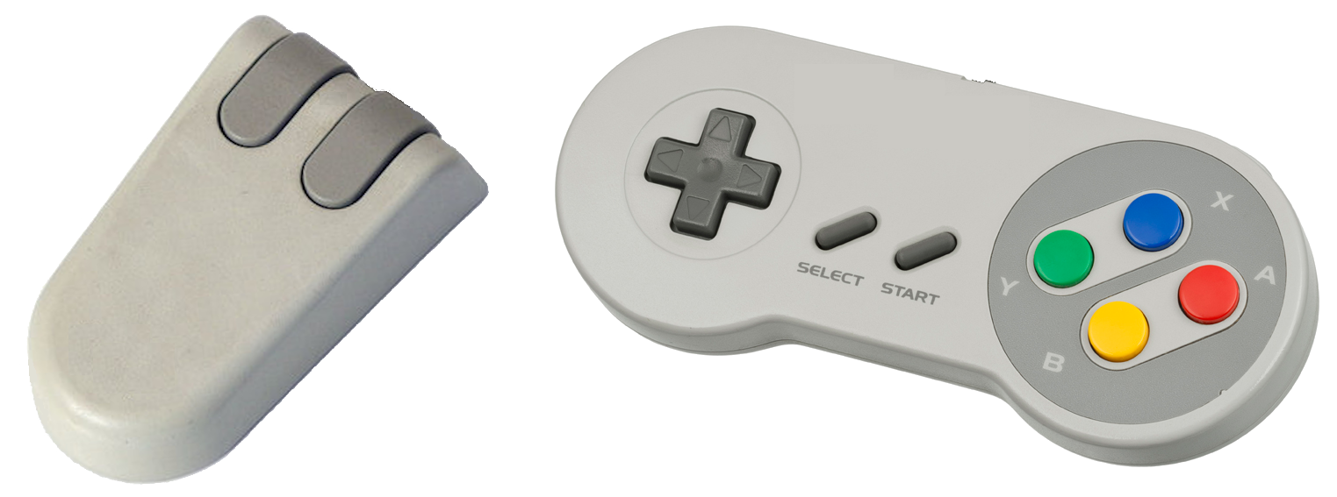
How to Program in Assembly Language for the
Lesson 14: Mouse & Joysticks

Slide 2
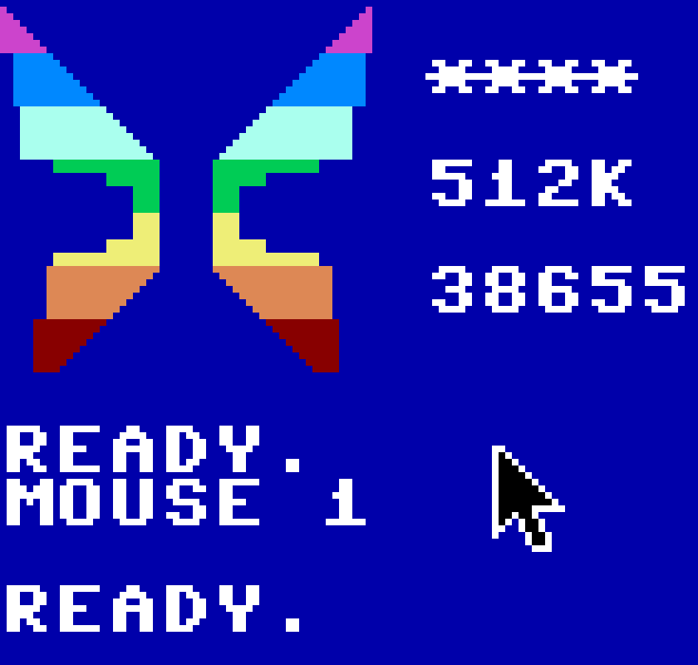
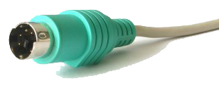
X16 Mouse
PS/2 Interface
Supports full 640x480 resolution
3 Digital Buttons
Customizable Sprite-based Cursor
BASIC support: MOUSE, MX, MY, MB
Kernal support: mouse_config, mouse_scan, mouse_get

Slide 3
mouse_config
ROM Address: $FF68
Equivalent of BASIC MOUSE command
Visibility = A (Same as argument to MOUSE)
  0: Hide
  1: Show Default Cursor
  $FF: Show Custom Cursor (Sprite 0)
Scale = X (Not supported by BASIC)
  0: No Change
  1: 640x480 Scale
  2: 320x240 Scale
Affected Registers: A,X,Y

Slide 4
mouse_scan
ROM Address: $FF71
Scans mouse and writes state to reserved RAM
No arguments or return values
Must be called before mouse_get
  Already called by default IRQ handler
  Must be called in custom IRQ handler only if default not called
Affected Registers: A,X,Y

Slide 5
mouse_get
ROM Address: $FF6B
Loads zero page and accumulator with mouse state values
Must be called after mouse_scan
Zero Page Address = X
@ Zero Page Address (4 bytes):
  X Position (16-bit, little-endian): 0-639
  Y Position (16-bit, little-endian): 0-479
A = Button States
  Bit 0: Left; 1: Right; 2: Middle; 3-7: Undefined
No Other Affected Registers

Slide 6
Get Mouse Click Coordinates
Enable Mouse
Wait for Click
Output:
  Coordinates on Zero Page (X: $30, Y: $32)
  Button ID (1,2,4) in A
mouse_config = $FF68 ldx #MOUSE_X
mouse_get = $FF6B @check_click:
MOUSE_X = $30 wai
MOUSE_Y = $32 jsr mouse_get
get_click: bit #$07
lda #1 beq @check_click
tax @return:
jsr mouse_config rts

Slide 7
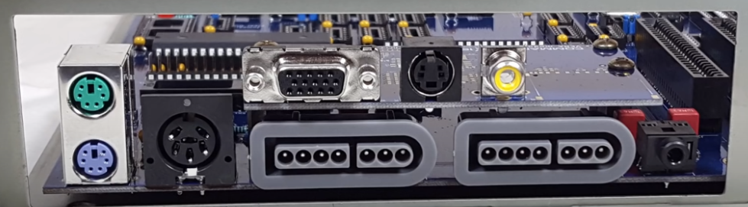
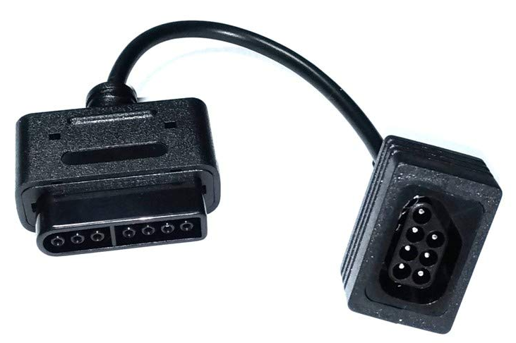
X16 “Joysticks”
2 Super Nintendo / Super FamiCom Connectors
Compatible with legacy and new controllers
  Passive adapter for NES / FamiCom Controllers
Joystick #1 (ID 0) not connected: NES buttons mapped to keyboard
  Cursor arrows = D-Pad
  Ctrl = NES A, SNES B
  Alt = NES B, SNES Y
  Space = Select
  Enter/Return = Start

Slide 8
joystick_scan
ROM Address: $FF53
Scans controllers and writes state to reserved RAM
No arguments or return values
Must be called before joystick_get
  Already called by default IRQ handler
  Must be called in custom IRQ handler only if default not called
Affected Registers: A,X,Y

Slide 9
joystick_get
ROM Address: $FF56
Loads registers with specified joystick state values
Must be called after joystick_scan
Joystick ID = A (0-3)
A = NES / Lower SNES bitmap
  NES (7-0): A | B | Select | Start | Up | Down | Left | Right
  SNES (7-0): B | Y | Select | Start | Up | Down | Left | Right
X = Upper SNES bitmap (NES: Bits 7-1 clear)
  SNES (7-0): A | X | SL | SR | <set> | <set> | <set> | <set>
Y = Joystick Present
  0: present; $FF: not present

Slide 10
Example Program:
Joystick Painting
Move “brush” with D-Pad
Change color with A button
Extra Program: Mouse Painting

