Slide 1

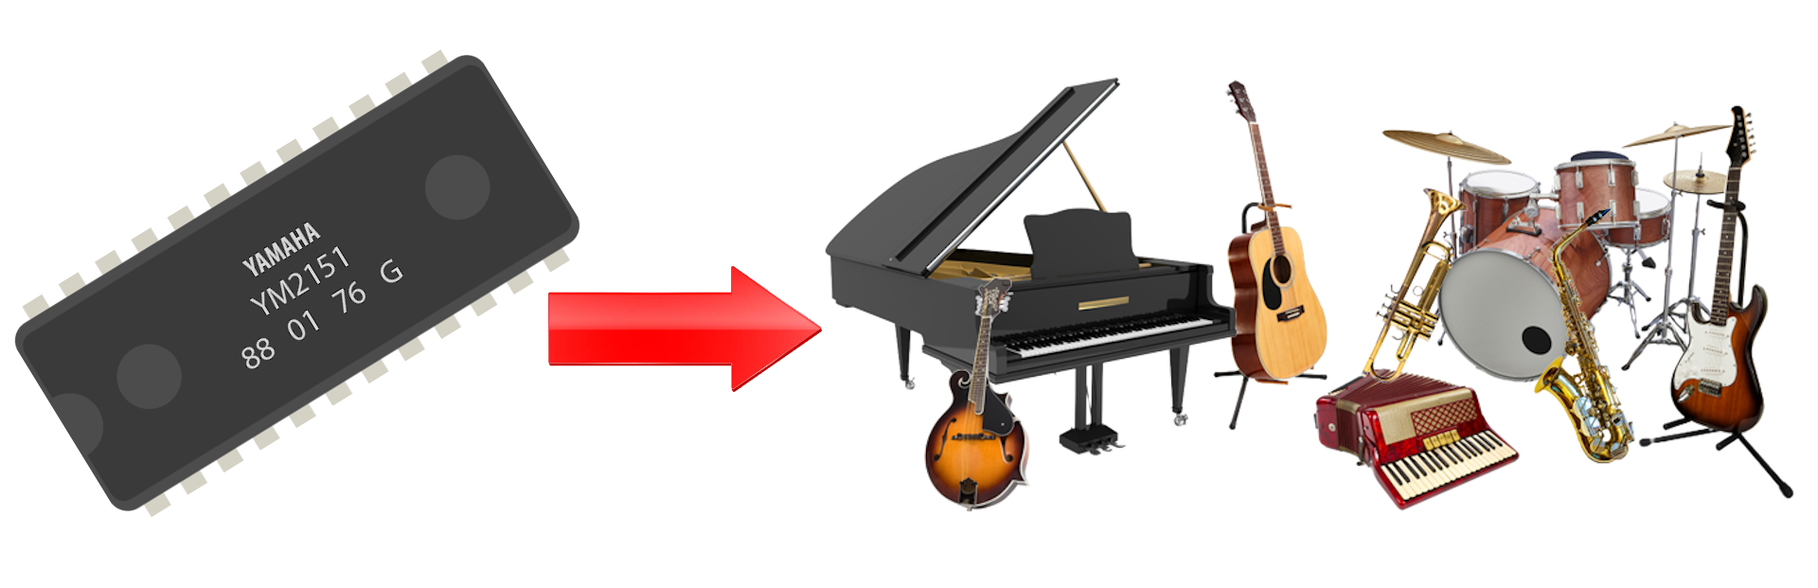
How to Program in Assembly Language for the
Lesson 17: FM Synthesis

Slide 2
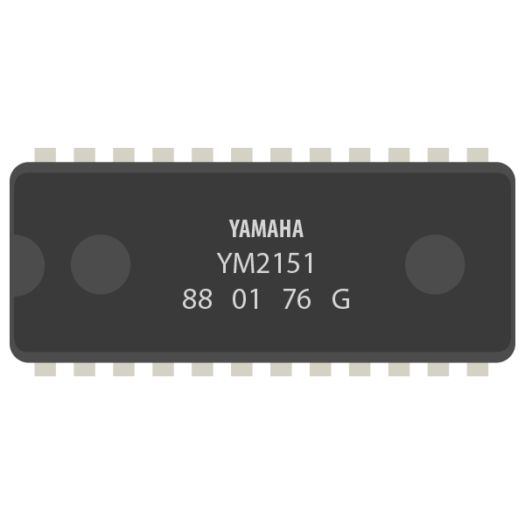
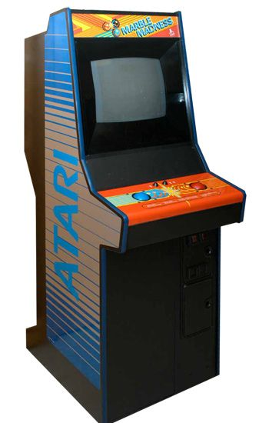
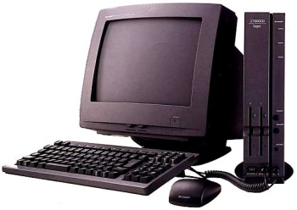
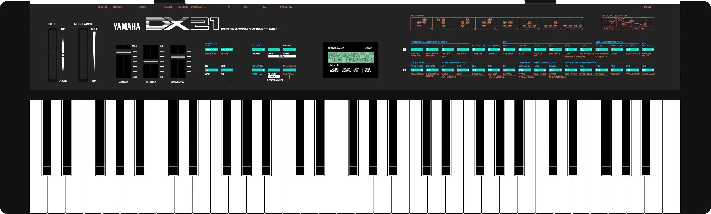
Yamaha YM2151
Also known as the FM Operator Type-M (OPM)
8 stereo voices
4-function Frequency Modulation
Noise generator
8 octave range

Slide 3
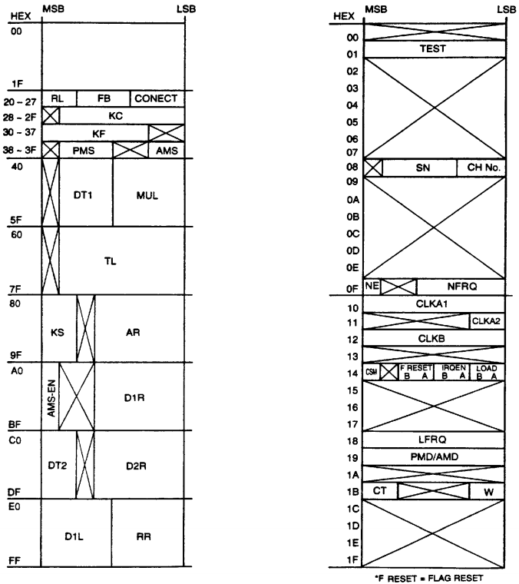
Register Interface
Wait for Write Ready
  Read $9FE1
  Bit 7 clear
Set register address
  Write $9FE0
Set register value
  Write $9FE1

Slide 4
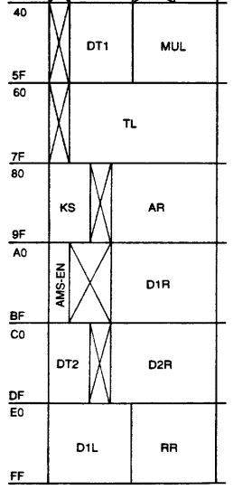
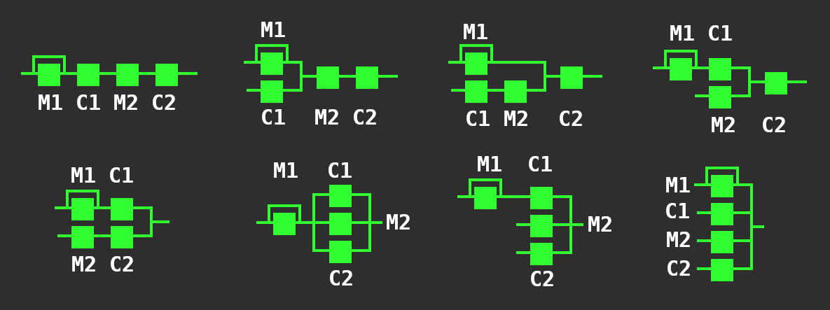
Defining Instruments
Write “Patch” configuration parameters for channel on each function.
  Functions: M1, C1, M2, C2
Set channel control registers
  Right/Left Channels, Feedback Level
  Function Connections:

Slide 5
Playing Notes
Key On (KON) Register: $08
  Bits 6:3 – Functions Enabled (C2, M2, C1, M1)
    All clear = Key Off
  Bits 2:0 – Channel Number (0-7)
Key Code (KC) Register: $28-$2F (per channel)
  Bits 6:4 – Octave (0-7)
  Bits 3:0 – Chromatic Note (0-2,4-6,8-10,12-14 → C# to C)
  $3E = Middle C
Key Fraction (KF) Register: $30-$37 (per channel)
  Bits 7:2 – Fraction (0-63 → 0 to 98.4 cents higher)

Slide 6
Repeating a Note
Play Middle C on second channel for half second, rest half second, repeat 10 times
YM_REG = $9FE0 ldx #10 ldy #30
YM_DATA = $9FE1 @cycle_loop: @wai_off_loop:
KON = $08 bit YM_DATA wai
ALL_ON = $78 bmi @cycle_loop dey
CH2 = $01 lda #KON bne @wait_off_loop
KC = $28 sta YM_REG dex
MIDDLE_C = $3E lda #(ALL_ON | CH2) bne @cycle_loop
sta YM_DATA rts
ostinato: ldy #30
lda #KON @wait_on_loop:
sta YM_REG wai
lda #CH2 dey
sta YM_DATA bne @wait_on_loop
lda #(KC | CH2) lda #KON
sta YM_REG sta YM_REG
lda #MIDDLE_C lda #CH2
sta YM_DATA sta YM_DATA

Slide 7
Noise Generator
Works through channel 8 (index 7) C2 function slot
  Play by writing $47 to KON
  Stop by writing $07 to KON
Noise Enable / Noise Frequency Register @ $0F
  Bit 7 – NE (0 = normal FM, 1 = noise)
  Bits 4:0 – NFRQ (freq = OPM clock freq / (32 * NFRQ))
    Range: 3.5 kHz (NFRQ = 31) to 111.9 kHz (NFRQ = 1)
VERA PSG: Better alternative?

Slide 8
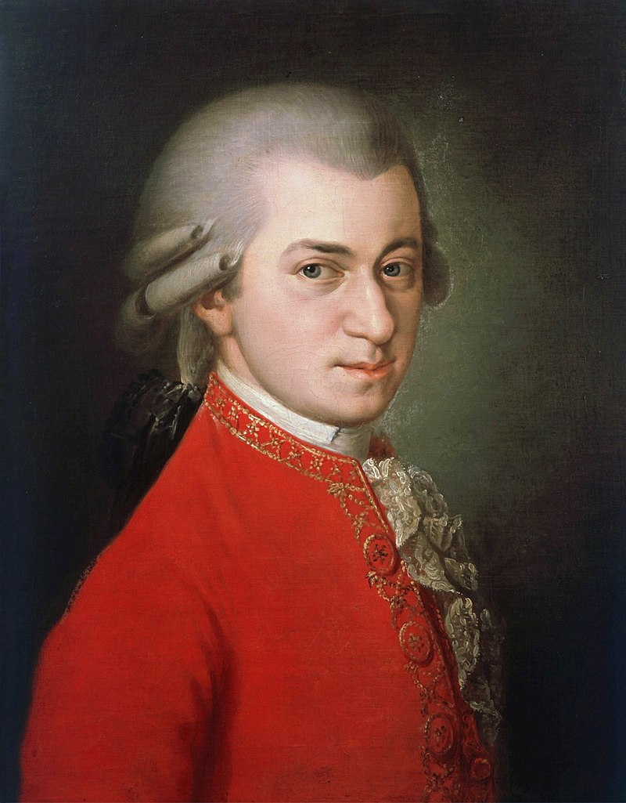
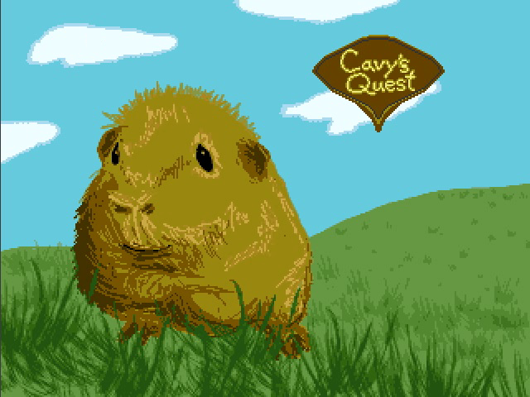
Example Program:
Music Player
Plays first 10 measures of “Eine kleine Nachtmusik”
  Wolfgang Amadeus Mozart (K. 525)
  “Mario Bros. Theme”
4 piano voices, 4 strings voices
Extra Program: Cavy’s Quest

