Slide 1

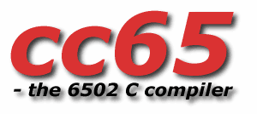
“Hello, cc65!”
Cross-development for the
using

Slide 2
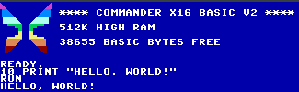
BASIC is so… basic.
Interactive, simple syntax, built in, BUT…
Hard-coded line numbers
Limited features
Monolithic structure
SLOOOOOOOOOOWWWWWWWWW

Slide 3
Enter cc65
Complete 6502 family development tool chain
Free and open source: https://github.com/cc65/cc65
Support for legacy and new systems
Code in C, Assembly, or both
Tools:
  cc65: C compiler
  ca65: 6502 family assembler
  ld65: 6502 object file linker
  And more...

Slide 4
C Development
Large subset of C Library (stdio, stdlib, etc.)
Platform-specific libraries (including X16)
Compile to assembly or machine code
Inline assembly
Macros, optimization, etc.

Slide 5
Assembly Development
Support for all common 6502 variants
  6502, 65C02, 65816, etc.
Platform specific support
Configurable segmentation
Absolute or relative linking
Extensive macro features

Slide 6
Mix it up!
Link object files from C and Assembly
Build libraries for reuse
Convert o65 to cc65 object files
  Statically link with dynamic libraries
  Link with closed-source libraries, other assembly syntaxes

