Slide 1
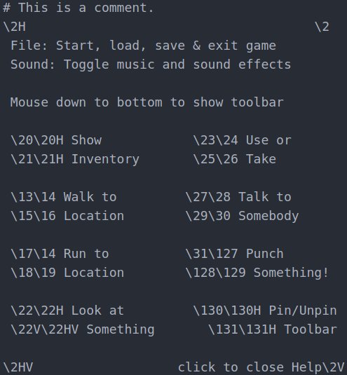
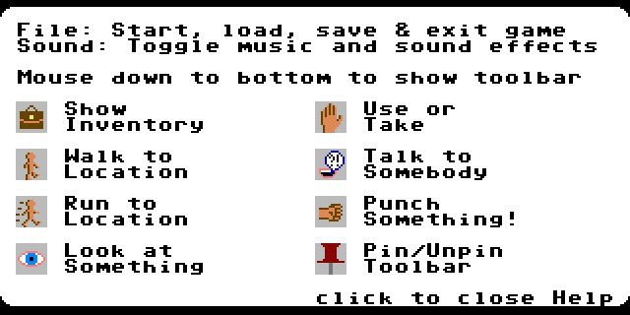
XCI Help Files
Comment
Tiles
Text

Slide 2
Syntax
Text
  Default, not preceded by # or \, including uncommented spaces
  Uses menu text colors
Comment
  Not used for layout, preceded by unescaped #
Escaped Tile
  Tiles using default palette
  Tile index escaped by preceding \
  Can be flipped with H and/or V suffix, e.g. “\12HV” is tile index 12 flipped both ways
Escaped Text
  Non-numerical character following \
  Required to render any \ or # characters using menu text colors (“\\” and “\#”, respectively)
  Required to render any H, V, h or v characters immediately after escaped tile, e.g. “\34V\Hello”

Slide 3
Uses
Controls
  Should explain game controls
About
  Should provide copyright/copyleft information

