Slide 1
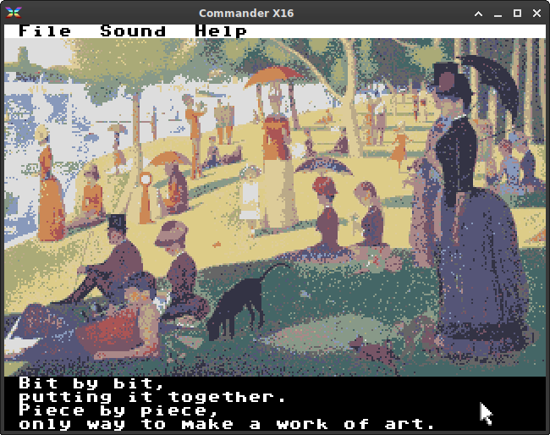
XCI: Putting It Together

