Slide 1
XCI Configuration Language
value
init
text 1 Hello, World!
wait 240
go_level 0 1
end_anim
key
arguments

Slide 2
Usage Tree
Main File
  menu_xci → Menu File
    inventory → Inventory File
  title_screen → Title Screen File
  zone → Zone File
    level → Level File

Slide 3
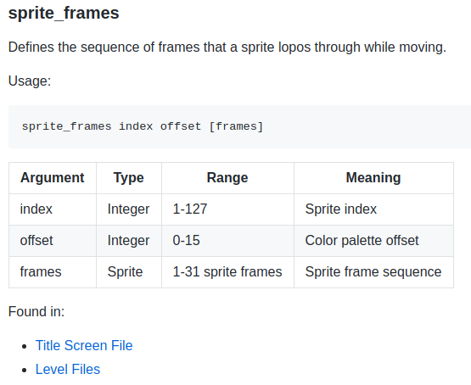
Syntax Guide
https://github.com/SlithyMatt/x16-xci/blob/master/XCI_SYNTAX.md
Key name
Description
Usage prototype
Argument Table
Occurrence

