Slide 1

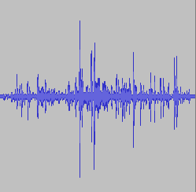

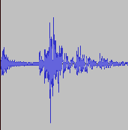
XCI Sound Effects
MUSIC
SFX0
SFX1
SFX2
XCI
SDK

Slide 2
Raw PCM Format
8-bit, signed PCM (Pulse Code Modulation)
Mono (single track)
4578 Hz sample rate
  8 kB = 1.789 seconds
No compression or meta-data!

Slide 3
Instructions
sound
  Associates ID with filename
play
  Plays sound (referenced by ID) in sequence

