Slide 1
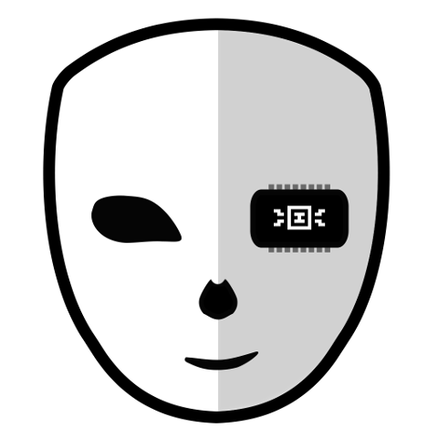
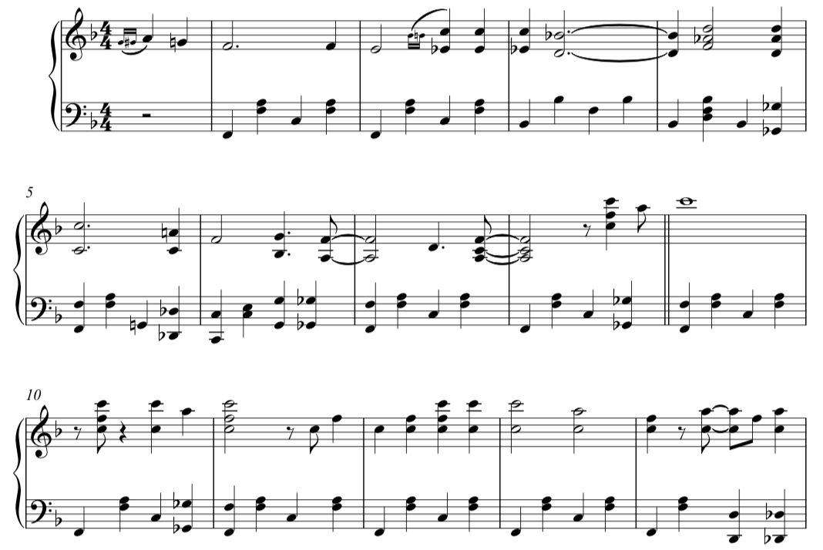


XCI Music
XCI
SDK

Slide 2
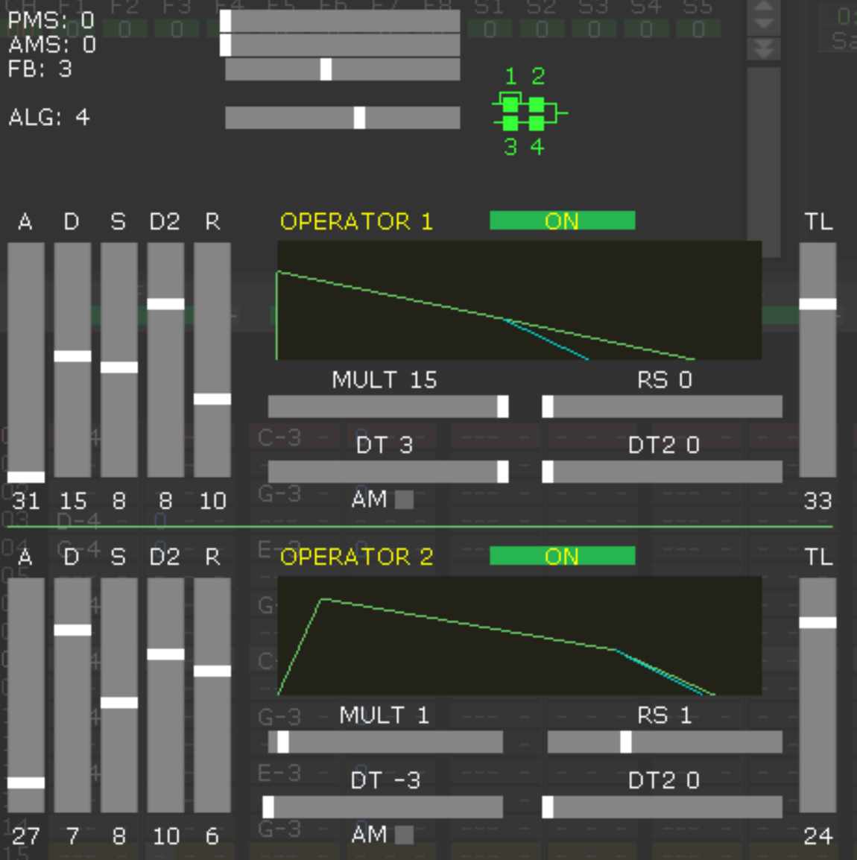
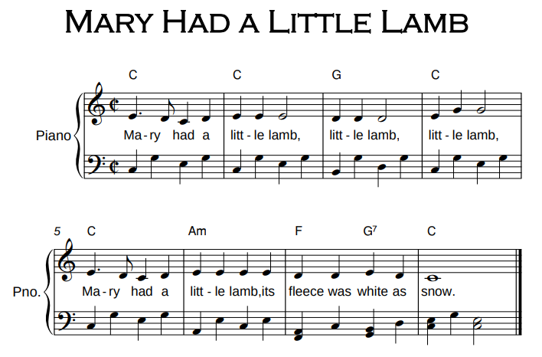
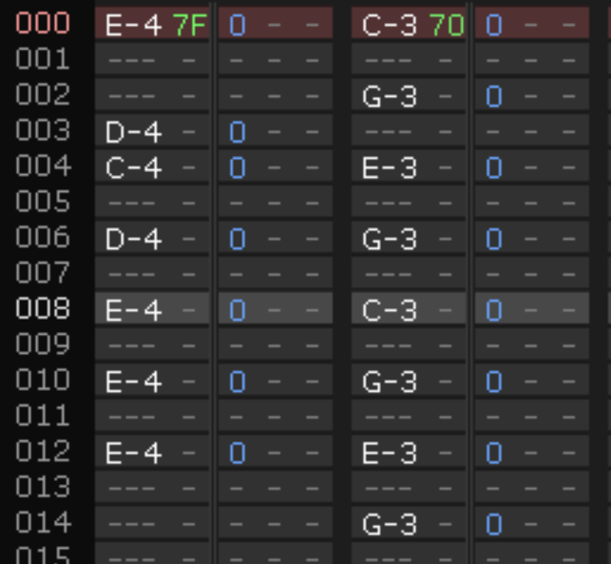
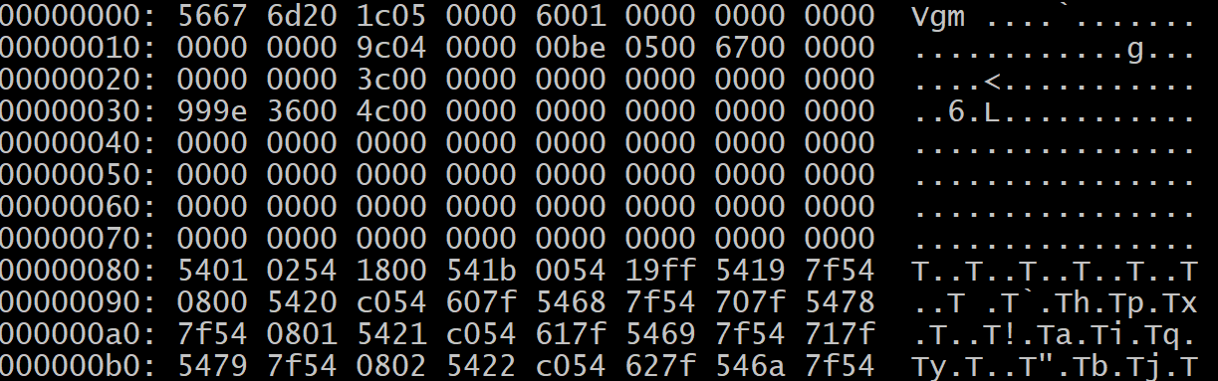
Tracking with Deflemask
Import and/or define FM instruments
Track music for YM2151
Export to VGM

Slide 3
Add to Game
VGM file size < 8 kB
  Fits in single RAM bank
    Shared with PCM sound effects
  One per level, title screen
Instruction: “music”
  Argument: VGM filename
    Must be relative to configuration directory

