Slide 1
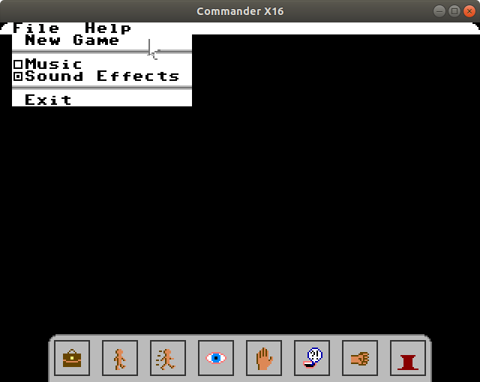
XCI Menus
Menu Bar
Menu
Toolbar

Slide 2
Tile Keys
menu_lc
menu_rc
menu_div
menu_uncheck
menu_check
menu_sp
tool_tiles

Slide 3
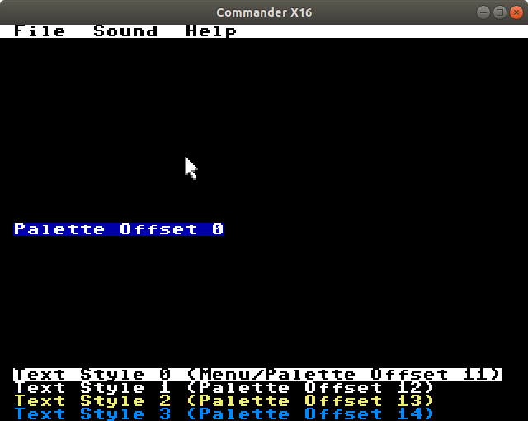
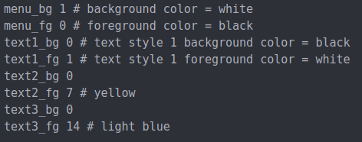
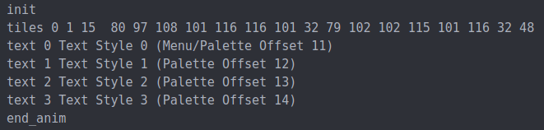
Text Styles
Palette Hex File
foreground
background
Menu File
Level File

Slide 4
Menu Items
menu_item value | Rendered as
new | “New Game”
load | “Load Game...”
save | “Save Game”
saveas | “Save As...”
exit | “Exit”
music | menu_check/menu_uncheck tile, “Music”
sfx | menu_check/menu_uncheck tile, “Sound Effect”
controls | “Controls”
about | “About”
div | menu_div tiles

Slide 5
Tools
UI Controls
inventory
pin
Triggers
walk
run
look
use
talk
strike

