Slide 1
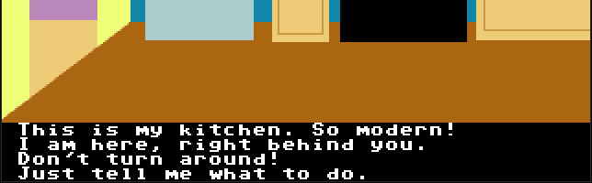
XCI Text Animation
4 lines
38 columns

Slide 2
Instructions
text – Render text at current line
clear – Clear all text and reset current line to 0
scroll – Scroll lines up by given number
line – Render blank at current line

Slide 3
Constraints
Only standard visible ASCII characters supported
  “ “ (32) to “~” (126)
  Any non-standard characters must replace standard
    e.g.: Replace “~” with “ñ” in tile 126, “Espa~ol” will be rendered as “Español”
Four background/foreground color combos available
  Menu Style (0) – black on white by default
  Text Styles 1-3 – All black backgrounds by default
  Only palette offset 0 (first 16) colors may be used for text

