Slide 1

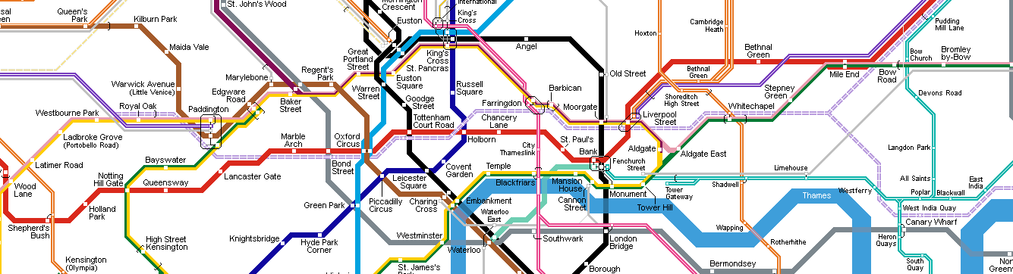
Z80 Assembly
for the
Lesson 4: Conditionality

Slide 2
Z80 Status Flags
S | Z | B5 | H | B3 | P/V | N | C
F Register:
  S: Signed – Value in A is negative
  Z: Zero – Value in A is zero
  B5: Bit 5 of last 8-bit opcode that altered flags
  H: Half-Carry – Overflow occurred with lower nybble
  B3: Bit 3 of last 8-bit opcode that altered flags
  P/V: Parity/Overflow – Parity bit or overflow occurred
  N: Add/Subtract – Subtract occurred since last add
  C: Carry – Bit to carry to next operation

Slide 3
Z80 Status Flags
S | Z | B5 | H | B3 | P/V | N | C
F Register:
  S: Signed – Value in A is negative
  Z: Zero – Value in A is zero
  B5: Bit 5 of last 8-bit opcode that altered flags
  H: Half-Carry – Overflow occurred with lower nybble
  B3: Bit 3 of last 8-bit opcode that altered flags
  P/V: Parity/Overflow – Parity bit or overflow occurred
  N: Add/Subtract – Subtract occurred since last add
  C: Carry – Bit to carry to next operation

Slide 4
Condition Mnemonic
Used as first operand for all conditional assembly instructions
  C - carry bit set (C = 1)
  NC - carry bit reset (C = 0)
  Z - zero bit set (Z = 1)
  NZ - zero bit reset (Z = 0)
  M - sign bit set (S = 1)
  P - sign bit reset (S = 0)
  PE - overflow bit set (P/V = 1)
  PO - overflow bit reset (P/V = 0)

Slide 5
JP: JumP
Jump PC to absolute address
Unconditional: Always jump
  Extended Immediate: jp $89AB
  Register Indirect: jp (hl) . jp (ix) . jp (iy)
Conditional: Jump if condition is true
  Supported conditions: C, NC, Z, NZ, M, P, PE, PO
  Target must be Extended Immediate address
  Example: jp nz,$CDEF

Slide 6
Simple Looping
Initialize loop index, decrement until Z bit set
Case Study: Multiply value in accumulator by 32 (2⁵)
ld b,5
loop:
sla a
dec b
jp nz,loop

Slide 7
CP: ComPare
Compares value in accumulator to another
Sets flags based on sign and comparison
Register Mode: Compare A with A, B, C, D, E, H, L, IXH, IXL, IYH, IYL
  Example: cp b
Immediate Mode: Compare A with 8-bit value
  Example: cp 42
Register Indirect: cp (hl)
Indexed: cp (ix+101) . cp (iy-57)

Slide 8
CP: ComPare
Result of comparison (N = value from operand):
  A == N: Z = 1
  A != N: Z = 0
  A < N: C = 1
  A >= N: C = 0

Slide 9
JR: Jump Relative
Jump to relative address
  Target address must be 8-bit offset from next instruction
Unconditional: Always jump
  Example: jr label
Conditional: Jump if condition is true
  Supported conditions: C, NC, Z, NZ
  Example: jr c,label

Slide 10
RET: RETurn
Returns from program or subroutine
Unconditional (no operand): Always return
Conditional: Return if condition is true
  Supported conditions: C, NC, Z, NZ, M, P, PE, PO
  Example: ret m

Slide 11
If/Else Implementation
Use CP and conditional JR and RET to implement if/else branching
Case Study: Normalize value towards 42
in C: in Z80 Assembly:
if (foo != 42) { ld a,(foo)
if (foo < 42) { cp 42
foo++; ret z
} else { jr nc,toohigh
foo--; inc a
} jr done
} toohigh:
return; dec a
done:
ld (foo),a
ret

Slide 12
CALL
Call subroutine at absolute address
PC jumps to address and execution continues until return
Next instruction called after return
Unconditional: Always call subroutine
  Example: call $89AB
Conditional: Call if condition is true
  Supported conditions: C, NC, Z, NZ, M, P, PE, PO
  Example: call pe,$CDEF

Slide 13
SCF – Set Carry Flag
Explicitly set the carry flag
  C = 1
Side Effects:
  H = 0
  N = 0
No other flags affected

Slide 14
CCF – Complement Carry Flag
Invert the carry flag
  C = !C
    If C == 0, C = 1
    Else, C = 0
Side Effects:
  H = !H
  N = 0
No other flags affected

Slide 15
DJNZ – Decrement and Jump if Not Zero
Decrements B
If B is not zero after decrement, jump to relative address
Does not affect any flags (Not even Z!)
Example: djnz label

Slide 16

Example Program
Use conditional instructions to control program flow
Print string three ways:
  Original
  All lowercase
  All uppercase

