Slide 1


Z80 Assembly
for the
Lesson 8: In and Out

Slide 2
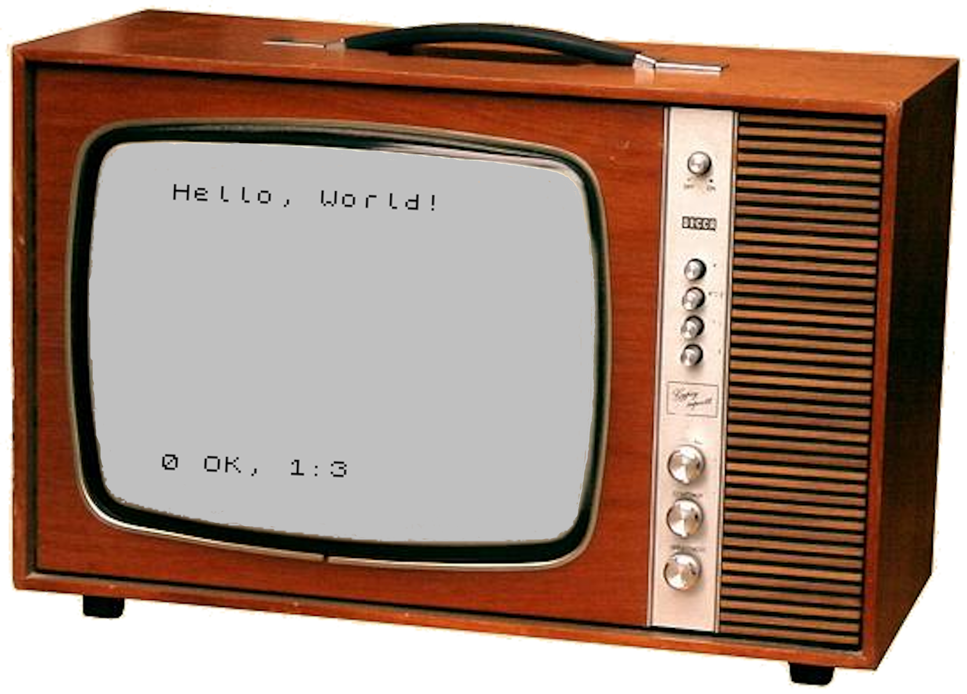
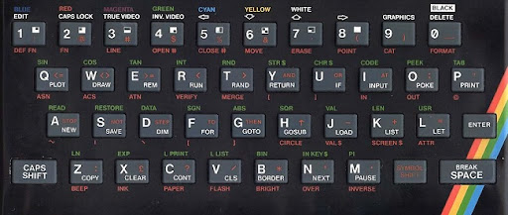
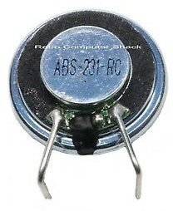
Z80 Ports
Z80
Memory
ADDRESS
ULA
|
16
DATA
|
8
MREQ
EN
IOREQ
EN

Slide 3
IN
First Operand: Destination of data
  Register: A, B, C, D, E, H, L
Second Operand: Port Address (7:0)
  Direct: Low byte hard-coded, High byte in A
    First operand must be A
    Example:
    ld a,$F7
    in a,($FE) ; A ← Port $F7FE
  Register Indirect: Address in BC
    Example:
    ld bc,$BFFE
    in d,(c) ; D ← Port $BFFE
    N = 0; H = 0; P/V = Parity; S = Op1 bit 7; Z = Op1 == 0

Slide 4
Keyboard Input
Port | Bit 4 | Bit 3 | Bit 2 | Bit 1 | Bit 0
$7FFE | B | N | M | Symbol Shift | Space
$BFFE | H | J | K | L | Enter
$DFFE | Y | U | I | O | P
$EFFE | 6 | 7 | 8 | 9 | 0
$F7FE | 5 | 4 | 3 | 2 | 1
$FBFE | T | R | E | W | Q
$FDFE | G | F | D | S | A
$FEFE | V | C | X | Z | Caps Shift
Example:
ld bc,$FEFE
in d,(c)
bit 0,d
ret nz
ld b,$7F
in e,(c)
bit 2,e
call z,handle_shift_m
ret

Slide 5
Keyboard Example
Store all key states in B, C, D, E, B’, C’, D’ and E’
ld a,$FE
in a,($FE)
ld bc,$FDFE
in d,(c)
ld b,$FB
in e,(c)
ld b,$F7
in h,(c)
ld b,$EF
in l,(c)
ld b,h
ld c,l
exx
ld bc,$DFFE
in d,(c)
ld b,$BF
in e,(c)
ld b,$7F
in h,(c)
ld b,h
ld c,a
A:
B:
C:
D:
E:
B’:
C’:
D’:
E’:
?
?
?
?
?
?
?
?
?

Slide 6
Keyboard Example
Store all key states in B, C, D, E, B’, C’, D’ and E’
ld a,$FE
in a,($FE)
ld bc,$FDFE
in d,(c)
ld b,$FB
in e,(c)
ld b,$F7
in h,(c)
ld b,$EF
in l,(c)
ld b,h
ld c,l
exx
ld bc,$DFFE
in d,(c)
ld b,$BF
in e,(c)
ld b,$7F
in h,(c)
ld b,h
ld c,a
A:
B:
C:
D:
E:
B’:
C’:
D’:
E’:
$FE
?
?
?
?
?
?
?
?

Slide 7
Keyboard Example
Store all key states in B, C, D, E, B’, C’, D’ and E’
ld a,$FE
in a,($FE)
ld bc,$FDFE
in d,(c)
ld b,$FB
in e,(c)
ld b,$F7
in h,(c)
ld b,$EF
in l,(c)
ld b,h
ld c,l
exx
ld bc,$DFFE
in d,(c)
ld b,$BF
in e,(c)
ld b,$7F
in h,(c)
ld b,h
ld c,a
A:
B:
C:
D:
E:
B’:
C’:
D’:
E’:
[V,C,X,Z,Shift]
?
?
?
?
?
?
?
?

Slide 8
Keyboard Example
Store all key states in B, C, D, E, B’, C’, D’ and E’
ld a,$FE
in a,($FE)
ld bc,$FDFE
in d,(c)
ld b,$FB
in e,(c)
ld b,$F7
in h,(c)
ld b,$EF
in l,(c)
ld b,h
ld c,l
exx
ld bc,$DFFE
in d,(c)
ld b,$BF
in e,(c)
ld b,$7F
in h,(c)
ld b,h
ld c,a
A:
B:
C:
D:
E:
B’:
C’:
D’:
E’:
[V,C,X,Z,Shift]
$FD
$FE
[G,F,D,S,A]
?
?
?
?
?

Slide 9
Keyboard Example
Store all key states in B, C, D, E, B’, C’, D’ and E’
ld a,$FE
in a,($FE)
ld bc,$FDFE
in d,(c)
ld b,$FB
in e,(c)
ld b,$F7
in h,(c)
ld b,$EF
in l,(c)
ld b,h
ld c,l
exx
ld bc,$DFFE
in d,(c)
ld b,$BF
in e,(c)
ld b,$7F
in h,(c)
ld b,h
ld c,a
A:
B:
C:
D:
E:
B’:
C’:
D’:
E’:
[V,C,X,Z,Shift]
$FB
$FE
[G,F,D,S,A]
[T,R,E,W,Q]
?
?
?
?

Slide 10
Keyboard Example
Store all key states in B, C, D, E, B’, C’, D’ and E’
ld a,$FE
in a,($FE)
ld bc,$FDFE
in d,(c)
ld b,$FB
in e,(c)
ld b,$F7
in h,(c)
ld b,$EF
in l,(c)
ld b,h
ld c,l
exx
ld bc,$DFFE
in d,(c)
ld b,$BF
in e,(c)
ld b,$7F
in h,(c)
ld b,h
ld c,a
A:
B:
C:
D:
E:
B’:
C’:
D’:
E’:
[V,C,X,Z,Shift]
[5,4,3,2,1]
[6,7,8,9,0]
[G,F,D,S,A]
[T,R,E,W,Q]
?
?
?
?

Slide 11
Keyboard Example
Store all key states in B, C, D, E, B’, C’, D’ and E’
ld a,$FE
in a,($FE)
ld bc,$FDFE
in d,(c)
ld b,$FB
in e,(c)
ld b,$F7
in h,(c)
ld b,$EF
in l,(c)
ld b,h
ld c,l
exx
ld bc,$DFFE
in d,(c)
ld b,$BF
in e,(c)
ld b,$7F
in h,(c)
ld b,h
ld c,a
A:
B:
C:
D:
E:
B’:
C’:
D’:
E’:
[V,C,X,Z,Shift]
?
?
?
?
[5,4,3,2,1]
[6,7,8,9,0]
[G,F,D,S,A]
[T,R,E,W,Q]

Slide 12
Keyboard Example
Store all key states in B, C, D, E, B’, C’, D’ and E’
ld a,$FE
in a,($FE)
ld bc,$FDFE
in d,(c)
ld b,$FB
in e,(c)
ld b,$F7
in h,(c)
ld b,$EF
in l,(c)
ld b,h
ld c,l
exx
ld bc,$DFFE
in d,(c)
ld b,$BF
in e,(c)
ld b,$7F
in h,(c)
ld b,h
ld c,a
A:
B:
C:
D:
E:
B’:
C’:
D’:
E’:
[V,C,X,Z,Shift]
$DF
$FE
[Y,U,I,O,P]
?
[5,4,3,2,1]
[6,7,8,9,0]
[G,F,D,S,A]
[T,R,E,W,Q]

Slide 13
Keyboard Example
Store all key states in B, C, D, E, B’, C’, D’ and E’
ld a,$FE
in a,($FE)
ld bc,$FDFE
in d,(c)
ld b,$FB
in e,(c)
ld b,$F7
in h,(c)
ld b,$EF
in l,(c)
ld b,h
ld c,l
exx
ld bc,$DFFE
in d,(c)
ld b,$BF
in e,(c)
ld b,$7F
in h,(c)
ld b,h
ld c,a
A:
B:
C:
D:
E:
B’:
C’:
D’:
E’:
[V,C,X,Z,Shift]
$BF
$FE
[Y,U,I,O,P]
[H,J,K,L,Enter]
[5,4,3,2,1]
[6,7,8,9,0]
[G,F,D,S,A]
[T,R,E,W,Q]

Slide 14
Keyboard Example
Store all key states in B, C, D, E, B’, C’, D’ and E’
ld a,$FE
in a,($FE)
ld bc,$FDFE
in d,(c)
ld b,$FB
in e,(c)
ld b,$F7
in h,(c)
ld b,$EF
in l,(c)
ld b,h
ld c,l
exx
ld bc,$DFFE
in d,(c)
ld b,$BF
in e,(c)
ld b,$7F
in h,(c)
ld b,h
ld c,a
A:
B:
C:
D:
E:
B’:
C’:
D’:
E’:
[V,C,X,Z,Shift]
[B,N,M,Sym,Space]
$FE
[Y,U,I,O,P]
[H,J,K,L,Enter]
[5,4,3,2,1]
[6,7,8,9,0]
[G,F,D,S,A]
[T,R,E,W,Q]

Slide 15
Keyboard Example
Store all key states in B, C, D, E, B’, C’, D’ and E’
ld a,$FE
in a,($FE)
ld bc,$FDFE
in d,(c)
ld b,$FB
in e,(c)
ld b,$F7
in h,(c)
ld b,$EF
in l,(c)
ld b,h
ld c,l
exx
ld bc,$DFFE
in d,(c)
ld b,$BF
in e,(c)
ld b,$7F
in h,(c)
ld b,h
ld c,a
A:
B:
C:
D:
E:
B’:
C’:
D’:
E’:
[V,C,X,Z,Shift]
[B,N,M,Sym,Space]
[V,C,X,Z,Shift]
[Y,U,I,O,P]
[H,J,K,L,Enter]
[5,4,3,2,1]
[6,7,8,9,0]
[G,F,D,S,A]
[T,R,E,W,Q]

Slide 16
OUT
First Operand: Port Address (7:0)
  Direct: Low byte hard-coded, High byte in A
    Second operand must be A
    Example:
    ld a,$10
    out ($FE),a ; $10 → Port $10FE
  Register Indirect: Address in BC
    Example:
    ld bc,$1FFD
    out (c),d ; D → Port $1FFD
Second Operand: Source of data
  Register: A, B, C, D, E, H, L
UNDOCUMENTED
...or zero

Slide 17
Sound Output
Piezoelectric beeper controlled by bit 4 of port $FE
Middle C = 261.6 Hz
  Period: 3.8226 ms (13,380 T-states @ 3.5 MHz)
  Output $10 for 6,690 T-states, zero for 6,690, repeat
For Spectrum 128k: AY-3-8912 controlled by ports $BFFD, $FFFD
  Read/write registers
  Set channels to notes

Slide 18
Sound Example
Play 25 Hz tone
Just flip bit 4 on $FE after every PAL frame (50 Hz) interrupt
ei
ld c,$fe
sound_loop:
xor $10
halt
out (c),a
jp sound_loop

Slide 19
IN Loop Instructions
INI: INput and Increment
  Same as:
    in (hl),(c)
    inc hl
    dec b
INIR: INput, Increment, Repeat
  Same as:
    ini_loop:
    ini
    jp nz,ini_loop
IND: INput and Decrement
  Same as:
    in (hl),(c)
    dec hl
    dec b
INDR: INput, Decrement, Repeat
  Same as:
    ind_loop:
    ind
    jp nz,ind_loop

Slide 20
OUT Loop Instructions
OUTI: OUTput and Increment
  Same as:
    out (c),(hl)
    inc hl
    dec b
OTIR: OUTput, Increment, Repeat
  Same as:
    outi_loop:
    outi
    jp nz,outi_loop
OUTD: OUTput and Decrement
  Same as:
    out (c),(hl)
    dec hl
    dec b
OTDR: OUTput, Decrement, Repeat
  Same as:
    outd_loop:
    outd
    jp nz,outd_loop

Slide 21
Example Program
Play tone while X key is pressed
Embedded applications need no screenshots!

