Slide 1

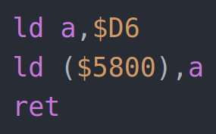
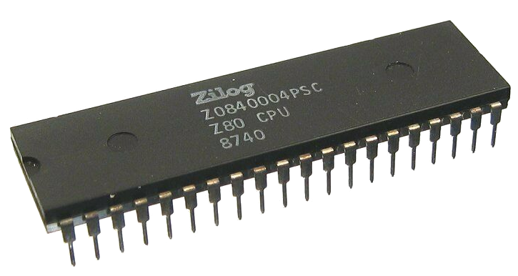
Z80 Assembly
for the
Lesson 1: The Basics

Slide 2
Definitions
A human-readable set of mnemonics that represents a processor’s machine language
Assembly Language:
The binary code that a processor executes from memory
Machine Language:
00111110
11010110
00110010
00000000
01011000
11001001

Slide 3
What is an Assembler?
Like a compiler, an assembler converts assembly language into machine language.
Develop on multiple platforms, target single processor family
Examples for the Z80:
  Zilog Macro Cross Assembler (OEM Standard)
  sjasmplus
  Zeus
  Vasm
  Crossware Z80

Slide 4
Z80 Architecture
A
F
A’
F’
B
C
B’
C’
BC
D
E
D’
E’
DE
H
L
H’
L’
HL
SP
PC
IX
IY
I
R

Slide 5
“Load” Mnemonic Syntax
LD destination,source
; Assembly: C:
ld a,42 ; A = 42
ld ($89AB),c ; *(0x89AB) = C
ld (hl),d ; *HL = D
ld bc,($CDEF) ; BC = *(0xCDEF)
ld a,(bc) ; A = *BC

Slide 6
Machine Language
Assembly Language Machine Language (hex)
ld a,b 78
ld a,($1234) 3A 34 12
inc a 3C
ret C9
ldir ED B0
rst $10 D7

Slide 7
Color Attributes
$5800 - $5AFF
←PAPER→
←INK→
Flash | Bright
Bit 7 6 5 4 3 2 1 0
0 |  | 000
1 |  | 001
2 |  | 010
3 |  | 011
4 |  | 100
5 |  | 101
6 |  | 110
7 |  | 111
11010110 = $D6

Slide 8
Our First Assembly Program
Assembly Language Machine Language (hex)
ld a,$D6 3E D6
ld ($5800),a 32 00 58
ret C9

Slide 9
