Slide 1

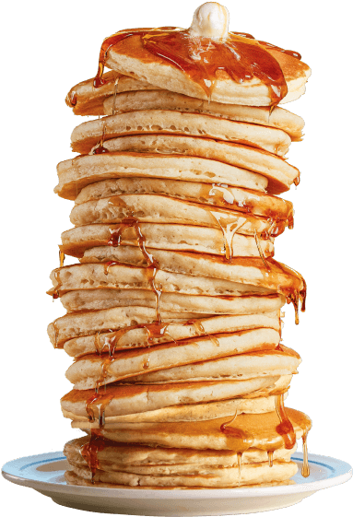
Z80 Assembly
for the
Lesson 6: The Stack

Slide 2
Z80 Architecture
A
F
A’
F’
B
C
B’
C’
D
E
D’
E’
H
L
H’
L’
SP
PC
IX
IY
I
R

Slide 3
ZX Spectrum 48k Memory Map
0000 | ROM | 16 kB
3FFF
4000 | Screen Bitmap (256x192) | 6 kB
57FF
5800 | Screen Color Attributes (32x24) | 768 Bytes
5AFF
5B00 | Reserved for BASIC | 1.20 kB
5CCA
5CCB | Contended User RAM | 8.80 kB
7FFF
8000 | Free User RAM | 31.84 kB
FF57
FF58 | User-Defined Graphics (UDG) | 168 Bytes
FFFF

Slide 4
Stack Behavior
SP: 16-bit Stack Pointer (to RAM)
PUSH: Decrement SP by 2 and store word there
POP: Load word at SP, then increment by 2
org $8000
ld hl,$FF58
ld sp,hl
push hl
call foo
pop hl
halt
foo:
ld hl,$1234
ret
STACK
FF53 | ??
FF54 | ??
FF55 | ??
FF56 | ??
FF57 | ??
FF58 | 00
REGISTERS
PC | SP | H | L
8000 | ???? | ?? | ??

Slide 5
Stack Behavior
SP: 16-bit Stack Pointer (to RAM)
PUSH: Decrement SP by 2 and store word there
POP: Load word at SP, then increment by 2
org $8000
ld hl,$FF58
ld sp,hl
push hl
call foo
pop hl
halt
foo:
ld hl,$1234
ret
STACK
FF53 | ??
FF54 | ??
FF55 | ??
FF56 | ??
FF57 | ??
FF58 | 00
REGISTERS
PC | SP | H | L
8003 | ???? | FF | 58

Slide 6
Stack Behavior
SP: 16-bit Stack Pointer (to RAM)
PUSH: Decrement SP by 2 and store word there
POP: Load word at SP, then increment by 2
org $8000
ld hl,$FF58
ld sp,hl
push hl
call foo
pop hl
halt
foo:
ld hl,$1234
ret
STACK
FF53 | ??
FF54 | ??
FF55 | ??
FF56 | ??
FF57 | ??
FF58 | 00
REGISTERS
PC | SP | H | L
8004 | FF58 | FF | 58

Slide 7
Stack Behavior
SP: 16-bit Stack Pointer (to RAM)
PUSH: Decrement SP by 2 and store word there
POP: Load word at SP, then increment by 2
org $8000
ld hl,$FF58
ld sp,hl
push hl
call foo
pop hl
halt
foo:
ld hl,$1234
ret
STACK
FF53 | ??
FF54 | ??
FF55 | ??
FF56 | 58
FF57 | FF
FF58 | 00
REGISTERS
PC | SP | H | L
8005 | FF56 | FF | 58

Slide 8
Stack Behavior
SP: 16-bit Stack Pointer (to RAM)
PUSH: Decrement SP by 2 and store word there
POP: Load word at SP, then increment by 2
org $8000
ld hl,$FF58
ld sp,hl
push hl
call foo
pop hl
halt
foo:
ld hl,$1234
ret
STACK
FF53 | ??
FF54 | 08
FF55 | 80
FF56 | 58
FF57 | FF
FF58 | 00
REGISTERS
PC | SP | H | L
800A | FF54 | FF | 58

Slide 9
Stack Behavior
SP: 16-bit Stack Pointer (to RAM)
PUSH: Decrement SP by 2 and store word there
POP: Load word at SP, then increment by 2
org $8000
ld hl,$FF58
ld sp,hl
push hl
call foo
pop hl
halt
foo:
ld hl,$1234
ret
STACK
FF53 | ??
FF54 | 08
FF55 | 80
FF56 | 58
FF57 | FF
FF58 | 00
REGISTERS
PC | SP | H | L
800D | FF54 | 12 | 34

Slide 10
Stack Behavior
SP: 16-bit Stack Pointer (to RAM)
PUSH: Decrement SP by 2 and store word there
POP: Load word at SP, then increment by 2
org $8000
ld hl,$FF58
ld sp,hl
push hl
call foo
pop hl
halt
foo:
ld hl,$1234
ret
STACK
FF53 | ??
FF54 | 08
FF55 | 80
FF56 | 58
FF57 | FF
FF58 | 00
REGISTERS
PC | SP | H | L
8008 | FF56 | 12 | 34

Slide 11
Stack Behavior
SP: 16-bit Stack Pointer (to RAM)
PUSH: Decrement SP by 2 and store word there
POP: Load word at SP, then increment by 2
org $8000
ld hl,$FF58
ld sp,hl
push hl
call foo
pop hl
halt
foo:
ld hl,$1234
ret
STACK
FF53 | ??
FF54 | 08
FF55 | 80
FF56 | 58
FF57 | FF
FF58 | 00
REGISTERS
PC | SP | H | L
8009 | FF58 | FF | 58

Slide 12
CALL Effects
Unconditional:
  PCOUT = operand
Conditional and taken:
  PCOUT = second operand
Unconditional OR conditional and taken:
  SPOUT = SPIN – 2
  (SPOUT) = PCIN + 3
Conditional and not taken:
  PCOUT = PCIN + 3

Slide 13
RST – call ReSeT vector
Shortcut for calling special routines on page zero
Operand: 8-bit address (upper byte zero)
  Supported Addresses: $00, $08, $10, $18, $20, $28, $30, $38
Effects:
  PCOUT = operand
  SPOUT = SPIN – 2
  (SPOUT) = PCIN + 1

Slide 14
RET Effects
Unconditional OR conditional and taken:
  PCOUT = (SPIN)
  SPOUT = SPIN + 2
Conditional and not taken:
  PCOUT = PCIN + 3

Slide 15
PUSH
Pushes register value to stack
Supported registers: AF, BC, DE, HL, IX, IY
Example: push hl
  Effects:
    SPOUT = SPIN – 2
    (SPOUT) = L
    (SPOUT + 1) = H

Slide 16
POP
Pops value off stack, stores it in register
Supported registers: AF, BC, DE, HL, IX, IY
Example: pop hl
  Effects:
    L = (SPIN)
    H = (SPIN + 1)
    SPOUT = SPIN + 2
Flags unaffected unless AF is popped, and flag values are retrieved from stack

Slide 17
RETI – RETurn from Interrupt
Unconditionally returns from Mode 2 interrupt routine
  Interrupt Modes 0 and 1 use normal RET instructions
Effects:
  PCOUT = (SPIN)
  SPOUT = SPIN + 2

Slide 18
RETN – RETurn from Non-maskable Interrupt
Unconditionally returns from non-maskable interrupt (NMI) routine
Effects:
  Re-enables maskable interrupts
  PCOUT = (SPIN)
  SPOUT = SPIN + 2

Slide 19
One Byte at a Time
Individual bytes can be “pushed” and “popped”
Example: Push and pop only A – not AF
sp_backup:
dw 0
push_a: pop_a:
dec sp ld (sp_backup),sp
ld (sp_backup),sp inc sp
ld hl,(sp_backup) ld hl,(sp_backup)
ld (hl),a ld a,(hl)
ret ret

Slide 20
Hot Swapping
Last word pushed to stack can be exchanged with register value
  HL, IX, IY
Example: Switch values between BC and HL via the stack
ld bc,$1234
ld hl,$5678
push bc
ex (sp),hl ; HL = $1234
pop bc ; BC = $5678

Slide 21
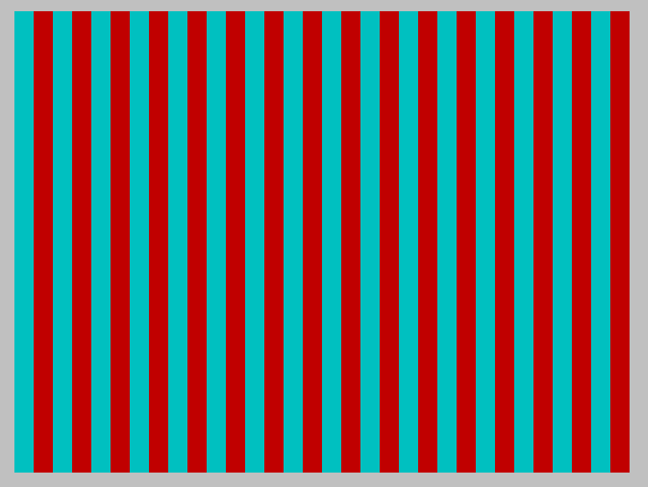
Example Program
Re-map the stack to screen memory
Render stripe pattern

