Slide 1


Z80 Assembly
for the
Lesson 3: Data in Motion

Slide 2
“Load” Mnemonic Syntax
LD destination,source
; Assembly: C:
ld a,42 ; A = 42
ld ($89AB),a ; *(0x89AB) = A
ld (hl),d ; *HL = D
ld bc,($CDEF) ; BC = *(0xCDEF)
ld a,(bc) ; A = *BC

Slide 3
Z80 Architecture
A
F
A’
F’
B
C
B’
C’
D
E
D’
E’
H
L
H’
L’
SP
PC
IX
IY
I
R

Slide 4
ZX Spectrum 48k Memory Map
0000 | ROM | 16 kB
3FFF
4000 | Screen Bitmap (256x192) | 6 kB
57FF
5800 | Screen Color Attributes (32x24) | 768 Bytes
5AFF
5B00 | Reserved for BASIC | 1.20 kB
5CCA
5CCB | Contended User RAM | 8.80 kB
7FFF
8000 | Free User RAM | 31.84 kB
FF57
FF58 | User-Defined Graphics (UDG) | 168 Bytes
FFFF

Slide 5
Hardware Ports
Input/Output devices mapped to 8-bit Port Addresses
  Port Address: Lower 8-bits of address bus
  Upper 8-bits of address bus may also be used during I/O request
ULA: Port $FE
  Keyboard
  Tape I/O
  Piezoelectric Beeper

Slide 6
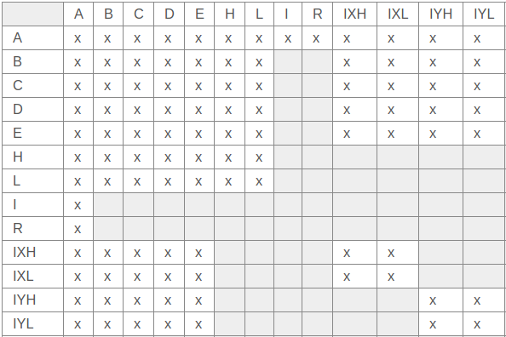
LD: LoaD
Operands: Destination, Source
181 Opcodes!
8-bit Register-to-Register:
Source
Destination
101!

Slide 7
LD: LoaD
16-bit Register-to-Register:
  ld sp,hl ld sp,ix ld sp,iy
Immediate Loads:
  Example: ld a,42
  Other destinations: B, C, D, E, H, L, IXH, IXL, IYH, IYL
Extended Immediate Loads:
  Example: ld bc,1323
  Other destinations: DE, HL, SP, IX, IY

Slide 8
LD: LoaD
8-Bit Direct to Register:
  Example: ld a,($1234)
  No other destinations
16-Bit Direct to Register:
  Example: ld bc,($5678)
  Other destinations: DE, HL, SP, IX, IY

Slide 9
LD: LoaD
8-Bit Register to Direct:
  Example: ld ($1234),a
  No other sources
16-Bit Register to Direct:
  Example: ld ($5678),bc
  Other sources: DE, HL, SP, IX, IY

Slide 10
LD: LoaD
Register Indirect to Register
  To A only: ld a,(bc) ld a,(de)
  From (HL):
    Example: ld a,(hl)
    Other destinations: B, C, D, E, H, L
Register to Register Indirect:
  From A only: ld (bc),a ld (de),a
  To (HL):
    Example: ld (hl),a
    Other sources: B, C, D, E, H, L

Slide 11
LD: LoaD
Indexed to Register
  From (offset from IX):
    Example: ld a,(ix+57)
    Other destinations: B, C, D, E, H, L
  From (offset from IY):
    Example: ld a,(iy-103)
    Other destinations: B, C, D, E, H, L
Register to Indexed
  To (offset from IX):
    Example: ld (ix+57),a
    Other sources: B, C, D, E, H, L
  To (offset from IY):
    Example: ld (iy-103),a
    Other sources: B, C, D, E, H, L

Slide 12
EX: EXchange
Operands: Two 16-bit locations
Locations exchange values
5 opcodes:
  ex af,af’
  ex de,hl
  ex (sp),hl
  ex (sp),ix
  ex (sp),iy

Slide 13
EXX: EXchange X
No operands
3 16-bit registers exchange values with alternates
Results:
  BC ↔ BC’
  DE ↔ DE’
  HL ↔ HL’

Slide 14
Using Alternate Registers
Alternate registers can’t be operated on directly
Instruction | A | BC | DE | HL | A’ | BC’ | DE’ | HL’
ld a,42 | 42 | ? | ? | ? | ? | ? | ? | ?
ex af,af’ | ? | ? | ? | ? | 42 | ? | ? | ?
ld a,57 | 57 | ? | ? | ? | 42 | ? | ? | ?
ex af,af’ | 42 | ? | ? | ? | 57 | ? | ? | ?
ld bc,6502 | 42 | 6502 | ? | ? | 57 | ? | ? | ?
ld de,768 | 42 | 6502 | 768 | ? | 57 | ? | ? | ?
ld hl,22528 | 42 | 6502 | 768 | 22528 | 57 | ? | ? | ?
exx | 42 | ? | ? | ? | 57 | 6502 | 768 | 22528
ld bc,8080 | 42 | 8080 | ? | ? | 57 | 6502 | 768 | 22528
ld de,6144 | 42 | 8080 | 6144 | ? | 57 | 6502 | 768 | 22528
ld hl,16384 | 42 | 8080 | 6144 | 16384 | 57 | 6502 | 768 | 22528
exx | 42 | 6502 | 768 | 22528 | 57 | 8080 | 6144 | 16384

Slide 15
LDI: LoaD-Increment
No operands
Copies byte value from one memory address to another
Increments both address registers
Decrements byte count register
Operation:
  (DE) = (HL)
  DE = DE + 1
  HL = HL + 1
  BC = BC - 1

Slide 16
LDIR: LoaD-Increment-Repeat
No operands
Copies data block to new memory location
Operation:
  repeat:
    LDI
  until BC == 0
Spoiler Alert: This could take a while!

Slide 17
Copying Data Block
Copy full 6912-byte screen buffer from $E000 to screen memory ($4000)
ld bc,6912
ld de,$4000
ld hl,$E000
ldir

Slide 18
LDD: LoaD-Decrement
No operands
Copies byte value from one memory address to another
Decrements both address registers and byte count register
Operation:
  (DE) = (HL)
  DE = DE - 1
  HL = HL - 1
  BC = BC - 1

Slide 19
LDDR: Load-Decrement-Repeat
No operands
Copies data block to new memory location
Reverse order and direction from LDIR
Operation:
  repeat:
    LDD
  until BC == 0
Spoiler Alert: This could also take a while!

Slide 20
Copying Data Block – Backwards!
Copy full 6912-byte screen buffer from $E000 to screen memory ($4000), starting from end of buffer
ld bc,6912
ld de,$5AFF ; $4000 + 6911
ld hl,$FAFF ; $E000 + 6911
lddr

Slide 21

Example Program
Use LD, EX, EXX, LDI, LDD, LDIR, LDDR to create and move data around

