Slide 1

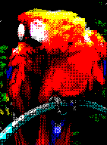
Z80 Assembly
for the
Lesson 11: Intro to Graphics

Slide 2
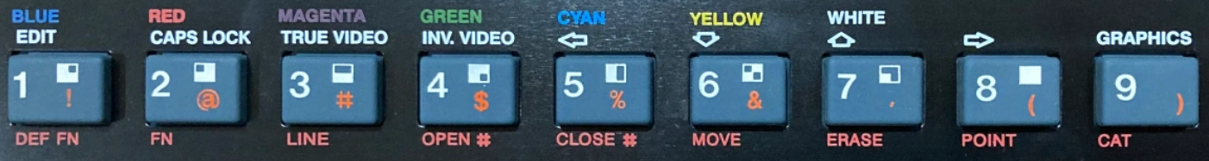
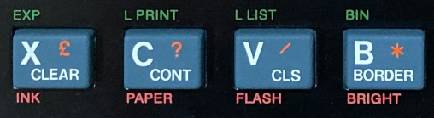
Graphics Characters
BASIC: Graphics input mode
Each character: 2x2 bitmap of quasi-pixels
  Quasi-pixel: 4x4 square of actual pixels
    Full Display: 64x48 quasi-pixels
  2 colors: Paper and Ink, same brightness

Slide 3
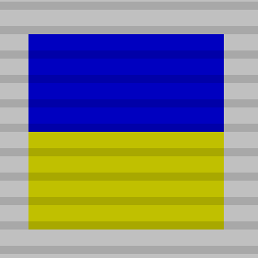
Graphics Character Codes
$80-$8F:
G Cursor: 8 1 2 3 4 5 6 7 ↑7 ↑6 ↑5 ↑4 ↑3 ↑2 ↑1 ↑8
Example:
ld a,$10 ; INK
rst $10
ld a,1 ; blue
rst $10
ld a,$11 ; PAPER
rst $10
ld a,6 ; yellow
rst $10
ld a,$83 ; upper half ink
rst $10

Slide 4
ZX Spectrum 48k Memory Map
0000 | ROM | 16 kB
3FFF
4000 | Screen Bitmap (256x192) | 6 kB
57FF
5800 | Screen Color Attributes (32x24) | 768 Bytes
5AFF
5B00 | Reserved for BASIC | 1.20 kB
5CCA
5CCB | Contended User RAM | 8.80 kB
7FFF
8000 | Free User RAM | 31.84 kB
FF57
FF58 | User-Defined Graphics (UDG) | 168 Bytes
FFFF

Slide 5
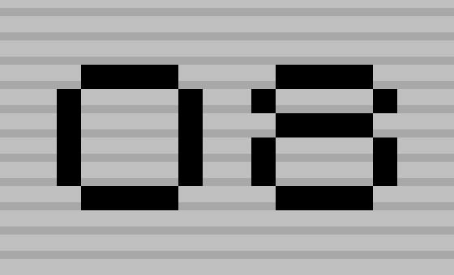
User-Defined Graphics (UDG)
21 8x8 Bitmaps stored in RAM $FF58 to $FFFF
Startup: “A” through “U” bitmaps copied from ROM
Codes $90 (A) to $A4 (U)
Example:
UDG_O_CODE = $9E
UDG_O_BITMAP = $FFC8
ld a,UDG_O_CODE
rst $10
ld a,%00111100
ld (UDG_O_BITMAP+3),a
ld a,UDG_O_CODE
rst $10

Slide 6
Direct Screen Access
Bitmap: $4000 to $57FF
Attributes: $5800 to $5AFF

Slide 7

Example Program
Graphics Via 4 Methods:
  Fixed Graphics Characters
  User-Defined Graphics Characters (UDG)
  Bitmap Loading
  Programmatic Bitmap Manipulation

