Slide 1
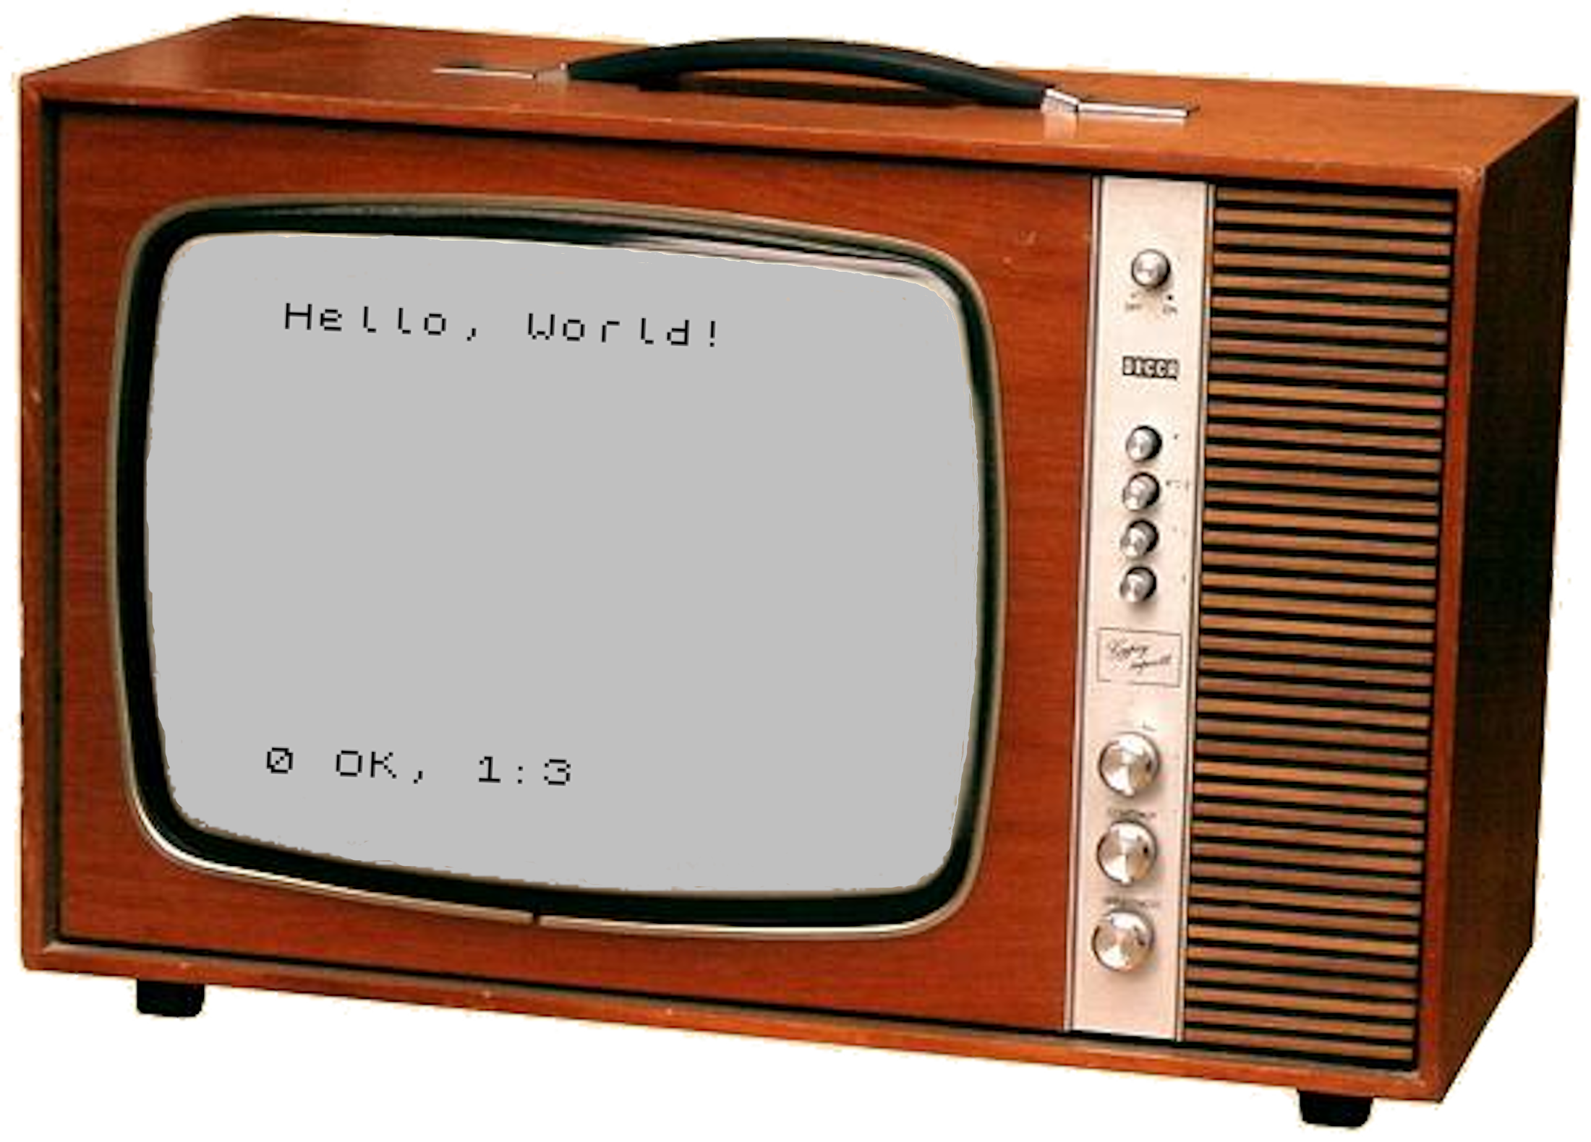
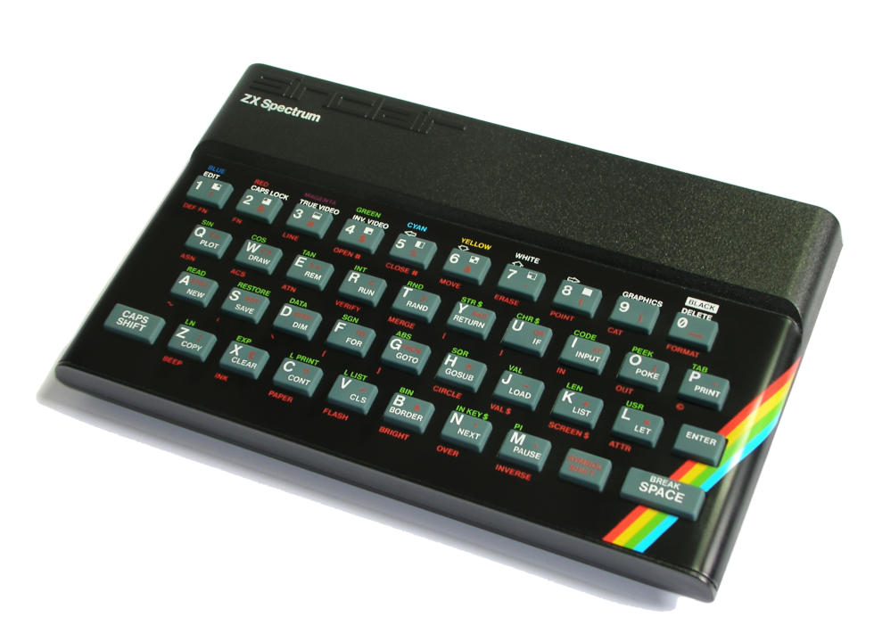
Hello, Speccy!
“Hello, World!”
on a
ZX Spectrum?
Not too
bad!
Not too
bad!

Slide 2
Sinclair ZX Spectrum
3.5 MHz Zilog Z80A
16 kB ROM
16 or 48 kB RAM
Graphics: 256x192, “16” colors
  ULA contends for screen RAM with CPU
Sound: 1-bit piezoelectric beeper
  Manual control of pulse frequency
Released 23 April 1982
  Price: £125 ($221.64) for 16kB, £175 ($310.29) for 48kB
  In 2021: £385 ($535.36) to £540 ($750.89)
  Compatible line continued through 1992

Slide 3
Spectrum 48kB Memory Map
0000 | ROM
3FFF
4000 | Screen Bitmap
57FF
5800 | Screen Color Attributes
5AFF
5B00 | Printer Buffer
 | System Variables
5CCA | Reserved
5CCB | Program RAM
FF57
FF58 | Reserved
FFFF

