Slide 1
Towards Efficient Compilation of the HPJava Language for HPC
Han-Ku Lee
June 12th, 2003
hkl@csit.fsu.edu
Pervasive Technology Lab Indiana University | Computer Science Florida State University

Slide 2
Introduction
HPJava is a new language for parallel computing developed by our research group at Florida State University, Indiana University
It extends Java with features from languages like Fortran
New features include multidimensional arrays and parallel data structures
It introduces a new parallel computing model, called the HPspmd programming model

Slide 3
Outline
Background on parallel computing
Multidimensional Arrays
HPspmd Programming Model
  HPJava
Multiarrays, Sections
HPJava compilation and optimization
Benchmarks
Future Works

Slide 4
Data Parallel Languages
Large data-structures, typically arrays, are split across nodes
Each node performs similar computations on a different part of the data structure
SIMD – Illiac IV and Connection Machine for example introduced a new concept, distributed arrays
MIMD – asynchronous, flexible, hard to program
SPMD – loosely synchronous model (SIMD+MIMD)
  Each node has its own local copy of program

Slide 5
HPF (High Performance Fortran)
By early 90s, value of portable, standardized languages universally acknowledged.
Goal of HPF Forum – a single language for High Performance programming. Effective across architectures—vector, SIMD, MIMD, though SPMD a focus.
HPF - an extension of Fortran 90 to support the data parallel programming model on distributed memory parallel computers
Supported by Cray, DEC, Fujitsu, HP, IBM, Intel, Maspar, Meiko, nCube, Sun, and Thinking Machines

Slide 6
Multidimensional Arrays (1)
Java is an attractive language, but needs to be improved for large computational tasks
Java provides array of arrays
  Time consumption for out-of bounds checking
  The cost of accessing an element

Slide 7
Array of Arrays in Java
X
X
Y
0
0
0
1
1
1
2
2
2
3
3
3
Array of array for 2D
Array of array in irregular structure

Slide 8
Multidimensional Arrays (2)
Z
True 2-dimensional Array

Slide 9
Multidimensional Arrays (3)
HPJava provides true multidimensional arrays and regular sections
For example
  int [[ * , * ]] a = new int [[ 5 , 5 ]] ;
  for (int i=0; i<4; i++) a [ i , i+1 ] = 19 ;
  foo ( a[[ : , 0 ]] ) ;
  int [[ * ]] b = new int [[ 100 ]] ;
  int [ ] c = new int [ 100 ] ;
  // b and c are NOT identical. Why ?

Slide 10
HPJava
HPspmd programming model
  a flexible hybrid of HPF-like data-parallel language and the popular, library-oriented, SPMD style
Base-language for HPspmd model should be clean and simple object semantics, cross-platform portability, security, and popular – Java

Slide 11
Features of HPJava
A language for parallel programming, especially suitable for massively parallel, distributed memory computers as well as shared memory machines.
Takes various ideas from HPF.
  e.g. - distributed array model
In other respects, HPJava is a lower level parallel programming language than HPF.
  explicit SPMD, needing explicit calls to communication libraries such as MPI or Adlib
The HPJava system is built on Java technology.
  The HPJava programming language is an extension of the Java programming language.

Slide 12
Benefits of our HPspmd Model
Translators are much easier to implement than HPF compilers. No compiler magic needed
Attractive framework for library development, avoiding inconsistent representations of distributed array arguments
Better prospects for handling irregular problems – easier to fall back on specialized libraries as required
Can directly call MPI functions from within an HPspmd program

Slide 13
Processes
Procs2 p = new Procs(2, 3) ;
on (p) {
Range x = new BlockRange(N, p.dim(0)) ;
Range y = new BlockRange(N, p.dim(1)) ;
float [[-,-]] a = new float [[x, y]] ;
float [[-,-]] b = new float [[x, y]] ;
float [[-,-]] c = new float [[x, y]] ;
… initialize ‘a’, ‘b’
overall (i=x for :)
overall (j=y for :)
c [i, j] = a [i, j] + b [i, j];
}
An HPJava program is concurrently started on all members of some process collection – process groups
on construct limits control to the active process group (APG), p
0
1
2
0
1
p

Slide 14
Multiarrays (1)
Type signature of a multiarray
T [[attr₀, …, attr_{R-1}]] bras
where R is the rank of the array and each term attr_{r} is either a single hyphen, - or a single asterisk, *, the term bras is a string of zero or more bracket pairs, []
T can be any Java type other than an array type. This signature represents the type of a distributed array whose elements have Java type
T bras
A distributed array type is not treated as a class type

Slide 15
Multiarrays (2)
(Sequential) true multidimensional arrays
Distributed Arrays
  The most important feature of HPJava
  A collective array shared by a number of processes
  True multidimensional array
  Can form a regular section of an distributed array

Slide 16
Distributed Arrays
0
1
2
a[0,0] a[0,1] a[0,2]
a[1,0] a[1,1] a[1,2]
a[2,0] a[2,1] a[2,2]
a[3,0] a[3,1] a[3,2]
a[0,3] a[0,4] a[0,5]
a[1,3] a[1,4] a[1,5]
a[2,3] a[2,4] a[2,5]
a[3,3] a[3,4] a[3,5]
a[0,6] a[0,7]
a[1,6] a[1,7]
a[2,6] a[2,7]
a[3,6] a[3,7]
0
a[4,0] a[4,1] a[4,2]
a[5,0] a[5,1] a[5,2]
a[6,0] a[6,1] a[6,2]
a[7,0] a[7,1] a[7,2]
a[4,3] a[4,4] a[4,5]
a[5,3] a[5,4] a[5,5]
a[6,3] a[6,4] a[6,5]
a[7,3] a[7,4] a[7,5]
a[4,6] a[4,7]
a[5,6] a[5,7]
a[6,6] a[6,7]
a[7,6] a[7,7]
1
int N = 8 ; Procs2 p = new Procs(2, 3) ;
on(p) {
Range x = new BlockRange(N, p.dim(0)) ;
Range y = new BlockRange(N, p.dim(1)) ;
int [[-,-]] a = new int [[x, y]] ;
}

Slide 17
Distribution format
HPJava provides further distribution formats for dimensions of distributed arrays without further extensions to the syntax
Instead, the Range class hierarchy is extended
BlockRange, CyclicRange, IrregRange, Dimension
ExtBlockRange – a BlockRange distribution extended with ghost regions
CollapsedRange – a range that is not distributed, i.e. all elements of the range mapped to a single process
BlockRange
CyclicRange
Range
ExtBlockRange
IrregRange
CollapsedRange
Dimension

Slide 18
overall constructs
overall (i = x for 1: N-2: 2)
a[i] = i` ;
Distributed parallel loop
i – distributed index whose value is symbolic location (not integer value)
Index triplet represents a lower bound, an upper bound, and a step – all of which are integer expressions
With a few exception, the subscript of a distributed array must be a distributed index, and x should be the range of the subscripted array (a)
This restriction is an important feature, ensuring that referenced array elements are locally held

Slide 19
Array Sections
0
1
2
a[0,0] a[0,1] a[0,2]
a[1,0] a[1,1] a[1,2]
a[2,0] a[2,1] a[2,2]
a[3,0] a[3,1] a[3,2]
a[0,3] a[0,4] a[0,5]
a[1,3] a[1,4] a[1,5]
a[2,3] a[2,4] a[2,5]
a[3,3] a[3,4] a[3,5]
a[0,6] a[0,7]
a[1,6] a[1,7]
a[2,6] a[2,7]
a[3,6] a[3,7]
HPJava supports subarrays modeled on the array sections of Fortran 90
The new array section is a subset of the elements of the parent array
Triplet subscript
0
a[4,0] a[4,1] a[4,2]
a[5,0] a[5,1] a[5,2]
a[6,0] a[6,1] a[6,2]
a[7,0] a[7,1] a[7,2]
a[4,3] a[4,4] a[4,5]
a[5,3] a[5,4] a[5,5]
a[6,3] a[6,4] a[6,5]
a[7,3] a[7,4] a[7,5]
a[4,6] a[4,7]
a[5,6] a[5,7]
a[6,6] a[6,7]
a[7,6] a[7,7]
1
int [[-,-]] a = new int [[x, y]] ;
int [[-,-]] b = a[[0 : N/2-1, 0 : N-1 : 2 ]] ;

Slide 20
Overview of HPJava execution
Source-to-source translation from HPJava to standard Java
  “Source-to-source optimization”
Compile to Java bytecode
Run bytecode (supported by communication libraries) on distributed collection of optimizing (JIT) JVMs

Slide 21
HPJava Architecture
Full HPJava
(Group, Range,
on, overall,…)
Multiarrays, Java
int[[*, *]]
Compiler
Java Source-to-Source Translator
And Optimization
Libraries
Adlib
OOMPH
MPJ
mpjdev
Native MPI
Jini

Slide 22
HPJava Compiler
Pretranslator
Translator
Maxval.hpj
Optimizer
Parser
using JavaCC
Unparser
Front-End
AST
Maxval.java

Slide 23
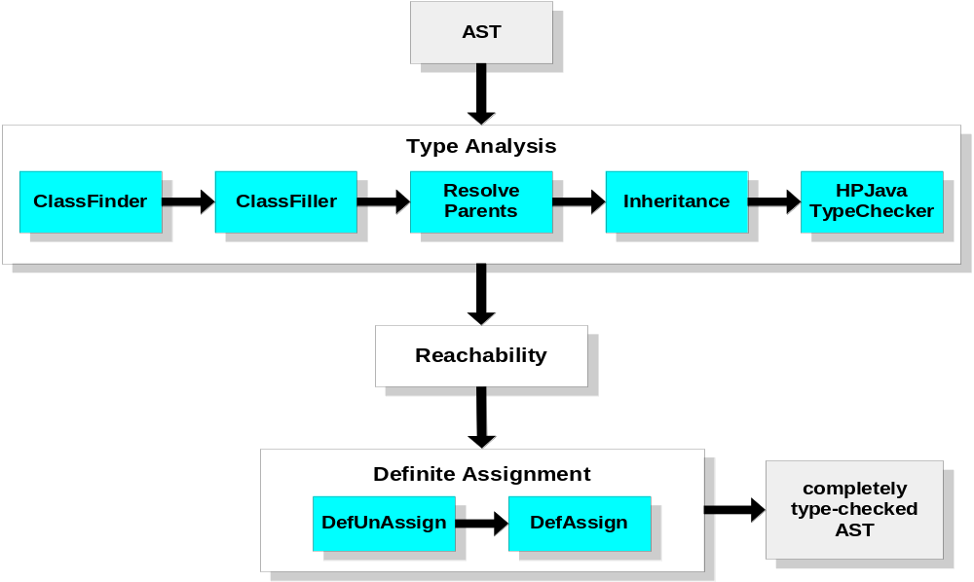
HPJava Front-End

Slide 24
Basic Translation Scheme
The HPJava system is not exactly a high-level parallel programming language – more like a tool to assist programmers generate SPMD parallel code
This suggests the translations the system applies should be relatively simple and well-documented, so programmers can exploit the tool more effectively
  We don’t expect the generated code to be human readable or modifiable, but at least the programmer should be able to work out what is going on
The HPJava specification defines the basic translation scheme as a series of schema

Slide 25
Translation of a distributed array declaration
Source: T [[attr₀, …, attr_{R-1}]] a ;
TRANSLATION: T [] a ’_{dat} ;
ArrayBase a ’_{bas} ;
DIMENSION_TYPE (attr₀) a ’₀ ;
…
DIMENSION_TYPE (attr_{R-1}) a ’_{R-1} ;
where DIMENSION_TYPE (attr_{r}) ≡ ArrayDim if attr_{r} is a hyphen, or
DIMENSION_TYPE (attr_{r}) ≡ SeqArrayDim if attr_{r} is a asterisk
e.g.
float [[-,*]] var ; ➔ float [] var__$DS ;
ArrayBase var__$bas ;
ArrayDim var__$0 ;
SeqArrayDim var__$1 ;

Slide 26
Translation of the overall construct
SOURCE: overall (i = x for e _{lo} : e _{hi} : e _{stp}) S
TRANSLATION: Block b = x.localBlock(T [e _{lo}], T [e _{hi}], T [e _{stp}]) ;
int shf = x.str() ;
Dimension dim = x.dim() ;
APGGroup p = apg.restrict(sim) ;
for (int l = 0; l < b.count; l ++) {
int sub = b.sub_bas + b.sub_stp * l ;
int glb = b.glb_bas + b.glb_stp * l ;
T [S | p]
}
where: i is an index name in the source program,
x is a simple expression in the source program,
e _{lo}, e _{hi}, and e _{stp} are expressions in the source,
S is a statement in the source program, and
b, shf, dim p, l, sub and glb are names of new variables

Slide 27
Optimization Strategies
Based on the observations for parallel algorithms such as Laplace equation using red-black iterations, distributed array element accesses are generally located in inner overall loops.
  The complexity of subscript expression of a multiarray element access
  The cost of HPJava compiler-generated method calls

Slide 28
Example of Optimization
Consider the nested overall and loop constructs
overall (i=x for :)
overall (j=y for :) {
float sum = 0 ;
for (int k=0; k<N; k++)
sum += a [i, k] * b [k, j] ;
c [i, j] = sum ;
}

Slide 29
A correct but naive translation
Block bi = x.localBlock() ; int shf_i = x.str() ;
Dimension dim_i = x.dim() ; APGGroup p_i = apg.restrict(dim_i ;
for (int lx = 0; lx<bi.count; lx ++) {
int sub_i = bi.sub_bas + bi.sub_stp * lx ; int glb_i = bi.glb_bas + bi.glb_stp * lx ;
Block bj = y.localBlock() ; int shf_j = y.str() ;
Dimension dim_j = y.dim() ; APGGroup p_j = apg.restrict(dim_j) ;
for (int ly = 0; ly<bj.count; ly ++) {
int sub_i = bi.sub_bas + bi.sub_stp * lx ; int glb_i = bi.glb_bas + bi.glb_stp * lx ;
float sum = 0 ;
for (int k = 0; k<N; k ++)
sum += a.dat() [a.bas() + (bi.sub_bas + bi.sub_stp * lx) * a.str(0) +
k * a.str(1)] *
b.dat() [b.bas() + (bj.sub_bas + bj.sub_stp * ly) * b.str(1) +
k * b.str(0)] ;
c.dat() [c.bas() + (bi.sub_bas + bi.sub_stp * lx) * c.str(0) +
(bj.sub_bas + bj.sub_stp * ly) * c.str(1)] = sum;
}
}

Slide 30
PRE (1)
Partially Redundancy Elimination
  A global optimization developed by Morel and Renvoise
  Combines and extends Common Subexpression Elimination and Loop-Invariant Code Motion
Partially redundant ?
  At point p if it is redundant along some, but not all, paths that reach p
Never lengthen an execution path

Slide 31
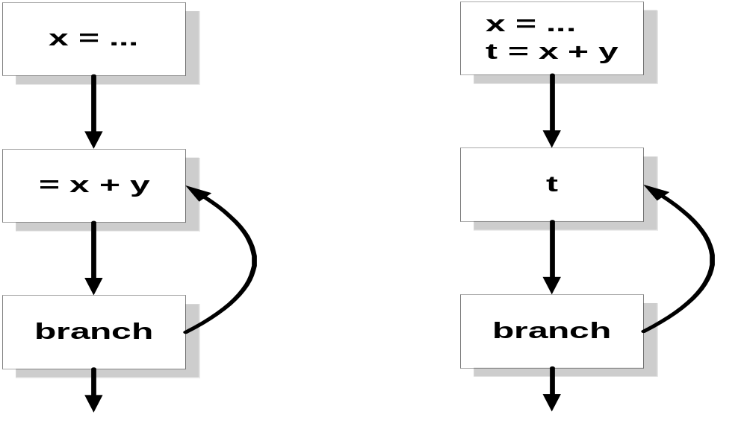
PRE (2)
Before PRE
After PRE

Slide 32
PRE (3)
Basic idea is simple
  Discover where expressions are partially redundant using data flow analysis
  Solve a data flow problem that shows where inserting copies of a computation would convert a partial redundancy into full redundancy
  Insert appropriate code and delete the redundant copy

Slide 33
Strength-Reduction
The complex subscript expressions can be greatly simplified by application of strength-reduction optimization
Replace expensive operations by equivalent cheaper ones on the target machines.
Additive operators are generally cheaper than multiplicative operator

Slide 34
Dead Code Elimination
To eliminate some variables not used
Implicit side effect with carelessly applying DCE for high-level languages
4 control variables and 2 control subscripts of an overall construct are often unused, and they are known to the compiler as “side effect free”

Slide 35
Loop Unrolling
Some loops have such a small body that most of the time is spent to increment the loop-counter variables and to test the loop-exit condition
More efficient by unrolling them, putting two or more copies of the loop body in a row
Optional

Slide 36
HPJOPT2 (HPJava OPTimization 2)
Step 1 – Applying Loop Unrolling
Step 2 – Hoist control variables to the outermost loop if loop invariant
Step 3 – Apply PRE and Strength Reduction
Step 4 – Apply Dead Code Elimination

Slide 37
Importance of Node Performance
HPJava translator generates efficient node code?
Why uncertain?
  Base language is Java
  Nature of the HPspmd model – its distribution format is unknown at compile-time
Benchmark on a single processor is important

Slide 38
Benchmark
Linux – Red Hat 7.3 on Pentium IV 1.5 GHz CPU with 512 MB memory and 256 KB cache
Shared Memory – Sun Solaris 9 with 8 Ultra SPARC III Cu 900 MHz processors and 16 GB of main memory

Slide 39
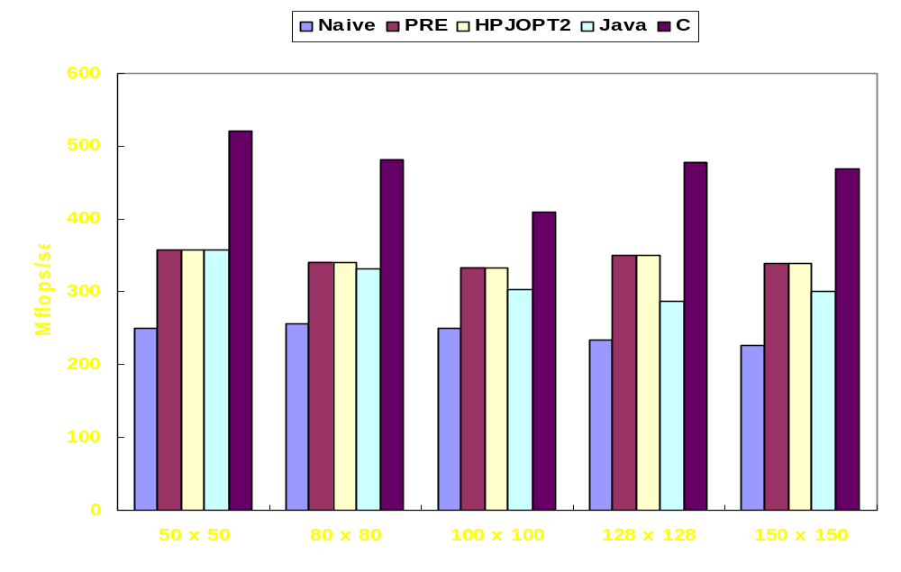
Direct Matrix Multiplication on Linux

Slide 40
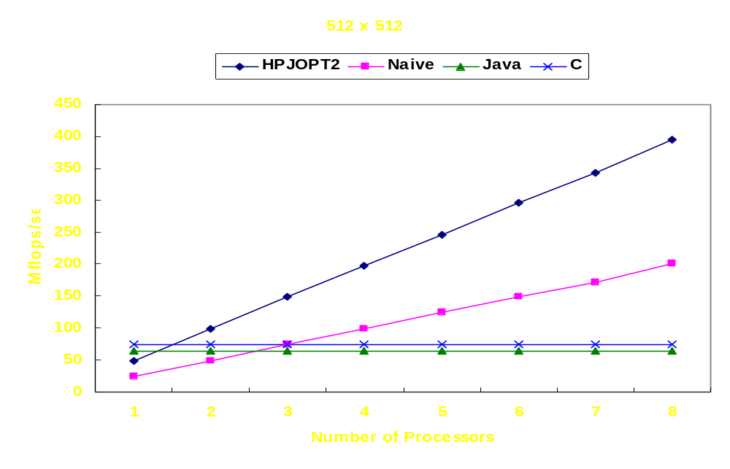
Direct Matrix Multiplication on SMP

Slide 41
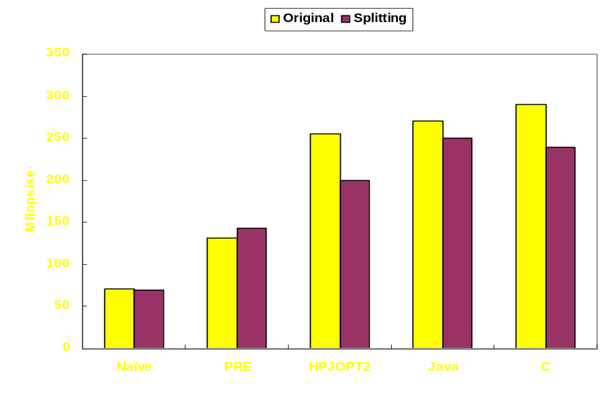
150 x 150 Laplace Equation using Red-Black Relaxation on Linux

Slide 42
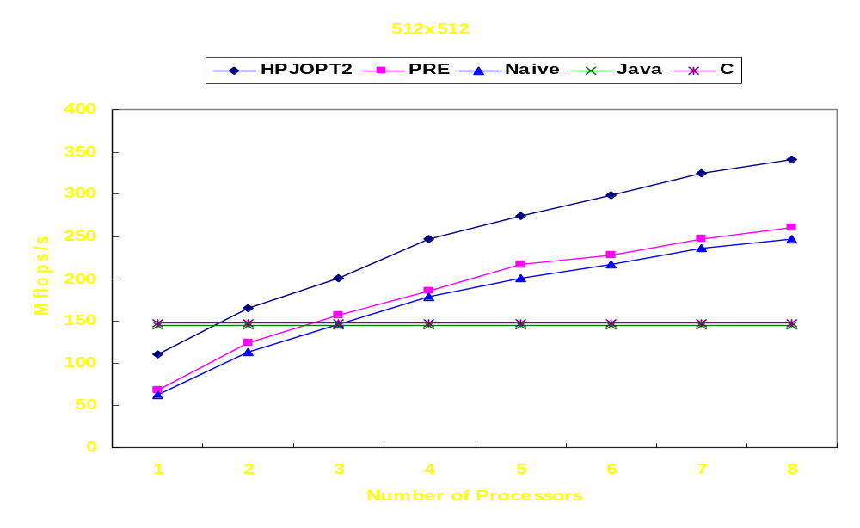
Laplace Equation using Red-Black Relaxation on SMP

Slide 43
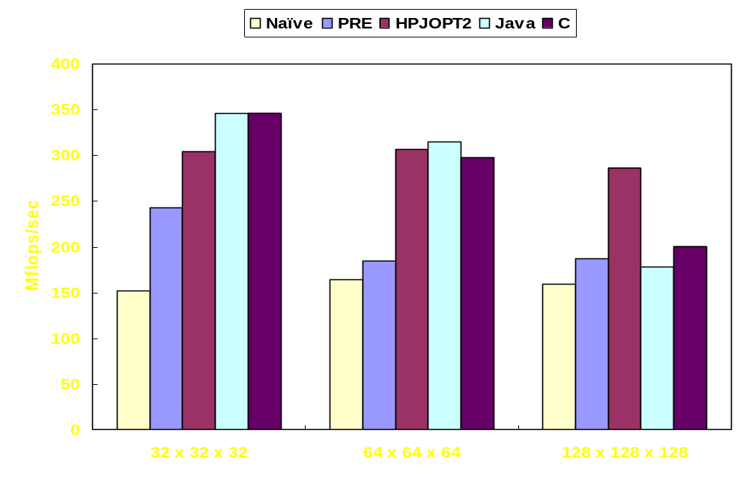
3D Diffusion on Linux

Slide 44
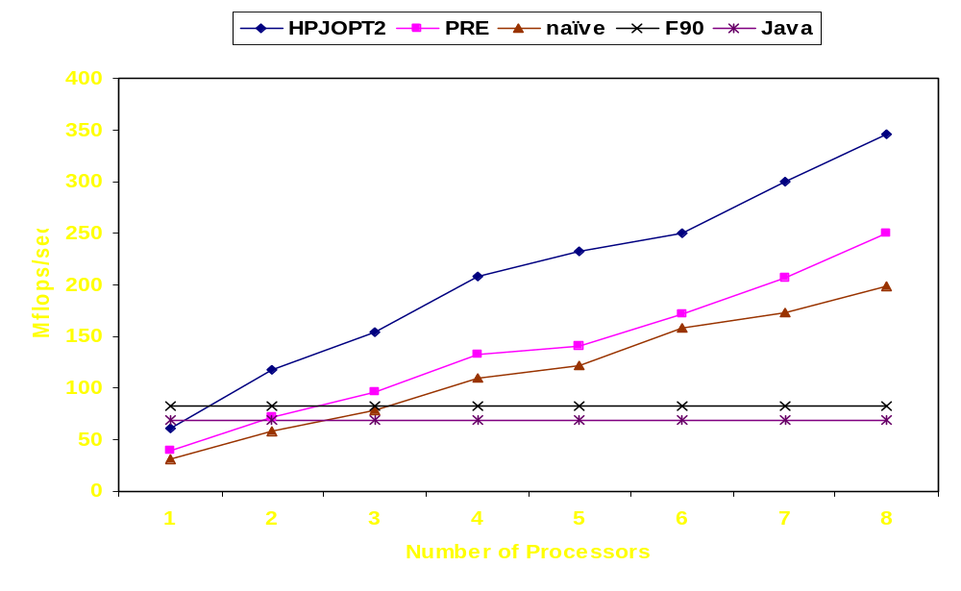
128 x 128 x 128 3D Diffusion on SMP

Slide 45
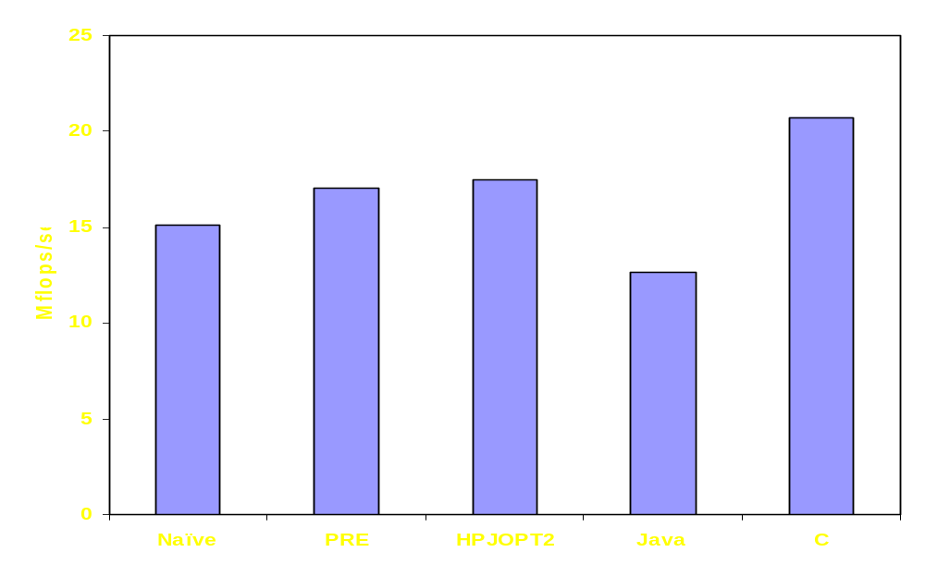
Q3 – Local Dependency Index on Linux

Slide 46
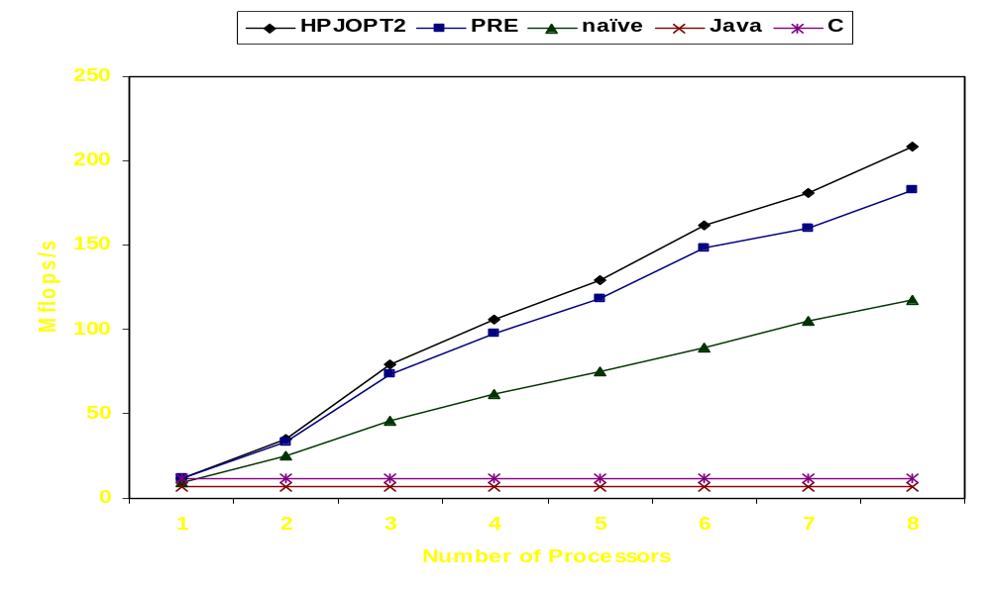
Q3 – Local Dependency Index on SMP

Slide 47
Current Status of HPJava
HPJava 1.0 is available
  http://www.hpjava.org
Fully supports the Java Language Specification
Tested and debugged against HPJava test suites and jacks (Automated Compiler Killing Suite from IBM)

Slide 48
Related Systems
Co-Array Fortran – Extension to Fortran95 for SPMD parallel processing
ZPL – Array programming language
Jade – Parallel object programming in Java
Timber – Java-based programming language for array- parallel programming
Titanium – Java-based language for parallel computing
HPJava – Pure Java implementation, data parallel language and explicit SPMD programming

Slide 49
Contributions
Proposed the potential of Java as a scientific (parallel) programming language
Pursued efficient compilation of the HPJava language for high-performance computing
Proved that the HPJava compilation and optimization scheme generates efficient node code for parallel programming
hkl – HPJava front- and back-end implementation, original implementation of JNI interfaces of Adlib, and benchmarks of the current HPJava system

Slide 50
Future Works
HPJava – improve translation and optimization scheme
High-Performance Grid-Enabled Environments
Java Numeric Working Group
Web Service Compilation

Slide 51
High-Performance Grid-Enabled Environments (1)
Grid Computing Environments
  Distributed, heterogeneous, dynamic for resources and performance
  Connected by global computer systems – end-computers, databases, instruments, etc
Should hide heterogeneity and complexity of grid environments without losing performance
Need to provide programming model
Successful programming model in sequential and parallel programming – HPspmd model
  Adaptability, security, and ultra-portability

Slide 52
High-Performance Grid-Enabled Environments (2)
Need nifty compilation technique, high-performance grid-enabled programming model, applications, components, and a better base language
HPJava
  Acceptable performance on matrix algorithms
  search engines and parameter searching
  BioComplexity Grid Environments at Indiana University

Slide 53
Java Numeric Working Group
One of active working group in Java Grande Forum
Recent efforts
  True multidimensional arrays
  Multiarray Package
  Enhanced for loops (i.e. foreach)
  Improvements in java.lang.Math

Slide 54
Web Service Compilation
(i.e. Grid Compilation)
Common feature between parallel computing and grid computing – messaging
Main difference for messaging between them – latency
Interesting, isn’t it?
A/V sessions need many control messages
  Client interface can be implemented in WSDL, XML
  Actual audio and video traffic use faster protocol
  Video transformation can be done by HPJava

Slide 55
Conclusion
HPspmd programming model
HPJava
  Multiarrays, overall constructs
  Compilation and optimization scheme
  Benchmarks
Future works

Slide 56
Acknowledgements
This work was supported in part by the National Science Foundation (NSF ) Division of Advanced Computational Infrastructure and Research
Contract number – 9872125

