Slide 1
Introduction to MPI Communication
Minnesota State University, Moorhead (2019)
Heecheon Park
Joshua DeNio

Slide 2
Message Passing Interface is a message passing standard to function in a wide array of parallel computation architects.
In this presentation, brief descriptions of MPI communication functions will be introduced.

Slide 3
Table of Contents
MPI Send
MPI Receive
Example of send and receive communication
MPI Broadcast
Example of broadcast
MPI Scatter
MPI Gather
Example of scatter and gather communication
MPI Reduce
Example of reduce

Slide 4
MPI if statements
If statements are used within the program body to regulate what node responds during that part of program execution.
int my_id ; // rank gets set on MPI_Comm_rank call
int main ( int argc, char *argv[] )
{
if ( my_id== master ) { //do stuff… }
}

Slide 5
MPI Send
Prototype:
int MPI_Send( void *data, int count, MPI_Datatype datatype, int destination, int tag, MPI_COMM communicator)
Parameter Description:
data: data to send count: size of the data to send datatype: data type of the data to send destination: cluster to send to tag: message tag communicator: medium of processes’ communication
MPI_Send() is a message sending function for blocking communication.

Slide 6
MPI Recv
Prototype:
int MPI_Recv( void *data, int count, MPI_Datatype datatype, int source, int tag, MPI_COMM communicator, MPI_Status *status)
Parameter Description:
data: data to receive count: size of the data to receive datatype: data type of the data to receive destination: cluster to receive from tag: message tag communicator: medium of processes’ communication status: Information about received message
MPI_Recv() is a message receiving function for blocking communication.

Slide 7
Send and Receive Communication Example
$mpicc mpi_sendrecv.c -o mpi_sendrecv $mpirun -np 3 ./mpi_sendrecv The number of row is 4. The number of columns is 4. ________________________ 1.0 2.0 3.0 4.0 5.0 6.0 7.0 8.0 9.0 10.0 11.0 12.0 13.0 14.0 15.0 16.0 ________________________ ************************ I am 2 of 3 ************************ 1.0 2.0 3.0 4.0 5.0 6.0 7.0 8.0 ************************ ************************ I am 3 of 3 ************************ 9.0 10.0 11.0 12.0 13.0 14.0 15.0 16.0 ************************
mat_sendrecv.c # include <mpi.h>
# include <stdio.h>
# include <stdlib.h>
int main ( int argc, char *argv[] )
{
int my_id ; // rank
int num_procs ; // size
int master = 0 ;
double *a ; // matrix A
double *a_row ;
int m = 4 ; // A is a m*m matrix
MPI_Status status ;
MPI_Init ( &argc, &argv ) ;
MPI_Comm_rank ( MPI_COMM_WORLD, &my_id ) ;
MPI_Comm_size ( MPI_COMM_WORLD, &num_procs ) ;
…
if (world_rank == master){
MPI_Send ( a, m*2, MPI_DOUBLE, 1, 0, MPI_COMM_WORLD ) ;
MPI_Send ( a+8, m*2, MPI_DOUBLE, 2, 0, MPI_COMM_WORLD ) ;
} else
MPI_Recv ( a_row, m*2, MPI_DOUBLE, master, MPI_ANY_TAG, MPI_COMM_WORLD, &status ); ...

Slide 8
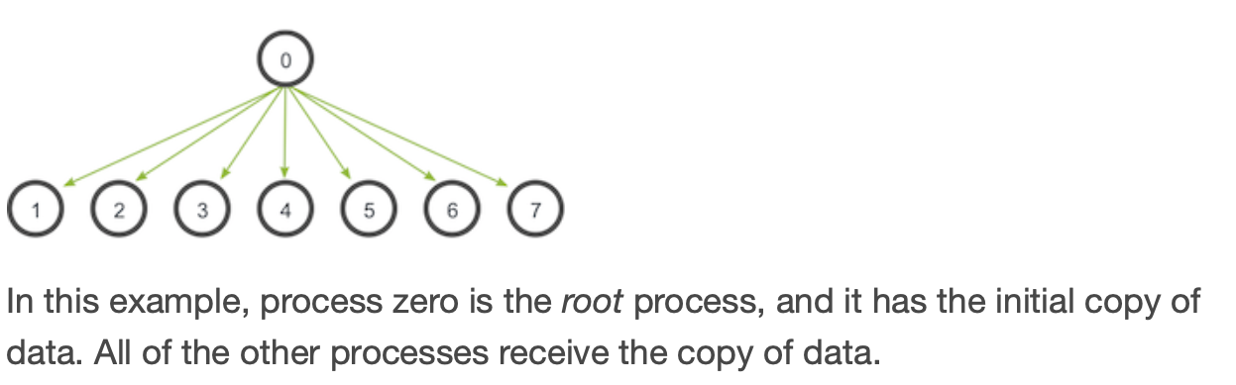
MPI Broadcast
Prototype:
int MPI_Bcast( void *data, int count, MPI_Datatype datatype, int root, MPI_COMM communicator)
Parameter Description:
data: data to broadcast count: size of the data to broadcast datatype: data type of the data to broadcast root: broadcasting process communicator: medium of processes’ communication
MPI_Broadcast() is a message broadcast function for blocking communication.

Slide 9
Broadcast Example
$mpicc bcast.c -o bcast $mpirun -np 4 ./bcast The number of row is 4. The number of col is 4. ________________________ 1.0 2.0 3.0 4.0 5.0 6.0 7.0 8.0 9.0 10.0 11.0 12.0 13.0 14.0 15.0 16.0 ________________________ Before Bcast, I am 2 of 4 ************************ 1.0 2.0 3.0 4.0 5.0 6.0 7.0 8.0 9.0 10.0 11.0 12.0 13.0 14.0 15.0 16.0 ************************ After Bcast, I am 3 of 4 ######################## 1.0 2.0 3.0 4.0 5.0 6.0 7.0 8.0 9.0 10.0 11.0 12.0 13.0 14.0 15.0 16.0 ######################## …..
bcast.c # include <mpi.h>
# include <stdio.h>
# include <stdlib.h>
int main ( int argc, char *argv[] )
{
int my_id ; // rank
int num_procs ; // size
int master = 0 ;
double *a ; // matrix A
double *a_row ;
int m = 4 ; // A is a m*m matrix
MPI_Status status ;
MPI_Init ( &argc, &argv ) ;
MPI_Comm_rank ( MPI_COMM_WORLD, &my_id ) ;
MPI_Comm_size ( MPI_COMM_WORLD, &num_procs ) ;
…
…
MPI_Bcast ( a, m*m, MPI_DOUBLE, master, MPI_COMM_WORLD ); … MPI_Finalize();

Slide 10
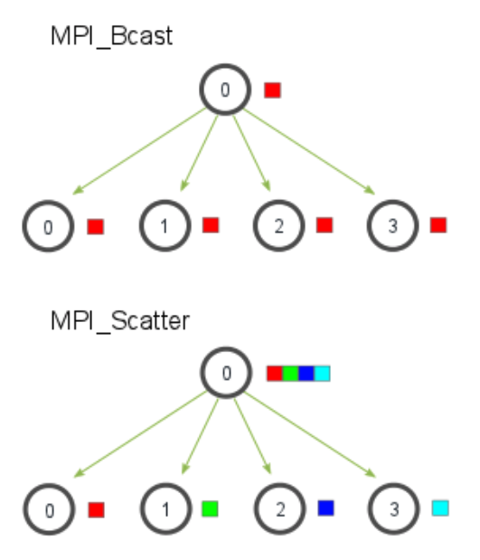
MPI Scatter
Prototype:
int MPI_Scatter( void *send_data, int send_count, MPI_Datatype send_datatype, void *recv_data, int recv_count, MPI_Datatype recv_datatype, int root, MPI_COMM communicator)
Parameter Description:
send_data: data to send send_count: size of the data to send send_datatype: data type of the data to send recv_data: data to receive recv_count: size of the data to receive recv_datatype: data type of the data to receive root: scattering process communicator: medium of processes’ communication
MPI_Scatter() is a message broadcast function to scatter data to clusters.

Slide 11
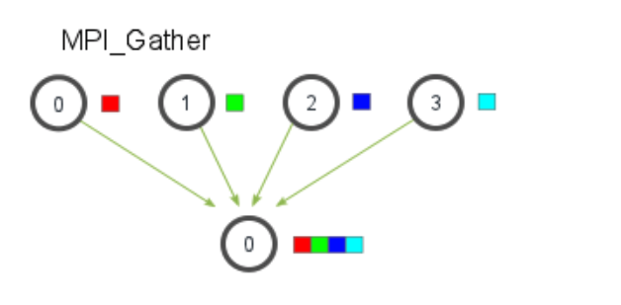
MPI Gather
Prototype:
int MPI_Gather( void *send_data, int send_count, MPI_Datatype send_datatype, void *recv_data, int recv_count, MPI_Datatype recv_datatype, int root, MPI_COMM communicator)
Parameter Description:
send_data: data to send send_count: size of the data to send send_datatype: data type of the data to send recv_data: data to receive recv_count: size of the data to receive recv_datatype: data type of the data to receive root: collecting process communicator: medium of processes’ communication
MPI_Gather() is a message collection function to receive data from clusters.

Slide 12
Scatter and Gather Example
$mpirun -np 2 ./mpi_scatter_and_gather 16 Array at master processor: 84.0 87.0 78.0 16.0 94.0 36.0 87.0 93.0 50.0 22.0 63.0 28.0 91.0 60.0 64.0 27.0 Array from the master processor has been scattered! ******************************************* Array from the master processor has been scattered! ******************************************* local array at processor 1: 84.0 87.0 78.0 16.0 94.0 36.0 87.0 93.0 local array at processor 0: 50.0 22.0 63.0 28.0 91.0 60.0 64.0 27.0 ******************************************* Gathering has been completed! ******************************************* Gathered array: 84.0 87.0 78.0 16.0 94.0 36.0 87.0 93.0 50.0 22.0 63.0 28.0 91.0 60.0 64.0 27.0
mpi_scatter_and_gather.c # include <mpi.h>
# include <stdio.h>
# include <stdlib.h>
int main ( int argc, char *argv[] )
{
int world_rank, world_size;
size_t arr_size;
MPI_Init(NULL, NULL);
MPI_Comm_rank(MPI_COMM_WORLD, &world_rank);
MPI_Comm_size(MPI_COMM_WORLD, &world_size);
float *arr = (float*) malloc(sizeof(float) * indexSize);
float *local_arr = (float *) malloc(sizeof(float) * indexSize / 2);
float *arr_gathered = (float*) malloc(sizeof(float) * indexSize);
…
…
// Scatter 8 floats from the array of 16 floats (arr) to local_arr
MPI_Scatter(arr, 8, MPI_FLOAT, local_arr, 8, MPI_FLOAT, MASTER, MPI_COMM_WORLD);
…
// Gather local_arr to arr_gathered
// arr_gathered takes 8 elements per process and that’s why recv_count is 8.
// Do not use total elements for recv_count.
MPI_Gather(local_arr, 8, MPI_FLOAT, arr_gathered, 8, MPI_FLOAT, MASTER, MPI_COMM_WORLD);

Slide 13
MPI_Reduce
The basic format for the reduce call looks like:
MPI_Reduce(void* send_data, void* recv_data, int count,MPI_Datatype datatype, MPI_Op op,
int root, MPI_Comm communicator);
MPI_Reduce is used to apply basic functions to arrays reducing the data

Slide 14
MPI_Reduce
Next we have have the datatype, the operator, roots rank, and the communicator.
The first value send data is an array of values of the datatype.
The second is an array for the return value; this field is only relevant on the master node.
Next is count which is the number of elements in send_data.

Slide 15
MPI_Reduce
op is the specified operation that will be applied to the values in send_data then the result will be sent to recv_data.
The recv_data field contains the reduced result after computation. It has a size of sizeof(datatype) * count

Slide 16
MPI_Reduce operators
MPI_BAND: is bitwise and
MPI_BOR: is bitwise or
MPI_MAXLOC: returns max and its rank location
MPI_MINLOC:returns min and its rank location
MPI_MAX: returns the max
MPI_MIN: returns the min
MPI_SUM: returns the sum
MPI_PROD: returns the product
MPI_LAND: is logical and
MPI_LOR: is logical or

Slide 17
MPI_Allreduce
This is done much the same as an MPI_Reduce call followed by a call to MPI_Bcast. this results in the return value being sent to all slave nodes as well as the master node.
MPI_Allreduce is much like MPI_Reduce but instead of returning the result to the master node the reduced value is sent to all nodes.

Slide 18
MPI_Allreduce
MPI_Allreduce(void* send_data,
void* recv_data, int count,
MPI_Datatype datatype,
MPI_Op op,
MPI_Comm communicator);
MPI_Allreduce
looks like:

Slide 19
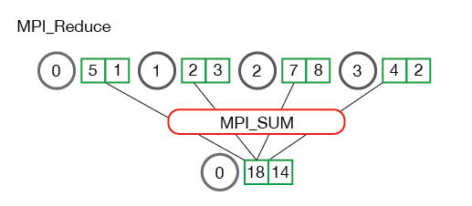
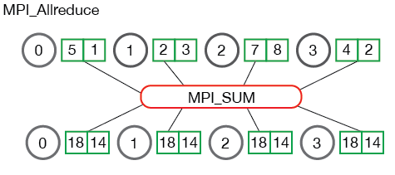
MPI_Reduce vs MPI_Allreduce

Slide 20
MPI_Reduce Example

