Slide 1
APIs for parallel computation
Minnesota State University Moorhead
Heecheon Park
Joshua DeNio

Slide 2
Message Passing Interface is a standardized low-level module to enhance parallel computation. To accommodate a high-level functionalities, several MPI supports for higher level languages have been invented to promote the more convenient implementation of MPI.

Slide 3
Table of Contents
MPI Java
MPJ
MPJ Express
MPI4Py

Slide 4
mpiJava
(mpiJava is not a superset of Java in a sense) that provides added native features but it wraps the standard message passing interface with Java Native Interface. mpiJava acts as a wrapper for MPI so there is occasional low-level conflicts between Java runtime and the interrupt mechanisms used in MPI environments.
mpiJava is an interface to the standard MPI.

Slide 5
mpiJava Example Snippets
import mpi.* ; class Hello { static public void main(String[] args) throws MPIException { MPI.Init(args) ; int my_rank; // Rank of process int source; // Rank of sender int dest; // Rank of receiver int tag=50; // Tag for messages int myrank = MPI.COMM_WORLD.Rank() ; int p = MPI.COMM_WORLD.Size() ; if(myrank != 0) { dest=0; char [] message = ("Greetings from process " + myrank).toCharArray() ; MPI.COMM_WORLD.Send(message, 0, message.length, MPI.CHAR,dest, tag) ; } else { // my_rank == 0 for (source =1;source < p;source++) { char [] message = new char [40] ; MPI.COMM_WORLD.Recv(message, 0, 40, MPI.CHAR, source, tag) ; System.out.println("received: " + new String(message) + " : ") ; } } MPI.Finalize(); }

Slide 6
MPJ
Unlike other MPI modules in Java, in which these modules are quite MPI-centric, MPJ extends to Java-centric features like MPJ_Objects datatype. Thus, MPJ functions do not send error messages; instead, it uses Java’s error exception mechanisms. i.e. throws MPJException
MPJ is more sophisticated implementation of mpiJava, JavaMPI, and MPIJ {MPJ is prototype for MPI implementation in Java}

Slide 7
MPJ Wrappers
The wrappers are compiled using the JCI Java to C interface generater.
MPJ is implemented using JNI (Java Native Interface) wrappers to native MPI software
JNI allows C functionality to access Java data and convert format when necessary.

Slide 8
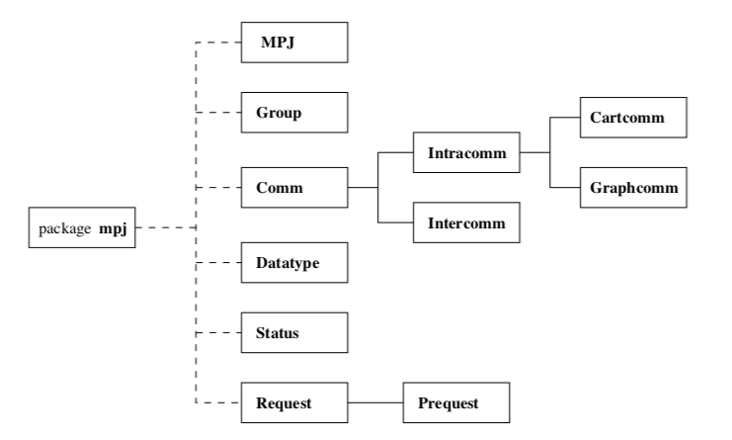
MPJ Package Structure
The MPJ class acts as a module containing global services, such as initialization, and many global constants like the default communicator COMM_WORLD. All communication functions in MPJ are members of Comm and its subclasses.

Slide 9
MPJ Datatype
The elements of datatype can be either primitive or class type. If the elements are objects, they must be serializable objects. MPJ Datatype are as follow: - MPJ.BYTE - MPJ.CHAR - MPJ.SHORT - MPJ.BOOLEAN - MPJ.INT - MPJ.LONG - MPJ.FLOAT - MPJ.DOUBLE - MPJ.OBJECT If the datatype is MPJ.OBJECT, the objects in the buffer are transparently serialized and unserialized inside the communication operations.

Slide 10
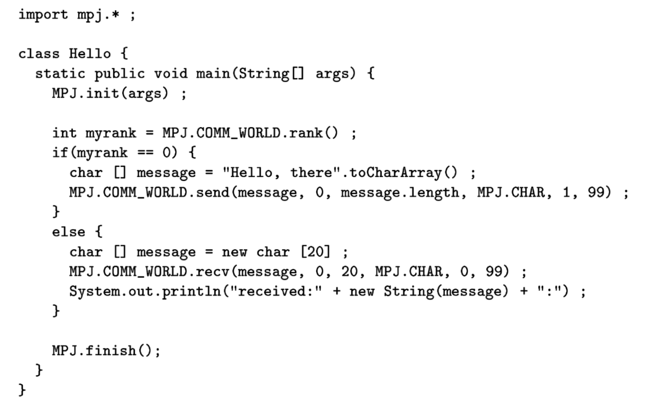
MPJ Example Snippets

Slide 11
Multidimensinal Arrays
To address this problem the Java Grande Forum has groups working on a new specification to create an array package that creates arrays as true scientific arrays instead of arrays of arrays.
This will make arrays much more usable in scientific computation.
Currently there are some problems using multidimensional arrays in MPJ. Bottlenecks are caused because MPJ can only send multidimensional arrays one of two ways: one row at a time, or by using Java Object serialization.

Slide 12
Messenger
We are only covering what are on the table of contents not HPJ
I mean MPJ
I’ll start on express

Slide 13
MPJ Express
MPJ Express Improves upon MPJ by allowing the user access to the cores of a machines CPU. This allows for much more control of threading and task execution.
MPJ Express is an improved version of the MPJ API

Slide 14
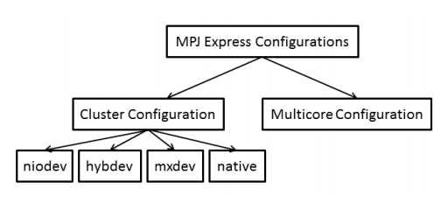
Multicore configuration
This configuration of MPJ Express is used to execute MPJ Express programs on laptops and desktops by activating multiple cores of the CPU.

Slide 15
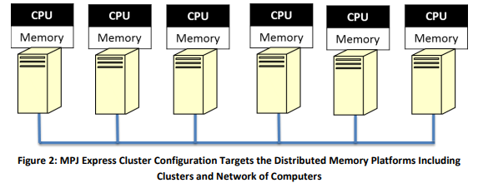
Cluster Configuration
The second MPJ configuration is the cluster configuration.

Slide 16
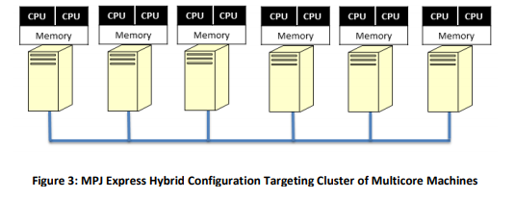
Hybrid Configuration
When Multicore configuration is used on the client nodes it is called hybrid configuration.

Slide 17
MPJ Express
The drawback is that it adds a deeper level of complexity to code
MPJ Express in hybrid configuration gives much more control over how processes are handled and has the potential to be much more useful than any of the two configurations alone.

Slide 18
mpi4py
mpi4py is constructed on top of the MPI-1/2/3 specifications and provides an object oriented interface that resembles the MPI-2 C++ bindings. Despite limited, mpi4py supports blocking, non-blocking and collective communications of Python objects.
mpi4py is Python’s implementation of MPI

Slide 19
mpi4py
Some examples include:
send(), recv(), bcast(), isend(), irecv(), scatter(), gather(), allgather(), alltotal()
test() and wait() are used to manage these instances.
mpi4py uses all lowercase method names for communication of generic Python objects
These methods return Request instances

Slide 20
mpi4py
Buffer arguments generally are specified as a list/tuple like [data, MPI.INT]
NumPy arrays can use automatic datatype discovery
For communication of buffer-like objects we use methods starting with an uppercase letter.
Some examples include: Send(), Recv(), Bcast(), Scatter(), Gather().

Slide 21
Installation and Execution
MPICH MPICH environments libopenmpi-dev mpi4py mpirun -np “number of processors” python3 “prog.py”

Slide 22
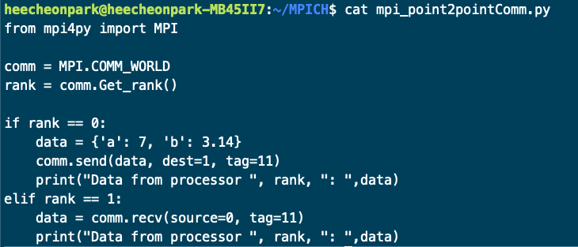
mpi4py Point2Point Comm example
Result: $mpirun -np 2 python3 mpi_p2pComm.py Data from processor 0 : {'a': 7, 'b': 3.14}
Data from processor 1 : {'a': 7, 'b': 3.14}

Slide 23
Sources
http://mpj-express.org/docs/guides/windowsguide.pdf
https://mpi4py.readthedocs.io/en/stable/
http://www.hpjava.org/papers/MPJ-CPE/cpempi.pdf
http://www.hpjava.org/mpijavareadme.html
mpiJava/doc/api(in mpiJava installation folder)

