Slide 1
LLM-as-a-Discriminator
Can LLM Detect Synthetic Data?
Manel Slokom, Malek Slokom, Thierno Kante

Slide 2
Privacy vs. Data Utility
The Tension
The Solution: Synthetic data
Organizations want to:
✓ Protect personal data
✓ Share useful insights
These goals often conflict
Generate artificial records that:
✓ Mimic real data patterns
✓ Protect individual privacy
✓ Enable data sharing
But: If someone can tell the data is synthetic, they can break privacy. Can they?

Slide 3
The question
Can a Large Language Model detect if the data is real or synthetic?
Why ask an LLM?
No model access needed (black-box audit)
Interpretable reasoning
Scales easily

Slide 4
How we test: LLM vs Human Judges
Input Data
🤖 LLM Judge
👤 Human Judges
Gemini 2.5 / LLaMA 3.1
2 annotators (HA1, HA2)
Structural violations
Expert visual inspection
C1
Table Only
C2
Table + Stats
C1
Table Only
C2
Table + Stats
SYNTHETIC ✓
SYNTHETIC ✓
Ideally: Both LLMs and Humans identify the same structural violations as the key discriminator

Slide 5
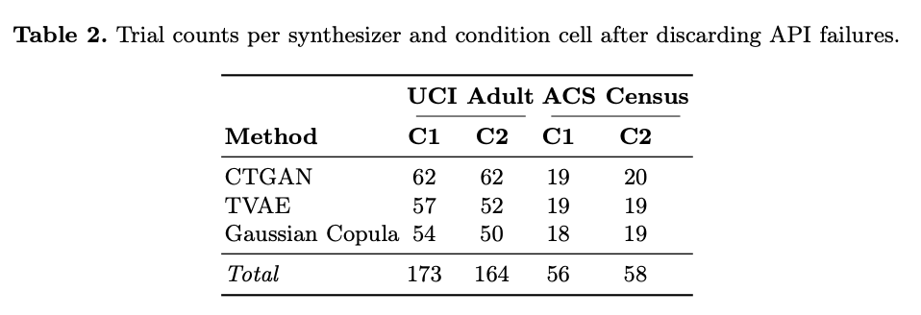
Experimental Design
451 valid experiments across:
Datasets:
2 census datasets: UCI Adult & ACS Census Income
Synthesis methods:
3 generators: CTGAN, TVAE, Gaussian Copula
LLM models:
Gemini 2.5-Flash vs. LLaMA 3.1-8B
Threat conditions:
C1 (table only) & C2 (table + metadata)
Baselines:
Human annotators (2 people, 240 trials) + Logistic regression Classifier
Trials and failures:
3600 trials in total (3 synthesisers x 2 conditions x 200 trials per cell) : 90.6% failed (quota errors)
* Temperature is equal to 0 for reproducibility.
Code : https://github.com/SlokomManel/LLM-as-a-Discriminator

Slide 6
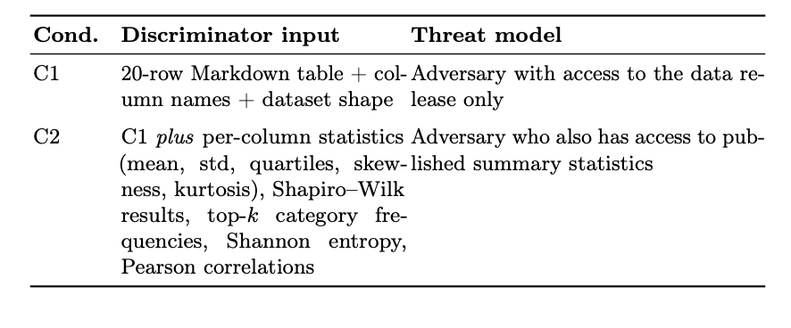
Two threat scenarios
Condition 1 (C1)
Condition 2 (C2)
Table Only
Table + Metadata
LLM sees:
• 20 rows
• Column names
• Dataset shape
Adversary with data release only
Same as C1 plus:
• Mean, std deviation
• Quartiles, skewness
• Category frequencies
• Correlations
Adversary with published stats

Slide 7
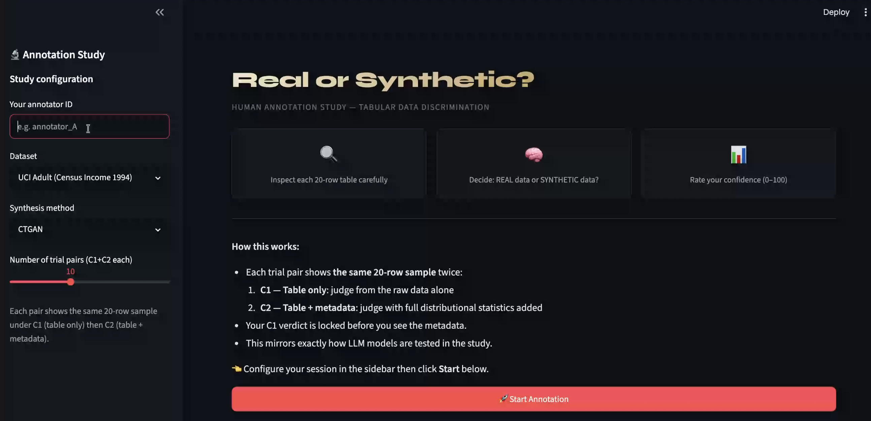
Human annotation study
✓ 2 human annotators
✓ 240 total trials (120 each)
✓ Same protocol as LLMs
✓ C1 then C2 per sample
✓ Real-time decision making
✓ Confidence scoring

Slide 8
Human annotator in action
Notes:
file:///Users/mslokom/Documents/research_directions/data-synthesis-sprite/PSD2026/results/human/streamlit-human_labeling_app-2026-05-31-01-57-42.webm

Slide 9
Key Finding: Model matters more than method
UCI Adult results
LLaMA: DRS = 0% (labels everything as REAL)
Gemini: DRS = 100% for CTGAN & TVAE (perfect detection)
ACS Census results
LLaMA: DRS = 0% (labels everything as SYNTHETIC - opposite bias!)
Gemini: DRS = 100% under C1, varies under C2
The discriminator model makes as much difference as the synthesis method itself!

Slide 10
Metadata's surprising effect
Adding distributional metadata doesn't always help...
ACS Census with Gemini:
CTGAN:
C1: 100%
C2: 0%
⬇️ -100%
TVAE:
C1: 100%
C2: 25%
⬇️ -75%
Gaussian Copula:
C1: 100%
C2: 100%
→ stable
When synthetic marginals align with real data, metadata can confuse the detector!

Slide 11
What LLMs Actually Notice
Gemini identifies structural violations:
❌ Education Mapping
"Bachelors" → 13, "10th" → 6 (inconsistent)
❌ Impossible Combos
"Never-married" + "Husband" (4.5% of CTGAN samples)
❌ Age/Education Conflicts
Age 18 with PhD (implausible)
❌ Sparse Distribution Anomalies
Capital gains/losses filled in (90%+ zeros in real data)
✓ Both humans and frontier LLMs spot the same constraint violations

Slide 12
What Humans and LLMs actually say
Structural violations: The primary clue
❌ Education mapping inconsistency
Gemini (LLM):
"'education_num' does not maintain a 1-to-1 mapping with 'education'; e.g., '10th' grade is assigned 4, not 6."
❌ Marital Status & Relationship contradiction
Gemini (LLM):
"Marital status 'Never-married' paired with relationship type 'Husband' is logically impossible" (4.5% of CTGAN samples)
Human Annotators:
"Never-married but also says Husband? That makes no sense."
❌ Capital Gains/Loss Anomaly
LLaMA:
"High skewness in 'capital_gain' and 'capital_loss'; large number of zeros in capital_gain." (Real: 90%+ zeros. Synthetic: filled in.)
✓ Both humans and LLMs independently identified the same structural violations as the key discriminator

Slide 13
How Humans compare to frontier LLMs
Human Annotators
Frontier LLM (Gemini)
Moderate Agreement
Matches or exceeds humans
• Annotator 1: 66.4%
• Annotator 2: 77.9%
Reason: Spot structural violations independently
• UCI Adult: DRS=100%
• ACS Census C1: DRS=100%
• Identifies same patterns
• Provides explicit reasoning
• Consistent across conditions

Slide 14
Practical Recommendations
LLM discrimination is a practical first-pass privacy audit tool (not a standalone guarantee)
When using LLM discrimination:
✓ Always report results per model (Gemini ≠ LLaMA)
✓ Report per condition (C1 and C2 may differ)
✓ Combine with formal baselines (record linkage, detection classifier, Membership Inference)
✓ Inspect LLM reasoning for explainability
✓ Consider data encoding effects (strings vs. integers)
✓ Don't rely on single metric for privacy guarantee

Slide 15
Limitations & Future Work
Study Constraints:
Future Work:
90.6% of planned trials failed due to API quotas (low per-cell N)
→ Stable local deployments to avoid API sparsity
Only 8B and ~50B parameter models tested
→ Broader synthesis methods (diffusion, LLM-based generators)
→ Larger human annotation studies
Zero-shot prompting only (chain-of-thought unexplored)
→ Joint privacy-utility reporting
Limited to 3 synthesis methods and 2 datasets
Diffusion & LLM-based generators not tested

Slide 16
💡 The key insight
Model choice matters as much as synthesis method choice
When evaluating synthetic data privacy, always ask: Which LLM discriminator was used?

Slide 17
Questions?
Code & results:
github.com/SlokomManel/LLM-as-a-Discriminator
Paper available on arXiv

