Slide 1

Company A Financial Analysis
Sydney Long

Slide 2
Understanding Company A Introduction
Longstanding Leadership in the Packaged Goods Space
Ranks #1 in Customer Service, best-in-class, large scale production and distribution
- Main competitor: Company B
- Niche for snacking options (mainly chocolate-related goods) and its global supply chain
Forecasted top-line growth
- The company expects net sales growth of 2-3% in 2024
Child Labor Law Issues
- Occasionally falls under scrutiny for alleged sourcing of cocoa from farms and factories involving child labor
- Since pledging to eliminate child labor from its cocoa supply chain, related lawsuits have been dismissed due to insufficient evidence linking the company directly
- Rising cocoa prices represent the largest threat to profitability
- Due to these price increases, the company is adopting a cautious outlook on its 2024 growth projections
- Founded in the 19th century, Company A has grown into a legacy brand within the snacking industry.
- Additional focus on other snacks such as baked goods and various beverages
- Hierarchical organization structure

Slide 3
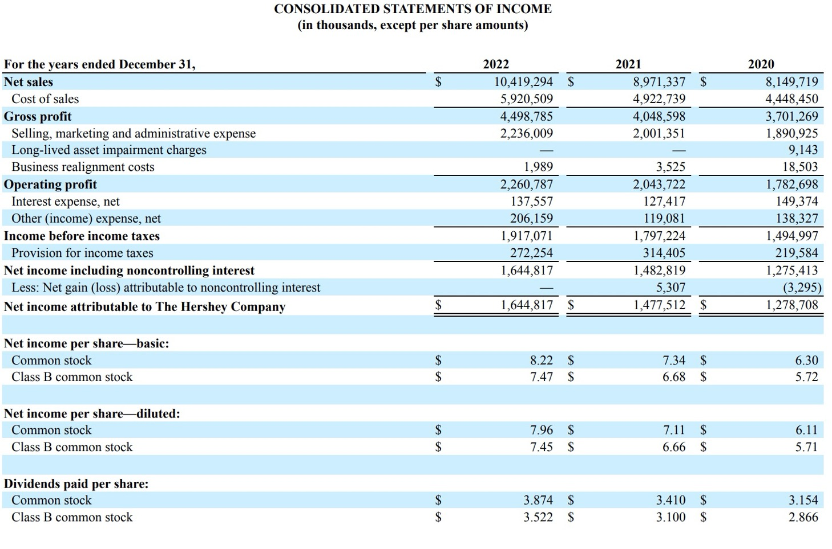

Slide 4
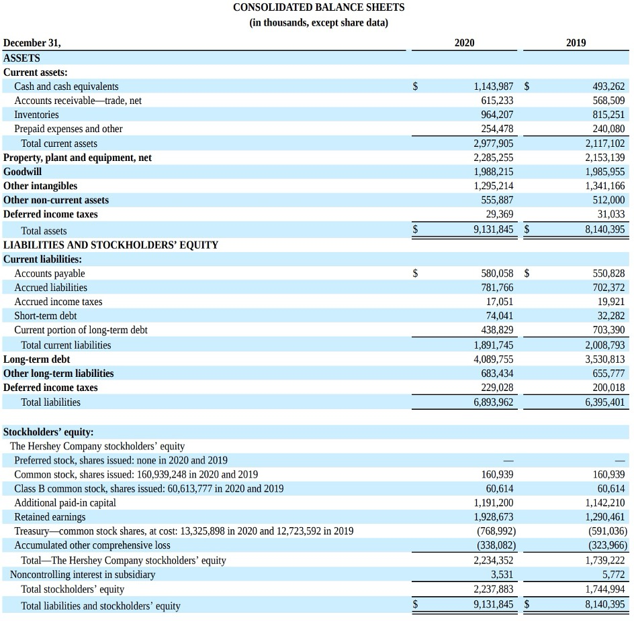
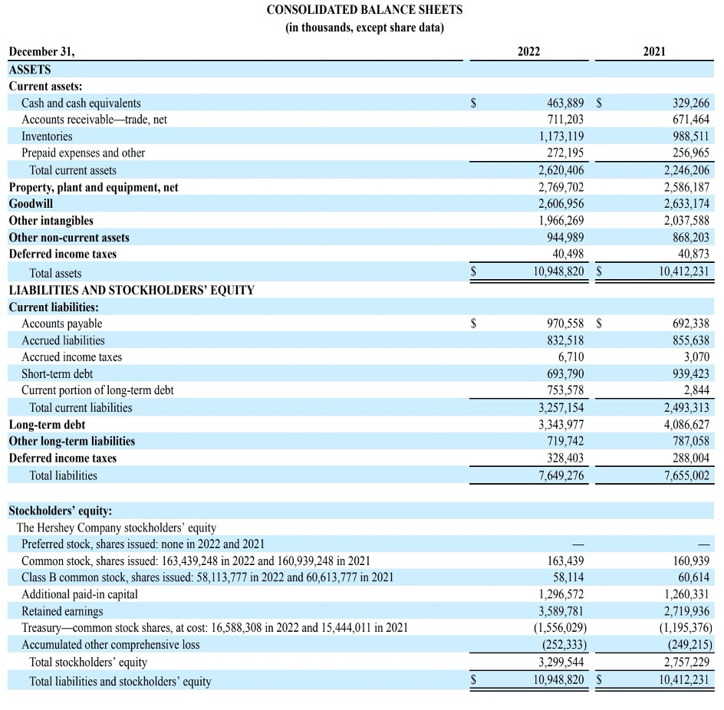

Slide 5
Short-Term Liquidity
Company A experienced strong liquidity in 2020, with both its current and quick ratios exceeding 1. However, these ratios have declined in the years since.
Currently, Company A nor Company B appear to have sufficient liquid assets to fully cover their short-term liabilities.
Company A
2022 2021 2020 2019
Current Ratio 0.81 0.90 1.57 1.05
Quick Ratio 0.44 0.50 1.06 0.65
Company B
2022 2021 2020 2019
Current Ratio 0.88 0.98 0.86 0.86
Quick Ratio 0.50 0.68 0.60 0.63
Table:
Good Ratio
Bad Ratio
Neutral

Slide 6
Activity Ratios
Although Company A performs slightly better, both companies have a favorable average collection period, under 60 days, which generally indicates strong efficiency in collecting receivables.
A higher total asset turnover ratio may be preferable, given that both operate in the retail sector. The current ratios may suggest that their assets are not being utilized as efficiently as they could be.
Company A
2022 2021 2020 2019
Inventory Turnover 5.05 4.98 4.61 5.35
Average Collection Period 24.91 27.32 27.55 25.98
Average Payment Period N/A net credit sales not provided
Total Assets Turnover 0.95 0.86 0.89 0.98
Company B
2022 2021 2020 2019
Inventory Turnover 3.45 3.79 4.25 4.99
Average Collection Period 42.97 46.75 46.50 46.39
Average Payment Period N/A net credit sales not provided
Total Assets Turnover 0.70 0.63 0.68 0.72
Table:
Good Ratio
Bad Ratio
Neutral

Slide 7
Financial Leverage
Company A has a lower debt ratio compared to Company B, whose 60%+ levels suggest higher financial risk. While both are managing debt, Company B may benefit from reducing leverage.
Both companies have strong Times Interest Earned ratios, but Company A’s has steadily improved, while Company B’s has declined.
Company A
2022 2021 2020 2019
Debt Ratio 0.37 0.48 0.46 0.44
Times Interest Earned Ratio 11.96 11.60 8.56 9.58
Company B
2022 2021 2020 2019
Debt Ratio 0.68 0.61 0.62 0.59
Times Interest Earned Ratio 9.03 11.34 14.16 12.39
Table:
Good Ratio
Bad Ratio
Neutral

Slide 8
Profitability and Market Ratios
Company A
2022 2021 2020 2019
Gross Profit Margin 43.2% 45.1% 45.4% 45.4%
Operating Profit Margin 21.7% 22.8% 21.9% 20.0%
Net Profit Margin 15.78% 16.46% 15.69% 14.39%
Earnings Per Share $7.96 $7.11 $6.11 $5.46
Return on Total Assets 15.02% 14.2% 14.01% 14.12%
Return on Common Equity 49.85% 53.59% 57.14% 65.89%
Overall, the percentages fall within healthy ranges. Company B’s ratios appear to be declining, while Company A shows stronger performance across most metrics.
Gross Profit Margin is close to 50% for both companies, which is solid—dropping below 30% would raise concerns. Company A saw a slight decline, likely due to rising cocoa prices.
Earnings per Share for Company A ended 2022 on a strong note, continuing its steady upward trend.
Company B
2022 2021 2020 2019
Gross Profit Margin 45.2% 48.0% 49.3% 49.8%
Operating Profit Margin 14.0% 14.0% 16.9% 14.8%
Net Profit Margin 10.16% 19.17% 14.67% 13.94%
Earnings Per Share $3.42 $6.06 $4.30 $4.30%
Return on Total Assets 7.10% 12.36% 9.98% 10.09%
Return on Common Equity 22.08% 31.81% 26.77% 24.23%

Slide 9
Market Ratios
Company A
2022 2021 2020 2019
Price/Earnings Ratio 28.2 26.3 24.1 26.1
Market/Book Ratio 14.4 14.5 14.2 17.6
Based on the Price-to-Earnings (P/E) ratios, investors are paying more per dollar of earnings for Company A than for Company B.
The Market-to-Book (M/B) ratio suggests that both companies may be overvalued, with investors paying more per dollar of book value for Company A’s stock compared to Company B.
Company B
2022 2021 2020 2019
Price/Earnings Ratio 23.2 21.1 23.4 25.9
Market/Book Ratio 6.88 6.55 6.32 5.71

Slide 10
CONSOLIDATED STATEMENTS OF INCOME AND COMMON-SIZED INCOME STATEMENT
For the years ended December 31, |  |  | 2021 | 2022 |  | 2021 | 2022 |  | Evaluation
Net sales |  |  | $8,971,337 | $8,149,719 |  | 100.00% | 100.00% |  | Same
Cost of sales |  |  | $4,922,739 | $4,448,450 |  | 54.87% | 54.58% |  | Worse
Gross profit |  |  | $4,048,598 | $3,701,269 |  | 45.13% | 45.42% |  | Better
Selling, marketing and administrative expense |  |  | $2,001,351 | $1,890,925 |  | 22.31% | 23.20% |  | Worse
Long-lived and intangible asset impairment charges |  |  | — | $9,143 |  | N/A | 0.11%
Business realignment costs |  |  | $3,525 | $18,503 |  | 0.04% | 0.23% |  | Worse
Operating profit |  |  | $2,043,722 | $1,782,698 |  | 22.78% | 21.87% |  | Worse
Interest expense, net |  |  | $127,417 | $149,374 |  | 1.42% | 1.83% |  | Worse
Other (income) expense, net |  |  | $119,081 | $138,327 |  | 1.33% | 1.70% |  | Worse
Income before income taxes |  |  | $1,797,224 | $1,494,997 |  | 20.03% | 18.34% |  | Worse
Provision for income taxes |  |  | $314,405 | $219,584 |  | 3.50% | 2.69% |  | Better
Net income including noncontrolling interest |  |  | $1,482,819 | $1,275,413 |  | 16.53% | 15.65% |  | Worse
Less: Net gain (loss) attributable to noncontrolling interest |  |  | $5,307 | -$3,295 |  | 0.06% | -0.04% |  | Worse
Net income attributable to The Hershey Company |  |  | $1,477,512 | $1,278,708 |  | 16.47% | 15.69% |  | Worse

Slide 11
- Current capital structure is strong, indicating low financial risk and sufficient assets to cover long-term debt. - 2022 long-term debt obligations totaled $3,343,977, a decrease from over $4 million in 2021. - The debt ratio declined from 0.48 in 2021 to 0.37 in 2022. - Total equity increased to $3,299,544 in 2022, up from $2,757,229 in 2021.
Capital Structure

Slide 12
Outlook
Performance
Strong long-term investment potential
Due to solid debt management and operational flexibility
Short-term risks
Potential for higher P/E ratios and stock price dips driven by fluctuating commodity costs
Consolidation period
Company A’s stock has been trading between $180–$200 over the past six months, showing limited growth during this period

Slide 13
Outlook
Strengths
Debt Management
Demonstrates responsible handling of debt, with an overall downward trend despite challenging economic conditions.
Accounts Receivable Efficiency
Maintains a strong collections process, with an average collection period consistently below 30 days over the past four years.
Market Specialization
Backed by decades of experience in the sector, Company A takes a focused approach to strategic acquisitions and business decisions—avoiding overextension compared to competitors.

Slide 14
Outlook
Weaknesses
Legal Exposure
The company periodically faces lawsuits related to the sourcing of its primary raw material, cocoa. This asset is difficult to cultivate and often under ethical scrutiny. These legal matters can be costly and impact profitability.
Raw Material Volatility
Cocoa prices are highly volatile, requiring frequent use of derivatives and operational adjustments. Additional commodities such as sugar and milk also present risks due to fluctuating market prices.
Limited Product Diversity
Heavy reliance on chocolate and confectionery products increases vulnerability to commodity-based risks. The lack of diversification may limit the company’s ability to adapt quickly in the face of supply chain or cost disruptions.

Slide 15



Summary and Conclusions
A Packaged Good Powerhouse
Positive Outlook
Strong Against Counterparts
Company A has built its reputation as a values-driven leader in the snacking industry by focusing on making chocolate and snack products affordable and widely accessible.
Company A demonstrates strong operational and production capabilities despite fluctuating commodity prices and has steadily increased its earnings per share. As a result, investor sentiment remains positive.
When comparing Company A to Company B, Company A stands out overall, particularly due to its effective debt management and strong inventory turnover.

Slide 16
Formulas
Current ratio = current assets/ current liabilities
Quick ratio = current assets-inventories/ current liabilities
Inventory Turnover = Cost of goods sold/Inventory
Average collection period=Accounts receivable/ average sales per day
Average payment period=accounts payable/credit sales /365
Total assets turnover=sales/total assets
Debt Ratio: total liabilities/total assets
Times Interest Earned Ratio: Earning before interest and taxes/interest expense
Gross Profit Margin: Gross Profits/sales
Operating Profit Margin: Operating Profits/Sales
Net Profit Margin: Earnings for Common Stockholders/sales
Earnings per share: Earnings for Common Stockholders/outstanding shares
Return total assets: Earnings for Common Stockholders /total assets
Return on common equity: Earnings for Common Stockholders /common stock equity

Slide 17

Thank you
This analysis is for educational purposes only and does not constitute financial advice or recommendations. The companies analyzed have been anonymized to maintain confidentiality and focus on academic learning. All data used is based on publicly available information. This report should not be used as the basis for any investment decisions.

