Slide 1

The Hershey Co.
Sydney Long

Slide 2
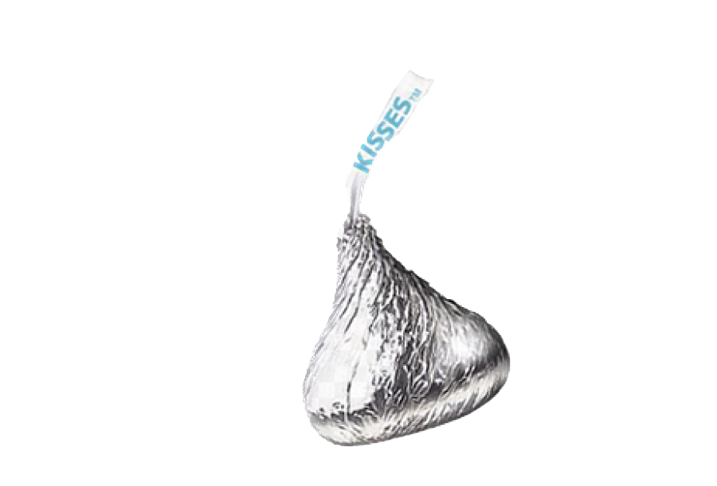
Understanding Hershey Co. Introduction
A Values-Driven, Snacking Powerhouse, Est. 1894.
Ranks #1 in Customer Service, best-in-class, large scale production and distribution
- Main competitor: Nestle
- Niche for snacking options (mainly chocolate-related goods) and its global supply chain
- Hershey describes as being “a best-in-class, large scale production and distribution”
Forecasted top-line growth
- Expects growth of 2-3% in net sales for 2024. Raising cocoa prices are the largest threat to their profit
- Now having to be cautionary in its 2024 growth projections as they are struggling with price increases.
Child Labor Law Issues
- Periodically falls under scrutiny for allegedly importing cocoa from farms and factories where children aid in its cultivation
- Pledged to end reliance on child labor to harvest cocoa in 2005, and lawsuits since then have been repeatedly dismissed due to investigators not finding a traceable connection
-One of the largest manufacturers of chocolate with an additional focus on other snacks such as baked goods and various beverages
- Milton Hershey established this company in 1894
- Hierarchical organization structure

Slide 3
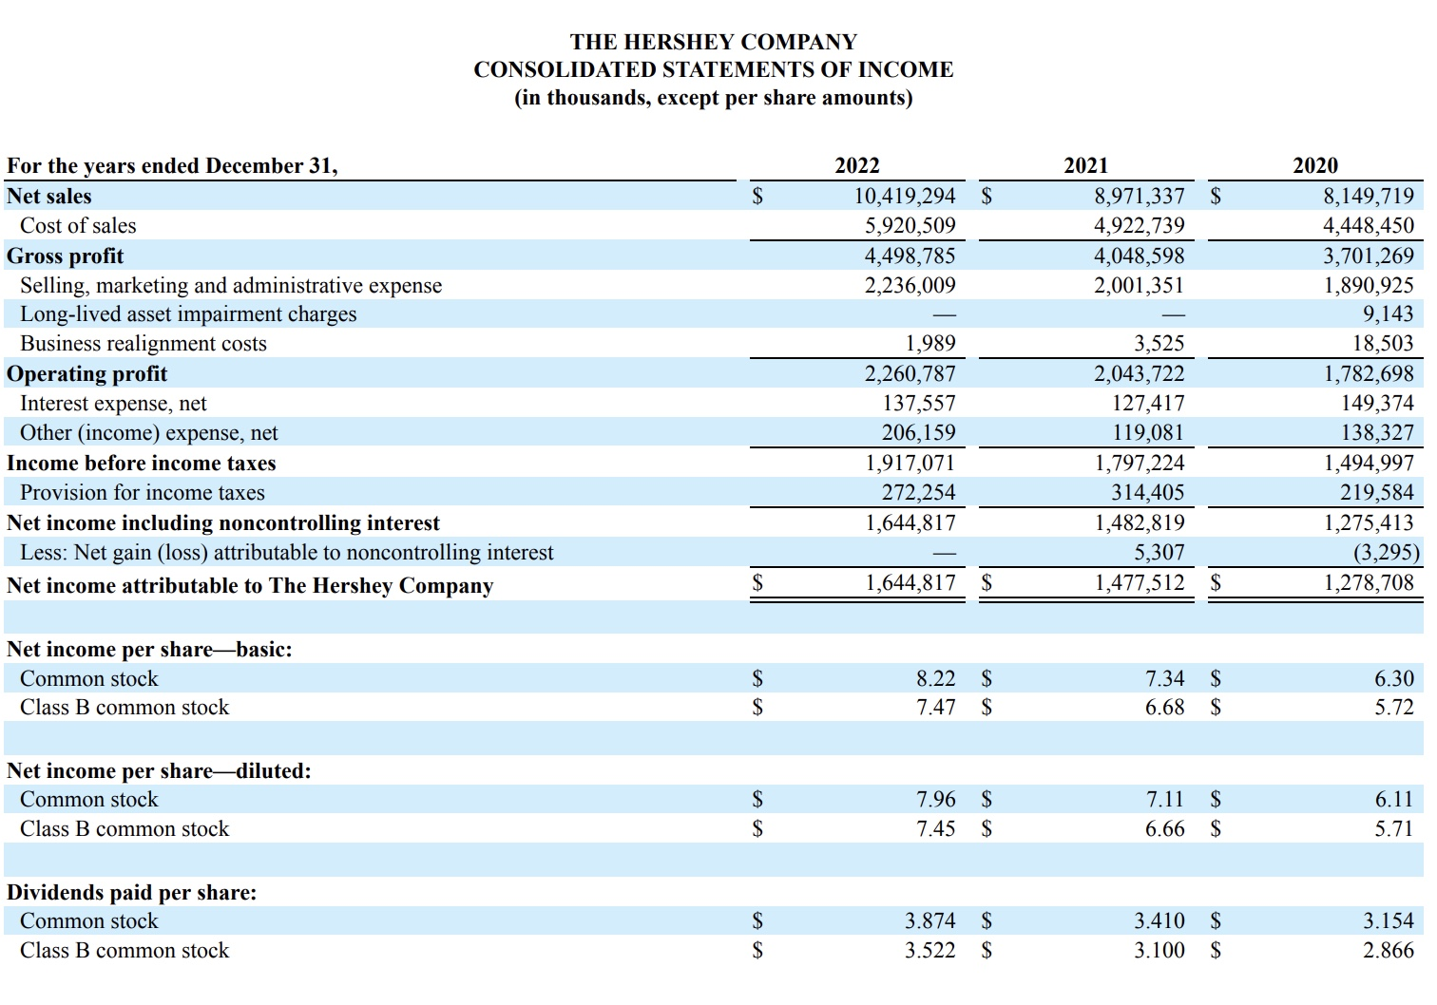
Source

Slide 4
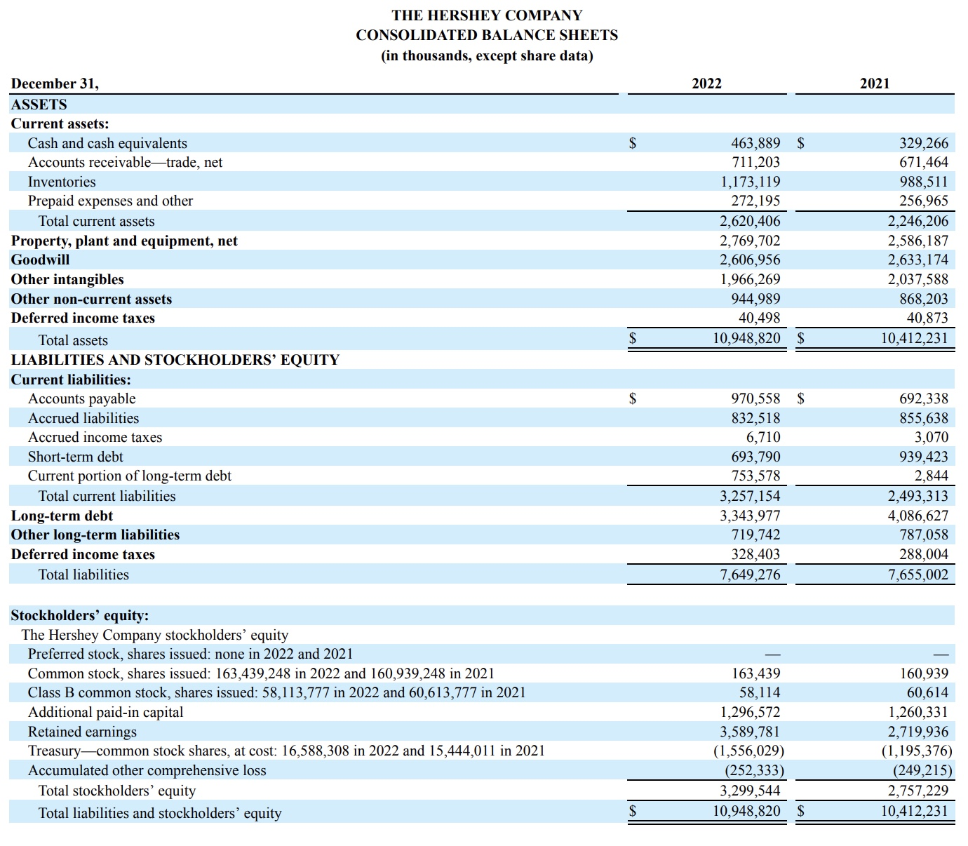
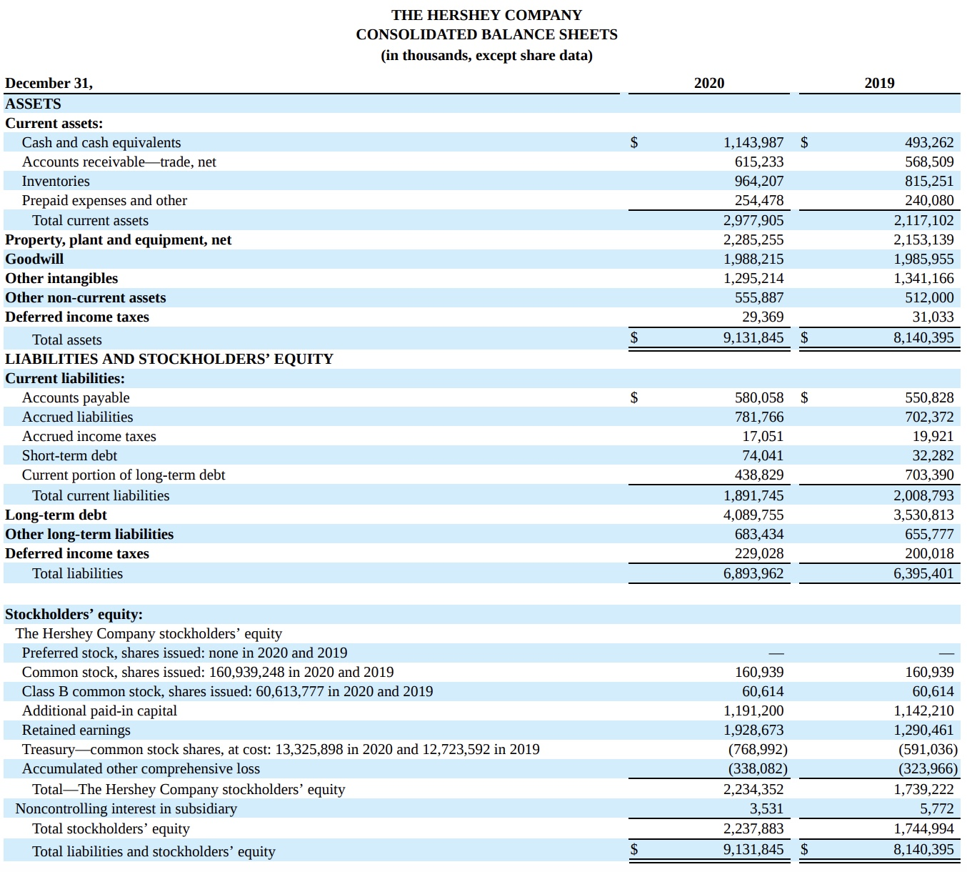
Source
Source

Slide 5
Short-Term Liquidity
Source
Source
Hershey Co.
2022 2021 2020 2019
Current Ratio 0.81 0.90 1.57 1.05
Quick Ratio 0.44 0.50 1.06 0.65
Hershey had a good year in 2020 with both the current and quick ratio being over 1, however in the years since it has declined.
Hershey nor Nestle seem to have enough liquid assets to cover short term liabilities.
Nestle
2022 2021 2020 2019
Current Ratio 0.88 0.98 0.86 0.86
Quick Ratio 0.50 0.68 0.60 0.63
Table:
Good Ratio
Bad Ratio
Neutral

Slide 6
Activity Ratios
Source
Source
Hershey Co.
2022 2021 2020 2019
Inventory Turnover 5.05 4.98 4.61 5.35
Average Collection Period 24.91 27.32 27.55 25.98
Average Payment Period N/A net credit sales not provided
Total Assets Turnover 0.95 0.86 0.89 0.98
Although Hershey is a bit better, both companies are in the green for average collection period as it is under 60 days, which generally means they are good at collecting receivables.
Want to see a higher total asset turnover ratio for these companies as they are in the retail sector. These scores may mean that their assets are not being as efficiently used.
Nestle
2022 2021 2020 2019
Inventory Turnover 3.45 3.79 4.25 4.99
Average Collection Period 42.97 46.75 46.50 46.39
Average Payment Period N/A net credit sales not provided
Total Assets Turnover 0.70 0.63 0.68 0.72
Table:
Good Ratio
Bad Ratio
Neutral

Slide 7
Financial Leverage
Source
Source
Hershey compares to Nestle in that their overall debt ratio is lower, although manageable it may be a good idea to start paying that down. Nestle is at about 60 and above across these years which is much more risky.
Times interest earned ratio: Both in the green meaning they are earning more money on its earnings than they are paying interest. Note: Hershey has steadily increased, while Nestle has decreased.
Hershey Co.
2022 2021 2020 2019
Debt Ratio 0.37 0.48 0.46 0.44
Times Interest Earned Ratio 11.96 11.60 8.56 9.58
Nestle
2022 2021 2020 2019
Debt Ratio 0.68 0.61 0.62 0.59
Times Interest Earned Ratio 9.03 11.34 14.16 12.39
Table:
Good Ratio
Bad Ratio
Neutral

Slide 8
Profitability and Market Ratios
Source
Source
Hershey Co.
2022 2021 2020 2019
Gross Profit Margin 43.2% 45.1% 45.4% 45.4%
Operating Profit Margin 21.7% 22.8% 21.9% 20.0%
Net Profit Margin 15.78% 16.46% 15.69% 14.39%
Earnings Per Share $7.96 $7.11 $6.11 $5.46
Return on Total Assets 15.02% 14.2% 14.01% 14.12%
Return on Common Equity 49.85% 53.59% 57.14% 65.89%
Overall, these percentages are within healthy ranges
Nestle ratios appear to be on a decline, with Hershey coming out stronger in their ratios overall.
Gross Profit Margin: Although this percentage can be higher, it is close to 50% for both companies. Dropping below 30% would be concerning.
Hershey company had a slight drop in the gross profit margin, and this could be due to the increasing cocoa prices.
Hershey earnings per share finishes out strong in 2022 after a steady incline in price.
Nestle
2022 2021 2020 2019
Gross Profit Margin 45.2% 48.0% 49.3% 49.8%
Operating Profit Margin 14.0% 14.0% 16.9% 14.8%
Net Profit Margin 10.16% 19.17% 14.67% 13.94%
Earnings Per Share $3.42 $6.06 $4.30 $4.30%
Return on Total Assets 7.10% 12.36% 9.98% 10.09%
Return on Common Equity 22.08% 31.81% 26.77% 24.23%

Slide 9
Market Ratios
Hershey Co.
2022 2021 2020 2019
Price/Earnings Ratio 28.2 26.3 24.1 26.1
Market/Book Ratio 14.4 14.5 14.2 17.6
Based on the price to earnings ratios, investors on average pay more for each dollar of Hershey Co. earnings than they are for Nestle.
The market to book ratio indicates that these companies may be overvalued, and investors are paying more for each dollar of book value for Hershey stock than Nestle.
Nestle
2022 2021 2020 2019
Price/Earnings Ratio 23.2 21.1 23.4 25.9
Market/Book Ratio 6.88 6.55 6.32 5.71

Slide 10
CONSOLIDATED STATEMENTS OF INCOME AND COMMON-SIZED INCOME STATEMENT
For the years ended December 31, |  |  | 2021 | 2022 |  | 2021 | 2022 |  | Evaluation
Net sales |  |  | $8,971,337 | $8,149,719 |  | 100.00% | 100.00% |  | Same
Cost of sales |  |  | $4,922,739 | $4,448,450 |  | 54.87% | 54.58% |  | Worse
Gross profit |  |  | $4,048,598 | $3,701,269 |  | 45.13% | 45.42% |  | Better
Selling, marketing and administrative expense |  |  | $2,001,351 | $1,890,925 |  | 22.31% | 23.20% |  | Worse
Long-lived and intangible asset impairment charges |  |  | — | $9,143 |  | N/A | 0.11%
Business realignment costs |  |  | $3,525 | $18,503 |  | 0.04% | 0.23% |  | Worse
Operating profit |  |  | $2,043,722 | $1,782,698 |  | 22.78% | 21.87% |  | Worse
Interest expense, net |  |  | $127,417 | $149,374 |  | 1.42% | 1.83% |  | Worse
Other (income) expense, net |  |  | $119,081 | $138,327 |  | 1.33% | 1.70% |  | Worse
Income before income taxes |  |  | $1,797,224 | $1,494,997 |  | 20.03% | 18.34% |  | Worse
Provision for income taxes |  |  | $314,405 | $219,584 |  | 3.50% | 2.69% |  | Better
Net income including noncontrolling interest |  |  | $1,482,819 | $1,275,413 |  | 16.53% | 15.65% |  | Worse
Less: Net gain (loss) attributable to noncontrolling interest |  |  | $5,307 | -$3,295 |  | 0.06% | -0.04% |  | Worse
Net income attributable to The Hershey Company |  |  | $1,477,512 | $1,278,708 |  | 16.47% | 15.69% |  | Worse
Source

Slide 11
- Current Capital Structure is strong - Indicates that they are low risk, and have the necessary assets to pay off long term debt - 2022 long term debt obligations: $3,343,977 -A decrease from over 4 million in 2021 - Decreased debt ratio from 0.48 in 2021 to 0.37 in 2022 - Total equity increased to $3,299,544 in 2022 from $2,757,229 in 2021
Capital Structure

Slide 12
Outlook
Performance
Strong long-term investment potential
Due to their ability to handle debt obligations and ability to adjust where needed
May see higher P/E ratios and drop in stock prices in the short-term
Due to fluctuating commodity costs
Consolidation period
Hershey stock appears to be In a period of consolidation (bouncing from $180-$200) over the past 6 months and has not had much growth

Slide 13
Outlook
Strengths
Debt
Responsible handling of debt and appears to be decreasing it overall despite current economic conditions
Accounts Receivable
good collection department with an average collection period below 30 for the past 4 years
Specialty in the market
Decades of experience in this sector. Hershey takes strategic acquisitions and business moves and does not spread themselves too thin compared to their counterparts

Slide 14
Outlook
Weaknesses
Lawsuits
The underlying asset (cocoa) is difficult to cultivate and often comes under scrutiny.
Periodically needing to handle lawsuits regarding that which can take up a large portion of profit
Raw Material Volatility
Cocoa is also a volatile raw material price wise, and Hershey is constantly battling with derivatives and needing to restructure certain aspects of production to make up for this volatility
Other commodities such as sugar and milk pose a risk due to fluctuating prices as well
Limited Product Diversity
Limited product diversity can be a weakness when the underlying commodities pose a threat.
Hershey largely depends on its chocolate and confectionary products.

Slide 15



Summary and Conclusions
A Values-Driven, Snacking Powerhouse
Overall positive outlook
Holds strong against its counterparts
Hershey Co. succeeds in being a values driven snacking powerhouse by making chocolate and snacking options affordable and available to everyone. This was Milton Hershey’s goal since 1894.
Hershey Co. excels in its strong operations and production despite fluctuating commodity prices and has steadily increased earnings per share. Because of this, investors have a positive outlook for the company.
When comparing Hershey to Nestle, Hershey still came on top overall with its key strengths against it being their handling of debt and positive inventory turnover

Slide 16
Formulas
Current ratio = current assets/ current liabilities
Quick ratio = current assets-inventories/ current liabilities
Inventory Turnover = Cost of goods sold/Inventory
Average collection period=Accounts receivable/ average sales per day
Average payment period=accounts payable/credit sales /365
Total assets turnover=sales/total assets
Debt Ratio: total liabilities/total assets
Times Interest Earned Ratio: Earning before interest and taxes/interest expense
Gross Profit Margin: Gross Profits/sales
Operating Profit Margin: Operating Profits/Sales
Net Profit Margin: Earnings for Common Stockholders/sales
Earnings per share: Earnings for Common Stockholders/outstanding shares
Return total assets: Earnings for Common Stockholders /total assets
Return on common equity: Earnings for Common Stockholders /common stock equity

Slide 17

Thank you References
Hershey Co. Filings: https://hershey.gcs-web.com/sec-filings?c=115590&p=irol-sec
Nestle Publications: https://www.nestle.com/investors/publications
About Hershey: https://www.thehersheycompany.com/en_us/home/about-us/the-company.html
Hershey Outlook: https://investors.thehersheycompany.com/content/hershey-corporate-investors/en-us/home/news-and-events/press-release/press-release-detail.html?122773
AP News Cocoa Prices: https://apnews.com/article/hershey-cocoa-valentine-chocolate-8c3e04f080b7d773470987dff1f9ca29
Child Labor: https://fortune.com/2023/08/15/chocolate-cocoa-child-labor-west-africa-lawsuit-hershey-nestle-mars/
Understanding Nestle: https://www.nestle.com/investors/overview#:~:text=Established%20over%20150%20years%20ago,products%20in%20188%20countries%20worldwide.

