Slide 1


Fundamentals of
Cybersecurity
SEC205

Slide 2
Security Bid Proposal
Sydney Long

Slide 3

A Comprehensive Solution
In a recent audit, a series of security issues have been discovered
Each issue will be addressed and resolved
Summary of costs

Slide 4

Equipment is Disappearing
Missing company provided laptops and headset equipment has led to hardware losses
Implement asset tracking software
ManageEngine AssetExplorer - $1,195/year

Slide 5

No building or computer room security
Unauthorized access to offices during off hours
Install security cameras
Arlo pro 4 security system - $1299/per system

Slide 6

No Acceptable User Policy (AUP)
Employees are unaware of up to date security practices
6 step guide
outline what is considered acceptable usage of company devices
clear expectations for internet and email usage
Data Protection and Confidentiality Requirements
Implement requirements for strong passwords (e.g., minimum length, complexity)
Establish protocols for securing mobile devices such as smartphones (E.G., VPN)
Specify the actions that will be taken if an employee violates the AUP, ranging from warnings to termination

Slide 7
No Malware Protection
Daily malware attacks (largest concern is phishing attacks)
Deploy endpoint protection software
Norton business security - $55/device ($4,125 for 75 devices)

Slide 8
No Intrusion Detection
Daily intrusions compromising systems
Install an intrusion detection system
Snort IDS - open-source with managed services starting at $2,000/year

Slide 9

Passwords Compromised
Weak password policies lead to breaches
Implement Acceptable Use Policy
Require complex password requirements
Passwords expire every 60 days
Require Multi-Factor Authentication through Microsoft authenticator

Slide 10
Internet Connection is Insecure
Insecure internet access is leading to vulnerabilities
Implement company wide VPN
AT&T Business VPN Package $66/device ($4950 for 75 devices)

Slide 11
Sensitive Information is Stolen
Data leaks occurring through unauthorized copies of information
Implement Data Loss Prevention (DLP) software
Symantec Data Loss Prevention by Broadcom $60/device annually ($4,500 for 75 devices)

Slide 12
No automated OS or app patching
Vulnerable systems due to outdated software
Automate patch management with SolarWinds Patch Manager
SolarWinds Patch Manager ($3,600/year)

Slide 13

Legacy software and systems
Outdated systems expose vulnerabilities
Migrate to modern systems with a phased upgrade plan
Cost dependent on systems, approximately $35,000 for equipment upgrades

Slide 14
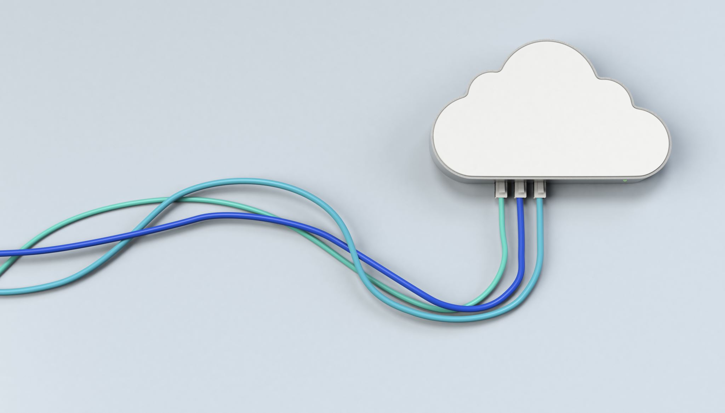
No Data Backup
Risk of permanent data loss
Deploy a cloud-based backup solution
Acronis Cyber Backup - $68/device ($5,100 for 75 devices)

Slide 15
No Disaster Recovery Plan
No plan for recovery in case of emergencies
Create a disaster recovery plan and use Azure Site Recovery for cloud-based DR services ($25 per month per instance, approximately $300/yr minimum)

Slide 16

Summary
Key Solutions Provided:
Enhanced physical and digital security
Employee training and policy enforcement
Robust backup and disaster recovery measures
Cost-effective tools and software for all needs
Total Security Cost Estimate: $60,743

Slide 17
Price and Cost Estimate
Updated Hardware cost estimates:
$400 for new laptop per employee
$66 for new headset per employee
Security Solutions Estimate: $25,743

Slide 18
References
ManageEngine. AssetExplorer: IT asset management software. https://www.manageengine.com/products/asset-explorer/
Arlo Security System. https://www.arlo.com/en-us/security-system/arlo-security-system.html
Norton Anti-Virus. https://pr.norton.com/products/norton-360-premium
Snort: Open source intrusion detection and prevention system. https://www.snort.org/
AT&T Business VPN. https://www.business.att.com/resources/knowledge-center/what-is-a-business-vpn.html
Symantec® Data Loss Prevention. https://docs.broadcom.com/doc/data-loss-prevention-family-en
Solarwinds Patch Manager. https://www.solarwinds.com/patch-manager
Acronis Cyber Protect. https://www.acronis.com/en-us/solutions/business/?utm_source=google&utm_medium=cpc&utm_campaign=MF-X-X-Cloud-Americas-NAM-EN-MQL-CloudSEMb-MSPcloud-G-PS&gad_source=1&gclid=Cj0KCQiAr7C6BhDRARIsAOUKifhhmy24L-g33a7cmGbaQgNfh1i-V0ff-Is10JF_ahgUjyeAcofK5mYaAvozEALw_wcB
Azure Site Recovery. https://azure.microsoft.com/en-us/pricing/details/site-recovery/#purchase-options

