Slide 1

IEO Progress
Mihai Glodici: 4538528
& quinn aelen:3982106
CB-13
Team 20

Slide 2
Table of Contents
Reflection on Assignments
Network Diagram
Problem Solving
Our Teamwork

Slide 3

Reflection on assignments
Personal Report
Wireshark
Building our Netkit Lab
Network routes, IP configuration
NetCat
TCP and UDP protocols

Slide 4
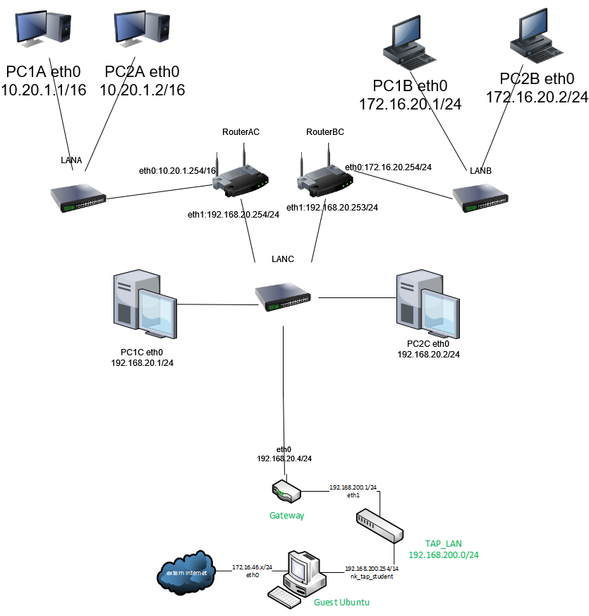
Network diagram

Slide 5
Problem Solving
Week 8
Figuring out Wireshark
Bluescreens on Linux installation
Laptop dying week 10
Communication with other students
Looking up information
Trial and error
Joining IT communities

Slide 6
Our Teamwork
Worked together on every assignment
Figured out problems and asked about them together
Finished week 10 on Mihai's laptop, because Quinn's got fried
Worked in person and from home together using screenshare

Slide 7

https://git.fhict.nl/I485522/beans-incorporated

