Slide 1


Evil Twin Wi-Fi Attacks: Demystified with Airgeddon

Slide 2

Understanding the Threat Landscape
In our wireless world, Evil Twin Wi-Fi attacks pose a serious security risk.
Using tools like Airgeddon, attackers can create rogue APs, tricking users into revealing sensitive information

Slide 3



Why is Evil Twin so Dangerous?
Passwords are captured in plain text, removing the time-consuming need of cracking the hash
All it takes is a “fool with a tool” and an unsuspecting network user to bypass the network Firewall
Can be done from far distances using amplification techniques

Slide 4

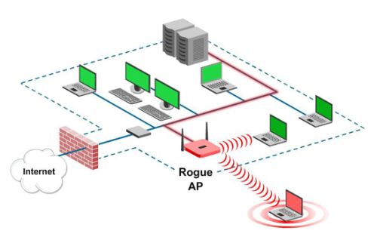
Probing the Critical Questions + Demo
https://youtu.be/4G22bh986r8
I aim to unravel how Airgeddon simplifies malicious AP deployment, the vulnerabilities exploited in these attacks, methods for detecting rogue APs, and the best defense strategies against these threats.
My lab: An Ubuntu VM, an iOS phone, and an Android phone with a personal mobile hotspot. Let's dive into a step-by-step demonstration of an Evil Twin Wi-Fi attack using Airgeddon.
Feel free to test if the Captive Portal works on your device by connecting to the "Sloop" AP
EvilTwinTest123.

Slide 5

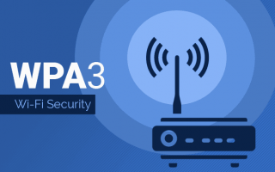

Countering the Threat - Answering the Research Questions
Airgeddon eases rogue AP deployment and captive portal creation. Key vulnerabilities: Weak encryption and user unawareness.
For detection: Network monitoring technologies and user education are crucial.
Defense strategies: Regular security audits, strong encryption (WPA3), and security awareness programs.

Slide 6



Slide 6: Securing Our Wireless World
Evil Twin Wi-Fi attacks are daunting, but we can counter them.
The key lies in robust encryption, updated firmware, smart configurations, and informed users.
Together, let's make our networks safer!

Slide 7

Thank you for your attention!

