Slide 1

3D Data Science with Python
Sergio Peral · ML Engineer, Teqyard
Notes:
TALK TRACK: Quick show of hands: who has written this loop? Keep it up if it finished before your coffee went cold. In 30 minutes you get a pipeline you can copy and the gotchas that cost me weeks; first, a confession about C++.
TIME: 20 s, ends at 0:20
LIKELY QUESTION: Does that loop really take until tomorrow on 12 million points?
ANSWER: The 12 million is the abstract's joke, not our data: this crop has 722 961 points and the 1 km AHN file 21 013 926. I haven't timed a 12 million point loop, so I don't quote a time; what I did measure is the cost per loop step, on slide 26.
CHECK BEFORE THE TALK:
• The code line is the abstract's joke word for word, as the speaker asked (it is a joke, not runnable: a loop body of only a comment would raise IndentationError). Fira Mono has no cup glyph: PowerPoint falls back to an emoji font; check the cup renders on the presenting laptop
TRACE:
• Code line: the talk abstract, with '...' as the loop body; shown, not run
• results/pipeline.json: points_in
• results/memory.json: tile_1km.points

Slide 2
3D meant C++; now Python drives it
C++ with PCL
Python with Open3D
using Cloud =
pcl::PointCloud<pcl::PointXYZ>;
Cloud::Ptr cloud(new Cloud);
Cloud down;
if (pcl::io::loadPCDFile(
"crop.pcd", *cloud)) return 1;
pcl::VoxelGrid<pcl::PointXYZ> vg;
vg.setInputCloud(cloud);
vg.setLeafSize(0.5f, 0.5f, 0.5f);
vg.filter(down);
std::cout << cloud->size()
<< " -> " << down.size() << "\n";
pcd = o3d.io.read_point_cloud(path)
down = pcd.voxel_down_sample(0.5)
print(len(pcd.points), "->",
len(down.points))
# output
722961 -> 232180
Why do the counts differ? PCL and Open3D anchor the 0.5 m voxel grid differently; both average the points in each voxel.
# output
722961 -> 230519
Intro · Data · Toolbox · Pipeline · Memory · Speed · Reality · Wrap-up
Notes:
TALK TRACK: For years, serious 3D work meant C++, like the greyed-out code on the left. Both programs on this slide are real: I compiled the PCL one and ran both on the same file from today's case, and the output under each is what they printed. Twelve lines of C++ against three of Python for the same job: load the cloud and keep one average point per half-metre voxel. The C++ is still there underneath; you just stopped writing it, and if that feels like flying, you're not the first. But a shorter program doesn't tell you what to compute; so what's the problem?
TIME: 35 s, ends at 0:55
LIKELY QUESTION: Why do the two counts differ?
ANSWER: Both average the points in each 0.5 m voxel, but the grids sit in different places: PCL anchors its voxels at multiples of the leaf size, Open3D at the minimum corner minus half a voxel. Redoing both rules in NumPy on the same file gives exactly the two counts on the slide. Neither is wrong; it's a reminder that 'voxel downsampling' is a family of algorithms.
CHECK BEFORE THE TALK:
• To rerun the C++ side: PCL_PREFIX=<micromamba env> uv run python snippets/run_all.py (docs/HOW_TO_UPDATE.md step 4); without PCL_PREFIX the .cpp is listed as NOT RUN and the left output box would still show the last recorded line
TRACE:
• snippets/s02_pcl.cpp: compiled and run on 2026-10-12, PCL 1.15.1 and g++ 15.3.0 from conda-forge in a user-space micromamba env; build: g++ -std=c++17 -O2 -Wall -Wextra s02_pcl.cpp $(pkg-config --cflags --libs pcl_io pcl_filters), no warnings
• snippets/s02_python.py; both read the same crop.pcd, written by snippets/_setup.py write_crop_pcd (local coordinates, float32 in the file)
• results/snippets.json: s02_pcl.cpp.output_line, s02_python.py.output_line (the two output boxes), compiler, pcl_version, build_cmd
• Grid anchoring: PCL filters/impl/voxel_grid.hpp floor(p * inverse_leaf); Open3D PointCloud::VoxelDownSample, GetMinBound() - voxel_size / 2; both re-implemented in NumPy on crop.pcd give the same counts

Slide 3

A city scan: millions of points, no names
722 961 points in one city block; none has a name.
Each point: x, y, z and little else
Cities register what stands in the street: trees, lamp posts, bollards
Naming points by hand doesn't scale
Today's question: does the scan agree with the register?
Data: AHN5, Het Waterschapshuis, CC BY 4.0.
Intro · Data · Toolbox · Pipeline · Memory · Speed · Reality · Wrap-up
Notes:
TALK TRACK: Here's the problem. A laser scan of a city is millions of points, and each one is x, y, z and little else: 722 961 of them in this one block, and not one says whether it's a tree, a roof or a lamp post. Cities keep registers of what stands in the street: trees, lamp posts, bollards. So the question for today is: does the scan agree with the register? To answer it, every point needs a class, and nobody names 722 961 points by hand. So here's the goal.
TIME: 45 s, ends at 1:40
LIKELY QUESTION: Why not just use AHN's own classes?
ANSWER: AHN marks ground and buildings and puts almost everything else, trees, poles, cars and facades, in one class called other. That's exactly the part a city register cares about.
TRACE:
• renders/f1_load.png (the raw crop, coloured by height)
• results/pipeline.json: crop.points
• results/bgt_street_furniture.json: the register used on slide 29

Slide 4
The goal: name every point, then check it
From x, y, z alone, in plain Python, and say how far to trust it.
In
Out
Checked against
One LAZ file, 200 m × 200 m
x, y, z per laser echo
A class per point: ground, buildings, vegetation, street furniture
Ground, buildings: AHN's own classes
Poles: the BGT register
Vegetation: no reference
Intro · Data · Toolbox · Pipeline · Memory · Speed · Reality · Wrap-up
Notes:
TALK TRACK: The goal: name every point from x, y and z alone, in plain Python, and say how far to trust the result. In: one LAZ file of 200 by 200 metres. Out: one of four classes per point: ground, buildings, vegetation or street furniture. Checked how? Ground and buildings against AHN's own classes, which I hid from the pipeline; the poles against the city's BGT register; vegetation has no reference, and I'll say so at the end. Along the way you'll see four rules that make this fast, small and trustworthy. Here's the map.
TIME: 40 s, ends at 2:20
LIKELY QUESTION: [pending]
ANSWER: [pending]
TRACE:
• Class 1 'overig' mixes vegetation, facades, cars and poles; street furniture goes into it by spec: AHN4 acquisition spec, research: reports/dataset.md
• The map: the BGT register of poles, slide 29 (expectation vs reality)

Slide 5
Eight chapters, three questions
Chapter | What you get | Rule | Min
Intro | The problem, the goal, this map |  | 3
Data | How a plane scans; the case; the scope |  | 3
Toolbox | Four rules; a library for every layer |  | 2
Pipeline | Six steps from LAZ file to labels | 1, 2 | 8
Memory | Does it fit? A full AHN sheet | 2 | 2
Speed | Is it fast? A loop against one call | 3 | 5
Reality | Is it right? The register against the scan | 4 | 1
Wrap-up | The rules in numbers; limits; next |  | 3
Intro · Data · Toolbox · Pipeline · Memory · Speed · Reality · Wrap-up
Notes:
TALK TRACK: Eight chapters, and they're the same eight as in the footer, where the current one is always highlighted. First the data and its limits, then the rules and the tools, then the six-step pipeline. After that, three questions about the result: does it fit, is it fast, and is it right? The last column says which rule each part proves. First: where do the points come from?
TIME: 40 s, ends at 3:00
LIKELY QUESTION: Why is the reality check at the end?
ANSWER: Because that's where I learned it: I computed first and looked afterwards. The goal slide already says what it's checked against, so you can watch for the answer.
TRACE:
• content.yaml slide 5 (roadmap, 2026-10-14); chapters: content.yaml meta.chapters

Slide 6
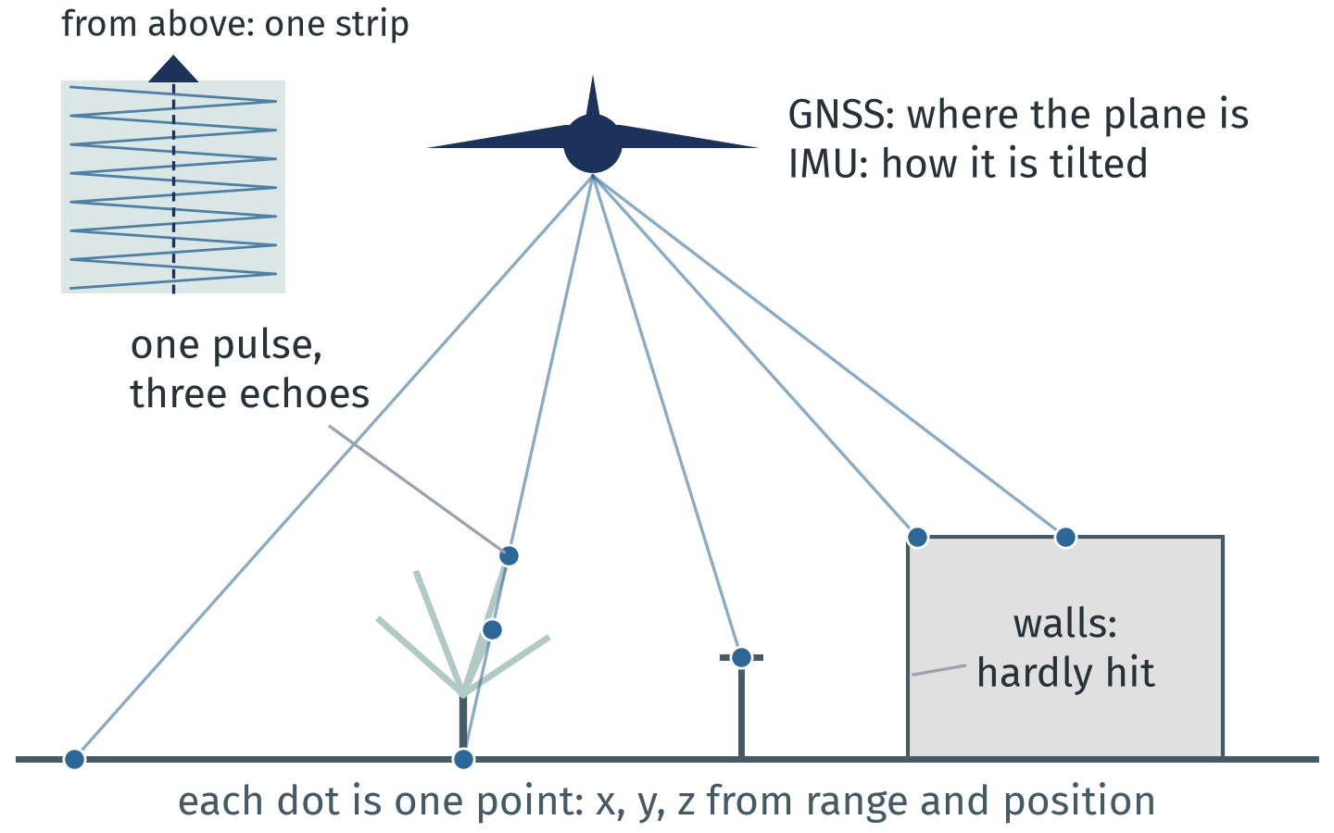
A plane sweeps a strip with a laser
x, y, z = range + GNSS position + IMU tilt.
A scanning laser, not one spot: it sweeps a strip
One pulse can leave up to 7 echoes, in trees most
Roofs dense, walls sparse, thin poles often missed
This crop: 691 011 pulses in 19.8 s of flight
Schematic side view, inset from above; not to scale.
Intro · Data · Toolbox · Pipeline · Memory · Speed · Reality · Wrap-up
Notes:
TALK TRACK: Where do these points come from? Not from one spot: from a plane with a scanning laser that sweeps a strip below it; the inset shows that strip from above. The time an echo takes to come back gives the range; GNSS says where the plane is and the IMU how it's tilted, and together they place each echo as one x, y, z point. One pulse can leave up to 7 echoes, mostly in trees, which is how we'll find vegetation. And because the plane looks almost straight down, roofs are dense, walls sparse, and thin poles often get missed: remember that one. This crop is 691 011 pulses from 19.8 s of flight. Here it is.
TIME: 55 s, ends at 3:55
LIKELY QUESTION: Is this LiDAR or photogrammetry?
ANSWER: LiDAR: the points are laser echoes, not matched photos, which is why a pulse can pass through a bare tree and echo several times. AHN5 has no colour; photogrammetry gives colour but no echoes under trees. Backup B6 lists other open sources, including scans from cars and tripods.
TRACE:
• Numbers: results/concepts.json acq (deck/concepts/make_figures.py acquisition(), from data/utrecht_jaarbeurs_200m.laz): pulses = distinct GPS times, echoes per pulse = number_of_returns, flight time = GPS time span, scan angle in 0.006 degree steps (1.0 to 12.0 degrees off vertical)
• Figure: deck/assets/concepts/a1_acquisition.png, schematic, not to scale
• Principle (time of flight, GNSS, IMU): general airborne laser scanning; leaf-off flight by AHN spec (research: reports/dataset.md)

Slide 7
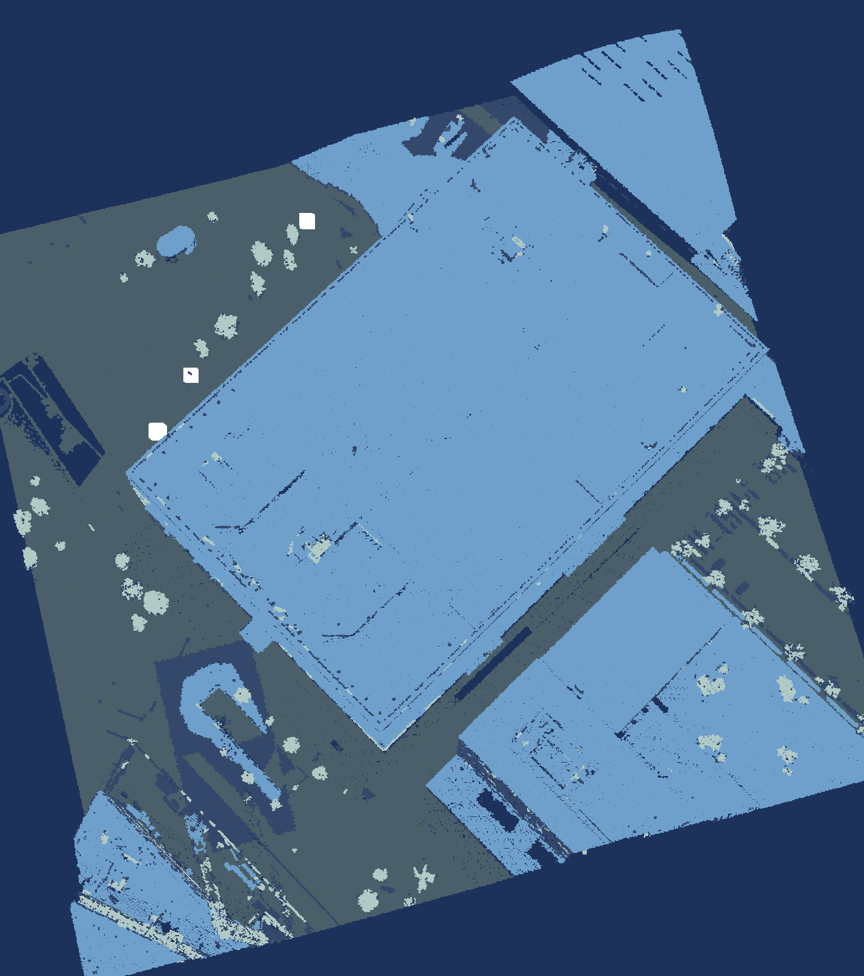
Today's case: the block around the Jaarbeurs
The data set
Jaarbeurs hall
Area
200 m × 200 m
Points
722 961
Density
about 18 per m²
Source
AHN5, ahn.nl
Flown
April 2023, night
File
LAZ, 4.3 MB
Coordinates
RD New + NAP
Licence
CC BY 4.0
Checked against AHN (ground, buildings) and the BGT pole register (street furniture).
Data: AHN5, Het Waterschapshuis, CC BY 4.0.
Intro · Data · Toolbox · Pipeline · Memory · Speed · Reality · Wrap-up
Notes:
TALK TRACK: This is our case for the whole talk: a 200 by 200 metre square of Utrecht around the Jaarbeurs hall, the big flat roof under the arrow. 722 961 points, about 18 per square metre, from AHN5, flown at night in April 2023 while the trees had no leaves. It's one 4.3 MB LAZ file in RD New coordinates with NAP heights, so everything is in metres, and it's CC BY 4.0, so you can use it too. I hid AHN's labels; the pipeline rebuilds four classes on its own. So what is this thing, as data?
TIME: 45 s, ends at 4:40
LIKELY QUESTION: Why this square and not a whole AHN file?
ANSWER: It's the venue, and it's small enough to run every step live in under a second, which is rule three, make it small first. The whole 1 km file has 21 million points; slide 22 shows what happens to memory when you load it, and how to stream it instead.
CHECK BEFORE THE TALK:
• Confirm which Jaarbeurs building the talk room is in. If it is this one, say 'the building we're sitting in'; the name of the building (Beatrixgebouw?) is UNVERIFIED, so the talk says only 'the Jaarbeurs hall at Jaarbeursplein 6'
TRACE:
• renders/f1_load.png (left frame), renders/f6_final.png (right frame)
• renders/render_spec.json
• renders/labels.json: f6_final (label chips), f1_load.jaarbeurs_edge (edge arrow position)
• results/pipeline.json: ground, buildings, crop.bbox_rd
• data/utrecht_jaarbeurs_200m.laz (crop box: data/fetch_ahn5.py CROP_BBOX_RD, RD 135715, 455475 to 135915, 455675)
• The hall: BAG pand 0344100000077882 (Jaarbeursplein 6, built 1970, use: bijeenkomstfunctie), footprint bbox RD 135747.7, 455512.5 to 135905.8, 455654.0, from the PDOK BAG WFS and locatieserver, checked 2026-10-11 (pipeline/render.py HALL_BBOX_RD)
• Arrow on the roof: renders/labels.json f1_load.jaarbeurs_hall; evidence in renders/render_spec.json labels.detail.f1_load.jaarbeurs_hall_note
• Class 1 definition ('overig'): AHN4 acquisition spec, research: reports/dataset.md
• Venue: Jaarbeurs Utrecht is the PyCon NL 2026 venue, confirmed on pycon-nl.org (research: reports/dataset.md); which building the talk room is in is UNVERIFIED
• Data set table: data/README.md (crop box, classes, flight time, file size), results/pipeline.json crop (points, classes); density computed from points and area
DATA SET:
• Area: RD New box x 135715 to 135915, y 455475 to 455675 (200 m by 200 m, 4 ha), cut from the 1 km AHN5 file 135000_455000 (21 013 926 points, 130 MB COPC LAZ)
• Points: 722 961; density 722 961 / 40 000 m2 = 18.1 points per m2 (all returns)
• Flown: one strip, GPS time about 23:51 UTC on 5 April 2023 (01:51 CEST on 6 April), leaf-off as AHN's spec asks
• File: LAS 1.4, point format 6 (x, y, z, intensity, return number, number of returns, classification, scan angle, GPS time); no colour; 4 336 320 bytes
• Coordinates: RD New (EPSG:28992), heights in m NAP; z from about -0.8 m to 101.6 m; the WKT record is in the file
• AHN classes in the crop: 1 other 109 363, 2 ground 262 712, 6 building 338 943, 26 civil structure 11 943; hidden from the pipeline, used only to score
• Licence: CC BY 4.0, Het Waterschapshuis; attribution on every slide that shows the data

Slide 8
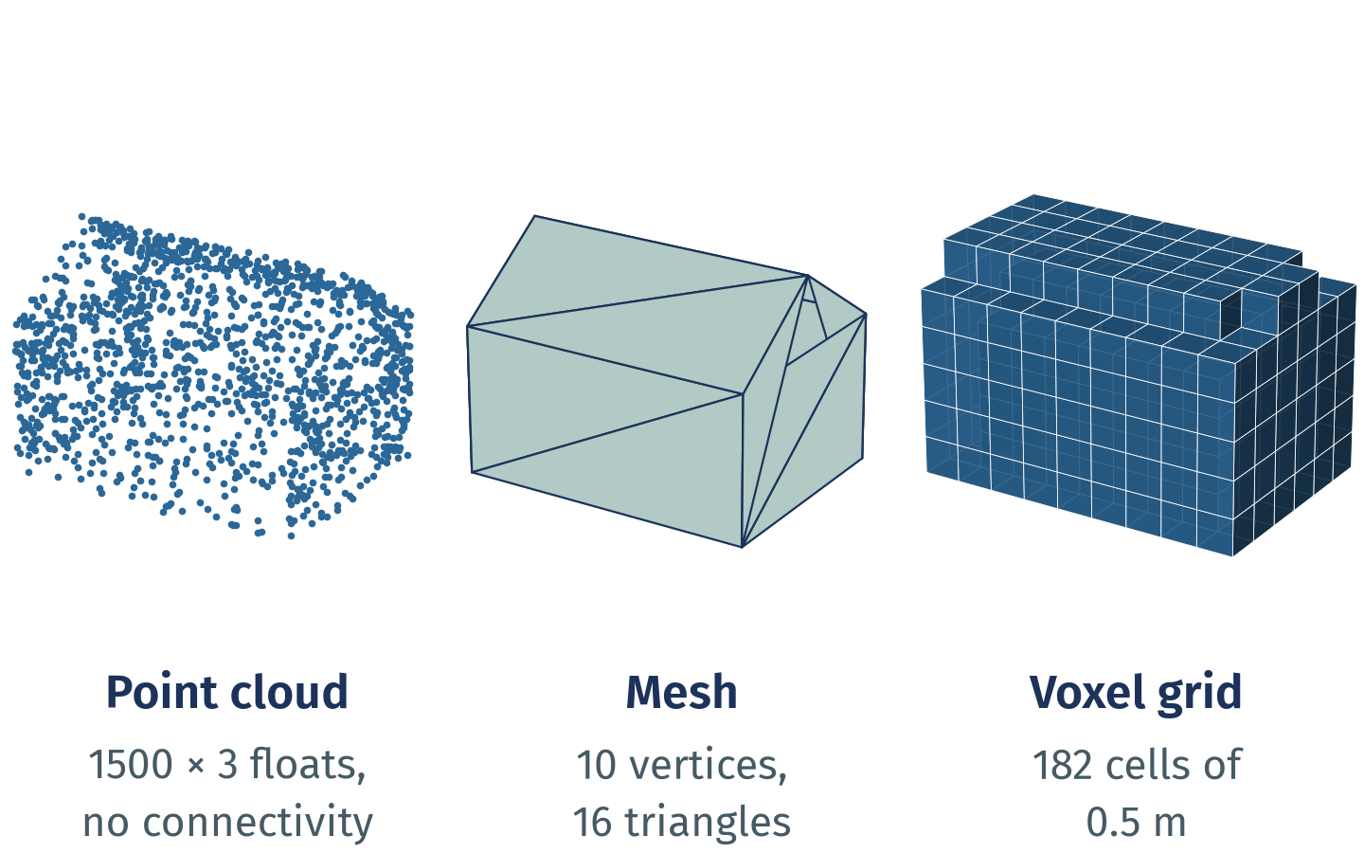
One object, three representations
Points measure, meshes connect, voxels index space. Convert only when the task needs it.
Point cloud: an unordered N×3 array plus attributes; no neighbours stored.
Mesh: vertices plus faces, so surfaces, normals and areas are defined.
Voxel grid: occupied cells at one resolution; detail below a cell is gone.
Intro · Data · Toolbox · Pipeline · Memory · Speed · Reality · Wrap-up
Notes:
TALK TRACK: What is this thing, as data? One house, drawn three ways. A scanner gives you the left one, a point cloud: an N by 3 array of x, y and z plus a column per attribute, samples of the surface with nothing joining them. A mesh adds the connections, so area and volume exist. A voxel grid trades exact positions for a regular index of space. Today's pipeline stays with points and uses voxels only to downsample. Each of the three trades something. Before we start: what this talk does, and doesn't.
TIME: 40 s, ends at 5:20
LIKELY QUESTION: Should I turn my point cloud into a mesh or voxels first?
ANSWER: Only when the question needs it: area, volume or a solid render want a mesh; occupancy and neighbour lookups like voxels. Every conversion loses detail and adds a parameter you then have to defend, such as the voxel size or the meshing depth. This pipeline stays with points.
TRACE:
• deck/appendix.yaml C1 (bullets, figure, citations; shown here as a main slide)
• deck/concepts/make_figures.py: deck/assets/concepts/c1_representations.png, results/concepts.json c1
• research: reports/mental_models.md section 1
WHY IT MATTERS: Choosing the representation decides which questions are cheap. Converting costs detail and adds a parameter you now have to justify.
EXAMPLE: Open3D: o3d.geometry.VoxelGrid.create_from_point_cloud(pcd, voxel_size) and TriangleMesh.create_from_point_cloud_poisson(pcd); PyVista: PolyData for points and meshes, ImageData for regular grids; trimesh: mesh.voxelized(pitch). Analogy: a dot-to-dot puzzle before the lines (points), after the lines (mesh), and as pixel art (voxels).
LIMITS AND DISAGREEMENTS:
• The figure is synthetic and tiny; real meshes from scans need cleaning and are rarely watertight.
• Dense voxel grids grow with the cube of the resolution; sparse structures (hashing, octrees) avoid that. Which is best depends on the task.
• Deep learning uses all three (point-based, mesh-based, voxel or sparse convolution); no representation wins everywhere (Guo et al. survey).
CITATIONS:
• Qi, Su, Mo, Guibas: PointNet, CVPR 2017 (arXiv 1612.00593, v2 10 Apr 2017), point sets are unordered
• Open3D 0.20.0 docs: PointCloud, TriangleMesh, voxelization tutorial (open3d.org/docs/latest, no date shown)
• PyVista 0.49.1 docs: What Is a Mesh? (docs.pyvista.org/user-guide/what-is-a-mesh.html, no date shown): a point cloud is a mesh without connectivity
• trimesh 5.1.1 docs (trimesh.org; PyPI 2026-10-02)
• Choy, Gwak, Savarese: Minkowski CNNs, CVPR 2019 (arXiv 1904.08755), sparse voxels
• Guo et al.: Deep Learning for 3D Point Clouds: A Survey, IEEE TPAMI 43(12), Dec 2021, doi 10.1109/TPAMI.2020.3005434
• Poux: 3D Data Science with Python, O'Reilly, 2025 (ISBN 9781098161330)
SOURCES AND STATUS:
• Bullet 1 "Point cloud: an unordered N×3 array plus attributes; no...": status verified; source: research: reports/mental_models.md section 1 (PointNet, Open3D PointCloud)
• Bullet 2 "Mesh: vertices plus faces, so surfaces, normals and areas...": status verified; source: research: reports/mental_models.md section 1 (Open3D TriangleMesh, PyVista data model, trimesh)
• Bullet 3 "Voxel grid: occupied cells at one resolution; detail below...": status verified; source: research: reports/mental_models.md section 1 (Open3D VoxelGrid; sparse voxels)
STATUS KEY: verified = checked in a research report.

Slide 9
What this talk does, and doesn't
In scope
Not today
Assumptions
Airborne LiDAR, AHN5
One 200 m × 200 m urban crop
Four classes, rule-based
Standard Python libraries
Speed and memory
Deep learning, trained models
Mobile or terrestrial scans
Meshes, registration
CRS in depth, production
State-of-the-art accuracy
Metres: RD New + NAP
Ground: one plane per 25 m tile
Voxel 0.5 m; inliers 0.4 m; objects > 0.3 m
DBSCAN eps 0.75 m, 6 points
Thresholds tuned on this crop
Intro · Data · Toolbox · Pipeline · Memory · Speed · Reality · Wrap-up
Notes:
TALK TRACK: So you know what not to expect: this is airborne LiDAR from AHN5, one 200 metre urban crop, four classes from hand-written rules, standard Python libraries, and an eye on speed and memory. Not today: deep learning, mobile or terrestrial scans, meshes, registering scans together, coordinate systems in depth, production, or state-of-the-art claims. The assumptions are on the right: coordinates in metres, so every threshold is in metres; ground is one plane per 25 metre tile; and the thresholds were tuned on this crop, so the results hold for this crop. AHN and the BGT are my references, and neither is perfect. Now, the four rules.
TIME: 40 s, ends at 6:00
LIKELY QUESTION: Would a neural network do better?
ANSWER: Probably, with labelled training data; that's out of scope today. Backup B5 compares a classifier with the rules on this crop.
TRACE:
• pipeline/run.py: VOXEL, GROUND (tile 25 m, ransac threshold 0.4 m, low percentile 2, window 1.5 m), EPS 0.75, MIN_POINTS 6, MIN_HEIGHT 0.3
• results/pipeline.json: params
OFF SLIDE:
• Ground candidates are the points within 1.5 m of the tile's 2nd height percentile
• AHN and BGT are the references, and neither is perfect
• Results hold for this crop only

Slide 10
Four rules this talk will prove
1
Think in arrays, not points
2
Make it small first
A point cloud is an N×3 table plus attribute columns.
Proof: Pipeline
Crop, tile and downsample; scale up last.
Proof: Pipeline, Memory
3
Let compiled code loop
4
Look before you compute
One call per array or tile, never per point.
Proof: Speed
Render it; check units, coordinates and classes.
Proof: Reality
Intro · Data · Toolbox · Pipeline · Memory · Speed · Reality · Wrap-up
Notes:
TALK TRACK: Four rules of thumb for 3D data; they're the mental model for the rest of the talk. One: think in arrays, not points: a point cloud is a table, so work on whole columns. Two: make it small first: crop, tile and downsample, then scale up. Three: let compiled code do the loops: one call per array or tile, never one per point. Four: look before you compute: render it, check units, coordinates and classes, because most 3D bugs are silent. They're numbered in the order the talk proves them; a badge top right marks each proof, and at the end they come back with the numbers. So which libraries do we have?
TIME: 30 s, ends at 6:30
LIKELY QUESTION: Aren't these just general data science rules?
ANSWER: Mostly, yes, and that's the point: 3D data is less exotic than it looks. What changes is the scale and the silence: a wrong coordinate system or float32 rounding doesn't raise an error, it just moves your points by centimetres, and a loop over points is a loop over millions.
TRACE:
• content.yaml slide 10 rules; the same four rules close the talk on slide 31 with their evidence
WHERE IN THE TALK:
• 1 Think in arrays: slides 8 and 15 (N by 3 arrays, copy or view at every hand-off)
• 2 Look before you compute: slides 7, 29, 30 and 22 (AHN classes, street furniture against the BGT register, uneven density, the file size before loading)
• 3 Make it small first: slides 16, 17 and 23 (voxels, tiles, the chunked read's peak)
• 4 Let compiled code loop: slides 24 to 28 (the quiz, the toll, the profiler, free threads)
MENTAL MODEL: The rules rest on the hidden mental-models section (C2 to C9, with citations; C1 and C5 are slides 8 and 30; slide B8 is the workflow); C8 ranks the ideas and says where each joins the talk.

Slide 11
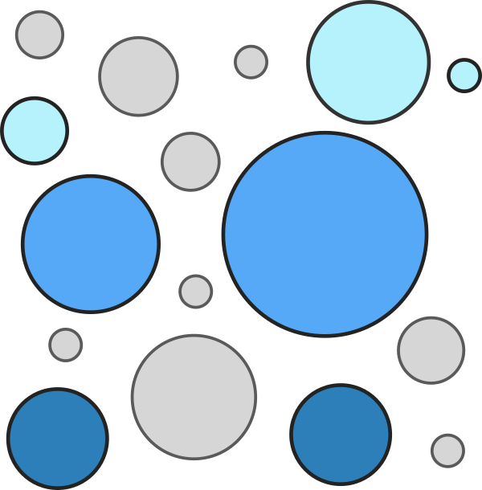











Python already has a library for every layer
Load and store
laspy
PDAL
pyproj
Arrays and speed
SciPy
Numba
Process
Visualise
Learn
scikit-learn
Intro · Data · Toolbox · Pipeline · Memory · Speed · Reality · Wrap-up
Notes:
TALK TRACK: Here's the toolbox: the Python 3D ecosystem, one row per layer, and only what this talk uses or names. The five with a blue outline are today's pipeline: laspy, NumPy, SciPy, Open3D and PyVista. The rest come up later: PDAL and pyproj for AHN files and Dutch coordinates, Numba and Dask when NumPy or RAM runs out, trimesh for meshes, and scikit-learn and PyTorch when rules stop being enough. The repo lists every library I checked, with status and licence. And they all share one trick.
TIME: 35 s, ends at 7:05
LIKELY QUESTION: Why is my favourite library not on the wall?
ANSWER: The wall is the selection this talk uses or mentions, from the 119 libraries and applications I checked. The full list is docs/ECOSYSTEM.md in the repo, with status, licence and release date per library. Open an issue or a pull request if one is missing.
IF SKIPPED: Not on the skip list (30 s); if very late at the start, say 'photograph this' and click on to slide 12.
CHECK BEFORE THE TALK:
• Logo use: logos are shown to identify projects; brand policies per file in deck/assets/logos/SOURCES.md and docs/OPEN_ITEMS.md. No company logos are on the wall. If one is not acceptable, remove its id from the wall row in content.yaml; the row closes up
• Logos are in their own colours (an exception to the palette, docs/DESIGN.md); the tiles are white or light grey so each logo stays legible
TRACE:
• Small print: Blue outline: used in today's pipeline. Logos belong to their owners; no endorsement implied. 119 libraries checked on PyPI and GitHub: docs/ECOSYSTEM.md in the repo.
• deck/ecosystem/ecosystem.yaml (merged by deck/ecosystem/merge.py from part1 to part3; each entry's evidence list: PyPI JSON and GitHub API, 2026-10-11)
• results/ecosystem.json: n_entries
• docs/ECOSYSTEM.md (same data); logo sources and brand-policy notes: deck/assets/logos/SOURCES.md
• Layers as the ecosystem map in Matthew Turk's SciPy 2016 talk on yt: research: reports/videos.md V4
RELEVANCE:
• Used in the pipeline (blue outline): laspy (load), NumPy (every step), SciPy (KDTree: height above ground, distances, paint-back), Open3D (voxels, RANSAC, DBSCAN), PyVista (renders)
• VTK: PyVista's engine, drawn under it
• PDAL: the standard LiDAR pipeline tool for AHN and COPC files (backup B2 territory); pyproj: RD New (EPSG:28992) to and from WGS84, slide 7; laspy's header.parse_crs() needs it
• Numba (B1, the escape hatch for a kernel that has no batched call) and Dask (arrays bigger than RAM, slide 22)
• trimesh and PyTorch3D: on the slide 11 wall but not in this pipeline; scikit-learn: the Random Forest of backup B5. PyTorch (backup B3) is dropped from the wall, PyTorch3D covers the Learn row
• Dropped on 2026-10-12 as not relevant to this talk: Potree, CloudCompare and QGIS (not Python libraries), GDAL (rasters), OpenCV, COLMAP and nerfstudio (images and photogrammetry), Matplotlib (not used), PyG and Pointcept (deep learning on point clouds, not covered)

Slide 12

Python plans; compiled code does the work
Every call you make here runs compiled code
NumPy: a compiled C core, with some C++
Open3D: C++, wrapped for Python
PyVista: VTK, which is C++
laspy: the lazrs decoder is Rust
Intro · Data · Toolbox · Pipeline · Memory · Speed · Reality · Wrap-up
Notes:
TALK TRACK: Let's see who's really behind the mask. Python is the interface. Take NumPy: when you add two arrays, a compiled C core does the loop, with some C++ in parts. Open3D is C++, PyVista draws with VTK, also C++, and laspy decodes with Rust. So the C++ never went away; you just call it from Python. What you pay for is the number of calls, and we'll measure that in the speed part. So Python writes the plan; here it is, in six steps.
TIME: 35 s, ends at 7:40
LIKELY QUESTION: Is Python really just a wrapper?
ANSWER: For the heavy 3D libraries, yes: Open3D and VTK (under PyVista) are C++, NumPy's core is C with some C++, and the lazrs decoder behind laspy is Rust; Python calls compiled code. That is also why the hand-off between libraries on slide 15 costs something.
CHECK BEFORE THE TALK:
• NumPy is mostly C (its core), with C++ in parts and BLAS/LAPACK underneath; the slide says "a compiled C core, with some C++" on purpose. Say "C++" for Open3D and VTK, which are C++ throughout
• Legibility: the caption and both logos should read from the back of the room (check on the presenting projector). The template and the logos belong to their owners; no endorsement is implied (small print on the slide)
TRACE:
• deck/assets/meme/python_cpp_unmasking.png: the Scooby-Doo unmasking template with the Python and C++ logos added
• Logos: Wikimedia Commons, Python-logo-notext.svg and ISO_C++_Logo.svg
• Credit (was the slide caption, moved here 2026-10-13): meme template: the Scooby-Doo unmasking scene (Hanna-Barbera). Python and C++ logos belong to their owners; no endorsement implied.

Slide 13
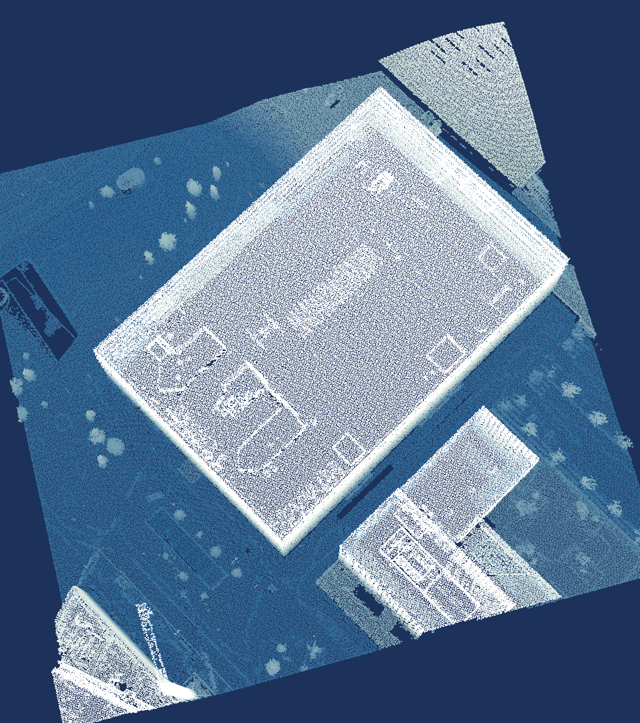
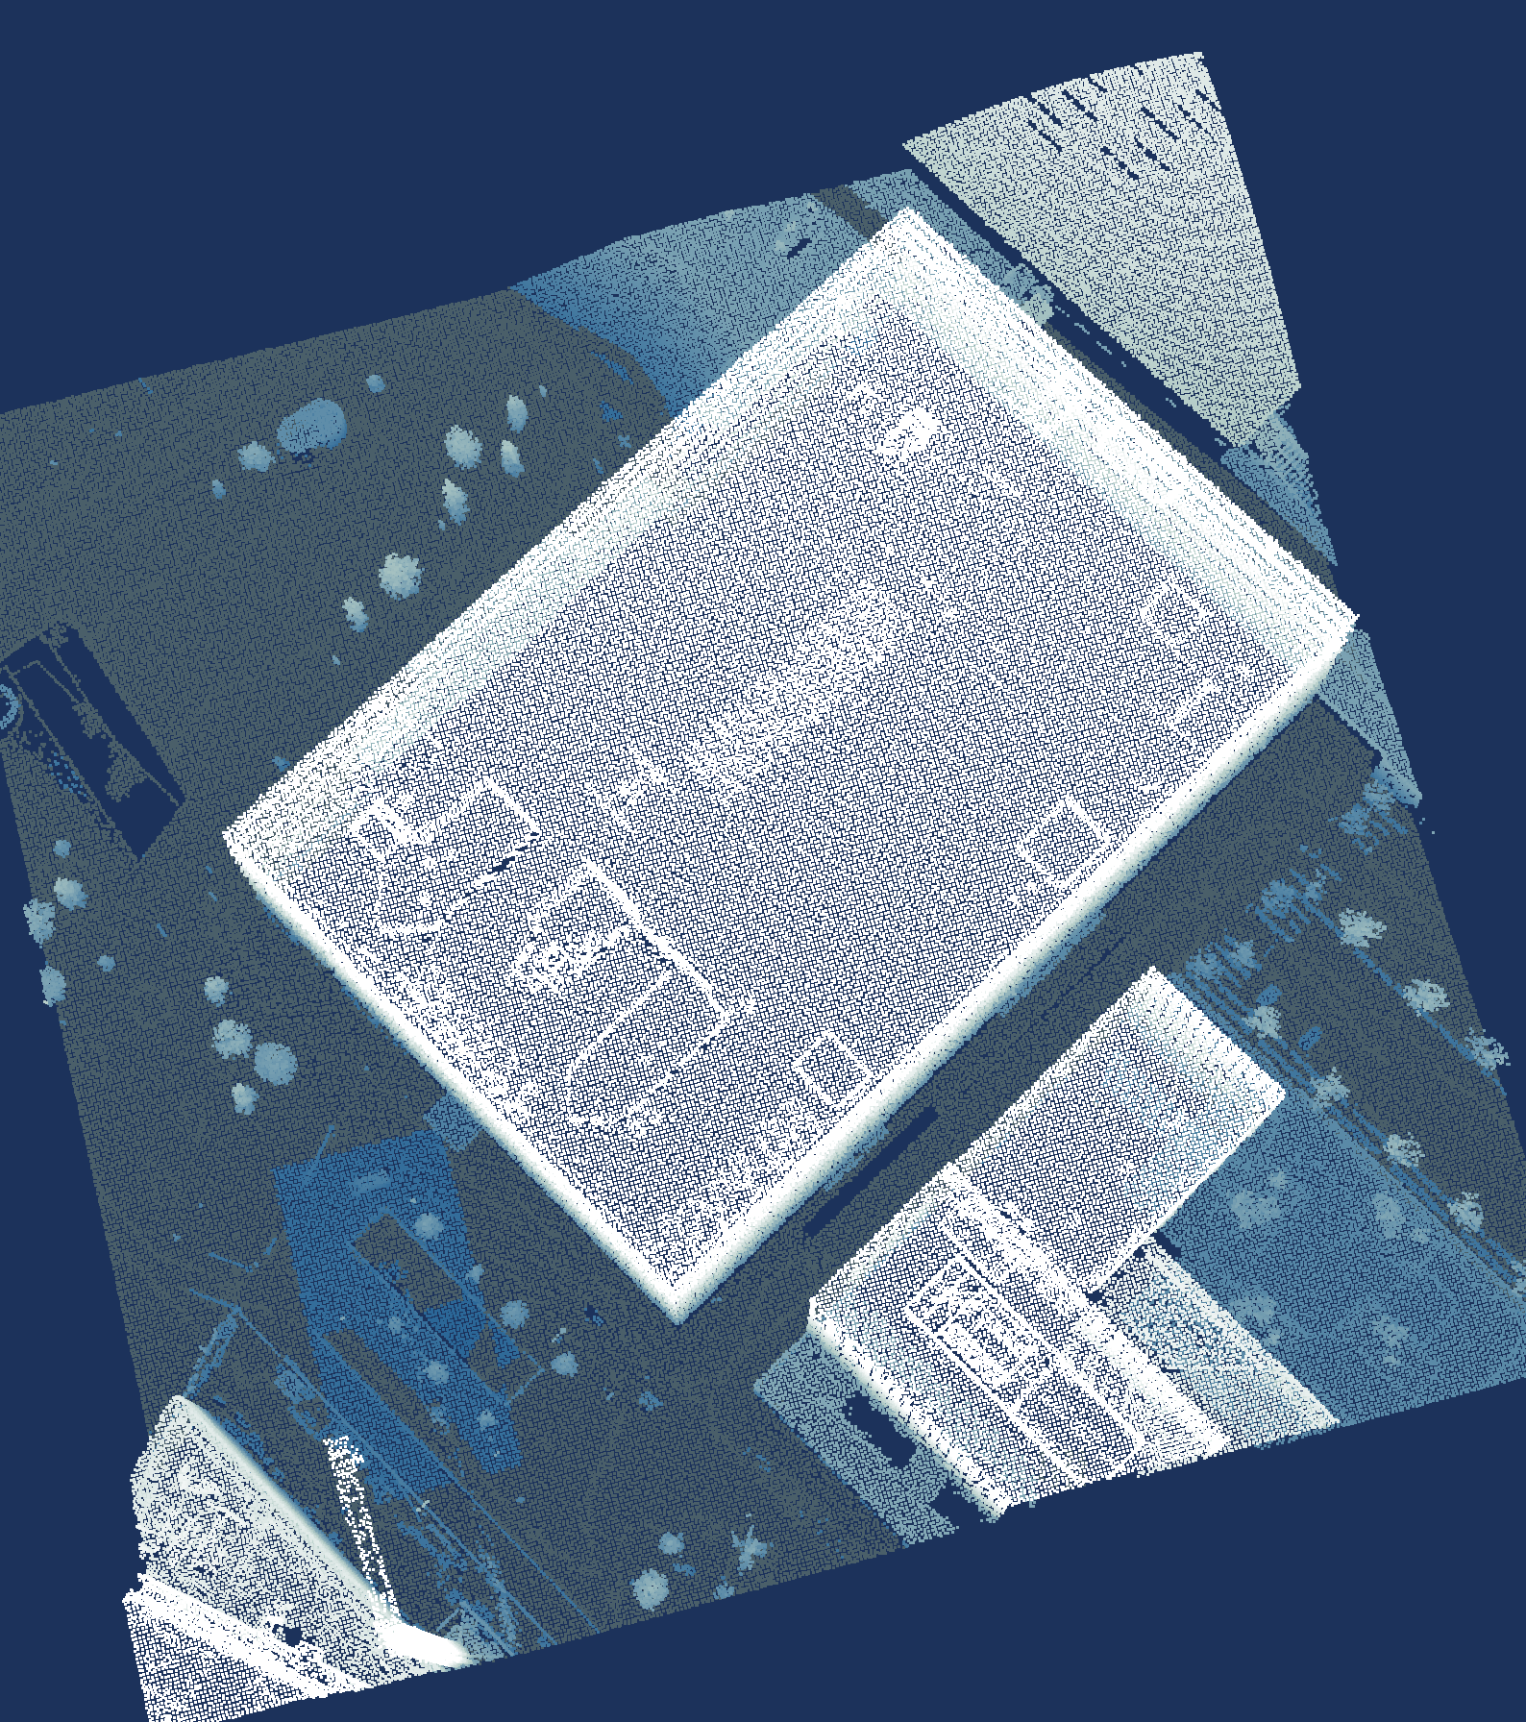
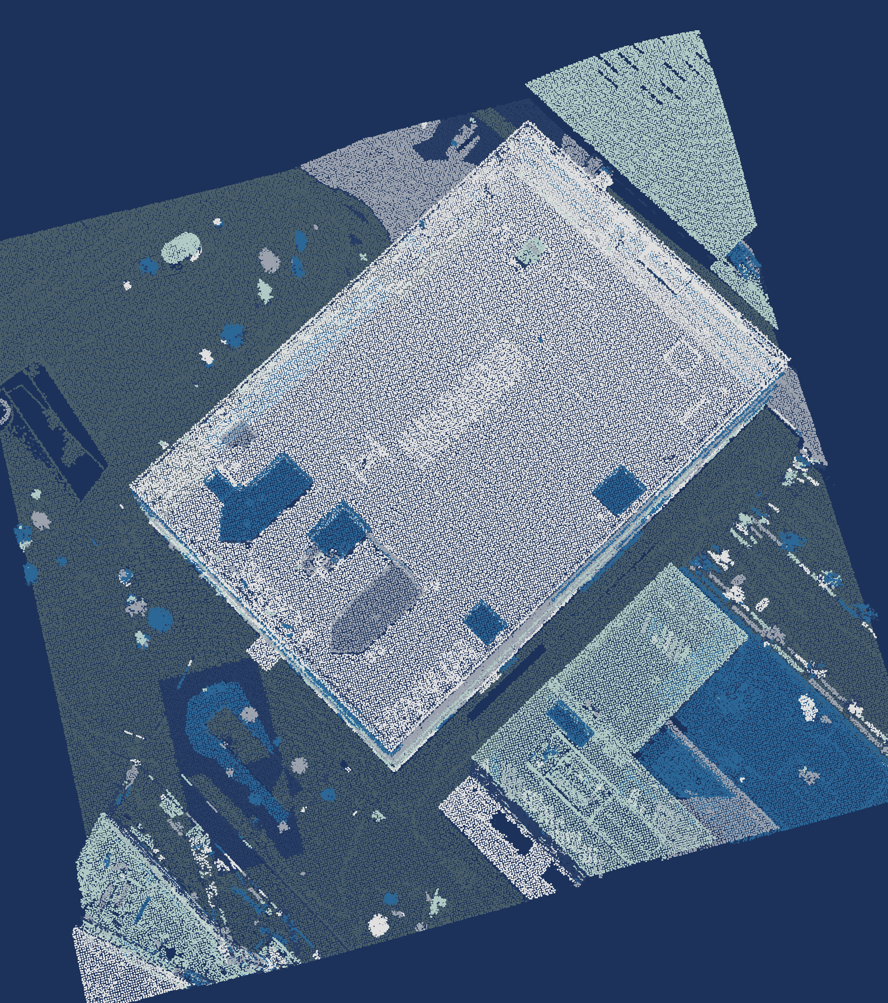
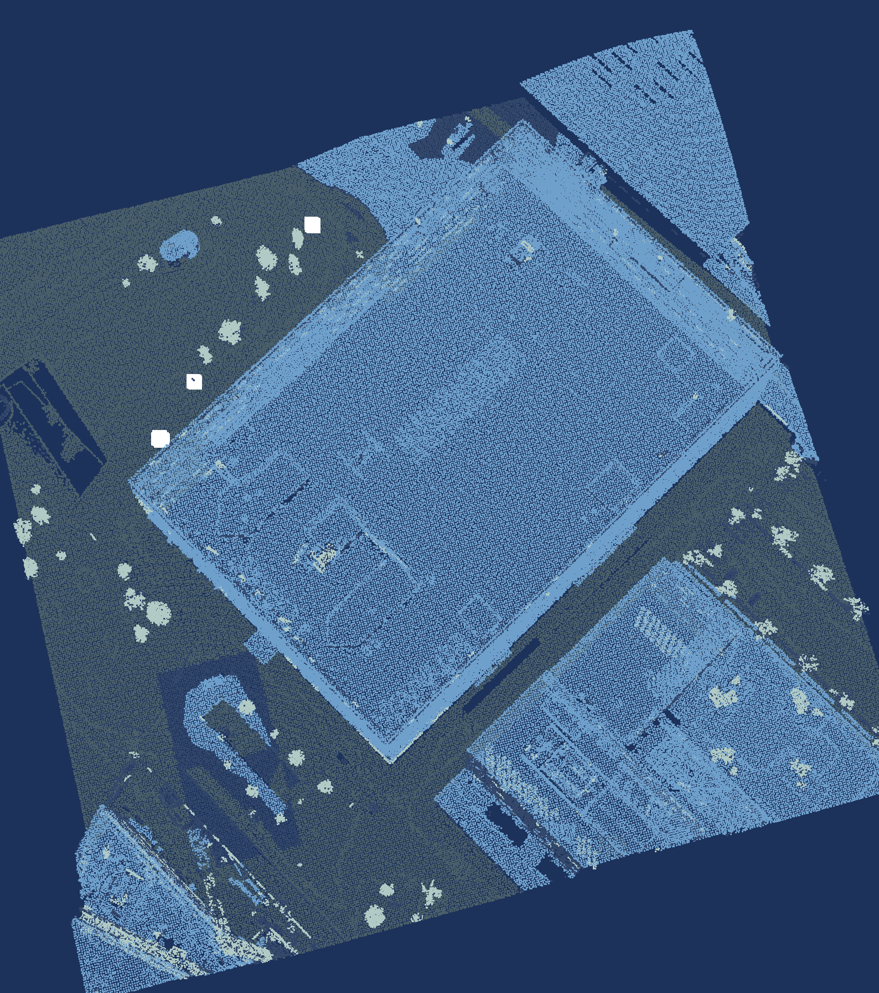
Six steps: from LAZ file to labels
Load
Voxel
downsampling
Ground
removal
Clustering
Labelling
Paint-back
laspy
Open3D
Open3D
Open3D, SciPy
NumPy, SciPy
SciPy, PyVista
Data: AHN5, Het Waterschapshuis, CC BY 4.0.
Intro · Data · Toolbox · Pipeline · Memory · Speed · Reality · Wrap-up
Notes:
TALK TRACK: Six steps turn this point cloud into labels: load, voxel downsampling, ground removal, clustering, labelling and paint-back. It's the same area and the same camera in every frame, so you can watch it change from slide to slide. Under each frame is the library that does the work, and NumPy carries the arrays between them. Step one.
TIME: 40 s, ends at 8:20
LIKELY QUESTION: Why remove the ground before clustering?
ANSWER: Because DBSCAN groups whatever touches, and the ground touches everything: left in, it would link the whole scene together through the road. That is reasoning; I didn't benchmark the other order.
TRACE:
• renders/f1_load.png, f2_voxel.png, f3_ground.png, f4_clusters.png, f5_labels.png, f6_final.png
• renders/render_spec.json (one camera for all frames)
WHY SEVERAL TOOLS IN ONE STEP:
• No library has a fast, batched call for every part of a step, so each part goes to the library that has one; because they all take and give NumPy arrays (slide 15), mixing them costs at most one copy
• Clustering, Open3D and SciPy: DBSCAN is Open3D's cluster_dbscan, but first SciPy's KDTree answers 'how high is each voxel above the ground?' (height_above, one query on all cores), so only voxels clearly above the ground go into DBSCAN; left in, the ground would link the whole scene into one cluster
• Labelling, NumPy and SciPy: NumPy computes every cluster's features at once with np.bincount over the cluster ids (top height, footprint, share of multiple returns); SciPy's KDTree gives each cluster its distance to the nearest building and tree for rules 3 and 4 (facade, free-standing)
• Visualisation, SciPy and PyVista: SciPy's KDTree paints the labels from the 232 180 voxels back onto all 722 961 points in one query; PyVista then renders them off-screen
• Load and ground removal use one library each for the work (laspy, Open3D), with NumPy for the arithmetic around the calls

Slide 14
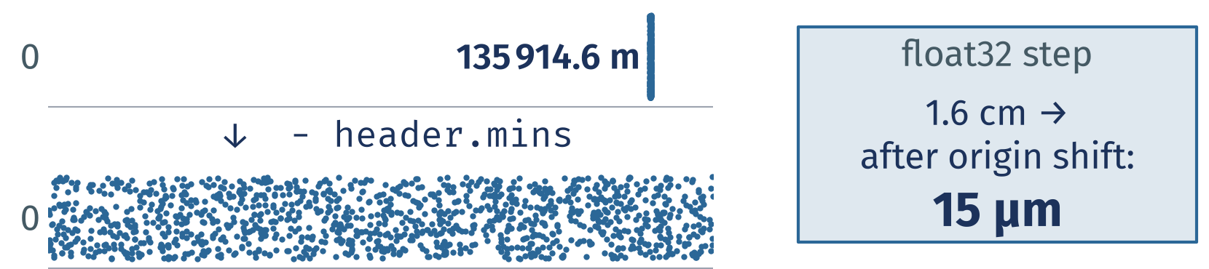
1 Load: subtract a local origin first
1 Load · Voxels · Ground · Clusters · Labels · Paint-back
1
Think in arrays, not points
import laspy
import open3d as o3d
las = laspy.read("crop.laz")
xyz = las.xyz - las.header.mins
v = o3d.utility.Vector3dVector(xyz)
pcd = o3d.geometry.PointCloud(v)
laspy hands you NumPy; a local origin keeps float32 precise.
Data: AHN5, Het Waterschapshuis, CC BY 4.0.
Intro · Data · Toolbox · Pipeline · Memory · Speed · Reality · Wrap-up
Notes:
TALK TRACK: Step one: laspy reads the LAZ file and gives you plain NumPy arrays. The first thing I do is subtract a local origin, the minimum corner from the file header. Dutch RD coordinates run to hundreds of thousands of metres, and at that size float32 can only step 1.6 cm in x and 3.1 cm in y; Open3D's PointCloud.from_legacy, for one, converts to float32 by default. After that it's one copy into Open3D as float64. And that short block hides more copies than you'd think.
TIME: 55 s, ends at 9:15
LIKELY QUESTION: Why not keep RD coordinates and stay in float64 everywhere?
ANSWER: You can, as long as nothing on the way casts to float32, and some tools do that quietly. Subtracting header.mins once makes it harmless, and fitted plane coefficients become readable numbers too.
TRACE:
• snippets/s08_load.py
• results/snippets.json: s08_load.py.ok
• renders/f1_load.png
• renders/render_spec.json (local origin = header.mins)
• data/utrecht_jaarbeurs_200m.laz
• float32 steps: np.spacing(np.float32(v)) at the crop's RD origin, deterministic; run it to check (results/research_facts.json float32_step_m, written by docs/research/research_facts.py)
• from_legacy defaults to float32 (dtype=Float32 in its signature; a tensor point cloud built from a float64 tensor stays float64): research: reports/libraries.md (03_open3d_tensor.py)
LINE BY LINE:
• import laspy / import open3d as o3d: the reader for LAS and LAZ, and the processing library
• las = laspy.read("crop.laz"): decompresses the whole file (lazrs backend) into a LasData object; every dimension becomes a NumPy array
• xyz = las.xyz - las.header.mins (key line): an N by 3 float64 array in metres, shifted so the minimum corner of the file is the origin; las.xyz is already a new array (slide 15), the subtraction makes one more
• v = o3d.utility.Vector3dVector(xyz): copies the array into Open3D's own C++ vector of 3D points (float64, fastest from a C-ordered array)
• pcd = o3d.geometry.PointCloud(v): the point cloud object every later Open3D call works on
SKETCH: The first point's x in RD is 135914.6 m; float32 can only step 1.6 cm at that size. After subtracting header.mins it is 199.6 m, where float32 steps 15 micrometres (np.spacing). That is why the origin comes off first: some tools cast to float32 without telling you.
MENTAL MODEL: Hidden C2 (every array needs a frame) and C3 (a transform is a matrix, order matters) go deeper on the local origin.

Slide 15
1 Load: pass views, not copies
1 Load · Voxels · Ground · Clusters · Labels · Paint-back
1
Think in arrays, not points
Why 24 B? x, y and z are three float64 values: 3 × 8 B.
Rule 1: each extra xyz copy costs 24 B per point → 0.5 GB per 1 km AHN file.
The problem: copies
copy
The solution: views
view
a
new memory → costs time & RAM
a
same memory → free, writes show through
b
b
las.xyz
copy
new array, every access
np.asarray(pcd.points)
view
writes reach the point cloud
Conditions: Ryzen 7 5700X, Python 3.13.15, NumPy 2.5.3; 722 961 points, median of 7 runs; AHN5 crop (CC BY 4.0). Full: results/python_facts.json.
Intro · Data · Toolbox · Pipeline · Memory · Speed · Reality · Wrap-up
Notes:
TALK TRACK: Rule one, think in arrays: Python passes whole arrays between the libraries, not points, and every hand-off is either a copy or a view. A copy is new memory, so it costs time and RAM; a view is the same memory, free, but a write through one name shows up in the other. las.xyz builds a brand-new array every time you touch it, so name it once. On the way back, np.asarray(pcd.points) is a writeable view. Off the slide: Open3D's Vector3dVector always copies, and given float32 it is 39× slower, so hand it float64; PyVista's PolyData shares memory with that view. Every extra xyz copy is 24 bytes per point, half a gigabyte for one 1 km AHN file. Step two.
TIME: 45 s, ends at 10:00
LIKELY QUESTION: Why does Vector3dVector copy at all?
ANSWER: Open3D keeps its points in its own C++ vector, which is what the name says, so it has to own that memory; np.asarray on the way back is a view into it, which is why writes reach the cloud. The fast way in is a C-ordered float64 array: 1.7 ms, against 8.2 ms for laspy's column-ordered one and 317 ms for float32.
IF SKIPPED: Skip-first number 5 (decide at the end of slide 14). If skipped, say on slide 16: "between the libraries Python passes whole arrays; las.xyz copies, np.asarray gives you a view".
TRACE:
• bench/python_facts.py (copy or view: write to one side, read the other, and np.shares_memory; timings 1 warm-up and 7 runs, median and IQR, idle check)
• results/python_facts.json: las_xyz.fresh_copy_each_access, las_xyz.f_contiguous, vector3dvector.copies, asarray_points.view, asarray_points.writeable, polydata.shares_memory_open3d_view, polydata.shares_memory_c_float64, timings.*, factor_v3d_float32_vs_float64_f, conditions
• snippets/s06b_handoffs.py (the four calls on the crop, with asserts); results/snippets.json: s06b_handoffs.py.ok
• pv.PolyData of laspy's F-ordered array does not share memory (results/python_facts.json polydata.shares_memory_f_float64); the slide's pts is Open3D's C-ordered view
• Candidate gotchas 'las.xyz' and 'Vector3dVector(float32)' are measured here (their slide is removed)
CONDITIONS IN FULL (the slide shows the short line): Conditions: Ryzen 7 5700X, 8 cores / 16 threads, 31.3 GiB RAM; Linux (Omarchy, kernel 7.2.5-3-omarchy); Python 3.13.15, NumPy 2.5.3, SciPy 1.18.1, Open3D 0.20.0, laspy 2.7.0, PyVista 0.49.0; N = 722 961 points, 7 runs after 1 warm-up, median and IQR of wall time over the timed runs; governor performance; boost on; measured 2026-10-11 20:06 UTC; data: the AHN5 crop of slide 5 (ahn.nl, Het Waterschapshuis, CC BY 4.0). Copy or view: checked by writing to one side and reading the other, and with np.shares_memory. float32: Vector3dVector of a float32 copy, 317 ms, against the float64 xyz of slide 12, 8.2 ms.
WHY IT MATTERS:
• Memory: one float64 xyz copy is 24 B per point (results/memory.json); 21 013 926 points × 24 B = 0.47 GB per copy of a 1 km AHN file, and the load-everything pipeline holds several (slide 27)
• Time: copying the crop into Open3D takes 1.7 ms from a C-ordered float64 array, 8.2 ms from laspy's column-ordered one and 317 ms from float32; np.asarray(pcd.points) takes 15 µs, because it copies nothing
• Correctness: a write through a view changes the point cloud behind it (np.asarray(pcd.points) -= origin moves Open3D's points); a write to a copy is silently lost (las.xyz[:] = 0 changes nothing in the file data)
• Rule of thumb: name an array once, pass it on, and copy only on purpose (astype, np.ascontiguousarray)

Slide 16
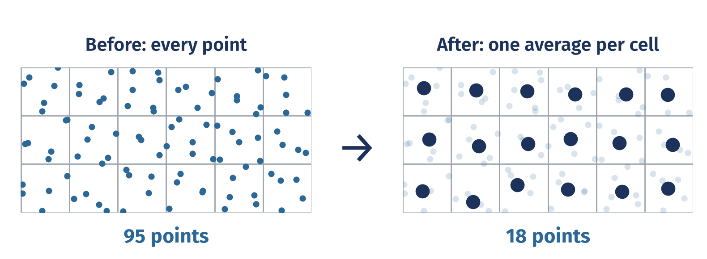
2 Voxel downsampling: one average per voxel
Load · 2 Voxels · Ground · Clusters · Labels · Paint-back
2
Make it small first
down = pcd.voxel_down_sample(0.5)
P = np.asarray(down.points)
print(len(xyz), "->", len(P))
Rule 2: 722 961 points in → 232 180 out at 0.5 m voxels.
Data: AHN5, Het Waterschapshuis, CC BY 4.0.
Intro · Data · Toolbox · Pipeline · Memory · Speed · Reality · Wrap-up
Notes:
TALK TRACK: Step two: lay a grid of 0.5 m voxels over the crop and replace all the points inside each voxel with their average. That leaves 32.1 % as many points, and every step after this gets cheaper. One catch: the average is a new point, not one of yours, and LAS attributes such as returns and class are dropped unless you carry them along. I store the multiple-return flag as a colour, so each voxel keeps its share of multiple returns for step five. That's rule two, make it small first. Next, the ground.
TIME: 50 s, ends at 10:50
LIKELY QUESTION: Why average? Why not keep one real point per voxel?
ANSWER: You can, and in the chunked read (backup B2) I do exactly that, because it streams. Open3D's voxel_down_sample returns the centroid: I checked that it equals the per-voxel mean, on a grid anchored half a voxel below the minimum corner.
TRACE:
• Sketch caption: 0.5 m voxels
• snippets/s09_voxel.py
• results/snippets.json: s09_voxel.py.ok
• results/pipeline.json: points_in, points_after_voxel, kept_share, params.voxel
• renders/f2_voxel.png
• Centroid and grid anchor: research: reports/critic.md section 2, reports/review/honesty.md row 9, notes/verify_facts.json
• Attributes dropped: research: reports/review/honesty.md rows 9 and 12
• results/pipeline.json: params.rules.features.multi
• Flag kept as colour: pipeline/steps.py to_open3d and multi_share; research: reports/review/honesty.md row 12 (review/honesty/run_extra.out)
LINE BY LINE:
• down = pcd.voxel_down_sample(0.5) (key line): lays a grid of 0.5 m cubes over the cloud (anchored at the minimum corner minus half a voxel) and replaces the points in each occupied cube by their average; colours, our multiple-return flag, are averaged too
• P = np.asarray(down.points): a view of the 232 180 voxel points as an N by 3 NumPy array, no copy
• print(len(xyz), "->", len(P)): 722 961 points in, 232 180 out, 32.1 % kept
SKETCH: A grid of cells, the small white dots are original points, the large sage dot in each occupied cell is their average: one new point per voxel, and empty cells give nothing. Dense areas shrink most, which is why every later step gets cheaper.

Slide 17
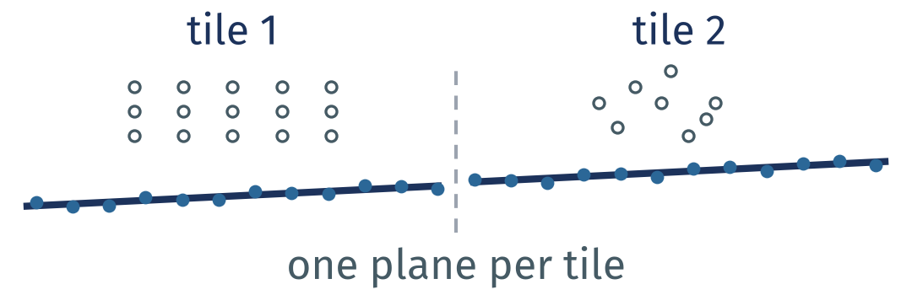
3 Ground removal: one plane per tile
Load · Voxels · 3 Ground · Clusters · Labels · Paint-back
2
Make it small first
o3d.utility.random.seed(0)
ground = np.zeros(len(P), bool)
for i in tiles(P, 25):
z0 = np.percentile(P[i, 2], 2)
low = i[P[i, 2] < z0 + 1.5]
t = down.select_by_index(low)
_, inl = t.segment_plane(
0.4, 3, 300,
probability=1.0)
ground[low[inl]] = z0 < 5
Scored against AHN's ground:
98 % precision, 94 % recall.
Fit one plane per tile;
roofs get none.
Data: AHN5, Het Waterschapshuis, CC BY 4.0.
Intro · Data · Toolbox · Pipeline · Memory · Speed · Reality · Wrap-up
Notes:
TALK TRACK: Step three. Every Dutch person in this room will tell you Utrecht is flat, and around the Jaarbeurs they are right: one plane for this whole crop scores 94.6 % recall against AHN's ground, the tiles 94.3 %, a tie. On the street where I built this, one plane scored 82.7 % and the tiles 94.5 %, so the code fits one RANSAC plane per 25 m tile, and the last line gives no ground to the 20 tiles under a roof, where RANSAC fits the roof. Note `probability=1.0`: without it, two seeded runs differ. Or, as import this puts it: flat is better than nested. With the ground gone, let's group what's left.
TIME: 70 s, ends at 12:00
LIKELY QUESTION: Why RANSAC per tile and not a dedicated ground filter such as CSF or SMRF?
ANSWER: I haven't benchmarked dedicated ground filters for this talk, so I won't claim they are better or worse. RANSAC per tile is one Open3D call you can read on a slide, and its inner test, distance to a plane, is exactly the benchmark in the next section.
CHECK BEFORE THE TALK:
• The slide 17 title no longer says 'Utrecht isn't flat': on the Jaarbeurs crop one plane ties with the tiles (results/pipeline.json single_plane); the joke now runs the other way
TRACE:
• Sketch caption: one plane per tile
• snippets/s10_ground.py
• results/snippets.json: s10_ground.py.ok
• results/pipeline.json: ground.precision, ground.recall, n_tiles, params.tile, params.ransac_threshold, params.ransac_n, params.ransac_iterations, params.ransac_probability, params.seed
• renders/f3_ground.png
• results/pipeline.json: checks.ransac_default_probability (seeded runs identical at 1.0, different at the default)
• results/pipeline.json: params_why.tile
• results/bench_cliff.json: plane.plane_fit (one plane on the whole crop)
• One plane against 25 m tiles, on this crop and on the first example street (data/previous/, Graadt van Roggenweg): results/pipeline.json single_plane, previous_street, params_why.tile; the roof tiles: tiles_flagged, snippets/s10_ground.py (z0 < 5 rule = the plausibility check on every accepted tile)
• Seeded runs differ without probability=1.0: research: review/honesty/snippets/s10_default_probability.py, reports/libraries.md FLAG 1
• Callout: 'Flat is better than nested.' is line 7 of `python -c "import this"` (checked by snippets/s10b_zen.py; results/snippets.json: s10b_zen.py.ok)
LINE BY LINE:
• o3d.utility.random.seed(0): RANSAC draws random points; a fixed seed makes the planes reproducible (together with probability=1.0, see below)
• ground = np.zeros(len(P), bool): one flag per voxel, nothing is ground yet
• for i in tiles(P, 25) (key line): splits the voxels into 25 m squares in plan view and loops over the 64 tiles, never over points; i holds the indices of one tile
• z0 = np.percentile(P[i, 2], 2): the tile's low height, the 2nd percentile, robust to a few points below the ground
• low = i[P[i, 2] < z0 + 1.5]: candidate ground, the voxels within 1.5 m of that low height (roofs and treetops are out before RANSAC starts)
• t = down.select_by_index(low): the candidates as their own Open3D point cloud
• _, inl = t.segment_plane(0.4, 3, 300, probability=1.0): RANSAC fits one plane: a voxel within 0.4 m of the plane is an inlier, each try uses 3 points, at most 300 tries; probability=1.0 turns off the early stop, without it two seeded runs differ
• ground[low[inl]] = z0 < 5: the inliers become ground, unless the tile's low point is more than 5 m up: then the tile is all roof and gets no ground (20 tiles)
SKETCH: A side view of two tiles: sage ground points along a gentle slope, a building and a tree above them in white. Each tile fits its own straight plane through its ground points, so the line can bend at the tile edge where the street does.

Slide 18

4 Clustering: DBSCAN groups points that touch
Load · Voxels · Ground · 4 Clusters · Labels · Paint-back
hag = height_above(P, ground)
up = ~ground & (hag > 0.3)
rest = down.select_by_index(
np.flatnonzero(up))
lab = rest.cluster_dbscan(
eps=0.75, min_points=6)
ids = np.asarray(lab)
print(ids.max() + 1, "clusters")
1 024 clusters. Clusters are not labels yet.
Neighbours within eps
make a cluster.
Data: AHN5, Het Waterschapshuis, CC BY 4.0.
Intro · Data · Toolbox · Pipeline · Memory · Speed · Reality · Wrap-up
Notes:
TALK TRACK: Step four: DBSCAN chains together points that sit within 0.75 m of each other, so 'touches' really means 'closer than eps'. On the voxels that aren't ground and sit more than 0.3 m above it, I get 1 024 clusters, and 10 % of those voxels are noise that belong to no cluster. A cluster is just a blob, not yet a building or a tree. And it's one library call over all voxels: rule three. Naming the blobs is the next step.
TIME: 50 s, ends at 12:50
LIKELY QUESTION: How do you choose eps and min_points?
ANSWER: By looking, plus one rule from testing: eps has to be clearly larger than the voxel size. Too small and most points become noise, too large and buildings fuse with their trees; prototype runs showed both. Here it is eps 0.75 m with min_points 6 on 0.5 m voxels.
TRACE:
• Sketch caption: eps = 0.75 m
• snippets/s11_cluster.py
• results/snippets.json: s11_cluster.py.ok
• results/pipeline.json: n_clusters, noise_share, params.eps, params.min_points, params.voxel
• renders/f4_clusters.png
• results/pipeline.json: params.cluster_min_height_m, noise_share_note, params_why.eps, params_why.min_points, param_choice
• eps against voxel size: research: reports/review/honesty.md row 11, reports/review/feasibility.md section 2 (prototype runs)
LINE BY LINE:
• hag = height_above(P, ground): for every voxel, its height above the nearest ground voxel in plan view (one SciPy KDTree query on all cores)
• up = ~ground & (hag > 0.3): the voxels that are not ground and stand more than 0.3 m above it, so kerbs and noise near the road stay out
• rest = down.select_by_index(np.flatnonzero(up)): those voxels as their own point cloud
• lab = rest.cluster_dbscan(eps=0.75, min_points=6) (key line): DBSCAN: a voxel with at least 6 neighbours within 0.75 m is a core point, clusters grow from core to core, and whatever no cluster reaches gets -1, noise
• ids = np.asarray(lab): one cluster id per voxel, as NumPy
• print(ids.max() + 1, "clusters"): ids start at 0, so the largest plus one is the count, 1 024
SKETCH: Two groups of points, each a cluster because every point has neighbours within eps, the dashed circle; the lone grey point has none and is noise. DBSCAN needs no number of clusters, only how close is close.
MENTAL MODEL: Hidden C4 (neighbourhood size changes the answer): eps, the voxel size and normal radii are the same kind of choice.

Slide 19
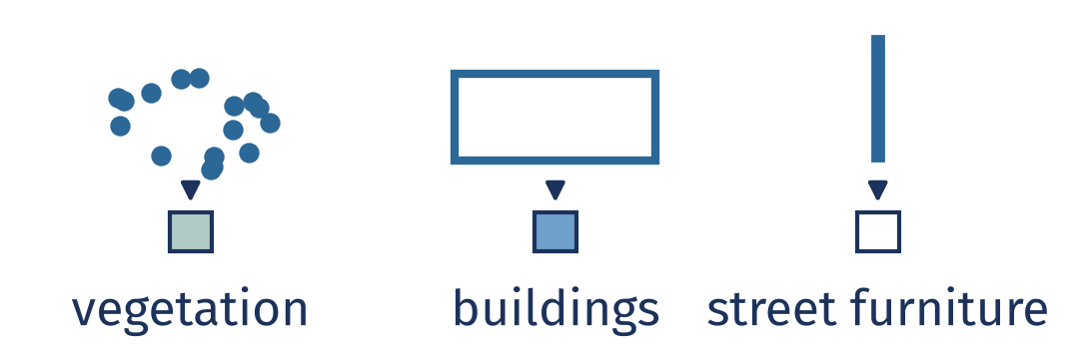
5 Labelling: the first rule that fires wins
Load · Voxels · Ground · Clusters · 5 Labels · Paint-back
2
Make it small first
def name(c):
if c.multi > 0.4 and c.top > 1:
return VEGETATION
if c.foot > 25 and c.top > 2.5:
return BUILDINGS
if c.to_building < 2: # facade
return BUILDINGS
if c.slender and c.free:
return STREET_FURNITURE
return UNLABELLED
Height, footprint and echoes decide the class.
1 024 clusters, not 232 180 points:
a Python loop is fine.
Data: AHN5, Het Waterschapshuis, CC BY 4.0.
Intro · Data · Toolbox · Pipeline · Memory · Speed · Reality · Wrap-up
Notes:
TALK TRACK: Step five names the blobs with a few rules per cluster: how tall it is, how big its footprint is, and what share of its points had more than one return. That last one is the clue for trees: AHN's spec asks for a leaf-off flight, and this one was flown in early April, so pulses slip between bare branches and a tree echoes several times, while roads and roofs mostly echo once. Street furniture is the honest weak spot: from the air a lamp post is a few dozen points at most, and DBSCAN drops objects of fewer than 6 voxels as noise, so my rules find 3 objects, 53 points in all. Cars fail the street furniture rule because they are not twice as tall as they are wide, so they stay unlabelled. And because these are 1 024 clusters, not 232 180 points, a plain Python loop over them is fine: rule two again. Then one last step paints these labels back onto every original point.
TIME: 65 s, ends at 13:55
LIKELY QUESTION: Why hand-written rules and not machine learning?
ANSWER: Rules fit on a slide and you can debug them. Machine learning needs training labels, and for vegetation and street furniture AHN has none: they are all inside class 1. Buildings, which AHN does label, score 83 % precision and 99 % recall against class 6. I did try Florent Poux's PCA plus Random Forest idea on these clusters (backup B5): against AHN's building class it scores 81 % balanced accuracy, my rules 66 %. But AHN files facades under class 1 and my rules call them building, so part of that gap is the forest copying AHN's convention.
TRACE:
• Sketch caption: shape → class
• Small print: Street furniture: 3 objects, 53 points, drawn enlarged. Poles nearly vanish.
• snippets/s12_label.py
• ML alternative: bench/eigen_features.py; results/eigen_features.json rules, forest_eigen_plus_rule_inputs (balanced accuracy weighted by points, spatial cross-validation); idea: research: reports/videos.md V3
• results/snippets.json: s12_label.py.ok
• results/pipeline.json: params.rules, n_objects, label_points, buildings.precision, buildings.recall
• renders/f5_labels.png
• renders/labels.json: f6_final (the same chip anchors as slides 20 and 21; checked on f5_labels.png)
• Leaf-off flight: AHN5 acquisition spec not checked; the AHN4 spec requires a leaf-off flight ('bladloze seizoen'); this crop was flown in the night of 2023-04-05 to 2023-04-06, about 01:51 CEST, one strip (point source id 1110; GPS time of the crop's points, checked 2026-10-11; the first example street was about 01:35, research: reports/dataset.md)
• Multiple-return share per AHN class on the crop: research: review/honesty/inspect_crop.out
• Lamp posts as a few dozen points: research: reports/dataset.md (pole_analysis.json, measured on the first example street, not on this crop)
• Cars fail rule 4: research: reports/build/pipeline.md; results/pipeline.json params.rules.slender (a car fails 'twice as tall as wide')
• Objects below min_points dropped as noise: results/pipeline.json street_furniture_note, params.min_points
• Street furniture drawn enlarged: renders/render_spec.json point_size_px
• What the 3 objects (53 points) are on the ground is UNVERIFIED (results/pipeline.json street_furniture_note: no imagery checked); do not call it a lamp post
LINE BY LINE:
• def name(c): the rules, applied to one cluster c with its features (computed for all clusters at once with np.bincount); the first rule that fires wins
• if c.multi > 0.4 and c.top > 1 (key line): more than 40 % of its points had several returns and its top is over 1 m: VEGETATION (leaf-off, the pulses pass between bare branches)
• if c.foot > 25 and c.top > 2.5: footprint over 25 m2 and taller than 2.5 m: BUILDINGS (roofs)
• if c.to_building < 2: within 2 m of a building in plan view: BUILDINGS too (facade fragments that DBSCAN split off their roof)
• if c.slender and c.free: at most 1.5 m wide, 1.5 to 15 m tall and at least twice as tall as wide, more than 2 m from buildings and 1 m from trees: STREET_FURNITURE
• return UNLABELLED: everything else, cars included (not twice as tall as wide)
SKETCH: Three cluster shapes and the class each one gets: a crown with many echoes becomes vegetation, a wide flat block a building, a thin pole street furniture. The rules only look at shape and echoes, never at AHN's labels.

Slide 20

6 Paint-back: every point takes its voxel's label
Load · Voxels · Ground · Clusters · Labels · 6 Paint-back
P = np.asarray(down.points)
_, j = KDTree(P).query(
xyz, workers=-1)
pl = pv.Plotter(off_screen=True)
pl.add_points(xyz, point_size=3,
scalars=RGB[cls[j]], rgb=True)
pl.camera_position = CAM
pl.screenshot("f6_final.png")
One KDTree query, then PyVista renders it.
One query labels all
722 961 points.
Data: AHN5, Het Waterschapshuis, CC BY 4.0.
Intro · Data · Toolbox · Pipeline · Memory · Speed · Reality · Wrap-up
Notes:
TALK TRACK: Step six: the labels live on the 232 180 voxel points, so one KDTree query gives each of the 722 961 original points the label of its nearest voxel point. PyVista then renders off-screen with one fixed camera, one PNG per step, which is why every frame in this talk lines up. One query for all points: rule three. Let's put all six steps together.
TIME: 35 s, ends at 14:30
LIKELY QUESTION: Why not Open3D's own viewer?
ANSWER: Open3D's draw_geometries opens a window and blocks until you close it. I needed identical frames from a script, without a window, and PyVista does that off-screen; in testing it also rendered headless, through EGL.
IF SKIPPED: Skip-first number 4. If skipped, say on slide 21: "every render here is PyVista, off-screen, one fixed camera".
TRACE:
• Sketch caption: nearest voxel's label
• Small print: Street furniture: 3 objects, 53 points, drawn enlarged. Poles nearly vanish.
• snippets/s13_render.py
• results/snippets.json: s13_render.py.ok
• results/labels_crop.npz
• results/pipeline.json: points_in, points_after_voxel
• renders/f6_final.png
• pipeline/render.py (makes the frame shown; draws the street furniture objects enlarged, renders/render_spec.json point_size_px)
• renders/render_spec.json
• renders/labels.json: f6_final
• Headless PyVista: research: reports/libraries.md (04_pyvista_render.py); draw_geometries blocks: research: reports/book.md
LINE BY LINE:
• P = np.asarray(down.points): the voxel points, a view
• _, j = KDTree(P).query(xyz, workers=-1): for each of the 722 961 original points, the index of its nearest voxel point; one query on all cores
• pl = pv.Plotter(off_screen=True) (key line): a renderer without a window, so a script can make the images, also headless
• pl.add_points(xyz, point_size=3, scalars=RGB[cls[j]], rgb=True): every original point coloured by the class of its nearest voxel; cls[j] is NumPy fancy indexing, one call
• pl.camera_position = CAM: the one fixed camera (renders/render_spec.json), never reset_camera, so every frame lines up
• pl.screenshot("f6_final.png"): writes the PNG you see on the right
SKETCH: Three large voxel points with their class colours and many small original points; each small point takes the colour of its nearest voxel point, the grey lines. That is the paint-back: the labels were computed on 232 180 voxels and land on all 722 961 points.

Slide 21
Six steps label every point in 0.6 s
Street furniture
Step
Library
Result
Time
Load
laspy
722 961 points
57 ms
Voxels
Open3D
232 180 voxels
84 ms
Ground
Open3D
98 % precision
81 ms
Buildings
Clusters
Open3D
1 024 clusters
137 ms
Labels
NumPy
4 classes
151 ms
Paint-back
SciPy
all points
99 ms
Vegetation
No loop over points: the label rules loop over 1 024 clusters.
Ground
Data: AHN5, Het Waterschapshuis, CC BY 4.0.
Intro · Data · Toolbox · Pipeline · Memory · Speed · Reality · Wrap-up
Notes:
TALK TRACK: So what did the six steps do? laspy loaded 722 961 points, Open3D cut them to 232 180 voxels, fitted the ground at 98 % precision against AHN and found 1 024 clusters, NumPy's rules turned the clusters into four classes, and SciPy painted those back onto every point. From file to labels that's 0.6 seconds on this crop, one run, so take it as indicative. No loop over points: the only Python loop runs over 1 024 clusters. That's 200 metres. Before we scale up, question one: does a whole AHN sheet even fit?
TIME: 50 s, ends at 15:20
LIKELY QUESTION: Can I run this on my own AHN file?
ANSWER: Yes, that's what the repo is for. For a whole 1 km AHN file or larger, start with the chunked read (backup B2), and expect to retune voxel size, tile size and eps for a different point density. Not in the Netherlands? Backup B6 lists other open sources.
CHECKPOINT: Skip-first order from here: 28, 27, 22 (20 and 15 are already behind you). Target: leave this slide by 15:20. Leaving after 16:30: skip 22. Further on: reach slide 27 by 21:30, otherwise skip 27 and 28. To skip: one sentence, then click.
CHECK BEFORE THE TALK:
• Repo URL is still a placeholder (content.yaml)
• Other open sources (B6): research: reports/videos.md V1
TRACE:
• Small print: One run, indicative; renders not included. Street furniture drawn enlarged.
• snippets/s14_pipeline.py
• pipeline/run.py
• results/snippets.json: s14_pipeline.py.ok
• results/pipeline.json: runtime_s (single run, indicative), versions
• results/pipeline.json: runtime_note
• No per-point Python loop: the loops in pipeline/steps.py run over tiles (remove_ground) and clusters (label)
• renders/f6_final.png
• renders/labels.json: f6_final
• Table: results/pipeline.json points_in, points_after_voxel, ground.precision, n_clusters, timings_s; '4 classes' = ground, buildings, vegetation, street furniture
THE SEVEN CALLS:
• The whole pipeline is seven calls in the repo (snippets/s14_pipeline.py, pipeline/run.py):
• las, xyz, _ = load("crop.laz") / multi = las.number_of_returns > 1 / pcd = to_open3d(xyz, multi) / down = downsample(pcd, 0.5) / ground, _ = remove_ground(down, 25) / ids = cluster(down, ground, 0.75, 6) / cls, _ = label(down, ground, ids) / full = paint_back(xyz, down, cls)
• Times per step (results/pipeline.json timings_s, one run): load 57 ms, copy into Open3D 16 ms, voxels 84 ms, ground 81 ms, clusters 137 ms, labels 151 ms, paint-back 99 ms; total 624 ms, renders not included

Slide 22
A full AHN sheet would need 74.2 GB
2
Make it small first
32 GB RAM
86 B per point in our pipeline
926 203 338 points × 86 B each.
It works on my machine (31.3 GiB RAM).
86 B per point measured on the 1 km AHN tile (21 013 926 points); the 926 203 338 points are the AHN5 sheet 2023_C_31HZ2 that holds the crop, computed, not run. Conditions: Ryzen 7 5700X, Python 3.13.15, NumPy 2.5.3; 21 013 926 points, median of 3 runs, each in a fresh process; AHN5 1 km file (CC BY 4.0). 1 GB = 2³⁰ B. Full: results/memory.json.
Intro · Data · Toolbox · Pipeline · Memory · Speed · Reality · Wrap-up
Notes:
TALK TRACK: Question one: does it fit? A 1 km AHN tile has 21 013 926 points, but the full-size files are 5 by 6.25 km, and the one with this area, 2023_C_31HZ2, has 926 203 338. At the 86 bytes per point I measured for our pipeline, that's about 74.2 GB, against 25.9 GB for the LAS records alone; both computed, not run. It works on my machine, just not for this file. So how do we get through it anyway?
TIME: 55 s, ends at 16:15
LIKELY QUESTION: The LAS record is 30 bytes. Why do you need so many more?
ANSWER: Because a working pipeline holds more than the record. Measured on the 1 km file: laspy.read peaks at 38 and keeps 30 bytes per point, the float64 xyz array adds 24, Open3D's own copy adds 24, and the downsampled cloud makes up the rest. Scaling to billions of points is on backup slide B2.
IF SKIPPED: Skip-first number 3. If skipped, say on slide 23: "a full-size AHN file has 926 203 338 points; at 86 B each that is 74.2 GB".
TRACE:
• Small print: Bytes per point measured on the 1 km AHN file 135000_455000 (21 013 926 points); totals for 2023_C_31HZ2.LAZ computed, not run. Our pipeline: load and voxel downsampling (slides 14 and 16), all arrays kept, after gc.collect() and malloc_trim(0); peak 154 B per point.
• bench/bench_memory.py
• results/memory.json: tile_1km.points, tile_1km.bytes_per_point (all five keys), big_file.points, big_file.computed_gb, ram_reference_gb
• results/memory.json: big_file.formulas (las_records uses the record size, our_pipeline the measured bytes per point)
• Our pipeline = bench/bench_memory.py case 'pipeline': laspy.read, xyz, Open3D copy, voxel_down_sample, everything kept (slides 14 and 16); the rest of the 86 B per point: the kept centroids, results/memory.json tile_1km.naive_kept_open3d_centroids
• big_file.points: LAS header via a 64 KB range request; the header bounds contain the crop (research: dataset/top_tile_headers.txt; size in km: results/research_facts.json ahn5_c_31hz2)
• Record size for point format 6: results/memory.json tile_1km.record_bytes; LAS 1.4 R16 and laspy.PointFormat(6).size (research: reports/memory.md, notes/verify_facts.json)
• Machine line: results/memory.json conditions.ram_gib (the machine all measurements ran on)
CONDITIONS IN FULL (the slide shows the short line): Conditions: Ryzen 7 5700X, 8 cores / 16 threads, 31.3 GiB RAM; Linux (Omarchy, kernel 7.2.5-3-omarchy); Python 3.13.15, NumPy 2.5.3, SciPy 1.18.1, Open3D 0.20.0, laspy 2.7.0; N = 21 013 926 points, median of 3 runs, each in a fresh subprocess; governor performance; boost on; measured 2026-10-11 20:10 UTC; data: AHN file 135000_455000 (AHN5, ahn.nl, Het Waterschapshuis, CC BY 4.0). Memory: increase over the process after imports; 1 GB = 2³⁰ bytes.
WHAT IS ON THE SLIDE:
• Title: the AHN5 file that holds this area, 2023_C_31HZ2, is 5 by 6.25 km with 926 203 338 points; loading it whole needs more than the 32 GB of a big laptop
• Bars: three computed bars for that file: the LAS records alone (30 B per point for point format 6), plus a float64 xyz copy (24 B per point more), and our load and voxel steps with every array kept (86 B per point); the dashed line labelled 32 GB RAM is the limit, the red part of a bar is past it
• Computed, not run: bytes per point measured on the 1 km file (21 013 926 points), multiplied by the big file's point count
• Hero: 86 B per point; where they go: laspy.read keeps 30, xyz adds 24, Open3D's copy 24, the voxel centroids the rest; the peak while running is 154 B per point
• Machine line: the RAM of the machine everything ran on, 31.3 GiB
• Units: GB = 2^30 bytes; memory figures are the increase over the process after its imports
MENTAL MODEL: Hidden C6 (memory follows N and the algorithm): linear storage against quadratic pairwise distances.

Slide 23
Stream chunks, keep the first point per voxel
2
Make it small first
v, keys, pts = 0.5, [], [] # voxel size: 0.5 m
with laspy.open(path) as f:
lo, hi = f.header.mins, f.header.maxs # local origin, extent
dims = ((hi - lo) // v).astype(np.int64) + 1 # voxels per axis
for c in f.chunk_iterator(1_000_000): # a million points
xyz = np.c_[c.x, c.y, c.z] - lo
ijk = (xyz // v).astype(np.int64).T # voxel index per axis
key = np.ravel_multi_index(ijk, dims) # one int64 per voxel
k, first = np.unique(key, return_index=True)
keys.append(k); pts.append(xyz[first]) # first per voxel
k, first = np.unique(np.concatenate(keys), return_index=True)
points = np.concatenate(pts)[first] # earliest chunk wins
3.0 GB → 0.8 GB
peak memory, 1 km AHN tile
Rule 2: make it small first, then scale up.
Measured on the 1 km AHN tile (21 013 926 points); the full sheet of slide 22 was not run. Conditions: Ryzen 7 5700X, Python 3.13.15, NumPy 2.5.3; 21 013 926 points, median of 3 runs, each in a fresh process; AHN5 1 km file (CC BY 4.0). 1 GB = 2³⁰ B. Full: results/memory.json.
Intro · Data · Toolbox · Pipeline · Memory · Speed · Reality · Wrap-up
Notes:
TALK TRACK: The fix is to never hold the whole file: laspy reads it in chunks of 1 000 000 points, each chunk keeps one point per 0.5 m voxel, and one np.unique at the end merges the chunks. On the 1 km file the load-everything pipeline from slides 14 and 16 peaks at 3.0 GB on top of what the imports already use; this loop peaks at 0.8 GB, and its points are exactly those of a load-everything first-point-per-voxel reference. It keeps the first point per voxel, not the average from slide 16, because a first point is a real point and it streams. I measured this on the 1 km tile; the full sheet I only computed. That's rule two: make it small first. It fits once it's small. Question two: why was the pipeline fast, and when isn't it? With a bet.
TIME: 60 s, ends at 17:15
LIKELY QUESTION: Does that always keep memory small?
ANSWER: No, there are two limits. It only helps if the voxel removes most points: on aerial data like AHN, very fine voxels keep almost everything, so output and memory stay large. And it only works for per-point steps; ground removal or clustering need neighbours, so those run on tiles with an overlap. More on B2.
CHECK BEFORE THE TALK:
• Checked: memory.tile_1km.chunked_equals_reference = true (results/memory.json), so 'exactly those of' may be said
TRACE:
• snippets/s21_chunked.py
• results/snippets.json: s21_chunked.py.ok
• bench/bench_memory.py
• results/memory.json: tile_1km.chunk_size, tile_1km.voxel, tile_1km.naive_peak_mb, tile_1km.chunked_peak_mb, tile_1km.chunked_equals_reference
• Fine voxels keep almost everything on AHN: research: reports/critic.md C3 and C4 (pilot)
• results/memory.json: tile_1km.cases.pipeline (the naive peak), tile_1km.naive_kept_open3d_centroids, tile_1km.chunked_kept_first_points
• Peaks are increases over the process after imports (results/memory.json tile_1km.units, conditions.extra.rss_method; tile_1km.baseline_mb_after_imports)
CONDITIONS IN FULL (the slide shows the short line): Conditions: Ryzen 7 5700X, 8 cores / 16 threads, 31.3 GiB RAM; Linux (Omarchy, kernel 7.2.5-3-omarchy); Python 3.13.15, NumPy 2.5.3, SciPy 1.18.1, Open3D 0.20.0, laspy 2.7.0; N = 21 013 926 points, median of 3 runs, each in a fresh subprocess; governor performance; boost on; measured 2026-10-11 20:10 UTC; data: AHN file 135000_455000 (AHN5, ahn.nl, Het Waterschapshuis, CC BY 4.0). Memory: increase over the process after imports; 1 GB = 2³⁰ bytes.
LINE BY LINE:
• v, keys, pts = 0.5, [], []: the voxel size, and two lists that collect each chunk's voxel keys and points
• with laspy.open(path) as f: opens the file without reading the points
• lo, hi = f.header.mins, f.header.maxs: the local origin and the extent, from the header alone
• dims = ((hi - lo) // v).astype(np.int64) + 1: the number of voxels along x, y and z
• for c in f.chunk_iterator(1_000_000) (key line): decompresses one million points at a time; only one chunk is in memory
• xyz = np.c_[c.x, c.y, c.z] - lo: the chunk's coordinates, local (a chunk has no .xyz, gotcha)
• ijk = (xyz // v).astype(np.int64).T: each point's voxel index per axis
• key = np.ravel_multi_index(ijk, dims): one int64 per voxel, so voxels compare as single numbers (faster than np.unique on rows)
• k, first = np.unique(key, return_index=True): the chunk's voxels and the first point in each
• keys.append(k); pts.append(xyz[first]): keep only those, the rest of the chunk is freed
• k, first = np.unique(np.concatenate(keys), return_index=True): merge the chunks; a voxel split over two chunks keeps its first occurrence
• points = np.concatenate(pts)[first]: the result, one real point per voxel; the earliest chunk wins

Slide 24
Quiz: which is faster, and by how much?
3
Let compiled code loop
Distance of every point to the ground plane, 722 961 points.
A
a, b, c, d = plane
h = np.empty(len(P)) # distances
for i, p in enumerate(P):
x, y, z = p[0], p[1], p[2]
h[i] = abs(a*x + b*y + c*z + d)
B
a, b, c, d = plane
x, y, z = P.T # columns, no copy
h = np.abs(a*x + b*y + c*z + d)
The faster one wins by about:
2×
10×
100×
1000×
Both give identical results (np.array_equal). P: the crop's xyz from slide 14, column-ordered. plane: one seeded segment_plane on the whole crop.
Intro · Data · Toolbox · Pipeline · Memory · Speed · Reality · Wrap-up
Notes:
TALK TRACK: Quiz time. Both blocks compute the same thing: the distance of all 722 961 points to the ground plane, and they give exactly the same numbers. A loops over the rows in Python; B is one NumPy expression on whole columns. Hands up if you think A is faster. And B? Now the real question: by how much, roughly 2, 10, 100 or 1000 times? Keep your answer in mind.
TIME: 60 s, ends at 18:15
LIKELY QUESTION: Why not P @ (a, b, c) + d? That's the idiomatic way.
ANSWER: In real code, use it. In my final run it even matched the loop bit for bit, but I left it out of the comparison: in my pilot runs OpenBLAS ran it on several threads, while the element-wise form runs on 1 thread, so the factor would mix the boundary with parallelism.
TRACE:
• snippets/s16_loop.py
• snippets/s16_vec.py
• results/snippets.json: s16_loop.py.ok, s16_vec.py.ok
• bench/bench_cliff.py
• results/bench_cliff.json: plane.equal, plane.vectorised.threads
• results/bench_cliff.json: plane.matmul_reference (expr, equal, max_abs_diff)
• results/bench_cliff.json: plane.n, plane.array.how (P = las.xyz - las.header.mins, the full crop)
• OpenBLAS threads for @ at 1M points (pilot only): research: reports/perf.md
LINE BY LINE:
• A: a, b, c, d = plane (the plane's coefficients from segment_plane); h = np.empty(len(P)) (one result per point); for i, p in enumerate(P) (key line: one Python iteration per point, each p is a row view); x, y, z = p[0], p[1], p[2] (three NumPy scalar lookups); h[i] = abs(a*x + b*y + c*z + d) (scalar arithmetic and one store)
• B: x, y, z = P.T (three column views, no copy); h = np.abs(a*x + b*y + c*z + d) (key line: a handful of NumPy calls, each on all points)

Slide 25
How much slower is the loop over rows?
3
Let compiled code loop
130× slower
Loop: 12 calls × 722 961 rows = 8.7 million calls
One expression: 7 calls in total
Same data, same answer, far fewer calls into compiled code.
Conditions: Ryzen 7 5700X, Python 3.13.15, NumPy 2.5.3; 722 961 points, median of 7 runs; AHN5 crop (CC BY 4.0). Full: results/bench_cliff.json.
Intro · Data · Toolbox · Pipeline · Memory · Speed · Reality · Wrap-up
Notes:
TALK TRACK: The answer: on 722 961 points the loop takes 317 ms and the single expression 2.4 ms: (click) that's 130×, so if you said 100, you win. The grey bar is drawn to scale: that sliver is the whole NumPy run. Same data, same machine, same result; what changed most is how many times we call into compiled code, and memory layout does the rest. Even a loop over plain Python floats, which avoids NumPy scalars, takes 78 ms, plus 107 ms to build those lists with P.tolist(). So where does the time go?
TIME: 70 s, ends at 19:25
LIKELY QUESTION: The abstract promised two orders of magnitude. Is that what you measured?
ANSWER: For this per-point arithmetic: 130×, with an IQR-bounded range of 128× to 131×. For KDTree queries the cliff is smaller, 6.2× on one thread, because each call does more real work; it grows to 58× once the single call uses all cores. More on slide 26 and B4. That is on the column-ordered array laspy gives you; on a row-ordered copy the expression slows to 3.6 ms and the factor drops to 88× (85× to 94×).
CHECK BEFORE THE TALK:
• Checked: bench.plane.factor.iqr_low = 128×, at least 100×, so 'two orders of magnitude' may be said, for this loop over NumPy rows only (it is not on the slide)
• The 130× hero holds for laspy's column-ordered array (slide 14 code), not for a C-ordered copy
TRACE:
• bench/bench_cliff.py
• results/bench_cliff.json: plane.n, plane.loop_numpy_rows, plane.vectorised, plane.loop_python_floats, plane.factor (median, iqr_low, iqr_high), knn.factor_loop_vs_1t, knn.factor_loop_vs_all, conditions (small print)
• results/bench_cliff.json: plane.sensitivity (vectorised_c_contiguous, factor_c_contiguous, tolist), plane.array (how, dtype, layout: the conditions line)
• Chart data embedded by deck/build_deck.py from these keys
CONDITIONS IN FULL (the slide shows the short line): Conditions: Ryzen 7 5700X, 8 cores / 16 threads, 31.3 GiB RAM; Linux (Omarchy, kernel 7.2.5-3-omarchy); Python 3.13.15, NumPy 2.5.3, SciPy 1.18.1, Open3D 0.20.0, laspy 2.7.0; N = 722 961 points, 7 runs after 1 warm-up, median and IQR of wall time over the timed runs; plane loop and expression on 1 thread each (CPU/wall 1.0); governor performance; boost on; measured 2026-10-11 20:08 UTC; data: the AHN5 crop of slide 5 (ahn.nl, Het Waterschapshuis, CC BY 4.0). Array: las.xyz − las.header.mins, float64, column-ordered as laspy returns it; on a row-ordered copy the factor is 88×.

Slide 26
Every trip into compiled code pays a toll
3
Let compiled code loop
for p in pts: f(p)
f(pts)
toll per crossing
work in compiled code
call and return
Python
compiled code
× N
N trips: 317 ms
1 trip: 2.4 ms
439 ns
per loop step
Rule 3: one call on the whole array, not N calls on single points.
Conditions: Ryzen 7 5700X, Python 3.13.15, NumPy 2.5.3; 722 961 points, median of 7 runs; AHN5 crop (CC BY 4.0). Full: results/bench_cliff.json.
Intro · Data · Toolbox · Pipeline · Memory · Speed · Reality · Wrap-up
Notes:
TALK TRACK: Here's where the time goes: Python above the line, compiled code below. Each loop step makes several small calls into NumPy, a row, three elements, a few scalar operations, and together they cost about 439 ns per point; the same loop on plain Python floats, one NumPy call per step, still costs 107 ns; the work itself costs 3.4 ns per point inside NumPy. It's like sending every point through the toll booth in its own car, when NumPy puts them all on one bus. C++ libraries are no exception: the KDTree query the loop uses costs 9.8 µs even when it finds nothing, against 2.1 µs per point inside one call, so the kNN loop is 6.2× slower than one call. So how do you find such a loop in your own code?
TIME: 70 s, ends at 20:35
LIKELY QUESTION: Why is the KDTree cliff so much smaller than the plane cliff?
ANSWER: Because the factor is roughly toll plus work, divided by work. A KDTree query does microseconds of real work, so a toll of a few microseconds only multiplies the time a few times; plane distance does nanoseconds of work, so the toll dominates. In the synthetic pilot, queries with more neighbours had a smaller cliff.
TRACE:
• bench/bench_cliff.py
• results/bench_cliff.json: plane.per_step_ns_loop, plane.per_step_ns_python_floats, plane.per_point_ns_vectorised, knn.k, knn.per_query_us_far_knn, knn.per_query_desc.per_query_us_far_knn (the call: query with k and distance_upper_bound), knn.per_point_us_one_call_1t, knn.factor_loop_vs_1t
• Toll model and neighbour-count sweep: research: reports/perf.md (synthetic pilot)
• Diagram drawn natively by deck/build_deck.py
CONDITIONS IN FULL (the slide shows the short line): Conditions: Ryzen 7 5700X, 8 cores / 16 threads, 31.3 GiB RAM; Linux (Omarchy, kernel 7.2.5-3-omarchy); Python 3.13.15, NumPy 2.5.3, SciPy 1.18.1, Open3D 0.20.0, laspy 2.7.0; N = 722 961 points, 7 runs after 1 warm-up, median and IQR of wall time over the timed runs; governor performance; boost on; measured 2026-10-11 20:08 UTC; data: the AHN5 crop of slide 5 (ahn.nl, Het Waterschapshuis, CC BY 4.0). KDTree query: SciPy KDTree.query with k = 16 and distance_upper_bound, one query point far outside the cloud (no neighbour found), median of 7 timeit repeats of 20 000 calls.

Slide 27
Profile before you vectorise
3
Let compiled code loop
$ scalene run --cpu-only loop.py
Python
native, i.e. NumPy
system
loop
for i, p in enumerate(P):
0 %
x, y, z = p[0], p[1], p[2]
0 %
h[i] = abs(a*x + b*y + c*z + d)
88 %
10.5 s
NumPy
h = np.abs(a*x + b*y + c*z + d)
0.7 %
79 ms
Different setup: under the profiler, each version runs 30 times; slide 25 holds the baseline timings. Conditions: Ryzen 7 5700X, Python 3.13.15, Scalene 2.3.0 (--cpu-only, a sample every 1 ms); 722 961 points, both versions 30 times per run, median of 3 runs; AHN5 crop (CC BY 4.0). Shares are of the whole run, imports and reading the file included; times are share × the 11.9 s run. Full: results/profile_scalene.json.
Intro · Data · Toolbox · Pipeline · Memory · Speed · Reality · Wrap-up
Notes:
TALK TRACK: You don't guess where the time goes; you ask a profiler. I used Scalene, a profiler for Python that shows time per line. One command, on the loop from the quiz. Each bar is one line of code, and its length is its share of the whole run: navy for time in the Python interpreter, blue for time in native code, here NumPy. The line that computes the distance takes 88 percent of the run, and almost all of it is NumPy, one value at a time. The same arithmetic as one expression takes 0.7 percent. So, could threads rescue the loop?
TIME: 50 s, ends at 21:25
LIKELY QUESTION: Why do the for line and the indexing line show 0 %?
ANSWER: Scalene samples the program with a timer and bills each sample to the line the interpreter is executing when it gets to handle it. A long call into C, such as NumPy arithmetic on scalars, is handled once it returns, so the time of the whole loop turn lands on the last line, the one with abs(). The three lines are one loop turn; read the 0 % lines as part of the 88 %. For a cross-check I also ran cProfile (bench/profile_loop.py), which gives the loop function 66 % of its run and abs() called 722 961 times, once per point.
CHECKPOINT: Arrive here by 21:30. Later than that: skip this slide and 28.
IF SKIPPED: Skip-first number 2. If skipped, say on the next slide shown: "a profiler finds such loops: Scalene puts one line at 88 percent".
TRACE:
• bench/profile_loop_scalene.py (runs `scalene run --cpu-only --cpu-sampling-rate 0.001 bench/cpuprof/loop.py --- 30` three times and stores the run with the median loop-line share)
• bench/cpuprof/loop.py (the slide lines of snippets/s16_loop.py and s16_vec.py as two functions, checked by the script itself; the plane from results/bench_cliff.json plane.coefficients; each function called 30 times so Scalene gets enough samples)
• results/profile_scalene.json (label FINAL): lines.for, lines.unpack, lines.loop_body, lines.vectorised (python, native, system, total, samples), loop_native_fraction, factor_loop_vs_vectorised, rest_percent, conditions
• Cross-check, not on the slide: cProfile, results/profile_loop.json and .txt (bench/profile_loop.py). The loop is 0.4 s of a 0.6 s run there; unprofiled, slide 25 gives the loop against the expression
HOW TO READ IT:
• Rows: the lines of the slide-18 loop (for, unpack, distance) and the one-expression version; bars: percent of the whole profiled run, 100 % being the full bar width
• Colours: navy = time in the Python interpreter, blue = time in native code that the line calls (NumPy here), grey = system (waiting, I/O)
• The distance line: 88 % of the run, of which 4.1 % Python, 82.3 % native, 1.7 % system. Native is NumPy arithmetic and abs on single np.float64 values: compiled code, but called 722 961 times, one point per call, which is the toll
• The rest of the run (11.3 %) is imports and reading the LAZ file
• The NumPy expression: 0.7 % of the run; Scalene says the loop line is 133 times the expression line, slide 25 measured 130×
• Sampling: every 1.0 ms, 30 repeats of both functions; loop line shares of the three runs 87.9, 88.0 and 88.4 %
• Run it: uv run --group profile scalene run --cpu-only -o out.json bench/cpuprof/loop.py, then scalene view out.json. Scalene skips any path with "scalene" in it; the directory is cpuprof for that reason

Slide 28
Will free-threaded Python save my loop?
3
Let compiled code loop
5.5× faster on 8 free threads
Loop: 12 calls × 722 961 rows = 8.7 million calls
8 threads: same calls, 1.1 million each
NumPy: 7 calls in total
Rule 3: one NumPy call still beats 8 threads by 27×; GIL threads gain nothing.
Different setup: Python 3.14 builds. Loop 336 ms and NumPy 2.3 ms here; 317 ms and 2.4 ms on 3.13 (slide 25). Conditions: Ryzen 7 5700X, CPython 3.14.7 free-threaded and 3.14.7, NumPy 2.5.4; 722 961 points, median of 7 runs; AHN5 crop (CC BY 4.0). Full: results/bench_freethreaded.json.
Intro · Data · Toolbox · Pipeline · Memory · Speed · Reality · Wrap-up
Notes:
TALK TRACK: Python 3.14 ships a free-threaded build, so I split the same loop over threads. With the GIL, 8 threads gain nothing; on Python 3.14t, without the GIL, they make the loop 5.5× faster. One NumPy call on one thread is still 27× faster than that. This is a different build from slide 25, so the times differ a little; the footnote says how. Free threading spreads the toll over your cores; it doesn't remove it. Rule three. Small and fast. Now the question from the start: does the scan agree with the register?
TIME: 50 s, ends at 22:15
LIKELY QUESTION: What about more threads, or multiprocessing?
ANSWER: On this CPU with 8 cores, 8 threads were the fastest I measured, 61 ms; all 16 hardware threads took 75 ms. I didn't benchmark multiprocessing; it would also have to copy or share the array.
IF SKIPPED: Skip-first number 1. If skipped, say on slide 29: 'free-threaded Python spreads the toll over your cores but doesn't remove it; now, does the scan agree with the register?'
CHECK BEFORE THE TALK:
• Say 'free-threaded build' (3.14t). The default CPython build still has the GIL
TRACE:
• bench/bench_freethreaded.py (driver in the project venv; workers in two throw-away venvs: CPython 3.14.7 free-threaded and default build, numpy and laspy[lazrs] only)
• results/bench_freethreaded.json: builds.free_threaded.timings (loop, threads_1 to threads_16, vectorised), builds.gil.timings, summary (best_threads_ft, ft_speedup_best_vs_loop, ft_vectorised_vs_best_threads, gil_speedup_vs_loop), builds.*.gil_enabled_at_end, builds.*.equal_to_vectorised, conditions
• Loop: the slide region of snippets/s16_loop.py compiled verbatim; threads: the same body over contiguous slices of P, ThreadPoolExecutor; vectorised: snippets/s16_vec.py
• 1 warm-up round and 7 timed rounds, variants in a seeded random order per round; load average below 1.0 before each build
CONDITIONS IN FULL (the slide shows the short line): Conditions: Ryzen 7 5700X, 8 cores / 16 threads, 31.3 GiB RAM; Linux (Omarchy, kernel 7.2.5-3-omarchy); CPython 3.14.7 free-threaded build (sys._is_gil_enabled() returns False) and the default build 3.14.7, NumPy 2.5.4, laspy 2.7.0; N = 722 961 points, 7 runs after 1 warm-up, median and IQR of wall time over the timed runs; governor performance; boost on; measured 2026-10-11 20:07 UTC; data: the AHN5 crop of slide 5 (ahn.nl, Het Waterschapshuis, CC BY 4.0). Loop: the slide 24 loop. Threads: the same loop body over N slices of P, concurrent.futures.ThreadPoolExecutor. Default build with the GIL: loop 327 ms, 8 threads 347 ms.

Slide 29
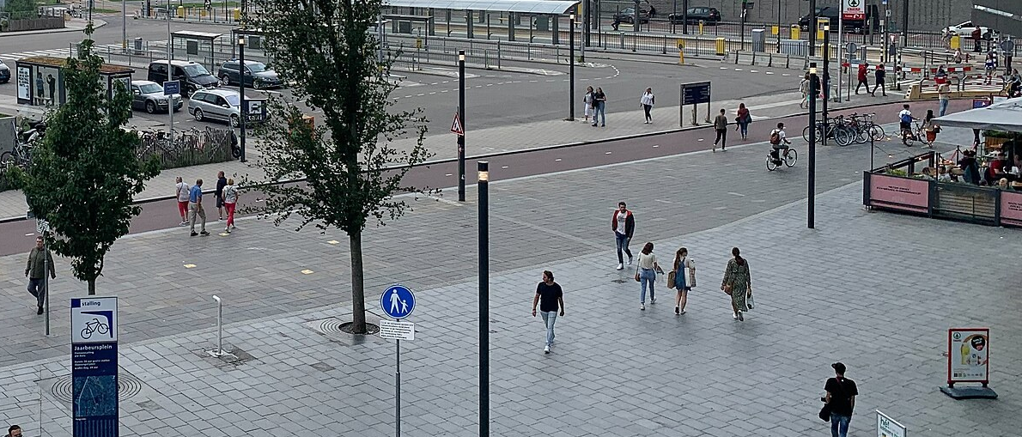

The register has 61 poles; we found 3
4
Look before you compute
Expectation: the BGT register
61 poles 51 lamp posts, 10 bollards
Reality: our pipeline
3 objects 2 of them on a lamp post
42 of 61 poles get no LiDAR point above 1.5 m.
Poles: BGT, Kadaster, CC BY 4.0. Photos: Wikimedia Commons, CC BY-SA 4.0 and CC BY 3.0.
Data: AHN5, Het Waterschapshuis, CC BY 4.0.
Intro · Data · Toolbox · Pipeline · Memory · Speed · Reality · Wrap-up
Notes:
TALK TRACK: Question three, the one from the start: does the scan agree with the register? A confession about street furniture. Expectation versus reality. The expectation isn't made up: the BGT, the Dutch large-scale topography register kept by the municipality, lists 61 poles inside this exact square, 51 lamp posts and 10 bollards, the small rings. Reality: my pipeline found 3 objects, the big rings, and two of them do stand on a registered lamp post. The data explains it: 42 of the 61 poles don't get a single LiDAR point more than 1.5 metres above the ground, and only 10 leave DBSCAN the six voxels it needs. Remember the plane: thin poles often get missed. Rule four, learned the hard way: I computed first and looked afterwards; you should look first. So why do poles get so few points?
TIME: 45 s, ends at 23:00
LIKELY QUESTION: Isn't the register out of date, or the flight too old?
ANSWER: Partly: 3 of the poles were first registered after the April 2023 flight, so they may not have existed yet. That doesn't change the picture: most poles that did exist are a few points or none from the air. The municipality's own 2021 street-light export disagrees with the BGT too, so registers aren't ground truth either.
TRACE:
• Photo credit: 2021 · Robot8A · CC BY-SA 4.0
• Photo credit: 2014 · V. van Werkhooven · CC BY 3.0
• Small print: Poles: BGT (Kadaster, CC BY 4.0) via PDOK, 2026-10-12. Points: within 0.6 m, over 1.5 m above ground. Photos: Jaarbeursplein, Wikimedia Commons.
• bench/bgt_street_furniture.py, results/bgt_street_furniture.json (label FINAL)
• BGT licence: CC BY 4.0 per the national geo register record (attribution Kadaster, BGT), CC0 1.0 on the PDOK API landing page; the slide credits Kadaster, BGT
• Rings: build_deck.py slide_expectation_map; poles projected with the stored camera (renders/render_spec.json), our objects at renders/render_spec.json frames[f6_final.png].street_furniture_visible patches
• results/pipeline.json: n_objects.street_furniture, street_furniture_objects
EVIDENCE:
• BGT via PDOK OGC API Features, queried 2026-10-12 08:04 UTC: paal 61 (lichtmast 51, afsluitpaal 10), straatmeubilair 29 (26 benches, 3 play objects), kast 4; current versions only, strictly inside the crop box
• Points within 0.6 m of each pole and more than 1.5 m above the local ground: 0 points 42, 1 to 5 4, 6 to 20 15, more than 20 none
• Poles with at least 6 occupied 0.5 m voxels above 1.5 m: 10, all lamp posts; half of them sit under building or viaduct points
• Our objects against the BGT: clusters 435 and 710 within 0.51 m and 0.49 m of a lamp post; cluster 719 is 4.97 m from the nearest one
• Map: 60 of the 61 poles project inside the render (one falls just outside the frame)
MENTAL MODEL: Slide 30 (a point cloud samples the surface unevenly) follows: the density map of this crop explains why poles get few points.

Slide 30
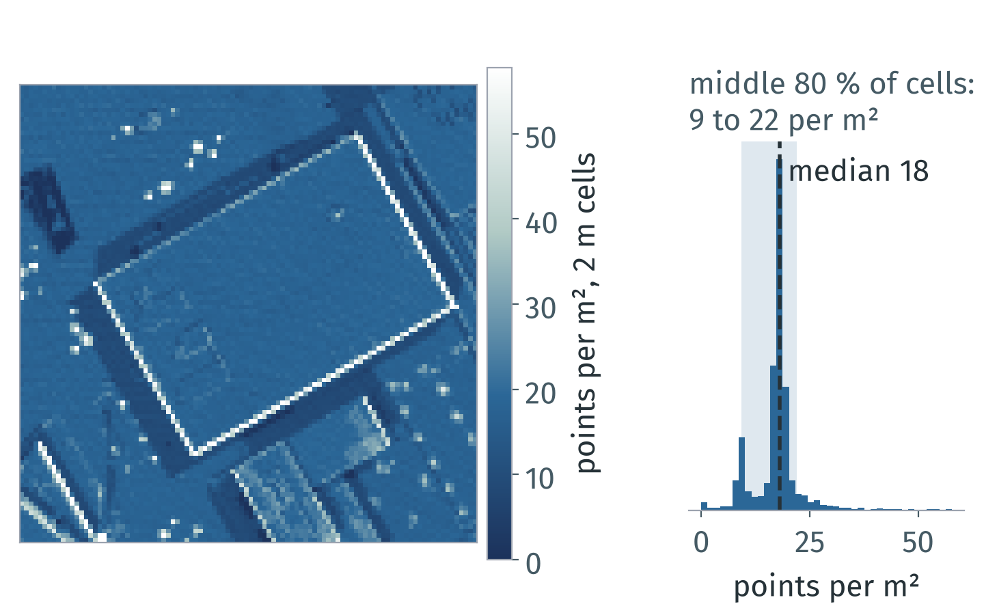
From the air, the city is sampled unevenly
4
Look before you compute
Rule 4: density, noise and gaps vary within one file. Measure them before tuning anything.
Here the middle 80 % of cells hold 9 to 22 points per m²; median 18.
Occlusion, flight-strip overlap, angle and material decide where points land.
Every point carries error: AHN4 specifies at most 5 cm in height; AHN5 publishes no figure yet.
Intro · Data · Toolbox · Pipeline · Memory · Speed · Reality · Wrap-up
Notes:
TALK TRACK: Why so few points on a pole? Because a scanner doesn't see the city, it samples it. This map counts points per square metre in our crop, median 18. Walls and tree crowns stack points into bright lines and spots, and some bands are thin, so a thin pole can fall between the samples. A radius tuned in one corner can fail in the next: measure density and error before you tune anything. That's rule four: look before you compute. So here are all four rules, with their numbers.
TIME: 30 s, ends at 23:30
LIKELY QUESTION: Is the density on the map the density of the surface?
ANSWER: Not quite: a map cell counts every point above it, so walls and tree crowns look denser than they are as surfaces; a per-surface density needs normals. And the published accuracy is a specification for the whole data set, not a guarantee for each point.
TRACE:
• deck/appendix.yaml C5 (bullets, figure, citations; shown here as a main slide)
• deck/concepts/make_figures.py: deck/assets/concepts/c5_density.png, results/concepts.json c5
• data/utrecht_jaarbeurs_200m.laz
• research: reports/mental_models.md section 6
WHY IT MATTERS: Thresholds, radii and quality scores all assume a density and an error level; uneven sampling makes them wrong in parts of the same file.
EXAMPLE: NumPy: np.histogram2d(x, y, bins=100, range=[[0, 200], [0, 200]]) gives this density map in one call. laspy: las.return_number and las.number_of_returns tell multiple echoes apart (slide 19).
LIMITS AND DISAGREEMENTS:
• Density per map cell mixes surface density with geometry: walls and canopies inflate it. A per-surface density needs normals (C4).
• Published accuracy is a specification for the whole data set, not a guarantee for each point; local errors near edges and on dark or wet surfaces can be larger.
• Which density is enough depends on the object size: lamp posts on slide 29 got few or no points.
CITATIONS:
• AHN Kwaliteitsbeschrijving (ahn.nl/kwaliteitsbeschrijving, no date shown, written before 2020): AHN4 height error at most 5 cm systematic and 5 cm stochastic; about 10 to 14 points per m2
• AHN5 tender, Nota van inlichtingen, 2022-08-18 (TenderNed 275983): base requirement 10 points per m2; no AHN5 accuracy figures published
• AHN: The making of (ahn.nl/ahn-making, no date shown, AHN3 process): flight strips overlap about 20 to 35 %, vegetation gives first or intermediate returns
• Manders: AHN3 vs AHN4 for 3D buildings, MSc thesis, 2023 (gdmc.nl; not peer reviewed): facade occlusion
• ASPRS Positional Accuracy Standards, Edition 2, Version 2, approved 2024-06-24 (via Geo Week News, 2024-07-03; ASPRS PDF not fetched)
SOURCES AND STATUS:
• Bullet 1 "Here the middle 80 % of cells hold 9 to 22 points per m²...": status token; source: results/concepts.json c5 (data/utrecht_jaarbeurs_200m.laz, 2 m cells)
• Bullet 2 "Occlusion, flight-strip overlap, angle and material decide...": status verified; source: research: reports/mental_models.md section 6
• Bullet 3 "Every point carries error: AHN4 specifies at most 5 cm in...": status verified; source: research: reports/mental_models.md section 6 (AHN Kwaliteitsbeschrijving; AHN5 tender)
STATUS KEY: token = filled from results/*.json; verified = checked in a research report.

Slide 31
Four rules, each backed by this talk's numbers
1
Think in arrays, not points
2
Make it small first
24 B per point per xyz copy
slides 14, 15
3.0 GB → 0.8 GB peak
slides 16, 17, 19, 22, 23
3
Let compiled code loop
4
Look before you compute
130× faster than a loop
slides 24 to 28
61 poles on the register, 3 found
slides 29, 30
Intro · Data · Toolbox · Pipeline · Memory · Speed · Reality · Wrap-up
Notes:
TALK TRACK: So, the four rules again, now with the evidence from this talk, one per click. Think in arrays: every unnecessary copy of the coordinates costs 24 bytes per point, half a gigabyte on one 1 km file, so pass views wherever you can. Make it small first: streaming took the 1 km tile from 3.0 GB to 0.8 GB. Let compiled code loop: the loop over rows was 130× slower. And look before you compute: 61 poles on the register, 3 found, and the data told us why. Before you copy any of it, what it doesn't do yet.
TIME: 75 s, ends at 24:45
LIKELY QUESTION: Do these rules apply outside 3D?
ANSWER: Three of them are plain data engineering, and the compiled-loop one holds wherever Python calls into compiled code, because the toll is per call. But I only measured them in this pipeline, so that's the evidence I can show.
TRACE:
• content.yaml slide 31 rules (the rules of slide 10 with evidence; click: true, one tile per click); tokens: results/memory.json tile_1km.bytes_per_point.xyz_float64, results/pipeline.json n_objects, results/bgt_street_furniture.json collections.paal.n, results/memory.json tile_1km peaks, results/bench_cliff.json plane.factor
• Replaces the old 'Three habits' tiles and the 'Loop over tiles, never over points' statement slide (both removed on 2026-10-12)

Slide 32
What this doesn't do yet, and what's next
A baseline in plain Python, not production accuracy.
Limits
Next
3 of 61 poles found
Vegetation: not scored
Buildings: 83 % precision, a lower bound
One 200 m crop, one timed run
Ground and clusters on tiles with overlap (B2)
A classifier for the labels (B5)
Your own point cloud (B6)
Intro · Data · Toolbox · Pipeline · Memory · Speed · Reality · Wrap-up
Notes:
TALK TRACK: What this doesn't do yet. My pipeline found 3 of 61 poles. Vegetation has nothing to score it against, because AHN puts trees in its other class. Buildings reach 83 % precision against AHN, a lower bound, because AHN files facades as other. And it's one 200 metre crop with one timed run. Next: ground removal and clustering on tiles with an overlap, a classifier for the labels, and your own data; each has a backup slide. A baseline in plain Python, not production accuracy.
TIME: 45 s, ends at 25:30
LIKELY QUESTION: What would you do first with more time?
ANSWER: Run it on tiles with an overlap over a whole AHN file, because ground removal and clustering need neighbours across tile edges; backup B2 has the numbers.
TRACE:
• results/pipeline.json n_objects, buildings (against AHN class 6; note: facades), ground; results/bgt_street_furniture.json collections.paal.n
• Next steps: appendix.yaml B2, B5, B6; notes slides 4, 19 and 23

Slide 33

Thank you
Write the plan in Python; let compiled code loop.
Try it on your own AHN tile.
Sergio Peral
sergioperalgarijo99@gmail.com
github.com/Sloppy1999
Data: AHN5, Het Waterschapshuis, CC BY 4.0.
Licence: creativecommons.org/licenses/by/4.0
Title shared with F. Poux, 3D Data Science with Python, O'Reilly 2025; this talk is independent.
Notes:
TALK TRACK: Everything you saw is in the repo behind this QR code: the pipeline, the snippets and the benchmarks. Try it on your own AHN tile. The point cloud is AHN5 from Het Waterschapshuis under CC BY 4.0, so you can use it too, as long as you credit it. If you keep one line: write the plan in Python, and let compiled code loop. Thank you to the Python community and to all of you for being here. I'm happy to take questions.
TIME: 45 s, ends at 26:15
LIKELY QUESTION: Is this talk based on the O'Reilly book with the same title?
ANSWER: No. The title is shared with Florent Poux's O'Reilly book from 2025; this talk and its code are independent. His YouTube channel is a good next step: backup B5 tests his PCA plus Random Forest idea on this area, and B6 lists the data sources from his beginner video.
CHECK BEFORE THE TALK:
• Publish the repo URL and QR only after the repo clean-up listed in the open items (docs/OPEN_ITEMS.md, section f)
• If the optional book-credit small print is dropped from the slide, say the credit aloud
TRACE:
• content.yaml slide 33: qr.url, contact (the repo is public)
• content.yaml meta.source_ahn (licence: research: reports/dataset.md)
• Book title and year: research: reports/book.md
• Poux's videos used for B5 and B6: research: reports/videos.md

Slide 34
Why not just use C++?
The heavy steps already run in compiled code: Open3D and SciPy's KDTree in C++, VTK under PyVista in C++, LAZ decoding in lazrs (Rust).
Python only orchestrates: no step loops over points, and the whole crop runs from load to paint-back in 0.6 s (single run, renders excluded, indicative).
The price is per call, not per language: 439 ns per loop step of slide 24 (several NumPy calls each), 3.4 ns per point inside NumPy, 3.2 µs for the cheapest KDTree call, 9.8 µs for an empty k = 16 query.
Here only the batched call used all cores: kNN in one call took 1.6 s on 1 thread, 165 ms on 16.
Compiled code pays off when your step has no batched call: a custom per-point kernel you would otherwise loop over in Python.
It also pays off when Python itself is the constraint: hard real-time budgets, embedded targets without a Python runtime. Not measured here.
NOT TESTED for this talk: Numba, Cython, writing your own C++ extension. No numbers quoted.
The PCL code on slide 2 shows the shape only: NOT RUN (no PCL toolchain on the build machine).
Timings: median of repeated runs. Pipeline runtime: one run.
Conditions: Ryzen 7 5700X, 8 cores / 16 threads, 31.3 GiB RAM; Linux (Omarchy, kernel 7.2.5-3-omarchy); Python 3.13.15, NumPy 2.5.3, SciPy 1.18.1, Open3D 0.20.0, laspy 2.7.0; N = 722 961 points, 7 runs after 1 warm-up, median and IQR of wall time over the timed runs; governor performance; boost on; measured 2026-10-11 20:08 UTC; data: the AHN5 crop of slide 5 (ahn.nl, Het Waterschapshuis, CC BY 4.0). Per-call costs: SciPy KDTree, one query point far outside the cloud (radius query, and kNN with k = 16), median of 7 timeit repeats of 20 000 calls.
Notes:
ANSWER IN Q&A: Short answer: you can, and the libraries here already did; Open3D, SciPy's KDTree and VTK are C++ under the hood. What you pay in Python is a toll per call, so the question is not "Python or C++" but "how many calls". Write compiled code yourself only when there is no batched call for your step, or when you can't ship a Python runtime. Checked: the loops in pipeline/steps.py run over tiles and clusters, never over points.
SOURCES AND STATUS:
• Bullet 1 "The heavy steps already run in compiled code: Open3D and...": status verified; source: research: reports/libraries.md section 1 (native core column)
• Bullet 2 "Python only orchestrates: no step loops over points, and...": status token; source: pipeline/run.py; results/pipeline.json runtime_s, runtime_note (load to paint-back, renders not included)
• Bullet 3 "The price is per call, not per language: 439 ns per loop...": status token; source: results/bench_cliff.json plane.per_step_ns_loop, plane.per_point_ns_vectorised, knn.per_query_us_far, knn.per_query_us_far_knn, knn.k
• Bullet 4 "Here only the batched call used all cores: kNN in one call...": status token; source: results/bench_cliff.json knn.one_call_1t, knn.one_call_all; research: reports/perf.md ('only the batched form can use workers=-1')
• Bullet 5 "Compiled code pays off when your step has no batched call...": status judgement; source: storyboard.md B1; follows from the measured toll above, not benchmarked separately
• Bullet 6 "It also pays off when Python itself is the constraint: hard...": status judgement; source: storyboard.md B1
• Bullet 7 "NOT TESTED for this talk: Numba, Cython, writing your own...": status not_tested; source: scope of this talk; none of the research reports benchmarked them
• Bullet 8 "The PCL code on slide 2 shows the shape only: NOT RUN (no...": status not_run; source: CONTRACTS.md (s02_pcl.cpp NOT RUN)
STATUS KEY: judgement = reasoning, not a measurement; not_run = not run; not_tested = not tested; token = filled from results/*.json; verified = checked in a research report.

Slide 35
How does this scale to billions of points?
AHN files: 1 km file 135000_455000, 21 013 926 points (130 MB LAZ); 5 × 6.25 km file 2023_C_31HZ2, 926 203 338 points (5.1 GB); its AHN4 edition: 1 290 104 537 points.
LAS records alone: 25.9 GB at 30 B per point (format 6); our pipeline (slides 14 and 16): 74.2 GB. Computed, not run.
COPC: laspy's CopcReader reads one box over HTTP with .query(Bounds(mins, maxs)). The same box as our crop, read remotely from the AHN5 1 km file: 722 961 points, the same as the local crop, about 16 MB in 33 requests and 1.5 s (single run).
Notes:
ANSWER IN Q&A: Billions are real in AHN: the AHN4 edition of the file that contains this area has 1 290 104 537 points. The answer is the same three moves: read only the box you need (COPC), stream per-point work in chunks, and run neighbour steps on tiles with an overlap. The chunked read keeps exactly the points of a load-everything first-point reference (memory.json tile_1km.chunked_equals_reference: yes). The 0.1 m share is measured on the crop (pipeline.json); the memory pilot's own percentages were synthetic data and are not used here.
SOURCES AND STATUS:
• Bullet 1 "AHN files: 1 km file 135000_455000, 21 013 926 points (130...": status verified; source: results/memory.json tile_1km.points, big_file.points; results/research_facts.json tile_1km_file (local file size, research: notes/verify_facts.json), ahn5_c_31hz2 (HTTP Content-Range total and LAS header bounds), ahn4_c_31hz2 (LAS header; research: dataset/top_tile_headers.txt, reports/dataset.md)
• Bullet 2 "LAS records alone: 25.9 GB at 30 B per point (format 6)...": status token; source: results/memory.json big_file.computed_gb, tile_1km.record_bytes, tile_1km.point_format; LAS 1.4 R16 and laspy.PointFormat(6).size (research: reports/memory.md, notes/verify_facts.json)
• Bullet 3 "COPC: laspy's CopcReader reads one box over HTTP with...": status token; source: results/copc_remote.json points_half_open, same_points_as_local_crop, classes_equal_local, mb, requests, seconds (bench/copc_remote.py: the crop's RD box from the AHN5 file the talk uses); signatures re-checked in research: notes/verify_facts.json. The file's total size is in research_facts tile_1km_file
STATUS KEY: token = filled from results/*.json; verified = checked in a research report.

Slide 36
Which GPU options actually help?
The open3d 0.20.0 wheel on PyPI is built with CUDA 12.6; o3d.core.cuda.is_available() is True on the test machine (RTX 3060). A CPU build, open3d-cpu 0.20.0, exists for Linux x86_64.
Plane fitting and DBSCAN are barely faster (table): their tensor docstrings say they wrap a CPU implementation and copy the data.
PyTorch3D has no documented install for Python 3.13: PyPI's latest is 0.7.4 (2023-05-10, macOS x86_64 wheels only), GitHub has v0.7.9 (2025-11-28), INSTALL.md lists PyTorch 2.1.0 to 2.4.1, and torch has cp313 wheels only from 2.5.0.
Source build of v0.7.9 against torch 2.14.1 (CPU, gcc 16.2.1) fails: C++20 required. An unofficial -std=c++20 patch builds and runs on CPU. CUDA build UNVERIFIED.
PyTorch3D knn_points on CPU, 100 000 × 100 000 points, k = 8: 29.4 s, against 55 ms for a SciPy KDTree build and query with workers=-1 (single runs).
NOT TESTED: the Open3D wheel without a GPU or driver, Open3D's PyTorch ops, a GPU run of this pipeline.
Open3D tensor API, 1 000 000 float32 points, RTX 3060 against CPU: single runs, indicative
Operation | CUDA | CPU
Voxel downsampling | 98 ms first call, 4.2 ms second | 250 ms
segment_plane | 62 ms | 68 ms
cluster_dbscan | 721 ms | 748 ms
Single runs on one machine (Ryzen 7 5700X, RTX 3060, Linux/Omarchy), CPython 3.13.15, Open3D 0.20.0 (CUDA 12.6 wheel), SciPy 1.18.1; PyTorch3D v0.7.9 (patched CPU build) on torch 2.14.1+cpu; synthetic point clouds (1 000 000 points for the Open3D table, 100 000 for knn_points); indicative only. No PyTorch3D GPU numbers: CUDA build UNVERIFIED.
Notes:
ANSWER IN Q&A: Short answer: for this pipeline, the GPU did not pay off. Only voxel downsampling got clearly faster on CUDA: 98 ms on the first call and 4.2 ms on the second, against 250 ms on CPU. Gotchas if you try it: .numpy() on a CUDA tensor raises RuntimeError (use .cpu().numpy()); PointCloud.from_legacy converts to float32 by default; the tensor segment_plane defaults (0.01, 3, 100, 0.999) differ from the legacy API. PyTorch3D is for training models on GPU tensors, not for a CPU pipeline on Python 3.13. All timings here are research single runs, not the final benchmark.
SOURCES AND STATUS:
• Bullet 1 "The open3d 0.20.0 wheel on PyPI is built with CUDA 12.6...": status verified; source: research: reports/libraries.md section 1; o3d._build_config re-checked in research: notes/verify_facts.json
• Bullet 2 "Plane fitting and DBSCAN are barely faster (table): their...": status verified; source: research: reports/libraries.md (Open3D tensor API section)
• Bullet 3 "PyTorch3D has no documented install for Python 3.13: PyPI's...": status verified; source: research: reports/libraries.md (PyPI JSON libraries/pypi/pytorch3d.json and torch.json, libraries/web/pt3d_INSTALL.md, libraries/web/pt3d_releases.json, fetched 2026-10-01)
• Bullet 4 "Source build of v0.7.9 against torch 2.14.1 (CPU, gcc...": status verified; source: research: libraries/pt3d_build2.log, pt3d_build3_cxx20.log, pt3d_cxx20.patch (reports/libraries.md)
• Bullet 5 "PyTorch3D knn_points on CPU, 100 000 × 100 000 points, k =...": status synthetic; source: results/research_facts.json pytorch3d_knn (research: libraries/07_torch_pytorch3d_interop.py, reports/libraries.md; a later single run in libraries/out_07_torch.txt gives similar values)
• Bullet 6 "NOT TESTED: the Open3D wheel without a GPU or driver...": status not_tested; source: research: reports/libraries.md FLAG 4 and 7
• Table row 1 "Voxel downsampling": status synthetic; source: results/research_facts.json open3d_tensor (research: libraries/03_open3d_tensor.py, out_03_open3d_tensor.txt, reports/libraries.md)
• Table row 2 "segment_plane": status synthetic; source: results/research_facts.json open3d_tensor (research: libraries/03_open3d_tensor.py, out_03_open3d_tensor.txt, reports/libraries.md)
• Table row 3 "cluster_dbscan": status synthetic; source: results/research_facts.json open3d_tensor (research: libraries/03_open3d_tensor.py, out_03_open3d_tensor.txt, reports/libraries.md)
STATUS KEY: not_tested = not tested; synthetic = measured in a research run on generated data (a synthetic street or point cloud), not AHN; verified = checked in a research report.

Slide 37
What can replace a KDTree?
Neighbour search options (Open3D 0.20.0, SciPy 1.18.1)
kNN, k = 16, 722 961 points: Python loop 9.6 s, one call 1.6 s (1 thread), 165 ms (16 threads).
So the loop costs 6.2× against one call on one thread, and 58× against all cores.
Fixed cost per call: 3.2 µs for an empty radius query, 9.8 µs for an empty k = 16 query; a typical query takes 14.1 µs.
Not shown: a brute-force double loop, because it changes the algorithm as well as the number of calls.
Option | Use it for | Note
SciPy KDTree, one call | All points at once; workers=-1 for all cores | This talk's choice; numbers at right
Open3D KDTreeFlann | search_knn_vector_3d and friends, one point per call | Per point, it is still a Python loop
Open3D NearestNeighborSearch | Batched kNN, fixed-radius and hybrid search (tensor API) | Many threads by default; radius search returns indices, distances, splits
Voxel grid hashing | One int64 key per voxel, then np.unique | Fixed cell size; np.unique(axis=0) is no faster than a dict loop
Octree (o3d.geometry.Octree) | Hierarchical cells for level of detail (in memory) | Not benchmarked here; out-of-core octrees are what COPC files store (B2)
Conditions: Ryzen 7 5700X, 8 cores / 16 threads, 31.3 GiB RAM; Linux (Omarchy, kernel 7.2.5-3-omarchy); Python 3.13.15, NumPy 2.5.3, SciPy 1.18.1, Open3D 0.20.0, laspy 2.7.0; N = 722 961 points, 7 runs after 1 warm-up, median and IQR of wall time over the timed runs; governor performance; boost on; measured 2026-10-11 20:08 UTC; data: the AHN5 crop of slide 5 (ahn.nl, Het Waterschapshuis, CC BY 4.0). Tree build excluded from every timing. Per-call costs: SciPy KDTree, median of 7 timeit repeats of 20 000 calls; empty queries use one point far outside the cloud, typical ones a seeded sample of 20 000 crop points.
Notes:
ANSWER IN Q&A: Short answer: the data structure matters less than the number of calls and the threads. In the synthetic pilot, Open3D's KDTreeFlann had a much cheaper call than SciPy, so a per-point loop over it was only modestly slower than Open3D's batched search on one thread; the big gap came from the batched search's default threads, so compare at equal threads. A uniform grid hash answers radius queries in the same complexity class as a tree (the pure-Python baseline of the synthetic pilot used one); it was not benchmarked as a vectorised method.
SOURCES AND STATUS:
• Table row 1 "SciPy KDTree, one call": status verified; source: results/bench_cliff.json knn; signatures in research: notes/verify_facts.json
• Table row 2 "Open3D KDTreeFlann": status verified; source: methods re-checked in research: notes/verify_facts.json; per-point loop timings in research: reports/perf.md (synthetic)
• Table row 3 "Open3D NearestNeighborSearch": status verified; source: research: reports/perf.md (variants E2 and E2_1t, verified gotchas); methods in notes/verify_facts.json
• Table row 4 "Voxel grid hashing": status verified; source: research: reports/critic.md section 2 (1 M points), reports/perf.md voxel table; snippets/s21_chunked.py
• Table row 5 "Octree (o3d.geometry.Octree)": status not_tested; source: API re-checked in research: notes/verify_facts.json (max_depth=8 accepted); in memory: the Open3D 0.20.0 Octree API is convert_from_point_cloud, insert_point, traverse, locate_leaf_node, to_voxel_grid, plus o3d.io.read_octree and write_octree (checked in the project venv, QA final round); out-of-core storage is the book's general octree material (research: reports/book.md), not Open3D; COPC stores an octree: laspy 2.7.0 laspy/copc.py (CopcInfo holds the octree centre, halved at each level; CopcReader.query takes a level); the book's octree timings state no hardware (UNVERIFIED, not used)
• Bullet 1 "kNN, k = 16, 722 961 points: Python loop 9.6 s, one call...": status token; source: results/bench_cliff.json knn.k, knn.n, knn.loop, knn.one_call_1t, knn.one_call_all
• Bullet 2 "So the loop costs 6.2× against one call on one thread, and...": status token; source: results/bench_cliff.json knn.factor_loop_vs_1t, knn.factor_loop_vs_all
• Bullet 3 "Fixed cost per call: 3.2 µs for an empty radius query, 9.8...": status token; source: results/bench_cliff.json knn.per_query_us_far, knn.per_query_us_far_knn, knn.k, knn.per_query_us_typical
• Bullet 4 "Not shown: a brute-force double loop, because it changes...": status verified; source: research: reports/critic.md C2
STATUS KEY: not_tested = not tested; token = filled from results/*.json; verified = checked in a research report.

Slide 38
Could a classifier replace the labelling rules?
Idea from F. Poux (PCA + Random Forest): describe each cluster by the eigenvalues of its covariance matrix (linearity, planarity, sphericity, plus verticality) and let a Random Forest name it.
In Python: one batched np.linalg.eigh over all 1 024 clusters takes 11 ms; a loop over clusters with np.cov takes 53 ms (4.9×), same features.
Building or not, against AHN class 6, share of points named right (427 853 points in 1 006 clusters)
Labeller | AHN buildings | Everything else | Balanced
Four rules of slide 19 | 99.3 % | 33.2 % | 66.3 %
Random Forest, eigenvalue features | 68.8 % | 92.4 % | 80.6 %
Random Forest, + the rules' inputs | 94.2 % | 63.8 % | 79.0 %
Forest: scikit-learn, cross-validated on 50 m blocks (5 folds), so no block is in training and test at once. Only building vs not: AHN has no vegetation class. Rules tuned on this crop (in-sample). AHN files many facades as class 1, so facade fragments count against the rules. One area, 104 AHN building clusters: indicative.
Conditions: Ryzen 7 5700X, 8 cores / 16 threads, 31.3 GiB RAM; Linux (Omarchy, kernel 7.2.5-3-omarchy); Python 3.13.15, NumPy 2.5.3, SciPy 1.18.1, Open3D 0.20.0, laspy 2.7.0, scikit-learn 1.9.1; N = 139 804 voxels in clusters, 7 runs after 1 warm-up, median and IQR of wall time over the timed runs; governor performance; boost on; measured 2026-10-11 20:07 UTC; data: the AHN5 crop of slide 5 (ahn.nl, Het Waterschapshuis, CC BY 4.0).
Notes:
ANSWER IN Q&A: Short answer: against AHN's building class, on this area the forest scores higher, but read the table with the caveat. Balanced accuracy is 81 % for the forest with the eigenvalue features alone and 79 % with the rules' inputs added, against 66 % for the rules. Most of the gap is one thing: AHN files facades, and the horizontal stripes along the hall's floors, under class 1 ("other"), while my facade rule calls them building, so they count as errors. The forest learns AHN's convention from AHN's labels, which the rules never see: "the model copies AHN" is a fairer reading than "the model sees better". Poux's idea is still the right next step once you have labelled data from many places, and the eigenvalue features need no tuning per city. In this run the weights were: planarity 26 %, linearity 19 %, multiple return share 18 %, verticality 15 %. The Python lesson is the talk's lesson again: compute the features for all clusters in one batched eigh call, not in a loop. And remember Poux's box: a classifier trained on three classes will name a fourth thing with full confidence.
SOURCES AND STATUS:
• Bullet 1 "Idea from F. Poux (PCA + Random Forest): describe each...": status verified; source: research: reports/videos.md V3 (10:10 to 25:00); bench/eigen_features.py
• Bullet 2 "In Python: one batched np.linalg.eigh over all 1 024...": status token; source: results/eigen_features.json n_clusters, timing.batched, timing.loop_over_clusters, timing.factor, features_identical_loop_vs_batched (verticality differs only where the eigenvector is arbitrary: verticality_differs_clusters)
• Table row 1 "Four rules of slide 19": status token; source: results/eigen_features.json rules (rule 2 or 3 = building; tuned on this crop, in-sample)
• Table row 2 "Random Forest, eigenvalue features": status token; source: results/eigen_features.json forest_eigen_only (GroupKFold on 50 m blocks, point weights)
• Table row 3 "Random Forest, + the rules' inputs": status token; source: results/eigen_features.json forest_eigen_plus_rule_inputs (top, footprint, multiple return share added)
STATUS KEY: token = filled from results/*.json; verified = checked in a research report.

Slide 39
Where can I get my own point cloud?
Open sources (all carry a licence: cite it)
Source | What you get | Note
AHN (ahn.nl) | Airborne LiDAR, all of the Netherlands, classified | This talk; CC BY 4.0
3DBAG (3dbag.nl) | Every Dutch building as a 3D model, made from AHN | Meshes, not points
OpenTopography | LiDAR and photogrammetry catalogue, mostly US | Filter by method, cut an area
National and city portals | France's LiDAR HD, Vancouver's open data, … | Tiles, like AHN files
Open Heritage 3D | Terrestrial laser scans of heritage sites | Licence and citation per data set
Sketchfab, TurboSquid | 3D models (meshes) | Filter for free and downloadable
Your own capture: photogrammetry (phone, camera) gives dense colour but noisy edges; LiDAR measures each pulse.
Only LiDAR returns several echoes per pulse: slide 19's vegetation rule needs them, a photo sees one surface per pixel.
Sources from F. Poux's beginner video on 3D tools (YouTube, 2025), except 3DBAG. Links checked 2026-10-11.
Notes:
ANSWER IN Q&A: Short answer: start with AHN if your area is in the Netherlands; data/fetch_ahn5.py downloads one AHN file and cuts the crop, so change its tile name, expected size and crop box constants. Outside the Netherlands, OpenTopography and national portals such as France's LiDAR HD have the same kind of airborne LiDAR. Florent Poux's beginner video lists these and more. If you capture yourself with a phone, you get photogrammetry: dense and coloured, but one surface per pixel, so the multiple-return rule for trees will not work and you need another feature.
SOURCES AND STATUS:
• Table row 1 "AHN (ahn.nl)": status verified; source: data/DATA_LICENSE.md; research: reports/videos.md V1 (07:00, AHN viewer)
• Table row 2 "3DBAG (3dbag.nl)": status judgement; source: 3dbag.nl reachable 2026-10-11; added for a Dutch audience, not from research: reports/videos.md
• Table row 3 "OpenTopography": status verified; source: research: reports/videos.md V1 (04:50 to 06:00); opentopography.org reachable 2026-10-11
• Table row 4 "National and city portals": status verified; source: research: reports/videos.md V1 (06:00 to 07:00); geoservices.ign.fr/lidarhd and opendata.vancouver.ca reachable 2026-10-11
• Table row 5 "Open Heritage 3D": status verified; source: research: reports/videos.md V1 (07:00 to 07:40); openheritage3d.org reachable 2026-10-11
• Table row 6 "Sketchfab, TurboSquid": status verified; source: research: reports/videos.md V1 (08:37 to 10:20)
• Bullet 1 "Your own capture: photogrammetry (phone, camera) gives...": status verified; source: research: reports/videos.md V1 (12:30 to 16:00)
• Bullet 2 "Only LiDAR returns several echoes per pulse: slide 19's...": status judgement; source: research: reports/videos.md V1 (photogrammetry matches images); pipeline/steps.py name, rule 1 (number_of_returns)
STATUS KEY: judgement = reasoning, not a measurement; verified = checked in a research report.

Slide 40
Which libraries have stopped moving?
Archived or stale: check before you depend on them
Library | Status | Latest release | Note
python-pcl | archived | 2019-05-10 | Repository archived
pclpy | stale | 2018-08-24 | Not archived, effectively unmaintained
pylas | archived | 2020-10-12 | Use laspy instead
MinkowskiEngine | stale | 2021-05-21 | Not archived; check the repository
TensorFlow Graphics | stale | 2021-12-03 | Not archived; check the repository
OpenSfM | stale | 2020-08-11 | Repository still active, no release since
MMDetection3D | stale | 2024-01-08 | Check your PyTorch version still works
Of 119 libraries and applications checked, 87 released within a year; 11 are stale and 2 archived.
pip install can fetch the wrong thing: PyTorch3D's newest releases are not on PyPI, and the kaolin package on PyPI is only a placeholder.
A release date is not quality: a finished library may be stable. It is a reason to look, not to reject.
Status from PyPI release dates and GitHub, checked 2026-10-11. Full list: docs/ECOSYSTEM.md.
Notes:
ANSWER IN Q&A: Short answer: look at the date before you install. python-pcl and pylas are archived, pclpy has not moved for years, and several deep learning libraries for sparse point clouds have had no release for a long time. This is from release dates and the archived flag, not from trying them. Two install traps I found while checking: the newest PyTorch3D is not on PyPI, and the kaolin name on PyPI is a placeholder. If your pipeline needs one of the stale ones, pin the version and check the repository's issues first.
SOURCES AND STATUS:
• Table row 1 "python-pcl": status token; source: results/ecosystem.json by_id.python-pcl; deck/ecosystem/ecosystem.yaml python-pcl (GitHub archived flag, PyPI release date)
• Table row 2 "pclpy": status token; source: results/ecosystem.json by_id.pclpy; ecosystem.yaml pclpy note (last push, last PyPI release)
• Table row 3 "pylas": status token; source: results/ecosystem.json by_id.pylas; ecosystem.yaml pylas (archived, superseded by laspy)
• Table row 4 "MinkowskiEngine": status token; source: results/ecosystem.json by_id.minkowskiengine; ecosystem.yaml minkowskiengine note
• Table row 5 "TensorFlow Graphics": status token; source: results/ecosystem.json by_id.tf-graphics; ecosystem.yaml tf-graphics note
• Table row 6 "OpenSfM": status token; source: results/ecosystem.json by_id.opensfm; ecosystem.yaml opensfm note (GitHub release against last push)
• Table row 7 "MMDetection3D": status judgement; source: results/ecosystem.json by_id.mmdet3d; ecosystem.yaml mmdet3d note; the PyTorch compatibility advice is judgement, not tested
• Bullet 1 "Of 119 libraries and applications checked, 87 released...": status token; source: results/ecosystem.json n_entries, by_status (12 months = active, 12 to 30 months = maintenance, older = stale; docs/ECOSYSTEM.md)
• Bullet 2 "pip install can fetch the wrong thing: PyTorch3D's newest...": status verified; source: deck/ecosystem/ecosystem.yaml pytorch3d and kaolin notes (PyPI JSON against GitHub releases, checked 2026-10-11)
• Bullet 3 "A release date is not quality: a finished library may be...": status judgement; source: judgement
STATUS KEY: judgement = reasoning, not a measurement; token = filled from results/*.json; verified = checked in a research report.

Slide 41
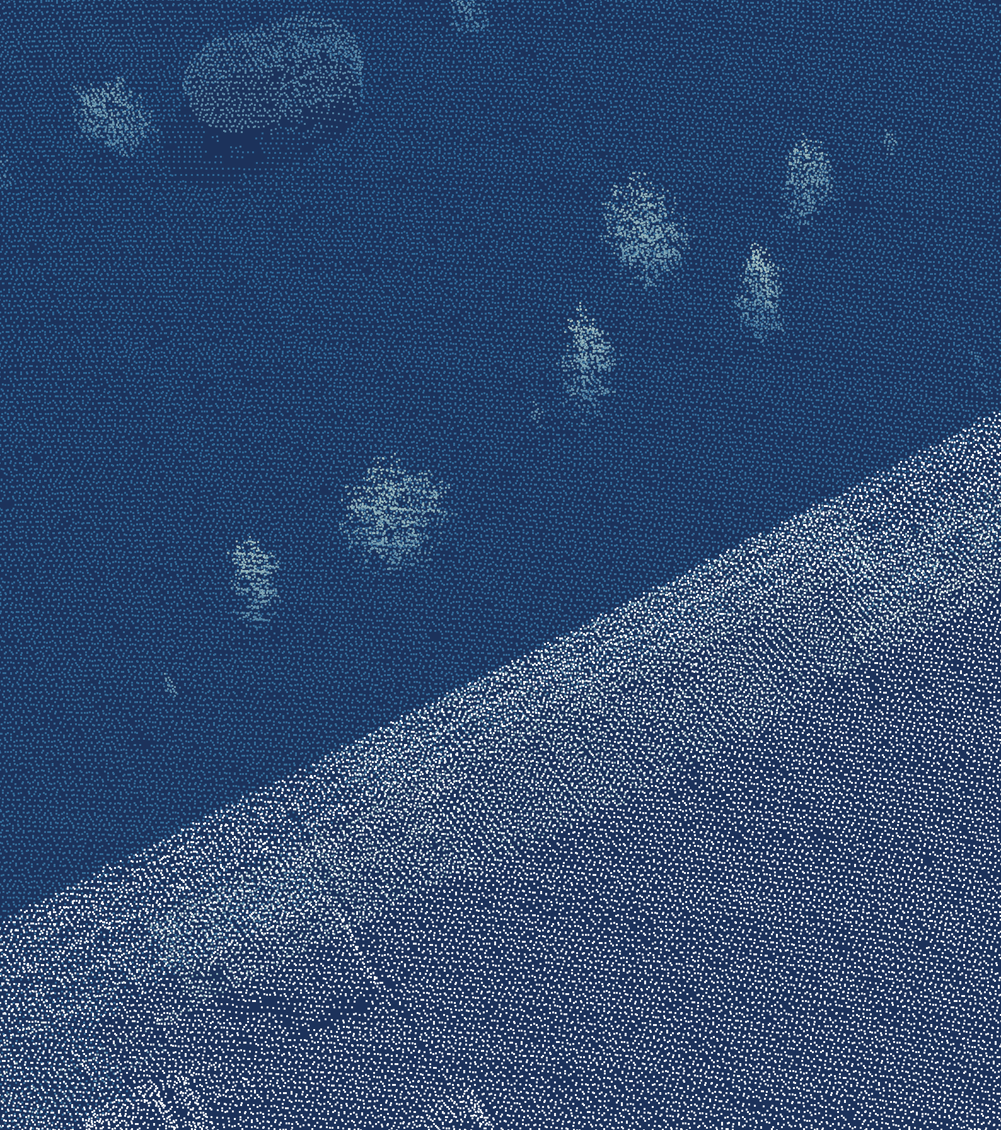
Where today's pipeline sits in a 3D project
Acquisition
Scan the scene
laspy
Preparation
Clean and register
NumPy, Open3D
1
2
Application
Ship it
Loop back when the data surprises
Exploration
Model and label
Open3D, SciPy
6
3
Visualisation
See it, trust it
PyVista
Analysis
Measure, monitor
NumPy, SciPy
5
4
Data: AHN5, Het Waterschapshuis, CC BY 4.0.
Notes:
ANSWER IN Q&A: Whatever the data, a 3D project goes round the same ring: acquire it, prepare it, explore it, analyse it, visualise it, ship it. The dark stages get the data, the blue ones understand it, the green ones deliver it. Under each stage is its Python tool: laspy reads, NumPy and Open3D prepare, Open3D and SciPy explore, PyVista shows. The dashed arrows are the real story: you loop back whenever the data surprises you. Today's pipeline is a small version of stages one to five.

Slide 42
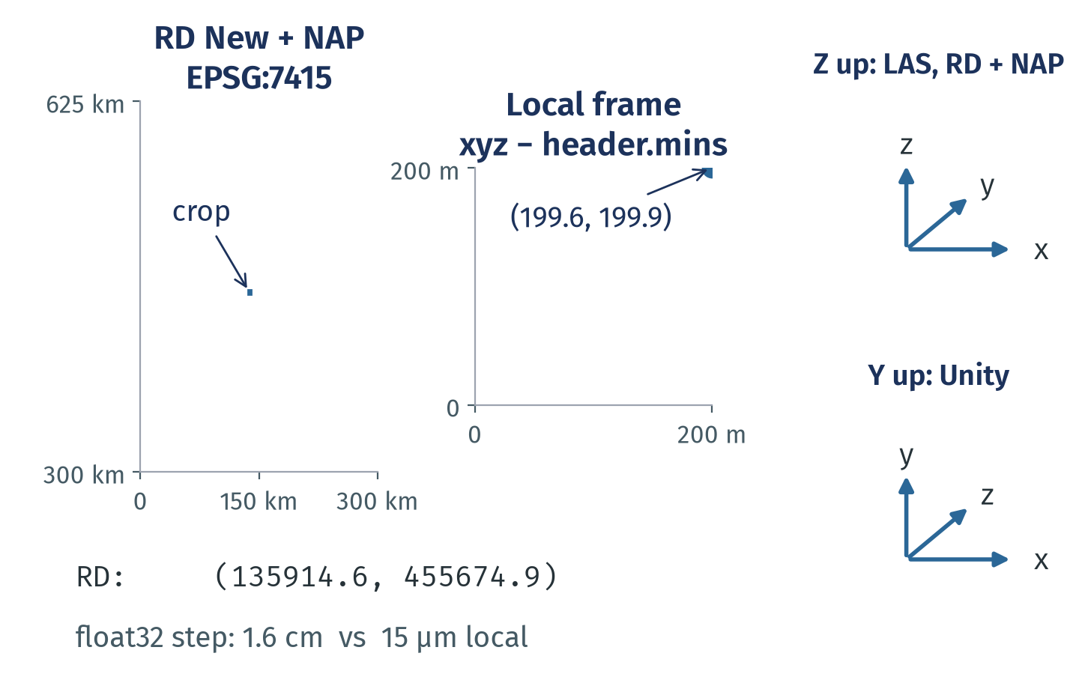
Coordinates mean nothing without a frame
Every array needs a frame: reference system, units, origin and which axis is up.
AHN: RD New metres plus NAP heights, EPSG:7415, stored in the file.
Subtract a local origin: float32 then resolves micrometres, not 1.6 cm.
Tools disagree on the up axis and on lat, lon order: check, never assume.
Notes:
TALK TRACK: A coordinate is three numbers plus a contract: which reference system, which units, which origin, which axis points up. Here the contract is RD New with NAP heights, in metres, and the file says so. The first point of our crop sits about a hundred and thirty-six kilometres east of RD's origin; subtract the header minimum and it's two hundred metres from ours. Same point, same metres, but now float32 can still resolve it to micrometres. The other silent trap is convention: LAS, GIS data and Blender are Z up, Unity is Y up and left-handed, and pyproj follows the authority's axis order unless you ask for x, y.
WHY IT MATTERS: Frame errors raise no exception: points land in the wrong place, mirrored, or rounded to centimetres, and the code still runs.
EXAMPLE: pyproj: Transformer.from_crs('EPSG:28992', 'EPSG:4326', always_xy=True) returns lon, lat; without always_xy, EPSG:4326 returns lat, lon. laspy: las.header.parse_crs() reads the CRS record; xyz = las.xyz - las.header.mins sets the local origin (slide 14).
LIMITS AND DISAGREEMENTS:
• Which axis is up, and handedness, differ between tools and file formats; read the docs of each tool you hand data to.
• A local origin is only safe if you keep it with the data to go back to RD.
• Whether float32 is enough depends on the extent and the precision you need, not on a rule.
CITATIONS:
• pyproj 3.7.2 Gotchas, Axis order changes in PROJ 6+ (pyproj4.github.io/pyproj/stable/gotchas.html, no date shown); Transformer always_xy
• EPSG:7415 Amersfoort / RD New + NAP height (epsg.io/7415, a mirror of the EPSG dataset; epsg.org not fetched)
• Unity 6.5 Manual, Quaternion: left-handed, Y up (docs.unity3d.com, no date shown); Blender Manual 2.91, Viewpoint: Z up (old manual version)
• ASPRS LAS 1.4 R16, 2025-08-27 (github.com/ASPRSorg/LAS releases): int32 coordinates with scale and offset; laspy docs: X is raw, x is scaled
• UNVERIFIED and left off the slide: Open3D's camera axis convention (not stated in the 0.20.0 API page)
SOURCES AND STATUS:
• Bullet 1 "AHN: RD New metres plus NAP heights, EPSG:7415, stored in...": status verified; source: results/pipeline.json crop.crs; research: reports/mental_models.md section 3
• Bullet 2 "Subtract a local origin: float32 then resolves micrometres...": status token; source: results/concepts.json c2 (np.spacing of float32 at the first point's x); slide 14
• Bullet 3 "Tools disagree on the up axis and on lat, lon order: check...": status verified; source: research: reports/mental_models.md section 3 (pyproj axis order; Unity Y up, Blender Z up)
STATUS KEY: token = filled from results/*.json; verified = checked in a research report.

Slide 43
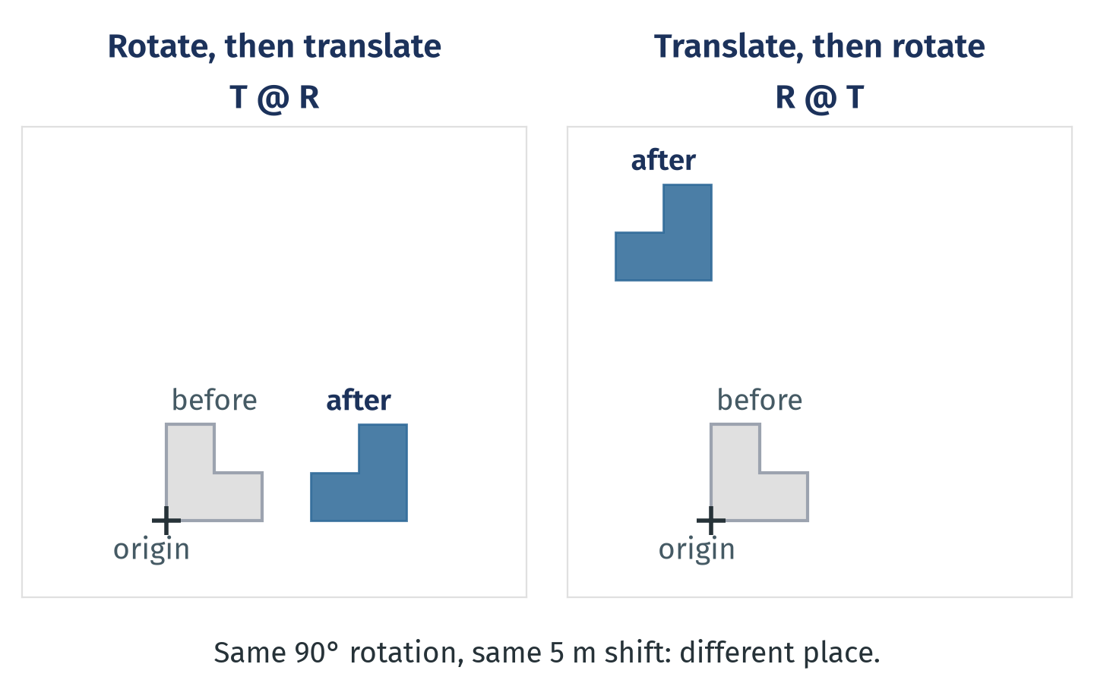
A transform is a matrix, and order matters
One four by four matrix moves a whole cloud; composing them is not commutative.
Rigid transform: rotation R and shift t in one homogeneous four by four matrix.
Apply it to all points at once: P @ R.T + t, or pcd.transform(T).
Euler angles hide a convention: SciPy's 'xyz' and 'XYZ' differ.
Notes:
TALK TRACK: Registration, camera poses, georeferencing: they're all the same object, a rotation plus a shift, packed into one four by four matrix so you can chain them by multiplying. The catch is the order. Rotating then shifting puts the house to the right; shifting then rotating swings it around the origin and it ends up somewhere else. Same two numbers, different answer, no error. Write down which frame each matrix maps from and to, and apply it to the whole array in one call.
WHY IT MATTERS: Every alignment step (registration, sensor to world, scan to map) is a chain of transforms; a swapped order or angle convention moves the data silently.
EXAMPLE: NumPy: P_world = P @ R.T + t. Open3D: pcd.transform(T) with a 4 by 4 array; ICP returns such a T. SciPy: Rotation.from_euler('xyz', angles, degrees=True).as_matrix(), where lowercase means extrinsic axes and uppercase intrinsic.
LIMITS AND DISAGREEMENTS:
• Row-vector code (P @ M) and column-vector maths (M @ p) write the same transform transposed; mixing them is a classic bug.
• Scale and shear make a transform affine, not rigid; normals then need the inverse transpose.
CITATIONS:
• Open3D 0.20.0 transformation tutorial and Geometry3D.transform (4 by 4 matrix), open3d.org/docs/latest (no date shown)
• SciPy 1.18.0 Rotation.from_euler: uppercase intrinsic, lowercase extrinsic, no mixing (docs.scipy.org)
• SciPy RigidTransform, added in SciPy 1.16.0 (2025-06-22): when composing transforms, the order is important
SOURCES AND STATUS:
• Bullet 1 "Rigid transform: rotation R and shift t in one homogeneous...": status verified; source: research: reports/mental_models.md section 4
• Bullet 2 "Apply it to all points at once: P @ R.T + t, or...": status verified; source: research: reports/mental_models.md section 4 (Open3D transform)
• Bullet 3 "Euler angles hide a convention: SciPy's 'xyz' and 'XYZ'...": status verified; source: research: reports/mental_models.md section 4 (SciPy Rotation, extrinsic and intrinsic)
STATUS KEY: verified = checked in a research report.

Slide 44
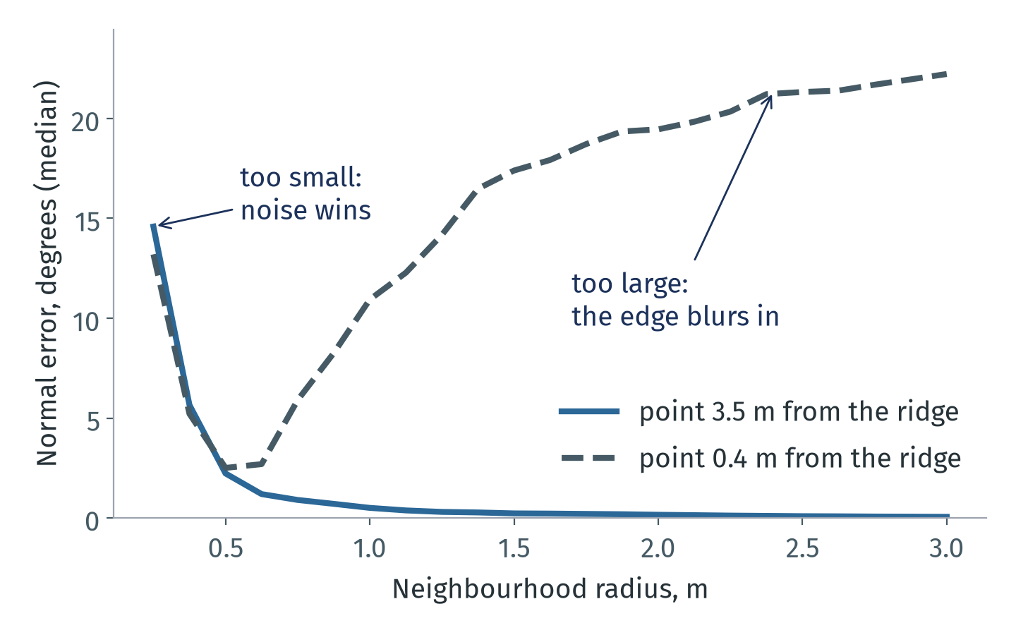
Neighbourhood size changes the answer
Points have no neighbours until you choose a radius; that choice is a model parameter.
Too small: a few noisy points, unstable normals and features.
Too large: the neighbourhood crosses edges and blurs them.
Tie the radius to point spacing; eps on slide 18 and the voxel on slide 16 are the same choice.
Notes:
TALK TRACK: A point cloud stores no neighbours, so every normal, curvature or eigenvalue feature starts with a choice: which points count as near. This chart is a synthetic roof at our density. Far from the ridge, a bigger neighbourhood just averages the noise away. Near the ridge, it helps up to about half a metre and then starts mixing in the other roof face, and the normal tilts. There is no universal radius: it depends on point spacing, noise and the size of the things you care about. DBSCAN's eps and the voxel size are the same decision in disguise.
WHY IT MATTERS: Normals, features, clustering and ground filters all depend on the neighbourhood; a radius tuned on one data set can fail on another density.
EXAMPLE: Open3D: pcd.estimate_normals(o3d.geometry.KDTreeSearchParamHybrid(radius=0.5, max_nn=30)); SciPy: KDTree(P).query_ball_point(P, r) for all points in one call. Analogy: judging the slope of a street from one paving stone versus the whole neighbourhood.
LIMITS AND DISAGREEMENTS:
• Synthetic data: the best radius here (about 0.5 m) is not a recommendation for other scans.
• Demantke et al. (2011) and Mitra and Nguyen (2003) choose the neighbourhood size per point instead of one global value; Weinmann et al. (2015) build on this for classification (their method detail UNVERIFIED here, paywalled).
• kNN neighbourhoods adapt to density, radius neighbourhoods keep a physical size; which is better depends on how uneven the density is (slide 30).
CITATIONS:
• Mitra and Nguyen: Estimating surface normals in noisy point cloud data, SoCG 2003, doi 10.1145/777792.777840: accuracy depends on noise, curvature, density and neighbourhood size
• Hoppe et al.: Surface reconstruction from unorganized points, SIGGRAPH 1992, doi 10.1145/142920.134011: normal from a plane fit to k neighbours
• Demantke et al.: Dimensionality based scale selection in 3D LiDAR point clouds, ISPRS Archives XXXVIII-5/W12, 2011
• Weinmann et al.: optimal neighborhoods, ISPRS J. 105, July 2015, doi 10.1016/j.isprsjprs.2015.01.016 (metadata verified; method summary UNVERIFIED, paywalled)
• Open3D point cloud tutorial, estimate_normals with KDTreeSearchParamHybrid (its 0.1 m radius suits indoor scans, not AHN spacing)
SOURCES AND STATUS:
• Bullet 1 "Too small: a few noisy points, unstable normals and...": status token; source: results/concepts.json c4.error_smallest_radius_deg; research: reports/mental_models.md section 5
• Bullet 2 "Too large: the neighbourhood crosses edges and blurs them.": status token; source: results/concepts.json c4.ridge_error_largest_radius_deg; research: reports/mental_models.md section 5 (Mitra and Nguyen)
• Bullet 3 "Tie the radius to point spacing; eps on slide 18 and the...": status judgement; source: judgement; slides 16 and 18
STATUS KEY: judgement = reasoning, not a measurement; token = filled from results/*.json.

Slide 45
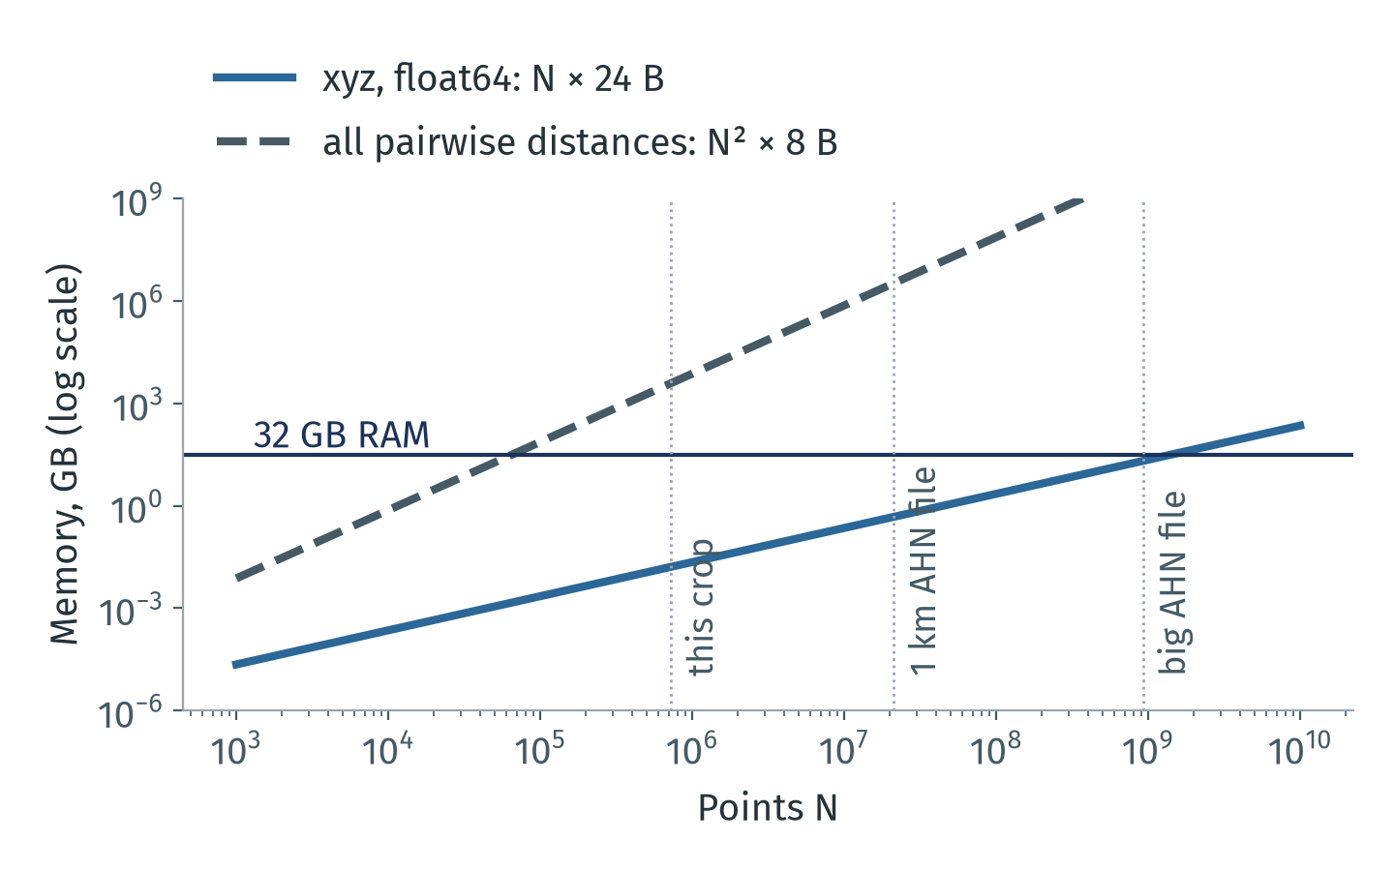
Memory follows N, and the algorithm
Linear work fits; anything quadratic in N never will. Pick algorithms by their growth.
This crop's pairwise distances: 3 894 GB. Its xyz: well under 1 GB.
Trees and grids keep neighbour search near N log N.
Past RAM, stream: chunks, tiles and COPC boxes (B2).
Notes:
TALK TRACK: Before you ask how fast, ask how it grows. Storing the points is linear: twenty-four bytes per point for float64 xyz, so even the big AHN file is about twenty gigabytes. Anything that compares every point with every other point is quadratic, and that line crosses our RAM before a hundred thousand points; for this crop it would be terabytes. That's why neighbour search goes through a tree or a grid, and why the RAM section of the talk streams chunks instead of loading everything. Big-O first, then the constant factors from the performance section.
WHY IT MATTERS: Scale decides feasibility before speed does; a correct method that is quadratic in N simply cannot run on real scans.
EXAMPLE: scipy.spatial.distance.pdist(P) on the crop would need terabytes; KDTree(P).query(P, k=8, workers=-1) does the neighbour job in one batched call. laspy.open(path).chunk_iterator(1_000_000) streams a file (B2).
LIMITS AND DISAGREEMENTS:
• Complexity classes hide constants: an N log N method with a Python loop per point can still lose (slides 24 to 26).
• KD-trees degrade towards linear query time in high dimensions; in 3D they behave well.
CITATIONS:
• Bentley: Multidimensional binary search trees, CACM 18(9), Sept 1975, doi 10.1145/361002.361007
• Friedman, Bentley, Finkel: logarithmic expected time best matches, ACM TOMS 3(3), 1977, doi 10.1145/355744.355745
• SciPy 1.18.0 KDTree docs: no Big-O stated; do not expect speed-ups in high dimensions
• laspy docs, chunk_iterator; PDAL docs, Pipeline stream mode (pdal.io, no date shown)
• Pairwise memory N squared × 8 B: arithmetic, no citation needed
SOURCES AND STATUS:
• Bullet 1 "This crop's pairwise distances: 3 894 GB. Its xyz: well...": status token; source: results/concepts.json c6.pairwise_gb_crop (crop points squared × 8 B)
• Bullet 2 "Trees and grids keep neighbour search near N log N.": status verified; source: research: reports/mental_models.md section 7 (KD-tree complexity)
• Bullet 3 "Past RAM, stream: chunks, tiles and COPC boxes (B2).": status verified; source: B2; research: reports/mental_models.md section 7 (laspy chunk_iterator, PDAL streaming)
STATUS KEY: token = filled from results/*.json; verified = checked in a research report.

Slide 46
Ideas outlive the library you use
Foundational idea, and how three libraries spell it (Open3D 0.20, PyVista 0.49, trimesh 5.1)
Idea | Open3D | PyVista | trimesh
Points as an N×3 array | PointCloud.points | PolyData(points) | PointCloud(vertices)
Surface with connectivity | TriangleMesh | PolyData with faces | Trimesh
Regular grid of cells | VoxelGrid | ImageData | Trimesh.voxelized(pitch)
Rigid transform, 4 by 4 | transform(T) | transform(T) | apply_transform(T)
Neighbourhoods | KDTreeFlann | find_closest_point | proximity, nearest
NumPy is the common language: every row converts with np.asarray, sometimes as a copy (slide 15).
Learn the idea once; map it to whichever library the job needs. None does everything (slide 13).
Names checked by import in this project's environment on 2026-10-12. APIs change between releases: read the docs of your version.
Notes:
TALK TRACK: This is the slide that separates what lasts from what changes. Points, surfaces, grids, transforms and neighbourhoods are the ideas; each library spells them differently. If you know the idea, switching from Open3D to PyVista or trimesh is a lookup, not a relearning. And NumPy arrays are how they talk to each other, with the copy or view question from slide 15 at every hand-off.
WHY IT MATTERS: Tools come and go (backup B7 lists the stale ones); the concepts transfer, and they are what you debug with.
EXAMPLE: The same 4 by 4 matrix T works in Open3D pcd.transform(T), PyVista mesh.transform(T) and trimesh mesh.apply_transform(T).
LIMITS AND DISAGREEMENTS:
• Not a ranking: each library has strengths the table does not show (Open3D: registration and reconstruction; PyVista: VTK filters and rendering; trimesh: mesh repair and queries).
• PyVista's transform returns a new object or works in place depending on version and arguments; check the docs of your version.
CITATIONS:
• NumPy 2.5 manual, Interoperability with NumPy (buffer protocol, __array_interface__, DLPack)
• PyPI release dates checked 2026-10-12: Open3D 0.20.0 (2026-09-16, 20 months after 0.19.0), PyVista 0.49.1 (2026-10-11), laspy 2.7.0 (2026-01-14), trimesh 5.1.1 (2026-10-02), pdal 3.5.5 (2026-07-31)
• Zhou, Park, Koltun: Open3D, arXiv 1801.09847, 2018-01-30; Sullivan and Kaszynski: PyVista, JOSS 4(37) 1450, 2019-05-19
SOURCES AND STATUS:
• Table row 1 "Points as an N×3 array": status verified; source: checked in the project venv 2026-10-12 (open3d 0.20.0, pyvista 0.49.0, trimesh 5.1.0); research: reports/mental_models.md section 8
• Table row 2 "Surface with connectivity": status verified; source: checked in the project venv 2026-10-12; research: reports/mental_models.md section 1
• Table row 3 "Regular grid of cells": status verified; source: checked in the project venv 2026-10-12 (hasattr on each name)
• Table row 4 "Rigid transform, 4 by 4": status verified; source: checked in the project venv 2026-10-12 (hasattr on each name)
• Table row 5 "Neighbourhoods": status verified; source: Open3D and trimesh names checked in the project venv; research: reports/mental_models.md section 5
• Bullet 1 "NumPy is the common language: every row converts with...": status verified; source: slide 15; results/python_facts.json; research: reports/mental_models.md section 8
• Bullet 2 "Learn the idea once; map it to whichever library the job...": status judgement; source: judgement; slide 13
STATUS KEY: judgement = reasoning, not a measurement; verified = checked in a research report.

Slide 47
Seven ideas worth presenting, in order
Priority for a beginner audience, and where each idea joins the main deck
# | Idea | One line for the audience | Joins at
1 | A point cloud is an array (slide 8) | N rows, x y z plus attributes, no order, no links | slide 8, rule 1
2 | Every array needs a frame (C2) | Reference system, units, origin, up axis | slide 14
3 | Neighbourhood size changes the answer (C4) | Radius, eps and voxel size are model choices | slides 16 to 18
4 | Samples, not the surface (C5) | Density and error vary; measure first | slide 30, in the main deck
5 | Memory follows N and the algorithm (C6) | Linear fits, quadratic never does | slide 22, rule 2
6 | Three representations (C1) | Points measure, meshes connect, voxels index | slide 8, in the main deck
7 | Transforms as matrices (C3) | One matrix per frame change, order matters | after slide 14
Narrative: what the data is (1, 6), where it is (2, 7), what is near what (3), how far to trust it (4), how big it gets (5). Close with C7: ideas outlive tools.
In the 30 minute slot the main deck carries 1, 4 and 6 in full (slides 8 and 30; the workflow ring is backup B8) and 2, 3 and 5 in short form; add C2 and C4 first if time allows.
Notes:
TALK TRACK: How to use this section. The ranking is for a mixed audience: first the ideas without which the pipeline makes no sense, last the ones that matter once you build your own. In a longer slot, unhide C2 after slide 14 and C4 after slide 18; each needs about a minute. In the 30 minute version, use them in Q&A, and say the one line in the third column at the slide named in the last column.
LIMITS AND DISAGREEMENTS:
• The ranking is judgement for an introductory audience; a robotics or graphics audience would put transforms (C3) and meshes (C1) first.
CITATIONS:
• Poux: 3D Data Science with Python, O'Reilly, 2025, for a book-length treatment (retailers disagree on the exact date)
• Guo et al. survey, TPAMI Dec 2021, for the deep learning side not covered here
SOURCES AND STATUS:
• Table row 1 "1": status judgement; source: slides 8 and 10
• Table row 2 "2": status judgement; source: C2
• Table row 3 "3": status judgement; source: C4
• Table row 4 "4": status judgement; source: C5
• Table row 5 "5": status judgement; source: C6
• Table row 6 "6": status judgement; source: C1
• Table row 7 "7": status judgement; source: C3
• Bullet 1 "Narrative: what the data is (1, 6), where it is (2, 7)...": status judgement; source: judgement
• Bullet 2 "In the 30 minute slot the main deck carries 1, 4 and 6 in...": status judgement; source: docs/TIMING.md; judgement
STATUS KEY: judgement = reasoning, not a measurement.

Slide 48
Glossary of 3D data terms
Term | Meaning in this talk
Point cloud | An unordered set of 3D points, stored as an N×3 array plus attribute columns
Mesh | Vertices plus faces (usually triangles) that define a surface
Voxel | A cell of a regular 3D grid; voxel downsampling keeps one point per cell
CRS | Coordinate reference system: what the numbers mean on Earth (here RD New + NAP)
Rigid transform | Rotation plus translation, written as one four by four matrix
Neighbourhood | The points within a radius or the k nearest; found with a KD-tree or grid
Normal | Direction perpendicular to the local surface, estimated from a neighbourhood
Density | Points per square metre; varies with overlap, occlusion and surface
LAS, LAZ, COPC | LiDAR file format; its compressed form; LAZ organised as an octree for box reads
Return | One echo of a laser pulse; a pulse through a tree can give several
Notes:
TALK TRACK: Reference slide for Q&A and for the handout. Every term is used with exactly this meaning in the talk; tile means the processing squares only, and AHN file means a download.
CITATIONS:
• COPC 1.0 specification (copc.io, 2021, no exact date): a LAZ 1.4 file organised as a clustered octree
• ASPRS LAS 1.4 R16 (2025-08-27); LAS 1.5 R00 approved Aug 2025 (lasformat.org)
SOURCES AND STATUS:
• Table row 1 "Point cloud": status verified; source: research: reports/mental_models.md section 1
• Table row 2 "Mesh": status verified; source: research: reports/mental_models.md section 1
• Table row 3 "Voxel": status verified; source: research: reports/mental_models.md section 1; slide 16
• Table row 4 "CRS": status verified; source: research: reports/mental_models.md section 3
• Table row 5 "Rigid transform": status verified; source: research: reports/mental_models.md section 4
• Table row 6 "Neighbourhood": status verified; source: research: reports/mental_models.md section 5
• Table row 7 "Normal": status verified; source: research: reports/mental_models.md section 5
• Table row 8 "Density": status verified; source: research: reports/mental_models.md section 6
• Table row 9 "LAS, LAZ, COPC": status verified; source: research: reports/mental_models.md section 2
• Table row 10 "Return": status verified; source: slide 19; research: reports/mental_models.md section 6
STATUS KEY: verified = checked in a research report.

