Slide 1

3D Data Science with Python
Sergio Peral · ML Engineer, Teqyard
Notes:
TALK TRACK: Quick show of hands: who has written this loop? Keep it up if it finished before your coffee went cold. In 30 minutes you get a pipeline you can copy and the gotchas that cost me weeks; first, a confession about C++.
TIME: 20 s, ends at 0:20
LIKELY QUESTION: Does that loop really take until tomorrow on 12 million points?
ANSWER: The 12 million is the abstract's joke, not our data: this crop has 722 961 points and the 1 km AHN file 21 013 926. I haven't timed a 12 million point loop, so I don't quote a time; what I did measure is the cost per loop step, on slide 23.
CHECK BEFORE THE TALK:
• The code line is the abstract's joke word for word, as the speaker asked (it is a joke, not runnable: a loop body of only a comment would raise IndentationError). Fira Mono has no cup glyph: PowerPoint falls back to an emoji font; check the cup renders on the presenting laptop
TRACE:
• Code line: the talk abstract, with '...' as the loop body; shown, not run
• results/pipeline.json: points_in
• results/memory.json: tile_1km.points

Slide 2
3D used to mean C++. Not anymore
C++ with PCL
Python with Open3D
using Cloud =
pcl::PointCloud<pcl::PointXYZ>;
Cloud::Ptr cloud(new Cloud);
Cloud down;
if (pcl::io::loadPCDFile(
"crop.pcd", *cloud)) return 1;
pcl::VoxelGrid<pcl::PointXYZ> vg;
vg.setInputCloud(cloud);
vg.setLeafSize(0.5f, 0.5f, 0.5f);
vg.filter(down);
std::cout << cloud->size()
<< " -> " << down.size() << "\n";
pcd = o3d.io.read_point_cloud(path)
down = pcd.voxel_down_sample(0.5)
print(len(pcd.points), "->",
len(down.points))
# output
722961 -> 232180
Why the counts differ: both average the points in each 0.5 m voxel, but the grids sit in different places. PCL anchors its voxels at multiples of the leaf size; Open3D at the minimum corner minus half a voxel.
# output
722961 -> 230519
C++ output: recorded Linux / PCL run; not rerun on this machine.
Notes:
TALK TRACK: For years, serious 3D work meant C++, like the greyed-out code on the left. Both programs on this slide are real: I compiled the PCL one and ran both on the same file from today's case, and the output under each is what they printed. Twelve lines of C++ against three of Python for the same job: load the cloud and keep one average point per half-metre voxel. The C++ is still there underneath; you just stopped writing it, and if that feels like flying, you're not the first.
TIME: 35 s, ends at 0:55
LIKELY QUESTION: Why do the two counts differ?
ANSWER: Both average the points in each 0.5 m voxel, but the grids sit in different places: PCL anchors its voxels at multiples of the leaf size, Open3D at the minimum corner minus half a voxel. Redoing both rules in NumPy on the same file gives exactly the two counts on the slide. Neither is wrong; it's a reminder that 'voxel downsampling' is a family of algorithms.
CHECK BEFORE THE TALK:
• To rerun the C++ side: PCL_PREFIX=<micromamba env> uv run python snippets/run_all.py (docs/HOW_TO_UPDATE.md step 4); without PCL_PREFIX the .cpp is listed as NOT RUN and the left output box would still show the last recorded line
TRACE:
• snippets/s02_pcl.cpp: compiled and run on 2026-10-12, PCL 1.15.1 and g++ 15.3.0 from conda-forge in a user-space micromamba env; build: g++ -std=c++17 -O2 -Wall -Wextra s02_pcl.cpp $(pkg-config --cflags --libs pcl_io pcl_filters), no warnings
• snippets/s02_python.py; both read the same crop.pcd, written by snippets/_setup.py write_crop_pcd (local coordinates, float32 in the file)
• results/snippets.json: s02_pcl.cpp.output_line, s02_python.py.output_line (the two output boxes), compiler, pcl_version, build_cmd
• Grid anchoring: PCL filters/impl/voxel_grid.hpp floor(p * inverse_leaf); Open3D PointCloud::VoxelDownSample, GetMinBound() - voxel_size / 2; both re-implemented in NumPy on crop.pcd give the same counts

Slide 3

Python is the interface. C++ does the work
Every call you make here runs compiled code
NumPy: a compiled C core, with some C++
Open3D: C++, wrapped for Python
PyVista: VTK, which is C++
laspy: the lazrs decoder is Rust
Python is used as a proxy to write higher-level code: the heavy loops run below it, in compiled code.
Notes:
TALK TRACK: Let's see who's really behind the mask. Python is the interface. Take NumPy: when you add two arrays, a compiled C core does the loop, with some C++ in parts. Open3D is C++, PyVista draws with VTK, also C++, and laspy decodes with Rust. So the C++ never went away; you just call it from Python, and the next slides use exactly that.
TIME: 30 s, ends at 1:25
LIKELY QUESTION: Is Python really just a wrapper?
ANSWER: For the heavy 3D libraries, yes: Open3D and VTK (under PyVista) are C++, NumPy's core is C with some C++, and the lazrs decoder behind laspy is Rust; Python calls compiled code. That is also why the hand-off between libraries on slide 10 costs something.
CHECK BEFORE THE TALK:
• NumPy is mostly C (its core), with C++ in parts and BLAS/LAPACK underneath; the slide says "a compiled C core, with some C++" on purpose. Say "C++" for Open3D and VTK, which are C++ throughout
• Legibility: the caption and both logos should read from the back of the room (check on the presenting projector). The template and the logos belong to their owners; no endorsement is implied (small print on the slide)
TRACE:
• deck/assets/meme/python_cpp_unmasking.png: the Scooby-Doo unmasking template with the Python and C++ logos added
• Logos: Wikimedia Commons, Python-logo-notext.svg and ISO_C++_Logo.svg
• Credit (was the slide caption, moved here 2026-10-13): meme template: the Scooby-Doo unmasking scene (Hanna-Barbera). Python and C++ logos belong to their owners; no endorsement implied.

Slide 4
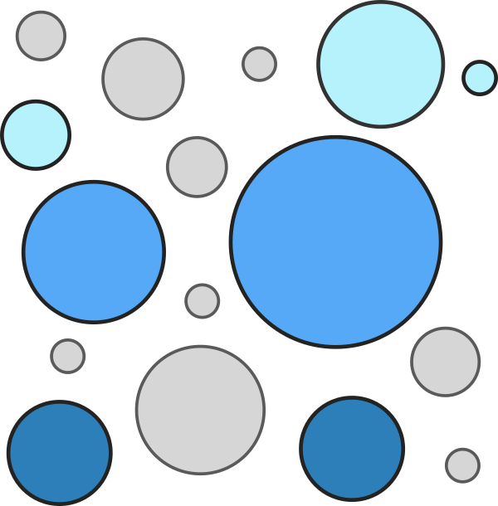











The Python 3D ecosystem
Load and store
laspy
PDAL
pyproj
Arrays and speed
SciPy
Numba
Process
Visualise
Learn
scikit-learn
Notes:
TALK TRACK: Before the hall: the Python 3D ecosystem, one row per layer, and only what this talk uses or names. The five with a blue outline are today's pipeline: laspy, NumPy, SciPy, Open3D and PyVista. The rest come up later: PDAL and pyproj for AHN files and Dutch coordinates, Numba and Dask when NumPy or RAM runs out, trimesh for meshes, and scikit-learn and PyTorch when rules stop being enough. The repo lists every library I checked, with status and licence.
TIME: 30 s, ends at 1:55
LIKELY QUESTION: Why is my favourite library not on the wall?
ANSWER: The wall is the selection this talk uses or mentions, from the 119 libraries and applications I checked. The full list is docs/ECOSYSTEM.md in the repo, with status, licence and release date per library. Open an issue or a pull request if one is missing.
IF SKIPPED: Not on the skip list (30 s); if very late at the start, say 'photograph this' and click on to slide 5.
CHECK BEFORE THE TALK:
• Logo use: logos are shown to identify projects; brand policies per file in deck/assets/logos/SOURCES.md and docs/OPEN_ITEMS.md. No company logos are on the wall. If one is not acceptable, remove its id from the wall row in content.yaml; the row closes up
• Logos are in their own colours (an exception to the palette, docs/DESIGN.md); the tiles are white or light grey so each logo stays legible
TRACE:
• Small print: Blue outline: used in today's pipeline. Logos belong to their owners; no endorsement implied. 119 libraries checked on PyPI and GitHub: docs/ECOSYSTEM.md in the repo.
• deck/ecosystem/ecosystem.yaml (merged by deck/ecosystem/merge.py from part1 to part3; each entry's evidence list: PyPI JSON and GitHub API, 2026-10-11)
• results/ecosystem.json: n_entries
• docs/ECOSYSTEM.md (same data); logo sources and brand-policy notes: deck/assets/logos/SOURCES.md
• Layers as the ecosystem map in Matthew Turk's SciPy 2016 talk on yt: research: reports/videos.md V4
RELEVANCE:
• Used in the pipeline (blue outline): laspy (load), NumPy (every step), SciPy (KDTree: height above ground, distances, paint-back), Open3D (voxels, RANSAC, DBSCAN), PyVista (renders)
• VTK: PyVista's engine, drawn under it
• PDAL: the standard LiDAR pipeline tool for AHN and COPC files (backup B2 territory); pyproj: RD New (EPSG:28992) to and from WGS84, slide 5; laspy's header.parse_crs() needs it
• Numba (B1, the escape hatch for a kernel that has no batched call) and Dask (arrays bigger than RAM, slide 26)
• trimesh and PyTorch3D: named on slide 9 as not in this pipeline; scikit-learn: the Random Forest of backup B5. PyTorch (backup B3) is dropped from the wall, PyTorch3D covers the Learn row
• Dropped on 2026-10-12 as not relevant to this talk: Potree, CloudCompare and QGIS (not Python libraries), GDAL (rasters), OpenCV, COLMAP and nerfstudio (images and photogrammetry), Matplotlib (not used), PyG and Pointcept (deep learning on point clouds, not covered)

Slide 5

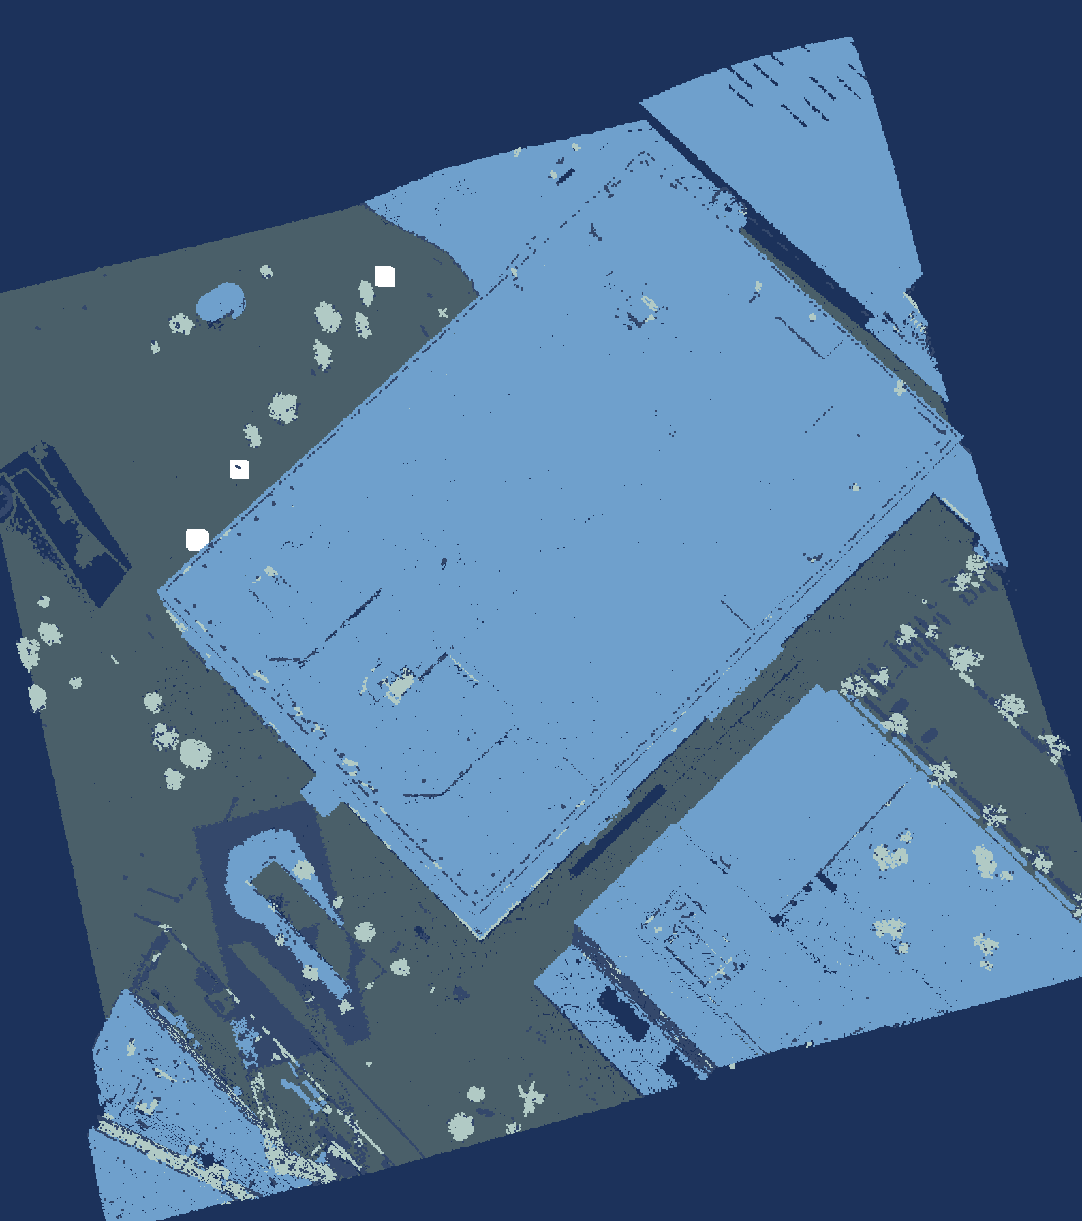
Today's case: the Jaarbeurs hall, from a plane
The data set
Jaarbeurs hall
Area
200 m × 200 m
Points
722 961
Density
about 18 per m²
Source
AHN5, ahn.nl
Flown
April 2023, night
File
LAZ, 4.3 MB
Coordinates
RD New + NAP
Licence
CC BY 4.0
Goal: ground, buildings, vegetation, street furniture; scored against AHN.
Data: AHN5, Het Waterschapshuis, CC BY 4.0.
Notes:
TALK TRACK: This is our case for the whole talk: a 200 by 200 metre square of Utrecht around the Jaarbeurs hall, the big flat roof under the arrow. The data set: 722 961 points, about 18 per square metre, from AHN5, the Dutch national elevation dataset, flown at night in April 2023 while the trees had no leaves. It's one 4.3 MB LAZ file in RD New coordinates with NAP heights, so everything is in metres, and it's CC BY 4.0, so you can use it too. AHN arrives already classified; I hid its labels, and the goal is to rebuild four classes, ground, buildings, vegetation and street furniture, and score ground and buildings against AHN's own. First: what is this thing, as data?
TIME: 65 s, ends at 3:00
LIKELY QUESTION: Why this square and not a whole AHN file?
ANSWER: It's the venue, and it's small enough to run every step live in under a second, which is rule three, make it small first. The whole 1 km file has 21 million points; slide 26 shows what happens to memory when you load it, and how to stream it instead.
CHECK BEFORE THE TALK:
• Confirm which Jaarbeurs building the talk room is in. If it is this one, say 'the building we're sitting in'; the name of the building (Beatrixgebouw?) is UNVERIFIED, so the talk says only 'the Jaarbeurs hall at Jaarbeursplein 6'
TRACE:
• renders/f1_load.png (left frame), renders/f6_final.png (right frame)
• renders/render_spec.json
• renders/labels.json: f6_final (label chips), f1_load.jaarbeurs_edge (edge arrow position)
• results/pipeline.json: ground, buildings, crop.bbox_rd
• data/utrecht_jaarbeurs_200m.laz (crop box: data/fetch_ahn5.py CROP_BBOX_RD, RD 135715, 455475 to 135915, 455675)
• The hall: BAG pand 0344100000077882 (Jaarbeursplein 6, built 1970, use: bijeenkomstfunctie), footprint bbox RD 135747.7, 455512.5 to 135905.8, 455654.0, from the PDOK BAG WFS and locatieserver, checked 2026-10-11 (pipeline/render.py HALL_BBOX_RD)
• Arrow on the roof: renders/labels.json f1_load.jaarbeurs_hall; evidence in renders/render_spec.json labels.detail.f1_load.jaarbeurs_hall_note
• Class 1 definition ('overig'): AHN4 acquisition spec, research: reports/dataset.md
• Venue: Jaarbeurs Utrecht is the PyCon NL 2026 venue, confirmed on pycon-nl.org (research: reports/dataset.md); which building the talk room is in is UNVERIFIED
• Data set table: data/README.md (crop box, classes, flight time, file size), results/pipeline.json crop (points, classes); density computed from points and area
DATA SET:
• Area: RD New box x 135715 to 135915, y 455475 to 455675 (200 m by 200 m, 4 ha), cut from the 1 km AHN5 file 135000_455000 (21 013 926 points, 130 MB COPC LAZ)
• Points: 722 961; density 722 961 / 40 000 m2 = 18.1 points per m2 (all returns)
• Flown: one strip, GPS time about 23:51 UTC on 5 April 2023 (01:51 CEST on 6 April), leaf-off as AHN's spec asks
• File: LAS 1.4, point format 6 (x, y, z, intensity, return number, number of returns, classification, scan angle, GPS time); no colour; 4 336 320 bytes
• Coordinates: RD New (EPSG:28992), heights in m NAP; z from about -0.8 m to 101.6 m; the WKT record is in the file
• AHN classes in the crop: 1 other 109 363, 2 ground 262 712, 6 building 338 943, 26 civil structure 11 943; hidden from the pipeline, used only to score
• Licence: CC BY 4.0, Het Waterschapshuis; attribution on every slide that shows the data

Slide 6
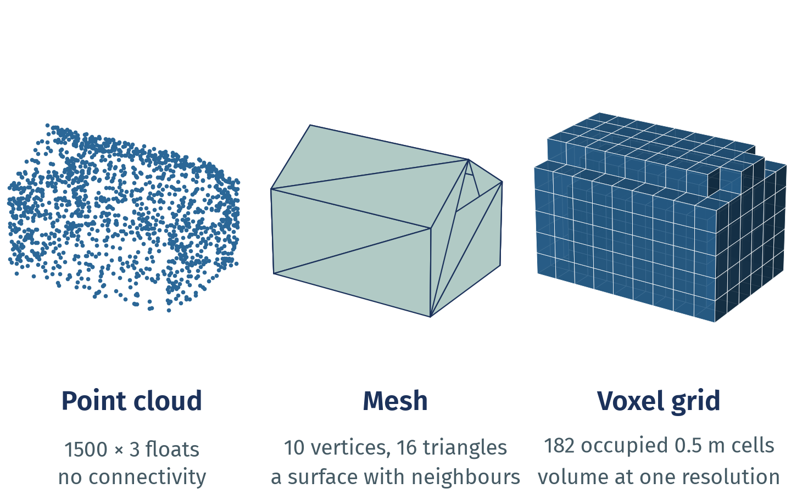
One object, three representations
Points measure, meshes connect, voxels index space. Convert only when the task needs it.
Point cloud: an unordered N×3 array plus attributes; no neighbours stored.
Mesh: vertices plus faces, so surfaces, normals and areas are defined.
Voxel grid: occupied cells at one resolution; detail below a cell is gone.
Notes:
TALK TRACK: What is this thing, as data? One house, drawn three ways. A scanner gives you the left one, a point cloud: an N by 3 array of x, y and z plus a column per attribute, samples of the surface with nothing joining them. A mesh adds the connections, so area and volume exist. A voxel grid trades exact positions for a regular index of space. Today's pipeline stays with points and uses voxels only to downsample. Each of the three trades something.
TIME: 40 s, ends at 3:40
LIKELY QUESTION: Should I turn my point cloud into a mesh or voxels first?
ANSWER: Only when the question needs it: area, volume or a solid render want a mesh; occupancy and neighbour lookups like voxels. Every conversion loses detail and adds a parameter you then have to defend, such as the voxel size or the meshing depth. This pipeline stays with points.
TRACE:
• deck/appendix.yaml C1 (bullets, figure, citations; shown here as a main slide)
• deck/concepts/make_figures.py: deck/assets/concepts/c1_representations.png, results/concepts.json c1
• research: reports/mental_models.md section 1
WHY IT MATTERS: Choosing the representation decides which questions are cheap. Converting costs detail and adds a parameter you now have to justify.
EXAMPLE: Open3D: o3d.geometry.VoxelGrid.create_from_point_cloud(pcd, voxel_size) and TriangleMesh.create_from_point_cloud_poisson(pcd); PyVista: PolyData for points and meshes, ImageData for regular grids; trimesh: mesh.voxelized(pitch). Analogy: a dot-to-dot puzzle before the lines (points), after the lines (mesh), and as pixel art (voxels).
LIMITS AND DISAGREEMENTS:
• The figure is synthetic and tiny; real meshes from scans need cleaning and are rarely watertight.
• Dense voxel grids grow with the cube of the resolution; sparse structures (hashing, octrees) avoid that. Which is best depends on the task.
• Deep learning uses all three (point-based, mesh-based, voxel or sparse convolution); no representation wins everywhere (Guo et al. survey).
CITATIONS:
• Qi, Su, Mo, Guibas: PointNet, CVPR 2017 (arXiv 1612.00593, v2 10 Apr 2017), point sets are unordered
• Open3D 0.20.0 docs: PointCloud, TriangleMesh, voxelization tutorial (open3d.org/docs/latest, no date shown)
• PyVista 0.49.1 docs: What Is a Mesh? (docs.pyvista.org/user-guide/what-is-a-mesh.html, no date shown): a point cloud is a mesh without connectivity
• trimesh 5.1.1 docs (trimesh.org; PyPI 2026-10-02)
• Choy, Gwak, Savarese: Minkowski CNNs, CVPR 2019 (arXiv 1904.08755), sparse voxels
• Guo et al.: Deep Learning for 3D Point Clouds: A Survey, IEEE TPAMI 43(12), Dec 2021, doi 10.1109/TPAMI.2020.3005434
• Poux: 3D Data Science with Python, O'Reilly, 2025 (ISBN 9781098161330)
SOURCES AND STATUS:
• Bullet 1 "Point cloud: an unordered N×3 array plus attributes; no...": status verified; source: research: reports/mental_models.md section 1 (PointNet, Open3D PointCloud)
• Bullet 2 "Mesh: vertices plus faces, so surfaces, normals and areas...": status verified; source: research: reports/mental_models.md section 1 (Open3D TriangleMesh, PyVista data model, trimesh)
• Bullet 3 "Voxel grid: occupied cells at one resolution; detail below...": status verified; source: research: reports/mental_models.md section 1 (Open3D VoxelGrid; sparse voxels)
STATUS KEY: verified = checked in a research report.

Slide 7
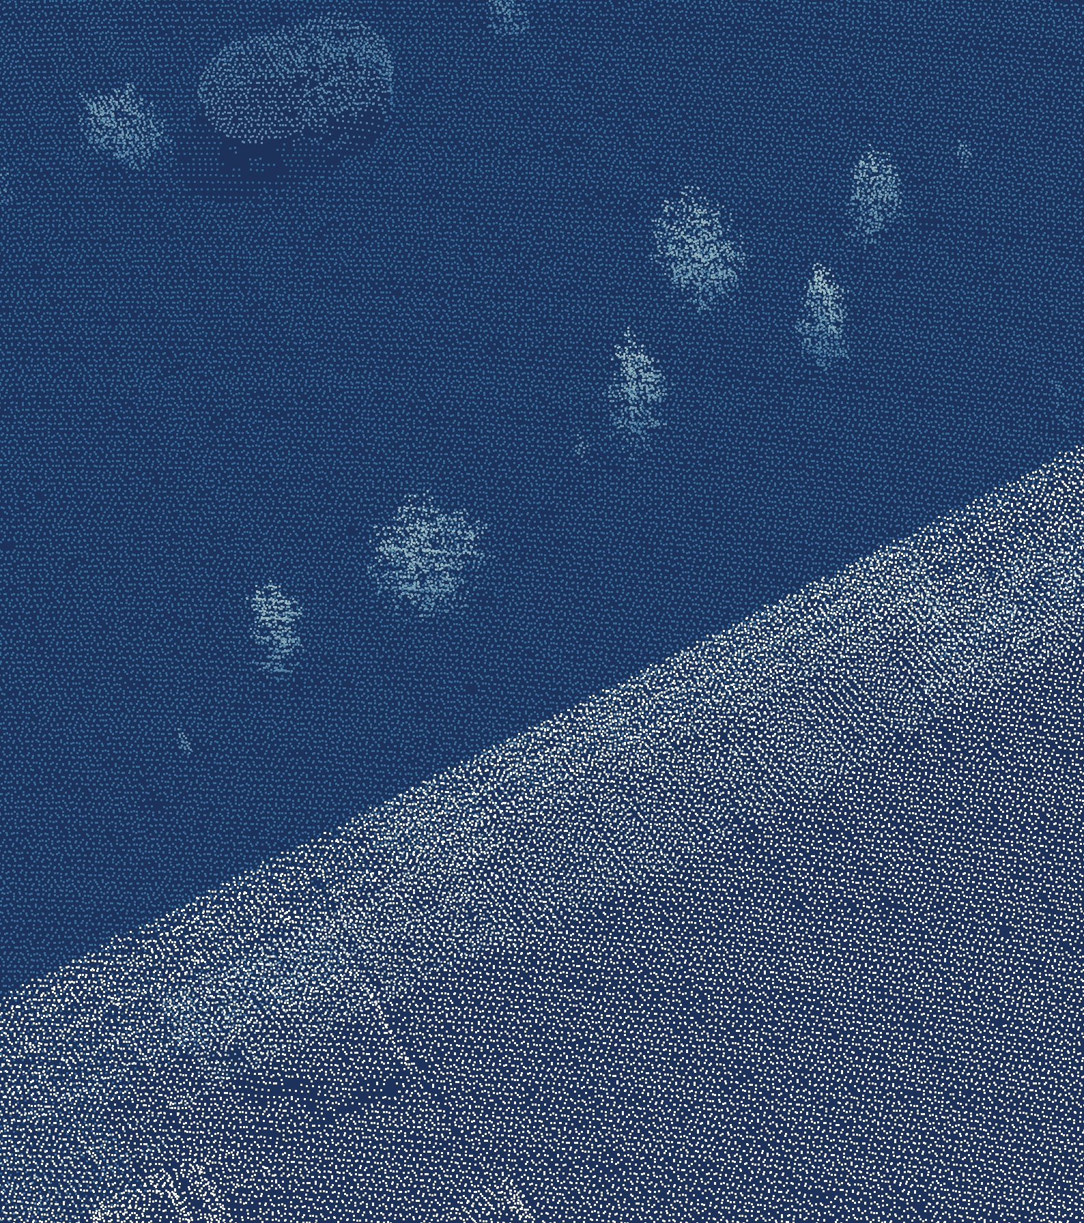
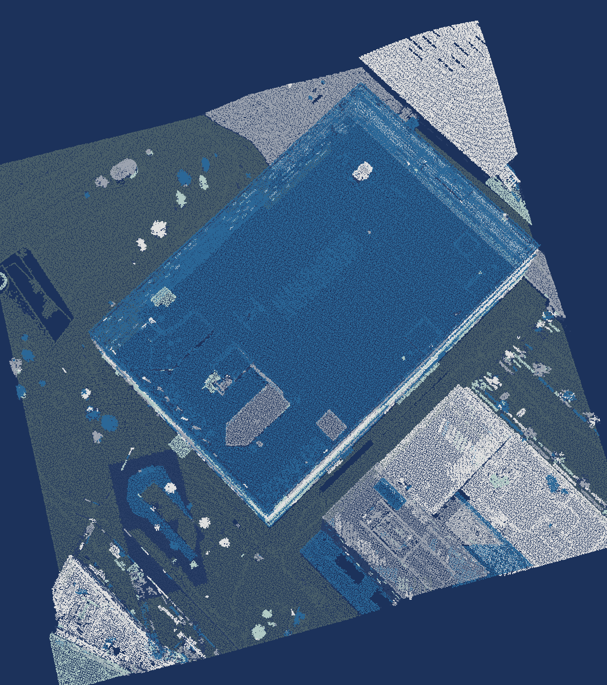
A 3D project moves through six stages
Acquisition
Scan the scene
laspy
Preparation
Clean and register
NumPy, Open3D
1
2
Application
Ship it
Loop back when the data surprises
Exploration
Model and label
Open3D, SciPy
6
3
Visualisation
See it, trust it
PyVista
Analysis
Measure, monitor
NumPy, SciPy
5
4
Data: AHN5, Het Waterschapshuis, CC BY 4.0.
Notes:
TALK TRACK: Whatever the data, a 3D project goes round the same ring, and each stage has its Python tool. The two dark blue stages get the data. One, acquisition: a scanner, a camera or a depth sensor gives you raw points, and laspy reads them from the LAZ file; this is what single points look like. Two, preparation: you clean the data and register scans into one coordinate system, with NumPy and Open3D. NumPy is the glue throughout: every library hands the next one an N by 3 array. The two lighter blue stages understand it. Three, exploration: Open3D and SciPy give you voxels, planes and clusters, here each cluster in its own colour. Four, analysis: you measure and monitor, again in NumPy and SciPy. The two green stages deliver it. Five, visualisation: PyVista draws the result, because you need to see it to trust it. Six, application: it ends up in a product. And the dashed arrows are the real story: you loop back, from analysis to preparation, from a render to a re-scan, whenever the data surprises you. Today's example is a small version of stages one to five. First, four rules of thumb I wish I'd had on day one.
TIME: 145 s, ends at 6:05
LIKELY QUESTION: Where does most of the time go?
ANSWER: Preparation, nearly always. Registration, cleaning and checking coordinates take far longer than any model, which is why the rules of thumb on the next slide are about getting the data small and trustworthy first.
TRACE:
• content.yaml slide 7 stages (the former chain slide merged in: laspy, NumPy, Open3D, PyVista with an image each); simplified from Figure 1-12, "A high-level view of the 3D data science workflow", in the book 3D Data Science with Python (O'Reilly)

Slide 8
Four rules of thumb for 3D data
1
Think in arrays, not
points
2
Look before you
compute
A point cloud is an N×3 table plus attribute columns.
Render it; check units, coordinates and classes.
3
Make it small first
4
Let compiled code loop
Crop, tile and downsample; scale up last.
One call per array or tile, never per point.
Notes:
TALK TRACK: Four rules of thumb for 3D data; they're the mental model for the rest of the talk, and I'll bring them back at the end with numbers. One: think in arrays, not points: a point cloud is a table, so work on whole columns. Two: look before you compute: render it, check units, coordinates and classes, because most 3D bugs are silent. Three: make it small first: crop, tile and downsample until it's fast to try things, then scale up. Four: let compiled code do the loops: one call per array or per tile, never one per point. Now, which library does what?
TIME: 45 s, ends at 6:50
LIKELY QUESTION: Aren't these just general data science rules?
ANSWER: Mostly, yes, and that's the point: 3D data is less exotic than it looks. What changes is the scale and the silence: a wrong coordinate system or float32 rounding doesn't raise an error, it just moves your points by centimetres, and a loop over points is a loop over millions.
TRACE:
• content.yaml slide 8 rules; the same four rules close the talk on slide 27 with their evidence
WHERE IN THE TALK:
• 1 Think in arrays: slides 6, 10 and 11 (N by 3 arrays, copy or view at every hand-off)
• 2 Look before you compute: slides 5, 20 and 26 (AHN classes, street furniture against the BGT register, the gotchas)
• 3 Make it small first: slides 13 and 15 (voxels, tiles, streaming chunks)
• 4 Let compiled code loop: slides 21 to 25 (the quiz, the toll, the profiler, free threads)
MENTAL MODEL: The rules rest on the hidden mental-models section (C2 to C9, with citations; C1 and C5 are slides 6 and 20; slide 7 is the workflow); C8 ranks the ideas and says where each joins the talk.

Slide 9
No single library does the whole job
Load
Voxel
downsampling
Ground
removal
Clustering
Labelling
Visualisation
laspy
LAS/LAZ in and out
Open3D
downsampling, planes, DBSCAN
PyVista
off-screen renders
SciPy KDTree
batch neighbour queries
NumPy
the arrays every step passes on
Notes:
TALK TRACK: Here's the landscape, mapped onto the six steps we're about to run, with NumPy carrying the arrays from step to step. laspy reads and writes LAS and LAZ, in chunks if you ask; Open3D does the heavy work: voxel downsampling, plane fitting and DBSCAN. SciPy's KDTree answers neighbour questions for all points in one call, and PyVista renders every image in this talk. So how do these libraries hand data to each other?
TIME: 55 s, ends at 7:45
LIKELY QUESTION: [pending]
ANSWER: [pending]
TRACE:
• research: reports/libraries.md section 1 (PyPI JSON fetched 2026-10-01, libraries/pypi/*.json)
• pipeline/run.py, pipeline/steps.py (imports: no trimesh; per-cluster features use NumPy, pipeline/steps.py cluster_features)
• results/pipeline.json: versions
• trimesh convex_hull and bounding_box_oriented checked on one pole: research: reports/libraries.md section 2 (libraries/06_trimesh_interop.py)
MENTAL MODEL: Hidden C7 (ideas outlive the library you use): the same idea spelled in Open3D, PyVista and trimesh.

Slide 10
Use views, not copies
An extra xyz copy costs 24 B per point → 0.5 GiB per 1 km file.
The problem: copies
copy
The solution: views
view
a
new memory → costs time & RAM
a
same memory → free, writes show through
b
b
las.xyz
copy
new array, every access
Vector3dVector(xyz)
copy
float32: 39× slower
np.asarray(pcd.points)
view
writes reach the point cloud
pv.PolyData(pts)
view
same memory as pts
Conditions: Ryzen 7 5700X, Python 3.13.15, NumPy 2.5.3; 722 961 points, median of 7 runs; AHN5 crop (CC BY 4.0). Full: results/python_facts.json.
Notes:
TALK TRACK: The chain works because Python passes whole arrays, not points, and every hand-off is either a copy or a view. The legend is the one idea: a copy is new memory, two names on two blocks, so it costs time and RAM, and changing one leaves the other alone. A view is two names on one block: free, but a write through one shows up in the other. las.xyz builds a brand-new array every time you touch it, so name it once. Vector3dVector always copies, and given float32 it takes a slow path, 39× slower. On the way back, np.asarray(pcd.points) is a writeable view, and PyVista's PolyData shares that same memory. Why it matters: every xyz copy is 24 bytes per point, half a gigabyte for one 1 km AHN file. Now, the six steps.
TIME: 70 s, ends at 8:55
LIKELY QUESTION: Why does Vector3dVector copy at all?
ANSWER: Open3D keeps its points in its own C++ vector, which is what the name says, so it has to own that memory; np.asarray on the way back is a view into it, which is why writes reach the cloud. The fast way in is a C-ordered float64 array: 1.7 ms, against 8.2 ms for laspy's column-ordered one and 317 ms for float32.
IF SKIPPED: Skip-first number 5 (decide at the end of slide 9). If skipped, say on slide 11: "between the libraries Python passes whole arrays; Vector3dVector copies, np.asarray gives you a view".
TRACE:
• bench/python_facts.py (copy or view: write to one side, read the other, and np.shares_memory; timings 1 warm-up and 7 runs, median and IQR, idle check)
• results/python_facts.json: las_xyz.fresh_copy_each_access, las_xyz.f_contiguous, vector3dvector.copies, asarray_points.view, asarray_points.writeable, polydata.shares_memory_open3d_view, polydata.shares_memory_c_float64, timings.*, factor_v3d_float32_vs_float64_f, conditions
• snippets/s06b_handoffs.py (the four calls on the crop, with asserts); results/snippets.json: s06b_handoffs.py.ok
• pv.PolyData of laspy's F-ordered array does not share memory (results/python_facts.json polydata.shares_memory_f_float64); the slide's pts is Open3D's C-ordered view
• Candidate gotchas 'las.xyz' and 'Vector3dVector(float32)' are measured here (their slide is removed)
CONDITIONS IN FULL (the slide shows the short line): Conditions: Ryzen 7 5700X, 8 cores / 16 threads, 31.3 GiB RAM; Linux (Omarchy, kernel 7.2.5-3-omarchy); Python 3.13.15, NumPy 2.5.3, SciPy 1.18.1, Open3D 0.20.0, laspy 2.7.0, PyVista 0.49.0; N = 722 961 points, 7 runs after 1 warm-up, median and IQR of wall time over the timed runs; governor performance; boost on; measured 2026-10-11 20:06 UTC; data: the AHN5 crop of slide 5 (ahn.nl, Het Waterschapshuis, CC BY 4.0). Copy or view: checked by writing to one side and reading the other, and with np.shares_memory. float32: Vector3dVector of a float32 copy, 317 ms, against the float64 xyz of slide 12, 8.2 ms.
WHY IT MATTERS:
• Memory: one float64 xyz copy is 24 B per point (results/memory.json); 21 013 926 points × 24 B = 0.47 GiB per copy of a 1 km AHN file, and the load-everything pipeline holds several (slide 25)
• Time: copying the crop into Open3D takes 1.7 ms from a C-ordered float64 array, 8.2 ms from laspy's column-ordered one and 317 ms from float32; np.asarray(pcd.points) takes 15 µs, because it copies nothing
• Correctness: a write through a view changes the point cloud behind it (np.asarray(pcd.points) -= origin moves Open3D's points); a write to a copy is silently lost (las.xyz[:] = 0 changes nothing in the file data)
• Rule of thumb: name an array once, pass it on, and copy only on purpose (astype, np.ascontiguousarray)

Slide 11
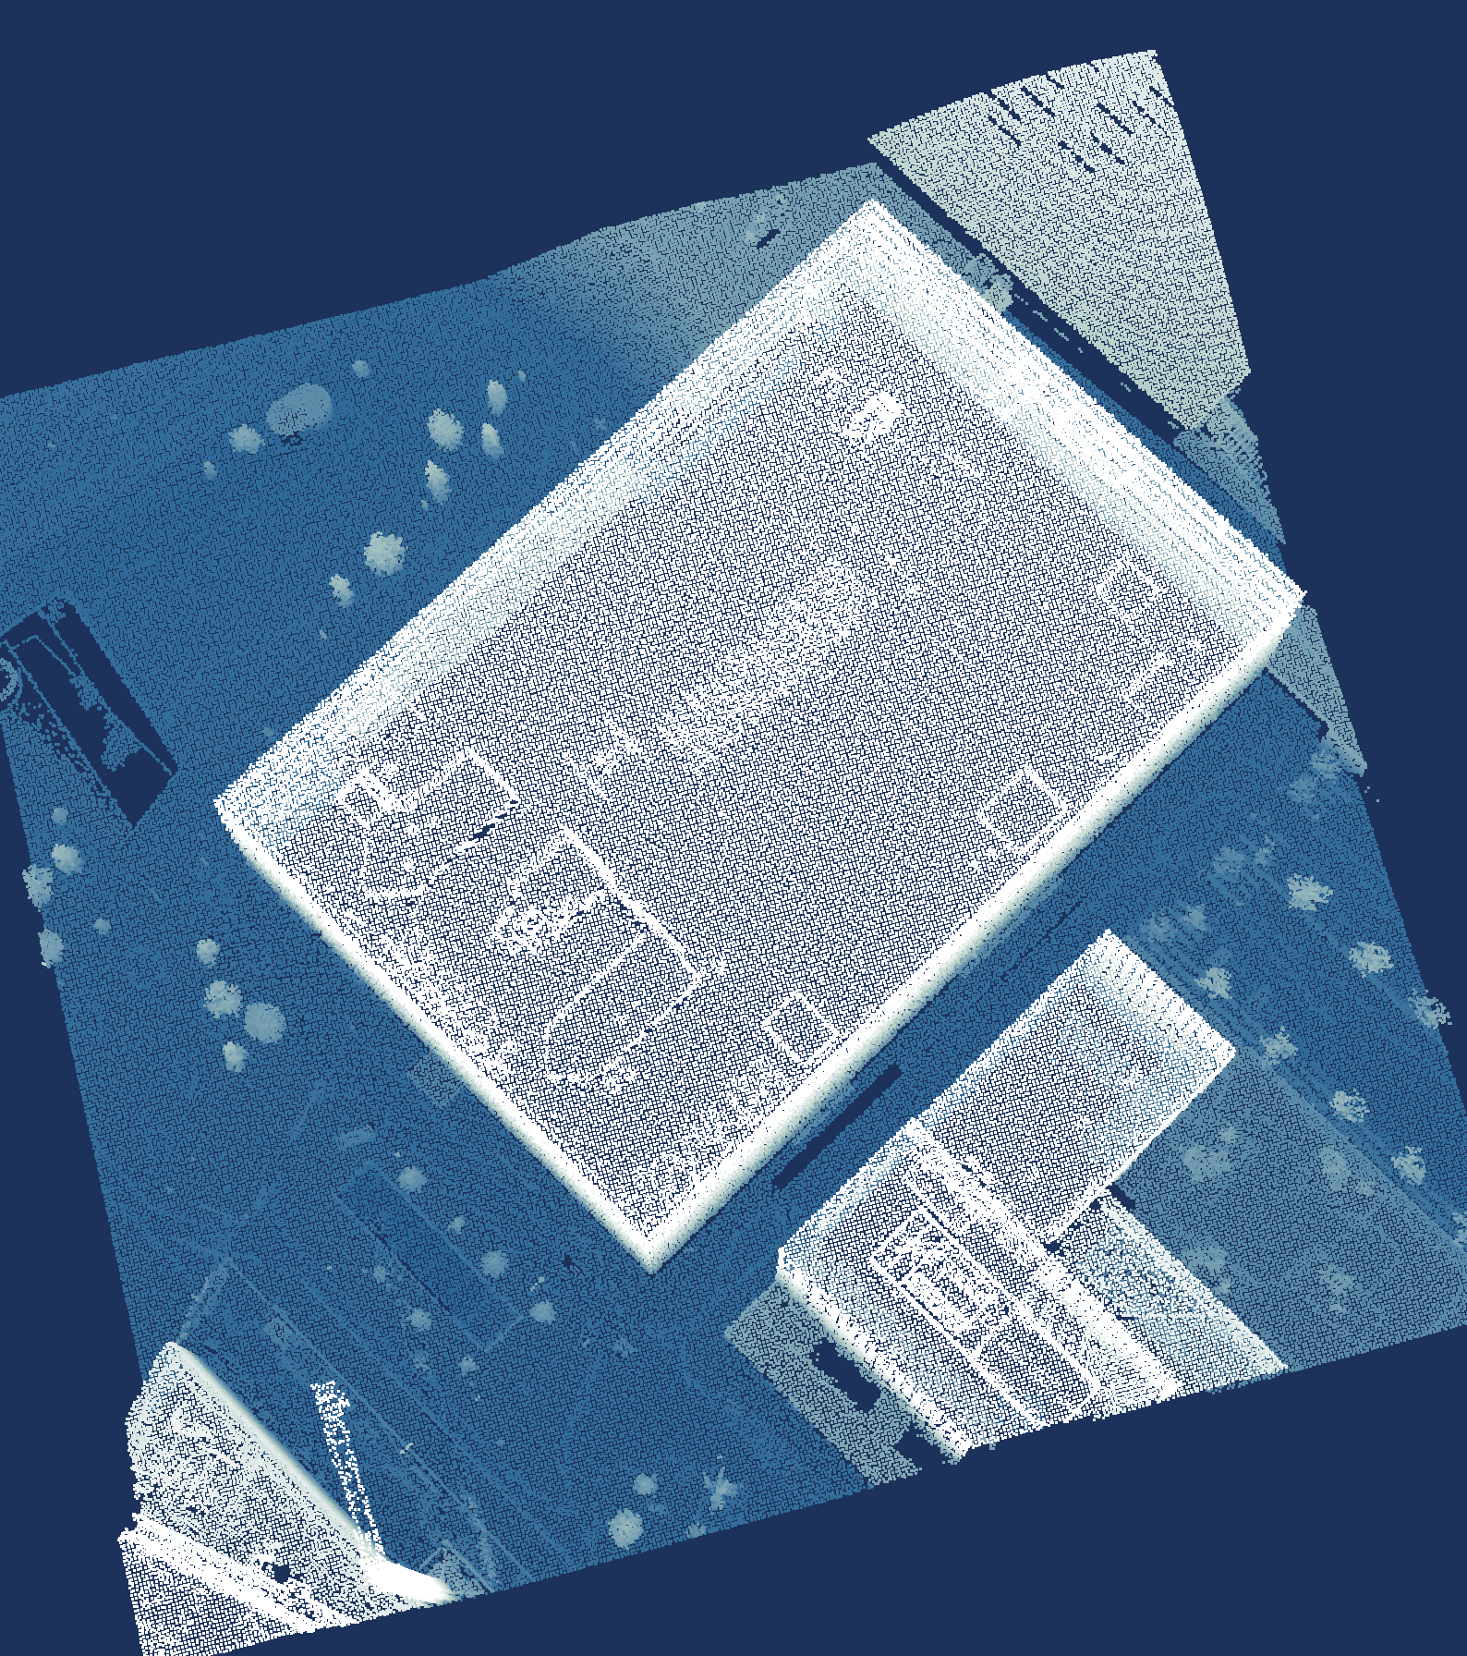
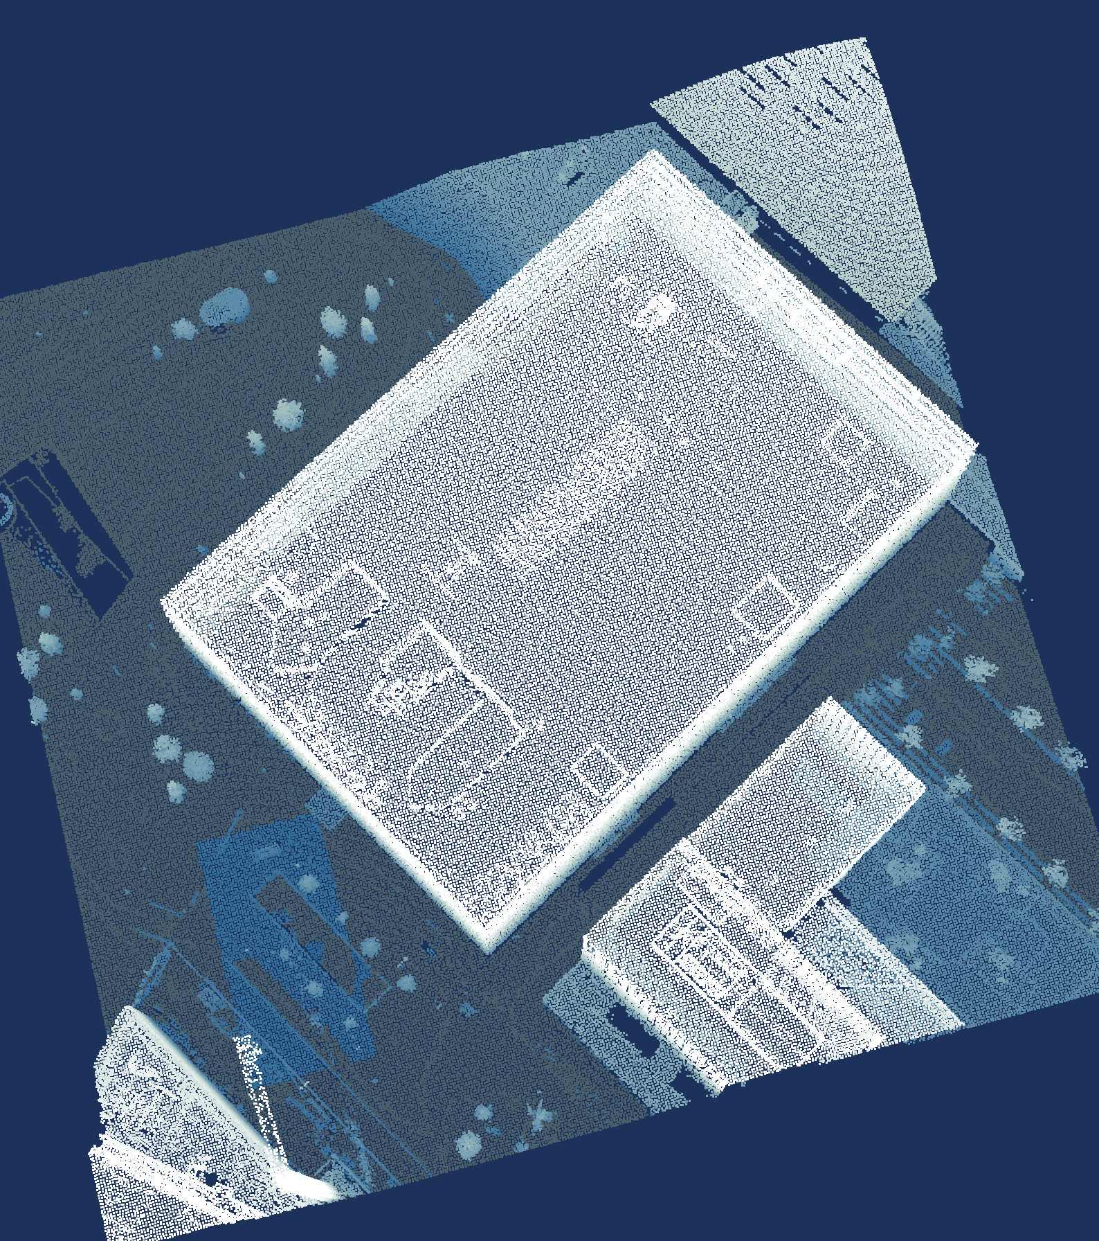
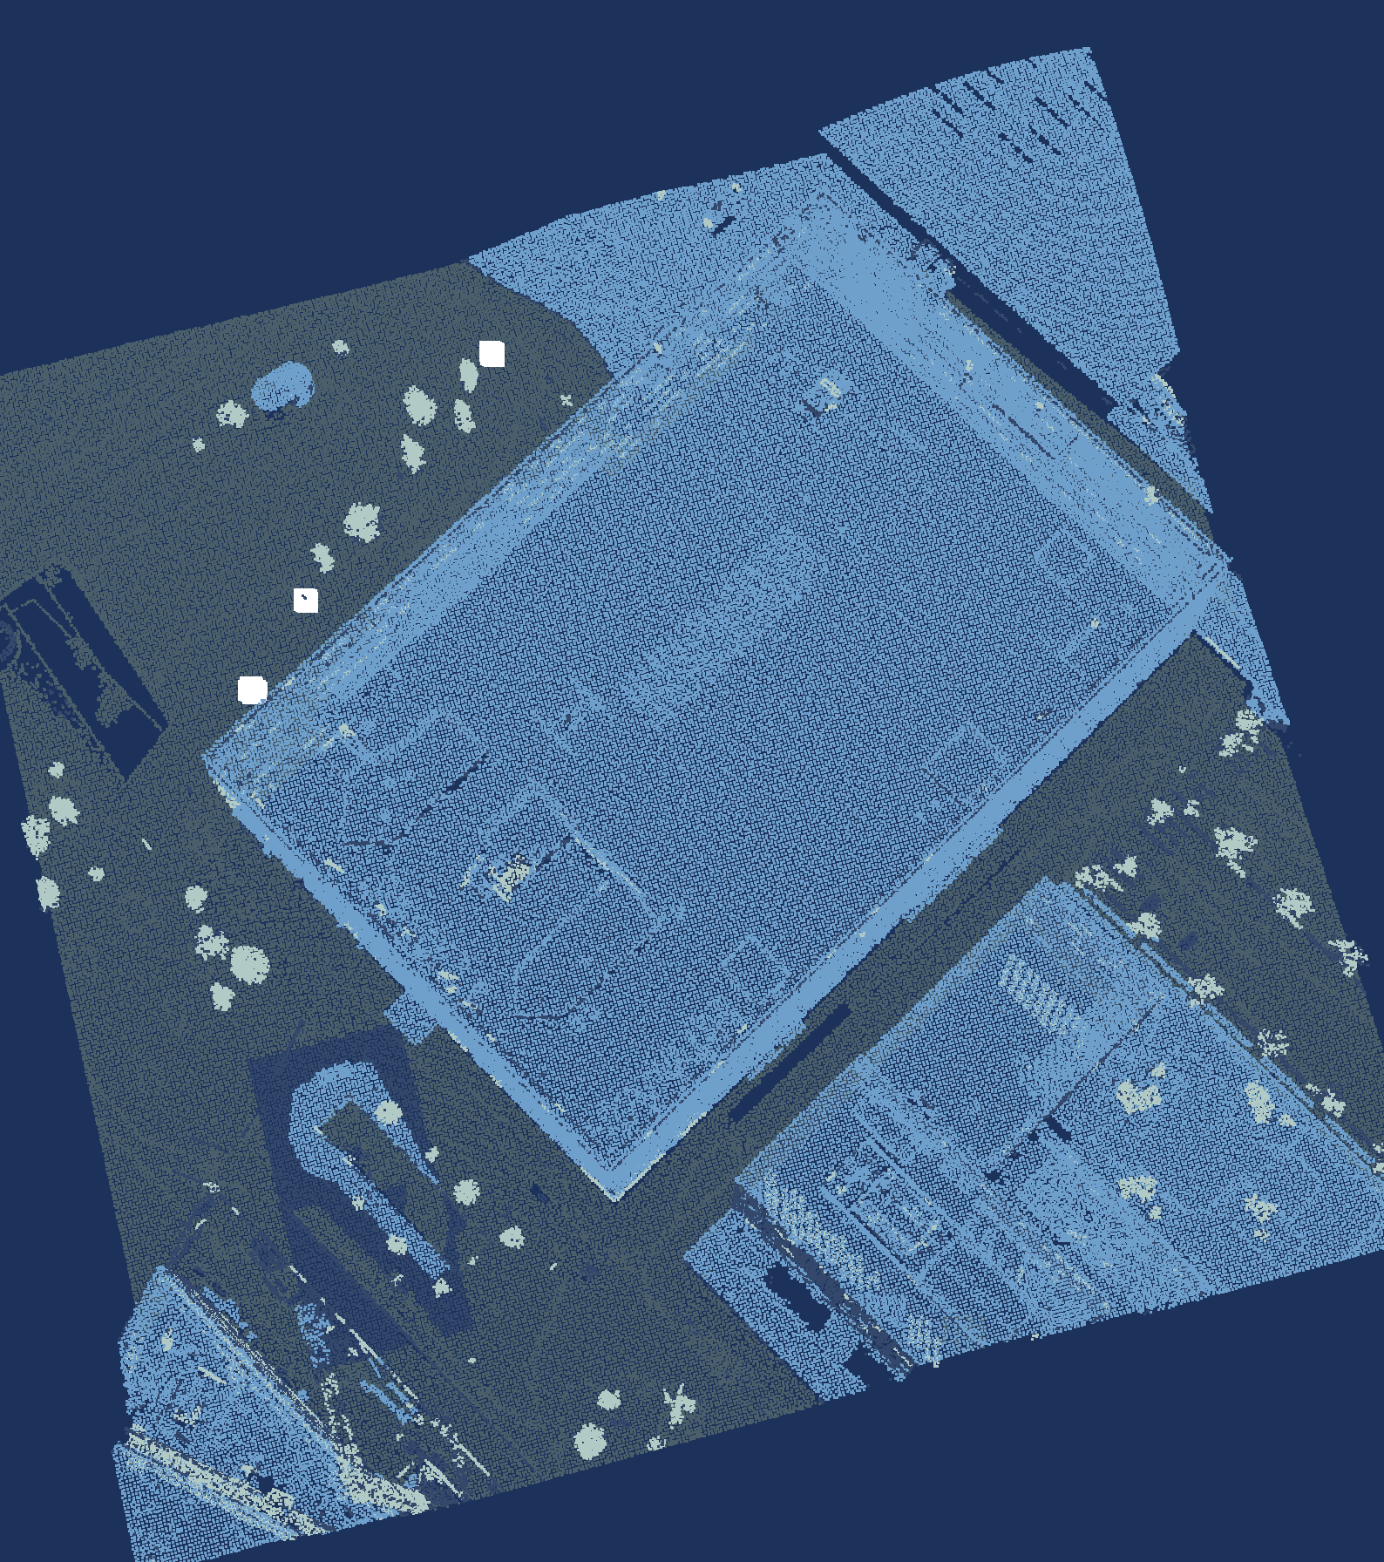
Six steps turn a point cloud into labels
Load
Voxel
downsampling
Ground
removal
Clustering
Labelling
Visualisation
laspy
Open3D
Open3D
Open3D, SciPy
NumPy, SciPy
SciPy, PyVista
Data: AHN5, Het Waterschapshuis, CC BY 4.0.
Notes:
TALK TRACK: Six steps turn this point cloud into labels: load, voxel downsampling, ground removal, clustering, labelling and visualisation. It's the same area and the same camera in every frame, so you can watch it change from slide to slide. Let's start with step one.
TIME: 25 s, ends at 9:20
LIKELY QUESTION: Why remove the ground before clustering?
ANSWER: Because DBSCAN groups whatever touches, and the ground touches everything: left in, it would link the whole scene together through the road. That is reasoning; I didn't benchmark the other order.
TRACE:
• renders/f1_load.png, f2_voxel.png, f3_ground.png, f4_clusters.png, f5_labels.png, f6_final.png
• renders/render_spec.json (one camera for all frames)
WHY SEVERAL TOOLS IN ONE STEP:
• No library has a fast, batched call for every part of a step, so each part goes to the library that has one; because they all take and give NumPy arrays (slide 10), mixing them costs at most one copy
• Clustering, Open3D and SciPy: DBSCAN is Open3D's cluster_dbscan, but first SciPy's KDTree answers 'how high is each voxel above the ground?' (height_above, one query on all cores), so only voxels clearly above the ground go into DBSCAN; left in, the ground would link the whole scene into one cluster
• Labelling, NumPy and SciPy: NumPy computes every cluster's features at once with np.bincount over the cluster ids (top height, footprint, share of multiple returns); SciPy's KDTree gives each cluster its distance to the nearest building and tree for rules 3 and 4 (facade, free-standing)
• Visualisation, SciPy and PyVista: SciPy's KDTree paints the labels from the 232 180 voxels back onto all 722 961 points in one query; PyVista then renders them off-screen
• Load and ground removal use one library each for the work (laspy, Open3D), with NumPy for the arithmetic around the calls

Slide 12
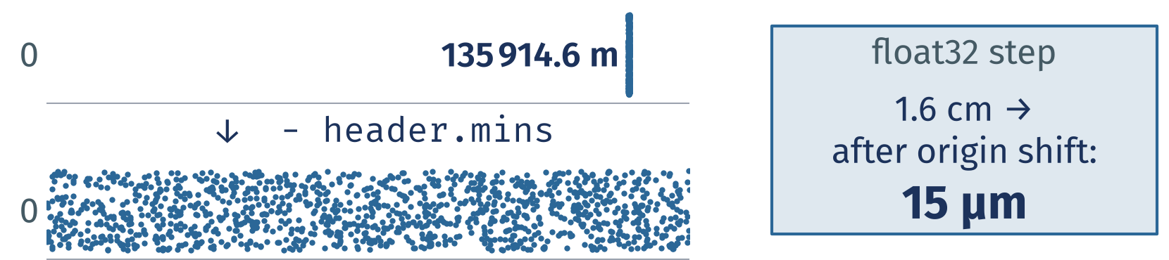
1 Load: laspy hands you NumPy
import laspy
import open3d as o3d
las = laspy.read("crop.laz")
xyz = las.xyz - las.header.mins
v = o3d.utility.Vector3dVector(xyz)
pcd = o3d.geometry.PointCloud(v)
Subtract a local origin before anything else.
Data: AHN5, Het Waterschapshuis, CC BY 4.0.
Notes:
TALK TRACK: Step one: laspy reads the LAZ file and gives you plain NumPy arrays. The first thing I do is subtract a local origin, the minimum corner from the file header. Dutch RD coordinates run to hundreds of thousands of metres, and at that size float32 can only step 1.6 cm in x and 3.1 cm in y; Open3D's PointCloud.from_legacy, for one, converts to float32 by default. After that it's one copy into Open3D as float64, and we're ready to shrink it.
TIME: 65 s, ends at 10:25
LIKELY QUESTION: Why not keep RD coordinates and stay in float64 everywhere?
ANSWER: You can, as long as nothing on the way casts to float32, and some tools do that quietly. Subtracting header.mins once makes it harmless, and fitted plane coefficients become readable numbers too.
TRACE:
• snippets/s08_load.py
• results/snippets.json: s08_load.py.ok
• renders/f1_load.png
• renders/render_spec.json (local origin = header.mins)
• data/utrecht_jaarbeurs_200m.laz
• float32 steps: np.spacing(np.float32(v)) at the crop's RD origin, deterministic; run it to check (results/research_facts.json float32_step_m, written by docs/research/research_facts.py)
• from_legacy defaults to float32 (dtype=Float32 in its signature; a tensor point cloud built from a float64 tensor stays float64): research: reports/libraries.md (03_open3d_tensor.py)
LINE BY LINE:
• import laspy / import open3d as o3d: the reader for LAS and LAZ, and the processing library
• las = laspy.read("crop.laz"): decompresses the whole file (lazrs backend) into a LasData object; every dimension becomes a NumPy array
• xyz = las.xyz - las.header.mins (key line): an N by 3 float64 array in metres, shifted so the minimum corner of the file is the origin; las.xyz is already a new array (slide 10), the subtraction makes one more
• v = o3d.utility.Vector3dVector(xyz): copies the array into Open3D's own C++ vector of 3D points (float64, fastest from a C-ordered array)
• pcd = o3d.geometry.PointCloud(v): the point cloud object every later Open3D call works on
SKETCH: The first point's x in RD is 135914.6 m; float32 can only step 1.6 cm at that size. After subtracting header.mins it is 199.6 m, where float32 steps 15 micrometres (np.spacing). That is why the origin comes off first: some tools cast to float32 without telling you.
MENTAL MODEL: Hidden C2 (every array needs a frame) and C3 (a transform is a matrix, order matters) go deeper on the local origin.

Slide 13
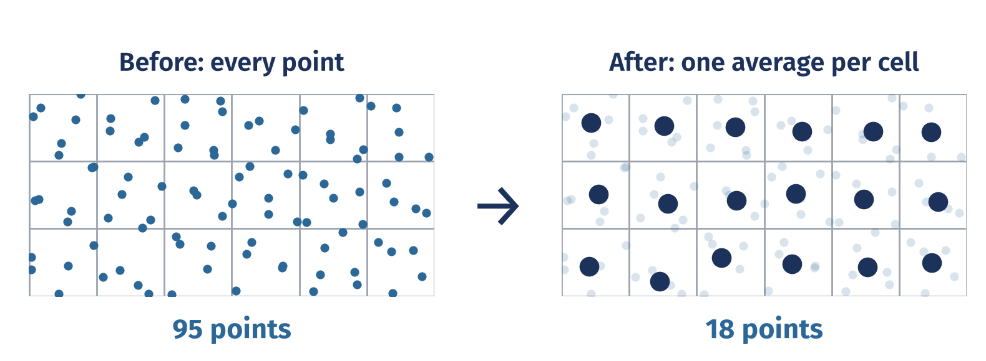
2 Voxel downsampling: one average per voxel
down = pcd.voxel_down_sample(0.5)
P = np.asarray(down.points)
print(len(xyz), "->", len(P))
722 961 points in → 232 180 out at 0.5 m voxels.
Data: AHN5, Het Waterschapshuis, CC BY 4.0.
Notes:
TALK TRACK: Step two: lay a grid of 0.5 m voxels over the crop and replace all the points inside each voxel with their average. That leaves 32.1 % as many points, and every step after this gets cheaper. One catch: the average is a new point, not one of yours, and LAS attributes such as returns and class are dropped unless you carry them along. I store the multiple-return flag as a colour, so each voxel keeps its share of multiple returns for step five. Next, the ground.
TIME: 55 s, ends at 11:20
LIKELY QUESTION: Why average? Why not keep one real point per voxel?
ANSWER: You can, and in the chunked read (backup B2) I do exactly that, because it streams. Open3D's voxel_down_sample returns the centroid: I checked that it equals the per-voxel mean, on a grid anchored half a voxel below the minimum corner.
TRACE:
• Sketch caption: 0.5 m voxels
• snippets/s09_voxel.py
• results/snippets.json: s09_voxel.py.ok
• results/pipeline.json: points_in, points_after_voxel, kept_share, params.voxel
• renders/f2_voxel.png
• Centroid and grid anchor: research: reports/critic.md section 2, reports/review/honesty.md row 9, notes/verify_facts.json
• Attributes dropped: research: reports/review/honesty.md rows 9 and 12
• results/pipeline.json: params.rules.features.multi
• Flag kept as colour: pipeline/steps.py to_open3d and multi_share; research: reports/review/honesty.md row 12 (review/honesty/run_extra.out)
LINE BY LINE:
• down = pcd.voxel_down_sample(0.5) (key line): lays a grid of 0.5 m cubes over the cloud (anchored at the minimum corner minus half a voxel) and replaces the points in each occupied cube by their average; colours, our multiple-return flag, are averaged too
• P = np.asarray(down.points): a view of the 232 180 voxel points as an N by 3 NumPy array, no copy
• print(len(xyz), "->", len(P)): 722 961 points in, 232 180 out, 32.1 % kept
SKETCH: A grid of cells, the small white dots are original points, the large sage dot in each occupied cell is their average: one new point per voxel, and empty cells give nothing. Dense areas shrink most, which is why every later step gets cheaper.

Slide 14
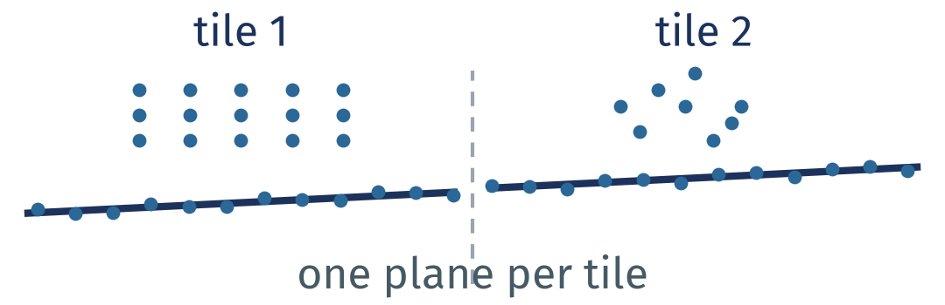
3 Ground removal: one plane per tile
params = steps.GroundParams(
tile=25, low_percentile=2,
low_window=1.5, threshold=0.4,
iterations=300,
max_tilt_deg=15,
max_above_median=2.5)
ground, planes = remove_ground(
down, params=params)
# Low points → RANSAC → roof check.
# Rejected tiles borrow a plane.
Scored against AHN's ground:
98.4 % precision, 94.4 % recall.
Check tilt and relative height;
borrow a plausible nearby plane.
Data: AHN5, Het Waterschapshuis, CC BY 4.0.
Notes:
TALK TRACK: The actual helper fits low candidates per tile, checks tilt and height relative to the median tile plane, and borrows a nearby accepted plane for rejected tiles. Subtracting header.mins shifts all three axes: Z is above the crop minimum, not above terrain. There is no absolute five-metre ground cutoff. Parameters are heuristics for this crop, not a universal terrain classifier. Precision 98 % and recall 94 % compare painted-back original-point labels with AHN class 2, which was withheld from classification. This is reference-label agreement on one crop, not independent field validation.
TIME: 75 s, ends at 12:35
LIKELY QUESTION: How do the indices map?
ANSWER: tiles returns indices in down; low preserves that ascending order; segment_plane returns indices in the selected subcloud, so low[inl] maps back to down. The slide calls the full helper and therefore includes the same plausibility repair as the scored pipeline.
TRACE:
• snippets/s10_ground.py
• pipeline/steps.py
• results/pipeline.json
• results/labels_crop.npz

Slide 15

4 Clustering: DBSCAN groups what touches
hag = height_above(P, ground)
up = ~ground & (hag > 0.3)
rest = down.select_by_index(
np.flatnonzero(up))
lab = rest.cluster_dbscan(
eps=0.75, min_points=6)
ids = np.asarray(lab)
print(ids.max() + 1, "clusters")
1 026 clusters. Clusters are not labels yet.
Neighbours within eps
make a cluster.
Data: AHN5, Het Waterschapshuis, CC BY 4.0.
Notes:
TALK TRACK: Step four: DBSCAN chains together points that sit within 0.75 m of each other, so 'touches' really means 'closer than eps'. On the voxels that aren't ground and sit more than 0.3 m above it, I get 1 026 clusters, and 10 % of those voxels are noise that belong to no cluster. A cluster is just a blob, not yet a building or a tree. Naming the blobs is the next step.
TIME: 55 s, ends at 13:30
LIKELY QUESTION: How do you choose eps and min_points?
ANSWER: By looking, plus one rule from testing: eps has to be clearly larger than the voxel size. Too small and most points become noise, too large and buildings fuse with their trees; prototype runs showed both. Here it is eps 0.75 m with min_points 6 on 0.5 m voxels.
TRACE:
• Sketch caption: eps = 0.75 m
• snippets/s11_cluster.py
• results/snippets.json: s11_cluster.py.ok
• results/pipeline.json: n_clusters, noise_share, params.eps, params.min_points, params.voxel
• renders/f4_clusters.png
• results/pipeline.json: params.cluster_min_height_m, noise_share_note, params_why.eps, params_why.min_points, param_choice
• eps against voxel size: research: reports/review/honesty.md row 11, reports/review/feasibility.md section 2 (prototype runs)
LINE BY LINE:
• hag = height_above(P, ground): for every voxel, its height above the nearest ground voxel in plan view (one SciPy KDTree query on all cores)
• up = ~ground & (hag > 0.3): the voxels that are not ground and stand more than 0.3 m above it, so kerbs and noise near the road stay out
• rest = down.select_by_index(np.flatnonzero(up)): those voxels as their own point cloud
• lab = rest.cluster_dbscan(eps=0.75, min_points=6) (key line): DBSCAN: a voxel with at least 6 neighbours within 0.75 m is a core point, clusters grow from core to core, and whatever no cluster reaches gets -1, noise
• ids = np.asarray(lab): one cluster id per voxel, as NumPy
• print(ids.max() + 1, "clusters"): ids start at 0, so the largest plus one is the count, 1 026
SKETCH: Two groups of points, each a cluster because every point has neighbours within eps, the dashed circle; the lone grey point has none and is noise. DBSCAN needs no number of clusters, only how close is close.
MENTAL MODEL: Hidden C4 (neighbourhood size changes the answer): eps, the voxel size and normal radii are the same kind of choice.

Slide 16
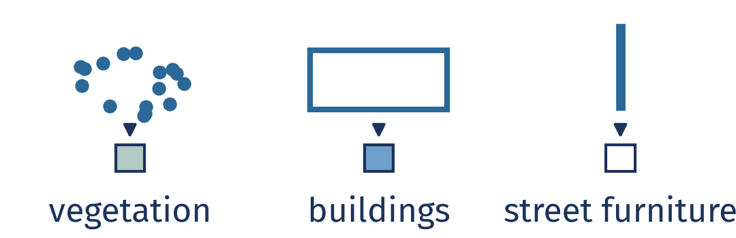
5 Labelling: rules name the clusters
def name(c):
if c.multi > 0.4 and c.top > 1:
return VEGETATION
if c.foot > 25 and c.top > 2.5:
return BUILDINGS
if c.to_building < 2: # facade
return BUILDINGS
if c.slender and c.free:
return STREET_FURNITURE
return UNLABELLED
Leaf-off scan: bare trees echo several times.
The first rule that fires
names the cluster.
Data: AHN5, Het Waterschapshuis, CC BY 4.0.
Notes:
TALK TRACK: Step five names the blobs with a few rules per cluster: how tall it is, how big its footprint is, and what share of its points had more than one return. That last one is the clue for trees: AHN's spec asks for a leaf-off flight, and this one was flown in early April, so pulses slip between bare branches and a tree echoes several times, while roads and roofs mostly echo once. Street furniture is the honest weak spot: from the air a lamp post is a few dozen points at most, and DBSCAN drops objects of fewer than 6 voxels as noise, so my rules find 3 objects, 53 points in all. Cars fail the street furniture rule because they are not twice as tall as they are wide, so they stay unlabelled. Then one last step paints these labels back onto every original point.
TIME: 70 s, ends at 14:40
LIKELY QUESTION: Why hand-written rules and not machine learning?
ANSWER: Rules fit on a slide and you can debug them. Machine learning needs training labels, and for vegetation and street furniture AHN has none: they are all inside class 1. Buildings, which AHN does label, score 82 % precision and 99 % recall against class 6. I did try Florent Poux's PCA plus Random Forest idea on these clusters (backup B5): against AHN's building class it scores 81 % balanced accuracy, my rules 66 %. But AHN files facades under class 1 and my rules call them building, so part of that gap is the forest copying AHN's convention.
TRACE:
• Sketch caption: shape → class
• Small print: Street furniture: 3 objects, 53 points, drawn enlarged. Poles nearly vanish.
• snippets/s12_label.py
• ML alternative: bench/eigen_features.py; results/eigen_features.json rules, forest_eigen_plus_rule_inputs (balanced accuracy weighted by points, spatial cross-validation); idea: research: reports/videos.md V3
• results/snippets.json: s12_label.py.ok
• results/pipeline.json: params.rules, n_objects, label_points, buildings.precision, buildings.recall
• renders/f5_labels.png
• renders/labels.json: f6_final (the same chip anchors as slides 17 and 18; checked on f5_labels.png)
• Leaf-off flight: AHN5 acquisition spec not checked; the AHN4 spec requires a leaf-off flight ('bladloze seizoen'); this crop was flown in the night of 2023-04-05 to 2023-04-06, about 01:51 CEST, one strip (point source id 1110; GPS time of the crop's points, checked 2026-10-11; the first example street was about 01:35, research: reports/dataset.md)
• Multiple-return share per AHN class on the crop: research: review/honesty/inspect_crop.out
• Lamp posts as a few dozen points: research: reports/dataset.md (pole_analysis.json, measured on the first example street, not on this crop)
• Cars fail rule 4: pipeline/steps.py; results/pipeline.json params.rules.slender (a car fails 'twice as tall as wide')
• Objects below min_points dropped as noise: results/pipeline.json street_furniture_note, params.min_points
• Street furniture drawn enlarged: renders/render_spec.json point_size_px
• What the 3 objects (53 points) are on the ground is UNVERIFIED (results/pipeline.json street_furniture_note: no imagery checked); do not call it a lamp post
LINE BY LINE:
• def name(c): the rules, applied to one cluster c with its features (computed for all clusters at once with np.bincount); the first rule that fires wins
• if c.multi > 0.4 and c.top > 1 (key line): more than 40 % of its points had several returns and its top is over 1 m: VEGETATION (leaf-off, the pulses pass between bare branches)
• if c.foot > 25 and c.top > 2.5: footprint over 25 m2 and taller than 2.5 m: BUILDINGS (roofs)
• if c.to_building < 2: within 2 m of a building in plan view: BUILDINGS too (facade fragments that DBSCAN split off their roof)
• if c.slender and c.free: at most 1.5 m wide, 1.5 to 15 m tall and at least twice as tall as wide, more than 2 m from buildings and 1 m from trees: STREET_FURNITURE
• return UNLABELLED: everything else, cars included (not twice as tall as wide)
SKETCH: Three cluster shapes and the class each one gets: a crown with many echoes becomes vegetation, a wide flat block a building, a thin pole street furniture. The rules only look at shape and echoes, never at AHN's labels.

Slide 17

6 Visualisation: PyVista paints every point
P = np.asarray(down.points)
_, j = KDTree(P).query(
xyz, workers=-1)
pl = pv.Plotter(off_screen=True)
pl.add_points(xyz, point_size=3,
scalars=RGB[cls[j]], rgb=True)
pl.camera_position = CAM
pl.screenshot("f6_final.png")
Fixed camera, off-screen, one PNG per step.
Paint the labels back
onto every point.
Data: AHN5, Het Waterschapshuis, CC BY 4.0.
Notes:
TALK TRACK: Step six: the labels live on the 232 180 voxel points, so one KDTree query gives each of the 722 961 original points the label of its nearest voxel point. PyVista then renders off-screen with one fixed camera, one PNG per step, which is why every frame in this talk lines up. Let's put all six steps together.
TIME: 40 s, ends at 15:20
LIKELY QUESTION: Why not Open3D's own viewer?
ANSWER: Open3D's draw_geometries opens a window and blocks until you close it. I needed identical frames from a script, without a window, and PyVista does that off-screen; in testing it also rendered headless, through EGL.
IF SKIPPED: Skip-first number 4. If skipped, say on slide 18: "every render here is PyVista, off-screen, one fixed camera".
TRACE:
• Sketch caption: nearest voxel's label
• Small print: Street furniture: 3 objects, 53 points, drawn enlarged. Poles nearly vanish.
• snippets/s13_render.py
• results/snippets.json: s13_render.py.ok
• results/labels_crop.npz
• results/pipeline.json: points_in, points_after_voxel
• renders/f6_final.png
• pipeline/render.py (makes the frame shown; draws the street furniture objects enlarged, renders/render_spec.json point_size_px)
• renders/render_spec.json
• renders/labels.json: f6_final
• Headless PyVista: research: reports/libraries.md (04_pyvista_render.py); draw_geometries blocks: research: reports/book.md
LINE BY LINE:
• P = np.asarray(down.points): the voxel points, a view
• _, j = KDTree(P).query(xyz, workers=-1): for each of the 722 961 original points, the index of its nearest voxel point; one query on all cores
• pl = pv.Plotter(off_screen=True) (key line): a renderer without a window, so a script can make the images, also headless
• pl.add_points(xyz, point_size=3, scalars=RGB[cls[j]], rgb=True): every original point coloured by the class of its nearest voxel; cls[j] is NumPy fancy indexing, one call
• pl.camera_position = CAM: the one fixed camera (renders/render_spec.json), never reset_camera, so every frame lines up
• pl.screenshot("f6_final.png"): writes the PNG you see on the right
SKETCH: Three large voxel points with their class colours and many small original points; each small point takes the colour of its nearest voxel point, the grey lines. That is the paint-back: the labels were computed on 232 180 voxels and land on all 722 961 points.

Slide 18
What the six steps did
Original scan
Pipeline labels
Ground
Buildings
Vegetation
Street furniture
Unlabelled
1.0 s, single run. Ground vs AHN class 2: 98 % precision / 94 % recall.
Data: AHN5, Het Waterschapshuis, CC BY 4.0.
Notes:
TALK TRACK: So what did the six steps do? laspy loaded 722 961 points, Open3D cut them to 232 180 voxels, fitted the ground at 98 % precision against AHN and found 1 026 clusters, NumPy's rules turned the clusters into four classes, and SciPy painted those back onto every point. From file to labels that's 1.0 seconds on this crop, one run, so take it as indicative, and not a single Python loop over points. First, a confession about street furniture.
TIME: 65 s, ends at 16:25
LIKELY QUESTION: Can I run this on my own AHN file?
ANSWER: Yes, that's what the repo is for. For a whole 1 km AHN file or larger, start with the chunked read (backup B2), and expect to retune voxel size, tile size and eps for a different point density. Not in the Netherlands? Backup B6 lists other open sources.
CHECKPOINT: Skip-first order: 26, 25, 18, 11. Target: leave this slide by 16:25. Leaving after 17:25: skip 26 and 25. Leaving after 18:55: also skip 18, and tell only one story on 26. Further on: reach slide 26 by 23:45, otherwise skip it. To skip: one sentence, then click.
CHECK BEFORE THE TALK:
• QR repository verified publicly accessible on 2026-10-14
• Other open sources (B6): research: reports/videos.md V1
TRACE:
• Small print: One run, indicative; renders not included. Street furniture drawn enlarged.
• snippets/s14_pipeline.py
• pipeline/run.py
• results/snippets.json: s14_pipeline.py.ok
• results/pipeline.json: runtime_s (single run, indicative), versions
• results/pipeline.json: runtime_note
• No per-point Python loop: the loops in pipeline/steps.py run over tiles (remove_ground) and clusters (label)
• renders/f6_final.png
• renders/labels.json: f6_final
• Before and after: same stored camera. Four predicted classes plus unlabelled; runtime excludes rendering.
THE SEVEN CALLS:
• The whole pipeline is seven calls in the repo (snippets/s14_pipeline.py, pipeline/run.py):
• las, xyz, _ = load("crop.laz") / multi = las.number_of_returns > 1 / pcd = to_open3d(xyz, multi) / down = downsample(pcd, 0.5) / ground, _ = remove_ground(down, 25) / ids = cluster(down, ground, 0.75, 6) / cls, _ = label(down, ground, ids) / full = paint_back(xyz, down, cls)
• Times per step (results/pipeline.json timings_s, one run): load 61 ms, copy into Open3D 8.0 ms, voxels 123 ms, ground 99 ms, clusters 270 ms, labels 260 ms, paint-back 178 ms; total 999 ms, renders not included

Slide 19
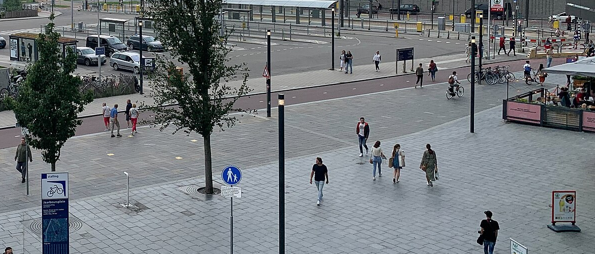

Expectation vs reality: street furniture
Expectation: the BGT register
61 poles 51 lamp posts, 10 bollards
Reality: our pipeline
3 objects 2 of them on a lamp post
42 of 61 poles get no LiDAR point above 1.5 m.
Poles: BGT, Kadaster, CC BY 4.0. Photos: Wikimedia Commons, CC BY-SA 4.0 and CC BY 3.0.
Data: AHN5, Het Waterschapshuis, CC BY 4.0.
Notes:
TALK TRACK: Expectation versus reality. The expectation isn't made up: the BGT, the Dutch large-scale topography register kept by the municipality, lists 61 poles inside this exact square, 51 lamp posts and 10 bollards, the small rings. Reality: my pipeline found 3 objects, the big rings, and two of them do stand on a registered lamp post. The data explains it: 42 of the 61 poles don't get a single LiDAR point more than 1.5 metres above the ground, and only 10 leave DBSCAN the six voxels it needs. Rule two in action: look at your data before you blame your algorithm. So why do poles get so few points?
TIME: 40 s, ends at 17:05
LIKELY QUESTION: Isn't the register out of date, or the flight too old?
ANSWER: Partly: 3 of the poles were first registered after the April 2023 flight, so they may not have existed yet. That doesn't change the picture: most poles that did exist are a few points or none from the air. The municipality's own 2021 street-light export disagrees with the BGT too, so registers aren't ground truth either.
TRACE:
• Photo credit: 2021 · Robot8A · CC BY-SA 4.0
• Photo credit: 2014 · V. van Werkhooven · CC BY 3.0
• Small print: Poles: BGT (Kadaster, CC BY 4.0) via PDOK, 2026-10-12. Points: within 0.6 m, over 1.5 m above ground. Photos: Jaarbeursplein, Wikimedia Commons.
• bench/bgt_street_furniture.py, results/bgt_street_furniture.json (label FINAL)
• BGT licence: CC BY 4.0 per the national geo register record (attribution Kadaster, BGT), CC0 1.0 on the PDOK API landing page; the slide credits Kadaster, BGT
• Rings: build_deck.py slide_expectation_map; poles projected with the stored camera (renders/render_spec.json), our objects at renders/render_spec.json frames[f6_final.png].street_furniture_visible patches
• results/pipeline.json: n_objects.street_furniture, street_furniture_objects
EVIDENCE:
• BGT via PDOK OGC API Features, queried 2026-10-12 08:04 UTC: paal 61 (lichtmast 51, afsluitpaal 10), straatmeubilair 29 (26 benches, 3 play objects), kast 4; current versions only, strictly inside the crop box
• Points within 0.6 m of each pole and more than 1.5 m above the local ground: 0 points 42, 1 to 5 4, 6 to 20 15, more than 20 none
• Poles with at least 6 occupied 0.5 m voxels above 1.5 m: 10, all lamp posts; half of them sit under building or viaduct points
• Our objects against the BGT: the two candidates within 0.51 m and 0.49 m of a lamp post; the third is 4.97 m from the nearest one
• Map: 60 of the 61 poles project inside the render (one falls just outside the frame)
MENTAL MODEL: Slide 20 (a point cloud samples the surface unevenly) follows: the density map of this crop explains why poles get few points.

Slide 20
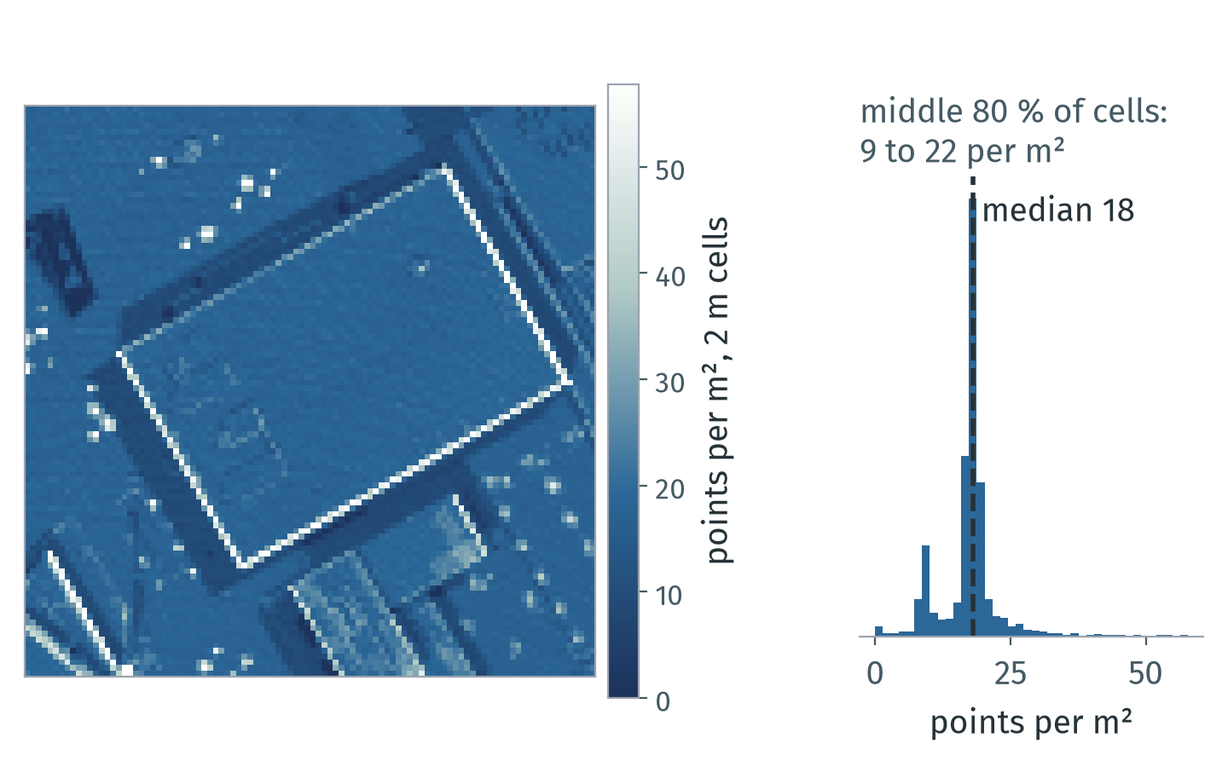
A point cloud samples the surface unevenly
Density, noise and gaps vary within one file. Measure them before tuning anything.
Here the middle 80 % of cells hold 9 to 22 points per m²; median 18.
Occlusion, flight-strip overlap, angle and material decide where points land.
Every point carries error: AHN4 specifies at most 5 cm in height; AHN5 publishes no figure yet.
Notes:
TALK TRACK: Why so few points on a pole? Because a scanner doesn't see the city, it samples it. This map counts points per square metre in our crop, median 18. Walls and tree crowns stack points into bright lines and spots, and some bands are thin, so a thin pole can fall between the samples. A radius tuned in one corner can fail in the next: measure density and error before you tune anything. We've turned the scan into labels. Now let's look at the Python decisions that made the pipeline fast enough to be practical. Think in arrays and let compiled code loop: first, a quiz.
TIME: 40 s, ends at 17:45
LIKELY QUESTION: Is the density on the map the density of the surface?
ANSWER: Not quite: a map cell counts every point above it, so walls and tree crowns look denser than they are as surfaces; a per-surface density needs normals. And the published accuracy is a specification for the whole data set, not a guarantee for each point.
TRACE:
• deck/appendix.yaml C5 (bullets, figure, citations; shown here as a main slide)
• deck/concepts/make_figures.py: deck/assets/concepts/c5_density.png, results/concepts.json c5
• data/utrecht_jaarbeurs_200m.laz
• research: reports/mental_models.md section 6
WHY IT MATTERS: Thresholds, radii and quality scores all assume a density and an error level; uneven sampling makes them wrong in parts of the same file.
EXAMPLE: NumPy: np.histogram2d(x, y, bins=100, range=[[0, 200], [0, 200]]) gives this density map in one call. laspy: las.return_number and las.number_of_returns tell multiple echoes apart (slide 16).
LIMITS AND DISAGREEMENTS:
• Density per map cell mixes surface density with geometry: walls and canopies inflate it. A per-surface density needs normals (C4).
• Published accuracy is a specification for the whole data set, not a guarantee for each point; local errors near edges and on dark or wet surfaces can be larger.
• Which density is enough depends on the object size: lamp posts on slide 19 got few or no points.
CITATIONS:
• AHN Kwaliteitsbeschrijving (ahn.nl/kwaliteitsbeschrijving, no date shown, written before 2020): AHN4 height error at most 5 cm systematic and 5 cm stochastic; about 10 to 14 points per m2
• AHN5 tender, Nota van inlichtingen, 2022-08-18 (TenderNed 275983): base requirement 10 points per m2; no AHN5 accuracy figures published
• AHN: The making of (ahn.nl/ahn-making, no date shown, AHN3 process): flight strips overlap about 20 to 35 %, vegetation gives first or intermediate returns
• Manders: AHN3 vs AHN4 for 3D buildings, MSc thesis, 2023 (gdmc.nl; not peer reviewed): facade occlusion
• ASPRS Positional Accuracy Standards, Edition 2, Version 2, approved 2024-06-24 (via Geo Week News, 2024-07-03; ASPRS PDF not fetched)
SOURCES AND STATUS:
• Bullet 1 "Here the middle 80 % of cells hold 9 to 22 points per m²...": status token; source: results/concepts.json c5 (data/utrecht_jaarbeurs_200m.laz, 2 m cells)
• Bullet 2 "Occlusion, flight-strip overlap, angle and material decide...": status verified; source: research: reports/mental_models.md section 6
• Bullet 3 "Every point carries error: AHN4 specifies at most 5 cm in...": status verified; source: research: reports/mental_models.md section 6 (AHN Kwaliteitsbeschrijving; AHN5 tender)
STATUS KEY: token = filled from results/*.json; verified = checked in a research report.

Slide 21
Quiz: which is faster, and by how much?
Distance of every point to the ground plane, 722 961 points.
A
a, b, c, d = plane
h = np.empty(len(P)) # distances
for i, p in enumerate(P):
x, y, z = p[0], p[1], p[2]
h[i] = abs(a*x + b*y + c*z + d)
B
a, b, c, d = plane
x, y, z = P.T # columns, no copy
h = np.abs(a*x + b*y + c*z + d)
The faster one wins by about:
2×
10×
100×
1000×
Both give identical results (np.array_equal). P: the crop's xyz from slide 12, column-ordered. plane: one seeded segment_plane on the whole crop.
Notes:
TALK TRACK: Quiz time. Both blocks compute the same thing: the distance of all 722 961 points to the ground plane, and they give exactly the same numbers. A loops over the rows in Python; B is one NumPy expression on whole columns. Hands up if you think A is faster. And B? Now the real question: by how much, roughly 2, 10, 100 or 1000 times? Keep your answer in mind.
TIME: 75 s, ends at 19:00
LIKELY QUESTION: Why not P @ (a, b, c) + d? That's the idiomatic way.
ANSWER: In real code, use it. In my final run it even matched the loop bit for bit, but I left it out of the comparison: in my pilot runs OpenBLAS ran it on several threads, while the element-wise form runs on 1 thread, so the factor would mix the boundary with parallelism.
TRACE:
• snippets/s16_loop.py
• snippets/s16_vec.py
• results/snippets.json: s16_loop.py.ok, s16_vec.py.ok
• bench/bench_cliff.py
• results/bench_cliff.json: plane.equal, plane.vectorised.threads
• results/bench_cliff.json: plane.matmul_reference (expr, equal, max_abs_diff)
• results/bench_cliff.json: plane.n, plane.array.how (P = las.xyz - las.header.mins, the full crop)
• OpenBLAS threads for @ at 1M points (pilot only): research: reports/perf.md
LINE BY LINE:
• A: a, b, c, d = plane (the plane's coefficients from segment_plane); h = np.empty(len(P)) (one result per point); for i, p in enumerate(P) (key line: one Python iteration per point, each p is a row view); x, y, z = p[0], p[1], p[2] (three NumPy scalar lookups); h[i] = abs(a*x + b*y + c*z + d) (scalar arithmetic and one store)
• B: x, y, z = P.T (three column views, no copy); h = np.abs(a*x + b*y + c*z + d) (key line: a handful of NumPy calls, each on all points)

Slide 22
How much slower is the loop over rows?
130× slower
Same data, same answer, far fewer calls into compiled code.
Conditions: Ryzen 7 5700X, Python 3.13.15, NumPy 2.5.3; 722 961 points, median of 7 runs; AHN5 crop (CC BY 4.0). Full: results/bench_cliff.json.
Notes:
TALK TRACK: The answer: on 722 961 points the loop takes 317 ms and the single expression 2.4 ms: (click) that's 130×, so if you said 100, you win. The axis is logarithmic, otherwise the grey bar would barely show. Same data, same machine, same result; what changed most is how many times we call into compiled code, and memory layout does the rest. Even a loop over plain Python floats, which avoids NumPy scalars, takes 78 ms, plus 107 ms to build those lists with P.tolist(). So where does the time go?
TIME: 80 s, ends at 20:20
LIKELY QUESTION: The abstract promised two orders of magnitude. Is that what you measured?
ANSWER: For this per-point arithmetic: 130×, with an IQR-bounded range of 128× to 131×. For KDTree queries the cliff is smaller, 6.2× on one thread, because each call does more real work; it grows to 58× once the single call uses all cores. More on slide 23 and B4. That is on the column-ordered array laspy gives you; on a row-ordered copy the expression slows to 3.6 ms and the factor drops to 88× (85× to 94×).
CHECK BEFORE THE TALK:
• Checked: bench.plane.factor.iqr_low = 128×, at least 100×, so 'two orders of magnitude' may be said, for this loop over NumPy rows only (it is not on the slide)
• The 130× hero holds for laspy's column-ordered array (slide 12 code), not for a C-ordered copy
TRACE:
• bench/bench_cliff.py
• results/bench_cliff.json: plane.n, plane.loop_numpy_rows, plane.vectorised, plane.loop_python_floats, plane.factor (median, iqr_low, iqr_high), knn.factor_loop_vs_1t, knn.factor_loop_vs_all, conditions (small print)
• results/bench_cliff.json: plane.sensitivity (vectorised_c_contiguous, factor_c_contiguous, tolist), plane.array (how, dtype, layout: the conditions line)
• Chart data embedded by deck/build_deck.py from these keys
CONDITIONS IN FULL (the slide shows the short line): Conditions: Ryzen 7 5700X, 8 cores / 16 threads, 31.3 GiB RAM; Linux (Omarchy, kernel 7.2.5-3-omarchy); Python 3.13.15, NumPy 2.5.3, SciPy 1.18.1, Open3D 0.20.0, laspy 2.7.0; N = 722 961 points, 7 runs after 1 warm-up, median and IQR of wall time over the timed runs; plane loop and expression on 1 thread each (CPU/wall 1.0); governor performance; boost on; measured 2026-10-11 20:08 UTC; data: the AHN5 crop of slide 5 (ahn.nl, Het Waterschapshuis, CC BY 4.0). Array: las.xyz − las.header.mins, float64, column-ordered as laspy returns it; on a row-ordered copy the factor is 88×.

Slide 23
Batch calls into compiled code
for p in pts: f(p)
f(pts)
toll per crossing
work in compiled code
call and return
Python
compiled code
× N
N trips: 317 ms
Array operations: 2.4 ms
439 ns
per full loop step
Prefer one call on the whole array over N calls on single points.
Conditions: Ryzen 7 5700X, Python 3.13.15, NumPy 2.5.3; 722 961 points, median of 7 runs; AHN5 crop (CC BY 4.0). Full: results/bench_cliff.json.
Notes:
TALK TRACK: Here's where the time goes: Python above the line, compiled code below. Each loop step makes several small calls into NumPy, a row, three elements, a few scalar operations, and together they cost about 439 ns per point; the same loop on plain Python floats, one NumPy call per step, still costs 107 ns; the work itself costs 3.4 ns per point inside NumPy. It's like sending every point through the toll booth in its own car, when NumPy puts them all on one bus. C++ libraries are no exception: the KDTree query the loop uses costs 9.8 µs even when it finds nothing, against 2.1 µs per point inside one call, so the kNN loop is 6.2× slower than one call. So how do you find such a loop in your own code?
TIME: 95 s, ends at 21:55
LIKELY QUESTION: Why is the KDTree cliff so much smaller than the plane cliff?
ANSWER: Because the factor is roughly toll plus work, divided by work. A KDTree query does microseconds of real work, so a toll of a few microseconds only multiplies the time a few times; plane distance does nanoseconds of work, so the toll dominates. In the synthetic pilot, queries with more neighbours had a smaller cliff.
TRACE:
• bench/bench_cliff.py
• results/bench_cliff.json: plane.per_step_ns_loop, plane.per_step_ns_python_floats, plane.per_point_ns_vectorised, knn.k, knn.per_query_us_far_knn, knn.per_query_desc.per_query_us_far_knn (the call: query with k and distance_upper_bound), knn.per_point_us_one_call_1t, knn.factor_loop_vs_1t
• Toll model and neighbour-count sweep: research: reports/perf.md (synthetic pilot)
• Diagram drawn natively by deck/build_deck.py
CONDITIONS IN FULL (the slide shows the short line): Conditions: Ryzen 7 5700X, 8 cores / 16 threads, 31.3 GiB RAM; Linux (Omarchy, kernel 7.2.5-3-omarchy); Python 3.13.15, NumPy 2.5.3, SciPy 1.18.1, Open3D 0.20.0, laspy 2.7.0; N = 722 961 points, 7 runs after 1 warm-up, median and IQR of wall time over the timed runs; governor performance; boost on; measured 2026-10-11 20:08 UTC; data: the AHN5 crop of slide 5 (ahn.nl, Het Waterschapshuis, CC BY 4.0). Loop-step time includes indexing and arithmetic, not just call overhead. The NumPy expression makes several array operations; the diagram shows the batching principle.

Slide 24
Profile before you vectorise
$ scalene run --cpu-only loop.py
Python
native, i.e. NumPy
system
loop
for i, p in enumerate(P):
0 %
x, y, z = p[0], p[1], p[2]
0 %
h[i] = abs(a*x + b*y + c*z + d)
88 %
10.5 s
NumPy
h = np.abs(a*x + b*y + c*z + d)
0.7 %
79 ms
Profile: 30 calls per version, plus imports and LAZ reading. Sample shares × run time; not single-call timings. Use slide 22 for speedup. Instrumentation also affects timings.
Conditions: Ryzen 7 5700X, Python 3.13.15, Scalene 2.3.0 (--cpu-only, a sample every 1 ms); 722 961 points, both versions 30 times per run, median of 3 runs; AHN5 crop (CC BY 4.0). Shares are of the whole run, imports and reading the file included; times are share × the 11.9 s run. Full: results/profile_scalene.json.
Notes:
TALK TRACK: You don't guess where the time goes; you ask a profiler. I used Scalene, a profiler for Python that shows time per line. One command, on the loop from the quiz. Each bar is one line of code, and its length is its share of the whole run: navy for time in the Python interpreter, blue for time in native code, here NumPy. The line that computes the distance takes 88 percent of the run, and almost all of it is NumPy, one value at a time. The same arithmetic as one expression takes 0.7 percent. These are sample-attributed totals over 30 calls per version, with imports and reading included in the denominator. Slide 22 times one call without the profiler. The repetition count, scope and instrumentation all differ; profiler overhead alone has not been isolated. Use this profile to locate work, and the standalone benchmark for speedup. Could threads rescue this loop?
TIME: 55 s, ends at 22:50
LIKELY QUESTION: Why do the for line and the indexing line show 0 %?
ANSWER: Scalene samples the program with a timer and bills each sample to the line the interpreter is executing when it gets to handle it. A long call into C, such as NumPy arithmetic on scalars, is handled once it returns, so the time of the whole loop turn lands on the last line, the one with abs(). The three lines are one loop turn; read the 0 % lines as part of the 88 %. For a cross-check I also ran cProfile (bench/profile_loop.py), which gives the loop function 66 % of its run and abs() called 722 961 times, once per point.
IF SKIPPED: Skip-first number 2. If skipped, say on the next slide shown: "a profiler finds such loops: Scalene puts one line at 88 percent".
TRACE:
• bench/profile_loop_scalene.py (runs `scalene run --cpu-only --cpu-sampling-rate 0.001 bench/cpuprof/loop.py --- 30` three times and stores the run with the median loop-line share)
• bench/cpuprof/loop.py (the slide lines of snippets/s16_loop.py and s16_vec.py as two functions, checked by the script itself; the plane from results/bench_cliff.json plane.coefficients; each function called 30 times so Scalene gets enough samples)
• results/profile_scalene.json (label FINAL): lines.for, lines.unpack, lines.loop_body, lines.vectorised (python, native, system, total, samples), loop_native_fraction, factor_loop_vs_vectorised, rest_percent, conditions
• Cross-check, not on the slide: cProfile, results/profile_loop.json and .txt (bench/profile_loop.py). The loop is 0.4 s of a 0.6 s run there; unprofiled, slide 22 gives the loop against the expression
HOW TO READ IT:
• Rows: the lines of the slide-18 loop (for, unpack, distance) and the one-expression version; bars: percent of the whole profiled run, 100 % being the full bar width
• Colours: navy = time in the Python interpreter, blue = time in native code that the line calls (NumPy here), grey = system (waiting, I/O)
• The distance line: 88 % of the run, of which 4.1 % Python, 82.3 % native, 1.7 % system. Native is NumPy arithmetic and abs on single np.float64 values: compiled code, but called 722 961 times, one point per call, which is the toll
• The rest of the run (11.3 %) is imports and reading the LAZ file
• The NumPy expression: 0.7 % of the run; Scalene says the loop line is 133 times the expression line, slide 22 measured 130×
• Sampling: every 1.0 ms, 30 repeats of both functions; loop line shares of the three runs 87.9, 88.0 and 88.4 %
• Run it: uv run --group profile scalene run --cpu-only -o out.json bench/cpuprof/loop.py, then scalene view out.json. Scalene skips any path with "scalene" in it; the directory is cpuprof for that reason

Slide 25
Will free-threaded Python save my loop?
5.5× faster on 8 free threads
For this loop, GIL threads are slower; one NumPy call is 27× faster.
Conditions: Ryzen 7 5700X, CPython 3.14.7 free-threaded and 3.14.7, NumPy 2.5.4; 722 961 points, median of 7 runs; AHN5 crop (CC BY 4.0). Full: results/bench_freethreaded.json.
Notes:
TALK TRACK: Python 3.14 ships a free-threaded build, so I split the same loop over threads. With the GIL, 8 threads gain nothing; on Python 3.14t, without the GIL, they make the loop 5.5× faster. One NumPy call on one thread is still 27× faster than that. Free threading spreads the toll over your cores; it doesn't remove it. Now the other way 3D data hurts: memory.
TIME: 50 s, ends at 23:40
LIKELY QUESTION: What about more threads, or multiprocessing?
ANSWER: On this CPU with 8 cores, 8 threads were the fastest I measured, 61 ms; all 16 hardware threads took 75 ms. I didn't benchmark multiprocessing; it would also have to copy or share the array.
IF SKIPPED: Skip-first number 1. If skipped, say on slide 26: 'free-threaded Python spreads the toll over your cores but doesn't remove it; now, memory'.
CHECK BEFORE THE TALK:
• Say 'free-threaded build' (3.14t). The default CPython build still has the GIL
TRACE:
• bench/bench_freethreaded.py (driver in the project venv; workers in two throw-away venvs: CPython 3.14.7 free-threaded and default build, numpy and laspy[lazrs] only)
• results/bench_freethreaded.json: builds.free_threaded.timings (loop, threads_1 to threads_16, vectorised), builds.gil.timings, summary (best_threads_ft, ft_speedup_best_vs_loop, ft_vectorised_vs_best_threads, gil_speedup_vs_loop), builds.*.gil_enabled_at_end, builds.*.equal_to_vectorised, conditions
• Loop: the slide region of snippets/s16_loop.py compiled verbatim; threads: the same body over contiguous slices of P, ThreadPoolExecutor; vectorised: snippets/s16_vec.py
• 1 warm-up round and 7 timed rounds, variants in a seeded random order per round; load average below 1.0 before each build
CONDITIONS IN FULL (the slide shows the short line): Conditions: Ryzen 7 5700X, 8 cores / 16 threads, 31.3 GiB RAM; Linux (Omarchy, kernel 7.2.5-3-omarchy); CPython 3.14.7 free-threaded build (sys._is_gil_enabled() returns False) and the default build 3.14.7, NumPy 2.5.4, laspy 2.7.0; N = 722 961 points, 7 runs after 1 warm-up, median and IQR of wall time over the timed runs; governor performance; boost on; measured 2026-10-11 20:07 UTC; data: the AHN5 crop of slide 5 (ahn.nl, Het Waterschapshuis, CC BY 4.0). Loop: the slide 21 loop. Threads: the same loop body over N slices of P, concurrent.futures.ThreadPoolExecutor. Default build with the GIL: loop 327 ms, 8 threads 347 ms.

Slide 26
Loading this area's AHN file outgrows 32 GiB
86 B retained per input point
926 203 338 points × ≈86 B each.
Load + voxels only. Retained estimate excludes temporary allocations; peak extrapolation: 133.1 GiB. Chunked peak measured on a different, smaller file.
Stream chunks to fit within RAM.
Conditions: Ryzen 7 5700X, Python 3.13.15, NumPy 2.5.3; 21 013 926 points, median of 3 runs, each in a fresh process; AHN5 1 km file (CC BY 4.0). 1 GiB = 2³⁰ B. Full: results/memory.json.
Notes:
TALK TRACK: Memory is the fourth engineering decision. The large file has 926 203 338 points. Its LAS records and float64 xyz alone require 46.6 GiB, calculated from the record sizes. On the smaller 1 km tile I measured about 86 bytes retained per input point by loading and voxel downsampling, with all arrays kept. Extrapolating gives 74.2 GiB; this is not the full classifier or peak memory. The peak extrapolation is 133.1 GiB, and neither was run on the large file. Chunked first-per-voxel processing measured 0.8 GiB peak on the 1 km tile. It is not a constant-memory guarantee: survivors and the output accumulate, and first points differ from Open3D centroids. Make it small first, and budget copies and temporaries deliberately.
TIME: 55 s, ends at 24:35
LIKELY QUESTION: The LAS record is 30 bytes. Why do you need so many more?
ANSWER: Because a working pipeline holds more than the record. Measured on the 1 km file: laspy.read peaks at 38 and keeps 30 bytes per point, the float64 xyz array adds 24, Open3D's own copy adds 24, and the downsampled cloud makes up the rest. Scaling to billions of points is on backup slide B2.
CHECKPOINT: Arrive here by 23:45. Later than that: skip this slide.
IF SKIPPED: Skip-first number 3. If skipped, say the one fact on slide 26: "a full-size AHN file has 926 203 338 points".
TRACE:
• Small print: Bytes per point measured on the 1 km AHN file 135000_455000 (21 013 926 points); totals for 2023_C_31HZ2.LAZ computed, not run. Our pipeline: load and voxel downsampling (slides 12 and 13), all arrays kept, after gc.collect() and malloc_trim(0); peak 154 B per point.
• bench/bench_memory.py
• results/memory.json: tile_1km.points, tile_1km.bytes_per_point (all five keys), big_file.points, big_file.computed_gb, ram_reference_gb
• results/memory.json: big_file.formulas (las_records uses the record size, our_pipeline the measured bytes per point)
• Our pipeline = bench/bench_memory.py case 'pipeline': laspy.read, xyz, Open3D copy, voxel_down_sample, everything kept (slides 12 and 13); the rest of the 86 B per point: the kept centroids, results/memory.json tile_1km.naive_kept_open3d_centroids
• big_file.points: LAS header via a 64 KB range request; the header bounds contain the crop (research: dataset/top_tile_headers.txt; size in km: results/research_facts.json ahn5_c_31hz2)
• Record size for point format 6: results/memory.json tile_1km.record_bytes; LAS 1.4 R16 and laspy.PointFormat(6).size (research: reports/memory.md, notes/verify_facts.json)
• Machine line: results/memory.json conditions.ram_gib (the machine all measurements ran on)
CONDITIONS IN FULL (the slide shows the short line): Conditions: Ryzen 7 5700X, 8 cores / 16 threads, 31.3 GiB RAM; Linux (Omarchy, kernel 7.2.5-3-omarchy); Python 3.13.15, NumPy 2.5.3, SciPy 1.18.1, Open3D 0.20.0, laspy 2.7.0; N = 21 013 926 points, median of 3 runs, each in a fresh subprocess; governor performance; boost on; measured 2026-10-11 20:10 UTC; data: AHN file 135000_455000 (AHN5, ahn.nl, Het Waterschapshuis, CC BY 4.0). Memory: increase over the process after imports; 1 GiB = 2³⁰ bytes.
WHAT IS ON THE SLIDE:
• Title: the AHN5 file that holds this area, 2023_C_31HZ2, is 5 by 6.25 km with 926 203 338 points; loading it whole needs more than the 32 GiB of a big laptop
• Bars: one reference bar, 32 GiB of RAM (navy), then three computed bars for that file: the LAS records alone (30 B per point for point format 6), plus a float64 xyz copy (24 B per point more), and our load and voxel steps with every array kept (86 B per point); the dashed line is 32 GiB
• Computed, not run: bytes per point measured on the 1 km file (21 013 926 points), multiplied by the big file's point count
• Hero: 86 B per point; where they go: laspy.read keeps 30, xyz adds 24, Open3D's copy 24, the voxel centroids the rest; the peak while running is 154 B per point
• Machine line: the RAM of the machine everything ran on, 31.3 GiB
• Units: GiB = 2^30 bytes; memory figures are the increase over the process after its imports
MENTAL MODEL: Hidden C6 (memory follows N and the algorithm): linear storage against quadratic pairwise distances.

Slide 27
Take the four rules home
1
Think in arrays, not
points
2
Look before you
compute
722 961 × 3, as views
slides 6, 11
61 poles on the map, 3 found
slides 19, 26
3
Make it small first
4
Let compiled code loop
3.0 GiB → 0.8 GiB peak
slides 13, 26
130× faster than a loop
slides 21 to 25
Notes:
TALK TRACK: So, the four rules again, now with the evidence from this talk. Think in arrays: 722 961 by 3, passed between four libraries as views wherever possible. Look before you compute: 61 poles on the map, 3 found, and the data told us why. Make it small first: streaming took the 1 km file from 3.0 GiB to 0.8 GiB. And let compiled code loop: the loop over rows was 130× slower. And you can copy every line of it.
TIME: 60 s, ends at 29:10
LIKELY QUESTION: Do these rules apply outside 3D?
ANSWER: Three of them are plain data engineering, and the compiled-loop one holds wherever Python calls into compiled code, because the toll is per call. But I only measured them in this pipeline, so that's the evidence I can show.
TRACE:
• content.yaml slide 27 rules (the rules of slide 8 with evidence); tokens: results/pipeline.json crop.points and n_objects, results/bgt_street_furniture.json collections.paal.n, results/memory.json tile_1km peaks, results/bench_cliff.json plane.factor
• Replaces the old 'Three habits' tiles and the 'Loop over tiles, never over points' statement slide (both removed on 2026-10-12)

Slide 28

Thank you
To the Python community and to everyone here today.
Sergio Peral
sergioperalgarijo99@gmail.com
github.com/Sloppy1999
Data: AHN5, Het Waterschapshuis, CC BY 4.0.
Licence: creativecommons.org/licenses/by/4.0
Notes:
TALK TRACK: Everything you saw is in the repo behind this QR code: the pipeline, the snippets and the benchmarks. The point cloud is AHN5 from Het Waterschapshuis under CC BY 4.0, so you can use it too, as long as you credit it. Thank you to the Python community and to all of you for being here. I'm happy to take questions.
TIME: 50 s, ends at 30:00
LIKELY QUESTION: Is this talk based on the O'Reilly book with the same title?
ANSWER: No. The title is shared with Florent Poux's O'Reilly book from 2025; this talk and its code are independent. His YouTube channel is a good next step: backup B5 tests his PCA plus Random Forest idea on this area, and B6 lists the data sources from his beginner video.
CHECK BEFORE THE TALK:
• Publish the repo URL and QR only after the repo clean-up listed in the open items (docs/OPEN_ITEMS.md, section f)
• Book title overlap is covered only if asked; the closing slide keeps the data attribution.
TRACE:
• content.yaml slide 28: QR repository returned HTTP 200 on 2026-10-14; contact is configured.
• content.yaml meta.source_ahn (licence: research: reports/dataset.md)
• Book title and year: research: reports/book.md
• Poux's videos used for B5 and B6: research: reports/videos.md

