Slide 1










2026
    Problem Statement ID – GEOAI 04
    Problem Statement Title- Bi-Temporal Satellite Change Detection for Rapid Urban Encroachment & Disaster Impact
    Team Name- Slothdevs
    Team Leader Name- Soham Patki
    Members Names- Vedashree Bhanage, Ayush More, Shreyas Yeole

Slide 2
NETRA
2026
1
OBJECTIVE
2
THE PROBLEM, AND HOW NETRA SOLVES IT
NETRA is a web app that compares a before and an after satellite image of the same area and shows only the changes that are real: flooding, new construction, encroachment and vegetation loss.
Every change is a ranked, GIS-ready polygon with its area, severity tier and a one-line reason, for disaster, urban and forest officers.
of India floods in an average year, under monsoon cloud that blinds optical satellites.
86.9 per km²
false alarms from a naive comparison of farmland where nothing was built.
people in India’s cities by 2050. Construction spreads faster than it can be checked.
7.4 M ha
951 M
Radar flood mode sees through cloud.
Overlap with expert flood maps on Indian test scenes: 0.57, against 0.27 for a naive threshold.
The false-alarm filter cuts that to 0.62 per km².
3,083 raw detections reduced to 22 on the same scene.
The optical engine flags new construction.
Navi Mumbai airport site: 2,185 raw detections reduced to 265 ranked changes.
3
PROPOSED SOLUTION FRAMEWORK: FROM TWO IMAGES TO A DECISION
1 · INGEST AND ALIGN
2 · DETECT CHANGE
3 · FILTER FALSE ALARMS
4 · VECTORISE AND RANK
5 · IMPACT AND EXPORT
A demo scene, a GeoTIFF pair, or any box in India
Fetches the two clearest Sentinel-2 images
Checks CRS, grid and resolution with Rasterio
Masks cloud and shadow
Spectral engine for Sentinel-2 (default)
Radar flood mode for Sentinel-1, single-date or before/after
Siamese U-Net trained on OSCD
BIT transformer for sharp imagery
Change-type rules and a speckle filter
Cloud, shadow and permanent water masked
Raw-to-filtered toggle with counts
Live sensitivity slider in the browser
Polygons with area, magnitude and centroid
Severity tier, from low to critical
A reason and a confidence on every polygon
Hectares changed; cropland and built-up land affected
Confirm or dismiss each change
GeoPackage, GeoJSON, PDF, CSV, KML
Permalink and QR code; works offline
4 · INNOVATION AND UNIQUENESS
Beyond the expected solution
Sees through monsoon cloud
Sentinel-1 radar flood mode, beyond the optical input expected.
Any area, no upload needed
Draw a box; NETRA fetches the clearest Sentinel-2 pair itself.
Impact, not just polygons
Cropland and built-up land affected, from ESA WorldCover and OSM.
Works offline, tunes live
Offline PWA; a sensitivity slider recomputes results in the browser.

Slide 3
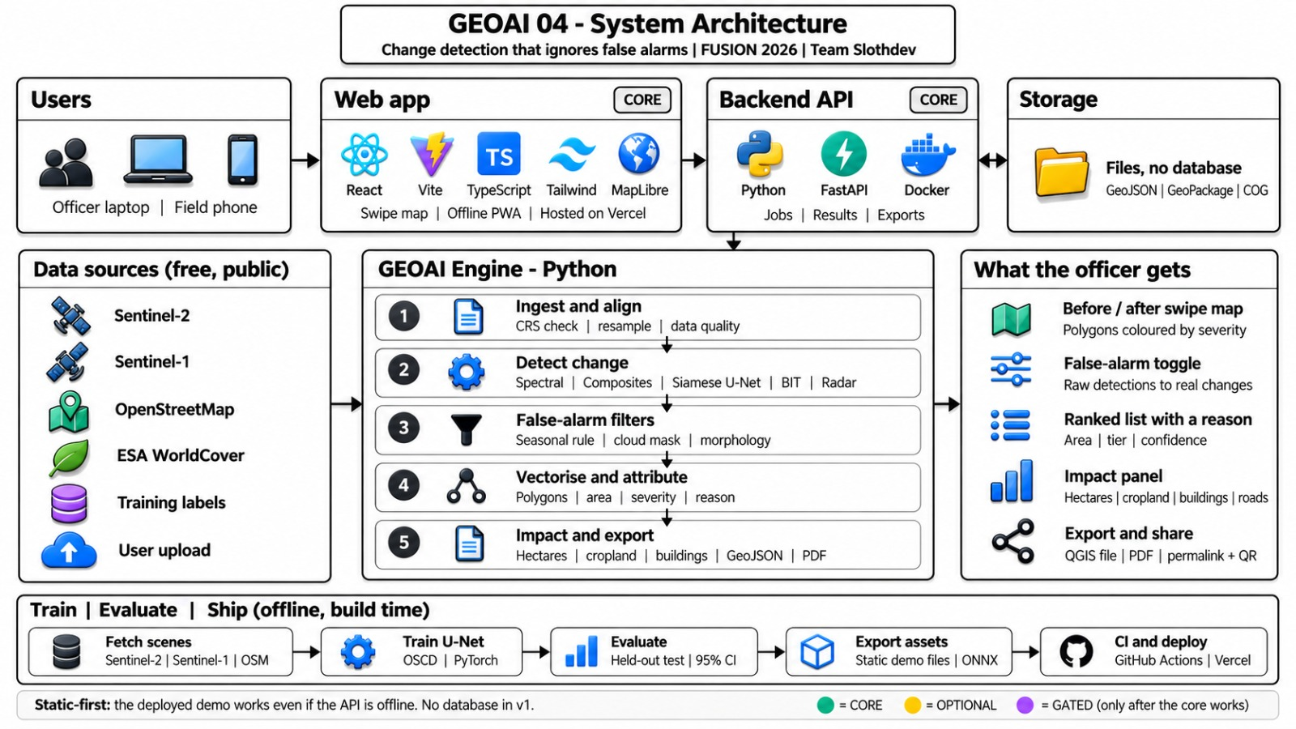






























TECHNICAL APPROACH
2026
Technology Stack
Front End
React 19
Vite
TypeScript
Tailwind CSS
MapLibre GL
Zustand
Python 3.11
FastAPI
Rasterio
Back End
GeoPandas
NumPy
scikit-image
PyTorch
ONNX
scikit-learn
AI & ML
Siamese U-Net
BIT model
Spectral rules
Sentinel-2
Sentinel-1
OSCD
Data
LEVIR-CD
Sen1Floods11
WorldCover
Cloud & Deploy
Render
Docker
GitHub CI
pytest
Vitest
Playwright
SDKs and API
STAC search (Element84 Earth Search)
OpenFreeMap base maps
fpdf2 and qrcode for PDF reports

Slide 4
FEASIBILITY AND VIABILITY
2026
FIVE PROBLEMS, AND HOW NETRA USES BEFORE-AND-AFTER SATELLITE IMAGES FOR EACH
FLOOD EXTENT
FLOOD DAMAGE
URBAN GROWTH
WETLAND LOSS
FALSE ALARMS
7.4 M ha
₹4.86 lakh crore
951 M
85%
Above 50%
of India flooded in an average year
flood damage, 1953 to 2021
people in India’s cities by 2050
of Chennai’s wetlands lost, 1988 to 2019
early accuracy of an existing state alert pilot
BEFORE vs AFTER
Radar image before the flood vs during it. Land that turned to open water is new flood.
BEFORE vs AFTER
The newly flooded area is laid over cropland and built-up maps of the same place.
BEFORE vs AFTER
An earlier image vs the latest. Built-up surfaces seen only in the later one are new construction.
BEFORE vs AFTER
Water and green cover earlier vs later. A lake bed turned to bare ground or buildings is flagged.
BEFORE vs AFTER
Two dates also differ in season, sun angle and cloud. NETRA separates those from real change.
NETRA RETURNS: Flood polygons with hectares and severity, even under cloud.
NETRA RETURNS: Hectares of cropland and built-up land affected.
NETRA RETURNS: New-construction polygons, ranked by area, with a reason.
NETRA RETURNS: Encroachment polygons on lakes and drains, while still small.
NETRA RETURNS: False alerts cut from 86.9 to 0.62 per km² on a control scene.
FEASIBILITY AND VIABILITY
STRATEGIC CHALLENGES AND SOLUTIONS
Characteristic
Feasibility
Viability
Potential Challenges
VS
Strategies To Overcome
Proven Principle
Spectral indices and radar water mapping are published methods
Engine, API and web app already work end to end
Monsoon Cloud
Optical satellites are blind in floods.
Radar sees through cloud; output is stated as open-water flood extent.
Data
Free Sentinel-1 and Sentinel-2 imagery; open labelled datasets
No imagery licence cost and no API keys
Learned Model Over-Flags
7.4 false polygons per km² on farmland.
The spectral engine (0.62 per km²) stays the default; learned is optional.
Compute
CPU only; one Docker container runs the API and site
No GPU server; the demo also works offline
Other Regions
Thresholds were tuned on Maharashtra.
Six regions checked by eye; rivers and dry soil are known confusers.
Test Readiness
Held-out results on floods, cities and buildings, with 95% intervals
221 Python and 137 web tests pass
Change Is Not Proof
Imagery shows change, not legality.
NETRA flags and ranks; officers verify on site and confirm or dismiss.

Slide 5
IMPACT AND BENEFITS
2026
KEY BENEFITS
SOCIAL IMPACTS AND BENEFITS
1. Flood extent is mapped during the monsoon, so relief reaches the worst-hit places sooner
2. Field staff spend their time on real changes, not false alarms
3. Citizens see evidence-based action on encroached lakes and commons
4. Works offline after one visit and opens on a phone from a QR code
#
BENEFIT
HOW NETRA DELIVERS IT
01
1
Flood maps during the monsoon
Radar mode maps open flood water through cloud, when optical images show nothing.
2
Fewer wasted field visits
False alarms are filtered out before an alert reaches a guard or surveyor.
Early action on encroachment
New construction on lakes, drains and public land is flagged while still small.
GOVERNANCE IMPACTS AND BENEFITS
3
1. Every department works from the same ranked, explained list of changes
2. Confirm and dismiss decisions build a verified record for each alert
3. Complements pilots such as Madhya Pradesh’s forest alert system (2025)
4. In line with global practice: xView2 and UNOSAT flood mapping
Decisions officers can defend
Every polygon carries its area, confidence, severity tier and a reason.
02
4
5
Impact in plain numbers
Hectares changed, cropland and built-up land affected, each with its source.
6
No licence cost
Free Sentinel imagery, open-source models and open maps.
ECONOMIC AND ENVIRONMENTAL BENEFITS
PERFORMANCE QUALIFICATION
1. No imagery or software licence cost for an agency
2. CPU-only processing, so no GPU server is needed
3. Fewer field trips spent checking false alerts
4. Forest, lake and wetland loss is caught while it can still be stopped
03
1. Flood maps, Indian test scenes: overlap with expert labels 0.57 vs 0.27 naive.
2. False alarms on a no-construction scene: 86.9 down to 0.62 per km².
3. Building change (BIT, LEVIR-CD test split): F1 0.90 vs 0.14 naive.
4. Learned Sentinel-2 model, 10 held-out cities: F1 0.54 vs 0.38 spectral.

Slide 6
RESEARCH AND REFERENCES
2026
Research, models and datasets
Evidence of need and demand
Tang et al., 2026. Shield: unsupervised disaster change detection. J. Remote Sensing 6, 0929.
https://doi.org/10.34133/remotesensing.0929
Goudemant et al., 2026. Embedded bi-temporal building damage assessment. arXiv:2609.37013.
https://arxiv.org/abs/2609.37013
Byun, Han and Chae, 2015. Image fusion-based change detection for flood extent. Remote Sensing 7.
https://doi.org/10.3390/rs70810347
Chen et al., 2021. BIT change detection model and pretrained weights. IEEE TGRS.
https://github.com/justchenhao/BIT_CD
LEVIR-CD. Building change detection dataset (listed in the problem statement).
https://justchenhao.github.io/LEVIR/
Daudt et al., 2018. Onera OSCD: Sentinel-2 change detection dataset.
https://www.kaggle.com/datasets/soumikrakshit/onera-satellite-change-detection-dataset
Bonafilia et al., 2020. Sen1Floods11: hand-labelled Sentinel-1 flood dataset.
https://github.com/cloudtostreet/Sen1Floods11
Factly, from CWC data. Flood damage, lives lost and area affected in India, 1953 to 2021.
https://factly.in/data-average-annual-economic-impact-due-to-floods-is-more-than-rs-25000-crores-after-the-year-2010
World Bank, July 2025. Towards Resilient and Prosperous Cities in India.
https://www.worldbank.org/en/news/press-release/2025/07/22/india-has-a-critical-opportunity-to-drive-resilient-urban-development-says-new-world-bank-report
Millennium Post. Wetlands at the Crossroads (Chennai wetland loss).
https://www.millenniumpost.in/opinion/wetlands-at-the-crossroads-654371
Business Standard, April 2025. Madhya Pradesh AI forest alert system.
https://www.business-standard.com/india-news/mp-first-state-to-launch-ai-based-real-time-forest-alert-system-officials-125042900640_1.html
Indian Masterminds, June 2025. Early accuracy of the Madhya Pradesh alert pilot.
https://indianmasterminds.com/feature-stories-on-bureaucrats-changemakers/from-code-to-conservation-how-this-ifs-officer-is-using-ai-satellite-data-to-fight-deforestation-in-mp-121910/
FedScoop, 2019. xView2 building damage challenge.
https://fedscoop.com/xview2-challenge-building-damage-disaster-recovery/
UNITAR, 2020. UNOSAT AI flood rapid mapping.
https://unitar.org/about/news-stories/news/unosat-introduces-ai-its-flood-rapid-mapping-operations-benefit-national-disaster-management

