Slide 1
Introduction to Data Science Lecture 4 Data Cleaning and Integration

Slide 2
Outline for this Evening
Data Cleaning
Perspectives on “Dirty Data”
Perspectives on Data Quality
Some problems and solutions
Data Integration
Item Similarity
Schema Matching

Slide 3

DB-hard Queries
Company_Name | Address | Market Cap
Google | Googleplex, Mtn. View, CA | $406Bn
Microsoft | Redmond, WA | $392Bn
Intl. Business Machines | Armonk, NY | $194Bn
SELECT Market_Cap
From Companies
Where Company_Name = “Apple”
Number of Rows: 0
Problem:
Missing Data

Slide 4
DB-hard Queries
Company_Name | Address | Market Cap
Google | Googleplex, Mtn. View, CA | $406Bn
Microsoft | Redmond, WA | $392Bn
Intl. Business Machines | Armonk, NY | $194Bn
SELECT Market_Cap
From Companies
Where Company_Name = “IBM”
Number of Rows: 0
Problem:
Entity Resolution

Slide 5
DB-hard Queries
Company_Name | Address | Market Cap
Google | Googleplex, Mtn. View, CA | $406
Microsoft | Redmond, WA | $392
Intl. Business Machines | Armonk, NY | $194
Sally’s Lemonade Stand | Alameda,CA | $460
SELECT MAX(Market_Cap)
From Companies
Number of Rows: 1
Problem:
Unit Mismatch

Slide 6
Data Quality Problems
(Source) Data is dirty on its own.
Transformations corrupt the data (complexity of software pipelines).
Data sets are clean but integration (i.e., combining them) screws them up.
“Rare” errors can become frequent after transformation or integration.
Data sets are clean but suffer “bit rot”
Old data loses its value/accuracy over time
Any combination of the above

Slide 7
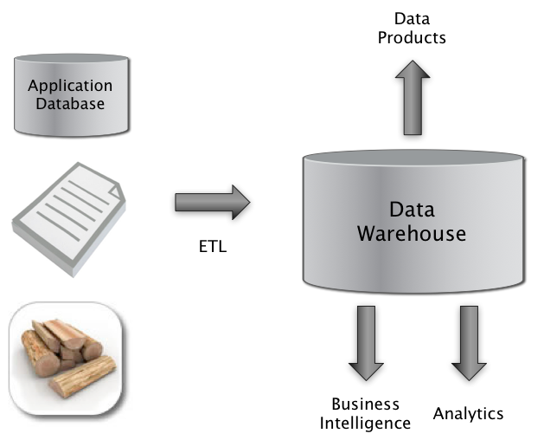

Big Picture: Where can Dirty Data Arise?
Integrate
Clean
Extract
Transform
Load

Slide 8
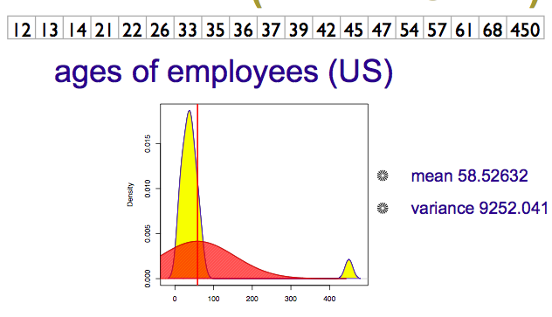

Numeric Outliers
Adapted from Joe Hellerstein’s 2012 CS 194 Guest Lecture

Slide 9
Dirty Data Problems
From Stanford Data Integration Course:
parsing text into fields (separator issues)
Naming conventions: ER: NYC vs New York
Missing required field (e.g. key field)
Different representations (2 vs Two)
Fields too long (get truncated)
Primary key violation (from un- to structured or during integration
Redundant Records (exact match or other)
Formatting issues – especially dates
Licensing issues/Privacy/ keep you from using the data as you would like?

Slide 10
Conventional Definition of Data Quality
Accuracy
The data was recorded correctly.
Completeness
All relevant data was recorded.
Uniqueness
Entities are recorded once.
Timeliness
The data is kept up to date.
Special problems in federated data: time consistency.
Consistency
The data agrees with itself.
Adapted from Ted Johnson’s SIGMOD 2003 Tutorial

Slide 11
Problems …
Unmeasurable
Accuracy and completeness are extremely difficult, perhaps impossible to measure.
Context independent
No accounting for what is important. E.g., if you are computing aggregates, you can tolerate a lot of inaccuracy.
Incomplete
What about interpretability, accessibility, metadata, analysis, etc.
Vague
The conventional definitions provide no guidance towards practical improvements of the data.
Adapted from Ted Johnson’s SIGMOD 2003 Tutorial

Slide 12
Finding a modern definition
We need a definition of data quality which
Reflects the use of the data
Leads to improvements in processes
Is measurable (we can define metrics)
First, we need a better understanding of how and where data quality problems occur
The data quality continuum
Adapted from Ted Johnson’s SIGMOD 2003 Tutorial

Slide 13
Meaning of Data Quality (2)
There are many types of data, which have different uses and typical quality problems
Federated data
High dimensional data
Descriptive data
Longitudinal data
Streaming data
Web (scraped) data
Numeric vs. categorical vs. text data
Adapted from Ted Johnson’s SIGMOD 2003 Tutorial

Slide 14
Meaning of Data Quality (2)
There are many uses of data
Operations
Aggregate analysis
Customer relations …
Data Interpretation : the data is useless if we don’t know all of the rules behind the data.
Data Suitability : Can you get the answer from the available data
Use of proxy data
Relevant data is missing
Adapted from Ted Johnson’s SIGMOD 2003 Tutorial
Notes:
Challenge in operations : many handoffs. Some processes more important than others.
Challenge in aggregate analysis: can tolerate errors, but you’re summing up over a lot of data, therefore likely to add in glitched data.
Customer relations : the fields must be accurate, but errors don’t spread.

Slide 15
The Data Quality Continuum
Data and information is not static, it flows in a data collection and usage process
Data gathering
Data delivery
Data storage
Data integration
Data retrieval
Data mining/analysis
Adapted from Ted Johnson’s SIGMOD 2003 Tutorial

Slide 16
Schema and Data Integration
Which problems does Integration exacerbate?
Which problems does schema on write help?
Mediated Schema
Semantic mappings
wrapper
wrapper
wrapper
wrapper
wrapper
Courtesy of Alon Halevy

Slide 17
Data Integration
Combine data sets (acquisitions, across departments).
Common source of problems
Heterogenous data : no common key, different field formats
Approximate matching
Different definitions
What is a customer: an account, an individual, a family, …
Time synchronization
Does the data relate to the same time periods? Are the time windows compatible?
Legacy data
IMS, spreadsheets, ad-hoc structures
Adapted from Ted Johnson’s SIGMOD 2003 Tutorial

Slide 18
Schema Matching
Original Problem: merge structured databases
But, even in a looser schema (e.g. NoSQL) world structural matching matters
WebTables paper shows an extreme version of this
2.6M Unique schemas (appear >1 time)
5.4M Unique attribute (field) names (>1 time)
Found by web crawling/scraping

Slide 19
WebTables Extracted Tables
Recovered Relations
ACSDb
Schema | Freq
make | model | year
Toyota | Camry | 1984
{make, model, year}
2
{make, model, year, color}
1
make | model | year
Mazda | Protégé | 2003
Chevrolet | Impala | 1979
{name, addr, city, state, zip}
1
{name, size, last-modified}
1
ACSDb is useful for computing attribute probabilities
p(“make”), p(“model”), p(“zipcode”)
p(“make” | “model”), p(“make” | “zipcode”)
make | model | year | color
Chrysler | Volare | 1974 | yellow
Nissan | Sentra | 1994 | red
name | addr | city | state | zip
Dan S | 16 Park | Seattle | WA | 98195
Alon H | 129 Elm | Belmont | CA | 94011
name | size | last-modified
Readme.txt | 182 | Apr 26, 2005
cac.xml | 813 | Jul 23, 2008

Slide 20
ACSDb* Applications
Schema Auto Complete
Attribute Synonym-Finding
Join Graph Traversal
*Attribute Correlation Statistics Database

Slide 21
Matching: Data and sTructure

Slide 22


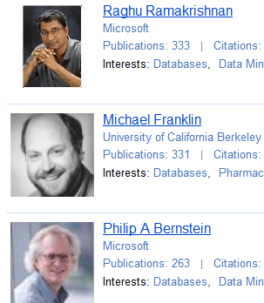
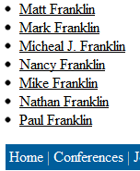
Example: Data Integration
Notes:
CrowdER Architecuture

Slide 23

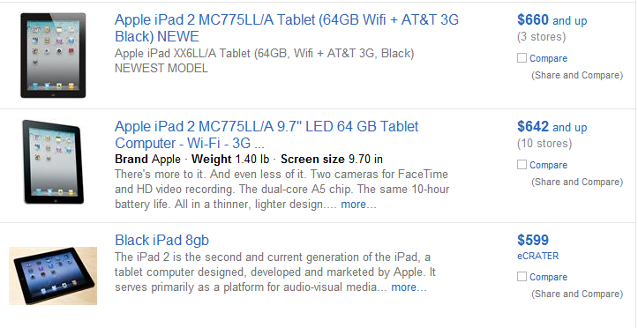
Example: DeDup/Cleaning

Slide 24
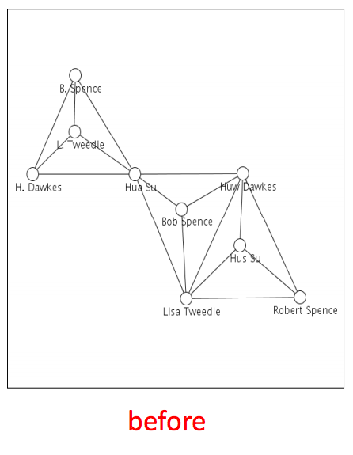
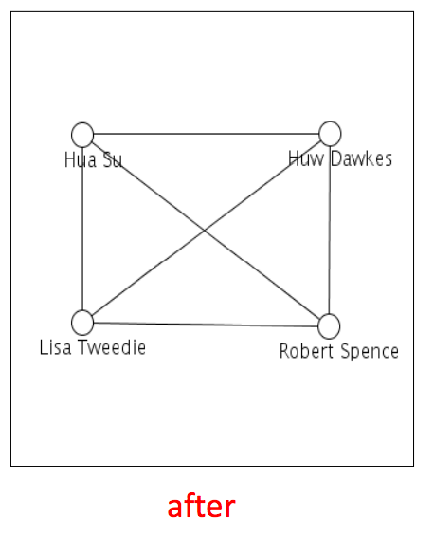
Example: Network Analysis
From: Getoor & Machanavajjhala: “Entity Resolution Tutorial”, VLDB 2012

Slide 25
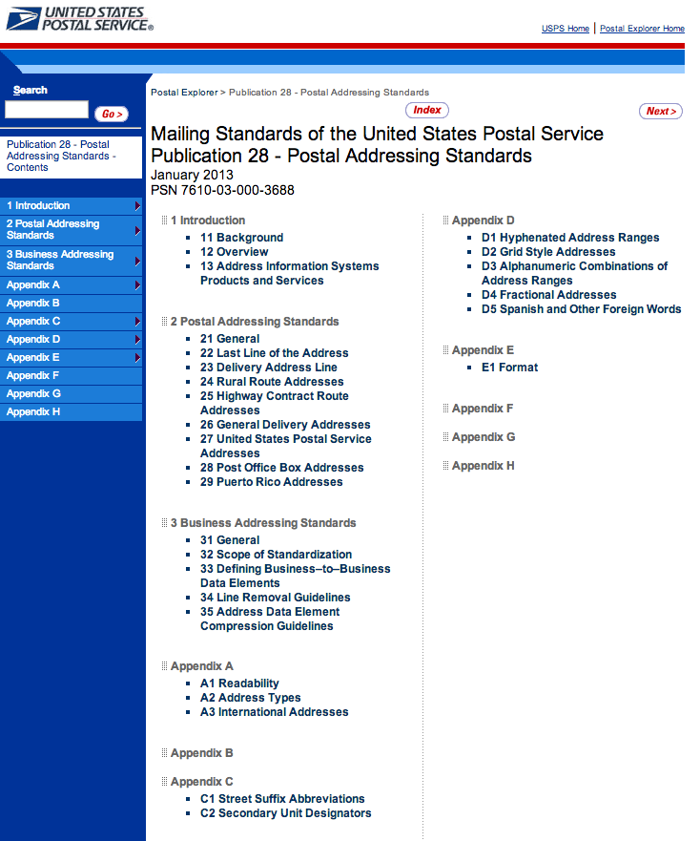
Preprocessing/Standardization
Simple idea:
Convert to canonical form
e.g. addresses

Slide 26
Approximate Matching
Relate tuples whose fields are “close”
Approximate string matching
Generally, based on edit distance.
Fast SQL expression using a q-gram index (a q-gram is like an n-gram on syllables)
Approximate tree matching
For Nested Data Structures (or flattened ones)
Much more expensive than string matching
Recent research in fast approximations
Feature vector matching
Similarity search
Many techniques discussed in the data mining literature.
Ad-hoc or Domain-focused matching
Use domain insights and/or clever tricks.

Slide 27
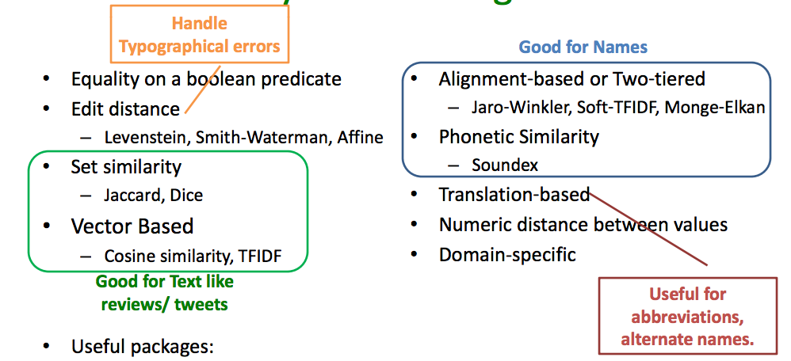
Some Similarity Measures
From: Getoor & Machanavajjhala: “Entity Resolution Tutorial”, VLDB 2012

Slide 28
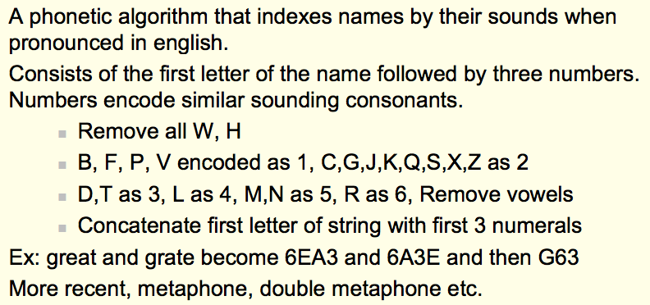
Soundex Encoding
From: Koudas, Sarawagi, Strivastava, “Record Linkage: Similarity Measures and Algorithms”, VLDB 2006

Slide 29
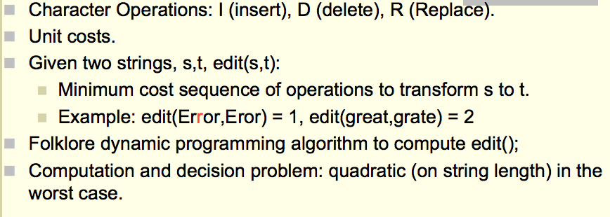
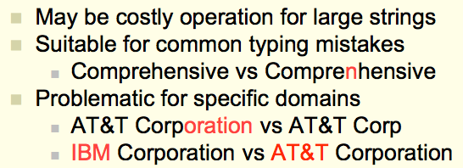
Edit Distance
From: Koudas, Sarawagi, Strivastava, “Record Linkage: Similarity Measures and Algorithms”, VLDB 2006

Slide 30
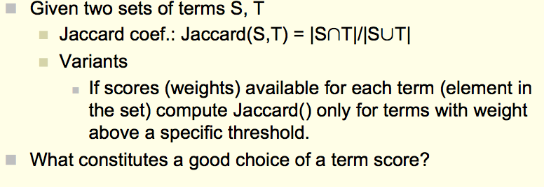
Overlap Metrics
Terms can be words or “q-grams” (sequence of q characters in a field:
e.g., {‘AT&’, ‘T&T’, ‘&T ‘, ‘T C’, …} for AT&T Corp.
From: Koudas, Sarawagi, Strivastava, “Record Linkage: Similarity Measures and Algorithms”, VLDB 2006

Slide 31
More Sophisticated Techniques
Evidence from multiple fields
Positive and Negative are possible
Evidence from linkage pattern with other records
Clustering-based approaches
…

Slide 32
Approximate Joins and Duplicate Elimination
Perform joins based on incomplete or corrupted information.
Approximate join : between two different tables
Duplicate elimination : within the same table
More general than approximate matching.
Semantics : Need to use special transforms and scoring functions.
Correlating information : verification from other sources, e.g. usage correlates with billing.
Missing data : Need to use several orthogonal search and scoring criteria.
But approximate matching is a valuable tool …

Slide 33
(Approximate Join Example)
Sales
“Gen” bucket
Provisioning
Sales
Provisioning
Genrl. Eclectic
General Magic
Gensys
Genomic Research
Genrl. Electric
Genomic Research
Gensys Inc.
Match
Genrl. Eclectic
Genomic Research
Gensys
Genrl. Electric
Genomic Research
Gensys Inc.

Slide 34
Algorithm (for scalability)
Partition data set
By hash on computed key
By sort order on computed key
By similarity search / approximate match on computed key
Perform scoring within the partition
Hash : all pairs
Sort order, similarity search : target record to retrieved records
Record pairs with high scores are matches
Use multiple computed keys / hash functions
Duplicate elimination : duplicate records form an equivalence class.

Slide 35
Schema Matching
Use similarity measures and structural cues (e.g. column names, data types, etc.) to match data definitions
Looking at data instances (or examples of them can help)
Constraints in the schema (if you have them) can also help.
Auxiliary Information: dictionaries, documentation, usage… ditto

Slide 36
Summary
Data Cleaning
Perspectives on “Dirty Data”
Perspectives on Data Quality
Some problems and solutions
Data Integration
Item Similarity
Schema Matching

