Slide 1
Introduction to Data Science 3 ½ more Basic Algorithms

Slide 2
Outline for this Evening
Three (+ ½) more Basic Algorithms
Naïve Bayes
Logistic Regression (+ ½ SVM )
Random Forests
Evaluation
Precision/Recall
Accuracy + weighted loss
ROC and AUC
Lift

Slide 3
Techniques
Supervised Learning:
kNN (k Nearest Neighbors)
Linear Regression
Naïve Bayes
Logistic Regression
Support Vector Machines
Random Forests
Unsupervised Learning:
Clustering
Factor analysis
Topic Models

Slide 4
Techniques
Supervised Learning:
kNN (k Nearest Neighbors)
Linear Regression
Naïve Bayes
Logistic Regression
Support Vector Machines
Random Forests
Unsupervised Learning:
Clustering
Factor analysis
Topic Models

Slide 5

Autonomy Corp

Slide 6
Bayes’ Theorem
P(A|B) = probability of A given that B is true.
P(A|B) =
In practice we are most interested in dealing with events e and data D.
e = “I have a cold”
D = “runny nose,” “watery eyes,” “coughing”
P(e|D)=
So Bayes’ theorem is “diagnostic”.
P(B|A)P(A)
P(B)
P(D|e)P(e)
P(D)

Slide 7
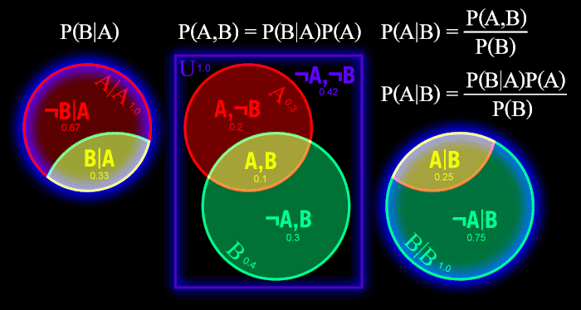
Bayes’ Theorem

Slide 8
Bayes’ Theorem
D = Data, e = some event
P(e|D) =
P(e) is called the prior probability of e. Its what we know (or think we know) about e with no other evidence.
P(D|e) is the conditional probability of D given that e happened, or just the likelihood of D. This can often be measured or computed precisely – it follows from your model assumptions.
P(e|D) is the posterior probability of e given D. It’s the answer we want, or the way we choose a best answer.
You can see that the posterior is heavily colored by the prior, so Bayes’ has a GIGO liability. e.g. its not used to test hypotheses
P(D|e)P(e)
P(D)
Notes:
e.g. what fraction of people got a cold last year? Even if you have a reliable viral test, you cant test everyone. You can sample but you have both error and bias. In practice the best clue is doctor’s visits. Or Sprint’s data.
GIGO = garbage in, garbage out

Slide 9

Naïve Bayes Classifier
Let’s assume we have an instance (e.g. a document d) with a set of features $\left(X_{1},…,X_{k}\right)$ and a set of classes $\left\{c_{j}\right\}$ to which the document might belong.
We want to find the most likely class that the document belongs to, given its features.
The joint probability of the class and features is:
$$Pr⁡\left(X_{1},…,X_{k},c_{j}\right)$$

Slide 10

Naïve Bayes Classifier
Key Assumption: (Naïve) the features are generated independently given $c_{j}$. Then the joint probability factors:
$$\operatorname{Pr}\left(X,c_{j}\right)=\operatorname{Pr}\left(X_{1},…,X_{k} | c_{j}\right)\operatorname{Pr}\left(c_{j}\right)=\operatorname{Pr}\left(c_{j}\right)\prod_{i=1}^{k}{\operatorname{Pr}\left(X_{i}|c_{j}\right)}$$
We would like to figure out the most likely class for (i.e. to classify) the document, which is the $c_{j}$ which maximizes:
$$Pr⁡\left(c_{j} | X_{1},…,X_{k}\right)$$

Slide 11

Naïve Bayes Classifier
Now from Bayes we know that:
$$\operatorname{Pr}\left({c_{j} | X}_{1},…,X_{k}\right)=\operatorname{Pr}\left(X_{1},…,X_{k} | c_{j}\right)\operatorname{Pr}\left(c_{j}\right)/\operatorname{Pr}\left(X_{1},…,X_{k}\right)$$
But to choose the best $c_{j}$, we can ignore $\operatorname{Pr}\left(X_{1},…,X_{k}\right)$ since it’s the same for every class. So we just have to maximize:
$$\operatorname{Pr}\left(X_{1},…,X_{k} | c_{j}\right)\operatorname{Pr}\left(c_{j}\right)$$
So finally we pick the category $c_{j}$ that maximizes:
$$\operatorname{Pr}\left(X_{1},…,X_{k} | c_{j}\right)\operatorname{Pr}\left(c_{j}\right)=\operatorname{Pr}\left(c_{j}\right)\prod_{i=1}^{k}{\operatorname{Pr}\left(X_{i}|c_{j}\right)}$$

Slide 12
Naïve Bayes Classifier
Now from Bayes we know that:
$$\operatorname{Pr}\left({c_{j} | X}_{1},…,X_{k}\right)=\operatorname{Pr}\left(X_{1},…,X_{k} | c_{j}\right)\operatorname{Pr}\left(c_{j}\right)/\operatorname{Pr}\left(X_{1},…,X_{k}\right)$$
But to choose the best $c_{j}$, we can ignore $\operatorname{Pr}\left(X_{1},…,X_{k}\right)$ since it’s the same for every class. So we just have to maximize:
$$\operatorname{Pr}\left(X_{1},…,X_{k} | c_{j}\right)\operatorname{Pr}\left(c_{j}\right)$$
So finally we pick the category $c_{j}$ that maximizes:
$$\operatorname{Pr}\left(X_{1},…,X_{k} | c_{j}\right)\operatorname{Pr}\left(c_{j}\right)=\operatorname{Pr}\left(c_{j}\right)\prod_{i=1}^{k}{\operatorname{Pr}\left(X_{i}|c_{j}\right)}$$
A
B
B
A
A
B

Slide 13

Data for Naïve Bayes
In order to find the best class, we need two pieces of data:
$\operatorname{Pr}\left(c_{j}\right)$ the prior probability for the class $c_{j}$.
$\operatorname{Pr}\left(X_{i}|c_{j}\right)$ the conditional probability of the feature $X_{i}$ given the class $c_{j}$.

Slide 14

Data for Naïve Bayes
For these two data, we only need to record counts:
$\operatorname{Pr}\left(c_{j}\right)=\frac{N_{d}\left(c_{j}\right)}{N_{d}}$
$\operatorname{Pr}\left(X_{i}|c_{j}\right)= \frac{N_{w}\left(X_{i},c_{j}\right)}{N_{w}\left(c_{j}\right)}$
Where $N_{d}\left(c_{j}\right)$ is the number of documents in class $c_{j}$, $N_{d}$ is the total number of documents.
$N_{w}\left(X_{i},c_{j}\right)$ is the number of times $X_{i}$ occurs in a document in $c_{j}$, and and $N_{w}\left(c_{j}\right)$ is the total number of features in all docs in $c_{j}$.

Slide 15
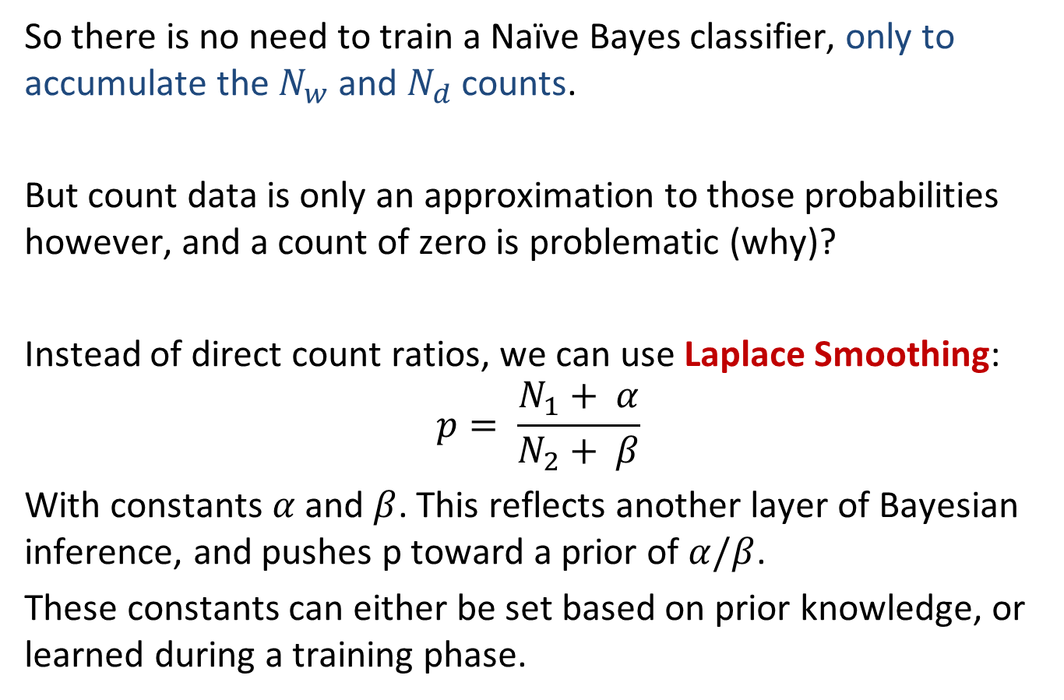
“Training” Naïve Bayes
So there is no need to train a Naïve Bayes classifier, only to accumulate the $N_{w}$ and $N_{d}$ counts.
But count data is only an approximation to those probabilities however, and a count of zero is problematic (why)?
Instead of direct count ratios, we can use Laplace Smoothing:
$$p= \frac{N_{1}+ α}{N_{2}+ β}$$
With constants $α$ and $β$. This reflects another layer of Bayesian inference, and pushes p toward a prior of $α/β$.
These constants can either be set based on prior knowledge, or learned during a training phase.

Slide 16
Good, Bad and Ugly of NB Classifiers
Simple and fast. Depend only on term frequency data for the classes. One shot, no iteration.
Very well-behaved numerically. Term weight depends only on frequency of that term. Decoupled from other terms.
Can work very well with sparse data, where combinations of dependent terms are rare.
Subject to error and bias when term probabilities are not independent (e.g. URL prefixes).
Can’t model patterns in the data.
Typically not as accurate as other methods.

Slide 17
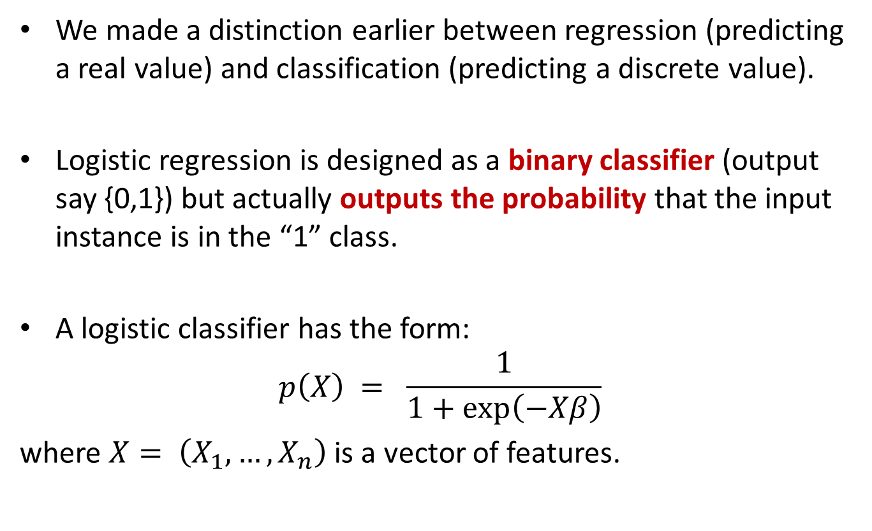
Logistic Regression
We made a distinction earlier between regression (predicting a real value) and classification (predicting a discrete value).
Logistic regression is designed as a binary classifier (output say {0,1}) but actually outputs the probability that the input instance is in the “1” class.
A logistic classifier has the form:
$$p\left(X\right) = \frac{1}{1+exp⁡\left(−Xβ\right)}$$
where $X= \left(X_{1},…,X_{n}\right)$ is a vector of features.

Slide 18
Logistic Regression
Logistic regression is probably the most widely used general-purpose classifier.
Its very scalable and can be very fast to train. It’s used for
Spam filtering
News message classification
Web site classification
Product classification
Most classification problems with large, sparse feature sets.
The only caveat is that it can overfit on very sparse data, so its often used with Regularization

Slide 19
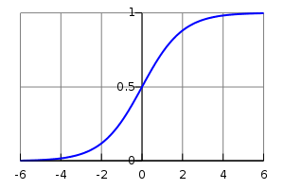

Logistic Regression
Logistic regression maps the “regression” value $−Xβ$ in (-∞,∞) to the range [0,1] using a “logistic” function:
$$p\left(X\right) = \frac{1}{1+exp⁡\left(−Xβ\right)}$$
i.e. the logistic function maps any value on the real line to a probability in the range [0,1]

Slide 20
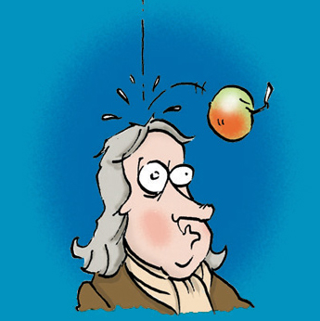
Logistic Regression
Where did the logistic function come from?

Slide 21
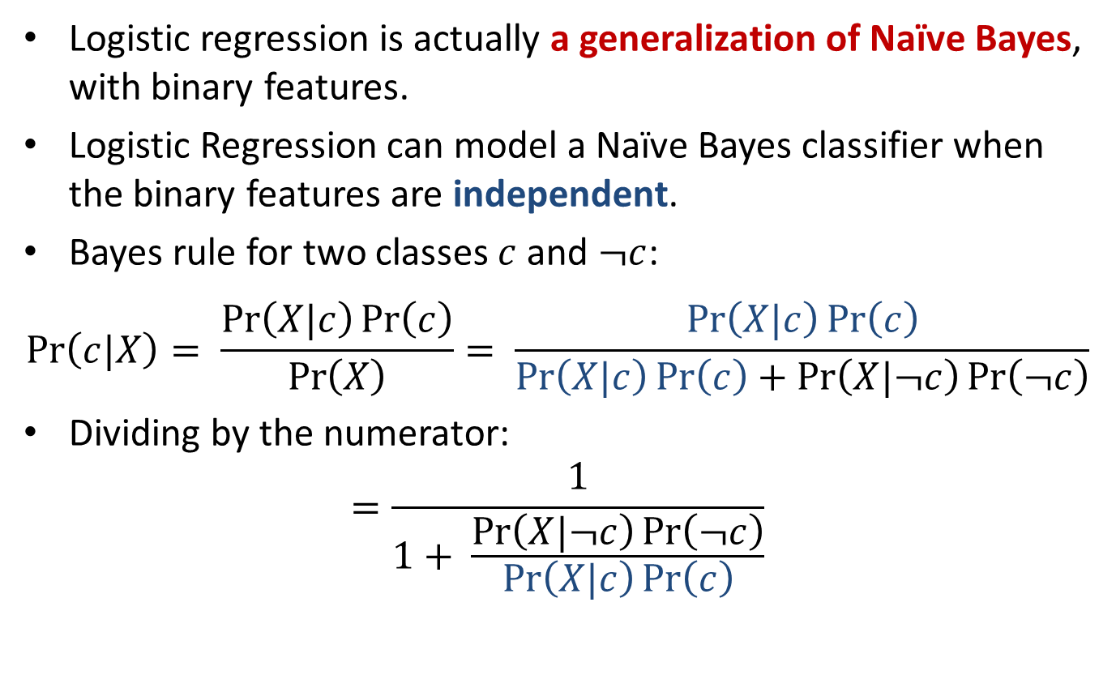
Logistic Regression and Naïve Bayes
Logistic regression is actually a generalization of Naïve Bayes, with binary features.
Logistic Regression can model a Naïve Bayes classifier when the binary features are independent.
Bayes rule for two classes $c$ and $¬c$:
$$\operatorname{Pr}\left(c|X\right)= \frac{\operatorname{Pr}\left(X|c\right)\operatorname{Pr}\left(c\right)}{\operatorname{Pr}\left(X\right)}= \frac{\operatorname{Pr}\left(X|c\right)\operatorname{Pr}\left(c\right)}{\operatorname{Pr}\left(X|c\right)\operatorname{Pr}\left(c\right)+\operatorname{Pr}\left(X|¬c\right)\operatorname{Pr}\left(¬c\right)}$$
Dividing by the numerator:
$$=\frac{1}{1+ \frac{\operatorname{Pr}\left(X|¬c\right)\operatorname{Pr}\left(¬c\right)}{\operatorname{Pr}\left(X|c\right)\operatorname{Pr}\left(c\right)}}$$

Slide 22
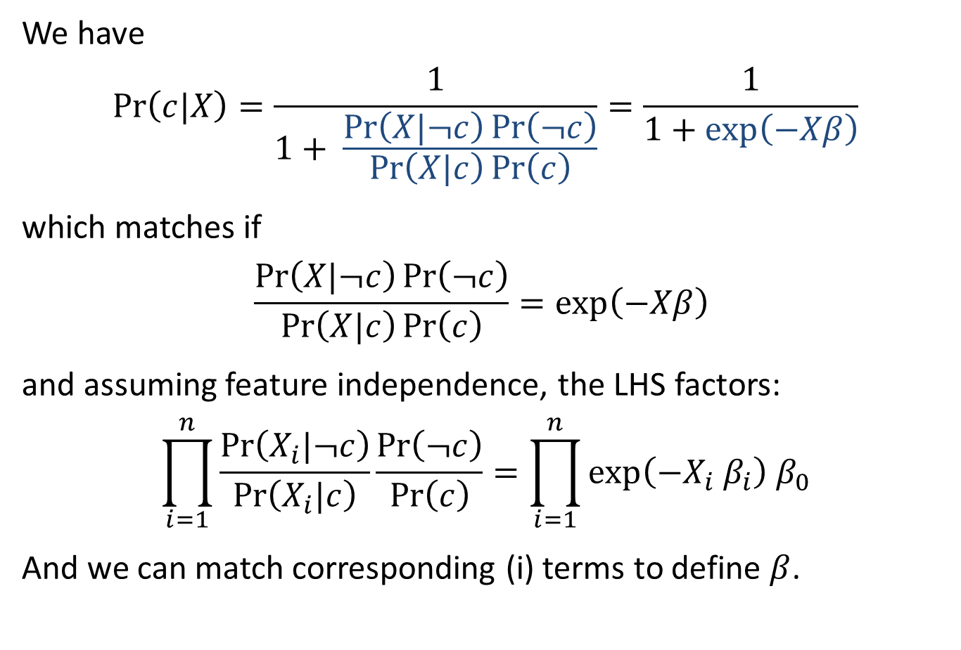
Logistic Regression and Naïve Bayes
We have
$$\operatorname{Pr}\left(c|X\right)=\frac{1}{1+ \frac{\operatorname{Pr}\left(X|¬c\right)\operatorname{Pr}\left(¬c\right)}{\operatorname{Pr}\left(X|c\right)\operatorname{Pr}\left(c\right)}}=\frac{1}{1+exp⁡\left(−Xβ\right)}$$
which matches if
$$\frac{\operatorname{Pr}\left(X|¬c\right)\operatorname{Pr}\left(¬c\right)}{\operatorname{Pr}\left(X|c\right)\operatorname{Pr}\left(c\right)}=exp\left(−Xβ\right)$$
and assuming feature independence, the LHS factors:
$$\prod_{i=1}^{n}{\frac{\operatorname{Pr}\left(X_{i}|¬c\right)}{\operatorname{Pr}\left(X_{i}|c\right)}}\frac{\operatorname{Pr}\left(¬c\right)}{\operatorname{Pr}\left(c\right)}=\prod_{i=1}^{n}{exp\left(−X_{i}{ β}_{i}\right)}{ β}_{0}$$
And we can match corresponding (i) terms to define $β$.

Slide 23

Logistic Regression and Naïve Bayes
Summary: Logistic regression has this form:
$$\operatorname{Pr}\left(c|X\right)=\frac{1}{1+exp⁡\left(−Xβ\right)}$$
Models Naïve Bayes formula with two classes
after dividing through by one of them
Models product of contributions from different (independent) features

Slide 24
Logistic Regression and Naïve Bayes
Because it can always learn an NB model but is more general, Logistic regression should do at least as well as naïve Bayes*
Logistic regression typically does better though because it can deal with dependencies between features, whereas Naïve Bayes cannot.
* - this may not be true if the Logistic model is overfit. L1 regularization is often used with LR to avoid overfitting.

Slide 25
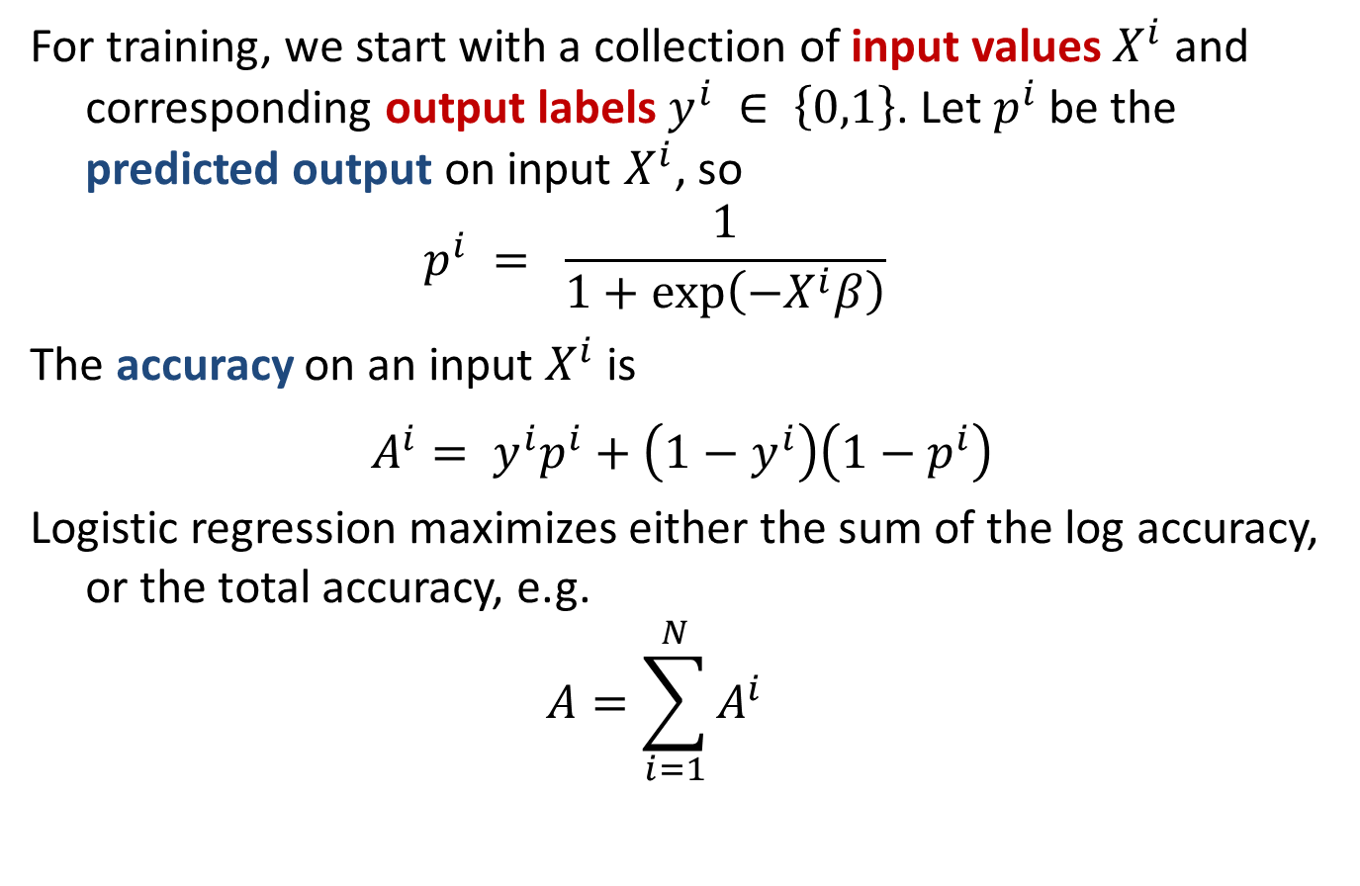
Logistic Training
For training, we start with a collection of input values $X^{i}$ and corresponding output labels $y^{i} ∈ \left\{0,1\right\}$. Let $p^{i}$ be the predicted output on input $X^{i}$, so
$$p^{i} = \frac{1}{1+exp⁡\left(−X^{i}β\right)}$$
The accuracy on an input $X^{i}$ is
$$A^{i}= y^{i}p^{i}+\left(1−y^{i}\right)\left(1−p^{i}\right)$$
Logistic regression maximizes either the sum of the log accuracy, or the total accuracy, e.g.
$$A=\sum_{i=1}^{N}{A^{i}}$$

Slide 26
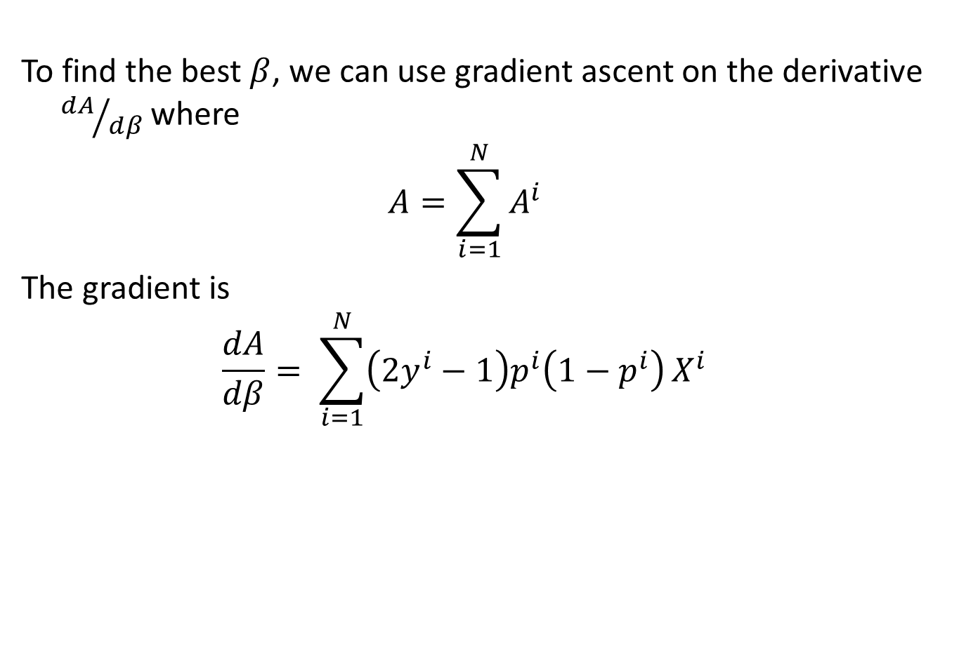
Logistic Training
To find the best $β$, we can use gradient ascent on the derivative ${dA}/{dβ}$ where
$$A=\sum_{i=1}^{N}{A^{i}}$$
The gradient is
$$\frac{dA}{dβ}= \sum_{i=1}^{N}{\left(2y^{i}−1\right)p^{i}\left(1−p^{i}\right)}X^{i}$$

Slide 27
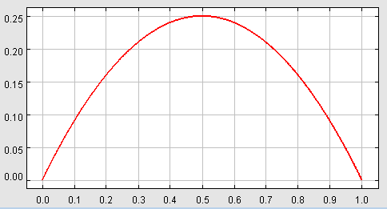
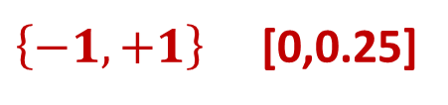
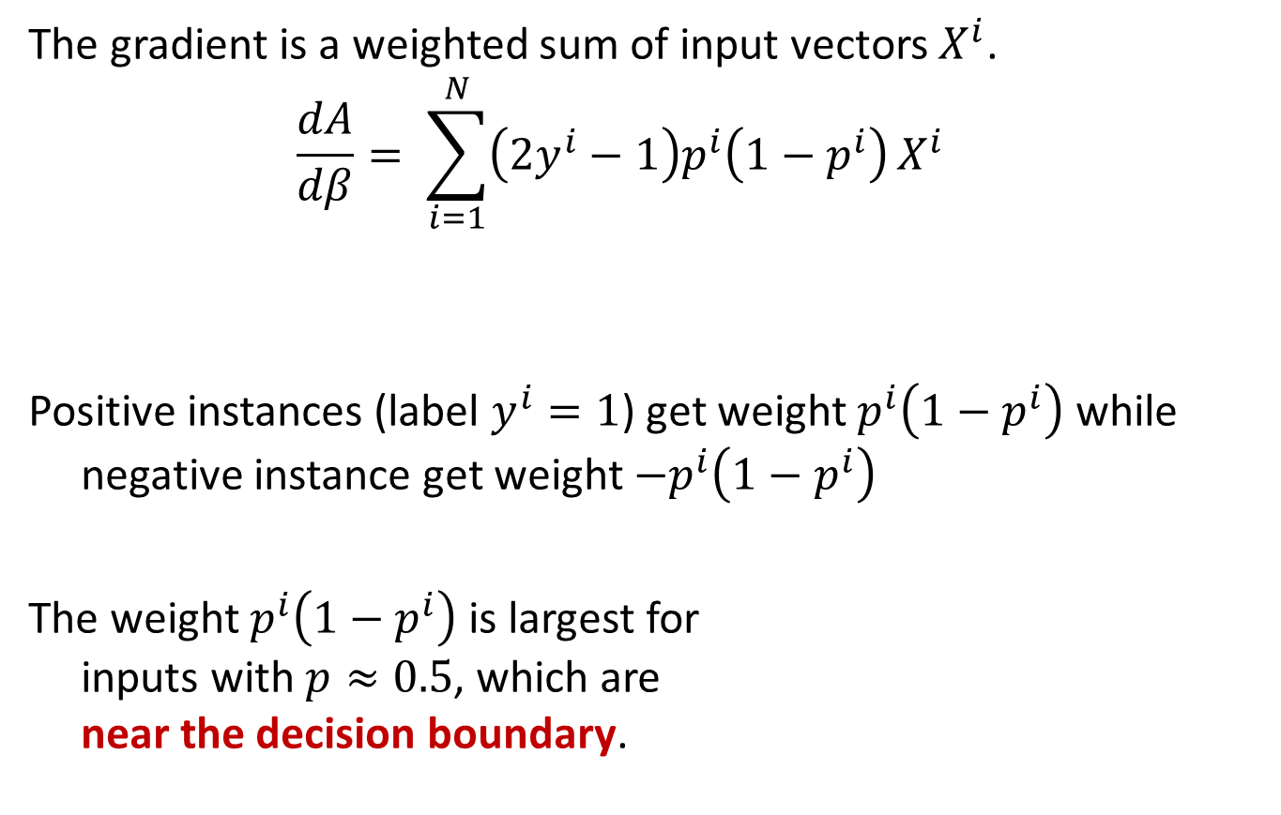
Logistic Training
The gradient is a weighted sum of input vectors $X^{i}$.
$$\frac{dA}{dβ}= \sum_{i=1}^{N}{\left(2y^{i}−1\right)p^{i}\left(1−p^{i}\right)}X^{i}$$
Positive instances (label $y^{i}=1$) get weight $p^{i}\left(1−p^{i}\right)$ while negative instance get weight ${−p}^{i}\left(1−p^{i}\right)$
The weight $p^{i}\left(1−p^{i}\right)$ is largest for inputs with $p≈0.5$, which are near the decision boundary.
$\left\{−1,+1\right\}$ [0,0.25]
y = p (1-p)

Slide 28
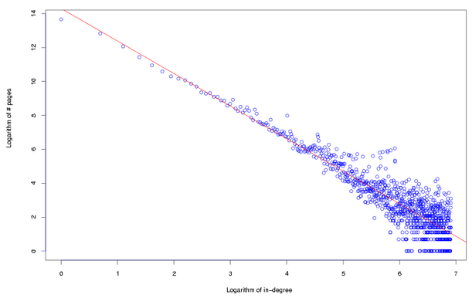
Logistic Regression Training - SGD
A very efficient way to train logistic models is with Stochastic Gradient Descent (SGD) – we keep updating the model with gradients from small blocks (mini-batches) of input data.
One challenge with training on power law data (i.e. most data) is that the terms in the gradient can have very different strengths (because of the power law distribution)

Slide 29
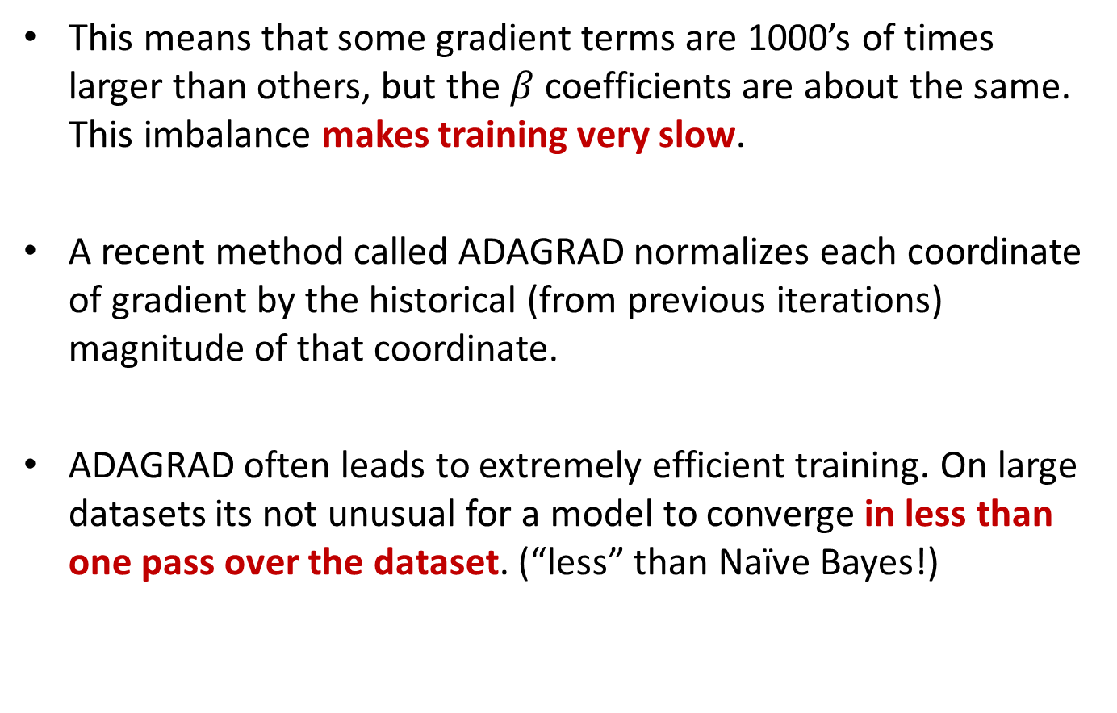
Logistic Regression Training - ADAGRAD
This means that some gradient terms are 1000’s of times larger than others, but the $β$ coefficients are about the same. This imbalance makes training very slow.
A recent method called ADAGRAD normalizes each coordinate of gradient by the historical (from previous iterations) magnitude of that coordinate.
ADAGRAD often leads to extremely efficient training. On large datasets its not unusual for a model to converge in less than one pass over the dataset. (“less” than Naïve Bayes!)

Slide 30
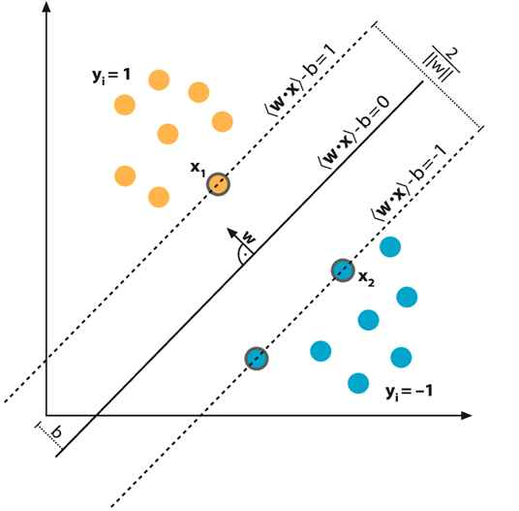

Support Vector Machines
A Support Vector Machine (SVM) is a classifier that tries to maximize the margin between training data and the classification boundary (the plane defined by $Xβ=0$)

Slide 31
Support Vector Machines
The idea is that maximizing the margin maximizes the chance that classification will be correct on new data. We assume the new data of each class is near the training data of that type.

Slide 32
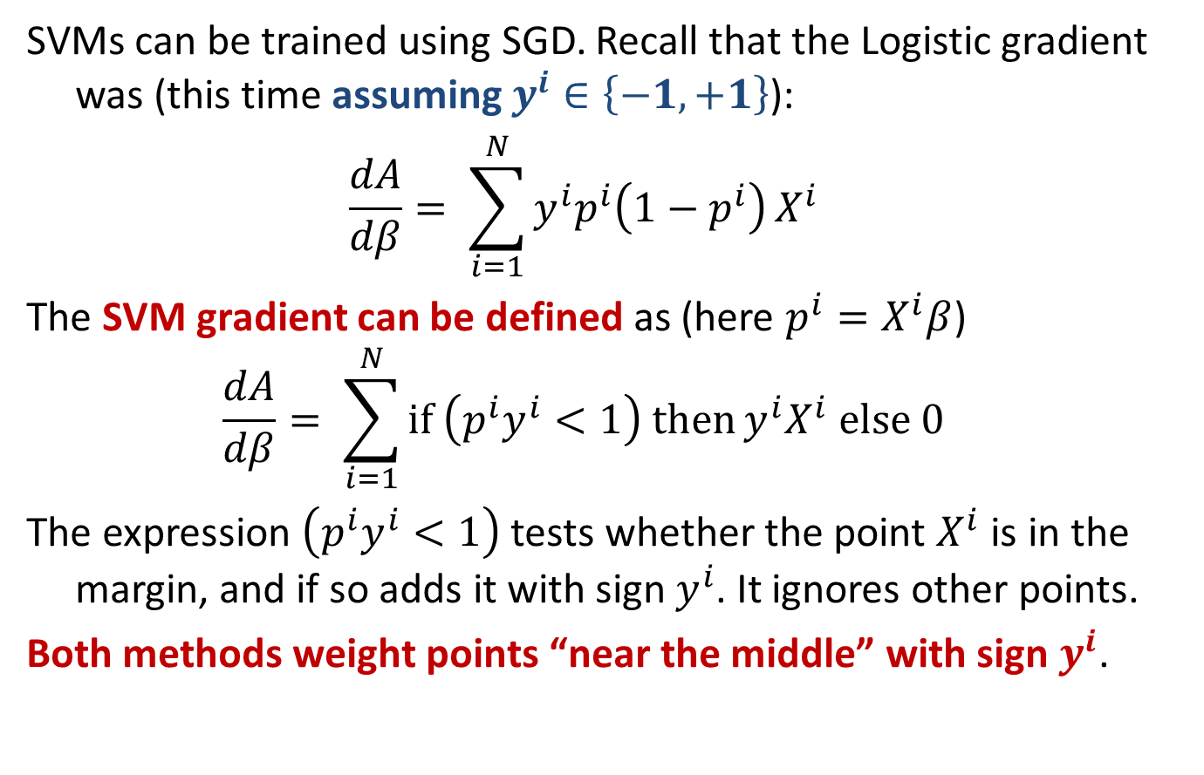
SVM Training
SVMs can be trained using SGD. Recall that the Logistic gradient was (this time assuming $y^{i}∈\left\{−1,+1\right\}$):
$$\frac{dA}{dβ}= \sum_{i=1}^{N}{y^{i}p^{i}\left(1−p^{i}\right)}X^{i}$$
The SVM gradient can be defined as (here $p^{i}=X^{i}β$)
$$\frac{dA}{dβ}= \sum_{i=1}^{N}{\text{if} \left(p^{i}y^{i}<1\right) \text{then}}{y^{i}X}^{i} \text{else} 0$$
The expression $\left(p^{i}y^{i}<1\right)$ tests whether the point $X^{i}$ is in the margin, and if so adds it with sign $y^{i}$. It ignores other points.
Both methods weight points “near the middle” with sign $y^{i}$.

Slide 33
SVM Training
This SGD training method (called Pegasos) is much faster than previous methods, and competitive with Logistic Regression.
Its also capable of training in less than one pass over a dataset.
We’ll try some of these in Lab 7.

Slide 34
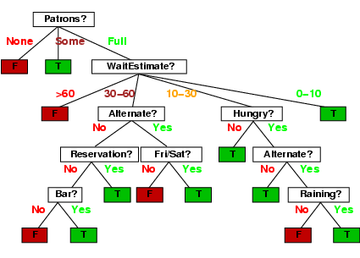
Decision trees
Walk from root to a class-labeled leaf.
At each node, branch based on the value of some feature.
Note you can use the same
attribute more than once.

Slide 35
Decision tree learning
If there are k features, a decision tree might have up to 2^{k} nodes. This is usually much too big in practice.
We want to find “efficient” (smaller) trees.
We can do this in a greedy manner by recursively choosing a best split feature at each node.

Slide 36
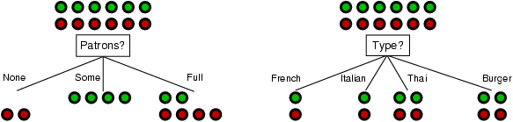
Choosing an attribute
Idea: a good features splits the examples into subsets that are (ideally) "all positive" or "all negative"
Patrons or type?
To wait or not to wait is still at 50%.

Slide 37
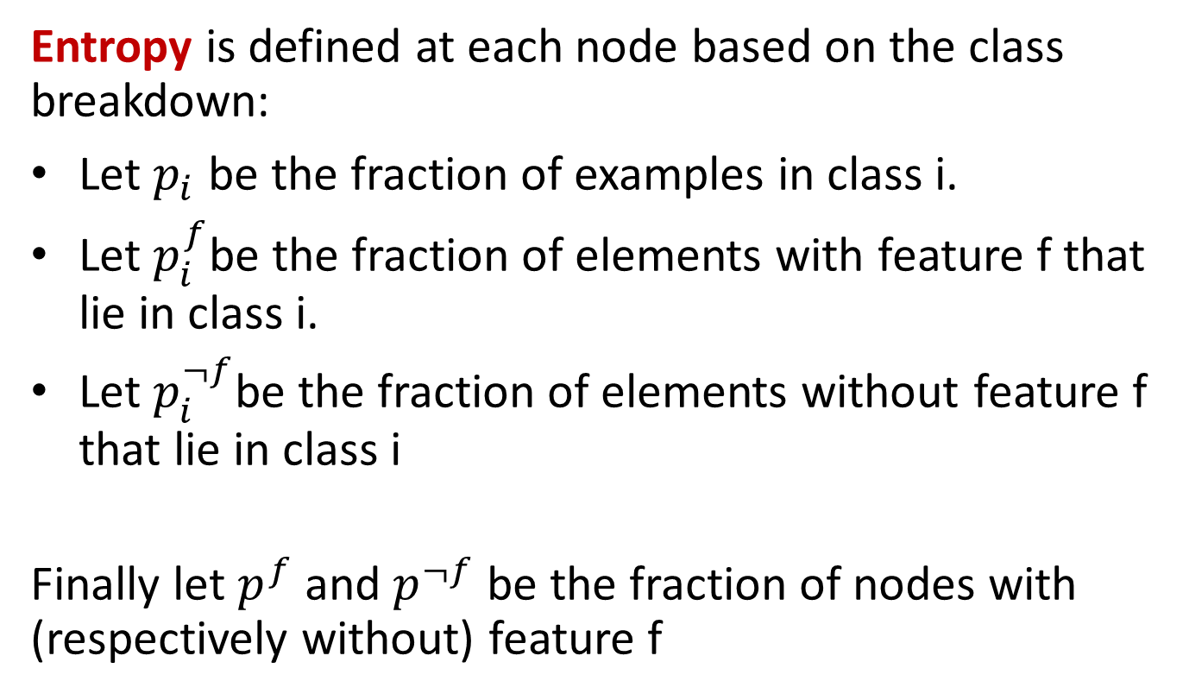
Using Information Theory
Entropy is defined at each node based on the class breakdown:
Let $p_{i}$ be the fraction of examples in class i.
Let $p_{i}^{f}$be the fraction of elements with feature f that lie in class i.
Let $p_{i}^{¬f}$be the fraction of elements without feature f that lie in class i
Finally let $p^{f}$ and $p^{¬f}$ be the fraction of nodes with (respectively without) feature f

Slide 38
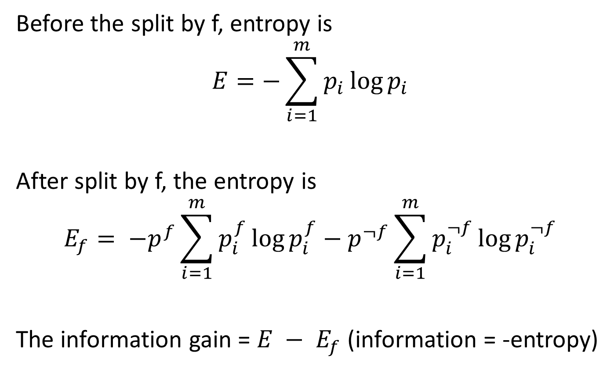
Information Gain
Before the split by f, entropy is
$$E=−\sum_{i=1}^{m}{p_{i}\log{p_{i}}}$$
After split by f, the entropy is
$$E_{f}= {−p}^{f}\sum_{i=1}^{m}{p_{i}^{f}\log{p_{i}^{f}}}−p^{¬f}\sum_{i=1}^{m}{p_{i}^{¬f}\log{p_{i}^{¬f}}}$$
The information gain = $E − E_{f}$ (information = -entropy)

Slide 39
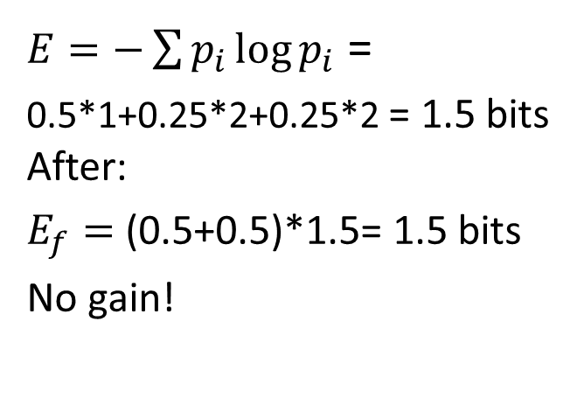
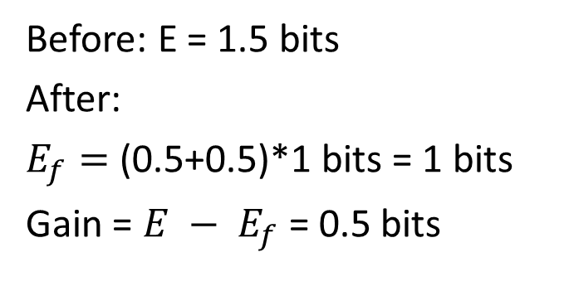
Example
P = (0.5,0.25,0.25)
P = (0.5,0.25,0.25)
AAAA
BB
CC
Classes A, B, C
AAAA
BB
CC
Split by Patrons feature
Split by Type feature
AA
B
C
AA
B
C
AA
CC
AA
BB
(0.5,0.25,0.25)
(0.5,0.25,0.25)
(0.5,0,0.5)
(0.5,0.5,0)
$E=−\sum{p_{i}\log{p_{i}}}$ =
0.5*1+0.25*2+0.25*2 = 1.5 bits After:
$E_{f}=$ (0.5+0.5)*1.5= 1.5 bits
No gain!
Before: E = 1.5 bits
After:
$E_{f}=$ (0.5+0.5)*1 bits = 1 bits
Gain = $E − E_{f}$ = 0.5 bits

Slide 40
Choosing best features
At each node, we choose the feature f which maximizes the information gain.
This tends to be produce mixtures of classes at each node that are more and more “pure” as you go down the tree.
If a node has examples all of one class c, we make it a leaf and output “c”. Otherwise, when we hit the depth limit, we output the most popular class at that node.

Slide 41
Ensemble Methods
Are like Crowdsourced machine learning algorithms:
Take a collection of simple or weak learners
Combine their results to make a single, better learner
Types:
Bagging: train learners in parallel on different samples of the data, then combine by voting (discrete output) or by averaging (continuous output).
Stacking: combine model outputs using a second-stage learner like linear regression.
Boosting: train learners on the filtered output of other learners.

Slide 42
Random Forests
Grow K trees on datasets sampled from the original dataset with replacement (bootstrap samples), p = number of features.
Draw K bootstrap samples of size N
Grow each Decision Tree, by selecting a random set of m out of p features at each node, and choosing the best feature to split on.
Aggregate the predictions of the trees (most popular vote) to produce the final class.
Typically m might be e.g. sqrt(p) but can be smaller.

Slide 43
Random Forests
Principles: we want to take a vote between different learners so we don’t want the models to be too similar. These two criteria ensure diversity in the individual trees:
Draw K bootstrap samples of size N:
Each tree is trained on different data.
Grow a Decision Tree, by selecting a random set of m out of p features at each node, and choosing the best feature to split on.
Corresponding nodes in different trees (usually) cant use the same feature to split.

Slide 44
Random Forests
Very popular in practice, probably the most popular classifier for dense data (<= a few thousand features)
Easy to implement (train a lot of trees). Good match for MapReduce.
Parallelizes easily (but not necessarily efficiently).
Not quite state-of-the-art accuracy – boosted trees generally do better – or DNNs.
Needs many passes over the data – at least the max depth of the trees. (<< boosted trees though)
Easy to overfit – hard to balance accuracy/fit tradeoff.

Slide 45
5 minute break

Slide 46
Outline for this Evening
Three (+ ½) more Basic Algorithms
Naïve Bayes
Logistic Regression (+ ½ SVM )
Random Forests
Evaluation
Precision/Recall
Accuracy + weighted loss
ROC and AUC
Lift

Slide 47
Precision and Recall
When evaluating a search tool or a classifier, we are interested in at least two performance measures:
Precision: Within a given set of positively-labeled results, the fraction that were true positives = tp/(tp + fp)
Recall: Given a set of positively-labeled results, the fraction of all positives that were retrieved = tp/(tp + fn)
Positively-labeled means judged “relevant” by the search engine or labeled as in the class by a classifier. tp = true positive, fp = false positive etc.

Slide 48
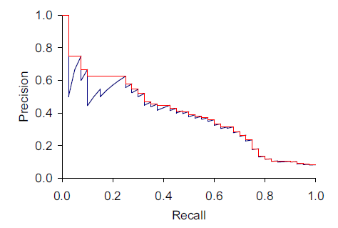
Precision and Recall
Search tools and classifiers normally assign scores to items. Sorting by score gives us a precision-recall plot which shows what performance would be for different score thresholds.
Score increasing

Slide 49
Be careful of “Accuracy”
The simplest measure of performance would be the fraction of items that are correctly classified, or the “accuracy” which is:
But this measure is dominated by the larger set (of positives or negatives) and favors trivial classifiers.
e.g. if 5% of items are truly positive, then a classifier that always says “negative” is 95% accurate.
tp + tn
tp + tn + fp + fn

Slide 50

Weighted loss
We can instead try to minimize a weight sum:
$$w_{1} \text{fn}+ w_{2} \text{fp}$$
And typically $w_{1}≫ w_{2}$, since positives are often much rarer (clicks or purchases or viewing a movie).

Slide 51


The weighted “F” measure
A measure that naturally combines precision and recall is the β-weighted F-measure:
F =
Which is the weighted harmonic mean of precision and recall. Setting β = 1 gives us the F₁ – measure. It can also be computed as:

Slide 52
Interpolated Recall
The true precision plot (blue) necessarily dips at high precision each time a fp appears in the item ordering. These can be removed by using “interpolated precision” which is defined as the max precision at any recall value r’ > the current r. An interpolated precision-recall curve is non-increasing.

Slide 53
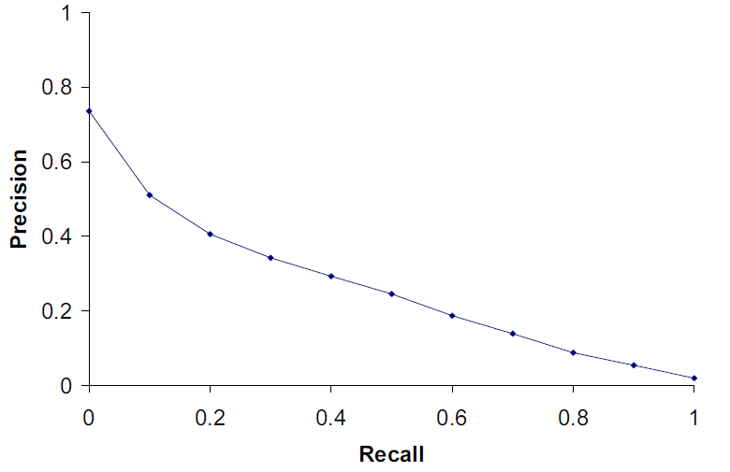
TREC Precision-Recall plots
We compute the interpolated precision values at ten values of recall, 0.1, 0.2,… 1.0.

Slide 54
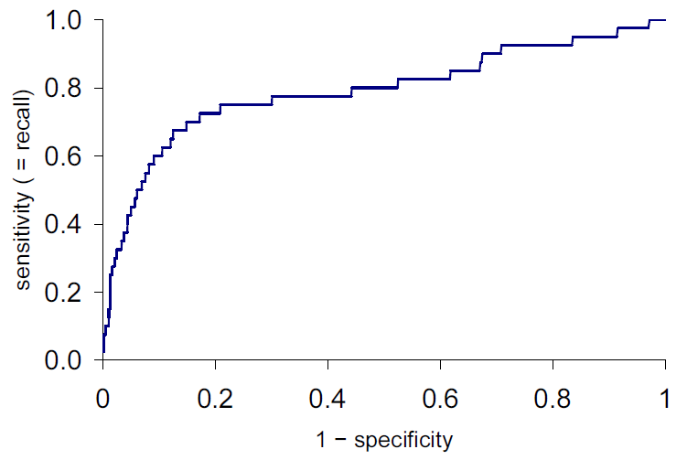
ROC plots
ROC is Receiver-Operating Characteristic. ROC plots
Y-axis: true positive rate = tp/(tp + fn), same as recall
X-axis: false positive rate = fp/(fp + tn) = 1 - specificity
Score increasing

Slide 55
ROC AUC
ROC AUC is the “Area Under the Curve” – a single number that captures the overall quality of the classifier. It should be between 0.5 (random classifier) and 1.0 (perfect).
Random ordering
area = 0.5

Slide 56
Lift Plot
A derivative of the ROC plot is the lift plot, which compares the performance of the actual classifier/search engine against random ordering, or sometimes against another classifier.
Lift is the ratio of these lengths

Slide 57
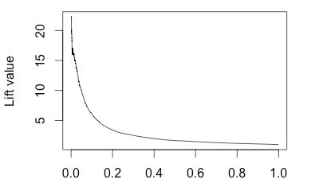
Lift Plot
Lift plots emphasize initial precision (typically what you care about), and performance in a problem-independent way.
Note: The lift plot points should be computed at regular spacing, e.g. 1/00 or 1/1000. Otherwise the initial lift value can be excessively high, and unstable.
1 - specificity

Slide 58
Summary
Three (+ ½) more Basic Algorithms
Naïve Bayes
Logistic Regression (+ ½ SVM )
Random Forests
Evaluation
Precision/Recall
Accuracy + weighted loss
ROC and AUC
Lift

