Slide 1
密码编码学与网络安全
电子工业出版社
2006 - 2007
Notes:
原版 “Cryptography and Network Security”, 4/e, by William Stallings
中译本 密码编码学与网络安全 第四版
PPT制作 林丰波
电子工业出版社 2006 - 2007

Slide 2
第14章 认证应用系统
14.1 Kerberos ↓
14.2 X.509/CA ↓
14.3 公钥基础设施PKI ↓
* 14.a PKI in Windows ↓
* 14.b EJBCA ↓
* 14.c OpenCA ↓
* 14.d CA with OpenSSL ↓

Slide 3
认证系统
Kerberos主要是局域网上的认证系统，它早期基于对称算法，封装了加密、鉴别等安全服务，提供了统一的用户接口。后期Kerberos也开始支持公钥，使用证书。
PKI/CA好像是解决电子商务安全的正确道路。CA是一个离线中心，因此适合互联网这种分布式又管理松散的环境。但是维护一个CA(不管是商用CA或自己独立的CA)给人的感觉是过于复杂。

Slide 4
14.1 Kerberos
LAN上的安全
Kerberos
Kerberos in Windows
Kerberos in Linux

Slide 5
LAN上安全
服务器、工作站、用户
  用户使用工作站访问服务器资源
局域网上安全问题
  窃听导致泄密
  重放攻击
  假冒用户，用户盗用工作站
  假冒工作站，工作站地址被盗用
对应的可能安全方法
  工作站核认用户身份
  工作站向服务器证实自己的身份(信任用户身份)
  用户和服务器相互认证/鉴别

Slide 6
Kerberos动机
目标
  防窃听，防假冒
  透明，只要输入一个口令
  可靠，合法性的唯一标识依据就是获得KB访问
  可扩展伸缩性，适应模块化和分布式
服务
  鉴别 Authentication
  授权 Authorization
  记帐 Accounting

Slide 7

Kerberos
The Network Authentication Protocol
  Kerberos is a network authentication protocol.
  It is designed to provide strong authentication for client/server applications by using secret-key cryptography.
  A free implementation of this protocol is available from the MIT. Kerberos is available in many commercial products as well.
  http://web.mit.edu/kerberos/www/
  http://www.faqs.org/faqs/kerberos-faq/general/
Notes:
In Greek mythology it is the three-headed dog that guarded the entrance to Hades.

Slide 8
阅读
Designing an Authentication System: a Dialogue in Four Scenes
  http://web.mit.edu/kerberos/www/dialogue.html
Notes:
Designing an Authentication System: a Dialogue in Four Scenes \
http://web.mit.edu/kerberos/www/dialogue.html
::
Designing an Authentication System:
a Dialogue in Four Scenes
Copyright 1988, 1997 Massachusetts Institute of Technology. All Rights Reserved.
Originally written by Bill Bryant, February 1988.
Cleaned up and converted to HTML by Theodore Ts'o, February, 1997. An afterword describing the changes in Version 5 of the Kerberos protocol was also added.
Abstract
This dialogue provides a fictitious account of the design of an open-network authentication system called "Charon." As the dialogue progresses, the characters Athena and Euripides discover the problems of security inherent in an open network environment. Each problem must be addressed in the design of Charon, and the design evolves accordingly. Athena and Euripides don't complete their work until the dialogue's close.
When they finish designing the system, Athena changes the system's name to "Kerberos," the name, coincidentally enough, of the authentication system that was designed and implemented at MIT's Project Athena. The dialogue's "Kerberos" system bears a striking resemblence to the system described in Kerberos: An Authentication Service for Open Network Systems presented at the Winter USENIX 1988, at Dallas, Texas.
Contents
Dramatis Personae
Scene I
Scene II
Scene III
Scene IV
Dramatis Personae
Athena an up and coming system developer.
Euripides a seasoned developer and resident crank.
Scene I
A cubicle area. Athena and Euripides are working at neighboring terminals. Athena: Hey Rip, this timesharing system is a drag. I can't get any work done because everyone else is logged in.
Euripides: Don't complain to me. I only work here.
Athena: You know what we need? We need to give everyone their own workstation so they don't have to worry about sharing computer cycles. And we'll use a network to connect all the workstations so folks can communicate with one another.
Euripides: Fine. So what do we need, about a thousand workstations?
Athena: More or less.
Euripides: Have you seen the size of a typical workstation's disk drive? There isn't enough room for all the software that you have on a timesharing machine.
Athena: I figured that out already. We can keep copies of the system software on various server machines. When you login to a workstation, the workstation accesses the system software by making a network connection with one of the servers. This setup lets a whole bunch of workstations use the same copy of the system software, and it makes software updates convenient. You don't have to trundle around to each workstation. Just modify the system software servers.
Euripides: All right. What are you going to do about personal files? With a timesharing system I can login and get to my files from any terminal that is connected to the system. Will I be able to walk up to any workstation and automatically get to my files? Or do I have to make like a PC user and keep my files on diskette? I hope not.
Athena: I think we can use other machines to provide personal file storage. You can login to any workstation and get to your files.
Euripides: What about printing? Does every workstation have its own printer? Whose money are you spending anyway? And what about electronic mail? How are you going to distribute mail to all these workstations?
Athena: Ah . . . Well obviously we don't have the cash to give everyone a printer, but we could have machines dedicated to print service. You send a job to a print server, and it prints it for you. You could do sort of the same thing with mail. Have a machine dedicated to mail service. You want your mail, you contact the mail server and pick up your mail.
Euripides: Your workstation system sounds really good Tina. When I get mine, you know what I'm going to do? I'm going to find out your username, and get my workstation to think that I am you. Then I'm going to contact the mail server and pick up your mail. I'm going to contact your file server and remove your files, and--
Athena: Can you do that?
Euripides: Sure! How are these network servers going to know that I'm not you?
Athena: Gee, I don't know. I guess I need to do some thinking.
Euripides: Sounds like it. Let me know when you figure it out.
Scene II
Euripides' office, the next morning. Euripides sits at his desk, reading his mail. Athena knocks on the door. Athena: Well I've figured out how to secure an open network environment so that unscrupulous folks like you cannot use network services in other people's names.
Euripides: Is that so? Have a seat.
She does.
Athena: Before I describe it, can I lay down one ground rule about this discussion?
Euripides: What's your rule?
Athena: Well suppose I say something like the following: "I want my electronic mail, so I contact the mail server and ask it to send the mail to my workstation." In reality I'm not the entity that contacts the mail server. I'm using a program to contact the mail server and retrieve my mail, a program that is a CLIENT of the mail service program.
But I don't want to say "the client does such-and-such" every time I refer to a transaction between the user and a network server. I'd just as soon say "I do such-and-such," keeping in mind of course that a client program is doing things on my behalf. Is that okay with you?
Euripides: Sure. No problem.
Athena: Good. All right, I'll begin by stating the problem I have solved. In an open network environment, machines that provide services must be able to confirm the identities of people who request service. If I contact the mail server and ask for my mail, the service program must be able to verify that I am who I claim to be, right?
Euripides: Right.
Athena: You could solve the problem clumsily by requiring the mail server to ask for a password before I could use it. I prove who I am to the server by giving it my password.
Euripides: That's clumsy all right. In a system like that, every server has to know your password. If the network has one thousand users, each server has to know one thousand passwords. If you want to change your password, you have to contact all servers and notify them of the change. I take it your system isn't this stupid.
Athena: My system isn't stupid. It works like this: Not only do people have passwords, services have passwords too. Each user knows her or his password, each service program knows its password, and there's an AUTHENTICATION SERVICE that knows ALL passwords--each user's password, and each service's password. The authentication service stores the passwords in a single, centralized database.
Euripides: Do you have a name for this authentication service?
Athena: I haven't thought of one yet. Do you have any ideas?
Euripides: What's the name of that fellow who ferries the dead across the River Styx?
Athena: Charon?
Euripides: Yeah, that's him. He won't take you across the river unless you can prove your identity.
Athena: There you go Rip, trying to rewrite Greek mythology again. Charon doesn't care about your identity. He just wants to make sure that you're dead.
Euripides: Have you got a better name?
Pause.
Athena: No, not really.
Euripides: Then let's call the authentication service "Charon."
Athena: Okay. I guess I should describe the system, huh?
Let's say you want to use a service, the mail service. In my system you cannot use a service unless, ah, Charon tells the service that you are who you claim to be. And you can't get the okay to use a service unless you have authenticated yourself to Charon. When you request authentication from Charon, you have to tell Charon the service for which you want the okay. If you want to use the mail server, you've got to tell Charon.
Charon asks you to prove your identity. You do so by providing your secret password. Charon takes your password and compares it to the one that is registered for you in the Charon database. If the two passwords match, Charon considers your identity proven.
Charon now has to convince the mail server that you are who you say you are. Since Charon knows all service passwords, it knows the mail service's password. It's conceivable that Charon could give you the password, which you could forward to the mail service as proof that you have authenticated yourself to Charon.
The problem is, Charon cannot give you the password directly, because then you would know it. The next time you wanted mail, you could circumvent Charon and use the mail server without correctly identifying yourself. You could even pretend to be someone else, and use the mail server in that other person's name.
So instead of giving you the mail server's password, Charon gives you a mail service TICKET. This ticket contains a version of your username that has been ENCRYPTED USING the MAIL SERVER'S PASSWORD.
Ticket in hand, you can now ask the mail service for your mail. You make your request by telling the mail server who you are, and furnishing the ticket that proves you are who you say you are.
The server uses its password to decrypt the ticket, and if the ticket decrypts properly, the server ends up with the username that Charon placed in the ticket.
The service compares this name with the name you sent along with the ticket. If the names match, the mail server considers your identity proven and proceeds to give you your mail.
What do you think of those apples?
Euripides: I've got some questions.
Athena: I figured. Well go ahead.
Euripides: When a service program decrypts a ticket, how does it know that it has decrypted the ticket properly?
Athena: I don't know.
Euripides: Maybe you should include the service's name in the ticket. That way when a service decrypts a ticket, it can gauge its success on whether or not it can find its name in the decrypted ticket.
Athena: That sounds good to me. So the ticket looks something like this:
(She scrawls the following on a pad of paper:)
TICKET - {username:servicename}
Euripides: So the service ticket contains just your username and the servicename?
Athena: Encrypted with the service's password.
Euripides: I don't think that's enough information to make the ticket secure.
Athena: What do you mean?
Euripides: Let's suppose you ask Charon for a mail server ticket. Charon prepares that ticket so that it has your username "tina" in it. Suppose I copy that ticket as it wizzes by on its way across the network from Charon to you. Suppose I convince my insecure workstation that my username is "tina." The mail client program on my workstation thinks I am you. In your name, the program forwards the stolen ticket to the mail server. The server decrypts the ticket and sees that it is valid. The username in the ticket matches the name of the user who sent the ticket. The mail server gives me your mail . . .
Athena: Oh! Well that's not so good.
Euripides: But I think I know a way to fix this problem. Or to at least provide a partial fix to it. I think Charon should include more information in the service tickets it produces. In addition to the username, the ticket should also include the NETWORK ADDRESS from which the user asked Charon for the ticket. That gives you an additional level of security.
I'll illustrate. Suppose I steal your mail ticket now. The ticket has your workstation's network address in it, and this address does not match my workstation's address. In your name I forward the purloined ticket to the mail server. The server program extracts the username and network address from the ticket and attempts to match that information against the username and network address of the entity that sent the ticket. The username matches, but the network address does not. The server rejects the ticket because obviously it was stolen.
Athena: Bravo, bravo! I wish I had thought of that.
Euripides: Well that's what I'm around for.
Athena: So the revised ticket design looks like this:
She scrawls the following on a chalkboard:
TICKET - {username:ws_address:servicename}
Athena: Now I'm really excited. Let's build a Charon system and see if it works!
Euripides: Not so fast. I have some other questions about your system.
Athena: All right. (Athena leans forward in her chair) Shoot.
Euripides: Sounds like I've got to get a new ticket every time I want to use a service. If I'm putting in a full day's work, I'll probably want to get my mail more than once. Do I have to get a new ticket every time I want to get my mail? If that's true, I don't like your system.
Athena: Ah . . . Well I don't see why tickets can't be reusable. If you get a ticket for the mail server, you ought to be able to use it again and again. For instance, when the mail client program makes a request for service in your name, it forwards a COPY of the ticket to the mail server.
Euripides: That's better. But I still have problems. You seem to imply that I have to give Charon my password every time I want to use a service for which I don't have a ticket. I login and want to access my files. I fire off a request to Charon for the proper ticket and this means that I've had to use my password. Then I want to read my mail. Another request to Charon, I have to enter my password again. Now suppose I want to send one of my mail messages to the print server. Another Charon request and, well you get the picture.
Athena: Uh, yeah, I do.
Euripides: And if that weren't bad enough, consider this: it sounds like when you authenticate yourself to Charon, you send your secret password over the network in cleartext. Clever people like yours truly can monitor the network and steal copies of people's passwords. If I've got your password, I can use any service in your name. Athena sighs.
Athena: These are serious problems. Guess I need to go back to the drawing board.
Scene III
The next morning, Athena catches Euripides at the coffee area. She taps him on the shoulder as he fills his cup. Athena: I've got a new version of Charon that solves our problems.
Euripides: Really? That was quick.
Athena: Well, you know, problems of this nature keep me up all night.
Euripides: Must be your guilty conscience. Shall we repair to yon small conference room?
Athena: Why not?
The two move to the small conference room.
Athena: I'll begin by stating the problems again, but I'll invert them so that they become requirements of the system.
Athena clears her throat.
Athena: The first requirement: Users only have to enter their passwords once, at the beginning of their workstation sessions. This requirement implies that you shouldn't have to enter your password every time you need a new service ticket. The second requirement: passwords should not be sent over the network in clear text.
Euripides: Okay.
Athena: I'll start with the first requirement: you should only have to use your password once. I've met this requirement by inventing a new network service. It's called the "ticket-granting" service, a service that issues Charon tickets to users who have already proven their identity to Charon. You can use this ticket-granting service if you have a ticket for it, a ticket-granting ticket.
The ticket-granting service is really just a version of Charon in as much as it has access to the Charon database. It's a part of Charon that lets you authenticate yourself with a ticket instead of a password.
Anyhow, the authentication system now works as follows: you login to a workstation and use a program called kinit to contact the Charon server. You prove your identity to Charon, and the kinit program gets you a ticket-granting ticket.
Now say you want to get your mail from the mail server. You don't have a mail server ticket yet, so you use the "ticket-granting" ticket to get the mail server ticket for you. You don't have to use your password to get the new ticket.
Euripides: Do I have to get a new "ticket-granting" ticket every time I need to get to another network service?.
Athena: No. Remember, we agreed last time that tickets can be reused. Once you have acquired a ticket-granting ticket, you don't need to get another. You use the ticket-granting ticket to get the other tickets you need.
Euripides: Okay, that makes sense. And since you can reuse tickets, once the ticket-granting service has given you a ticket for a particular service, you don't need to get that particular ticket again.
Athena: Yeah, isn't that elegant?
Euripides: Okay, I buy it so far . . . As long as you didn't have to send your password in cleartext over the network when you got the ticket-granting ticket.
Athena: Like I said, I've solved that problem as well. The thing is, when I say you have to contact Charon to get the ticket-granting ticket, I make it sound as though you have to send your password in cleartext over the network to the Charon Server. But it doesn't have to be that way.
Here's really what happens. When you use the kinit program to get the ticket-granting ticket, kinit doesn't send your password to the Charon server, kinit sends only your username.
Euripides: Fine.
Athena: Charon uses the username to look up your password. Next Charon builds a packet of data that contains the ticket-granting ticket. Before it sends you the packet, Charon uses your password to encrypt the packet's contents.
Your workstation receives the ticket packet. You enter your password. Kinit attempts to decrypt the ticket with the password you entered. If kinit succeeds, you have successfully authenticated yourself to Charon. You now possess a ticket-granting ticket, and that ticket can get you the other tickets you require.
How's that for some fancy thinking?
Euripides: I don't know . . . I'm trying to think myself. You know, I think the parts of the system that you just described work pretty well. Your system requires me to authenticate myself only once. Thereafter Charon can issue me service tickets without my being aware of it. Seamless, seamless in that regard. But there's something about the design of the service ticket that troubles me somehow. It has to do with the fact that tickets are reusable. Now I agree that they have to be reusable, but reusable tickets are, by their nature, very dangerous.
Athena: What do you mean?
Euripides: Look at it this way. Suppose you are using an insecure workstation. In the course of your login session you acquire a mail service ticket, a printing service ticket, and a file service ticket. Suppose you inadvertantly leave these tickets on the workstation when you logout.
Now suppose I login to the workstation and find those tickets. I'm feeling like causing trouble, so I make the workstation think that I am you. Since the tickets are made out in your name, I can use the mail client program to access your mail, I can use the file service client to access and remove your files, and I can use the printing command to run up huge bills on your account. All because these tickets have been accidentally left lying around.
And nothing can keep me from copying these tickets to a place of my own. I can continue to use them for all eternity.
Athena: But that's an easy fix. We just write a program that destroys a user's tickets after each login session. You can't use tickets that have been destroyed.
Euripides: Well obviously your system must have a ticket-destroying program, but it's foolish to make users rely on such a thing. You can't count on users to remember to destroy their tickets every time they finish a workstation session. And even if you rely upon your users to destroy their tickets, consider the following scenario.
I've got a program that watches the network and copies service tickets as they zip accross the network. Suppose I feel like victimizing you. I wait for you to begin a workstation session, I turn on my program and copy a bunch of your tickets.
I wait for you to finish your session, and eventually you logout and leave. I fiddle with my workstation's network software and change its address so that it matches the address of the workstation you were using when you acquired the tickets I copied. I make my workstation believe that I am you. I have your tickets, your username, and the correct network address. I can REPLAY these tickets and use services in your name.
It doesn't matter that you destroyed your tickets before you ended your workstation session. The tickets I have stolen are valid for as long as I care to use them, because your current ticket design does not place a limit on the number of times you can reuse a ticket, or on how long a ticket remains valid.
Athena: Oh I see what you're saying! Tickets can't be valid forever because they would then constitute a huge security risk. We have to restrict the length of time for which a ticket can be used, perhaps give each ticket some kind of expiration date.
Euripides: Exactly. I think each ticket needs to have two additional pieces of information: a lifespan that indicates the length of time for which the ticket is valid, and a timestamp that indicates the date and time at which Charon issued the ticket. So a ticket would look something like this:
Euripides goes to the chalkboard and scrawls the following:
TICKET {username:address:servicename:lifespan:timestamp}
Euripides: Now when a service decrypts tickets, it checks the ticket's username and address against the name and address of the person sending the ticket, and it uses the timestamp and lifespan information to see if the ticket has expired.
Athena: All right. What kind of lifetime should the typical service ticket have?
Euripides: I don't know. Probably the length of a typical workstation session. Say eight hours.
Athena: So if I sit at my workstation for more than eight hours, all my tickets expire. That includes my ticket-granting ticket. So I have to reauthenticate myself to Charon after eight hours.
Euripides: That's not unreasonable is it?
Athena: I guess not. So we're settled -- tickets expire after eight hours. Now I've got a question for you. Suppose I have copied YOUR tickets from the network--
Euripides: (Eyes twinkling) Aw, Tina! You wouldn't really do that would you?
Athena: This is just for the sake of argument. I've copied your tickets. Now I wait for you to logout. Suppose you have a doctor's appointment or a class to attend, so you end your workstation session after a couple of hours. You are a smart boots and have destroyed your copies of the tickets before logging out.
But I've stolen your tickets, and they are good for about six hours. That gives me ample time to pillage your files and print one thousand copies of whatever in your name.
See, the lifetime-timestamp business works fine in the event that a ticket thief chooses to replay the ticket after the ticket has expired. If the thief can replay the ticket before that . . .
Euripides: Uh, well . . . Of course you are right.
Athena: I think we have run into a major problem. (She sighs.)
Pause.
Euripides: I guess that means you'll be busy tonight. Want more coffee?
Athena: Why not. The two head for the coffee machine.
Scene IV
The next morning in Euripides' office. Athena knocks on the door.
Euripides: You've got rings under your eyes this morning.
Athena: Well, you know. Another one of those long nights.
Euripides: Have you solved the replay problem?
Athena: I think so.
Euripides: Have a seat.
She does.
Athena: As usual, I feel compelled to restate the problem. Tickets are reusable within a limited timespan, say eight hours. If someone steals your tickets and chooses to replay them before they expire, we can't do anything to stop them.
Euripides: That's the problem.
Athena: We could beat the problem if we designed the tickets so they couldn't be reusable.
Euripides: But then you would have to get a new ticket every time you wanted to use a network service.
Athena: Right. That is a clumsy solution at best. (Pause.) Ah, how do I proceed with my argument? (She ponders for a moment.)
All right, I'm going to restate the problem again, this time in the form of a requirement. A network service must be able to prove that the person using a ticket is the same person to whom that ticket was issued.
Let me trace the authentication process again and see if I can tease out an appropriate way to illustrate my solution to this problem.
I want to use a certain network service. I access that service by starting a client program on my workstation. The client sends three things to the service machine-- my name, my workstation's network address, and the appropriate service ticket.
The ticket contains the name of the person it was issued to and the address of the workstation that person was using when he or she acquired the ticket. It also contains an expiration date in the form of a lifespan and a timestamp. All this information has been encrypted in the service's Charon password.
Our current authentication scheme relies on the following tests:
Can the service decrypt the ticket?
Has the ticket expired?
Do the name and workstation address specified in the ticket match the name and address of the person who sent the ticket?
What do these tests prove? The first test proves that the ticket either did or did not come from Charon. If the ticket cannot be decrypted, it did not come from the real Charon. The real Charon would have encrypted the ticket with the service's password. Charon and the service are the only two entities that know the service's password. If the ticket decrypts successfully, the service knows that it came from the real Charon. This test prevents folks from building fake Charon tickets.
The second test checks the ticket's lifespan and timestamp. If it has expired, the service rejects the ticket. This test stops people from using old tickets, tickets that perhaps were stolen.
The third test checks the ticket-user's name and address against the name and address of the person specified in the ticket. If the test fails, the ticket-user has obtained (perhaps surreptitiously) another person's ticket. The ticket is of course rejected.
If the names and addresses do match, what has the test proved? Nothing. Scallywags can steal tickets from the network, change their workstation addresses and usernames appropriately, and rifle other folks resources. As I pointed out yesterday, tickets can be replayed as long as they haven't expired. They can be replayed because a service cannot determine that the person sending the ticket is actually the ticket's legitimate owner.
The service cannot make this determination because it does not share a secret with the user. Look at it this way. If I'm on watch at Elsinore, you know, the castle in Hamlet, and you are supposed to relieve me, I'm not supposed to let you take my place unless you can provide the correct password. That's the case where the two of us share a secret. And it's probably a secret that someone else made up for everyone who stands on watch.
So I was thinking last night, why not have Charon make up a password for the legitimate ticket-owner to share with the service? Charon gives a copy of this session key to the service, and a copy to the user. When the service receives a ticket from a user, it can use the session key to test the user's identity.
Euripides: Wait a second. How is Charon going to give both parties the session key?
Athena: The ticket-owner gets the session key as part of the reply from Charon. Like this:
She scrawls the following on a chalkboard:
CHARON REPLY - [sessionkey|ticket]
The service's copy of the session key comes inside the ticket, and the service gets the key when it decrypts the ticket. So the ticket looks like this:
TICKET - {sessionkey:username:address:servicename:lifespan:timestamp}
When you want to get to a service, the client program you start builds what I call an AUTHENTICATOR. The authenticator contains your name and your workstation's address. The client encrypts this information with the session key, the copy of the session key you received when you requested the ticket.
AUTHENTICATOR - {username:address} encrypted with session key
After building the authenticator, the client sends it and the ticket to the service. The service cannot decrypt the authenticator yet because it doesn't have the session key. That key is in the ticket, so the service first decrypts the ticket.
After decrypting the ticket, the service ends up with the the following information:
The ticket's lifespan and timestamp;
The ticket-owner's name;
The ticket-owner's network address;
The session key.
The service checks to see if the ticket has expired. If all is well in that regard, the service next uses the session key to decrypt the authenticator. If the decryption proceeds without a hitch, the service ends up with a username and a network address. The service tests this information against the name and address found in the ticket, AND the name and address of the person who sent the ticket and authenticator. If everything matches, the service has determined that the ticket-sender is indeed the ticket's real owner.
Athena pauses, clears her throat, drinks some coffee.
I think the session key-authenticator business takes care of the replay problem.
Euripides: Maybe. But I wonder . . . To break this version of the system, I must have the proper authenticator for the service.
Athena: No. You must have the authenticator AND the ticket for the service. The authenticator is worthless without the ticket because the service cannot decrypt the authenticator without first having the appropriate session key, and the service cannnot get the appropriate session key without first decrypting the ticket.
Euripides: Okay, I understand that, but didn't you say that when a client program contacts the server, it sends the ticket and matching authenticator together?
Athena: Yes, I guess I said that.
Euripides: If that's what actually happens, what prevents me from stealing the ticket and authenticator at the same time? I'm sure I could write a program to do the job. If I've got the ticket and its authenticator, I believe I can use the two as long as the ticket has not expired. I just have to change my workstation address and username appropriately. True?
Athena: (Biting her lip) True. How dispiriting.
Euripides: Wait, wait, wait! This isn't such a big deal. Tickets are reusable as long as they haven't expired, but that doesn't mean that authenticators have to be reusable. Suppose we design the system so that authenticators can only be used once. Does that buy us anything?
Athena: Well, it might. Let's see, the client program builds the authenticator, then sends it with the ticket to the service. You copy both ticket and authenticator as they move from my workstation to the server. But the ticket and authenticator arrive at the server before you can send your copies. If the authenticator can only be used once, your copy of it is no good, and you lose when you attempt to replay your ticket and authenticator.
Well, that's a relief. So all we have to do is invent a way to make the authenticator a one-time usable thing.
Euripides: No problem. Let's just put a lifespan and timestamp on them. Suppose each authenticator has a lifespan of a couple of minutes. When you want to use a service, your client program builds the authenticator, stamps it with the current time, then sends it and the ticket to the server.
The server receives the ticket and authenticator and goes about its business. When the server decrypts the authenticator, it checks the authenticator's lifespan and timestamp. If the authenticator hasn't expired, and everything else checks properly, the server considers you authenticated.
Suppose I copied the athenticator and ticket as they crossed the network. I have to change my workstation's network address and my username, and I have to do this all in a couple of minutes. That's a pretty tall order. In fact I don't think it's possible. Unless . . .
Well, here's a potential problem. Suppose that instead of copying the ticket and authenticator as they travel from your workstation to the server, I copy original ticket packet that comes from Charon, the packet you receive when you ask Charon to give you a ticket.
This packet, as I recall, has two copies of the session key in it: one for you and one for the service. The one for the service is hidden in the ticket and I can't get to it, but what about the other one, the one you use to build authenticators?
If I can get that copy of the session key, I can build my own authenticators, and if I can build my own authenticators, I can break the system.
Athena: That's something I thought about last night, but then I traced the process of acquiring tickets and found that it wasn't possible to steal authenticators that way.
You sit down at a workstation and use the kinit program to get your ticket-granting ticket. Kinit asks for your username, and after you enter it, kinit forwards the name to Charon.
Charon uses your name to look up your password, then proceeds to build a ticket-granting ticket for you. As part of this process, Charon creates a session key that you will share with the ticket-granting service. Charon puts a copy of the session key in the ticket-granting ticket, and puts your copy in the the ticket packet that you are about to receive. But before it sends you this packet, Charon encrypts the whole thing with your password.
Charon sends the packet across the network. Someone can copy the packet as it goes by, but they can't do anything with it because it has been encrypted with your password. Specifically, no one can steal the ticket-granting session key.
Kinit receives the ticket packet and prompts you for a password, which you enter. If you enter the correct password, kinit can decrypt the packet and give you your copy of the session key.
Now that you've taken care of the kinit business, you want to get your mail. You start the mail client program. This program looks for a mail service ticket and doesn't find one (after all, you haven't tried to get your mail yet). The client must use the ticket-granting ticket to ask the ticket-granting service for a mail service ticket.
The client builds an authenticator for the ticket-granting transaction and encrypts the authenticator with your copy of the ticket-granting session key. The client then sends Charon the authenticator, the ticket-granting ticket, your name, your workstation's address, and the name of the mail service.
The ticket-granting service receives this stuff and runs through the authentication checks. If everything checks properly, the ticket-granting service ends up with a copy of the session key that it shares with you. Now the ticket-granting service builds you a mail service ticket, and during this process, creates a new session key for you to share with the mail service.
The ticket-granting service now prepares a ticket packet to send back to your workstation. The packet contains the ticket and your copy of the mail service session key. But before it sends the packet, the ticket-granting service encrypts the packet with its copy of the TICKET-GRANTING session key. That done, the packet is sent on its way.
So here comes the mail service ticket packet, loping across the network. Suppose some network ogre copies it as it goes by. The ogre is out of luck because the packet is encrypted with the ticket-granting session key; you and the ticket-granting service are the only entities that know this key. Since the ogre cannot decrypt the mail ticket packet, the ogre cannot discover the MAIL SESSION KEY. Without this session key, the ogre cannot use any of the mail service tickets you might subsequently send across the network.
So I think we're safe. What do you think?
Euripides: Perhaps.
Athena: Perhaps! Is that all you can say!
Euripides: (laughing) Don't get upset. You should know my ways by now. I guess it is mean of me, and you up half the night.
Athena: Pthhhhh!
Euripides: All right, three-quarters of the night. Actually, the system is beginning to sound acceptible. This session key business solves a problem that I thought of last night: the problem of mutual authentication.
Pause.
Mind if I talk for a minute?
Athena: (A trifle coldly) Be my guest.
Euripides: You are so kind. (Euripides clears his throat.) Last night, while visions of session keys and authenticators danced in your head, I was trying to find new problems with the system, and I found one that I thought was pretty serious. I'll illustrate it by way of the following scenario.
Suppose you are sick of your current job and have determined that it is in your best interest to move on. You want to print your resume on the company's wizz-bang laser printer so that headhunters and potential employers can take note of your classiness.
So you enter the printing command, and direct it to send the resume to the appropriate print server. The command gets the proper service ticket, if you don't already have it, then sends the ticket in your name to the appropriate print server. At least that's where you think it's headed. You don't in fact know that the request is headed for the right print server.
Suppose that some unscrupulous hacker--say it's your boss--has screwed system around so that he redirects your request and its ticket to the print server in his office. His print service program doesn't care about the ticket or its contents. It throws away the ticket and sends a message to your workstation indicating that the ticket passed muster, and that the server is ready and willing to print your job. The printing command sends the job to the fraudulant print server and the enemy ends up with your resume.
I'll state the problem by way of contrast. Without session keys and authenticators, Charon can protect its servers from false users, but it cannot protect its users from false servers. The system needs a way for client programs to authenticate the server before sending sensitive information to the service. The system must allow for mutual authentication.
But the session key solves this problem as long as you design your client programs properly. Back to the print server scenario. I want a print client program that makes sure the service it's sending jobs to is the legitimate service.
Here's what such a program does. I enter the printing command and give it a filename, the name of my resume. Assume that I have a print service ticket and session key. The client program uses the session key to build an authenticator, then sends the authenticator and ticket to the "supposed" print server. The client DOES NOT send the resume yet; it waits for a response from the service.
The real service receives the ticket and authenticator, decrypts the ticket and extracts the session key, then uses the session key to decrypt the authenticator. This done, the service runs all the appropriate authentication tests.
Assume the tests confirm my identity. Now the server prepares a reply packet so that it can prove its identity to the client program. It uses its copy of the session key to encrypt the reply packet, then sends the packet to the waiting client.
The client receives the packet and attempts to decrypt it with my copy of the session key. If the packet decrypts properly and yields the correct server response message, my client program knows that the server that encrypted the packet is the real server. Now the client sends the resume job to the print service.
Suppose my boss screwed around the system so that his print server poses as the one I want. My client sends the authenticator and ticket to the "print service" and waits for a response. The fake print service cannot generate the correct response because it cannot decrypt the ticket and get the session key. My client will not send the job unless it receives the correct response. Eventually the client gives up waiting and exits. My print job does not get completed, but at least my resume did not end up on the desk of the enemy.
You know, I think we have a solid basis on which to implement the Charon Authentication System.
Athena: Perhaps. Anyway, I don't like the name "Charon."
Euripides: You don't? Since when?
Athena: I've never liked it, because the name doesn't make sense. I was talking to my Uncle Hades about it the other day, and he suggested another name, the name of his three-headed watch dog.
Euripides: Oh, you mean "Cerberus."
Athena: Bite your tongue Rip! "Cerberus" indeed . . .
Euripides: Er, isn't that the name?
Athena: Yeah, if you happen to be a Roman! I'm a Greek goddess, he's a Greek watch dog, and his name is "Kerberos," "Kerberos" with a K.
Euripides: Okay, okay, don't throw thunderbolts. I'll buy the name. Actually, it has a nice ring to it. Adios Charon and hello to Kerberos.
Afterword
The dialogue was written in 1988 to help its readers understand the fundamental reasons for why the Kerberos V4 protocol was the way it was. Over the years, it has served this job very well.
When I converted this document to HTML, I was amazed how much of this document was still applicable for the Kerberos V5 protocol. Although many things were changed, the basic core ideas of the protocol have remained the same. Indeed, there are only two changes where Kerberos V5 differs from description of the "Kerberos" protocol in this dialoge.
The first change was born out of the recognition that using a small five minute time skew wasn't necessarily sufficient to prevent replay attacks from an attacker who used a program to automatically grab the ticket and the authenticator as they traversed the network, and then immediately resent them to launch a replay attack.
In Kerberos V5, authenticators are made to be truly "once-only" by having servers which accept tickets to have a "replay cache" which keeps note of authenticators have been presented to the server recently. If an attacker tries to snatch an authenticator and reuse it, even during the five-minute acceptance window, the replay cache will be able to determine that the authenticator has already been presented to the server.
The second major change to the protocol is that the ticket is no longer encrypted in the user's password when it is sent from the Kerberos server to kinit during the initial ticket exchange. The ticket is already encrypted in the ticket granting server's secret key; furthermore when it is actually used to obtain other tickets, it gets sent in the network in the clear anyway. Hence, there is no reason why the ticket should be encrypted again in the user's password. (The rest of the Kerberos server's reply to the user, containing for example the user's copy of the ticket session key, is still encrypted in the user's password, of course.)
A similar change was also made to the ticket granting service (TGS) protocol; tickets returned by TGS are also no longer encrypted by the ticket-granting ticket's service key, since application tickets are already encrypted by the application server's secret key. So for example, the packet that in Kerberos V4 which would have looked like this:
KDC_REPLY = {TICKET, client, server, K_session}K_user
where "{X}K_Y" is read "X encrypted using key K_Y" and
TICKET = {client, server, start_time, lifetime, K_session}K_server
In Kerberos V5, the KDC_REPLY now would look like this:
KDC_REPLY = TICKET, {client, server, K_session}K_user
Of course, there are many new features in Kerberos V5 as well. Users can now securely forward their tickets so that they can be used at another network location; in addition, users may also delagate a subset of their authorization rights to a server, so that the server can act as a proxy on behalf of a user. Other new features include the ability to replace DES with a more secure cryptographic algorithm, such as triple-DES. Readers who are interested in more of the changes between Kerberos V4 and V5 are invited to read The Evolution of the Kerberos Authentication System, which was authored by Cliff Neumann and Theodore Ts'o.
I hope you've enjoyed this quick little introduction to the Kerberos protocol. I wish you well in your futher explorations!
Theodore Ts'o, February 1997.
--------------------------------------------------------------------------------
Permission to use, copy, modify, and distribute this documentation for any purpose and without fee is hereby granted, provided that the above copyright notice appear in all copies and that both that copyright notice and this permission notice appear in supporting documentation, and that the name of M.I.T. not be used in advertising or publicity pertaining to distribution of the documentation without specific, written prior permission. M.I.T. makes no representations about the suitability of this documentation for any purpose. It is provided "as is" without express or implied warranty.
For comments/suggestions about this page, mail: tytso@mit.edu

Slide 9
Kerberos v4的启发协议
V4 核心举例
  C是客户、V是服务器、AS是鉴别服务器
  C －> AS：ID_{c}＋P_{c}＋ID_{v}，P_{c}是c的口令
  C <－ AS：Ticket ＝ E_{kv}(ID_{c}＋AD_{c}＋ID_{v})
    AD_{c}是C的网络地址，kv是AS和V的共享密钥
  C －> V ：ID_{c}＋Ticket
问题
  P_{c}的明文传输
  用户口令的一次输入，重复使用
  票据的生存周期
  对服务器的鉴别

Slide 10
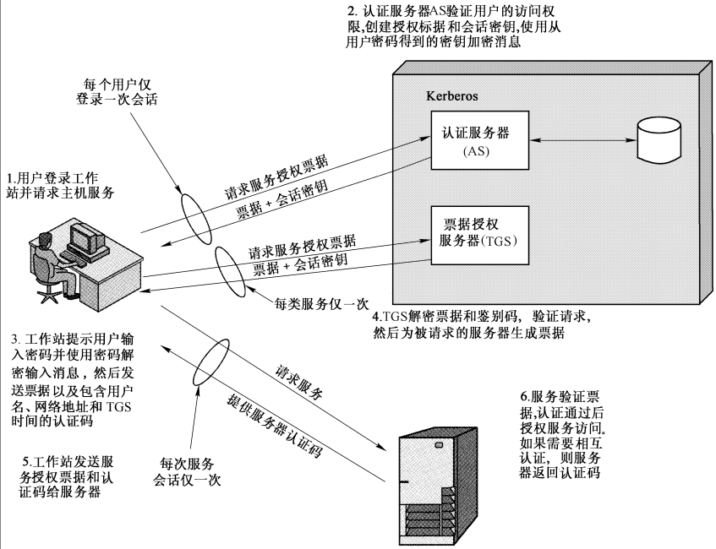
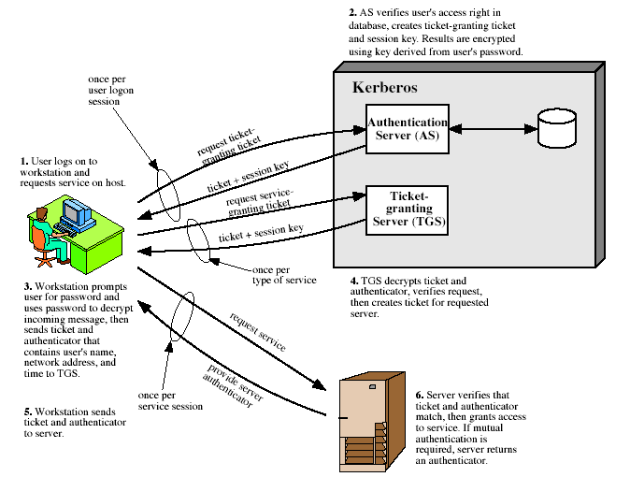
Kerberos v4 Overview

Slide 11
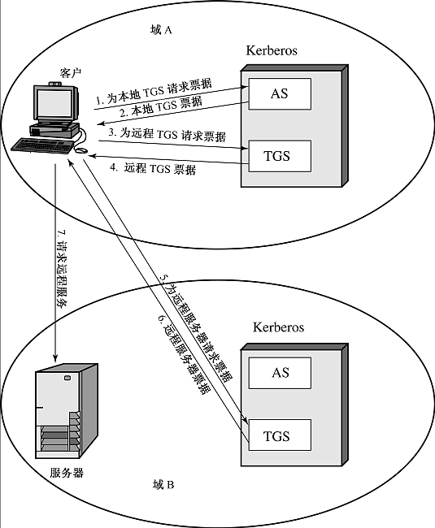
Kerberos v4
请求域间服务

Slide 12
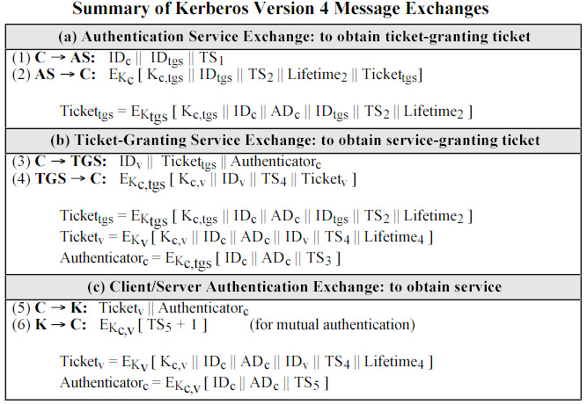
Kerberos v4 Message

Slide 13
Kerberos v5
改进
  不仅依赖于DES
  不仅使用IP协议
  使用ASN.1/BER数据编码规则
  扩展了票据有效期
  鉴别的转发(代理/转让)
  加强了领域间的鉴别能力
  省去了不必要的双重加密
  PCBC－CBC
  增强了抗口令攻击的能力
  增加了一票据对会话密钥的能力

Slide 14
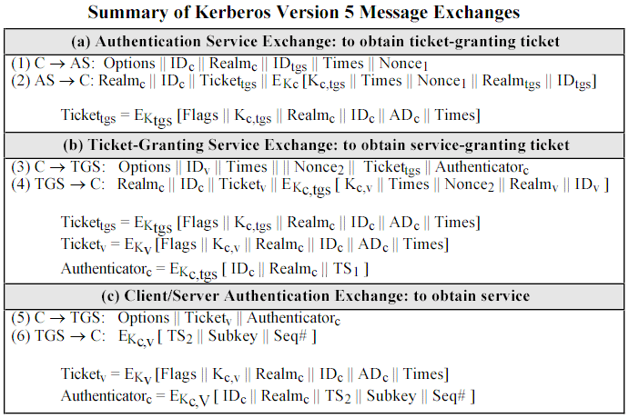
Kerberos v5 Message

Slide 15
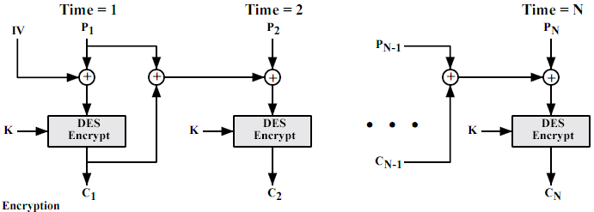
Kerberos中的passwd、key、enc
passwd → key
  n个字符的串→7n个比特序列→往返56b折叠并xor
56bit DES key－PCBC
  Cn＝Ek(Cn-1 XOR Pn-1 XOR Pn)

Slide 16
Kerberos Distribution
The MIT Kerberos Team
  http://web.mit.edu/kerberos/www/
Kerberos in Linux
  #rpm -qa | grep krb
  Configuring a Kerberos 5 Server
  Configuring a Kerberos 5 Client
  http://www.redhat.com/docs/manuals/linux/RHL-9-Manual/ref-guide/ch-kerberos.html

Slide 17
Kerberos in Windows
密钥发行中心 (KDC)
  一种网络服务，提供在 Kerberos V5 身份验证协议中使用的会话票证和临时会话密钥。
票证
  用于安全原则的标识数据集，是为了进行用户身份验证而由域控制器发行的。Windows 中的两种票证形式是票证授予式票证 (TGT) 和服务票证。
票证授予式票证 (TGT)
  用户登录时，Kerberos 密钥分发中心 (KDC) 颁发给用户的凭据。当服务要求会话票证时，用户必须向 KDC 递交 TGT。因为 TGT 对于用户的登录会话活动通常是有效的，它有时称为“用户票证”。
票证授予服务 (TGS)
  由“Kerberos V5 密钥分发中心 (KDC)”服务提供的一种 Kerberos V5 服务，它在域中发行允许用户验证服务的服务票证。

Slide 18
Kerberos in Windows (2k3)
Kerberos V5 身份验证
  Kerberos V5 是在域中进行身份验证的主要安全协议；同时要验证用户的身份和网络服务。
Kerberos V5 工作原理概述
  Kerberos V5 身份验证机制颁发用于访问网络服务的票证。这些票证包含加密的数据，其中包括加密的密码，用于向请求的服务确定用户的身份。
  除了输入密码或智能卡凭据，整个身份验证过程对用户都是不可见的。
  Kerberos V5 中的一项重要服务是密钥发行中心 (KDC)。KDC 作为 Active Directory 目录服务的一部分在每个域控制器上运行，它存储了所有客户端密码和其他帐户信息。

Slide 19
-
  Kerberos V5 身份验证过程按如下方式工作：
  (1)客户端上的用户使用密码或智能卡向 KDC 进行身份验证。
  (2)KDC 为此客户颁发一个特别的票证授予式票证。客户端系统使用 TGT 访问票证授予服务 (TGS)，这是域控制器上的 Kerberos V5 身份验证机制的一部分。
  (3)TGS 接着向客户颁发服务票证。
  (4)客户向请求的网络服务出示服务票证。服务票证向此服务证明用户的身份，同时也向该用户证明服务的身份。
  Kerberos V5 服务安装在每个域控制器上，每个域控制器作为 KDC 使用。域控制器在用户登录会话中作为该用户的首选 KDC 运行。
  Kerberos 客户端安装在每个工作站和服务器上。客户端使用域名服务 (DNS) 定位最近的可用域控制器。如果首选 KDC 不可用，系统将定位备用的 KDC 来提供身份验证。

Slide 20
Windows域
了解以下概念
  Windows Server
  Domain / Active Directory
  Workstation join the Domain
  Login into a Domain
  Resource in a Domain
并练习验证相关概念
  使用虚拟机Vmware

Slide 21
Kerberos in Linux
Kerberos Infrastructure HOWTO
  http://www.tldp.org/HOWTO/Kerberos-Infrastructure-HOWTO/index.html
In Fedora Core based GNU/Linux
  the packages required to provide Kerberos service are:
    “#rpm -qa > grep krb”
  krb5-server
  krb5-libs
About choosing a realm name

Slide 22
Kerberos in Linux
/etc/krb5.conf
default_realm = GNUD.IE
[realms]
GNUD.IE = {
kdc = kerberos1.gnud.ie:88
kdc = kerberos2.gnud.ie:88
admin_server = kerberos1.gnud.ie:749
default_domain = gnud.ie
}
[domain_realm]
.gnud.ie = GNUD.IE
gnud.ie = GNUD.IE

Slide 23
Kerberos in Linux
To initialize and create the Kerberos database:
# /usr/Kerberos/sbin/kdb5_util create -s
edit the acl file to grant administrative access
  /etc/krb5.conf
  /var/Kerberos/krb5kdc/kdc.conf
/var/Kerberos/krb5kdc/kadm5.acl
any account which ends with a /admin in the GNUD.IE realm is granted full access privileges:
*/admin@GNUD.IE *

Slide 24
Kerberos in Linux
Create administrative user
# /usr/Kerberos/sbin/kadmin.local -q "addprinc admin/admin"
To start automatically
# /sbin/chkconfig krb5kdc on
# /sbin/chkconfig kadmin on
Start up manually
# /etc/rc.d/init.d/krb5kdc start
# /etc/rc.d/init.d/kadmin start
Create the user principal
# kadmin.local

Slide 25
Kerberos in Linux
Time Synchronization
The Network Time Protocol (NTP)
NTP package
/etc/ntp.conf
  server time.nist.gov

Slide 26
Kerberos in Linux
Client package
krb5-workstation
/etc/krb5.conf
/var/Kerberos/krb5kdc/kdc.conf
Test Kerberos authentication using the kinit
$ kinit <username>
the KDC log (server side)
/var/log/Kerberos/krb5kdc.log

Slide 27
Kerberos in Linux
PAM - Pluggable Authentication Module
/usr/share/doc/pam_krb5-1.55/pam.d
auth required /lib/security/pam_krb5.so use_first_pass
Apache Web Server
<Directory "/home/httpd/htdocs/content">
AllowOverride None
AuthType KerberosV5
AuthName "Kerberos Login"
KrbAuthRealm GNUD.IE
require valid-user
</Directory>
vs. wins
  http://www.microsoft.com/windows2000/techinfo/planning/security/kerbsteps.asp

Slide 28
Additional Resources
RFC 1510 (2942/3244)
  http://www.rfc-editor.org/rfcsearch.html
Kerberos FAQ
  http://www.faqs.org/faqs/kerberos-faq/general/index.html
Fermilab Kerberos
  http://www.fnal.gov/docs/strongauth/
  http://www.fnal.gov/docs/strongauth/html/
http://www.redhat.com/docs/manuals/linux/RHL-9-Manual/ref-guide/pt-security-reference.html

Slide 29
14.2 X.509/CA
X509定义了公钥认证服务框架。
Certificate 证书印象
PKI/X.509
CA in Win2k
EJBCA

Slide 30
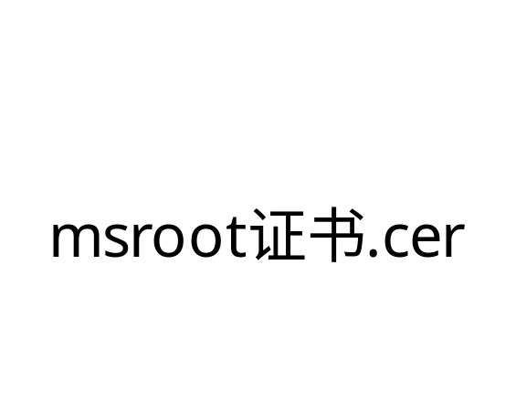
Certificate 证书印象
证书是可靠发布公钥的载体
  公钥及其持有人信息
    其他信息(用途、有效期、)
  签发人及其签名(对上面信息)
例子解析见备注行
Notes:
>openssl x509 -inform der -text < msroot.cer
Certificate:
Data:
Version: 3 (0x2)
Serial Number:
c1:00:8b:3c:3c:88:11:d1:3e:f6:63:ec:df:40
Signature Algorithm: md5WithRSAEncryption
Issuer: OU=Copyright (c) 1997 Microsoft Corp., OU=Microsoft Corporation,
CN=Microsoft Root Authority
Validity
Not Before: Jan 10 07:00:00 1997 GMT
Not After : Dec 31 07:00:00 2020 GMT
Subject: OU=Copyright (c) 1997 Microsoft Corp., OU=Microsoft Corporation
, CN=Microsoft Root Authority
Subject Public Key Info:
Public Key Algorithm: rsaEncryption
RSA Public Key: (2048 bit)
Modulus (2048 bit):
00:a9:02:bd:c1:70:e6:3b:f2:4e:1b:28:9f:97:78:
5e:30:ea:a2:a9:8d:25:5f:f8:fe:95:4c:a3:b7:fe:
9d:a2:20:3e:7c:51:a2:9b:a2:8f:60:32:6b:d1:42:
64:79:ee:ac:76:c9:54:da:f2:eb:9c:86:1c:8f:9f:
84:66:b3:c5:6b:7a:62:23:d6:1d:3c:de:0f:01:92:
e8:96:c4:bf:2d:66:9a:9a:68:26:99:d0:3a:2c:bf:
0c:b5:58:26:c1:46:e7:0a:3e:38:96:2c:a9:28:39:
a8:ec:49:83:42:e3:84:0f:bb:9a:6c:55:61:ac:82:
7c:a1:60:2d:77:4c:e9:99:b4:64:3b:9a:50:1c:31:
08:24:14:9f:a9:e7:91:2b:18:e6:3d:98:63:14:60:
58:05:65:9f:1d:37:52:87:f7:a7:ef:94:02:c6:1b:
d3:bf:55:45:b3:89:80:bf:3a:ec:54:94:4e:ae:fd:
a7:7a:6d:74:4e:af:18:cc:96:09:28:21:00:57:90:
60:69:37:bb:4b:12:07:3c:56:ff:5b:fb:a4:66:0a:
08:a6:d2:81:56:57:ef:b6:3b:5e:16:81:77:04:da:
f6:be:ae:80:95:fe:b0:cd:7f:d6:a7:1a:72:5c:3c:
ca:bc:f0:08:a3:22:30:b3:06:85:c9:b3:20:77:13:
85:df
Exponent: 65537 (0x10001)
X509v3 extensions:
2.5.29.1:
0....[.p.ir.#Q~..M....r0p1+0)..U..."Copyright (c) 1997 Microsoft
Corp.1.0...U....Microsoft Corporation1!0...U....Microsoft Root Authority......<
<...>.c..@
Signature Algorithm: md5WithRSAEncryption
95:e8:0b:c0:8d:f3:97:18:35:ed:b8:01:24:d8:77:11:f3:5c:
60:32:9f:9e:0b:cb:3e:05:91:88:8f:c9:3a:e6:21:f2:f0:57:
93:2c:b5:a0:47:c8:62:ef:fc:d7:cc:3b:3b:5a:a9:36:54:69:
fe:24:6d:3f:c9:cc:aa:de:05:7c:dd:31:8d:3d:9f:10:70:6a:
bb:fe:12:4f:18:69:c0:fc:d0:43:e3:11:5a:20:4f:ea:62:7b:
af:aa:19:c8:2b:37:25:2d:be:65:a1:12:8a:25:0f:63:a3:f7:
54:1c:f9:21:c9:d6:15:f3:52:ac:6e:43:32:07:fd:82:17:f8:
e5:67:6c:0d:51:f6:bd:f1:52:c7:bd:e7:c4:30:fc:20:31:09:
88:1d:95:29:1a:4d:d5:1d:02:a5:f1:80:e0:03:b4:5b:f4:b1:
dd:c8:57:ee:65:49:c7:52:54:b6:b4:03:28:12:ff:90:d6:f0:
08:8f:7e:b8:97:c5:ab:37:2c:e4:7a:e4:a8:77:e3:76:a0:00:
d0:6a:3f:c1:d2:36:8a:e0:41:12:a8:35:6a:1b:6a:db:35:e1:
d4:1c:04:e4:a8:45:04:c8:5a:33:38:6e:4d:1c:0d:62:b7:0a:
a2:8c:d3:d5:54:3f:46:cd:1c:55:a6:70:db:12:3a:87:93:75:
9f:a7:d2:a0
-----BEGIN CERTIFICATE-----
MIIEEjCCAvqgAwIBAgIPAMEAizw8iBHRPvZj7N9AMA0GCSqGSIb3DQEBBAUAMHAx
KzApBgNVBAsTIkNvcHlyaWdodCAoYykgMTk5NyBNaWNyb3NvZnQgQ29ycC4xHjAc
BgNVBAsTFU1pY3Jvc29mdCBDb3Jwb3JhdGlvbjEhMB8GA1UEAxMYTWljcm9zb2Z0
IFJvb3QgQXV0aG9yaXR5MB4XDTk3MDExMDA3MDAwMFoXDTIwMTIzMTA3MDAwMFow
cDErMCkGA1UECxMiQ29weXJpZ2h0IChjKSAxOTk3IE1pY3Jvc29mdCBDb3JwLjEe
MBwGA1UECxMVTWljcm9zb2Z0IENvcnBvcmF0aW9uMSEwHwYDVQQDExhNaWNyb3Nv
ZnQgUm9vdCBBdXRob3JpdHkwggEiMA0GCSqGSIb3DQEBAQUAA4IBDwAwggEKAoIB
AQCpAr3BcOY78k4bKJ+XeF4w6qKpjSVf+P6VTKO3/p2iID58UaKboo9gMmvRQmR5
7qx2yVTa8uuchhyPn4Rms8VremIj1h083g8BkuiWxL8tZpqaaCaZ0Dosvwy1WCbB
RucKPjiWLKkoOajsSYNC44QPu5psVWGsgnyhYC13TOmZtGQ7mlAcMQgkFJ+p55Er
GOY9mGMUYFgFZZ8dN1KH96fvlALGG9O/VUWziYC/OuxUlE6u/ad6bXROrxjMlgko
IQBXkGBpN7tLEgc8Vv9b+6RmCgim0oFWV++2O14WgXcE2va+roCV/rDNf9anGnJc
PMq88AijIjCzBoXJsyB3E4XfAgMBAAGjgagwgaUwgaIGA1UdAQSBmjCBl4AQW9Bw
72lyniNRfhSyTY7/y6FyMHAxKzApBgNVBAsTIkNvcHlyaWdodCAoYykgMTk5NyBN
aWNyb3NvZnQgQ29ycC4xHjAcBgNVBAsTFU1pY3Jvc29mdCBDb3Jwb3JhdGlvbjEh
MB8GA1UEAxMYTWljcm9zb2Z0IFJvb3QgQXV0aG9yaXR5gg8AwQCLPDyIEdE+9mPs
30AwDQYJKoZIhvcNAQEEBQADggEBAJXoC8CN85cYNe24ASTYdxHzXGAyn54Lyz4F
kYiPyTrmIfLwV5MstaBHyGLv/NfMOztaqTZUaf4kbT/JzKreBXzdMY09nxBwarv+
Ek8YacD80EPjEVogT+pie6+qGcgrNyUtvmWhEoolD2Oj91Qc+SHJ1hXzUqxuQzIH
/YIX+OVnbA1R9r3xUse958Qw/CAxCYgdlSkaTdUdAqXxgOADtFv0sd3IV+5lScdS
VLa0AygS/5DW8AiPfriXxas3LOR65Kh343agANBqP8HSNorgQRKoNWobats14dQc
BOSoRQTIWjM4bk0cDWK3CqKM09VUP0bNHFWmcNsSOoeTdZ+n0qA=
-----END CERTIFICATE-----
>

Slide 31
X.509
分发公钥
证书格式
  内容、格式和编码、签名
鉴别协议
  X509中推荐的协议
应用
  IPSec、SSL/TLS、SET、S/MIME、PGP、…
RFC 2459
  Internet X.509 Public Key Infrastructure Certificate and CRL Profile
Notes:
http://www.ietf.org/rfc/rfc2459.txt Internet X.509 Public Key Infrastructure Certificate and CRL Profile

Slide 32
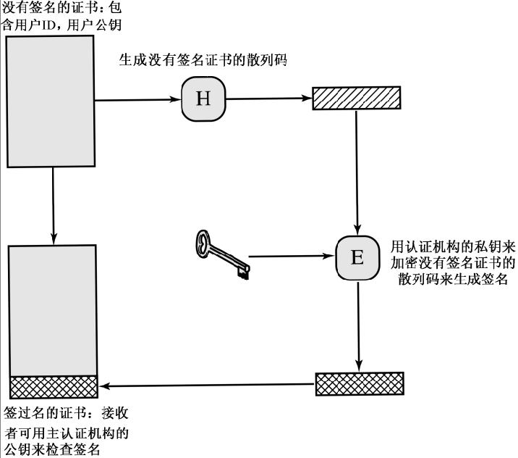
从公钥到证书
审核

Slide 33
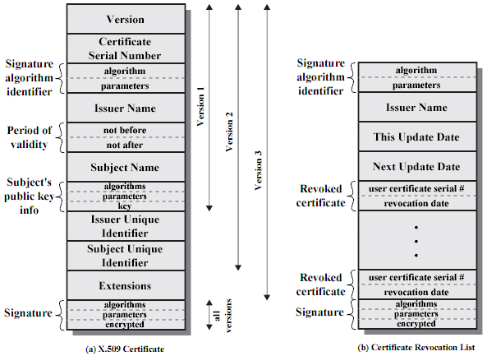
证书格式
版本
序列号
签名算法标识
其参数
签发者名字
不早于，不迟于
主题名(持有人名)
算法标识
其参数
公钥
签发人标识(重名)
持有人标识
扩展
签名算法
参数
签名

Slide 34
X509v3 扩展
V3以可选扩展项的形式体现
    (扩展名字，值，是否可忽略)
  密钥标识符
  密钥用途
    签名、加密、密钥交换、CA等组合
  私钥使用期限
    对应的公钥一般有更长的期限以用于验证
  策略信息等
  颁发者和持有人的更多信息
  证书路径的约束信息
ASN.1 编码解析
  #openssl asn1parse -in root.pem -dump

Slide 35
证书中心 CA
Certificate Authority
  权威的证书签发者
    接受请求、审核、(收费)、签发
  商业CA机构
Certificate Request
  申请人产生自己的公钥(私钥)
  提交PKCS#10格式的申请
    公钥、自己的身份信息，用户自己的签名
审核颁发
  面对面的交涉; 代理RA
证书发布
  X500目录; 在线交换

Slide 36
证书的获得等问题
证书是公开的，不需保密
  这很好
信任
  对证书的信任基于对中心的信任
CA是分层次的
  以减轻负载和压力(尤其是审核)
对多个中心的信任
  分散了风险，也引入了风险

Slide 37
证书的自证明
前提: 已经有CA的公钥
  CA公钥一般是自签名证书的形式
  必须可靠的获得，离线手工
取得对方的证书
  证书是公开的，不需保密
  查目录；在线交换
判断证书是否有效
  验证证书中的签名是否是CA的真实签名
  (只是说这个证书是有效的)

Slide 38
信任关系
信任
  信任CA
  信任CA的签名
  信任CA签发的证书
  信任该持有人拥有这个公钥 <持有人，公钥>
层次
  CA组织成为层次关系
  信任链
    信任某CA则信任其子CA及其子CA签发的证书
CA之间的相互信任
  相互给对方的公钥签署一个证书

Slide 39
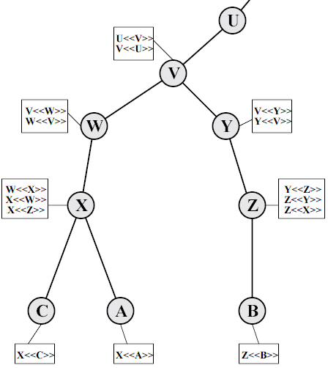
CA Tree
A和B之间
如何达成相互信任
Notes:
比如,我的身份证是济南公安局签发的,你的身份证是北京公安局签发的,但是都归中国公安部管,所以相互信任.
但是,他的证件是美国签发的,对不起,我不能信任他.

Slide 40
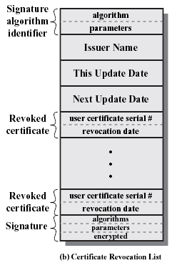
证书的撤销
证书中的有效期
证书提前作废的原因
  私钥泄密
    用户自己的、CA的
  持有人身份变化
CRL - certificate revocation list
  由CA定期公布的证书黑名单
  作废证书的序列号的表
  (序列号,撤销时间)
  表的创建日期
  其他信息
    CRL位置、下次CRL更新时间
  签名

Slide 41
Online Certificate Status Protocol
OCSP 在线证书状态协议
  可以用在线方式查询指定证书的状态
RFC 2560 – OCSP

Slide 42
使用证书进行身份鉴别
前提: 已经有某人的真实证书(公钥)
  查目录或在线交换
鉴别
  鉴别对方是否是真实的持有人(某人)
  看对方是否拥有证书中公钥对应的私钥
  使用挑战－应答机制
举例
  SSL协议

Slide 43
使用证书的鉴别过程
鉴别－
A要和B通信，A要弄清楚B是否是他所期望的真的B
A－>B：A向B请求证书
A<－B：B的证书
A ：A检查B的证书是否是A所信任的中心签发的
A－>B：A给B一个随机报文，让B签个名来看看
B ：B签名，在签名之前可施加自己的影响成分
A<－B：B的签名
A ：检验是否通过了B的证书里的公钥的验证
Notes:
这个协议的执行流程当然可以更优化些，比如SSL。

Slide 44
Terminology
ITU - International Telecommunication Union
  http://www.itu.int/
X.500 spec
  Information technology - Open Systems Interconnection - The Directory: Overview of concepts, models and services
X.509 spec
  Information technology - Open Systems Interconnection - The Directory: Public-key and attribute certificate frameworks
Online Doc ($/CHF)
  http://www.itu.int/itudoc/itu-t/rec/x/x500up.html

Slide 45
术语：X.500目录服务
Directory
  A directory is a database optimized for read operations. Directories often support powerful search and browsing capabilities.
    A directory is like a phone book, and is not like a directory (folder) on your computer. Like a phone book, the directory holds information about a thing, like a doctor: First, you find the phone book, then you find "Doctors," then you look for the type of doctor, then you decide which doctor you want to see. The directory is like that.
X.500 － distributed hierarchical database
  分布式层次数据库
    InterNIC
  发布人员信息（尤其是证书）

Slide 46
术语：LDAP
Lightweight Directory Access Protocol
  is an open-standard protocol for accessing X.500 directory services. LDAP is a lightweight alternative to the X.500 Directory Access Protocol (DAP) for use on the Internet. The protocol runs over Internet transport protocols, such as TCP.
  LDAP was defined by the IETF in order to encourage adoption of X.500 directories.
ldapman
  http://www.ldapman.org/
OpenLDAP
  http://www.openldap.org/
Actrive Directory in win2k
Notes:
An Introduction to LDAP http://ldapman.org/articles/intro_to_ldap.html
（中译本） http://www.linuxaid.com.cn/engineer/brimmer/html/LDAP.htm

Slide 47
术语：DN - distinguished name
o="FooBar, Inc.", c=US
  以X.500格式表示的基准DN
o=foobar.com
  用公司的Internet地址表示的基准DN
dc=foobar, dc=com
  用DNS域名的不同部分组成的基准DN
cn=Oatmeal Deluxe,ou=recipes,dc=foobar,dc=com
  燕麦粥 食谱 …
* dn: cn=Oatmeal Deluxe, ou=recipes, dc=foobar, dc=com
  cn: Instant Oatmeal Deluxe
  recipeCuisine: breakfast
  recipeIngredient: 1 packet instant oatmeal
  recipeIngredient: 1 cup water
  recipeIngredient: 1 pinch salt
  recipeIngredient: 1 tsp brown sugar
  recipeIngredient: 1/4 apple, any type

Slide 48
术语：ASN.1
ASN.1
  a notation for describing abstract types and values
  X.208
Type / Tag number (decimal) / Tag number (hexadecimal)
INTEGER 2 02
BIT STRING 3 03
OCTET STRING 4 04
NULL 5 05
OBJECT ID 6 06
SEQUENCE 16 10
SET and SET OF 17 11
PrintableString 19 13
T61String 20 14
IA5String 22 16
UTCTime 23 17

Slide 49
术语：BER/DER
Basic Encoding Rules (x.209)
  The Basic Encoding Rules for ASN.1, abbreviated BER, give one or more ways to represent any ASN.1 value as an octet string.
Distinguished Encoding Rules
  The Distinguished Encoding Rules for ASN.1, abbreviated DER, are a subset of BER, and give exactly one way to represent any ASN.1 value as an octet string.
  DER is defined in Section 8.7 of X.509.
* layman.doc

Slide 50
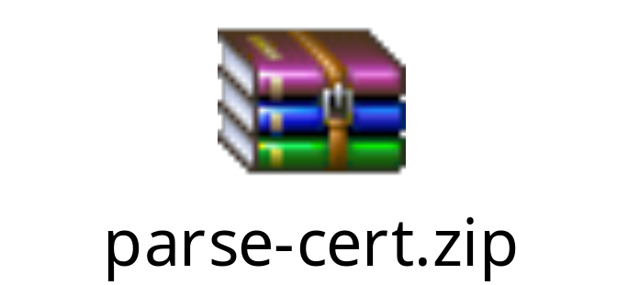
编码例子
30 82 xx xx
  30 seq
  8 随后的半个字节指示了随后的长度
  2 2个字节

Slide 51
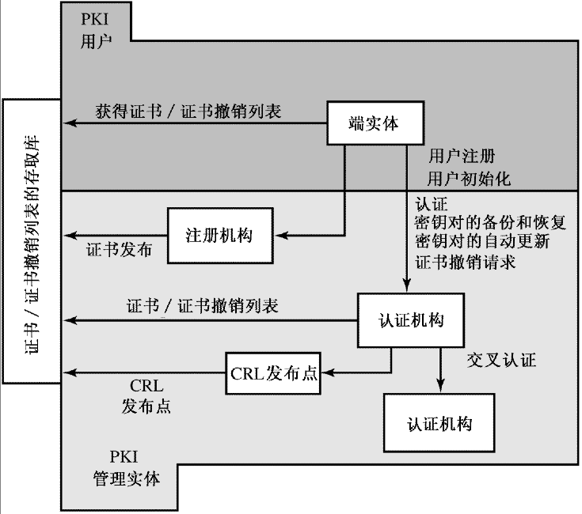
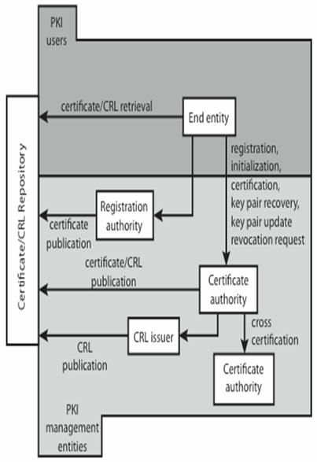
14.3PKI

Slide 52
PKIX
IETF PKIX charter
  http://www.ietf.org/html.charters/pkix-charter.html

Slide 53
14.a PKI in Windows
Windows中对PKI的支持
  一个简陋但是可用的CA
  可在IE和IIS之间跑HTTPS（HTTP+SSL）
  可使用Outlook*Express收发加密+签名邮件
实验任务
  自己配置一个CA
  发放若干个证书
  并在IIS、IE、OE中测试

Slide 54
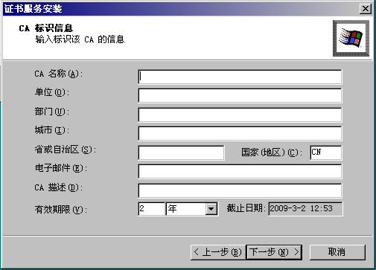
CA安装
需Windows Server
手工添加CA组件并配置参数

Slide 55
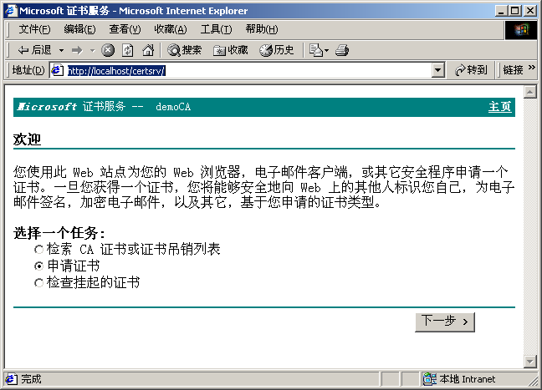
给IE申请一个证书
如果要求客户身份
IE中申请用户证书
在CA的IE界面申请

Slide 56
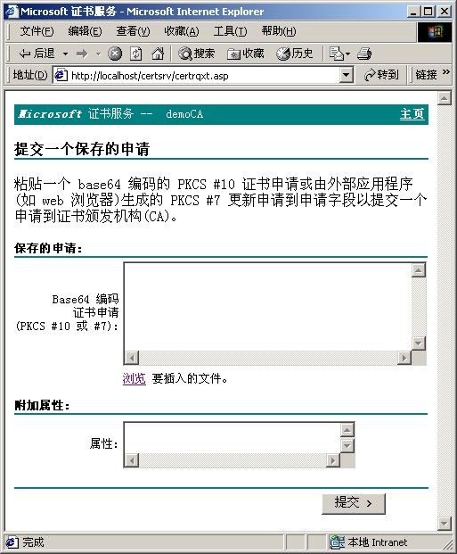
给IIS申请一个证书
安装IIS，新建一个WebServer
为启用SSL产生RSA钥和PKCS#10 Req
通过CA的IE界面提交申请：PKCS#10 Req
在CA管理器中颁发、导出cer/der
回到IIS的WebServer
导入cer/der
设置SSL端口
让该WebServer请求SSL

Slide 57
HTTPS
然后可以尝试用HTTPS协议访问IIS
  https://localhost/ or https://that’server/
  http://localhost/ or http://that’server/

Slide 58
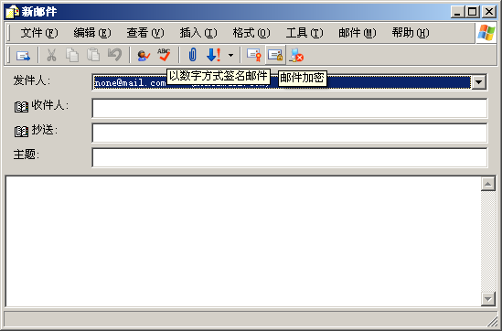
收发安全邮件
使用IE中的证书（个人证书）
OExp中使用RSA证书保护邮件
在CA的IE界面申请
在OExp中使用
参见 第15章

Slide 59
PKI in Windows Server 课堂演示
使用虚拟机
基本环境
服务器：windows server
CA server
IIS
客户端：windows
IE
Outlook Express

Slide 60
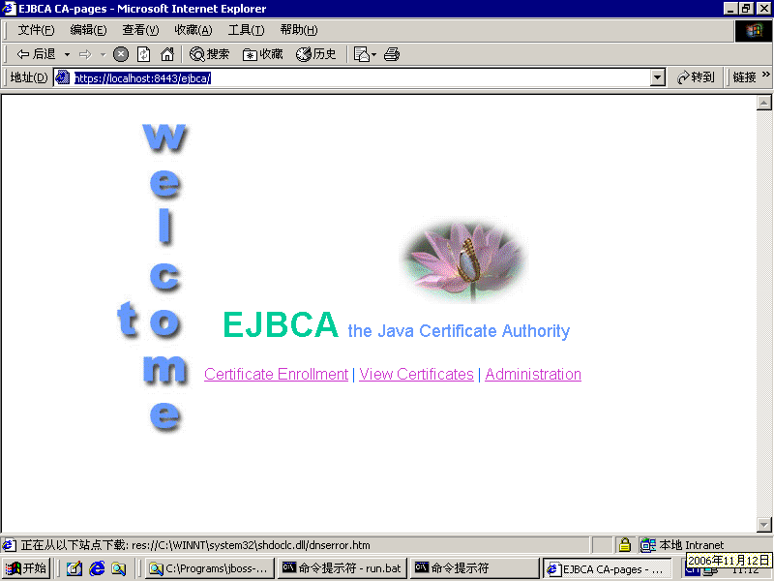
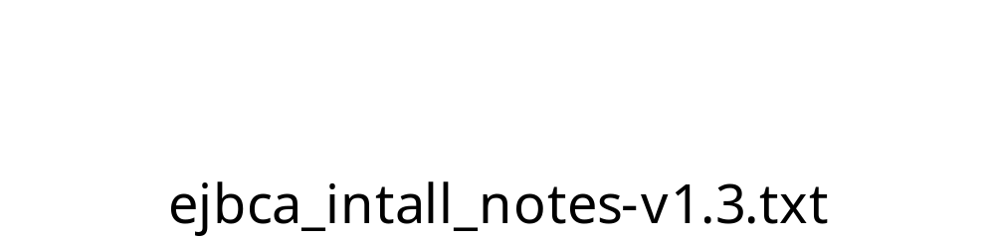
14.b EJBCA
EJBCA是一个基于JAVA的CA，应用较广泛。
请看安装札记。
Notes:
安装EJBCA步骤总结
=================
by linfb@sdu.edu.cn 22:40 2004-9-7
安装EJBCA需要
JDK 1.4.x
JBOSS 3.2.x or 3.0.x
Ant 1.6.x
安装JDK
安装Ant
安装JBoss
设置环境变量：
JAVA_HOME
ANT_HOME
JBOSS_HOME
EJBCA_HOME
PATH
%PATH%加入JDK, ANT, JBOSS的bin路径
// %JAVA_HOME%\bin;%JBOSS_HOME%\bin;%ANT_HOME%\bin in windows
// $JAVA_HOME\bin:$JBOSS_HOME\bin:$ANT_HOME\bin in linux
额外的需要
jce_policy
http://java.sun.com/j2se/1.4.2/docs/guide/security/jce/JCERefGuide.html
在%EJBCA_HOME%, ant/build
ant # 注意得有提示：BUILD SUCCESSFUL
ant deploy # ejbca-ca.ear
启动JBoss服务
./bin/run.bat
注意JBoss的默认端口8080可能和已有程序冲突
在ejbca目录
执行'install.cmd' # 'install.cmd' in wins
你会发现它提示需要强加密包 JCE !!!
安装JCE
下载jce_policy-1_4_2.zip
把其中的两个jar文件复制到?:/program files/jre/lib/security目录即可
CA参数
按照提示输入即可
重启JBoss
导入p12/superadmin.p12到windows
访问EJBCA界面：https://localhost:8443/ejbca
或者可以测试CA
runtest.cmd
在Linux中安装EJBCA试验记录
==========================
使用版本
Debian3.1R0a的net安装，
然后用apt-get从dvd1和dvd2中提取其它组件。
JDK 1.4.2_10 (.bin)
EJBCA 3.1.3
ant 1.6
JBOSS 4.0.2
安装JDK
#chmod +x j2sdk-1_4_2_10-linux-i586.bin
#./j2sdk-1_4_2_10-linux-i586.bin
增加/修改环境变量
export JAVA_HOME=/root/j2sdk1.4.2_10
export PATH=$PATH:$JAVA_HOME/bin
export CLASSPATH=$JAVA_HOME/lib:$JAVA_HOME/jre/lib:.
安装ant
#apt-get install ant
安装JBoss
#unzip jboss-4.0.2.zip
export JBOSS_HOME=/root/jboss-4.0.2
export PATH=$PATH:$JBOSS_HOME/bin
安装EJBCA
#unzip ejbca_3_1_3.zip
#cd ejbca
#ant bootstrap
#ant install
Restart JBoss
一次失败安装尝试（新版本问题）
========================
更新 //23:57 2005-10-19
使用
ANT 1.6.5
JDK 1.5
JBOSS 4.0.2
EJBCA 3.1.2
注意事项
不需要jce了
ejbca
>copy ejbca.properties.sample ejbca.properties
>ant bootstrap
>ant install
// 或许不要在安装路径中包含空格
// 还没有到达最后成功状态
在Windows 2000 Server in vmwgare中的安装实验
============================================
Windows 2000 Server in vmwgare
Windows2000DomainServer('passwd')[md5=6f81].zip
JDK
j2sdk-1_4_2_12-windows-i586-p.exe
jce_policy-1_4_2.zip （放到JDK|JRE的lib/security/.）
设置JAVA_HOME环境变量
ANT
apache-ant-1.6.5-bin.zip
set ANT_HOME
JBOSS
jboss-4.0.5.GA.zip
set JBOSS_HOME
EJBCA
ejbca_3_3_1.zip
set EJBCA_HOME
PATH
%PATH%加入JDK, ANT, JBOSS的bin路径
// %JAVA_HOME%\bin;%JBOSS_HOME%\bin;%ANT_HOME%\bin in windows
// $JAVA_HOME\bin:$JBOSS_HOME\bin:$ANT_HOME\bin in linux
build/deploy ejbca
Copy ejbca.properties.sample to ejbca.properties
EJBCA_HOME> ant j2ee:run
EJBCA_HOME> ant bootstrap
EJBCA_HOME> ant install
tomcat.jks
superadmin.p12 --> IE, pwd is 'ejbca'
Stop JBoss (ctrl+c)
EJBCA_HOME> ant deploy
JBOSS_HOME> bin\run.bat # Start JBoss again
https://localhost:8443/ejbca/
http://localhost:8080/ejbca
tips: ant javatruststore
至此成功。2:39 2006-11-13

Slide 61
14.c OpenCA
OpenCA，一个复杂的CA系统
  http://www.openca.org/
阅读材料：
  http://www-900.ibm.com/developerWorks/cn/security/se-pkiusing/index.shtml

Slide 62
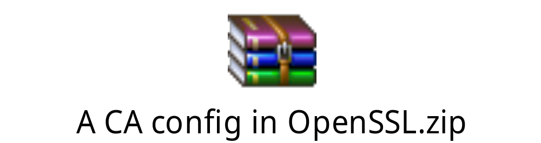
14.d CA with OpenSSL
OpenSSL
  下载、编译、安装、配置
相关功能目录
  ./apps/demoCA，./certs
openssl子命令(证书相关)
  asn1parse、ca、crl、crl2pkcs7、nseq、ocsp、pkcs12、req、x509
* 练习
  配置一个该CA，颁发证书，并试用

Slide 63
mkdir -p ./demoCA/{private,newcerts}
touch ./demoCA/index.txt
echo 01 > ./demoCA/serial
openssl genrsa -out ./demoCA/private/cakey.pem 1024
openssl req -new -days 1000 -key ./demoCA/private/cakey.pem -out careq.pem
openssl ca -selfsign -in careq.pem -out ./demoCA/cacert.pem
#CA ready

Slide 64
# user1
openssl genrsa -out userkey.pem 1024
openssl req -new -days 3650 -key userkey.pem -out userreq.pem
openssl ca -in userreq.pem -out usercert.pem
mv *.pem ./demoCA/newcerts/.
Notes:
//REF 佚名
把所有 shell 命令放到一起纵览一下：
# 建立 CA 目录结构
mkdir -p ./demoCA/{private,newcerts}
touch ./demoCA/index.txt
echo 01 > ./demoCA/serial
# 生成 CA 的 RSA 密钥对
openssl genrsa -out ./demoCA/private/cakey.pem 1024
# 生成 CA 证书请求
openssl req -new -days 3650 -key ./demoCA/private/cakey.pem -out careq.pem
# 自签发 CA 证书
openssl ca -selfsign -in careq.pem -out ./demoCA/cacert.pem
# 以上两步可以合二为一
openssl req -new -x509 -days 3650 -key ./demoCA/private/cakey.pem -out ./demoCA/cacert.pem
# 生成用户的 RSA 密钥对
openssl genrsa -out userkey.pem
# 生成用户证书请求
openssl req -new -days 3650 -key userkey.pem -out userreq.pem
# 使用 CA 签发用户证书
openssl ca -in userreq.pem -out usercert.pem

Slide 65

证书解析
手工演示
  in windows
  use openssl.exe
    openssl x509 -in cert.pem -text
编程
  参考 .\apps\x509.c
其他
  证书厂商提供的解析库API

Slide 66
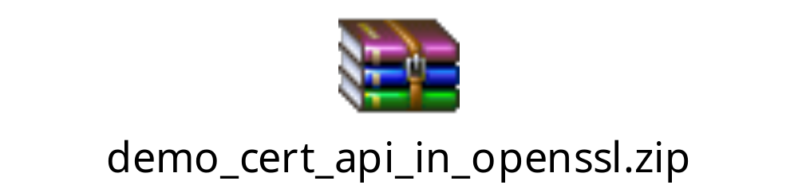
证书操作 (in OpenSSL)
PEM_read_bio_X509_AUX()
X509_get_version()
X509_get_issuer_name()
X509_get_subject_name()
X509_get_pubkey()
X509_verify()
解析证书例程
Notes:
#include <stdio.h>
#include <string.h>
#include <stdlib.h>
#include <openssl/pem.h>
#include <openssl/x509.h>
#define root_cert "cacert.pem" // '1
#define user_cert "u1.pem" // '2
main()
{
BIO *fcert1, *fcert2;
X509 *x1, *x2;
EVP_PKEY *k1, *k2;
SSL_load_error_strings(); /* readable error messages */
SSL_library_init();
fcert1 = BIO_new(BIO_s_file());
fcert2 = BIO_new(BIO_s_file());
BIO_read_filename(fcert1, root_cert);
BIO_read_filename(fcert2, user_cert);
x1 = PEM_read_bio_X509_AUX(fcert1, NULL, NULL, NULL);
x2 = PEM_read_bio_X509_AUX(fcert2, NULL, NULL, NULL);
#define show_hehe(x) \
printf("ver = %d\n", X509_get_version(x)); \
\
puts("issuer:"); \
{ char buf[1000]; \
X509_NAME *a = X509_get_issuer_name(x); \
X509_NAME_oneline(a, buf, 1000); \
puts(buf); \
} \
\
puts("subject:"); \
{ char buf[1000]; \
X509_NAME *a = X509_get_subject_name(x);\
X509_NAME_oneline(a, buf, 1000); \
puts(buf); \
}
show_hehe(x1);
show_hehe(x2);
k1 = X509_get_pubkey(x1);
k2 = X509_get_pubkey(x2);
#if 0 // 这一部分还有错误，可能是思路不对，请做为练习改之。
// 现在ok了。
ret = X509_verify(x1, k1); // 返回1
ret = X509_verify(x2, k1); // 1
ret = X509_verify(x1, k2); // 0
ret = X509_verify(x2, k2); // 0
#endif
if (X509_verify(x1, k1)>0) // 返回1
if (X509_verify(x2, k1)) // 1
puts("all ok");
// 这说明这个用户(user_cert)的证书
// 确实是这个中心(root_cert)签发的
return 0;
}

Slide 67
推荐阅读：CA运营机构及其它
请看IE中受信任的证书颁发机构
VeriSign http://www.verisign.com/
SDCA http://www.sdca.com.cn/
Shop365 http://www.shop365.com.cn/
SHECA http://www.sheca.com/
CFCA http://www.cfca.com.cn/
CNCA (gd) http://www.cnca.net
Misc
  http://count.jsedu.net/dzsw_aqx/dzsw_aqx_ml.html

Slide 68
资料链接
Kerberos
  http://web.mit.edu/kerberos/www/
X509
  http://www.webopedia.com/TERM/X/X_509.html
  http://www.ietf.org/rfc/rfc2459.txt
制作 SSL X.509 CERT
  http://www.imacat.idv.tw/tech/sslcerts.html.zh-cn
PKI
  http://directory.google.com/Top/Computers/Security/Public_Key_Infrastructure/
  http://www.google.com/search?q=pki&ie=UTF-8&oe=UTF-8&hl=zh-CN&lr=

Slide 69
关键词 Key Terms
authentication authentication server
Kerberos Kerberos realm
lifetime nonce
propagating cipher block chaining (PCBC) mode
public-key certificate
realm sequence number
subkey ticket
ticket-granting server (TGS)
X.509 certificate

Slide 70
小结
Kerberos适合在LAN上使用，Windows域就是用的它。PKI是互联网这种分布式环境安全的主要解决方法。PKI的核心是CA的建设，CA的优点在于其是离线中心。CA的一个麻烦事是证书黑名单(CRL/OCSP)的处理。PKI的部署较为繁琐，而且PKI主要帮助通信加密、抗抵赖等，对于系统安全问题(病毒和黑客)帮助不大，因此降低了用户部署的积极性。

Slide 71
Q & A

