Slide 1
密码编码学与网络安全
电子工业出版社
2006 - 2007
Notes:
原版 “Cryptography and Network Security”, 4/e, by William Stallings
中译本 密码编码学与网络安全 第四版
PPT制作 林丰波
电子工业出版社 2006-2007

Slide 2
第16章 IP安全
* 16.a VPN介绍 ↓
16.1 IPSec ↓
16.2 IPSec体系结构 ↓
16.3 IPSec/AH ↓
16.4 IPSec/ESP ↓
16.5 安全关联组合 ↓
16.6 密钥管理 ↓
* 16.b VPN实验 ↓
* 16.c OpenVPN ↓

Slide 3
16.a VPN介绍
适应场合
  分布式办公环境
  安全的远程访问
  Intranet/Extranet
  电子商务/EDI
优点
  对应用透明
  低成本、方便灵活
Notes:
http://www.vpnc.org/

Slide 4
VPN适用场合
Virtual Private Network
  build secure tunnels through untrusted public networks using standard protocols
  confidentiality, authentication, and message integrity
专线私有网
  如银行、证券、大公司分公司等专线网络
  线路完全在用户自己的掌控之下，一般无加密
  加密的专线网
借助公网互联的私有网
  IP VPN

Slide 5
VPN类型
Trusted VPN
  租用专线，相信提供商的线路的专用性可安全
  能控制路径和路由
Secure VPN
  使用互联网线路，在网络边缘加解密
  不担心如何路由
Hybrid VPN
  在Trusted VPN基础之上的混合模式

Slide 6
Trusted VPN
Before the Internet became nearly-universal, a virtual private network consisted of one or more circuits leased from a communications provider. The basic idea was that a customer could use these leased circuits in the same way that they used physical cables in their local network.
The privacy afforded by these legacy VPNs was only that the communications provider assured the customer that no one else would use the same circuit. A leased circuit ran through one or more communications switches, any of which could be compromised by someone wanting to observe the network traffic.
The VPN customer trusted the VPN provider to maintain the integrity of the circuits and to use the best available business practices to avoid snooping of the network traffic. Thus, these are called trusted VPNs.
Notes:
租用专线制作VPN

Slide 7
Secure VPN
As the Internet became more popular as a corporate communications medium, security became much more of a pressing issue for both customers and providers. Seeing that trusted VPNs offered no real security, vendors started to create protocols that would allow traffic to be encrypted at the edge of one network or at the originating computer, moved over the Internet like any other data, and then decrypted when it reached the corporate network or a receiving computer.
This encrypted traffic acts like it is in a tunnel between the two networks: even if an attacker can see the traffic, they cannot read it, and they cannot change the traffic without the changes being seen by the receiving party and therefore rejected. Networks that are constructed using encryption are called secure VPNs.
Notes:
互联网普及了，自己做VPN。此时把互联网当做隧道传输加密数据分组。

Slide 8
Hybrid VPN
More recently, service providers have begun to offer a new type of trusted VPNs, this time using the Internet instead of the raw telephone system as the substrate for communications. These new trusted VPNs still do not offer security, but they give customers a way to easily create network segments for wide area networks (WANs).
A secure VPN can be run as part of a trusted VPN, creating a third type of VPN that is very new on the market: hybrid VPNs.
The secure parts of a hybrid VPN might be controlled by the customer (such as by using secure VPN equipment on their sites) or by the same provider that provides the trusted part of the hybrid VPN. Sometimes an entire hybrid VPN is secured with the secure VPN, but more commonly, only a part of a hybrid VPN is secure.

Slide 9
评价VPN
安全性
伸缩性
方便部署
可靠性
网络管理能力
策略管理能力

Slide 10
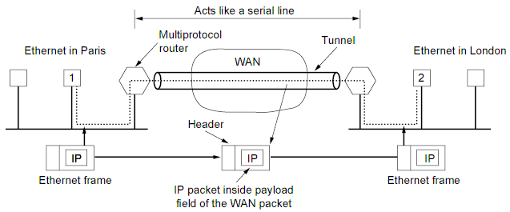

隧道 Tunnel
* Tunnel vs. Tranport

Slide 11
VPN and Extranet/Intranet
Internet
Intranet
Extranet

Slide 12
VPN Tech
ATM
Frame Relay
MPLS
IPSec
  IPSec in L2TP （RFC 3193）
SSL/VPN
PPTP/L2TP
SOCKS
Notes:
Main > Computer > Security at
http://computer.howstuffworks.com/channel.htm?ch=computer&sub=sub-security

Slide 13
ATM VPN
ATM
FR
…
Notes:
Main > Computer > Security at http://computer.howstuffworks.com/channel.htm?ch=computer&sub=sub-security

Slide 14
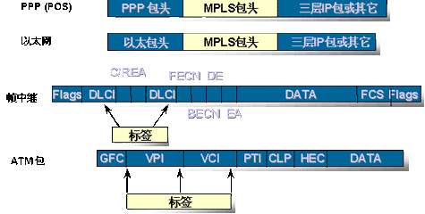
MPLS
Multiprotocol Label Switching
  http://www.ietf.org/html.charters/mpls-charter.html

Slide 15
PPTP/L2TP
Point-to-Point Protocol RFC 1661
Point-to-Point Tunneling Protocol RFC 2637
  PPP＋EAP，by MS
Layer2 Tunneling Protocol RFC2661
  by $＋
练习：PPTP in Windows
Refer site
  http://www.net130.com/netbass/vpn.htm
  RFC 3193

Slide 16
VPN in Windows
基本意图
  很多公司内部LAN使用网关NAT访问网络，内部网上有内部数据资料。节省IP也安全。
  出差员工通过互联网访问到网关，获得一个内部网络IP地址及其身份，从而能够访问内部网络资料。
  内部数据途径公网传输时的加密问题。

Slide 17
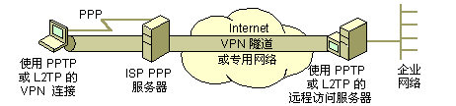
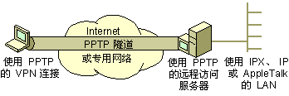
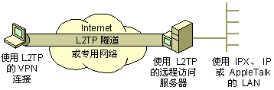
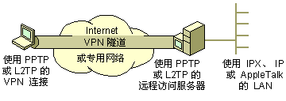
PPTP/L2TP Figure in Windows

Slide 18
试验：VPN in Windows
VPN在线帮助文档
    开始－帮助－查 ”VPN”(XP中文档较全面)
  PPP/PPTP/L2TP
  IPSec
VPN in Windows 2000/XP/9x
  路由和远程访问
  新建连接－VPN类型
IPSec/IPv6/v4 in Windows XP
  ipv6.exe
IPSec/IPv6 in Windows 2003
  netsh.exe

Slide 19
16.1 IPSec
IPv4安全问题

Slide 20
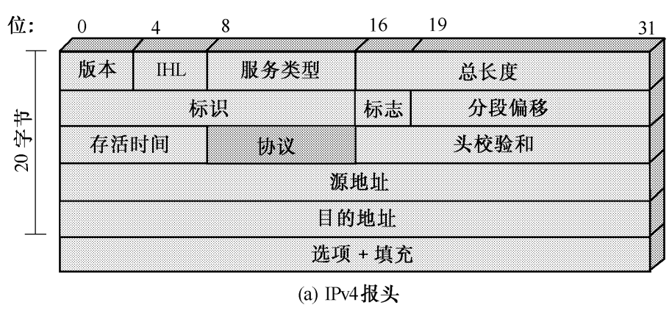
IPv4 hdr
0 1 2 3
0 1 2 3 4 5 6 7 8 9 0 1 2 3 4 5 6 7 8 9 0 1 2 3 4 5 6 7 8 9 0 1
+-+-+-+-+-+-+-+-+-+-+-+-+-+-+-+-+-+-+-+-+-+-+-+-+-+-+-+-+-+-+-+-+
|Version| IHL |Type of Service| Total Length |
+-+-+-+-+-+-+-+-+-+-+-+-+-+-+-+-+-+-+-+-+-+-+-+-+-+-+-+-+-+-+-+-+
| Identification |Flags| Fragment Offset |
+-+-+-+-+-+-+-+-+-+-+-+-+-+-+-+-+-+-+-+-+-+-+-+-+-+-+-+-+-+-+-+-+
| Time to Live | Protocol | Header Checksum |
+-+-+-+-+-+-+-+-+-+-+-+-+-+-+-+-+-+-+-+-+-+-+-+-+-+-+-+-+-+-+-+-+
| Source Address |
+-+-+-+-+-+-+-+-+-+-+-+-+-+-+-+-+-+-+-+-+-+-+-+-+-+-+-+-+-+-+-+-+
| Destination Address |
+-+-+-+-+-+-+-+-+-+-+-+-+-+-+-+-+-+-+-+-+-+-+-+-+-+-+-+-+-+-+-+-+
| Options | Padding |
+-+-+-+-+-+-+-+-+-+-+-+-+-+-+-+-+-+-+-+-+-+-+-+-+-+-+-+-+-+-+-+-+

Slide 21
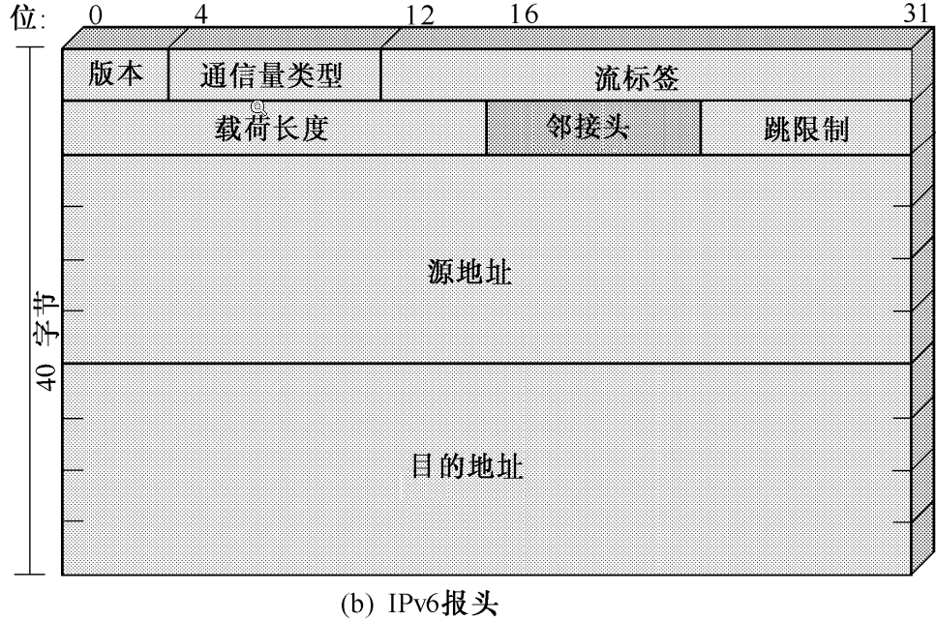
IPv6 hdr
+-+-+-+-+-+-+-+-+-+-+-+-+-+-+-+-+-+-+-+-+-+-+-+-+-+-+-+-+-+-+-+-+
|Version| Traffic Class | Flow Label |
+-+-+-+-+-+-+-+-+-+-+-+-+-+-+-+-+-+-+-+-+-+-+-+-+-+-+-+-+-+-+-+-+
| Payload Length | Next Header | Hop Limit |
+-+-+-+-+-+-+-+-+-+-+-+-+-+-+-+-+-+-+-+-+-+-+-+-+-+-+-+-+-+-+-+-+
| |
+ +
| |
+ Source Address +
| |
+ +
| |
+-+-+-+-+-+-+-+-+-+-+-+-+-+-+-+-+-+-+-+-+-+-+-+-+-+-+-+-+-+-+-+-+
| |
+ +
| |
+ Destination Address +
| |
+ +
| |
+-+-+-+-+-+-+-+-+-+-+-+-+-+-+-+-+-+-+-+-+-+-+-+-+-+-+-+-+-+-+-+-+

Slide 22
Internet Secure Overview
Security in the Internet Architecture
  RFC 1636 1994
    http://www.faqs.org/rfcs/rfc1636.html
  routing, mobility, realtime service
  Firewall
  End-system security
  Secure QOS
  Authentication
  Conclusion & Suggestion

Slide 23
IPSec in IPv4/v6
安全性
  IPSec
IPv6 in WinXP(!2k)
  地址字段128bits
  …
link
  http://www.ipv6.org/
  http://www.faqs.org/ftp/rfc/rfc2460.txt
  http://www.ipv6.net.edu.cn/

Slide 24
IPSec
IPSec is Internet Protocol Security
  It uses strong cryptography to provide both authentication and encryption services.
  Authentication ensures that packets are from the right sender and have not been altered in transit.
  Encryption prevents unauthorized reading of packet contents.
  Integrality

Slide 25
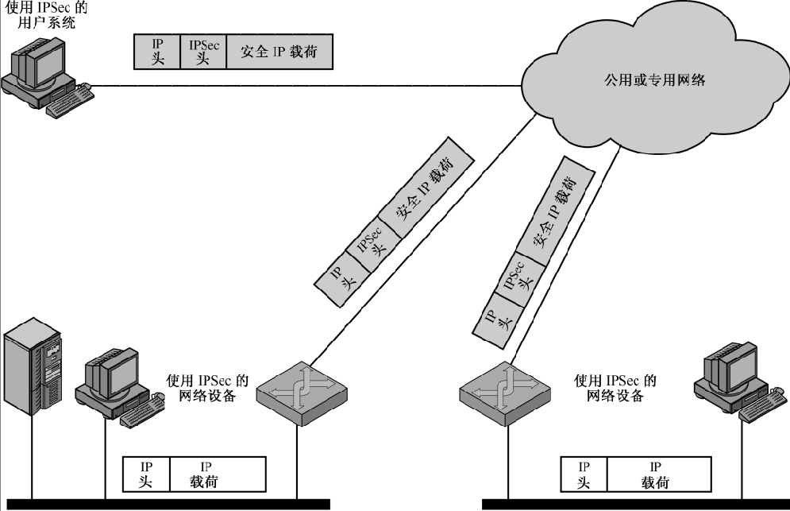
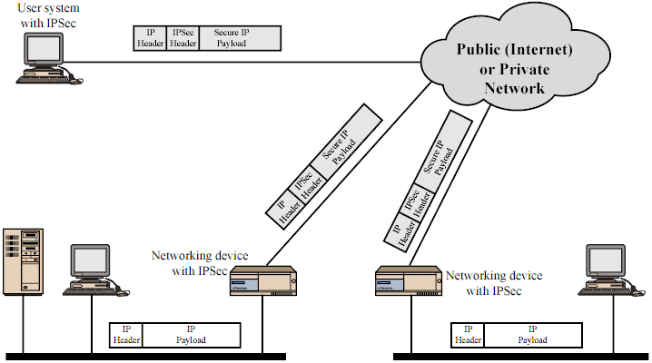
IPSec应用示意图

Slide 26
IPSec 服务
访问控制
无连接安全性
数据源的鉴别
拒绝重放的分组
加密
有限的通信量机密性

Slide 27
16.2 IPSec体系结构
RFC

Slide 28
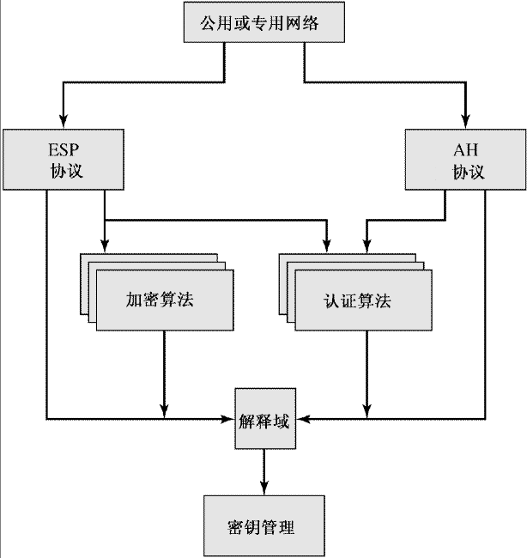
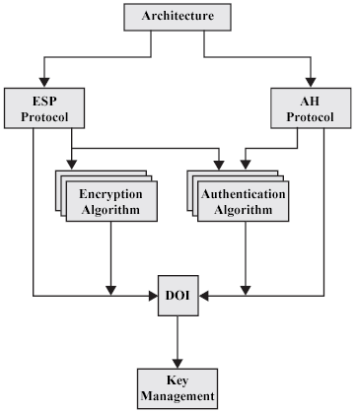
DOC
Overview
DOI
  Domains of Interpretation

Slide 29
IPSec规范
rfc2401 体系结构
  Security Architecture for the Internet Protocol
rfc2402 鉴别首部 AH
  Authentication Header
rfc2406 封装安全有效载荷 ESP
  Encapsulating Security Payload
rfc2407/8 ISAKMP
rfc2409 密钥管理 The Internet Key Exchange (IKE)
其他：加密、鉴别、散列算法的用法
  DES 3DES DH MD5 SHA1 RSA HMAC
Notes:
IP Security Protocol (ipsec)’ RFC
http://www.ietf.org/html.charters/ipsec-charter.html

Slide 30
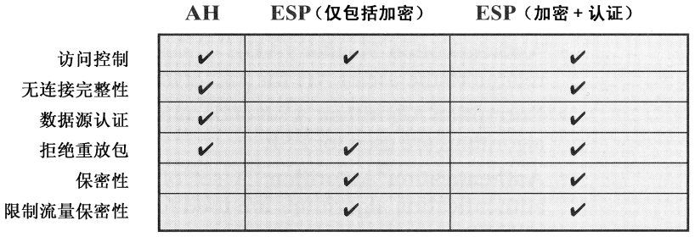
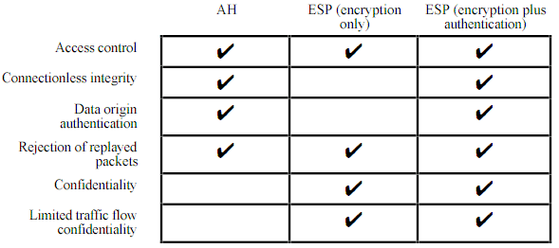
IPSec协议-服务

Slide 31
安全关联
安全关联SA - Security Association
  发送方→接收方的单向关联
  收发双方协商好的安全相关参数
  用于AH或ESP
  SPI 本地参数表的索引号
    计数器、防重放窗口、生存期
    AH信息、ESP信息
    隧道 or 传输方式
  IP目的地址
  协议标识

Slide 32
两种工作模式
隧道方式
  加密整个IP分组，并放在一个新的IP分组的有效载荷部分
  两个LAN通过VPN网关连接的情况
  路由器或防火墙
  有限的防通信量分析能力
运输方式
  只加密有效载荷部分，不加密地址等头部分
  用于两个机器之间直接连接的情况
  比如远程拨入方式

Slide 33
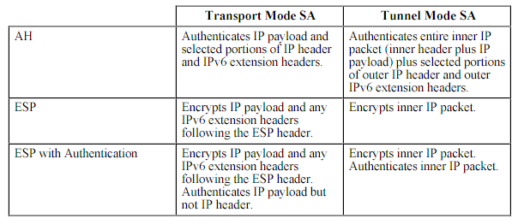
Tunnel vs. Transport

Slide 34
16.3 IPSec/AH
AH提供的服务
AH头结构
模式

Slide 35
AH提供的服务
提供鉴别服务
  检测传输过程中的改变
  发现地址欺骗攻击
  杜绝重放攻击 (序列号的宽度问题)
相应的技术手段
  HMAC-MD5/SHA1，但是只是用前96比特
  序号

Slide 36
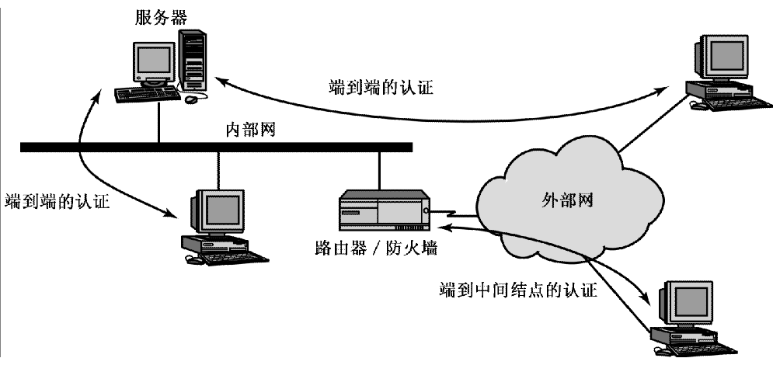
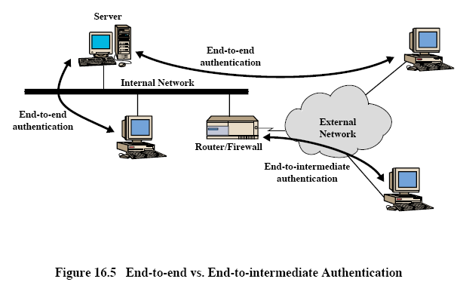
AH

Slide 37
AH
+------------+-------------------+------------+-------+---------------+
| IPv6 Header| Hop-by-Hop/Routing| Auth Header| Others| Upper Protocol|
+------------+-------------------+------------+-------+---------------+
When used with IPv6, the Authentication Header normally appears after
the IPv6 Hop-by-Hop Header and before the IPv6 Destination Options.
+-------------+--------------+-------------------------------+
| IPv4 Header | Auth Header | Upper Protocol (e.g. TCP, UDP)|
+-------------+--------------+-------------------------------+
When used with IPv4, the Authentication Header normally follows the
main IPv4 header.
+---------------+---------------+---------------+---------------+
| Next Header | Length | RESERVED |
+---------------+---------------+---------------+---------------+
| Security Parameters Index |
+---------------+---------------+---------------+---------------+
| |
+ Authentication Data (variable number of 32-bit words) |
| |
+---------------+---------------+---------------+---------------+
1 2 3 4 5 6 7 8 1 2 3 4 5 6 7 8 1 2 3 4 5 6 7 8 1 2 3 4 5 6 7 8
Authentication Header syntax

Slide 38
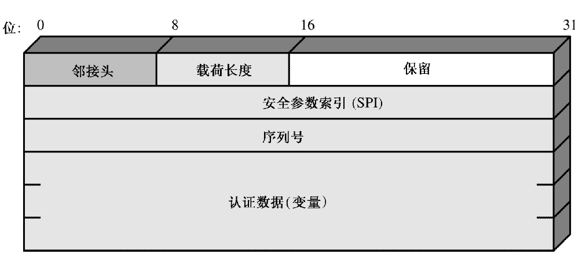
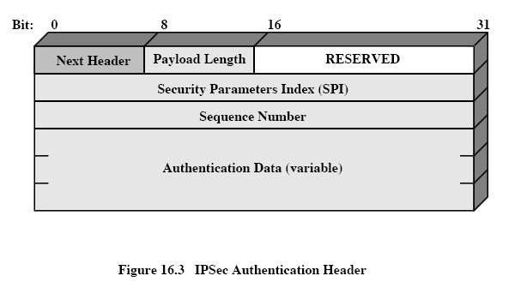
AH

Slide 39
AH
on IPv4
  IP+TCP+DATA
  IP+AH+TCP+DATA (transport)
  NewIP+AH+IP+TCP+DATA (tunnel)
on IPv6
* in RFC 2402

Slide 40
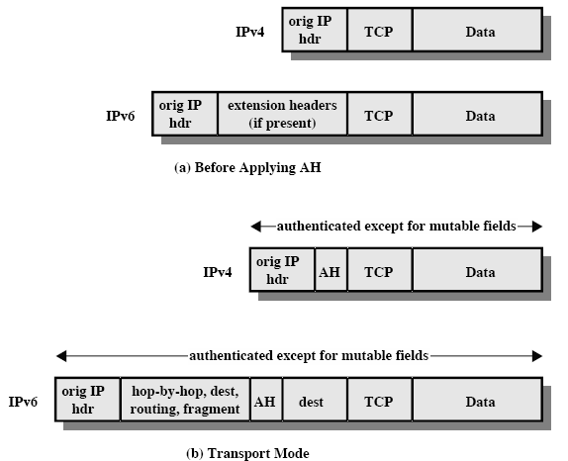
AH – 传输模式

Slide 41
AH – 隧道模式

Slide 42
16.4 IPSec/ESP
ESP服务
ESP模式

Slide 43
ESP提供的服务
机密性服务
  对(至少)数据部分加密
  填充
算法
  3DES、RC5、IDEA、CAST、Blowfish

Slide 44
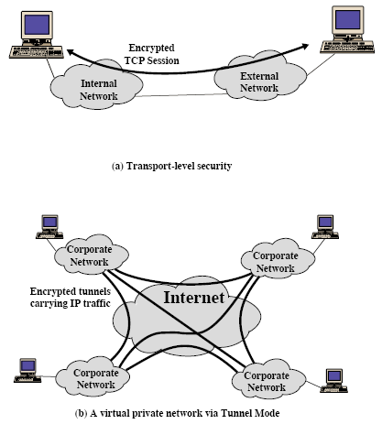
ESP

Slide 45
ESP
|<-- Unencrypted -->|<---- Encrypted ------>|
+-------------+--------------------+------------+---------------------+
| IP Header | Other IP Headers | ESP Header | encrypted data |
+-------------+--------------------+------------+---------------------+
A more detailed diagram of the ESP Header follows below.
+-------------+--------------------+------------+---------------------+
| Security Association Identifier (SPI), 32 bits |
+=============+====================+============+=====================+
| Opaque Transform Data, variable length |
+-------------+--------------------+------------+---------------------+

Slide 46
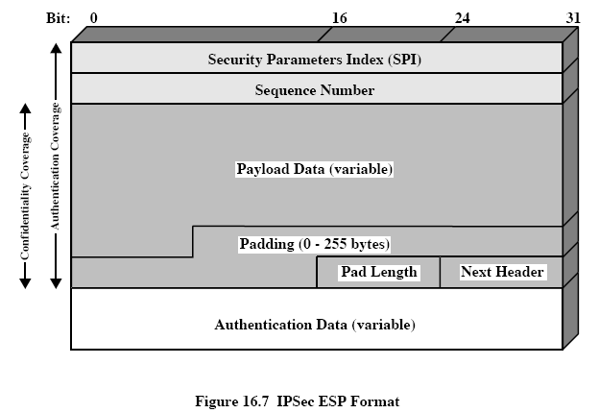
ESP

Slide 47
ESP
on IPv4
  IP+TCP+DATA
  IP+ESPhdr+TCP+DATA+ESPtl+ESPauth
  NewIP+ESPhdr+IP+TCP+DATA+ESPtl+ESPauth
on IPv6
* in RFC 2406

Slide 48
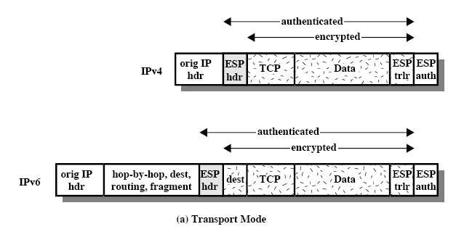
ESP – 传输模式

Slide 49
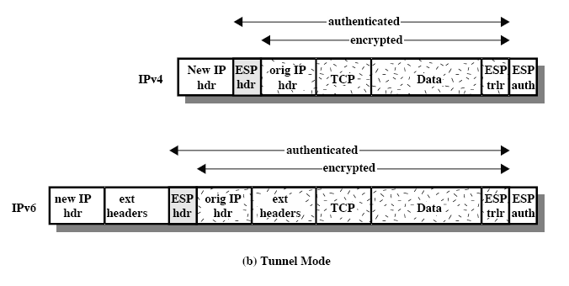
ESP – 隧道模式

Slide 50
16.5 安全关联组合
单个的SA可以实现AH或ESP协议，但不能两者都实现。因此，有时需要多个SA。
SA的组合方式：
  传输邻接
  隧道迭代

Slide 51
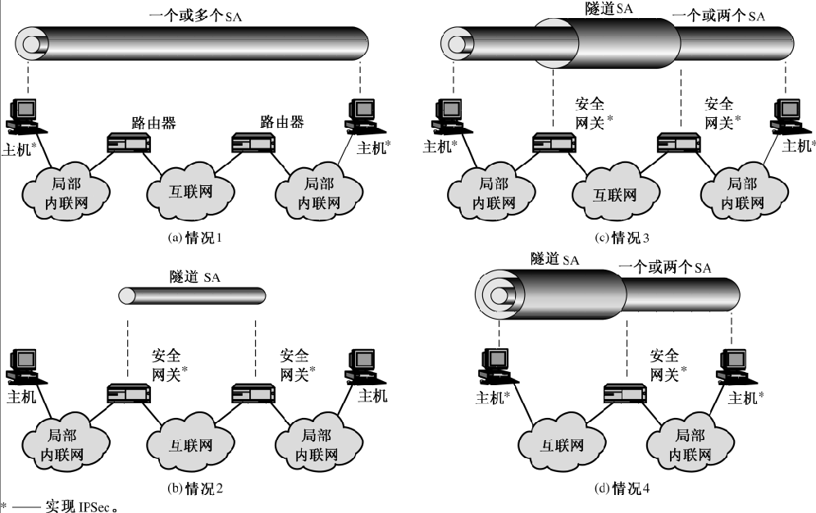
安全关联组合

Slide 52
16.6 密钥管理
自动的 vs. 手工的
Oakley 密钥确定协议
  RFC 2412，改进的DH
ISAKMP
  Internet Security Association and Key Management Protocol RFC 2407/8/9/4306
  用来建立、协商、修改、删除安全关联
证书的使用
Notes:
IKE builds upon the Oakley protocol.

Slide 53
Oakley
基于D-H方法协商密钥
  对D-H进行认证，避免中间人攻击
  使用临时交互号防止重放攻击
使用三种认证方法
  数字签名
  公钥加密
  对称密钥加密

Slide 54
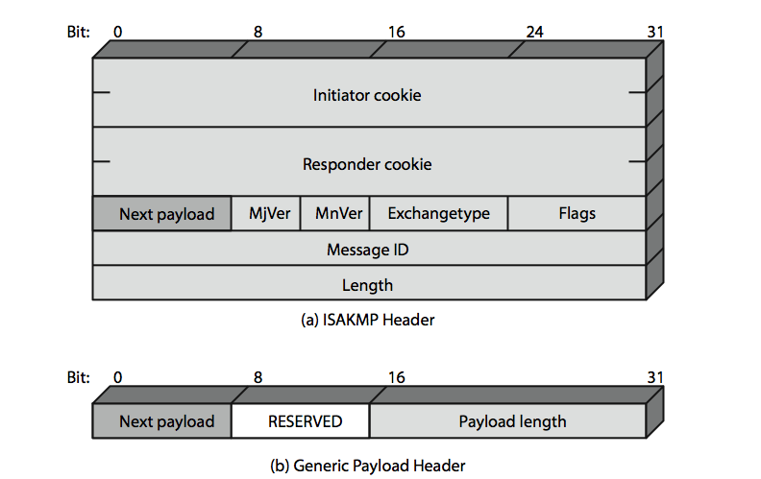
ISAKMP

Slide 55
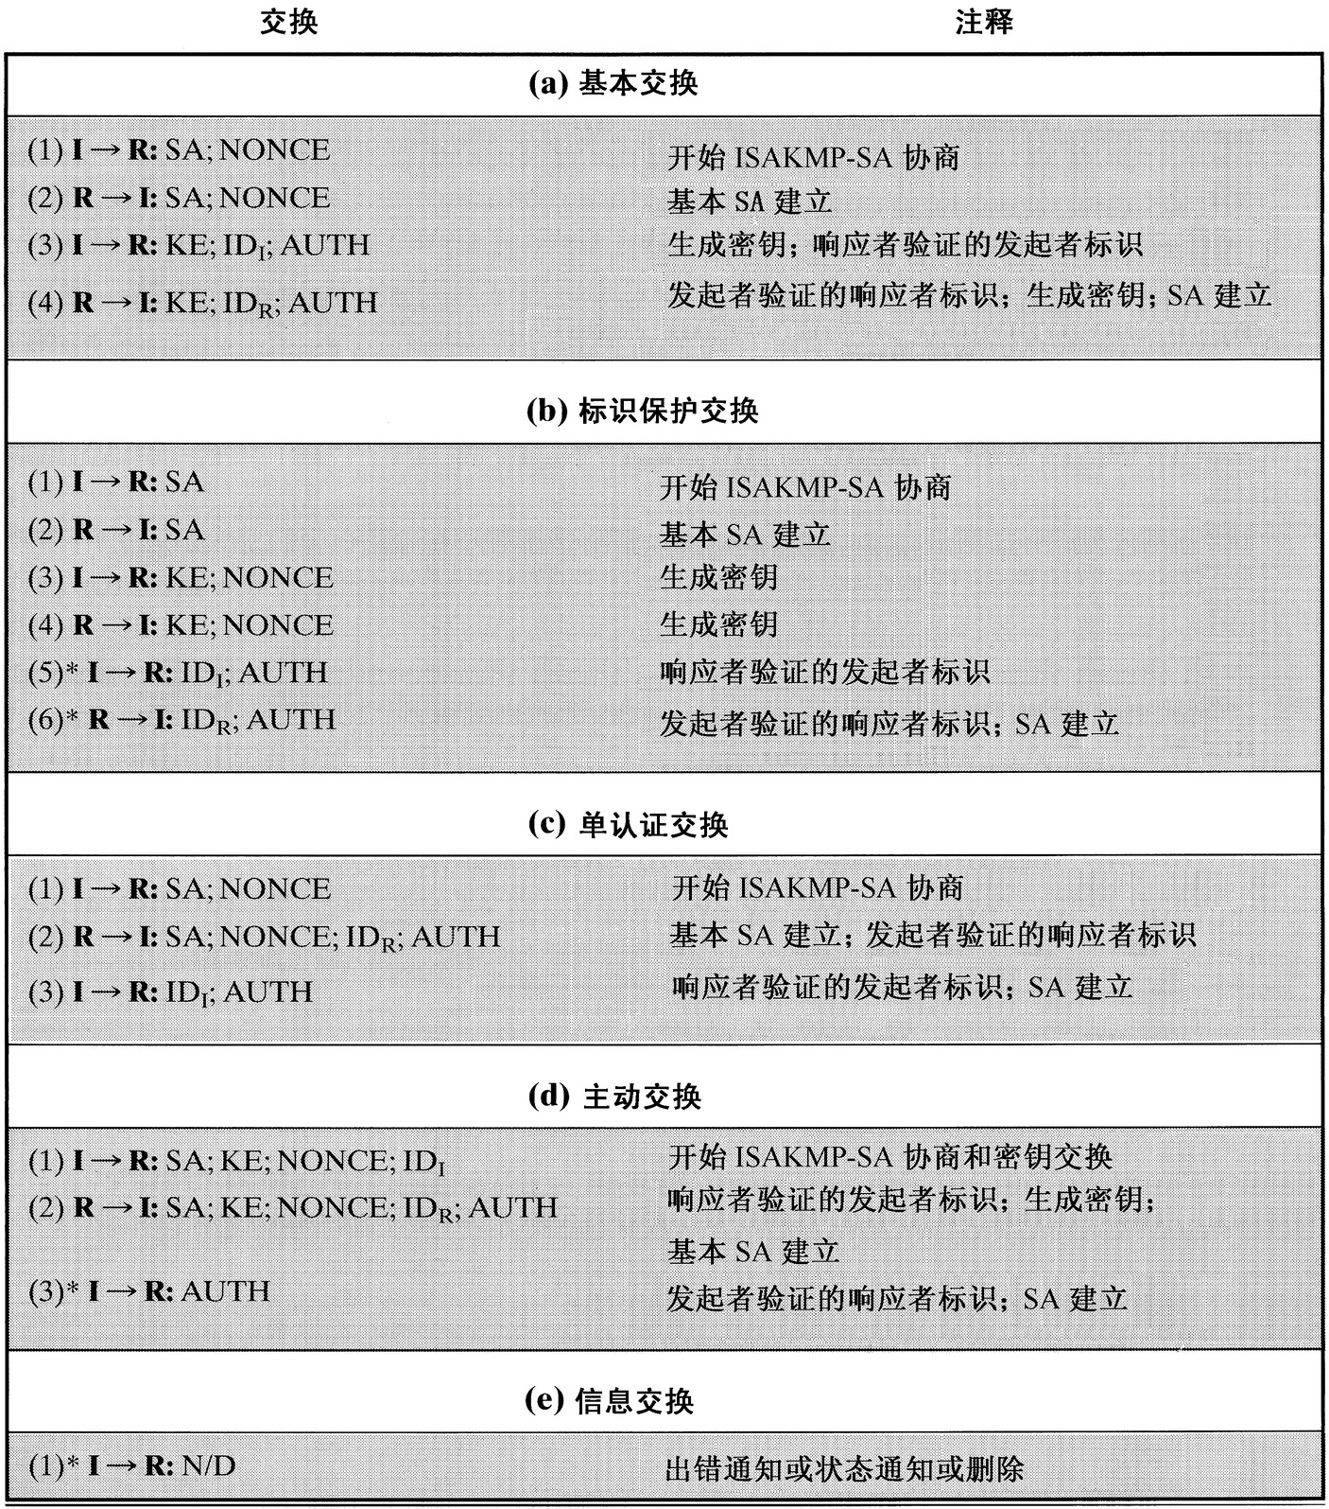
ISAKMP

Slide 56
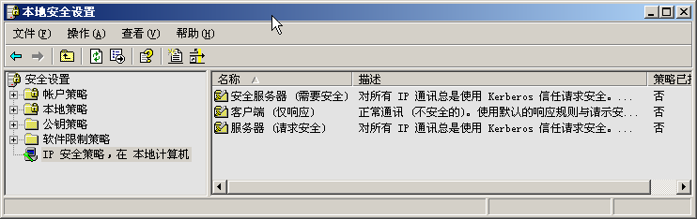
16.b VPN实验
IPSec in IPv4
IPSec6
  http://211.86.49.238/linfb/techrpt/
Notes:
详情见 http://211.86.49.238/linfb/techrpt/

Slide 57
VPN in PGP
PGP安全保护
  邮件
  文件/磁盘分区
  网络电话
  VPN
PGPnet - VPN in PGP 6.5.8
  NDIS驱动
  IPSec (?)

Slide 58
Free S/WAN (obsoleted)
Intr
  Linux FreeS/WAN is an implementation of IPSEC & IKE for Linux.
  http://www.freeswan.org/
工作方式
  以kernel patch的方式
  修改、扩充了lk的网络相关功能
两个后继者
  OpenSwan
  StrongSwan

Slide 59
16.c OpenVPN
SSL Based VPN
OpenVPN
  http://openvpn.sourceforge.net/
试用并写实验报告
Notes:
详细试验报告 http://211.86.49.238/linfb/techrpt/

Slide 60
案例1：使用OpenVPN架设远程网桥
真实背景
  受机房IP地址所限，某刀片服务器(xenserver)只分得一个正式IP地址，因此虚拟机只能用NAT方式使用内部地址，然后在xen上用iptable或socat建立tcp端口映射，以便虚拟机被访问到。
  同时，办公楼的局域网有大量正式IP地址空闲未用（默认dhcp，也允许手动自选IP）
目标
  把办公室局域网和虚拟机内网桥接起来，这样虚拟机和办公室机器的地位是一样的，可获得正式IP地址。

Slide 61
（非远程）桥接示意图
桥
LAN1
LAN2
桥可以是windows（从xp到server都行）或者是linux
Windows：选中两或多个网卡，右键菜单“桥接”
Linux：备注行
Notes:
aptitude install bridge-utils
btctl addbr br0
brctl addif br0 eth0
brctl addif br0 eth1
ifconfig br0 up
Ifconfig br0 a.b.c.d

Slide 62
远程桥接示意图
桥C
桥S
LAN0
LAN1
LAN2
桥C把LAN1和LAN0连起来
桥S把LAN0和LAN2连起来
用OpenVPN构造LAN0

Slide 63
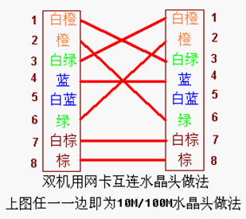
双机网线(不经交换机)直连
交叉网线
自动识别

Slide 64
远程桥接进一步示意图
桥C
桥S
LAN0
LAN1
LAN2
实际中，桥C是xen虚拟机，桥S是vmware虚拟机。

Slide 65
案例2：使用OpenVPN提速10倍
背景
  校园网IP网速被限制，用bt下载平均为50k左右。
  限速应该是针对校内每个IP的限速
  办公室局域网IP空闲的很多，利用率在10-50%
目标
  给单机网卡设置10个不同的IP，BT会不会更快些
  //我家的宽带够宽
  使用这个10个IP（和我家里的某机器）建立10个OpenVPN连接，把这个10个连接bonding起来。
  Bond后也要用到远程桥接

Slide 66
示意图：桥S有10个IP
桥C
桥S
…
LAN0
LAN1
LAN2

Slide 67
配置线索
10个openvpn的conf配置文件（客户/服务器两端对照）
10个openvpn建立网卡tun0到tun9
把这个10个网卡bonding到设备bond0
可以给bond0设置ip地址比如服务端10.1.1.1客户端10.1.1.2
在10.1.1.1和10.1.1.2之间建立一个新的openvpn连接tap10
把tap10和各自的局域网桥接，从而实现远程桥接
Notes:
# cat setup-bond
modprobe bonding
echo +bond0 > /sys/class/net/bonding_masters
ifconfig tun0 down
… # for (())
ifconfig tun9 down
echo +tun0 > /sys/class/net/bond0/bonding/slaves
…
echo +tun9 > /sys/class/net/bond0/bonding/slaves
echo 0 > /sys/class/net/bond0/bonding/mode
echo 100 > /sys/class/net/bond0/bonding/miimon
ifconfig bond0 10.1.1.1/24
ifconfig tun0 up
…
ifconfig tun9 up
#echo 1 > /proc/sys/net/ipv4/ip_forward
#route add -net 0/0 gw 10.1.1.2
#iptables -t nat -D POSTROUTING -s 192.168.88.0/24 -o bind0 -j MASQUERADE
#iptables -t nat -D POSTROUTING -s 192.168.88.0/24 -o bind0 -j MASQUERADE
#iptables -t nat -A POSTROUTING -s 192.168.88.0/24 -o bind0 -j MASQUERADE
#iptables -t nat -D POSTROUTING -o bind0 -j MASQUERADE
#iptables -t nat -A POSTROUTING -o bind0 -j MASQUERADE
#iptables --list -n -t nat
ping 10.1.1.2 -c 5
root@bond:~#

Slide 68


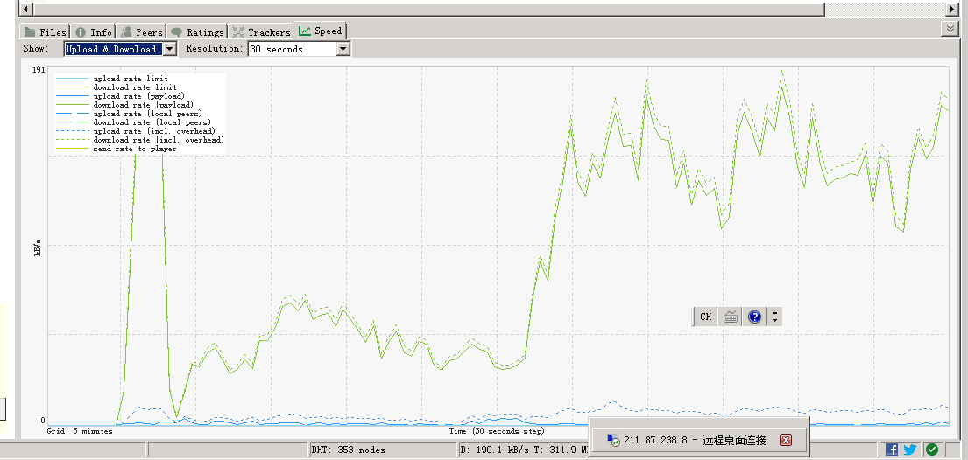
启用bond前后对比

Slide 69
设置为走教育网
route delete 0.0.0.0
route add 0.0.0.0 mask 0.0.0.0 211.87.235.1

Slide 70
设置为走bond和铁通
route delete 0.0.0.0
route add 0.0.0.0 mask 0.0.0.0 192.168.1.1
route add 0.0.0.0 mask 0.0.0.0 192.168.88.2
// 校内(教育网)别走bond
route delete 211.86.0.0
route add 211.87.0.0 mask 255.255.0.0 211.86.50.254
route delete 211.87.0.0
route add 211.86.0.0 mask 255.255.0.0 211.86.50.254
route delete 202.194.0.0
route add 202.194.0.0 mask 255.255.0.0 211.86.50.254
…

Slide 71
额外的瓶颈
从教育网到铁通网络(绕北京吗)
家里机器使用无线连接（穿墙后速度降低到700k以下）

Slide 72
另一个思路
还是校园网，每个IP限速50k
如果有很多空闲IP可以取用，那么给一个网卡设置10个IP是不是能提速10倍呢？
如果是使用单个TCP连接的应用，不行。
如果像迅雷或BT这种P2P下载，可以。
使用DLL注入写个外挂程序，当迅雷bind或connect或sendto的时候，强制当前socket的绑定地址均匀分布到10个这不同的IP上即可。
未验证。

Slide 73
Other VPN Implement and links
CIPE - Crypto IP Encapsulation
  http://sites.inka.de/sites/bigred/devel/cipe.html
VTun - Virtual Tunnels
  http://vtun.sourceforge.net/
  More http://sourceforge.net/search/
Virtual Private Network Consortium -- VPNC
  http://www.vpnc.org/
VPN Labs
  http://vpnlabs.org/
专题
  http://www.chinaitlab.com/www/special/vpn.asp
How it works
  http://computer.howstuffworks.com/vpn.htm

Slide 74
关键词 Key Terms
anti-replay service
authentication header (AH)
encapsulating security payload (ESP)
Internet Security Association and Key Management Protocol (ISAKMP)
IP Security (IPSec)
Oakley key determination protocol
IPv4 IPv6
replay attack security association (SA)
transport mode tunnel mode

Slide 75
小结
IPSec是IPv6的一部分。
IPSec因太过复杂而其安全性受质疑。
OpenVPN值得推荐。

Slide 76
Q & A

