Slide 1
AUTOMATED ATTENDANCE MANAGEMENT SYSTEM
A Four-Factor Biometric, Geofenced, BLE Proximity Verification and visual dynamic OTP
DEVELOPED FOR:
CORE SYSTEM CAPABILITIES:
Final Year Project.
• GPS Geofencing with Native Android Anti-Mock Protection
• BLE Scan Matching Room Beacons & Visual Time-Sensitive OTPs
• On-device ML Kit Facial Liveness + Server-side Deep Face Recognition

Slide 2
PROBLEM STATEMENT
The Attendance Dilemma in Higher Education
The Critical Cost of Manual Attendance
Proxy Attendance (Buddy Punching)
Absent students routinely ask classmates to mark them present on sign-in sheets or log responses using shared account links.
• Traditional manual roll calls take 10 to 15 minutes per lecture, wasting valuable instructional hours across semesters.
• Paper registers are fragile, prone to damage, and offer zero security controls against malicious modifications.
• Compiling reports manually creates immense administrative overhead, causing transcription errors and data delays.
• Physical tracking systems lack an audit trail, making it extremely difficult to verify records during inspections.
Location & Identity Fraud
Students utilize GPS spoofing apps or display a photograph of an absent peer to simple camera scanners to falsify their presence.
QR Code Exploitation
Static QR codes displayed on projectors are instantly photographed and shared via messaging groups, allowing remote sign-ins.
AUTOMATED ATTENDANCE MANAGEMENT SYSTEM | TECHNICAL SHOWCASE
1 / 31

Slide 3
EXISTING SYSTEM LIMITATIONS
Why Current Automated Systems Fail
Common Technical Flaws & Security Exploits
Static QR Scan Failures
GPS Spoofing Flaws
Static Biometric Flaws
• No Proximity Proof: QR images are sent to external student groups instantly.
• Absent students scan shared QR images from dorms or off-campus locations.
• Zero user validation occurs when the QR scanner acts independently of bios.
• Android mock location services allow apps to inject custom latitude/longitude.
• GPS drift inside concrete buildings causes false-positives and rejects.
• No verification of whether the student is actually inside the room or outside.
• Facial scanners without liveness check can be fooled using prints/screens.
• Device sharing: one student logs into multiple accounts on their phone.
• Heavy server latency when matching raw images without local filtering.
AUTOMATED ATTENDANCE MANAGEMENT SYSTEM | TECHNICAL SHOWCASE
2 / 31

Slide 4
PROPOSED SOLUTION
The Four-Factor Verification Shield
01
02
03
04
GPS GEOFENCING
BLE ROOM PROXIMITY
VISUAL DYNAMIC OTP
LIVENESS & BIOMETRICS
Checks device coordinates against campus boundaries using Android location services, checking and blocking mock providers natively.
Scans BLE advertisements from the classroom beacon. Proves physical presence inside the lecture hall via signal attenuation.
A time-sensitive 5-digit hex code generated by the admin. Displayed to students in-class and expires within 10 minutes.
Google ML Kit prompts randomized head turns to verify liveness. Server performs deep 128D facial vector matching.
AUTOMATED ATTENDANCE MANAGEMENT SYSTEM | TECHNICAL SHOWCASE
3 / 31

Slide 5
PROJECT OVERVIEW
Project Overview & Ecosystem Mapping
Ecosystem Integration & Workflow Loop
• Dynamic Classrooms: Faculty initializes secure, temporary attendance sessions that broadcast dynamic identifiers and visual OTPs.
• Sensor Fusion Client: Students utilize a custom Kotlin Android app integrating camera, GPS sensors, and Bluetooth hardware to scan environments.
• Asynchronous Processing: The FastAPI backend acts as a gateway, validating physical proximity, verifying identity vectors, and persisting logs.
• Anti-Proxy Validation: Verification is failed if any single credential check, location validation, or facial liveness scan is bypassed.
• Integrated Reporting: Automatic CSV logs are generated inside classes, tracking cumulative statistics, absences, and registration vectors.
Ecosystem Workflow loop
1. Faculty Starts Session
2. Student Scans Environment
3. ML Face & Liveness Engine
4. Save DB & Append CSV
AUTOMATED ATTENDANCE MANAGEMENT SYSTEM | TECHNICAL SHOWCASE
4 / 31

Slide 6
TECHNOLOGY STACK
Built with Modern SaaS Technologies
STUDENT MOBILE CLIENT
API GATEWAY & BACKEND
STORAGE & ML MATCHING
• Kotlin: Primary language for Android Native App Development.
• CameraX Jetpack API: Robust and unified camera preview and image capture framework.
• Google ML Kit: Runs on-device face detection and head Euler angles extraction.
• BLE Scanning Engine: Bluetooth Low Energy scanner for beacon filtering.
• Retrofit & OkHttp: Secure network request management with dynamic headers.
• FastAPI: Python framework for high-throughput, async request routing.
• Uvicorn: Lightning-fast ASGI web server implementation.
• JWT Authentication: Cryptographically signed security tokens for users.
• Passlib & BCrypt: Password hashing and security context storage.
• CSV Logger: File-append log engine representing physical sheets.
• MongoDB NoSQL: JSON document database storing student and session records.
• dlib / Face Recognition: Computes 128D biometric face vectors on the server.
• OpenCV Python: Resizes and normalizes images for dlib performance.
• NumPy Library: Calculates fast vectorized Euclidean distance for matches.
• PyMongo: Low-latency driver connecting Python directly to database.
AUTOMATED ATTENDANCE MANAGEMENT SYSTEM | TECHNICAL SHOWCASE
5 / 31

Slide 7
TECHNICAL ARCHITECTURE
End-to-End System Architecture
Student Device
FastAPI Gateway
Deep Learning Engine
Storage Layer
Android App (Kotlin UI)
ASGI Web Server (Uvicorn)
OpenCV Python (Image Normalizer)
MongoDB Atlas DB
ML Kit (Liveness Step)
APIRouter (Route handling)
dlib Engine (HOG Face Detector)
Static File Store (JPG)
Location & BLE (GPS / BLE Scan)
Auth Middleware (JWT active_token)
Face Encoder (128D vector extraction)
Retrofit Client (Network requests)
Controllers (Business logic)
CSV Log Exporters
NumPy Evaluator (Euclidean matching)
AUTOMATED ATTENDANCE MANAGEMENT SYSTEM | TECHNICAL SHOWCASE
6 / 31

Slide 8
SYSTEM COMPONENTS
Modular Application Design
01
ADMIN PORTAL & SYSTEM SETUP
02
STUDENT DEVICE UTILITIES
• Class Creation: Define subject names, branches, and schedules.
• Student Registration: Add roll numbers and names to class lists.
• Session Controller: Activate BLE codes and dynamic visual OTPs.
• Report Engine: View present/absent statistics and export CSVs.
• Ecosystem Select: Log in as a student or connect as admin.
• GPS Verification: Pulls active GPS coordinates from Android.
• BLE Proximity Scan: Searches nearby BLE beacons for classroom validation.
• Visual OTP Verification: Input visual validation codes directly.
03
COMPUTER VISION BIOMETRIC
04
AUTHENTICATION & MIDDLEWARE
• ML Kit Analyzer: Local face search, checking yaw and pitch.
• Head-Turn Tracker: Evaluates random directions for anti-spoof.
• Face Cropper: Local scaling & cropping to minimize upload sizes.
• dlib Matcher: Server matches 128D face encodings within 0.5 limit.
• JWT Management: Secure token generation mapping to admin/student.
• Single-Device Lock: Server compares requests with DB active_token.
• Password Encryption: Bcrypt hashing applied during registration.
• CORS & Security Settings: Restricts API routing to trusted clients.
AUTOMATED ATTENDANCE MANAGEMENT SYSTEM | TECHNICAL SHOWCASE
7 / 31

Slide 9
DATA MODELING
MongoDB Collection Schemas & Relations
ADMINS
REGISTERED_STUDENTS
STUDENTS
Primary Admin Details
Onboarded Accounts
Authorized Rolls
• _id: ObjectId
• name: String
• email: String (Unique)
• password: Hash (Bcrypt)
• _id: ObjectId
• name / roll / email
• password: Hash
• face_encoding: Array[128]
• class_id: String
• active_token: JWT
• _id: ObjectId
• name / roll
• class_id: String
• class_name: String
• attendance_status: Str
CLASSES
ATTENDANCE
ATTENDANCE_SESSIONS
Class & Schedules
Attendance Logs
Active Live Sessions
• _id: ObjectId
• class_name / section
• department / semester
• created_by: AdminId
• students: Array[Objects]
• expires_at: DateTime
• _id: ObjectId
• student_id: ObjectId
• name / roll
• class_name: String
• date: String (YYYY-MM-DD)
• status: Str ('Present')
• _id: ObjectId
• class_id: String
• session_code / session_uuid
• bluetooth_name: String
• classroom_beacon: String
• otp_code: String
• active: Boolean
AUTOMATED ATTENDANCE MANAGEMENT SYSTEM | TECHNICAL SHOWCASE
8 / 31

Slide 10
ACCESS CONTROL
Secure Authentication & Single Device Locking
Student Onboarding (Face Enrollment)
Login & Session Device Locking (active_token)
• Pre-Authorization Check: Registration fails if the student's name and roll number are not pre-authorized by an admin in students collection.
• Initial Registration: Users input email, roll number, password, and upload a registration photo.
• Duplicate Face Check: Server extracts a 128D face vector. Scans database registered_students collection for any matching vector (Euclidean distance < 0.5). Blocks duplicate registrations.
• Bcrypt & JWT Setup: Password is hashed using bcrypt. Profile is stored in registered_students collection containing the facial vector.
• Credential Check: User logs in with email and password via bcrypt comparison.
• Unique JWT Generation: FastAPI creates a unique JWT token embedding user ID and role ('student').
• Session Locking (Database Update): The database updates registered_students with the new JWT as the current 'active_token'.
• Authorization Guard (Middleware): Every request carries the token. The auth dependency compares the request token against active_token in the DB.
• Proxy Defense: If a student shares credentials, a login on a second device updates the active_token. The first device is immediately logged out.
AUTOMATED ATTENDANCE MANAGEMENT SYSTEM | TECHNICAL SHOWCASE
9 / 31

Slide 11
PROCESS DESIGN
Faculty Admin Session Creation
Steps for starting an attendance session
Step 1
Step 2
Step 3
Step 4
Step 5
Step 6
LOGIN
CREATE CLASS
START SESSION
GENERATE META
BROADCAST/SHOW
AUTO-EXPIRE
Logs into Admin dashboard via secure bcrypt auth.
Defines name, section, year, and semester.
Clicks 'Start' for a specific class to trigger session creation.
Server creates dynamic UUID, BLE identifier & 5-digit hex OTP.
Beacon starts advertising BLE name. Visual OTP is shown on screen.
The active session expires automatically in 10 minutes.
AUTOMATED ATTENDANCE MANAGEMENT SYSTEM | TECHNICAL SHOWCASE
10 / 31

Slide 12
USER EXPERIENCE
Student Attendance Marking Journey
Steps to log verification variables and verify attendance
Step 1
Step 2
Step 3
Step 4
Step 5
Step 6
JOIN CLASS
GPS LOCK
ENTER OTP
BLE VERIFY
LIVENESS SCAN
MARK PRESENT
Student opens Android app, selects class, and taps Mark Attendance.
App pulls location. Coordinates must be within 200m of campus.
Manually enters the 5-digit hex OTP shown by the professor.
App scans BLE advertisements. Finds matching room beacon.
Front camera opens. Prompts head turns to verify liveness.
Server processes face match, registers present status, logs in CSV.
AUTOMATED ATTENDANCE MANAGEMENT SYSTEM | TECHNICAL SHOWCASE
11 / 31

Slide 13
COMMUNICATION ENGINEERING
Proximity Proof via BLE Beacons
Bluetooth Low Energy (BLE) Verification Core
• Scan Window: Upon starting verification, the student app activates background BLE scanning for exactly 4 seconds.
• Name Filter: The app filters all nearby advertisements, checking for names matching the classroom beacon string (e.g. 'CLASS_CSE_A').
• Signal Strength (RSSI) Check: Device RSSI values are collected. High attenuation indicates long distance from the beacon.
• Proximity Proof: If the expected classroom beacon is detected in the scan map, it confirms the user is inside the physical room.
• Fail Handling: If the beacon is missing or RSSI drops below the room threshold, the scan fails. Blocks logins from adjacent corridors or hallways.
BLE Verification Proximity Proof Flow
Teacher Phone / Beacon CLASS_CSE_A Adv
Student BLE Scanner 4-Second Scan Map
Name Filter & RSSI Distance Match
Accept: Inside Room Reject: Mismatch Error
AUTOMATED ATTENDANCE MANAGEMENT SYSTEM | TECHNICAL SHOWCASE
12 / 31

Slide 14
COMPUTER VISION & ML
Biometric Face Recognition Flow
Server-Side Facial Embedding Extraction & Distance Scoring
Biometric Face Comparison Flow
• Image Upload: The client sends a cropped front face JPEG via a multipart form to the '/api/attendance/mark' route.
• Downscaling Preprocessing: The server resizes the image by 0.5x using OpenCV to speed up localization pipelines.
• HOG Face Locator: OpenCV and dlib utilize the Histogram of Oriented Gradients (HOG) algorithm to locate the face bounding box.
• 128-Dimensional Vector: Dlib's deep learning face recognition model computes a 128D floating-point vector mapping unique facial nodes.
• Euclidean Distance Check: Calculates np.linalg.norm(stored_vector - upload_vector). Values < 0.5 indicate a match.
Uploaded image (Multipart JPEG)
Face Bounding Box (OpenCV / HOG)
128D Face Embedding (dlib extraction)
Euclidean Evaluator np.linalg.norm()
Distance < 0.5 Check
AUTOMATED ATTENDANCE MANAGEMENT SYSTEM | TECHNICAL SHOWCASE
13 / 31

Slide 15
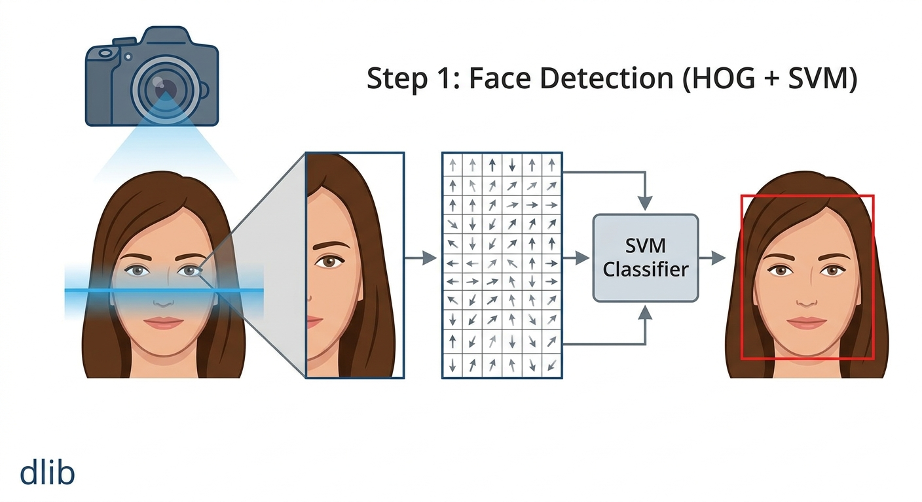
COMPUTER VISION & ML
Face Recognition
Image Capture
The camera captures the student's face.
HOG Feature Extraction
Histogram of Oriented Gradients (HOG) analyzes edge directions and facial structures.
Converts the image into numerical gradient features.
SVM Classification
A Support Vector Machine (SVM) classifier examines the extracted features.
Determines whether a region contains a face or not.
Face Localization
A bounding box is drawn around the detected face.
The detected region is passed to the next stage for landmark detection.
AUTOMATED ATTENDANCE MANAGEMENT SYSTEM | TECHNICAL SHOWCASE
14 / 31

Slide 16
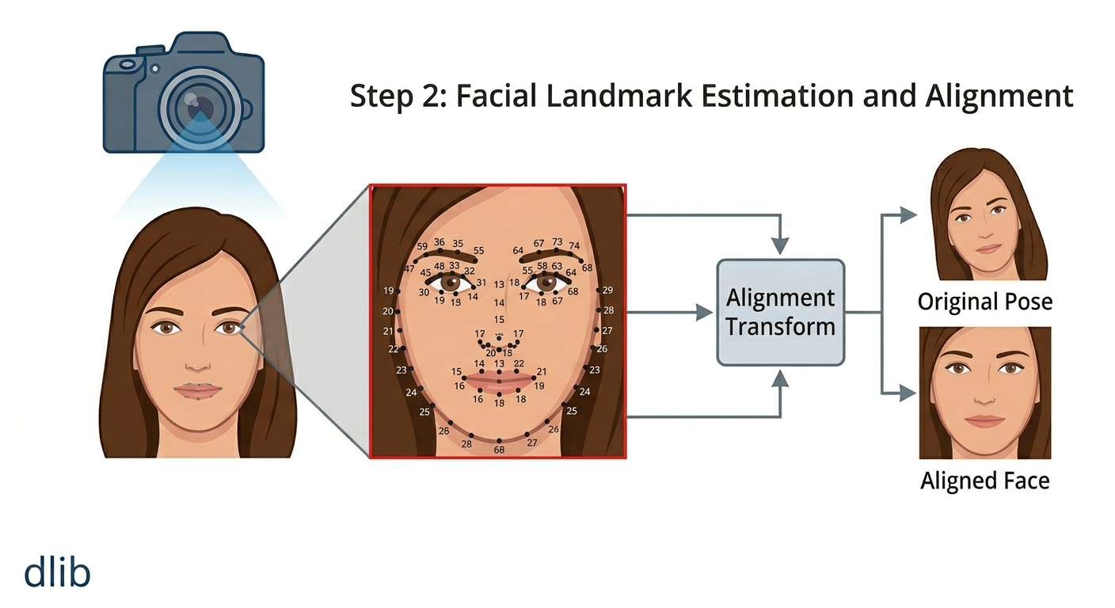
COMPUTER VISION & ML
Face Recognition
Facial Landmark Detection
2. Landmark Estimation
Each landmark is assigned precise coordinates on the face.
The model predicts the geometric structure of the face.
These landmarks help understand facial orientation and pose.
After detecting a face, dlib identifies 68 facial landmark points.
These points represent key facial regions:
Eyes
Eyebrows
Nose
Mouth
Jawline
Jawline : 17 Points
PointsEyebrows : 10 Points
PointsEyes : 12 Points
PointsNose : 9 Points
PointsMouth : 20 Points
AUTOMATED ATTENDANCE MANAGEMENT SYSTEM | TECHNICAL SHOWCASE
15 / 31

Slide 17
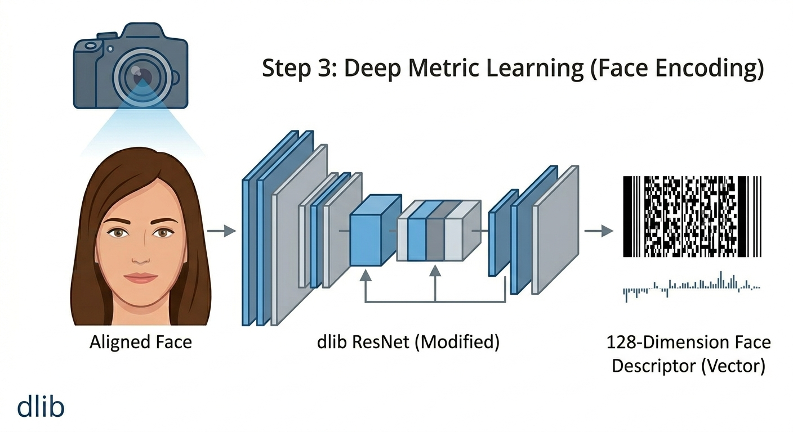
COMPUTER VISION & ML
Face Recognition
Aligned Face Input
Uses the aligned face from the previous stage.
Ensures consistent facial positioning.
2. Deep Neural Network
dlib's modified ResNet extracts facial features.
Learns unique characteristics of each face.
4. Face Encoding
Converts the face into a 128-D vector.
Acts as a mathematical face signature.
Output
Aligned Face
↓
ResNet Model
↓
128D Encoding
AUTOMATED ATTENDANCE MANAGEMENT SYSTEM | TECHNICAL SHOWCASE
16 / 31

Slide 18
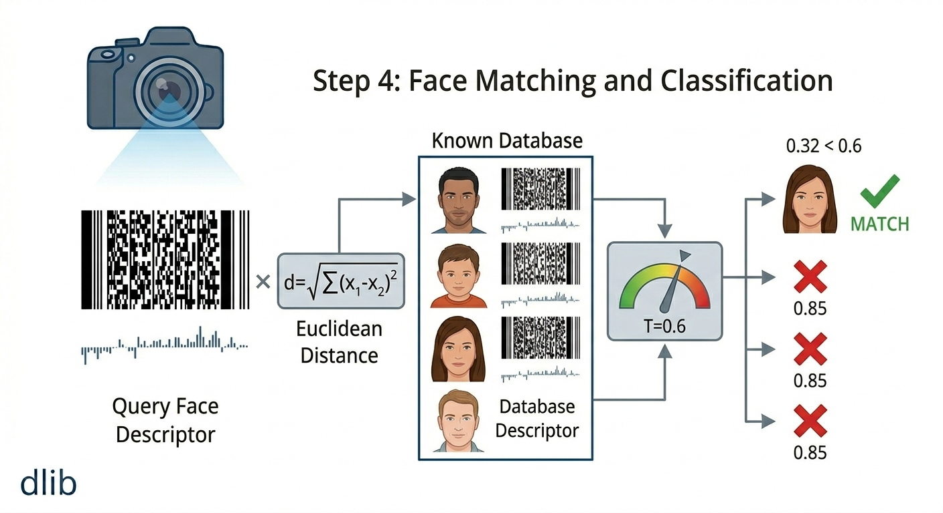
COMPUTER VISION & ML
Face Recognition
Face Encoding Input
Uses the generated 128D face encoding.
Acts as a unique facial signature.
2. Database Comparison
Compares the query encoding with stored encodings.
Calculates similarity using Euclidean Distance.
Matching Process
Lower distance indicates higher similarity.
The closest matching face is selected.
4. Classification
A bounding box is drawn around the detected face.
The detected region is passed to the next stage for landmark detection.
AUTOMATED ATTENDANCE MANAGEMENT SYSTEM | TECHNICAL SHOWCASE
17 / 31

Slide 19
ECOSYSTEM SECURITY
Multi-Factor Verification Funnel
Why the funnel structure is used
Verification Funnel Steps
• Efficient Cascade: Sensor validations are run hierarchically to filter out non-compliant requests before running heavy computer vision models.
• Resource Preservation: Server-side deep face recognition is only executed if the client has already passed GPS, BLE, OTP, and liveness steps.
• Cryptographic Integrity: All factors must compile correctly. Failure at any single point terminates the transaction, preventing false logs.
• Real-time Updates: When a student passes the funnel, their database state is changed to 'Present' and written to the class CSV.
GPS Geofencing Check (<200 meters of college coords)
Active Session Check & Classroom Beacon Match
Visual dynamic OTP validation (10 min expiry)
Android client head-turn Liveness Check
Server Face vector matching (<0.5)
Attendance Marked
AUTOMATED ATTENDANCE MANAGEMENT SYSTEM | TECHNICAL SHOWCASE
18 / 31

Slide 20
SYSTEM SECURITY
Multi-Layered Security Architecture
DATA SECURITY
CLIENT SENSOR INTEGRITY
BIOMETRIC PROTECTION
• Bcrypt Password Hash: User passwords are encrypted with dynamic salt cycles.
• JWT Tokens: Client requests contain cryptographically signed tokens.
• CORS Protocols: Backend restricts API cross-origin routing.
• Secure Storage: Face encodings are stored as numerical arrays, preventing image theft.
• Anti-Mocking: Native Android code flags location.isFromMockProvider.
• BLE Proximity: Validates presence using signal power limits (RSSI).
• Visual OTP: Uses in-class displays to block remote code submissions.
• No Local Cache: Verification photos are deleted from memory after upload.
• Face Duplicate Filter: Blocks multiple profiles registering with same face.
• Euler Yaw Checks: Enforces randomized left/right head movements.
• dlib Distance Threshold: Evaluates vector margins at a strict 0.5 limit.
• Aspect Ratio Normalizer: Dynamic crop window limits spoofing borders.
AUTOMATED ATTENDANCE MANAGEMENT SYSTEM | TECHNICAL SHOWCASE
19 / 31

Slide 21
ANTI-FRAUD MECHANISMS
Ecosystem Defenses Against Proxy Attendance
Defeating Attendance Manipulation Hacks
Ecosystem Defeat Matrix
• GPS Mocking Bypass: Defeated! Using Android location API, requests containing mock coordinates are flagged and rejected immediately.
• QR Code Sharing: Defeated! QR scans are replaced by classroom BLE scans and visual OTPs, preventing remote links.
• Photo Spoofing: Defeated! On-device face detection requires active yaw turns (turning left/right) to prove liveness.
• Account Credentials Sharing: Defeated! During user login, the database records the unique active JWT token. Logins on new devices overwrite this token, invalidating old sessions.
Attack Vector
Proposed Mitigation
Status
GPS spoof / mock locations
Native Android flag check
DEFEATED
Sharing QR screen scans
BLE room scan + visual OTP
DEFEATED
Printed peer photos
Interactive liveness turns
DEFEATED
Sharing credentials
Single active JWT session lock
DEFEATED
Multiple accounts
Registration duplicate face block
DEFEATED
AUTOMATED ATTENDANCE MANAGEMENT SYSTEM | TECHNICAL SHOWCASE
20 / 31

Slide 22
DATA ETHICS & COMPLIANCE
Privacy, Consent, and Data Protection
CONSENT & COLLECTION
DATA ENCRYPTION
RETENTION & CONTROL
• Explicit Opt-In: Students must explicitly opt-in to face verification during account onboarding.
• Zero Image Persistence: Raw verification photos are processed in memory and immediately discarded.
• Alternative Verification: Manual override or OTP verification option is provided for users opting out.
• Numerical Vectors: Stores only 128D mathematical vectors; raw images are never kept on the server.
• Encrypted Identifiers: Relational database links vectors to hashed profiles, securing student identities.
• Secure Transmissions: All client-server request payloads are encrypted via HTTPS protocols.
• Retention Policy: Daily attendance logs are archived and purged from active DBs semester-wise.
• Self-Service Purge: Students can delete their biometric profiles, instantly removing vectors from NoSQL DB.
• Access Auditing: Administrative report access is logged to prevent internal data exposure.
AUTOMATED ATTENDANCE MANAGEMENT SYSTEM | TECHNICAL SHOWCASE
21 / 31

Slide 23
BACKEND INTERFACES
FastAPI REST API Architecture
AUTHENTICATION ROUTER (/api/auth)
ATTENDANCE CONTROLLER (/api/attendance)
• POST /login: Authenticates student; returns JWT; updates active_token.
• POST /register: Saves account details, verifies rolls, saves face vector.
• JWT Verification Middleware: Intercepts requests to validate tokens.
• POST /mark: Multi-factor verification gateway (GPS, BLE, OTP, face upload).
• POST /unmark: Allows admins to reset attendance status to Absent.
• GET /status: Returns daily presence status (Present/Absent).
• GET /history: Returns student's last 7 attendance logs.
SESSION MANAGEMENT (/api/session)
CLASS & STUDENT GROUP (/api/class)
• POST /start/{class_id}: Generates dynamic session identifiers and OTP codes.
• POST /stop/{class_id}: Deactivates attendance window, disabling code inputs.
• GET /active/{class_id}: Client pulls expected beacon and OTP code variables.
• POST /create: Initializes class templates mapping to departments.
• POST /add-students: Uploads roll lists; builds student collections.
• GET /all: Returns active classes mapped to the calling Admin's ID.
• GET /students/{class_id}: Returns detailed classroom lists and attendance stats.
AUTOMATED ATTENDANCE MANAGEMENT SYSTEM | TECHNICAL SHOWCASE
22 / 31

Slide 24
SYSTEM OPTIMIZATION
High-Performance System Optimizations
01
VECTORIZED FACE MATCH
02
IMAGE DOWNSCALING & PREPROCESSING
Face recognition utilizes NumPy-based Euclidean distance comparisons. Vector matching is run in under 15ms, minimizing CPU bottlenecks.
Android crops photos to face oval boundaries before uploading. Server downscales images by 0.5x using OpenCV to speed up face localization.
03
DATABASE INDEXES
04
ASYNCHRONOUS EXPORT
Indexes are created on roll and email collections in MongoDB, ensuring query times remain under 5ms even during concurrent student access.
FastAPI writes student records to class CSV spreadsheets in the background, preventing writing operations from blocking API responses.
AUTOMATED ATTENDANCE MANAGEMENT SYSTEM | TECHNICAL SHOWCASE
23 / 31

Slide 25
SYSTEM IMPLEMENTATION
Infrastructure & System Pre-requisites
Server & Backend Infrastructure
Client Devices & In-Class Hardware
• OS Environment: Ubuntu Server 22.04 LTS recommended, or any Docker-compatible virtual private server (VPS).
• Python ASGI Backend: Python 3.10+ installation with Uvicorn ASGI server for high-concurrency request routing.
• Database Deployment: MongoDB Community Edition for self-hosted setups, or MongoDB Atlas for managed cloud storage.
• Biometric Library Compilation: Pre-installed build tools (CMake, gcc/g++) required to compile C++ dlib dependencies.
• Android Client OS: Android 8.0 Oreo (API Level 26) or higher required to support CameraX API and BLE features.
• Hardware Permissions: User must grant Camera, Fine Location, and Bluetooth Scanning permissions during runtime.
• Classroom BLE Beacons: Bluetooth Low Energy beacons (iBeacon format) deployed and calibrated in each classroom.
• In-Class Displays: Projection screens or monitor setups to show the dynamic visual OTP code during verification windows.
AUTOMATED ATTENDANCE MANAGEMENT SYSTEM | TECHNICAL SHOWCASE
24 / 31

Slide 26
FINANCIAL FEASIBILITY
Cost Structure & Financial Feasibility
Estimated Operational Cost Breakdown
Economic Value & ROI Analysis
• Zero License Fees: Built entirely on open-source dependencies (FastAPI, OpenCV, ML Kit), eliminating recurring user licensing costs.
• Hardware Cost Savings: Eliminates the need for dedicated biometric hardware terminals by leveraging students' existing mobile devices.
• Administrative Efficiency: Pays for itself rapidly by recovering over 15 hours of manual roll-call time per course per semester.
• Scale Flexibility: Free tier database and low-cost server tiers allow initial pilot testing without any upfront software capital expense.
Component
Specification
Estimated Cost
Cloud Server VM
2 vCPU, 4GB RAM VPS
$15 - $40 / mo
NoSQL Database
MongoDB Atlas (M10 tier)
$0 - $30 / mo
Physical BLE Beacons
1 Unit per Classroom
$15 / room (one-time)
Domain & Security
Custom Domain + SSL
$10 / year
User App Deployment
Google Play Console fee
$25 (one-time)
AUTOMATED ATTENDANCE MANAGEMENT SYSTEM | TECHNICAL SHOWCASE
25 / 31

Slide 27
ENGINEERING JOURNEY
Technical Challenges & Engineering Solutions
01
Android BLE Scan Latency & Mismatch
02
Camera Aspect-Ratio Image Warping
Challenge: Android BLE scanner takes time to locate and return advertising beacons, causing timeouts. Resolution: Switched scan settings to Low Latency Mode and created a 4-second scan accumulation map to filter room beacons.
Challenge: Raw output from front cameras is stretched or distorted when loading face models, affecting accuracy. Resolution: Programmed custom cropping logic mapping coordinates directly to CameraX viewfinders.
03
GPS Drift in Concrete Buildings
04
Concurrency & Write-blocking
Challenge: Thick concrete classroom walls block GPS signals, causing drift and false failures. Resolution: Set GPS checks to a wider 200m range and combined location coordinates with local room BLE scans.
Challenge: Heavy database read/write requests slow down responses during large classroom attendance sessions. Resolution: Setup indexed fields on student rolls and set FastAPI to write class CSVs asynchronously.
AUTOMATED ATTENDANCE MANAGEMENT SYSTEM | TECHNICAL SHOWCASE
26 / 31

Slide 28
SYSTEM PERFORMANCE
Measurable Benefits & Operational Impact
System Advantages & Value Delivery
• Security Hardening: Eliminates buddy punching, QR sharing, and GPS spoofing completely.
• Administrative Time Savings: Reduces roll call times from 10 minutes to under 5 seconds per student.
• Paperless Tracking: Saves administrative hours by automating classroom statistics and monthly reports.
• Self-contained: Fully open-source dependencies run without expensive third-party APIs.
• Real-time visibility: Dashboard updates instantly when students pass verification.
PROXY ELIMINATION
Significantly reduces common proxy attendance attempts..
< 5s
VERIFICATION SPEED
Fast and smooth student login verification.
0
MANUAL CALCULATION
Automatic real-time Excel/CSV exports.
AUTOMATED ATTENDANCE MANAGEMENT SYSTEM | TECHNICAL SHOWCASE
27/ 31

Slide 29
FUTURE ROADMAP
Next-Gen Attendance Advancements
EDGE FACE RECOGNITION
MULTI-SPECTRAL LIVENESS
AI PREDICTIVE ANALYTICS
• Run facial similarity checks locally using TensorFlow Lite on device.
• Saves bandwidth: Uploads only verification hashes instead of full photos.
• Zero server CV overhead: Scales easily to thousands of concurrent users.
• Incorporate IR/depth sensors on phones supporting advanced biometric API.
• Defeats high-res 3D masks and deepfake screens.
• Continuous verification: Track attendance status throughout the lecture.
• Analyze student attendance trends using machine learning models.
• Predicts semester dropouts and alerts advisors automatically.
• Optimizes classroom schedules by identifying peaks in student absence.
AUTOMATED ATTENDANCE MANAGEMENT SYSTEM | TECHNICAL SHOWCASE
28 / 31

Slide 30
PROJECT BOUNDARIES
Current System Limitations & Constraints
BIOMETRIC & ENVIRONMENT
HARDWARE & NETWORKS
OPERATIONAL SYSTEM
• Lighting Dependency: Extreme low-light conditions in lecture halls can degrade facial recognition accuracy.
• Occlusion Sensitivity: Users must remove heavy facial coverings, sunglasses, or medical masks for biometric scanning.
• Device Alignment: Low-resolution front cameras may experience higher vector distance mismatch margins.
• GPS Signal Blockage: Dense concrete classroom walls can block GPS signals, making BLE scans the critical fallback.
• Beacon Range Calibration: Requiring precise transmission power calibration to prevent corridor/adjacent room bleeding.
• Platform Lock-in: Native client software is currently restricted to Android devices, lacking iOS support.
• Onboarding Overhead: Requires a one-time onboarding enrollment step for face vector database initialization.
• Proxy Token Sharing: While JWT session locks block multi-device logins, they do not prevent students from sharing OTPs offsite if BLE is bypassed.
• Server Latency: Simultaneous uploads of image binaries at the end of a session can cause brief queue bottlenecks.
AUTOMATED ATTENDANCE MANAGEMENT SYSTEM | TECHNICAL SHOWCASE
29 / 31

Slide 31
UX DESIGN SHOWCASE
Client Mobile Interface Walkthrough
Key User Interface Screens & Interactive Elements
01
02
03
04
SPLASH & ROLE SELECT
LOGIN & REGISTER
STUDENT DASHBOARD
CODE INPUT DIALOG
Interactive role select with custom canvas mesh backgrounds.
Includes email validation, passwords, and face enrollment.
Shows weekly graphs, active sessions, and attendance statuses.
A Material Design popup checking dynamic visual OTP codes.
05
06
07
08
BLE SCANNER VIEW
LIVENESS OVERLAY
SUCCESS SCREEN
REPORTS & EXPORT
Real-time background scanner filtering room beacons.
Draws face framing ovals and arrow directions for head turns.
Lottie animation playing on verified attendance marks.
Class list overview displaying real-time CSV statistics.
AUTOMATED ATTENDANCE MANAGEMENT SYSTEM | TECHNICAL SHOWCASE
30 / 31

Slide 32
SUMMARY
Securing Modern Classrooms
Project Conclusion & Accomplishments
• Successfully designed, implemented, and verified a secure, multi-factor automated attendance management system.
• Integrated mobile sensors, local ML analytics, and server-side biometrics to create a robust security shield.
• Eliminated attendance vulnerabilities (GPS mocking, QR sharing, buddy punching, static photos).
• Greatly reduced administrative load for teachers by automating statistics and spreadsheet logs.
• Ecosystem ready for deployment across academic and enterprise training environments.
KEY DELIVERABLE METRICS
• Secure: Low Euclidean matching limits.
• Fast: Complete verification takes under 5s.
• Automated: Logs compiled in real-time CSV formats.
• No Spoofing: Robust head-turning liveness detection.
• On-device Processing: Client-side facial analysis.
AUTOMATED ATTENDANCE MANAGEMENT SYSTEM | TECHNICAL SHOWCASE
31 / 31

Slide 33
THANK YOU!
Questions & Feedback
AUTOMATED ATTENDANCE MANAGEMENT SYSTEM
• Ecosystem Source: github.com/Slothyi/Automated-attendance-management-system
• Technical Architecture: Python FastAPI Gateway | Kotlin Android App
• Biometrics Engine: Google ML Kit Face Analysis & dlib 128D Matching

