Slide 1
CEN 352 – ARTIFICIAL INTELLIGENCE PROJECT GROUP MEMBERS: ATEA CASLLI DANIELA SHAHINI ENIA ÇERRI IRVI RRIKA ROSELA BERBERI THANAS PAPA

Slide 2
STUDENT PERFORMANCE THE "STUDENT PERFORMANCE" DATASET FROM THE UCI MACHINE LEARNING REPOSITORY INCLUDES DATA RELATED TO STUDENTS' DEMOGRAPHIC, SOCIAL, AND ACADEMIC INFORMATION. THESE DATA ARE GATHERED FROM TWO PORTUGUESE HIGH SCHOOLS AND FOCUS ON STUDENT PERFORMANCE IN PORTUGUESE LANGUAGE COURSE.
FEATURES: 30 INSTANCES: 649 MISSING VALUES: NO SUBJECT AREA: SOCIAL SCIENCE MAIN TASK: PREDICT STUDENT PERFORMANCE ON HIGH SCHOOL

Slide 3
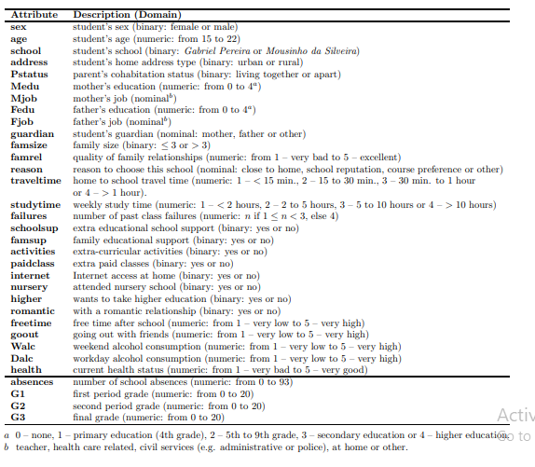
FEATURE DESCRIPTION

Slide 4
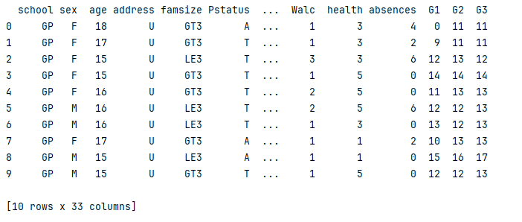
DATASET VIEW

Slide 5
The dataset will be modeled under three goals: i) binary classification (pass/fail); ii) classification with five levels (from I very good or excellent to V - insufficient); and iii) regression,
Since we suspected that the G1 and G2 grades would have a high impact, three input configurations were tested for each model: • A - with all variables from Table 1 except G3 (the output); • B - similar to A but without G2 (the second period grade); • C - similar to B but without G1 (the first period grade).

Slide 6
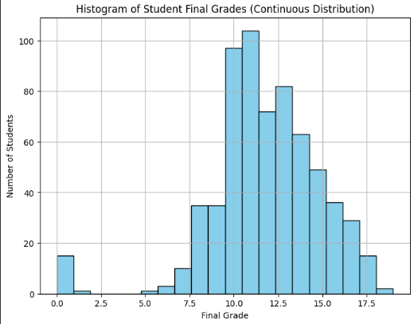
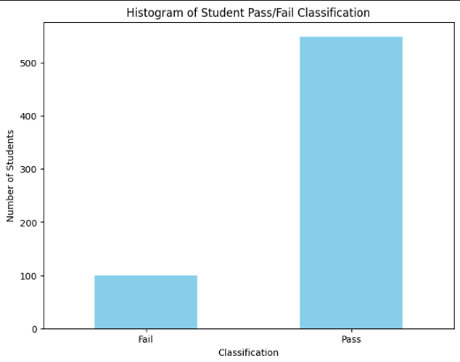
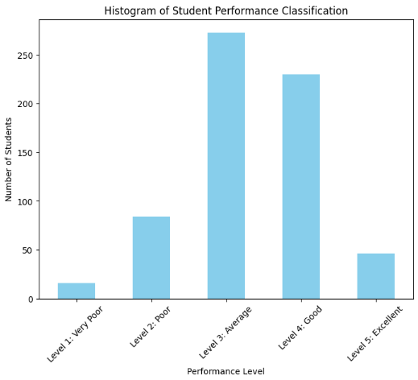
DATA DISTRIBUTION

Slide 7
MODELS
NAIVE BAYES
RANDOM TREES
DECISION TREE
SUPPORT VECTOR MACHINE
NEURAL NETWORK
LOGISTIC REGRESSION
DEEP LEARNING
HYBRID LEARNING

Slide 8
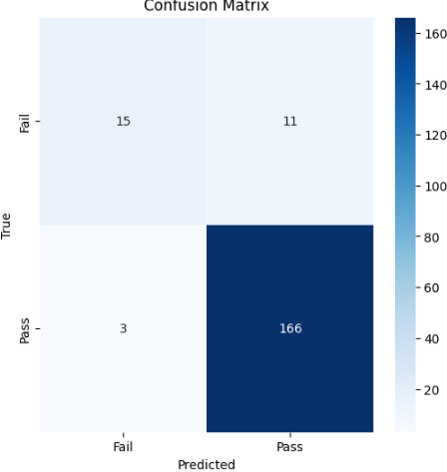
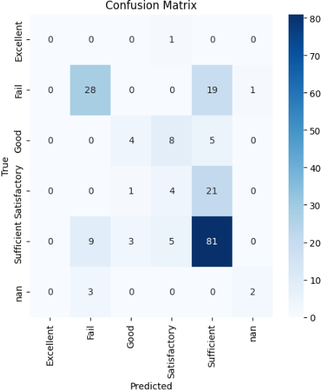
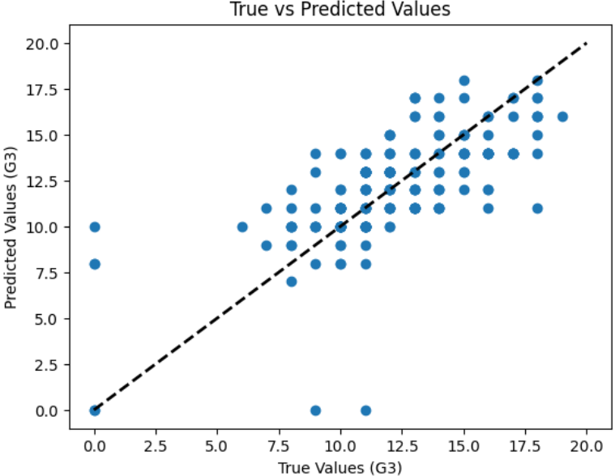
NAÏVE BAYES
Naive Bayes is a simple probabilistic classifier based on applying Bayes' Theorem with the "naive" assumption that features are conditionally independent.
For better results, I changed:
Test size to 0.35 for Regression classifier;
and kept using Z-score normalization as it gave the best result on all of them.

Slide 9
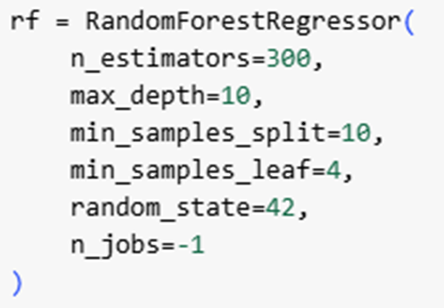
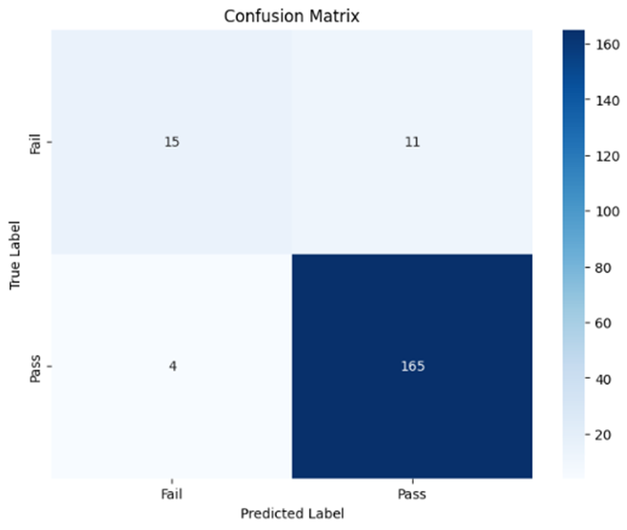
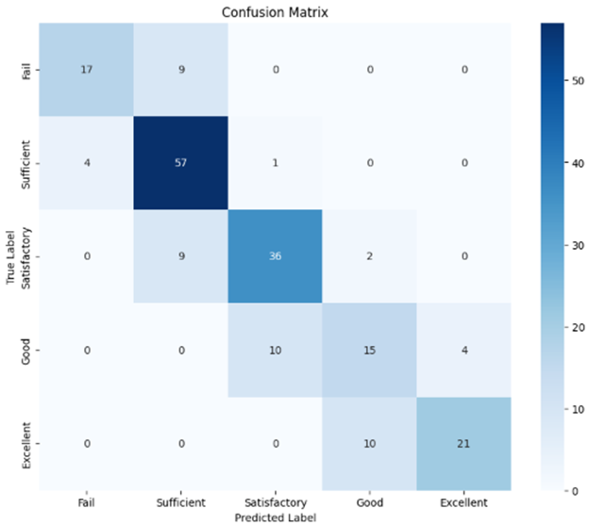
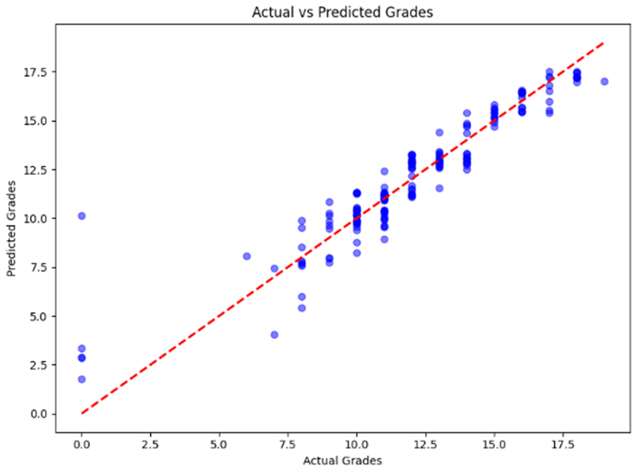
RANDOM FOREST
n_estimators=300 ensures the ensemble is large enough to reduce variance
max_depth=10 limits tree depth to prevent overfitting.
min_samples_split=10 and min_samples_leaf=4 control the minimum number of samples required to split a node or to form a leaf, promoting generalized trees and reducing overfitting.

Slide 10
DECISION TREE
-Tuned hyperparameters like max_depth to balance bias and variance.
- Avoided overfitting by limiting tree depth.
- Solved data leakage issues by excluding target-derived features during preprocessing.
Findings:
If 13.5 ≤ G1 ≤ 14.5 and activities = No, then Fail. (5 Level Classification - B)
If G1 is Good (13.5 ≤ G1 ≤ 14.5) and the student does not participate in extracurricular activities, it is very likely that the student's final grade will be a Fail. This emphasizes the importance of engagement in extracurricular activities as a factor in academic success.
If failures >= 1 and school = MS, then Fail. (Binary Classification - B)
This rule indicates that students with at least 1 past failure and who attend the "Mousinho da Silveira" school are highly likely to fail their final grade (G3). This suggests that past academic struggles, combined with certain school-specific factors, contribute significantly to poor outcomes.
If G1<= 9.5 and G2 >= 8.5, then Pass (Binary Classification - A)
This rule highlights that G2 plays a dominant role in determining the final outcome (Pass), even when the performance in G1 is relatively lower. This emphasizes the importance of strong performance in the later term, suggesting that interventions and support in Term 2 can significantly impact students' success.

Slide 11
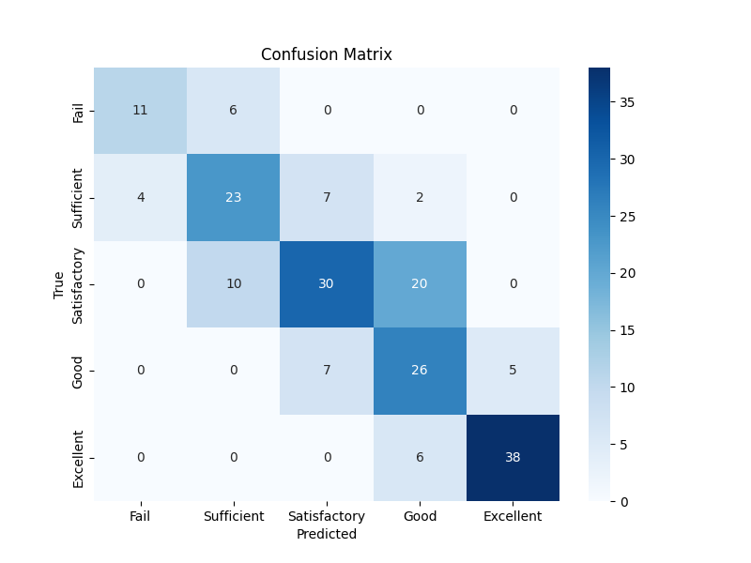
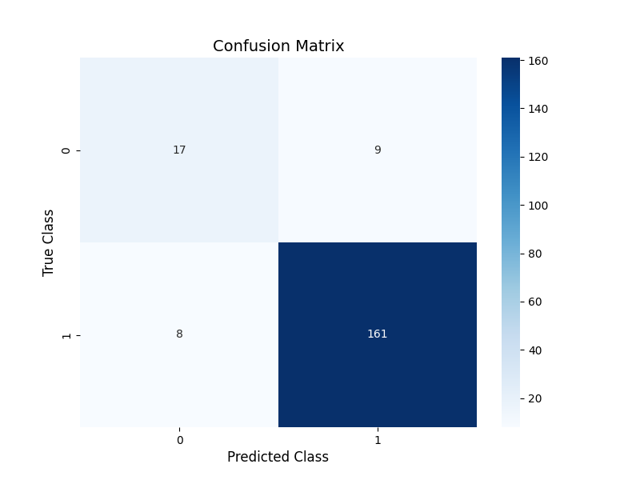
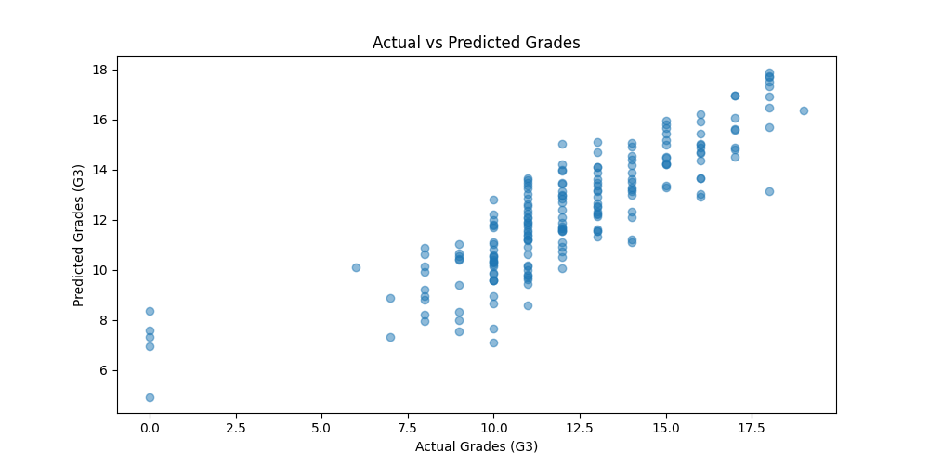
SUPPORT VECTOR MACHINE
1. Dataset Normalization
Scaling: Features normalized using StandardScaler for uniformity and faster convergence.
Encoding: Categorical features encoded using OneHotEncoder.
PCA: Handles high-dimensional data, reduces overfitting by discarding less useful dimensions (By using the Elbow Rule for finding the best number of components to achieve highest accuracy; in our case 23 components)
2. Hyperparameter Tuning: Using ‘Grid Search Parameters’ to find the best parameters with best results

Slide 12
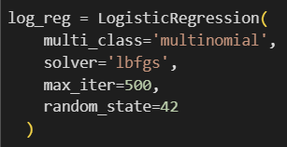
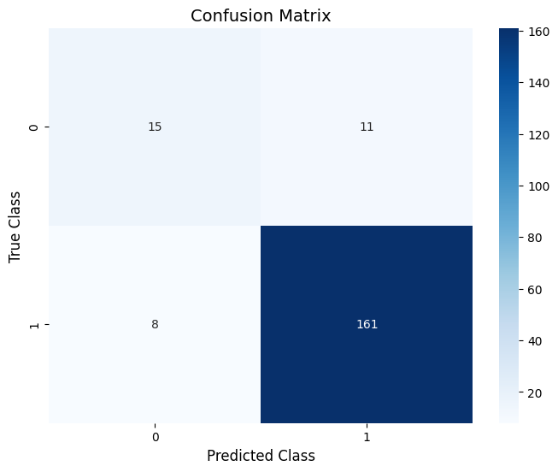
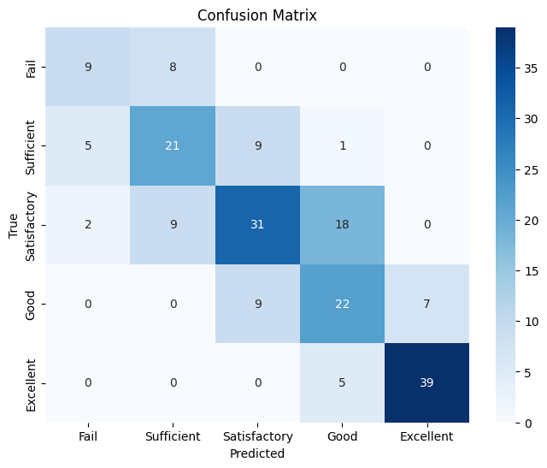
LOGISTIC REGRESSION
Data Preprocessing:
One-hot encoding for categorical features.
Standardization of numerical features using StandardScaler.
Splitting data into training (70%) and testing (30%).
Model Training:
Binary Classification: Logistic Regression with default binary settings.
Multi-Class Classification: Logistic Regression with multinomial setting (multi_class='multinomial', solver=lbfgs)

Slide 13
DEEP LEARNING
Deep Learning Model for Grade Prediction
The model is a fully connected neural network with:
Input Layer: Size based on preprocessed features.
Hidden Layers: 128, 64, and 32 nodes with ReLU activation, batch normalization, and dropout regularization (0.3, 0.3, 0.2).
Output Layer: Single node with sigmoid activation for binary classification (pass/fail).
Preprocessing:
Scaling: Features scaled using StandardScaler for uniformity.
Encoding: Categorical features encoded with OneHotEncoder.
Training:
Optimizer: Adam (learning rate=0.001).
Loss: Binary cross-entropy.
Regularization: Early stopping and learning rate reduction.
Hyperparameters:
Layers: 3 hidden layers.
Dropout rates: 0.3 for first two layers, 0.2 for the third.

Slide 14
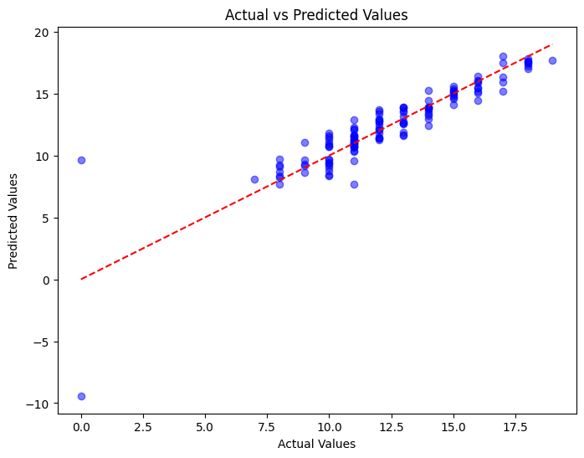
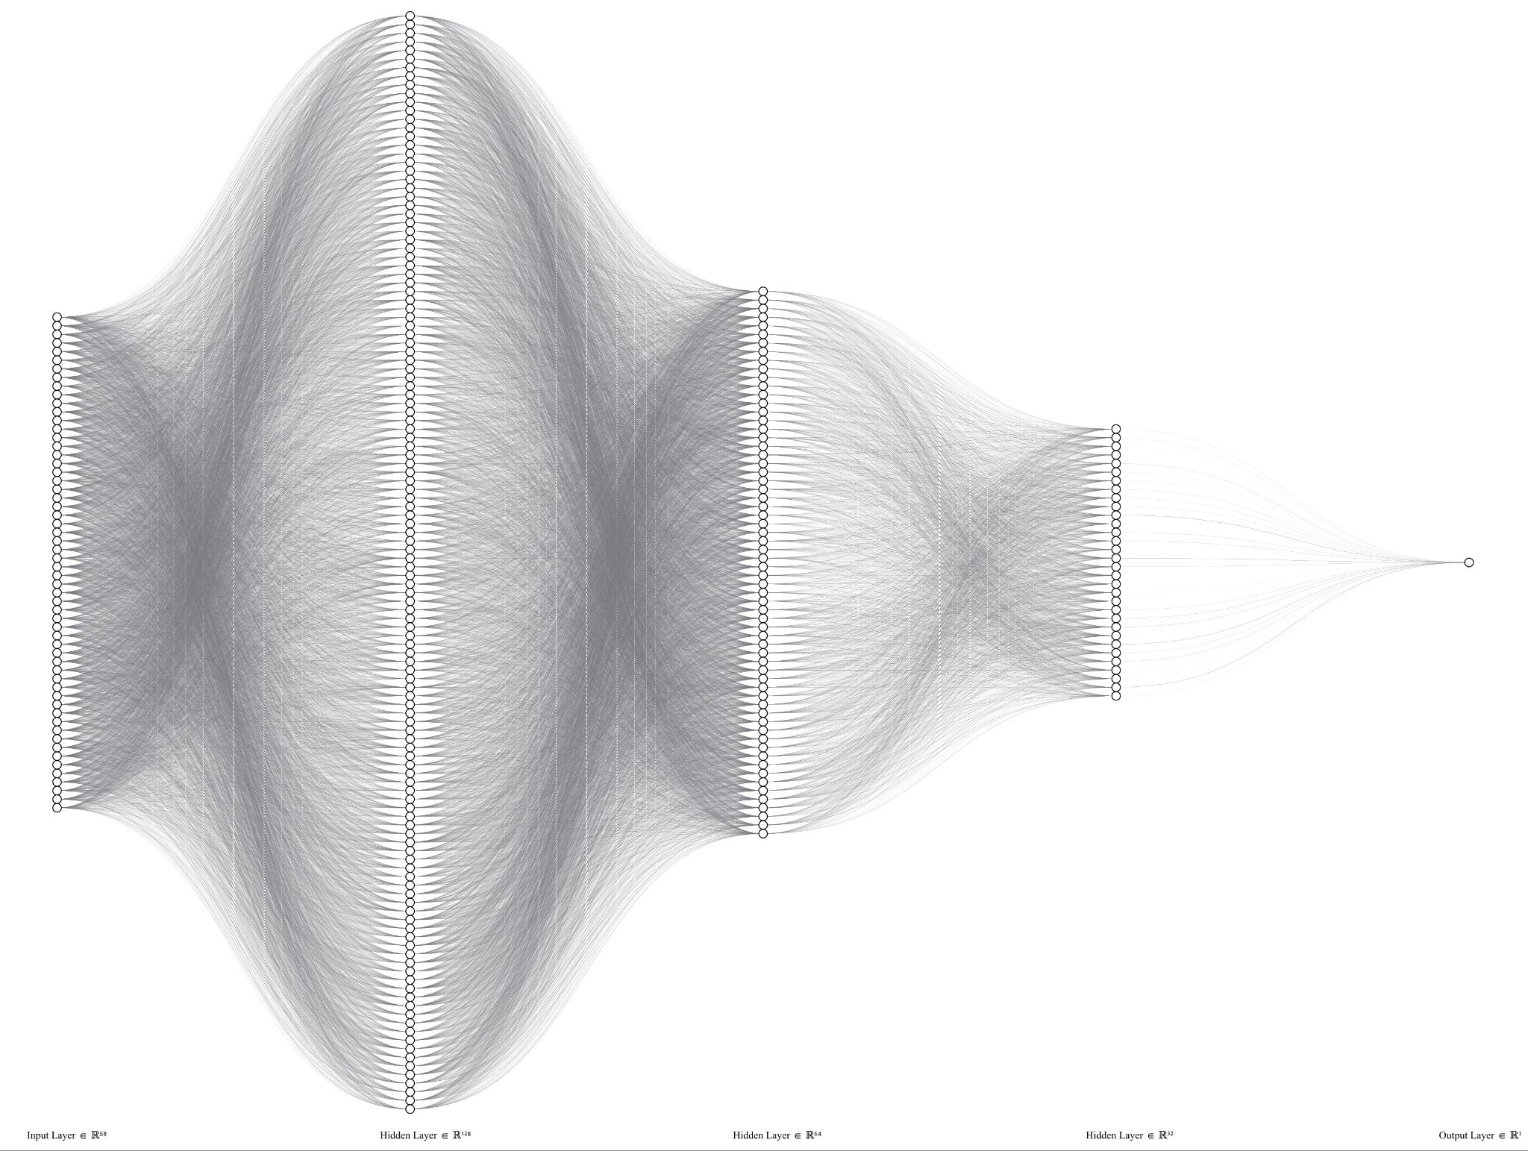
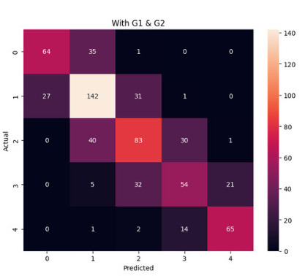
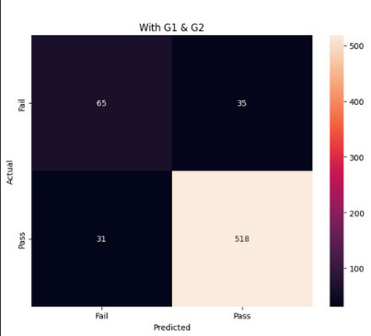

Slide 15
Neural Network (MLP)
The neural network used is based on the MLP structure, with one input layer, one hidden layer and one output layer, the hidden layer has 59 nodes, while the nodes of the input layer depend on the number of features after one-hot encoding, and the number of output nodes depends on the task. We used the tensorflow library to create a Sequential model for our grade predictions. 1. Dataset Normalization
Scaling: Features normalized using StandardScaler for uniformity and faster convergence.
Encoding: Categorical features encoded using OneHotEncoder.
2. Hyperparameter Tuning: Optimal Hyperparameters were found by a simple brute force approach, where various for loops were carried out in order to find the combination which yields the best results. The number of hidden layers is 1, with 59 nodes and the sigmoid activation function.
3.Training:An 80% and 20% ratio was used to split the training and testing data. Regularization (Droupout of 0.1) was utilized in order to prevent overfitting.Some parameters are:
Optimizer: Adam
Epochs: 100
Batch size: 15
Learning rate: 0.001

Slide 16
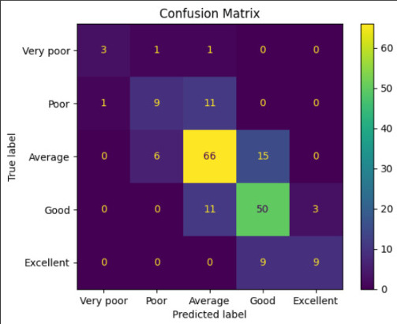
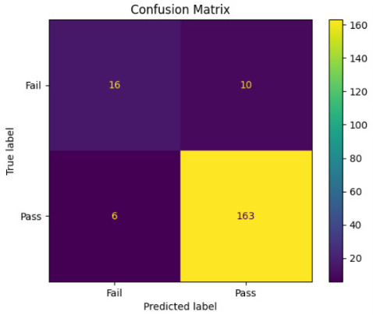
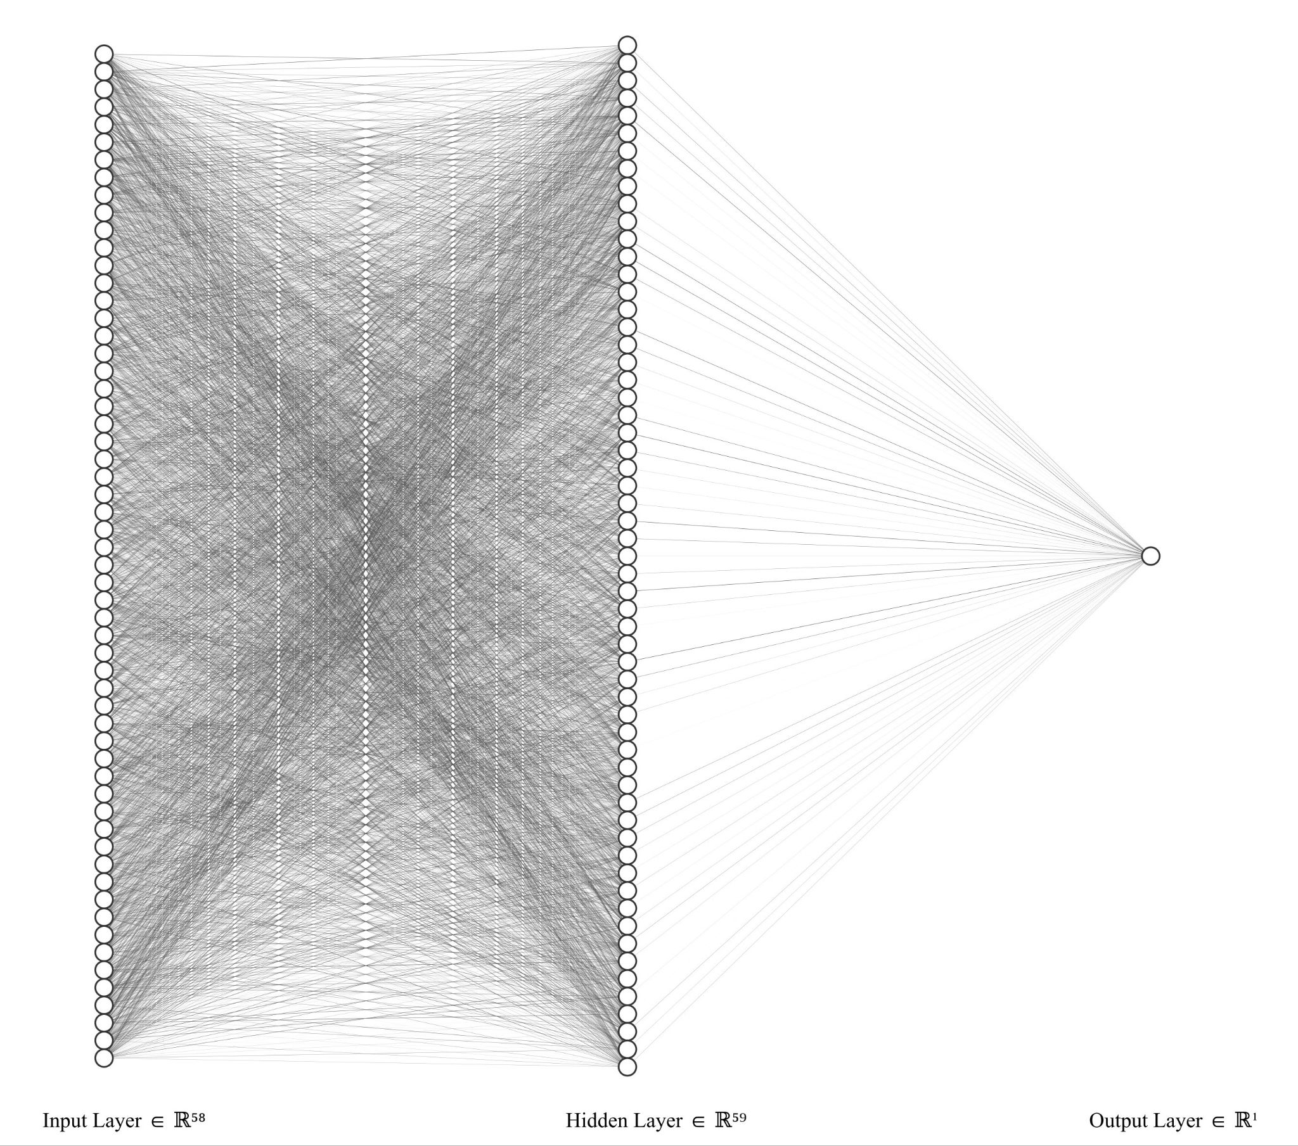
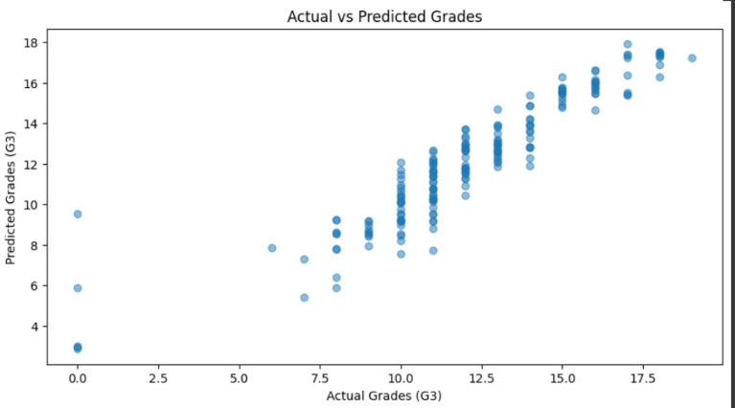

Slide 17
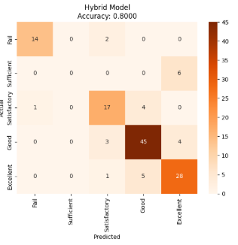
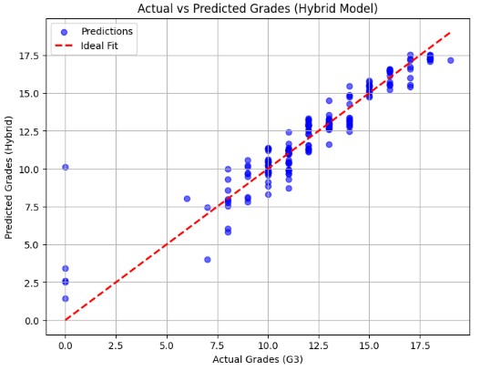
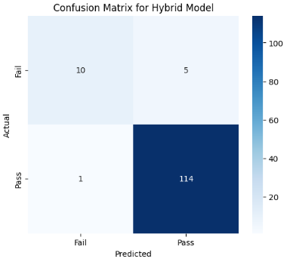
HYBRID MODEL
This hybrid model combines the strengths of Machine Learning Models alongside a Neural Network Model in order to capture both simple and complex relationships that may be present in the data. The machine learning models consist of the Random Forest model and the Decision Tree model, for the regression and classification tasks respectfully.

Slide 18
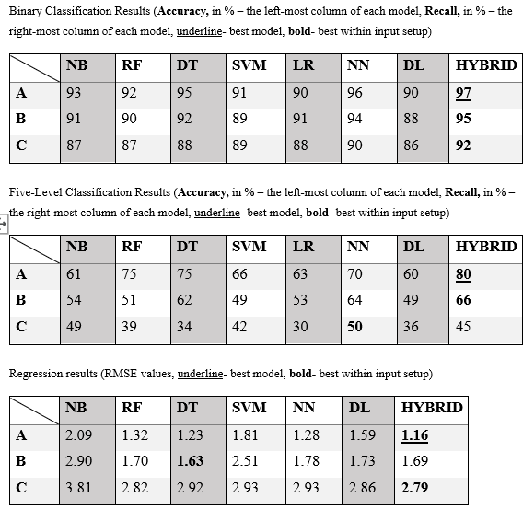
RESULTS

Slide 19
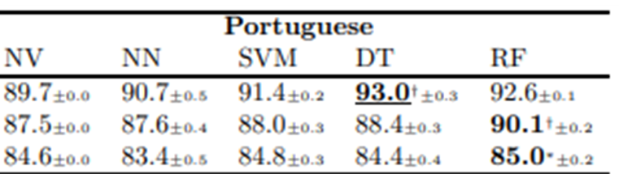
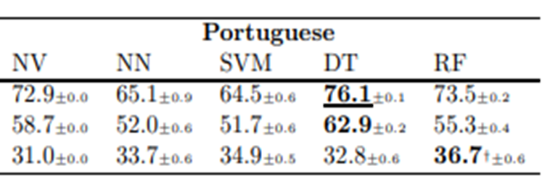
STATE OF ART
Binary Classification
5-Level-Classification
These tables show the results conducted by a study taken in 2008 in Portugal high schools^{[1]} using the same dataset (except they also conducted research and tried to predict grades of students in Mathematics which had a size sample of 350 students).
Regression
[1] Cortez, P. and Silva, A.M.G., 2008. Using Data Mining to Predict Secondary School Student Performance. University of Minho. Available at: <https://repositorium.sdum.uminho.pt/bitstream/1822/8024/1/student.pdf>

Slide 20
HEAD TO HEAD COMPARISON OF THE BEST MODELS *Hybrid model excluded
 | Binary Classification |  | 5 level Classification |  | Regression
Year | 2025 | 2008 | 2025 | 2008 | 2025 | 2008
A | NN-96 | DT-93 | RF,DT-75 | DT-76 | NN-1.28 | NV,RF-1.32
B | NN-94 | RF-90.1 | DT-62 | DT-63 | DT-1.63 | DF-1.78
C | NN-90 | RF-85 | NN-50 | RF-37 | RF-2.82 | RF-2.67

