Slide 1
Rover Team Meeting
SLUGBOTICS
26
September
2025

Slide 2
Agenda
01
Welcome & Introductions
10 min.
02
Git & Github Setup
20 min.
03
VSCode Setup & Introduction
20 min.
04
Collaborating as a Group
30 min.
05
Python Installation & Basics
25 min.
06
Wrap UP & Q&A
15 min.
Confidential

Slide 3
Welcome to the first Rover Team Meeting!
Introduce Leaders
Do you have prior coding experience?
If so, what?
Expectations of Meeting:
Install and config. VSCode
Understand Git
Generate and config. SSH Keys
Practice Pull Requests
Install and config. Python
Learn where to find more advanced resources

Slide 4
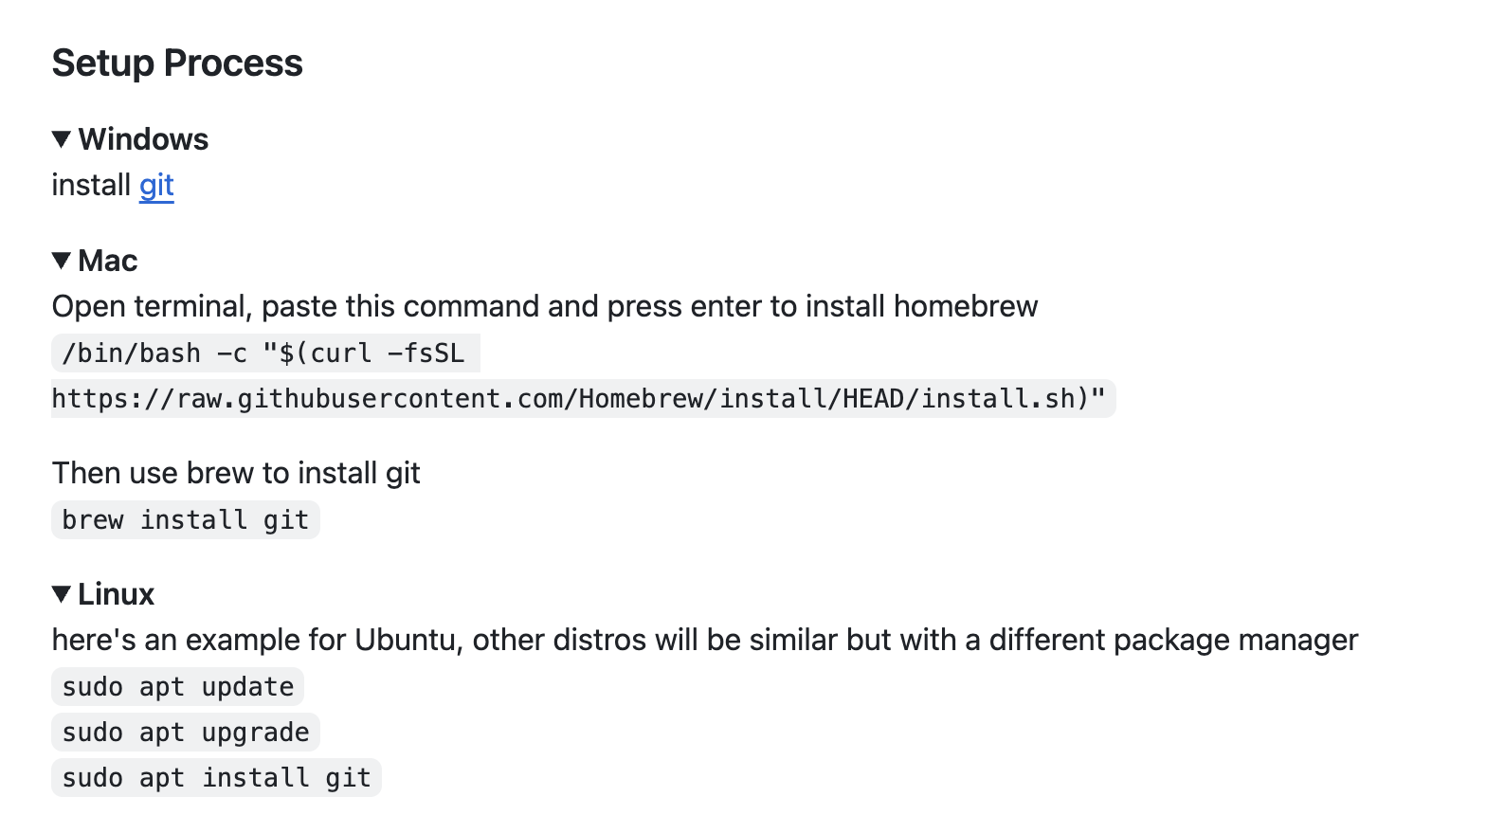
Git Setup

Slide 5
SSH Keys
Secure Shell (SSH) Keys are a pair of cryptographic keys that prove your identity to the server.
They’re used to connect to remote machines, such as a raspberry pi.
`ssh-keygen -t ed25519 -C “your-email@example.com” # Generate a key
`ssh-copy-id pi@<IP_ADDRESS>` # Add your key to the raspberry pi (or other computer)
`ssh pi@<IP_ADDRESS>` # connect to the raspberry pi

Slide 6
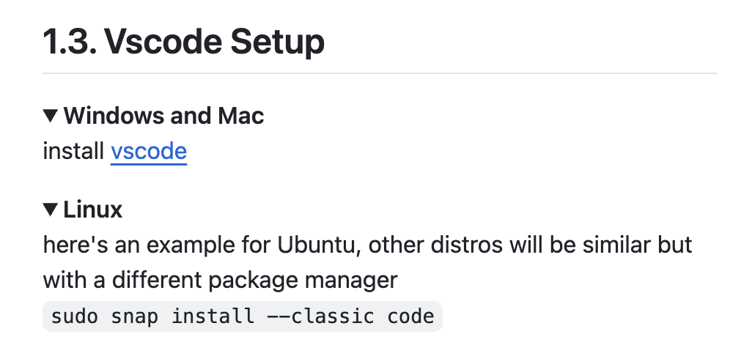
Intro. to VSCode
Download VSCode
Go over extensions
Run a basic script

Slide 7
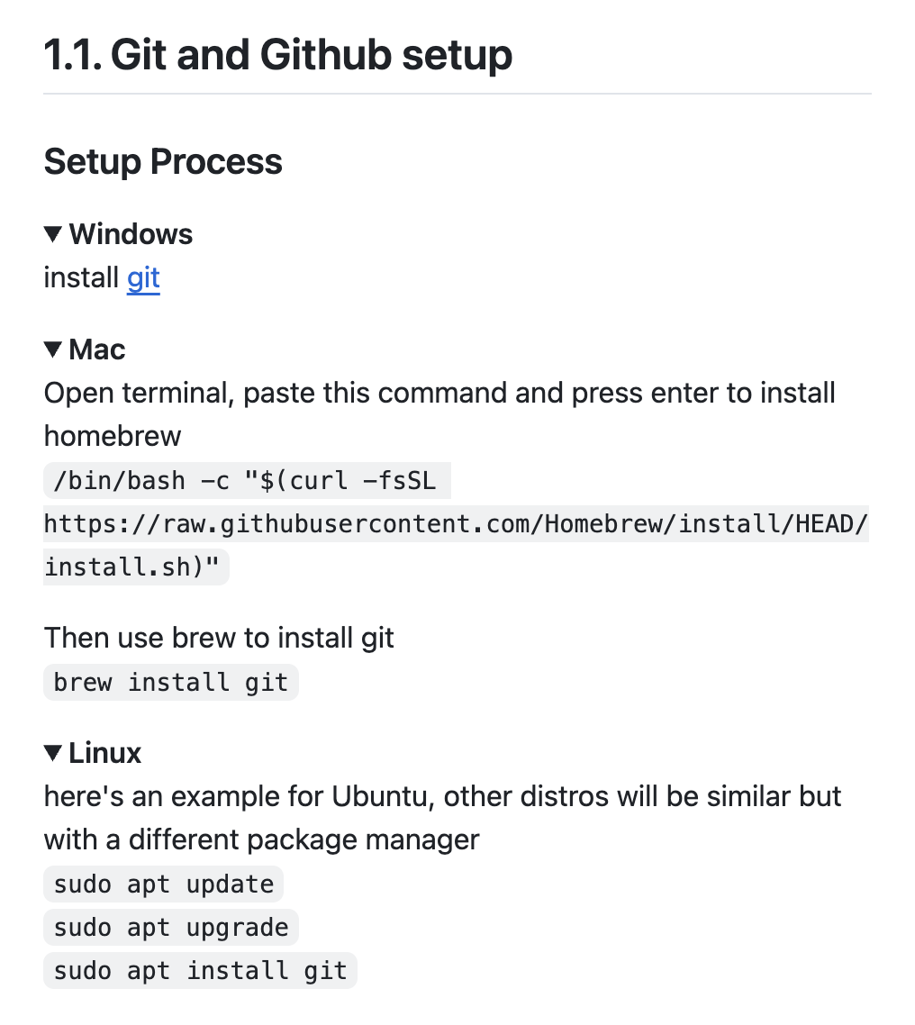
Git & Github Setup
What are repositories?
Commits? Branches?

Slide 8
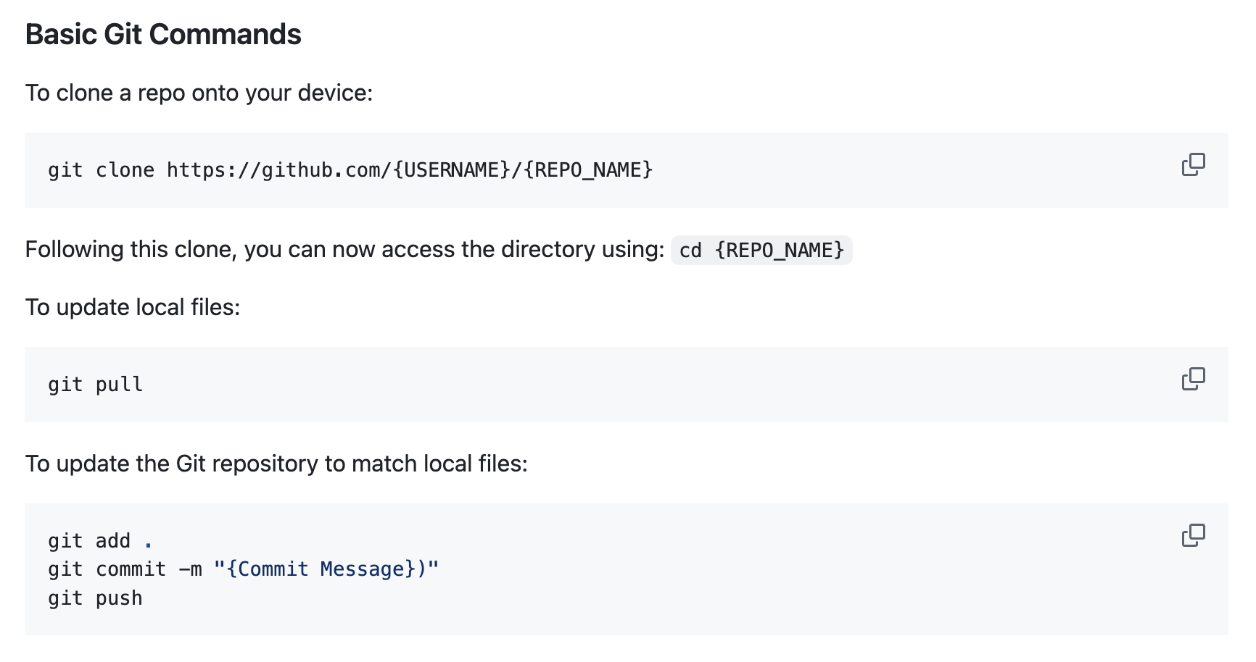
Basic Git Commands
Practice cloning, editing, committing, and pushing changes to the Starter Repo
Demonstrate Pull Request, reviewing the changes, and merging
Group Activity: Students open PRs to a shared repo

Slide 9
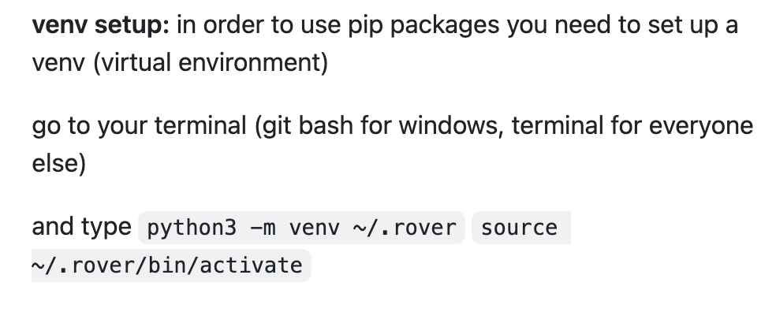
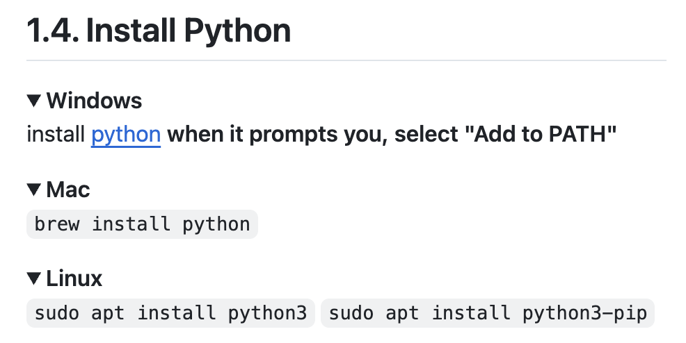
Python Installation and Basics
Install Python
Explain Virtual environments

Slide 10
Live Coding Demo
Follow Alongside to create a classic script “Hello World!” as well as perform basic mathematical operations
Optional Extension:
Create/Edit a script, commit changes, and open a Pull Request

Slide 11
Wrap Up & Q&A
Git/Github
VSCode
PRs
Python Basics
Accessing the SoftwareOnboarding2025 Repo
Additional Resources:
VS Code Docs
Git Handbook
Python Beginner Docs
Practice makes perfect! Applying your knowledge to personal projects and group repositories is the best way to learn!

