Slide 1
Project 2 Skyview
By: Thomas Hoerger

Slide 2
Step 1 create Login Page:

Slide 3
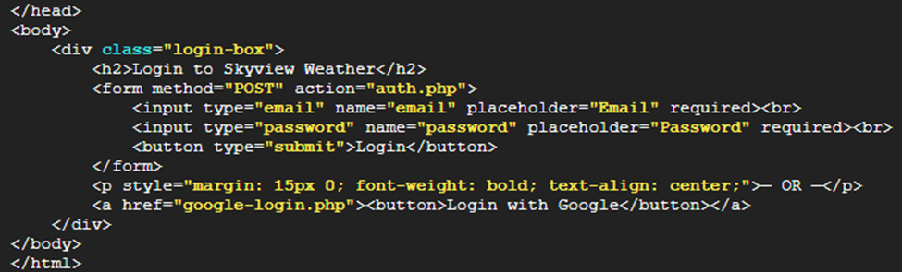
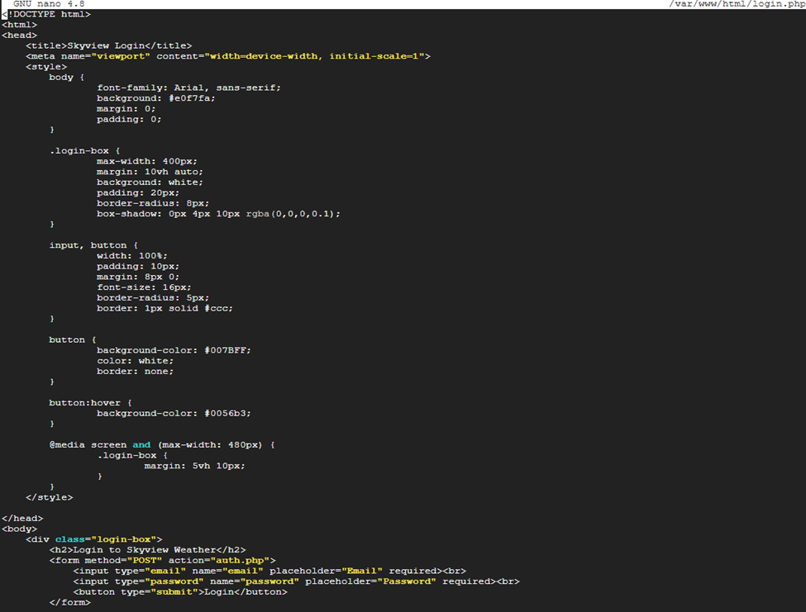
Step 2 Write Login Page Code:

Slide 4
Step 3 Create auth.php to Handle Logins:

Slide 5
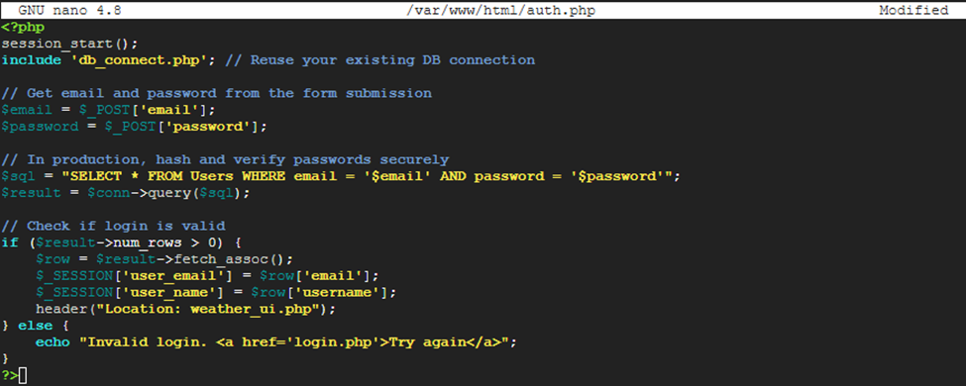
Step 4 Write Code for auth.php:

Slide 6
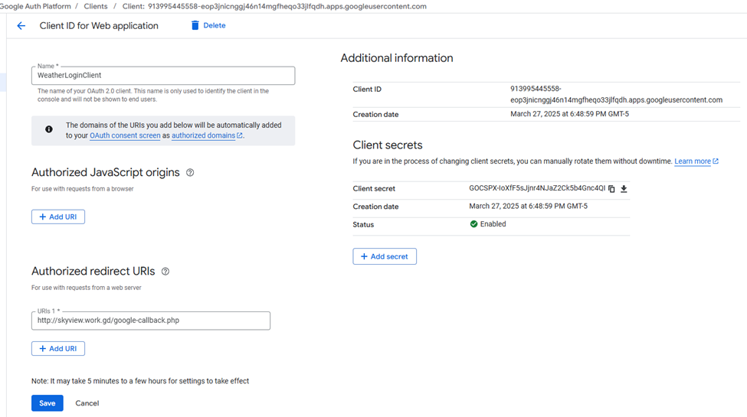
Step 5 Set Up Google OAuth 2.0 Login:

Slide 7
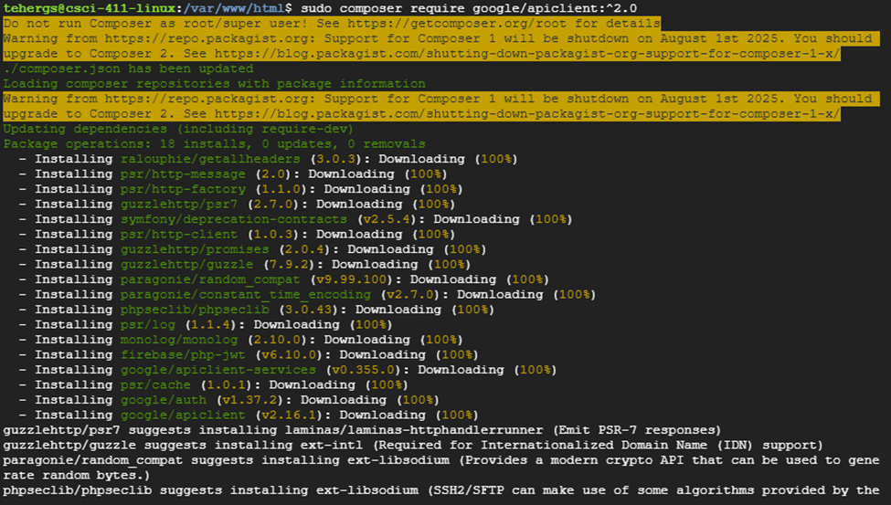
Step 6 Install Google OAuth PHP Library:

Slide 8
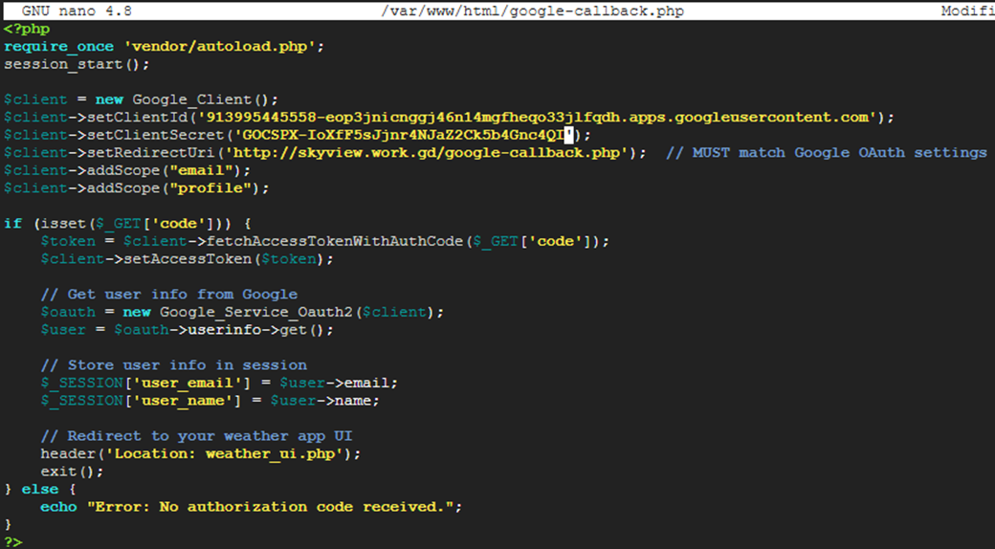
Step 7 Create google-callback.php (Handles Google Login Response):

Slide 9
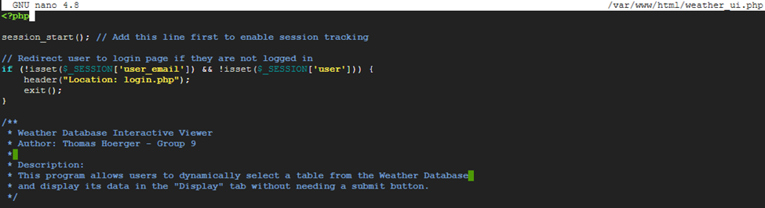
Step 8 Update weather_ui.php to Require Login:

Slide 10

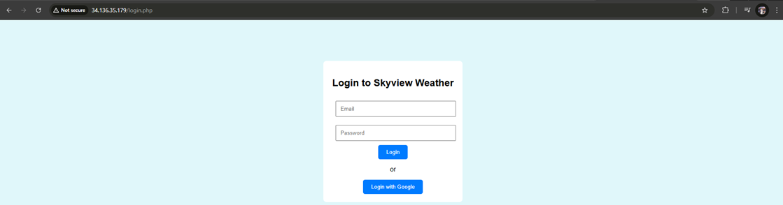
Step 9 Test to Make Sure it Redirects You to login.php if You’re Not Logged in:

Slide 11
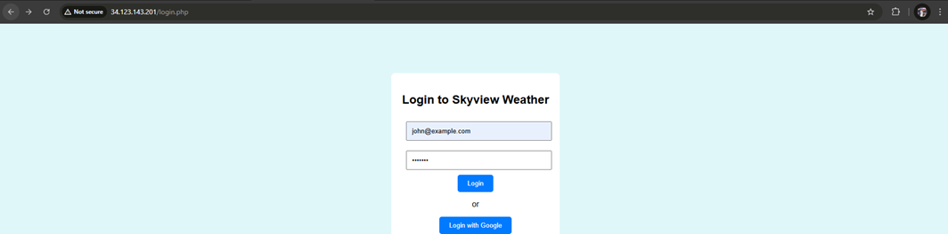
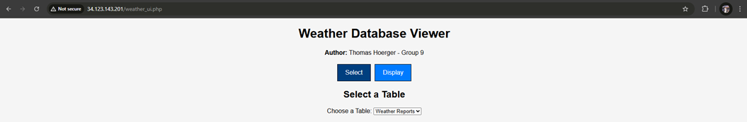
Step 10 Test logging in with a Test User:

Slide 12
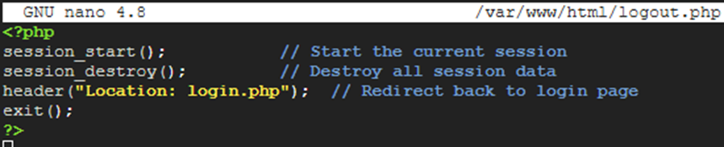
Step 11 Create a Logout Option:

Slide 13
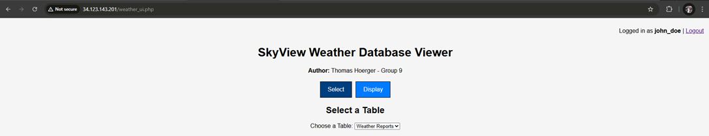
Step 12 Add a Logout to weather_ui.php:

Slide 14
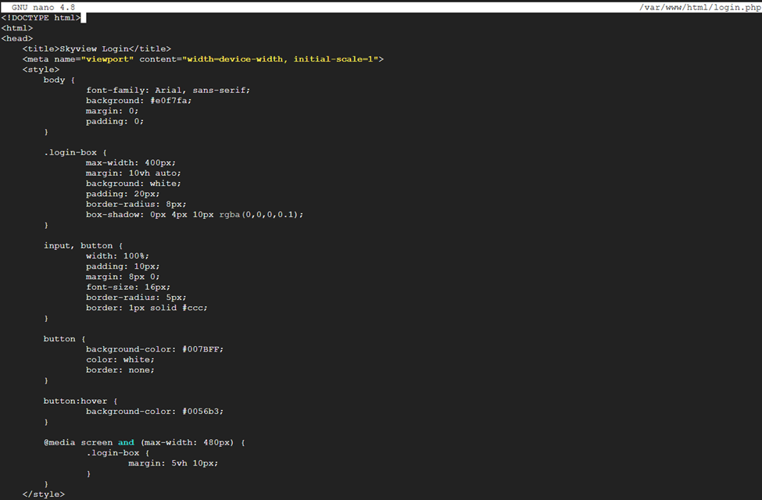
Step 13 Have your HCI/GUI/UI/UX running on at least 2 platforms: laptop and mobile (Edit Style Sheet):

Slide 15
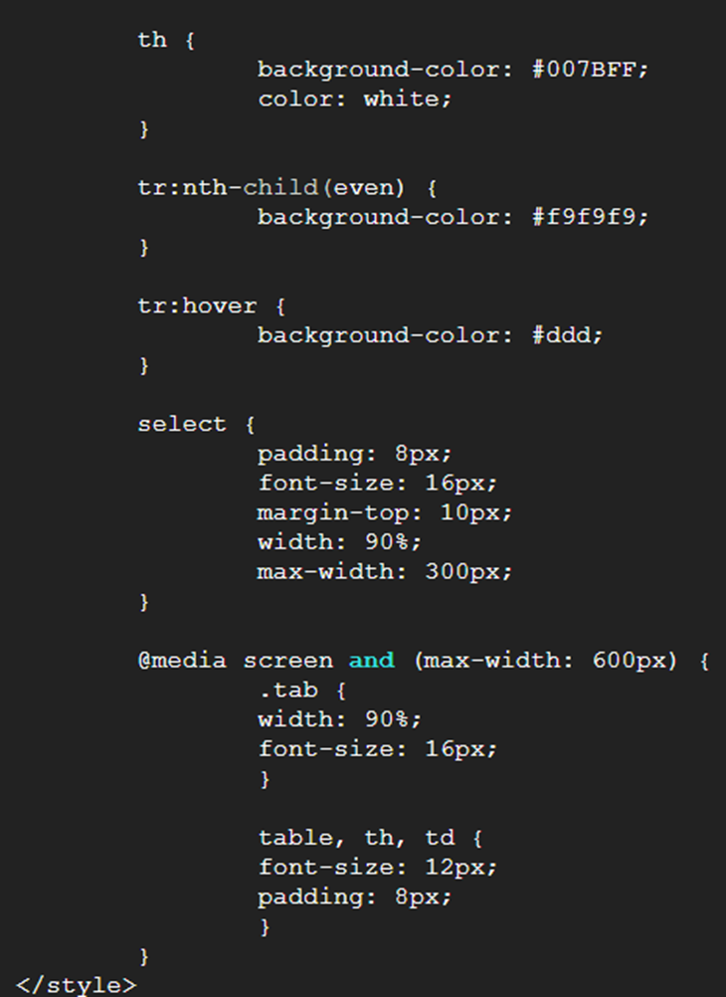
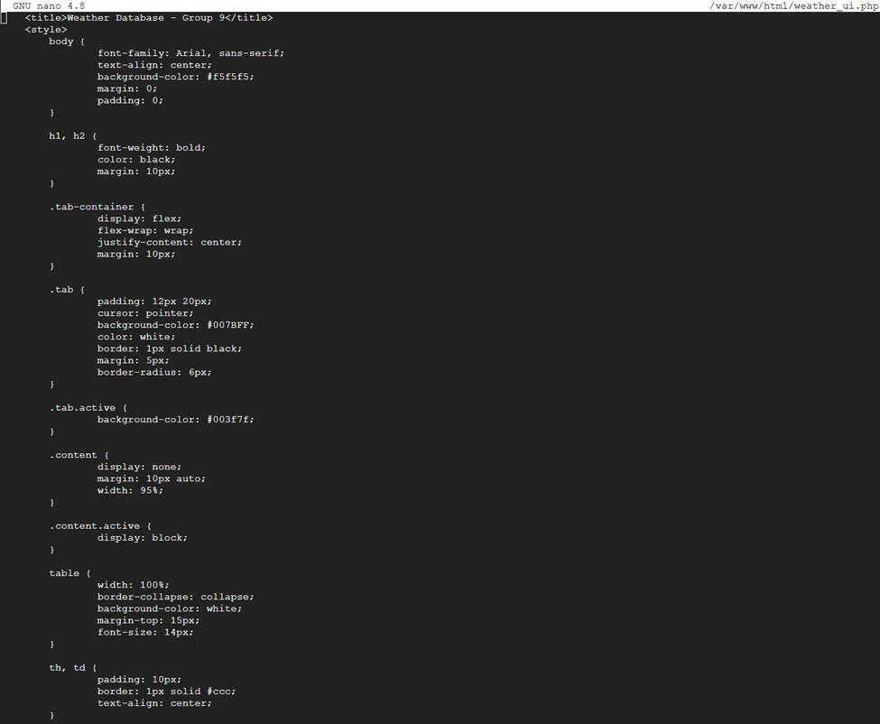
Step 13 Continued:

Slide 16
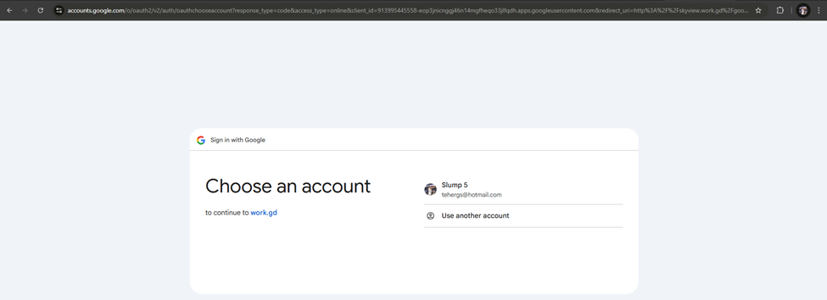
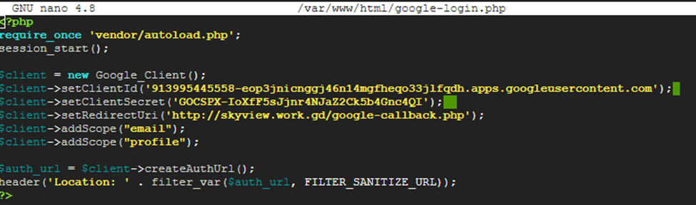
Step 14 Test Google Login (Works just need to wait for DNS propagation delay to use skyview.work.gd because I changed my VPS IP to a static one)

Slide 17
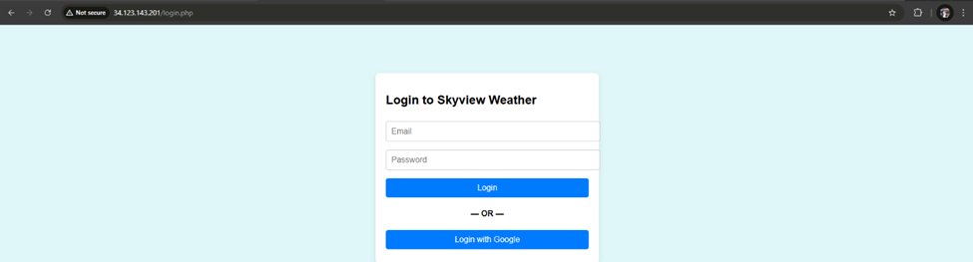
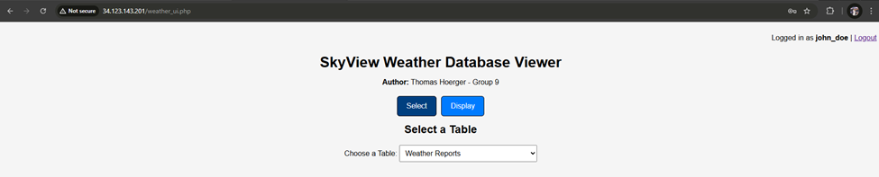
Step 15 Test Website on PC and Mobile:
PC:

Slide 18
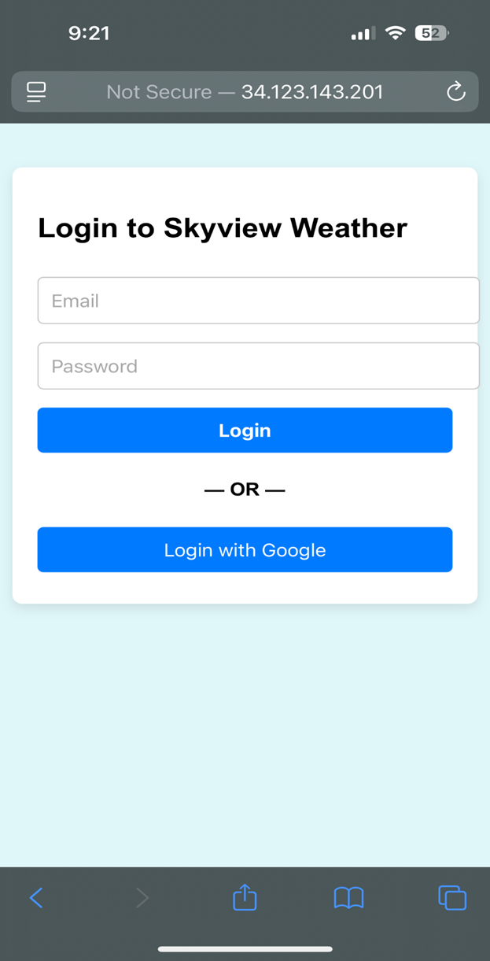
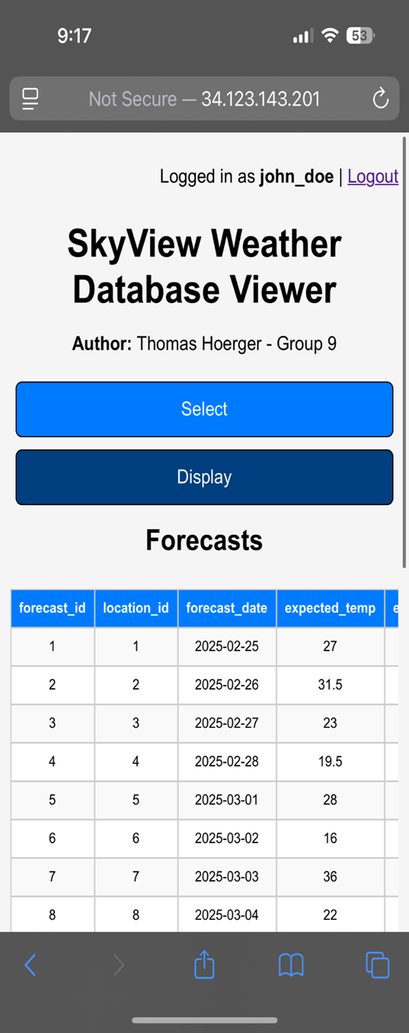
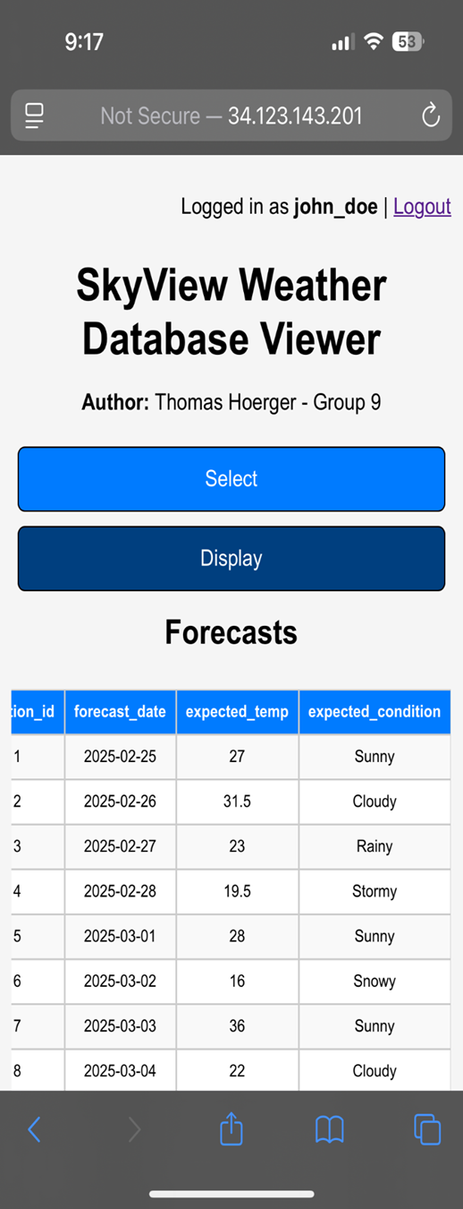
Step 15 Continued:
Mobile:

