Slide 1
Midterm Presentation Skyview
By: Thomas Hoerger – Group 9

Slide 2
Step 1 create file:

Slide 3
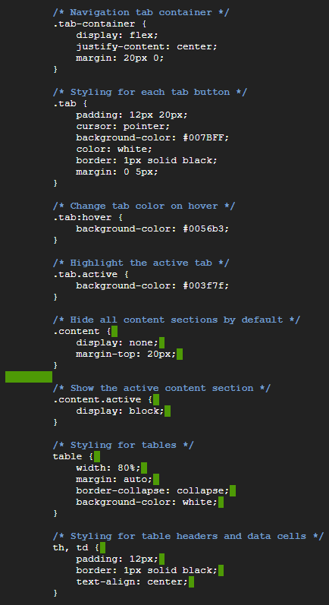
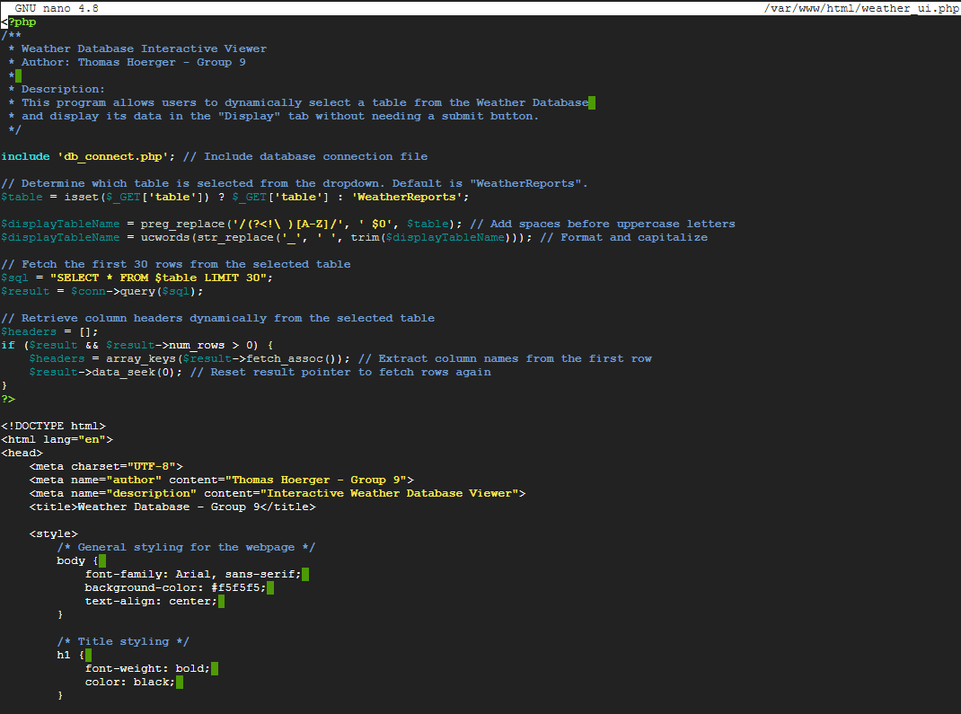
Step 2 write code:

Slide 4
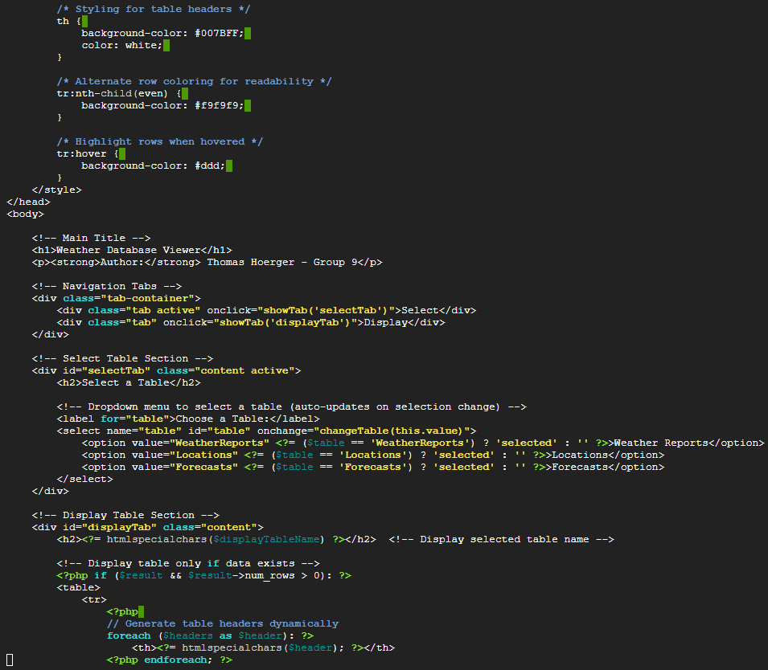
Step 2 continued:

Slide 5
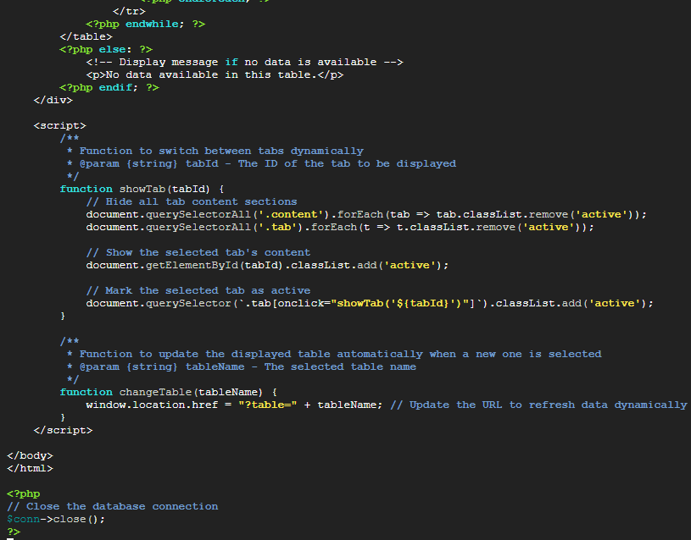
Step 2 continued:

Slide 6
Step 3 restart Apache to apply changes:

Slide 7
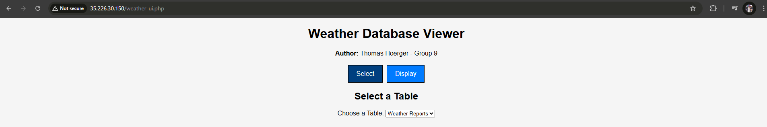
Step 4 go to http://(External IP)/weather_ui.php:

Slide 8
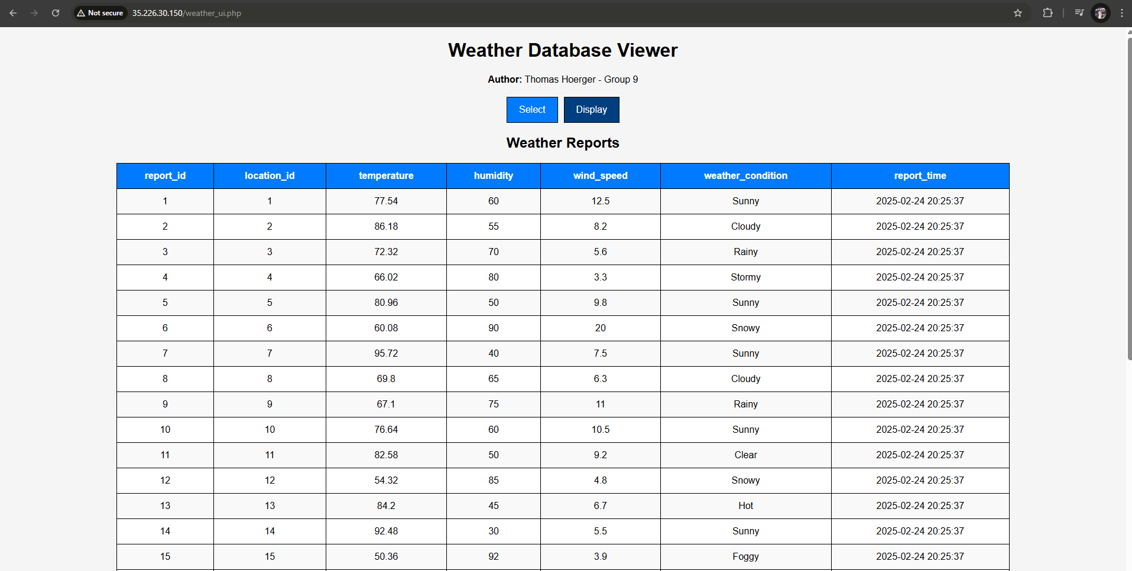
Step 4 continued:

Slide 9
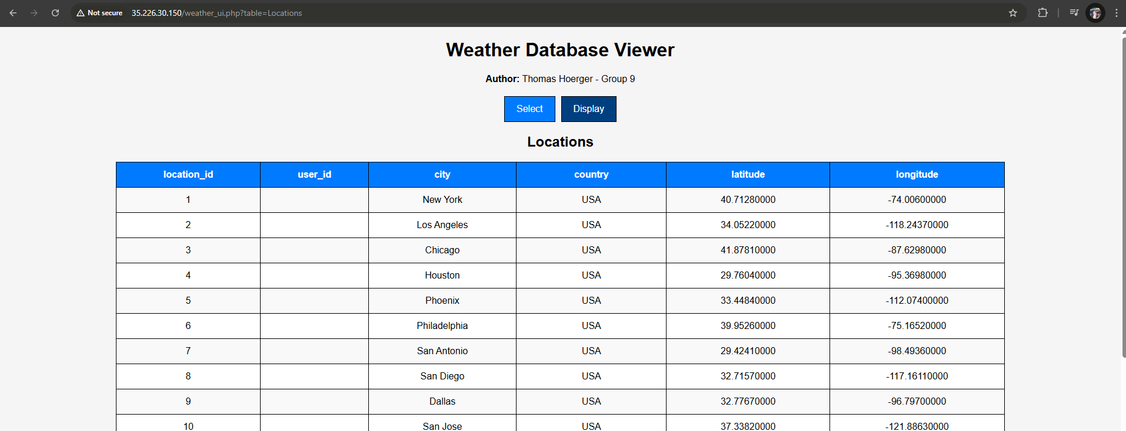
Step 4 continued:

Slide 10
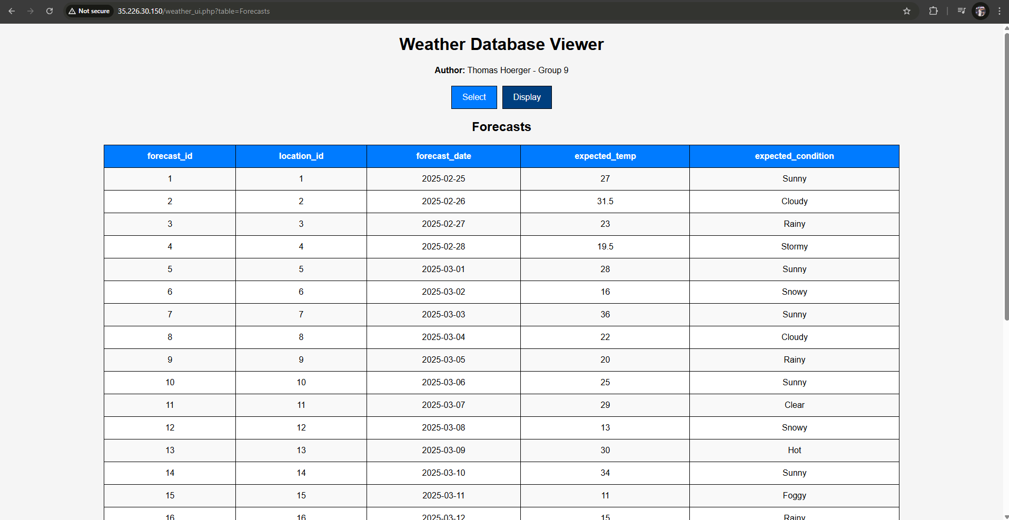
Step 4 continued:

Slide 11
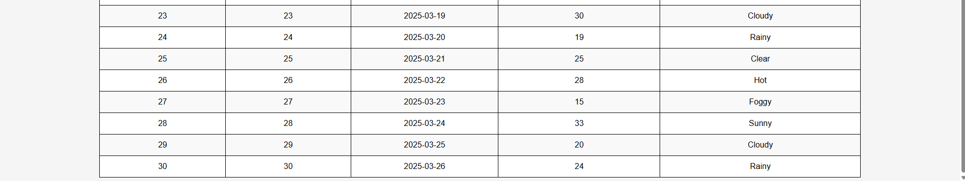
Step 4 continued showing at least 30 rows:

Slide 12
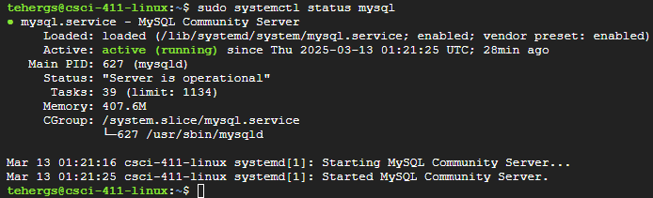
Step 5 show MySQL is running:

Slide 13
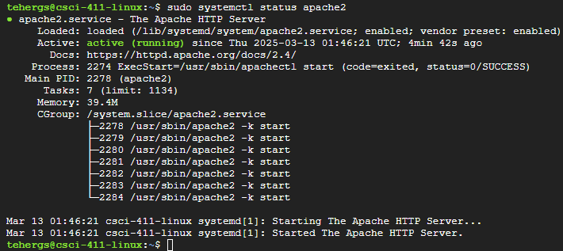
Step 6 show Apache is running:

