Slide 1
Group Docker project
Brady Theisen, Thomas Hoerger, Jake Cronk

Slide 2
STEPS FOR IMPLEMENTATION

Slide 3
Create docker network

Slide 4
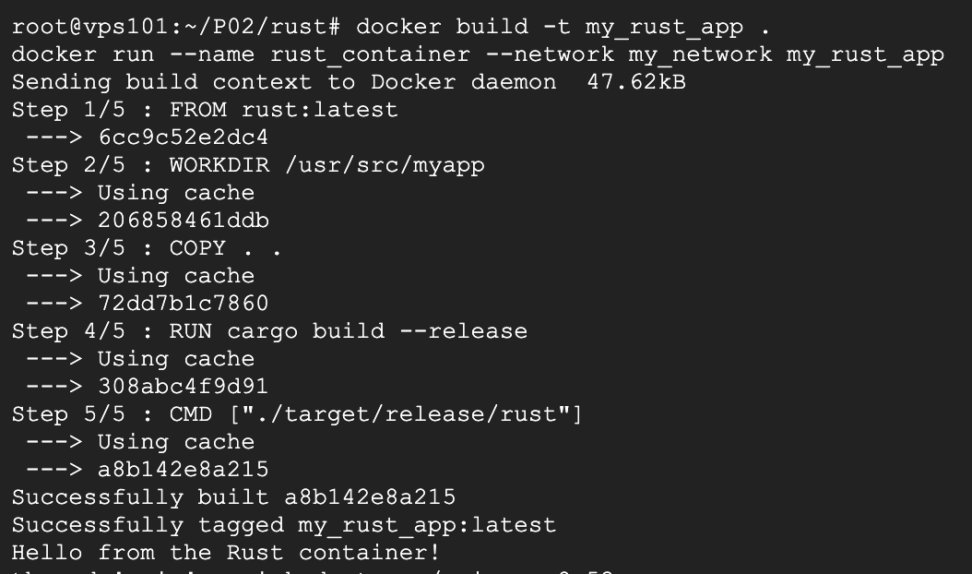
Building/running containers

Slide 5
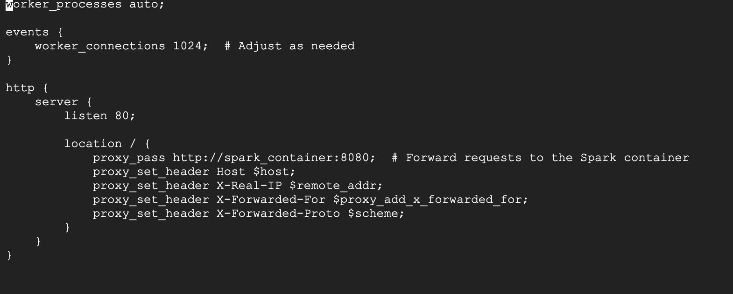
NGINx configuration

Slide 6
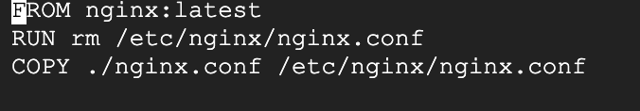
Nginx dockerfile

Slide 7
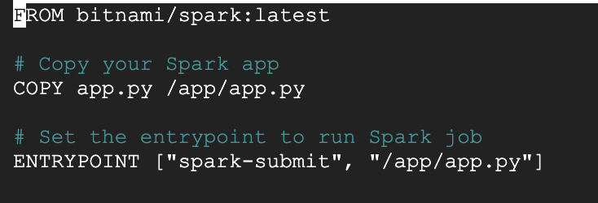
Spark dockerfile

Slide 8
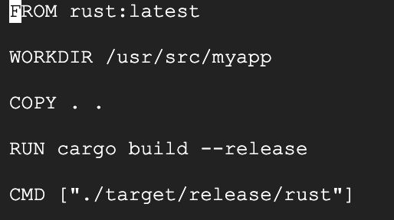
Rust dockerfile

Slide 9
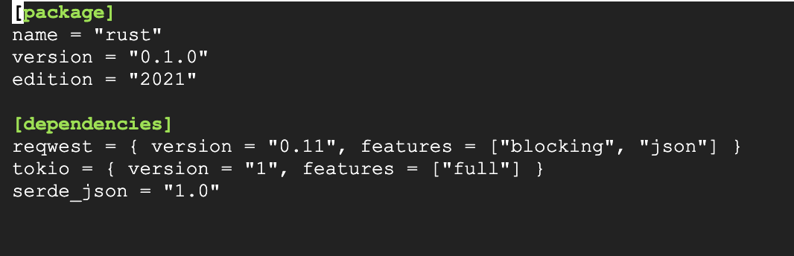
Rust cargo.toml

Slide 10
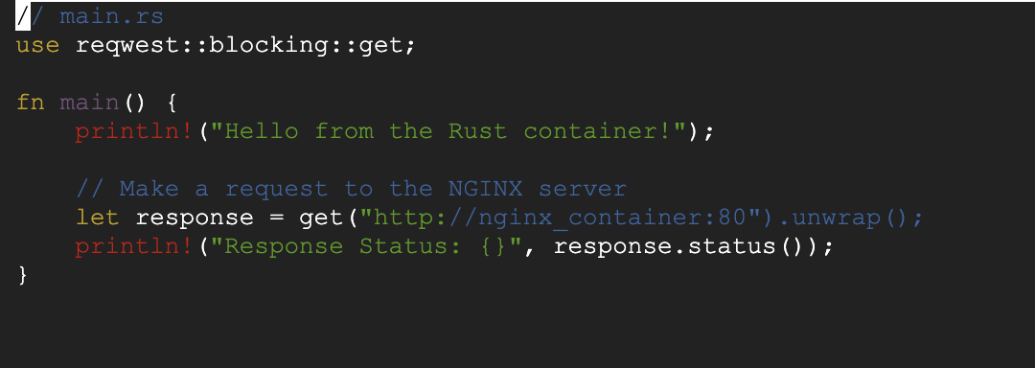
Rust main.rs

Slide 11
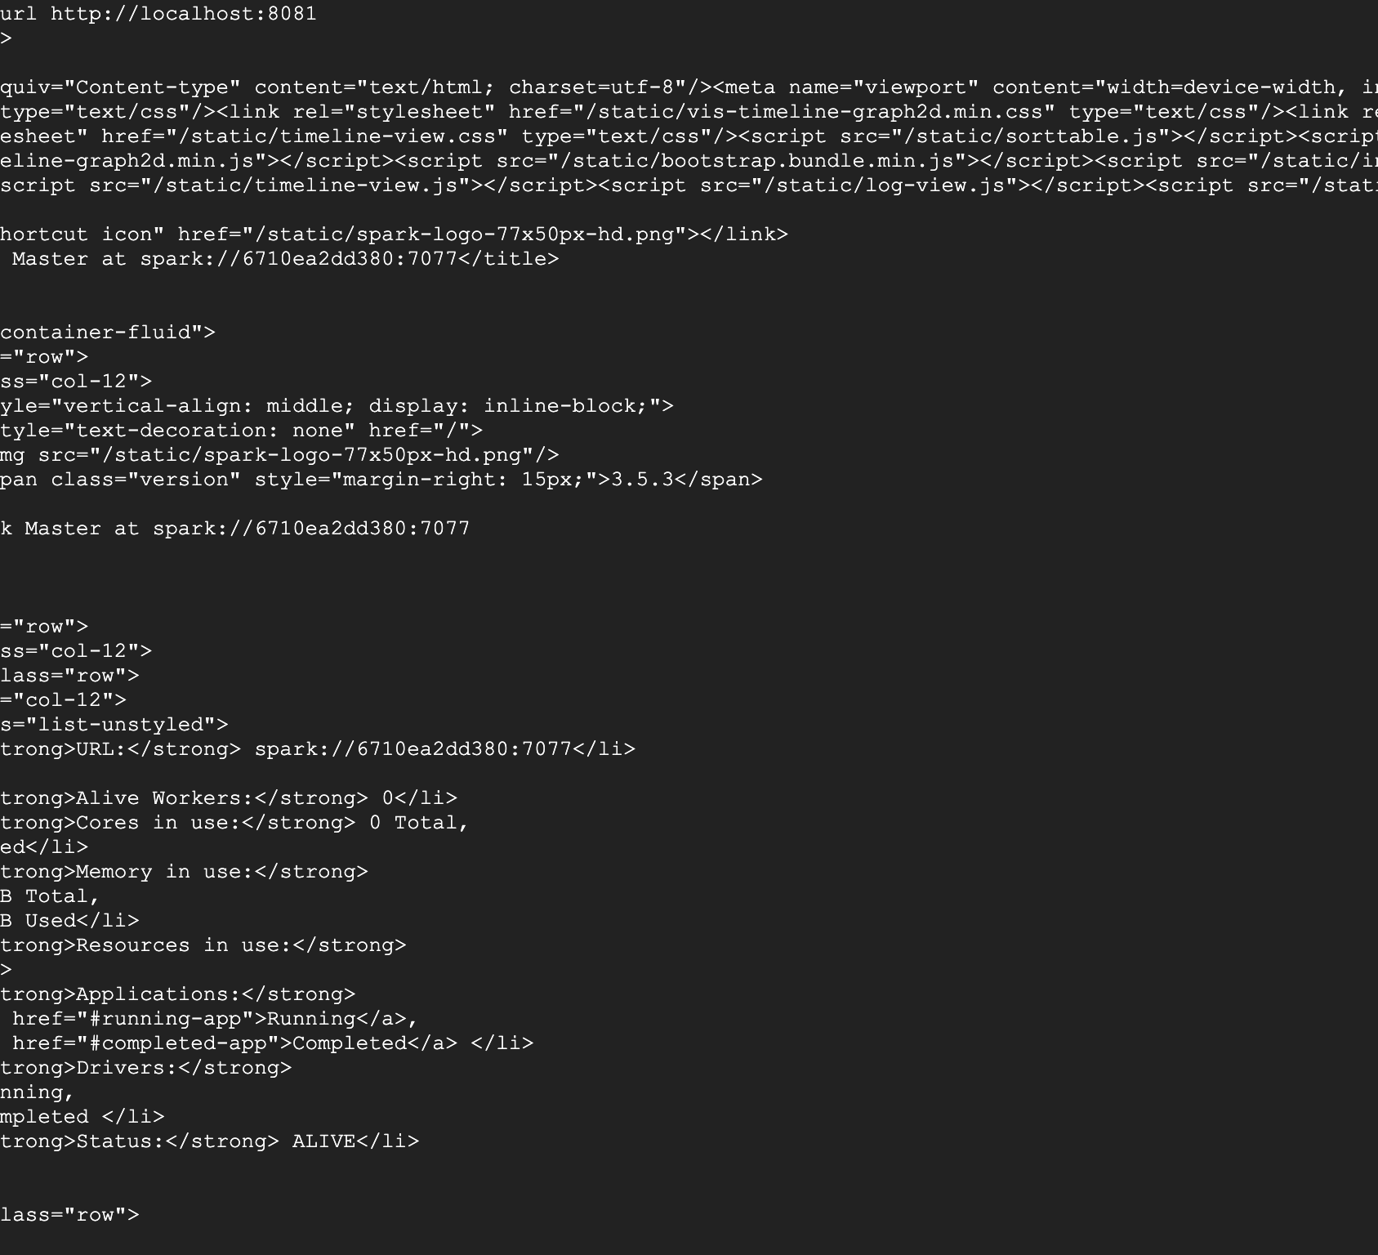

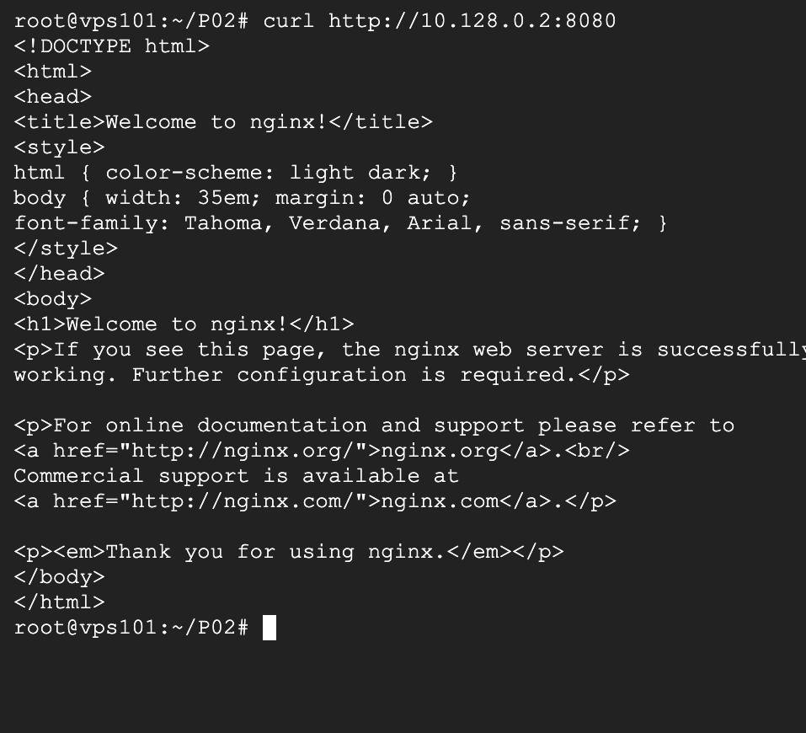
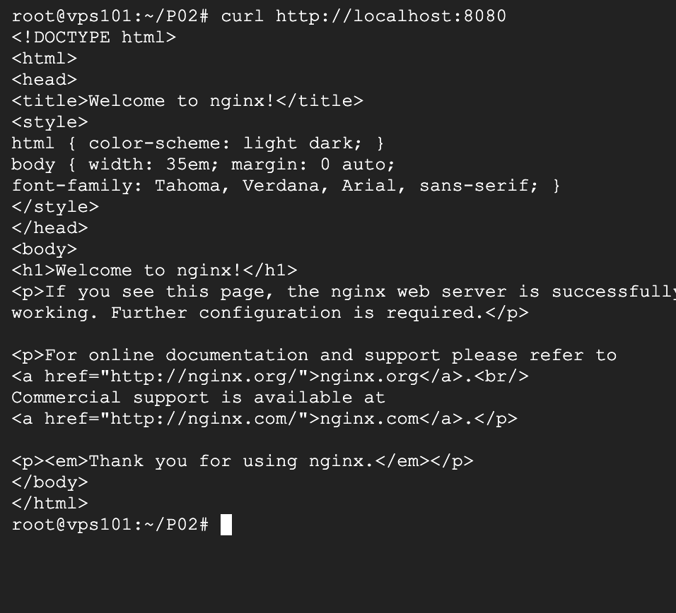
Testing
Curl commands were used to test interconnectivity between spark and nginx

Slide 12
Delta lake connectivity

Slide 13
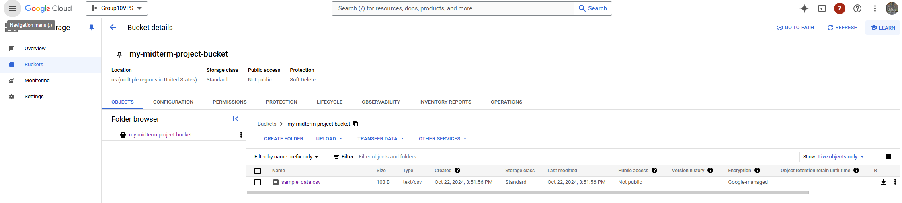
CREATE GOOGLE CLOUD BUCKET WITH Sample data

Slide 14
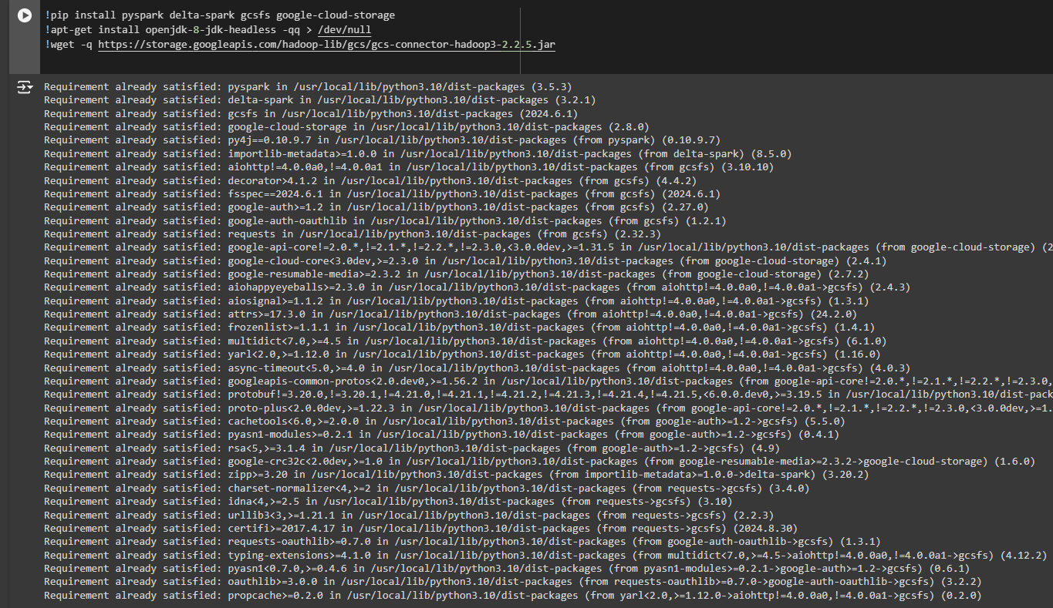
Install required packages

Slide 15
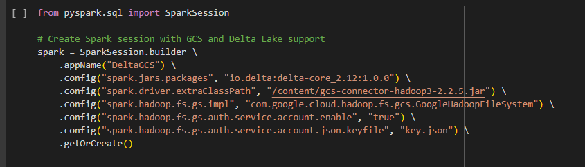
Create spark session with gcs and delta lake support

Slide 16
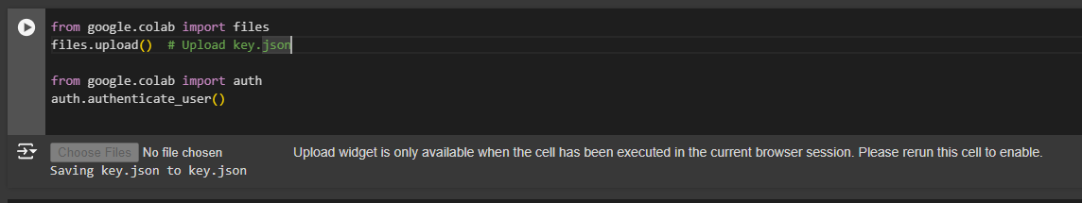
UPLOAD KEY / LOGIN TO GOOGLE

Slide 17
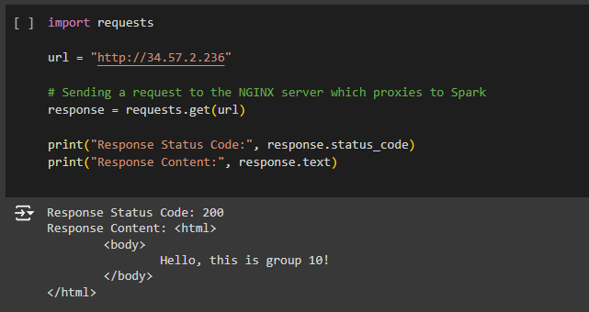
Showing connectivity with nginx

Slide 18
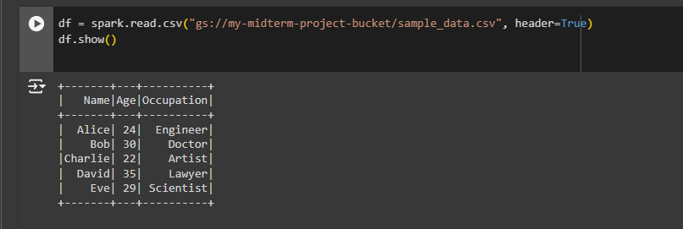
ACCESS SAMPLE DATA FROM BUCKET ON THE CLOUD

