Slide 1

Replacement exam
Thomas Hoerger

Slide 2
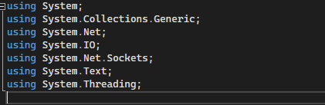
Dependencies
Import dependencies

Slide 3
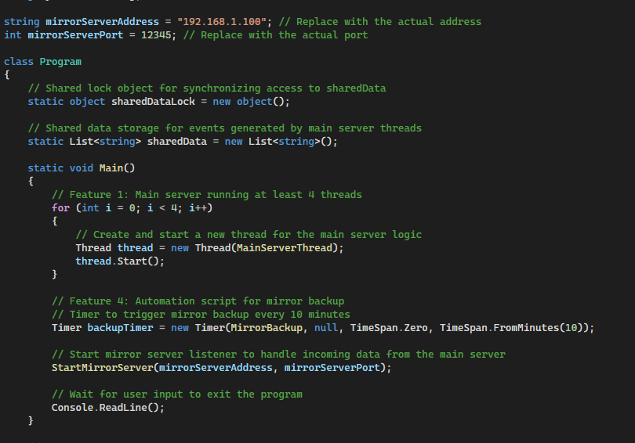
Main Function
Program class and main function.

Slide 4
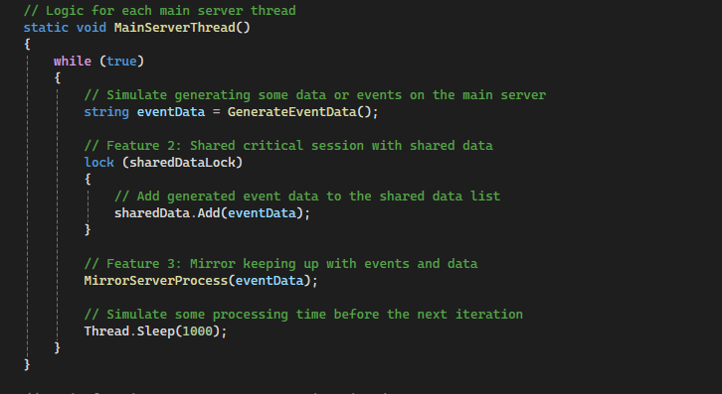
Main Server Thread Function
Logic for each main server thread.

Slide 5
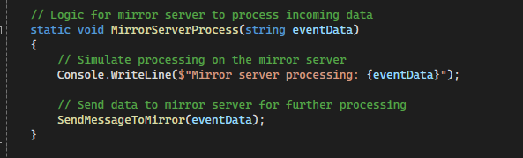
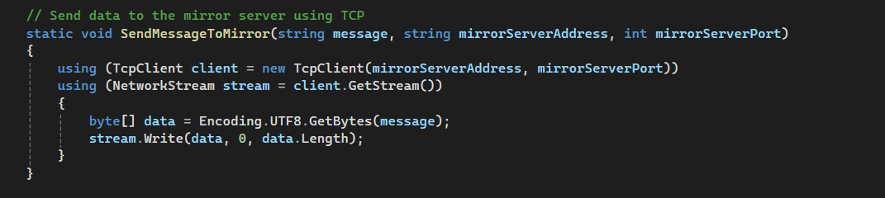
Mirror Server Process and Send Message To Mirror Functions
Logic for mirror server to process incoming data.
Logic to send data to mirror server using TCP.

Slide 6
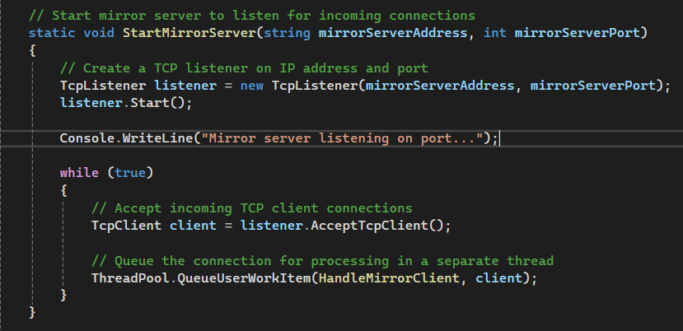
Start Mirror Server Function
Logic to start the mirror server and listen for incoming connections

Slide 7
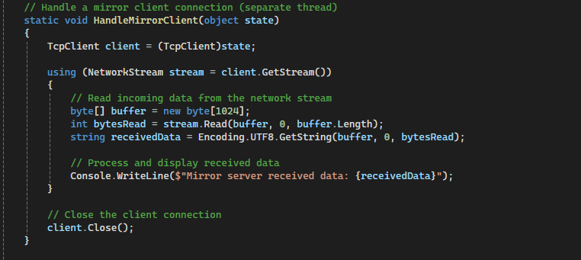
Handle Mirror Client Function
Function to handle the mirror client connection.

Slide 8
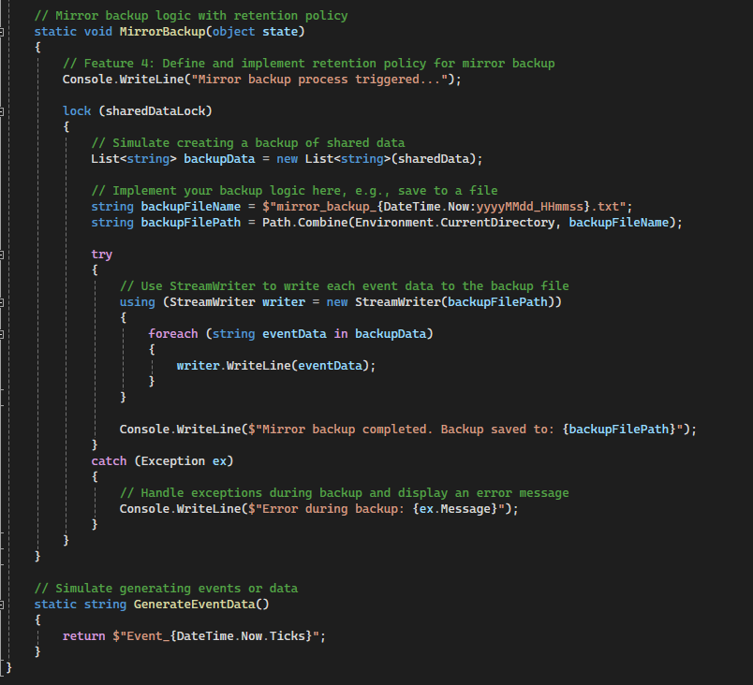
Mirror Backup Function
Function to backup the mirror server
Function to generate events or data.

