Slide 1
Diabetes Prediction Using an Artificial Neural Network with a Calibrated, Explainable Ensemble
Padmanaban (RA2411026050113) | Kishor A (RA2411026050085) | Shakithyan (RA2411026050090)
AIML, SRM Institute of Science and Technology | Faculty: Bhuvaneswari Amma N G | October 2026

Slide 2
Problem and Objectives
• Binary classification of the Pima Indians Diabetes Outcome label from 8 measurements (768 women, 35% positive)
• Not a diagnosis or onset forecast: educational demonstrator
• Objectives: leakage-controlled pipeline, ANN vs 4 learners, calibrated ensemble, validated threshold, ablation, explanations, local app

Slide 3
Literature Survey and Gap
• Sisodia 2018: Naive Bayes 76.3% on Pima (10-fold CV)
• Zou 2018: RF, NN with PCA/mRMR; Sneha 2019: feature selection helps
• Tasin 2023, Hasan 2025: ensembles/AutoML with SHAP and apps
• Grinsztajn 2022: trees often beat deep nets on tabular data
• Gap: single accuracy numbers, little calibration reporting, explanations of stand-alone models, optimistic CV
Notes:
Full comparison table is Table 1 in the report.

Slide 4
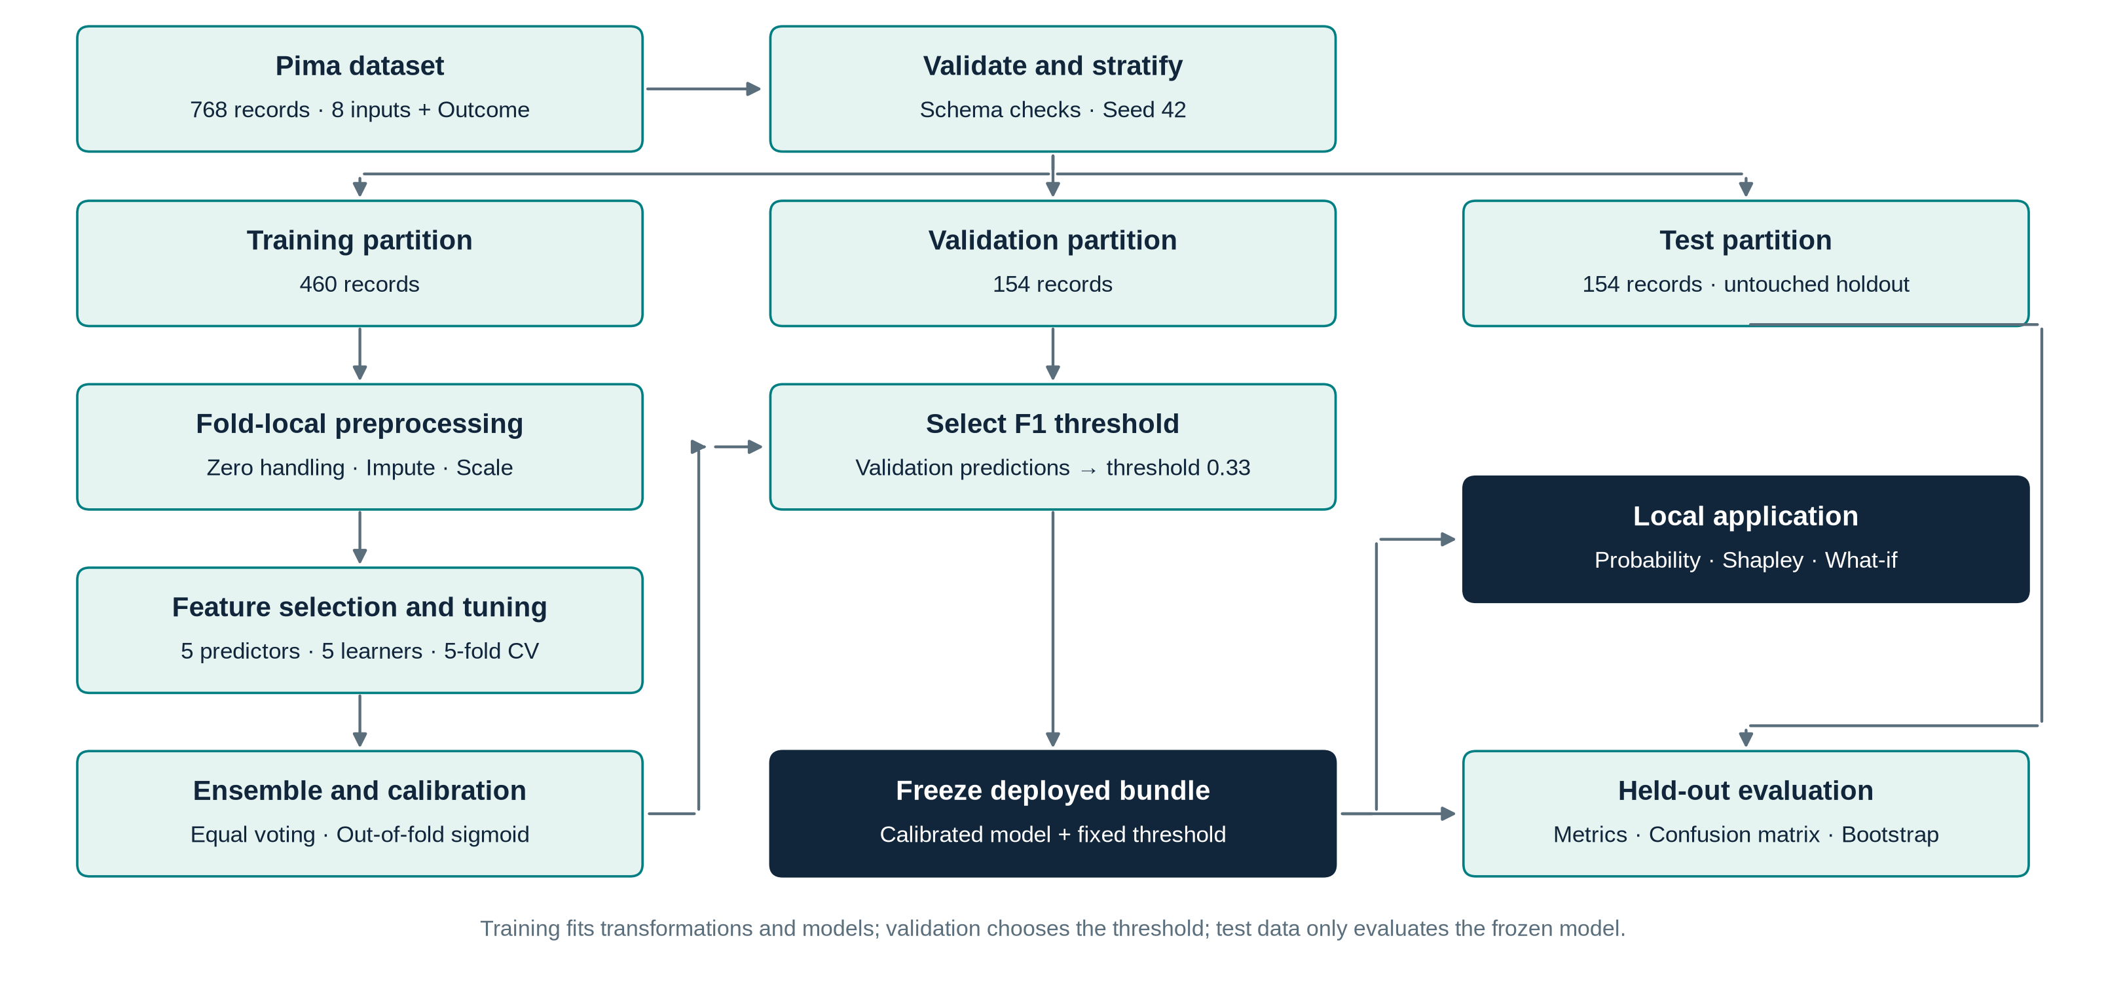
Proposed Methodology
• Fixed-seed stratified split: 460 train / 154 validation / 154 test
• Zeros in Glucose, BP, Skin, Insulin, BMI treated as missing; imputation, scaling, selection fitted per fold
• Five tuned models (6 random configs x 5-fold CV each)
• Equal-weight soft voting, out-of-fold sigmoid calibration
• Threshold 0.33 chosen on validation (max F1); test used once

Slide 5
ANN Architecture
• Input: 5 selected features
• Hidden: 32 ReLU units: h = ReLU(W1 x + b1)
• Output: p = sigmoid(W2 h + b2)
• Loss: L2-regularised cross-entropy; Adam, lr 0.003, alpha 0.001, early stopping
• Selected CV AUC 0.821

Slide 6
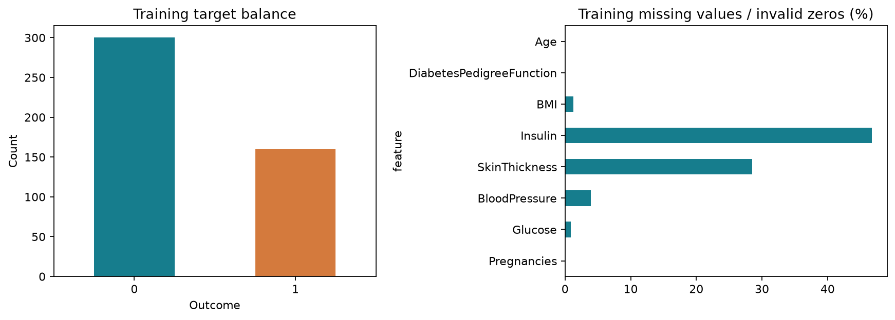
Dataset and Exploration
• Insulin 46.7% and skin thickness 28.5% missing (zeros)
• Correlation with Outcome: Glucose 0.50, BMI 0.34, Insulin 0.31
• Dummy classifier: 64.9% accuracy, recall 0

Slide 7
Feature Representation Ablation (5-fold CV AUC)
• Logistic: original 0.826, engineered 0.825, selected 0.821
• ANN: original 0.795, engineered 0.756 (unstable), selected 0.808
• Selected 5 features chosen on training data only

Slide 8
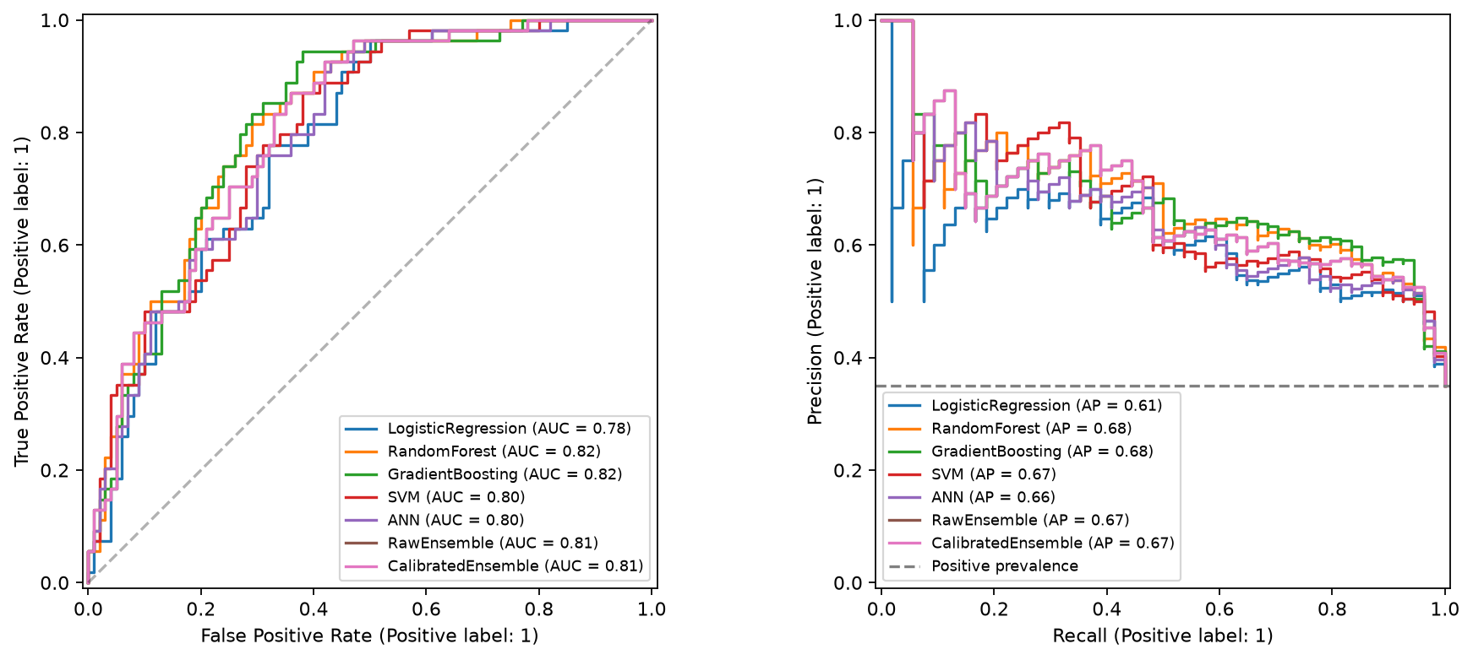
ROC and Precision-Recall
• All models far above no-skill
• Gradient boosting AUC 0.822, RF 0.821, ensemble 0.811, SVM 0.800, ANN 0.796, LR 0.783

Slide 9
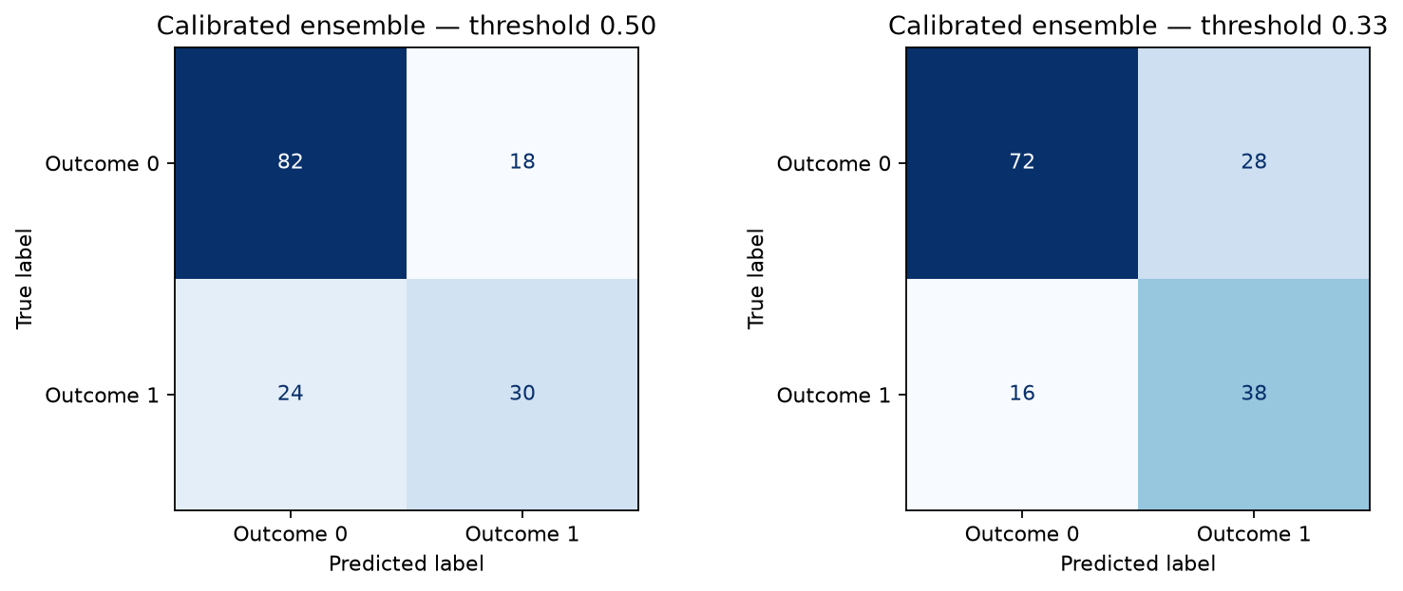
Deployed Ensemble Results (test, n = 154)
• AUC 0.811 (95% CI 0.736-0.876)
• At threshold 0.33: accuracy 71.4%, recall 70.4%, specificity 72.0%, F1 0.633
• Confusion: TN 72, FP 28, FN 16, TP 38
• At 0.50: recall only 55.6%: threshold matters
• McNemar vs ANN p = 1.0; AUC difference +0.015 (CI 0.0006-0.032)

Slide 10
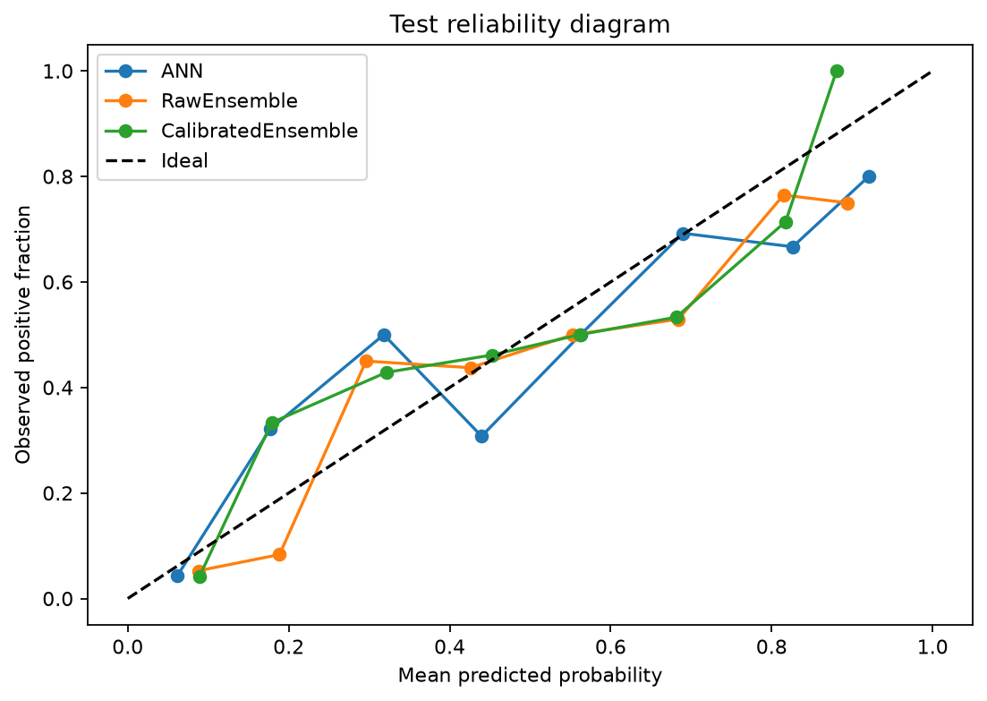
Calibration
• ECE 0.125 -> 0.086 (better)
• Brier 0.1709 -> 0.1746 (slightly worse)
• AUC unchanged (monotonic mapping)
• Mixed evidence, reported honestly

Slide 11
Ablation Study
• Representation: engineered features hurt the ANN
• Models: dummy 0.50 < LR 0.783 < ANN 0.796 < SVM 0.800 < ensemble 0.811 < RF 0.821 < GB 0.822 (test AUC)
• Calibration: ECE -31%, Brier +0.004
• Threshold: recall 55.6% -> 70.4% for -10 pts specificity
• Permutation: Glucose -0.142 AUC, BMI -0.041, Age -0.036

Slide 12
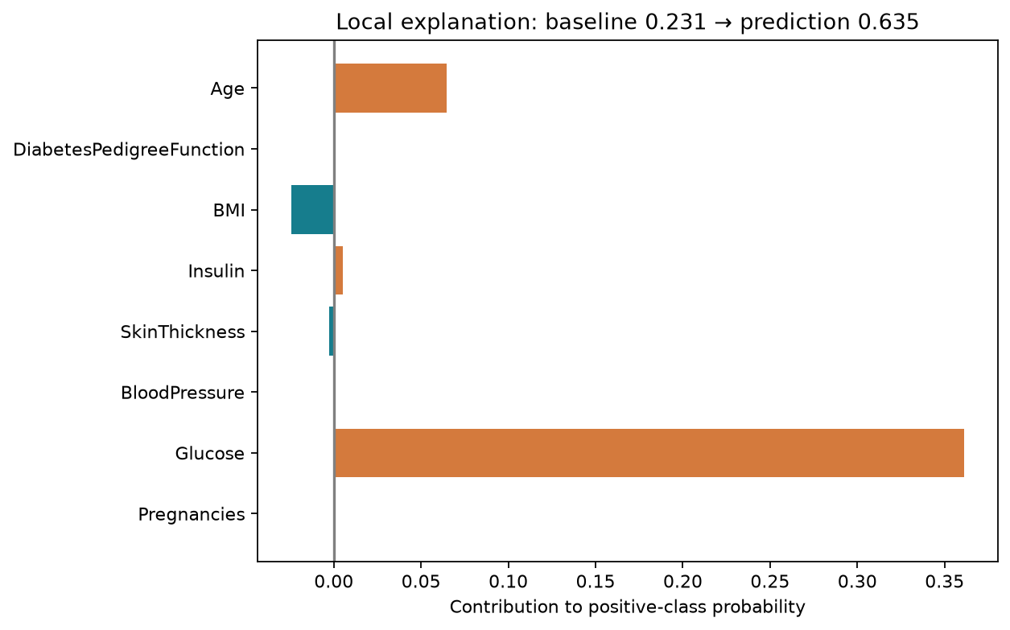
Explainability
• Exact Shapley over 256 coalitions on the full deployed pipeline
• Additivity error 2.2e-16
• Glucose dominates; BMI and age follow

Slide 13
State-of-the-Art Comparison
• Literature: ~76% (ADAP, Naive Bayes), 75.7% ANN, 81.8% boosting (protocols differ)
• This work: 71.4-74.0% on a strict one-shot held-out test
• Lower numbers reflect stricter protocol; adds calibration, validated threshold, CI and explanations

Slide 14
Limitations and Future Work
• 154-row test set: wide intervals
• Heavy missingness; single historical population; no external validation
• Non-nested CV is optimistic
• Future: nested CV, external cohort, multiple imputation, subgroup analysis

Slide 15
Conclusion
• ANN competitive but not superior on small tabular data
• Calibrated ensemble: AUC 0.811, recall 70.4% at validated threshold
• Glucose is the dominant predictor
• Educational demonstrator, not a clinical tool

Slide 16
References (selected)
• Smith et al. 1988, ADAP, SCAMC
• Sisodia & Sisodia 2018, Procedia CS 132
• Zou et al. 2018, Front. Genet. 9:515
• Lundberg & Lee 2017, NeurIPS; Guo et al. 2017, ICML
• Breiman 2001; Friedman 2001; Kingma & Ba 2015
• Full list of 35 references in the report

