Slide 1

Group Project 2021
Team 14
Penetration Testing Scenario

Slide 2
Team Roles
Kenneth Brown: Project Manager
Davide Pisanu: PM Support & Server Administrator
Connor Grattan: Web Team Lead & Back-End Developer
Jake Salt: Web Team & Front-End Developer
Tom Neil: Security Team Lead
Luis Loaysa: Security Team

Slide 3
Critical Aims
Create a Virtual Machine test-bed
Optimised to accommodate security penetration testing
To be used by the client for teaching 4th year pen-testing labs
Create a vulnerable E-Commerce website within the test-bed network
To be used for carrying out web-based attacks, such as Cross-Site Scripting
Modern OS versions and hardware used to maintain a realistic scenario & improve on current labs running outdated OS versions.

Slide 4
Additional Aims
Create challenging scenarios for students
Create scenarios & labs which provide students with opportunities for self-directed learning
Create a logical exploit path through privilege escalation techniques
Opportunity for the whole team to further knowledge & improve skillsets

Slide 5

Technical Approach - Server
Proxmox -VM Platform
Open-source server management platform
Integrates KVM, LXC, and QEMU virtualisation
Enterprise-class features
Efficient Virtual Environment

Slide 6
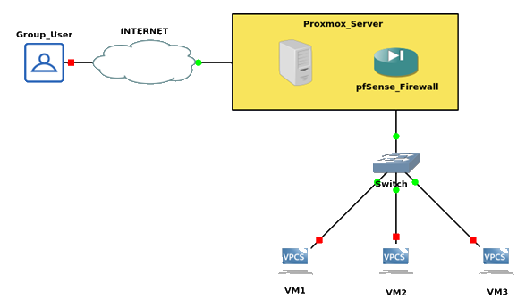
VPN Setup
OpenVPN
Trusted Security
Adaptable
Open Source
Supports multiple encryption standards

Slide 7
VPN Setup
pfSense
Simple but effective design
Open source FreeBSD
Implementation
OpenVPN Server
Certificate Authority

Slide 8
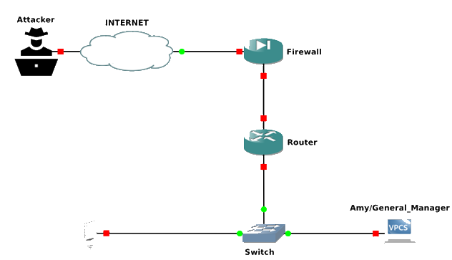
Network Topology
Operating Systems deployed: -
Windows Server 2016 (Web Server/AD)
Windows 10-1809 (AD User)
Kali Linux (Attacker)
Vulnerabilities: -
Unpatched versions of Windows’ OS
Weak Firewall Rules
Hosted Website specifically configured for exploits

Slide 9
Technical Approach – E-Commerce site
i-Fruit.com
Web Tour Presented by Connor Grattan

Slide 10
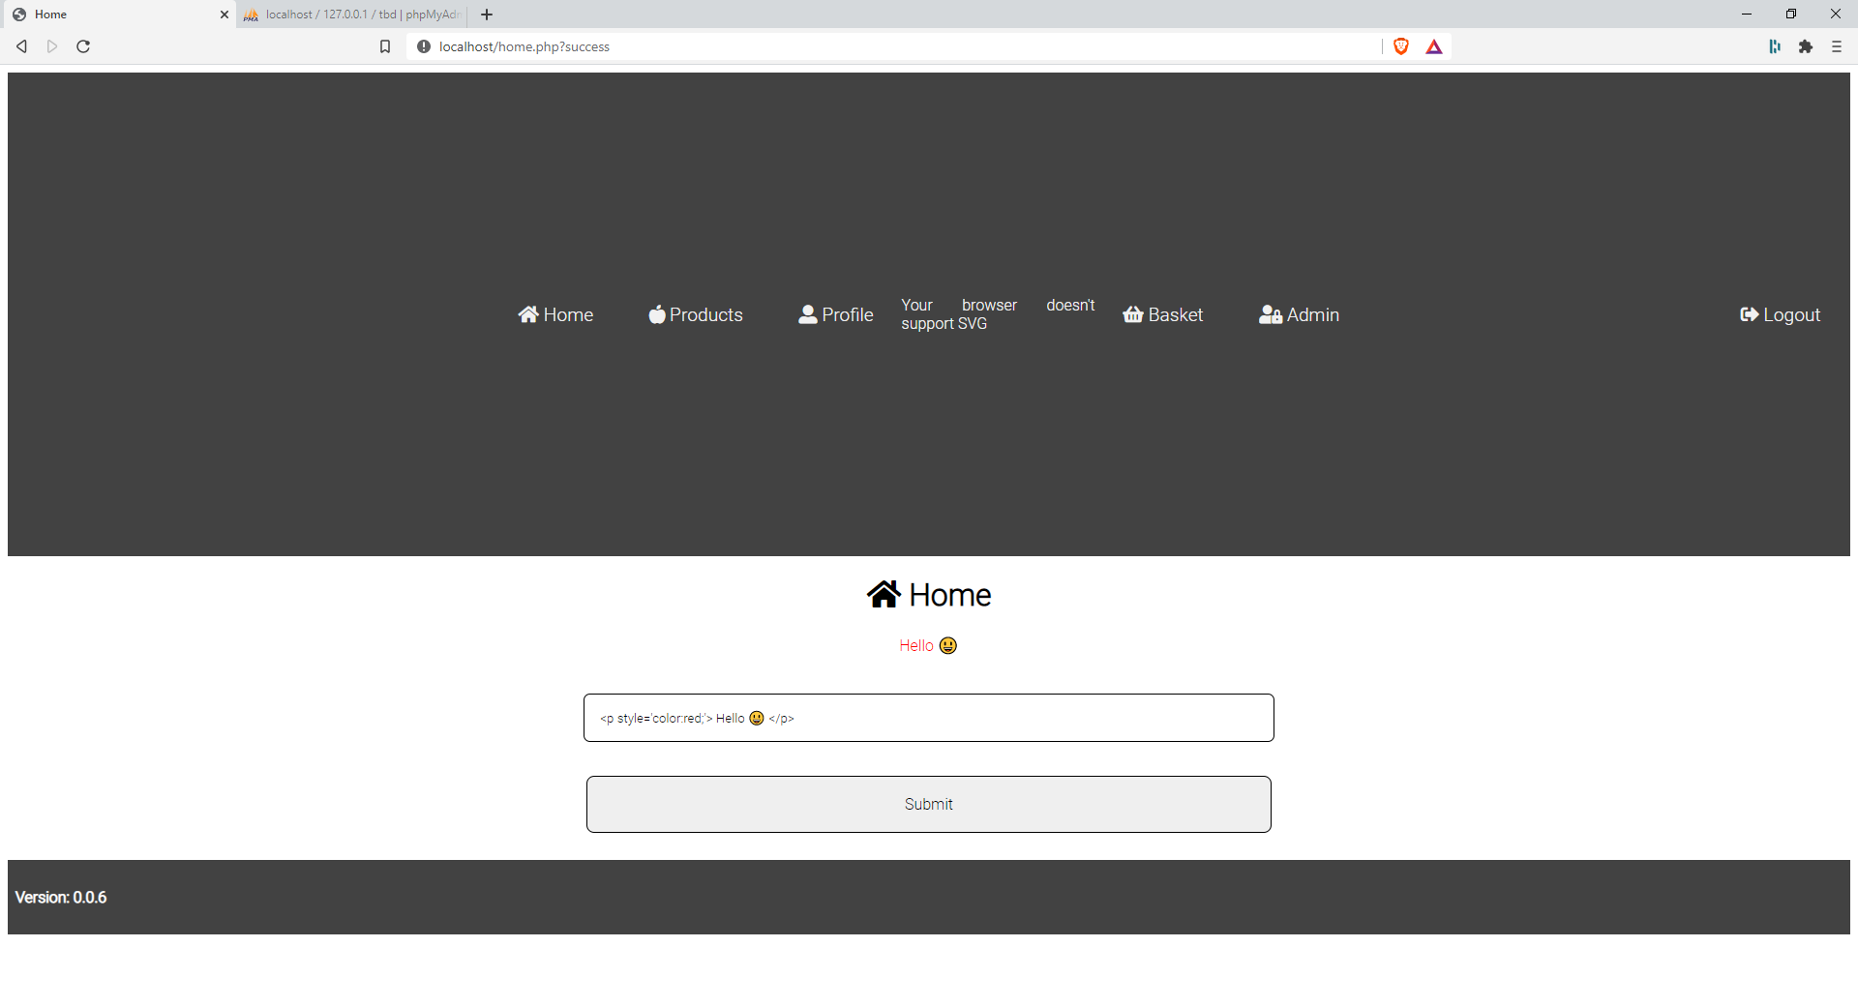
Website –Index Page

Slide 11
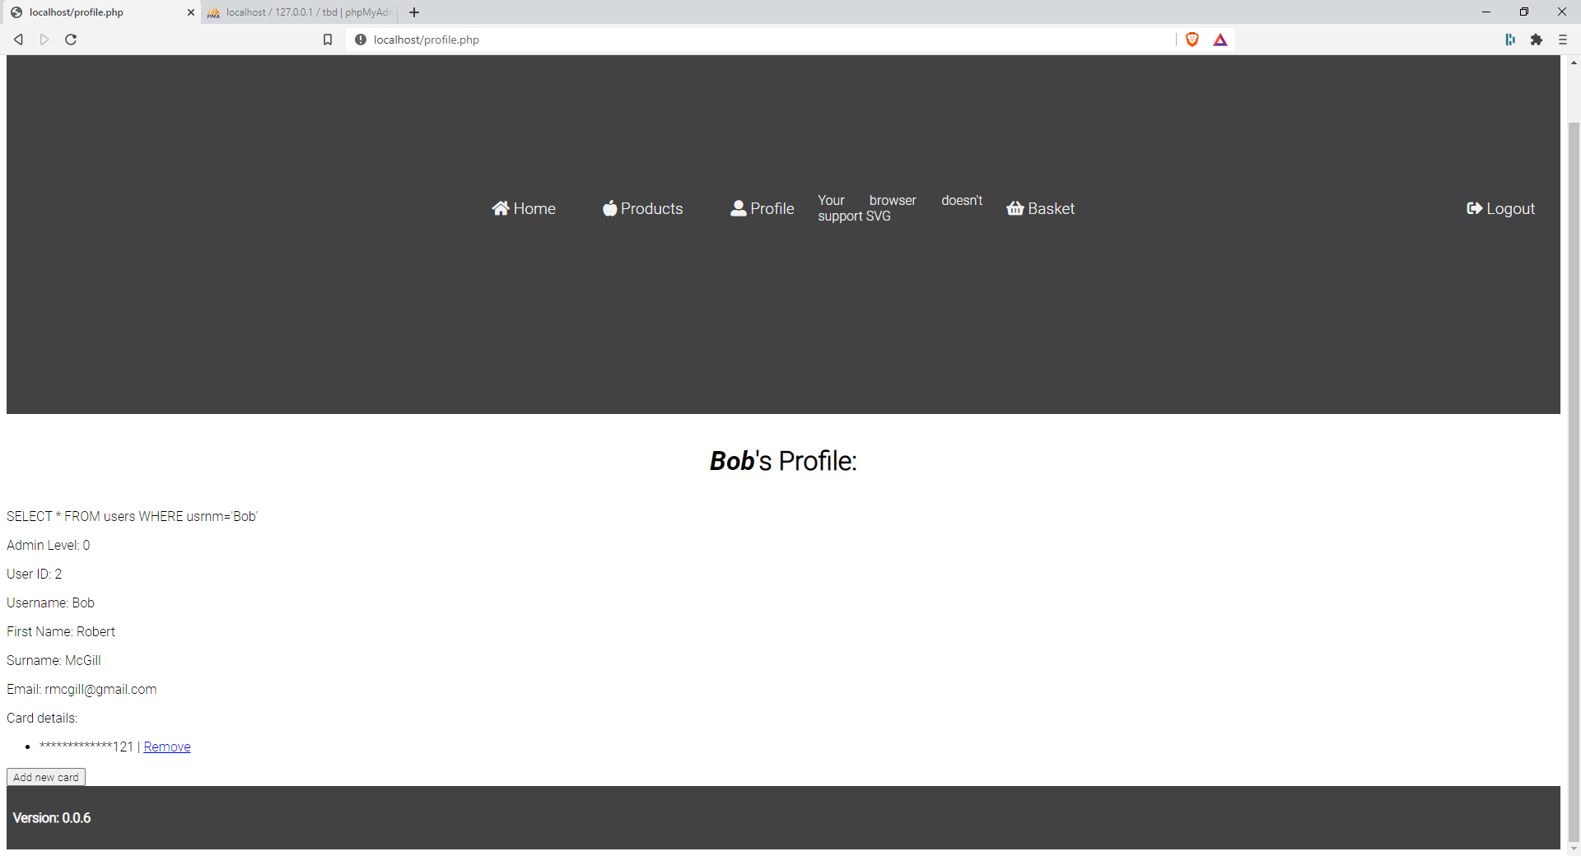
Website –User Profile Page

Slide 12
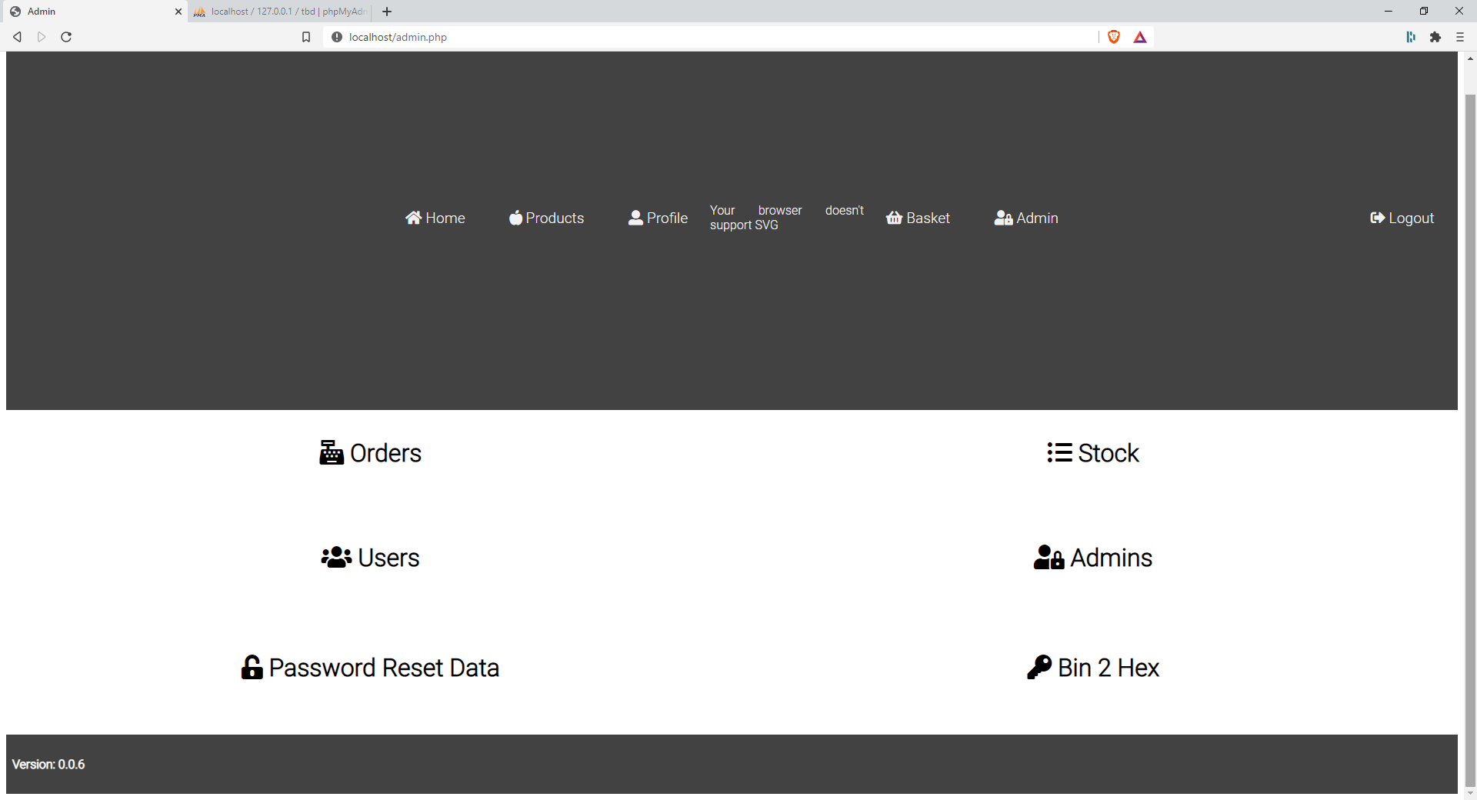
Website –Admin User Page

Slide 13
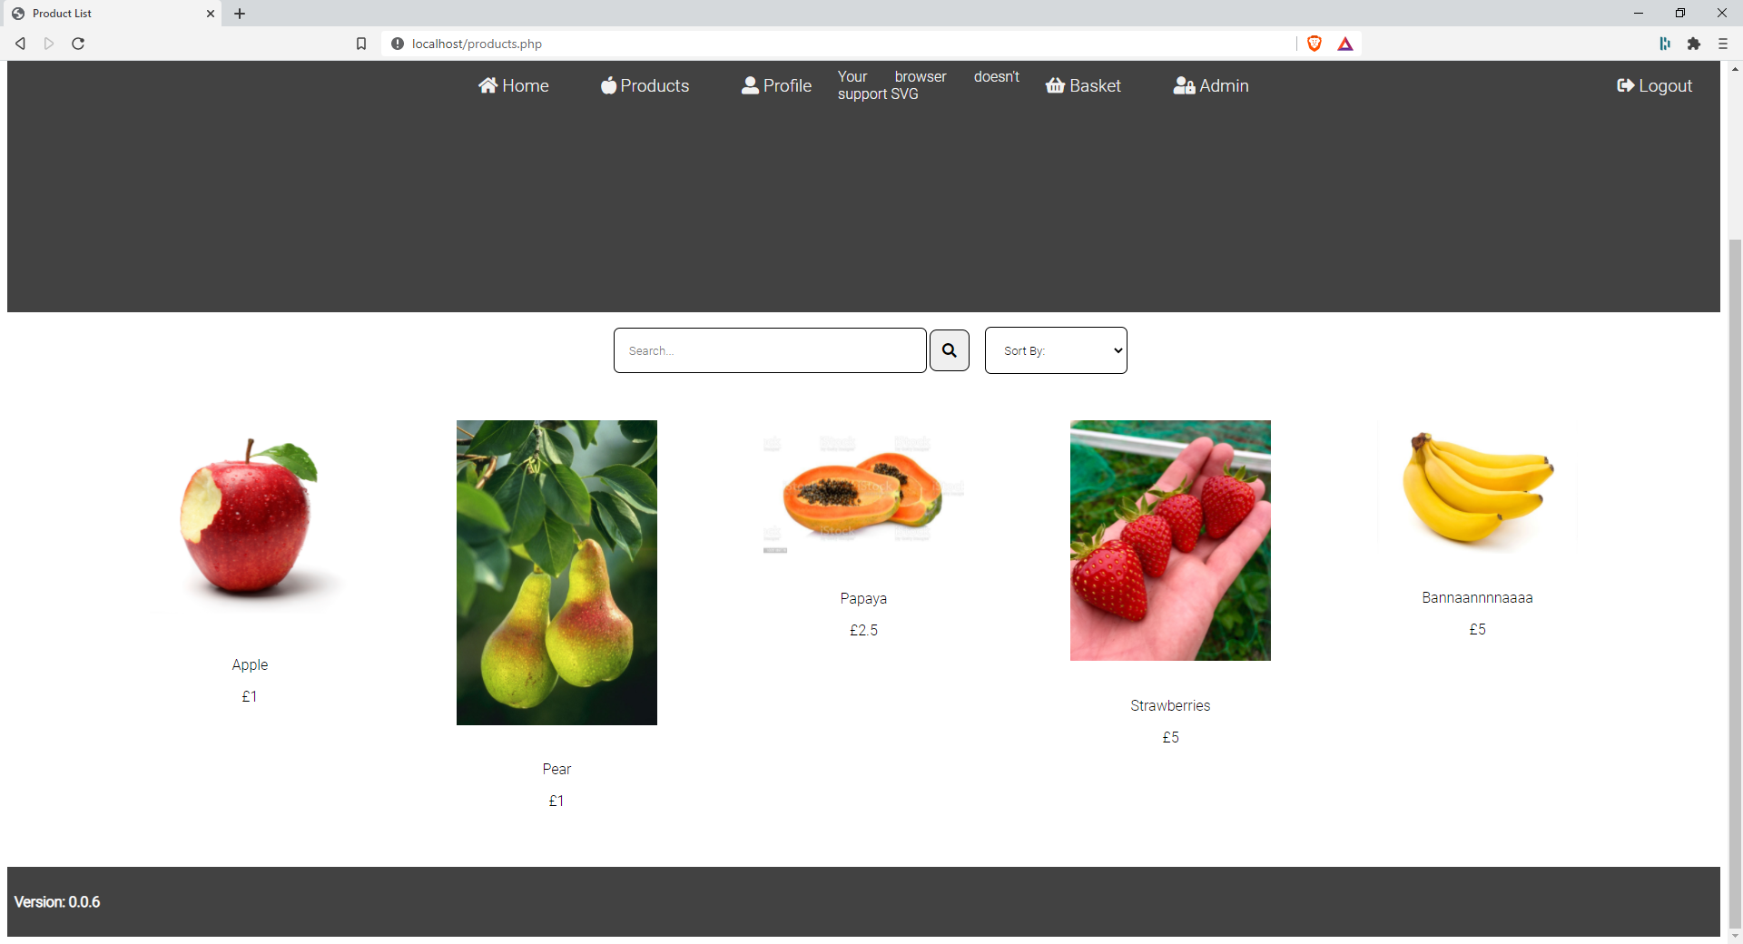
Website –Products Page

Slide 14
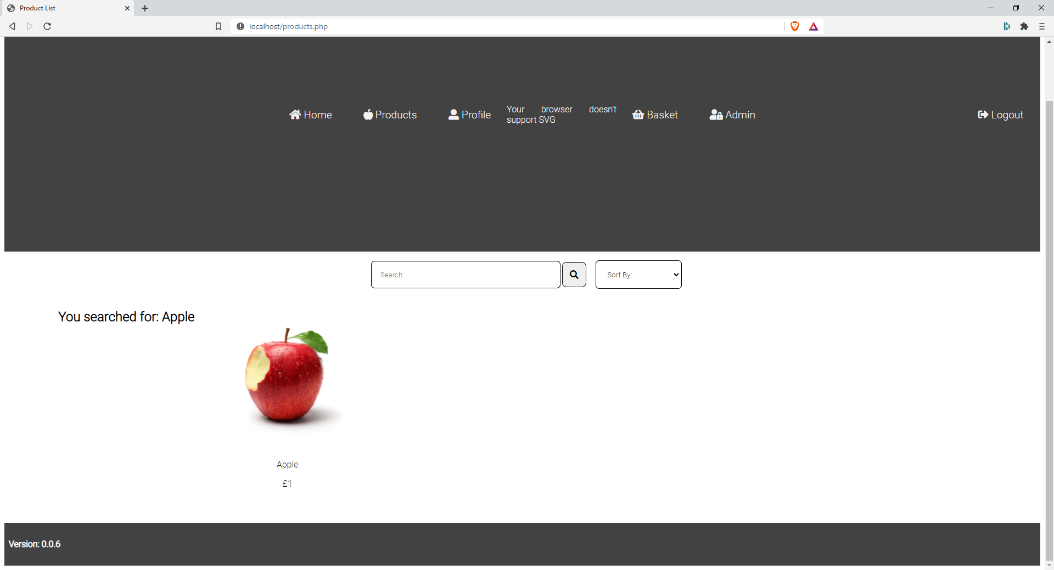
Website –Search Bar Feature

Slide 15
Website –Back-End Specs
XAMPP
Apache web server
MySQL database: -
Users, can store admins and also hashed passwords
Products
Card details, acts as a ‘treasure’ to be found
Orders

Slide 16
Website –Vulnerabilities
Search bar Cross-Site Scripting
Use of password reset to gather or modify specific accounts’ details
Absence of a specific server header allows for clickjacking
Potential for Bot-Net Deployments
EternalBlue & PSEXEC Exploits

Slide 17
Cross Site Scripting - Setup
My area of focus was on implementing a XSS vulnerability on the website
The software used was a Kali Linux VM hosting the specifically developed project website
The “Burpsuite” application was used for the performing some of the security testing of the web application
The intention was to use “Burpsuite” for the initial mapping & analysis of the website’s attack surface
An extension called “FoxyProxy” was also configured to allow for routing of traffic through it

Slide 18
Cross-Site Scripting - Process
As highlighted in the vulnerabilities overview, the website has a search bar included within the products page – allowing for user input
This is a known route for testing XSS vulnerabilities
From conducting research on XSS testing approaches, a useful “Github” repository was containing an array of scripts.

Slide 19
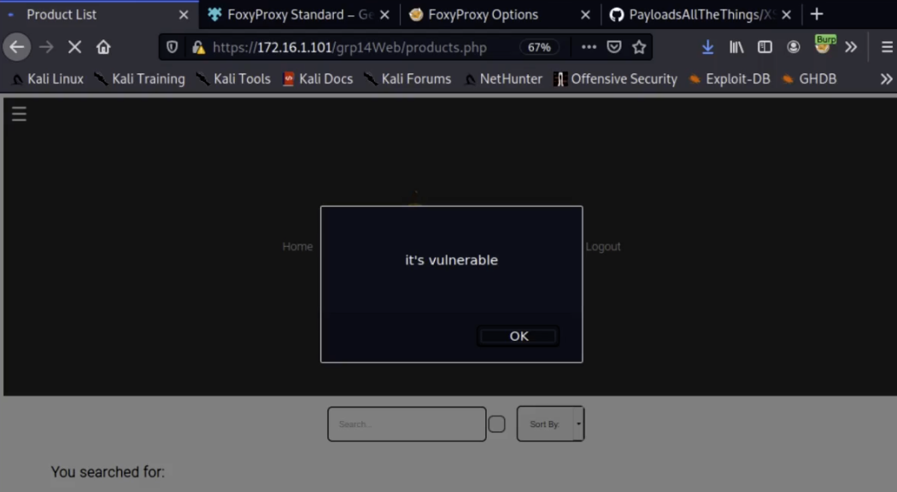
Cross-Site Scripting - Process
From here, the first approach was to input some text within the search bar to see the website’s response
Then within Burpsuite, the initial text input was replaced with a basic JavaScript alert function.
This confirmed the website’s products page was vulnerable to the XSS attacks

Slide 20
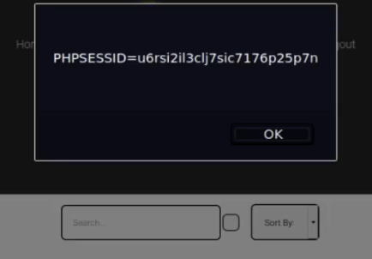
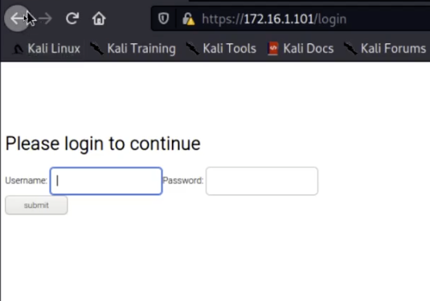

Cross-Site Scripting - Results
Further scripts were tested on the site – another alert popup containing users document cookies
UI redressing to modify the HTML content of the page to display an alternative login
Along with being able to completely strip the contents of the HTML displayed on the products page.
Notes:
Hand over to Luis covering Clickjacking

Slide 21
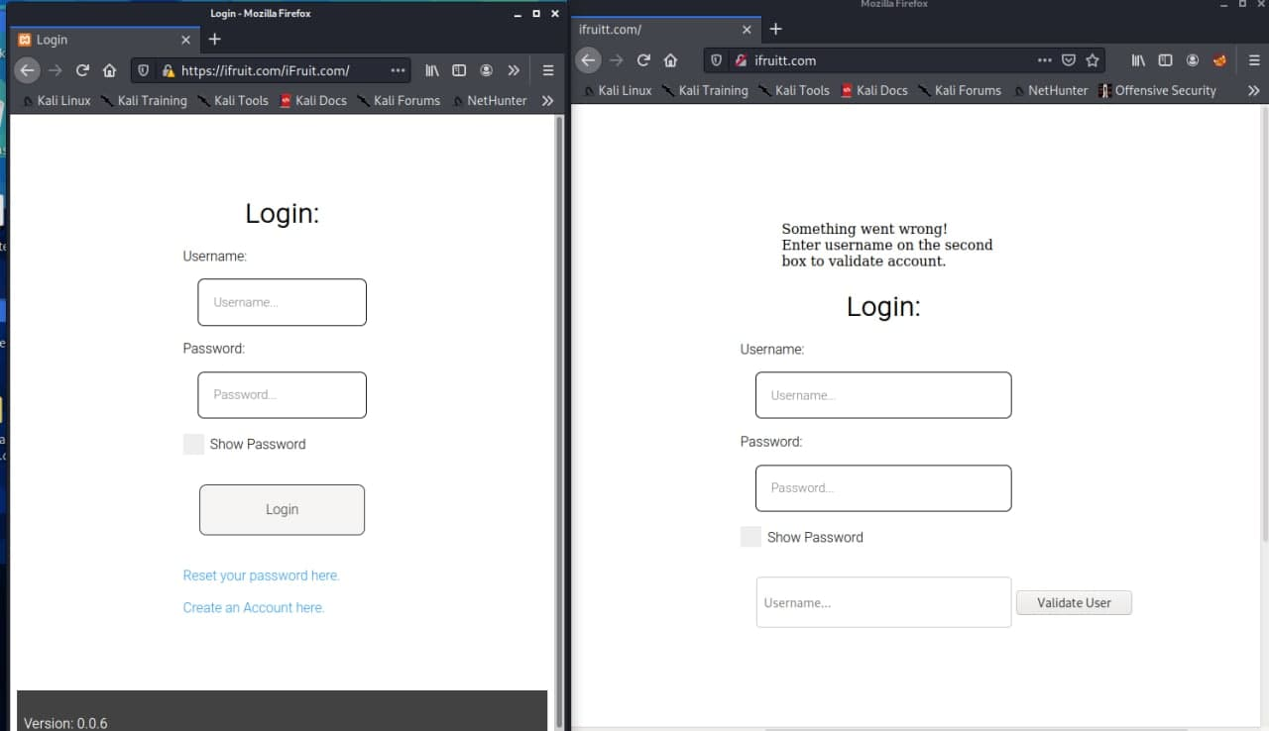
Clickjacking Attack
Aim: - Retrieve username through a forged website with similar name to the original.
Requirements: - HTML, CSS, Apache2 and PHP partially.
Student Lab Approach: - Something, something, something, DARKSIDE. Something, something, something, COMPLETE.

Slide 22
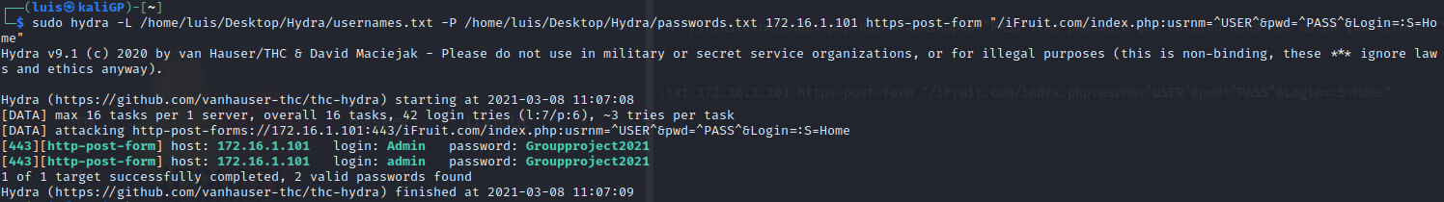
Brute Force Attack
Aim: - Extract usernames and password combinations.
Requirements: - Hydra and error messages from the victim’s website.
Student Lab Approach: - TBC

Slide 23
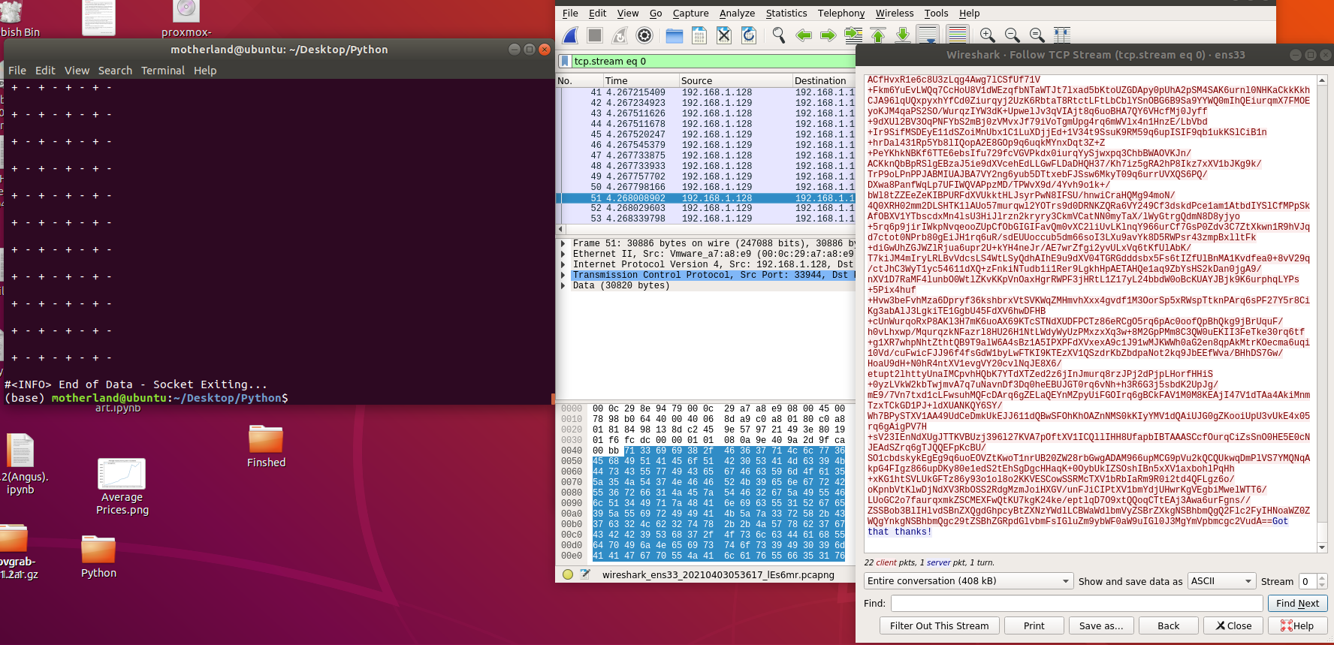
Python Bot Attack
Aim: - Open communication from a remote machine without user knowledge.
Requirements: - Python, Stenography, Ciphers, Wireshark, concealment strategies.
Student Lab Approach: -

Slide 24

Web User Password Reset Exploit
Uses a pre-existing admin account to compromise other user accounts in the database.
TELL ME MORE!
CAN’T…… SOZ

Slide 25
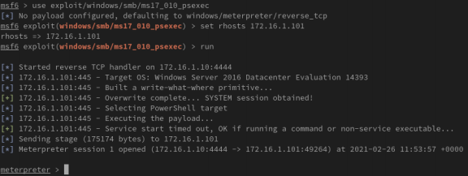
PSEXEC & Reverse TCP Exploits
FILEFORMAT Exploit Deployment: -
Create files for trigger Vulnerabilities
Move MVK files on Kalie /html dir
Send malicious mail to the AD users
Start a reverse TCP session
Gain Access to AD user

Slide 26
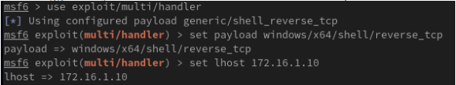

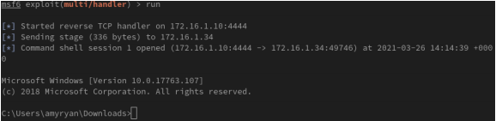
PSEXEC & Reverse TCP Exploits
Steps Involved: -
Access to targeted machine with High privileges User (system)
Create a New Administrator User
Craft mail and forward to all the AD users
Start to listen the LAN Traffic
Gain Access to AD User

Slide 27
Technical Limitations
Remote working / COVID 19 restrictions
ISP Cut Offs
Scope / Time limitations
E-commerce payment system

Slide 28
Future Roadmap
Complete the remaining “WIP” exploits (“SQLi”, “FTP Server”, “Bots”).
Continue adding functionality to the site & server (“OWASP FS”)
Apply new exploits to the environment (“Rainbow Tables”)
Improve the realism of the environment by adding further layers of security to its network (“Patches, OS Versions, Firewall Rules”)

Slide 29
Any Questions?
If anyone has any questions, feel free to ask them now!

