Slide 1
Group Project 2021
TEAM 14
Penetration Testing Scenario

Slide 2
Team Roles
Kenneth Brown – Project Manager
Davide Pisanu – PM Support / Server Administrator
Connor Grattan – Web Team Manager / Back-End Developer
Jake Salt – Web Team / Front-End Developer
Tom Neil – Security Team Manager
Luis Loaysa – Security Team

Slide 3
Project Critical Aims
Create a Virtual Machine testbed
Specifically optimised to accommodate security penetration testing
To be used by the client for teaching 4th year pen-testing labs
Create a vulnerable E-Commerce website within the testbed network
To be used for carrying out web-based attacks, such as Cross-Site Scripting & SQL Injections
Testbed Network must utilise modern OS versions and hardware to maintain a realistic scenario & improve on current labs which still use older OS versions

Slide 4
Further Project Aims
Create challenging scenarios for students
Create Scenarios/Labs which provide students opportunities for self-directed learning
Create a logical exploit path through privilege escalation techniques
Opportunity for the whole team to further knowledge & improve skillsets

Slide 6
Project Platform
Proxmox
Open-Source server management platform
Integrates KVM, LXC and QEMU virtualization
Enterprise-class features
Efficient VE

Slide 7
VPN Set-up
OpenVPN
Trusted Security
Adaptable
Open Source
Supports Multiple Encryption Standards

Slide 8
VPN Set-up
pfSense
Simple but effective design
Open source (FreeBSD)
Implementation
OpenVPN Server
Certificate Authority

Slide 9
Network Topology
OSs Deployed in our Scenario
Windows Server 2016(Web Server/AD)
Windows 10-1809 (AD User)
Kali Linux (Attacker)
Vulnerabilities
Unpatched versions of Windows Oss
Weak Firewall Rules
Hosted Website Exposed to Attacks

Slide 10
Website Tour – General Guide
Connor talks through tour

Slide 11
Front-End Specs
Search function
Admin-controlled message on home page

Slide 12
Back-End Specs
- XAMPP
- Apache web server
- MySQL database:
- Users, can store admins and also has hashed passwords
- Products
- Card details, acts as a ‘treasure’ to find
- Orders

Slide 13
Vulnerabilities Overview
Search bar XSS
Using password reset to gather or modify specific accounts’ details
Missing server header allows for clickjacking

Slide 14
XXS Set-up
- software used was a kali linux vm hosting the specifically developed project website, www.iFruit.com
decided to use Burp Suite for performing the security testing of the web application
this was used with a view of implementing the application for the initial mapping and
analysis of the website’s attack surface
when launching Burp Suite you will be faced with a popup relating to a certificate warning –
an extension, FoxyProxy, should be installed to allow the routing of traffic through it
click on the icon once installed, select options and configure proxy type/proxy IP add/port.
Once configured, the FoxyProxy icon should be selected

Slide 15
XXS Process
as the setup of Burp Suite and FoxyProxy has been completed, navigate round the www.iFruit.com website to create a site map of the application being tested
from researching techniques related to cross-site scripting, it is known as a type of injection implemented by an attacker where they send malicious code – usually in the form of a browser side script
main XSS approaches are split into two categories: stored and reflected. Based on these categories the following attacks are possible – cookie stealing, keylogging, phishing attacks and port scanning
the products page has a user input box which is known as a route for testing XSS approaches

Slide 16
XXS Process 2
first approach was to input some text within the search box to see how the site reacts and review within burpsuite
from here the initial text string input was amended and a very basic JavaScript alert function using the following code, ‘‘ was input and forwarded back to the website for review
further scripts were implemented using a github repo of known XSS scripts
another alert popup was generated containing users document cookies; ‘’ , UI redressing to modify the HTML content of the page to display an alternative login page; ‘

Slide 17
XXS Process 3
another alert popup was generated containing users document cookies; ‘’ , UI redressing to modify the HTML content of the page to display an alternative login page; <SCRIPT GOES HERE>

Slide 18
XXS RESULTS
SHOW RESULTS [image]

Slide 19
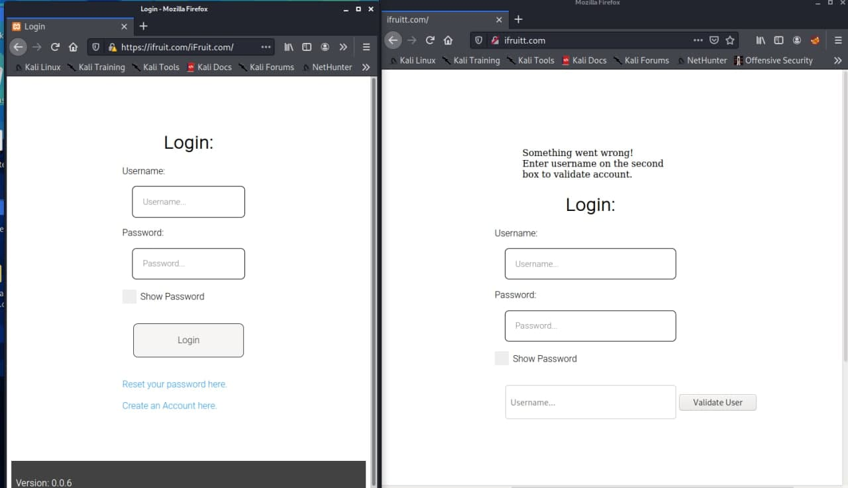
Clickjacking
BurpSuit
OWASP
iFrame, Apache2, username retrieval

Slide 20
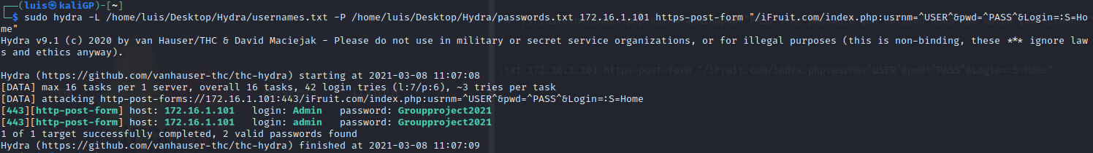
Brute Force
Website login error message
Hydra
Rockyou.txt

Slide 21
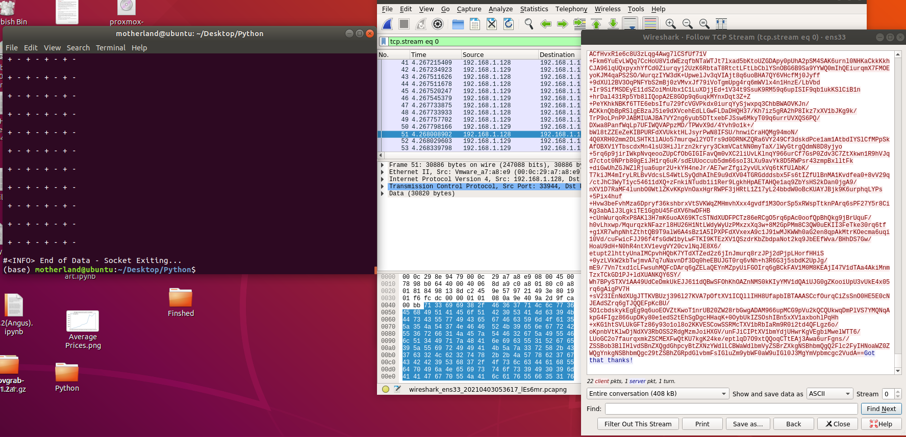
Bot
Plain text messages and ciphers, Vigenere, Base64
Stenography
ZIP File Shortcut executing CMD

Slide 22
iFruit password hack
•The password hack can be used to gain entry to a pre-existing user account using the website’s in-built password reset function.
•This can only be performed by an admin.
•This is done by gathering a random username and resetting the password on the login page, then logging into an admin account and gathering the ‘token’ and the ‘validator’ from the password reset table, taking the validator in to the ‘bin 2 hex’ page and pasting it into the box, then change the URL to ‘ifruit.com/pwdreset/newpwd.php?selector=selector&validator=validator’

Slide 23
PROCESS

Slide 24
RESULTS

Slide 25
PSEXEC & Reverse TCP
“FILEFORMAT” EXPLOIT DEPLOYMENT
Create files for trigger Vulnerabilities
Move MVK files on Kali /html dir
Send malicious mail to the AD users
Start a Reverse TCP session
Gain Access to AD User

Slide 26
PSEXEC & Reverse TCP
PSEXEC
Module is often used by penetration testers
Able to execute arbitrary processes
SMBv2 Vulnerabilities
Deployment
Set Remote Host
Start Meterpreter Session
Create New User & login through SSH
Add New User to the Mail Server

Slide 27
Technical Limitations
Remote Server
ISP Cut Off
Scope Creep
SQLi
Professional SEC Experience (Lack of)
COVID 19 Limitations

Slide 28
Future Roadmap
Complete the remaining WIP exploits (SQLi, FTP Server, Bots)
Continue adding functionality to the site & server (OWASP FS)
Apply new exploits to the environment (Rainbow Tables)
Improve the realism of the environment by adding further layers of security to its network (Patches, OS Versions, Firewall Rules)

Slide 29
QUESTIONS?
QUESTIONS!?
Questions?

